Slide 1
Welfare Analysis

Slide 2
Micro HW Pt 2 due tomorrow morning at 9:00am
LC or CEP due Wednesday during class
Micro HW Pt 3 due Thursday afternoon
Micro Exam on Thursday

Slide 3
We’ve learned that markets are usually a pretty good way to organize economic activity
Advantages and disadvantages?
In this section of the course, we look into that a little more deeply
We will see that our market equilibrium will maximize total welfare between producers and consumers

Slide 4
If a transaction occurs we can probably assume that buyers and sellers receive benefits from taking part in the market
Otherwise it wouldn’t have occurred!
Welfare economics is the study of how the allocation of resources affects economic well-being

Slide 5
Consumer surplus measures economic welfare from the buyer’s side.
Producer surplus measures economic welfare from the seller’s side.
Total surplus is the sum of consumer and producer surplus.

Slide 6
Presumably, there is some max a person would be willing to pay for any good
Willingness to pay
It measures how much the buyer values the good or service.
This is not the amount the buyer wants to pay!
That amount is always____

Slide 7
Consumer surplus is the difference between the buyer’s willingness to pay for a good and the amount the buyer actually has to pay to get it.
CS = Willingness to pay – Price
CS measures the net benefit that buyers receive from a good as the buyers themselves perceive it.

Slide 14
What happens as the price decreases?

Slide 16
Producer surplus is the amount a seller is paid for a good minus the minimum s/he would have accepted.
It measures the benefit to sellers participating in a market.

Slide 18
Just as consumer surplus is related to the demand curve, producer surplus is closely related to the supply curve.

Slide 22
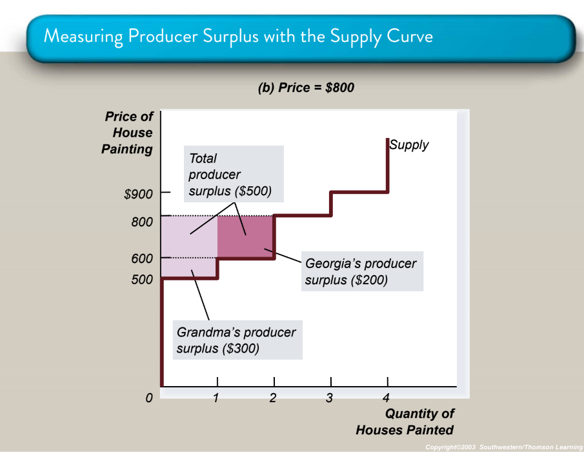

Slide 25
Consumer surplus and producer surplus may be used to address the following question:
Is the allocation of resources determined by free markets desirable?

Slide 26
Total surplus= Consumer surplus + producer surplus
Or
Total surplus= Value to buyer – cost to seller

Slide 27
Efficiency is the property of a resource allocation of maximizing the total surplus received by all members of society.
We like the market equilibrium b/c it is the point associated with maximum total surplus

Slide 28
In addition to market efficiency, we might also care about equity – the fairness of the distribution of well-being among the various buyers and sellers.
Note that “fairness” is a difficult term to define and while it’s important, us economists don’t claim to know what’s “fair” any more than anyone else so we generally don’t say much about it (at least not in class)
For now, we are only looking at efficiency (max’ing total surplus). We’ll turn later to the issue of equity.

Slide 30
Note that it’s the equilibrium price that maximizes the total surplus
All units of the good that are “worth it” to somebody are produced, and no goods that aren’t “worth it” are produced

Slide 31
Laissez faire Market Equilibrium
Because the equilibrium outcome is an efficient allocation of resources, the social planner may choose to leave the market outcome as he/she finds it
The policy approach when the government does not interfere with the market is known as laissez faire

Slide 32
Under ideal conditions, the equilibrium gets us these great results….
…but in reality, some things might get in the way
Market power
Externalities

Slide 33
Market Power
If a market system is not perfectly competitive, market power may result.
Market power is the ability to influence prices.
Market power can cause markets to be inefficient because it keeps price and quantity from the equilibrium of supply and demand.
Perhaps governmental intervention is appropriate in cases where this is an issue?

Slide 34
Externalities
Externalities are the effects on other people not involved in the transaction
Can be positive or negative
In the presence of externalities, markets will lead to a sub-optimal result
So again, perhaps governmental intervention can improve market outcomes?

Slide 35
Practice Questions
An early freeze in Normandy ruins half of the apple harvest. What happens to consumer surplus in the market for apples? Illustrate your answer with a S/D graph.

Slide 36
Practice Questions
Suppose the demand for bread increases. What happens to the producer surplus in the market for bread? Illustrate your answer with a S/D graph.

Slide 37
Practice Questions
Assume:
Qd= 50 - P
Qs= -10 + 0.5P
Find P^{e} and Q^{e}
Graph supply and demand
Calculate CS, PS, and total surplus

Slide 38
Now (in the above question) assume a $30 price ceiling is imposed.
Calculate CS, PS, and total surplus in this scenario.
How do CS, PS, and TS compare to the previous slide?

Slide 39
<<answers provided in class>>

Slide 40
Taxes

Slide 41
Taxes
In a free, unregulated market system, market forces establish equilibrium price and exchange quantities.
One of the roles of economists is to use their theories to assist in the development of policies.

Slide 42
Governments levy taxes to raise revenue for public projects.
However
Taxes discourage market activity.
When a good is taxed, the quantity sold is smaller (due to the law of demand)
Buyers and sellers share the tax burden.
Generates “dead weight loss” (loss of surplus)

Slide 43
Some types of taxes
A direct tax is levied on income and wealth
Taxes gov’t takes from your paycheck or a firm’s profits
An indirect tax is levied on the sale of goods and services.
A specific tax is a set amount per unit of expenditure, for example, €0.75 per litre of petrol or €2.50 on a bottle of whisky.
A “flat amount”
An ad valorem tax is expressed as a percentage, for example a 10 per cent tax.

Slide 44
Think about this statement:
“I really love consuming soft drinks but I just read that the gov’t will create a new tax on them. I sure hope they collect the tax from the soft drink companies so they have to pay it rather than consumers like me!”

Slide 45
With a specific tax:
Supply curve shifts up by the amount of the tax
Quantity sold falls
Even though the tax is levied on sellers, buyers and sellers will share the burden of the tax; buyers pay more for the good and sellers receive less (because of the tax)
A tax on sellers places a wedge between the price buyers pay and the price sellers receive.

Slide 49
An ad valorem tax on sellers.
Like the specific tax, the buyers and sellers will share the burden of the tax
Supply curve shifts up but not by a parallel amount.
For example if VAT is introduced at 20% then:
A product costing €20 means the seller pays €4 VAT.
A product costing €50 means the seller pays €10 VAT.
At low prices, the amount of the tax paid is relatively low but 20 per cent of higher prices means the seller has to give more to the government.

Slide 50
We believe that in most cases, a tax will be paid by both buyers and sellers of the product
But perhaps (probably?) not equally
What will influence this?

Slide 51
A nice review of these ideas, from a different voice, can be found below.
It’s pretty simplistic and designed for high school students, but hey, it can still be helpful:)
https://www.youtube.com/watch?v=9gwTH4Yme8I&t=2s

Slide 52
Practice Question
Demand:
P=20-2Qd
Supply:
P=10+3Qs
First, calculate Pe, Qe, CS, and PS

Slide 53
Now assume a $5 specific tax on producers
Calculate
the new price consumers pay
the new price producers receive (net of the tax)
CS
PS
Tax revenue collected
Dead weight loss

Slide 54
Another practice question:
P=10,000-3Qd
P=2,000+5Qs
Tax on producers of $1,000 per unit
Calc CS, PS before tax
Calc CS, PS, tax revenue, and DWL after tax

