Slide 1
Market Structure
Session 8

Slide 2
The term “market structure” refers to the environment in which a firm operates
If you were put in the CEO’s chair of a company, what are some things you would want to know about the environment the firm exists in?

Slide 3
Market concentration
Lots of small firms? One or two big ones?
Barriers to entry and exit
Cost structure
Regulatory environment

Slide 4
In “Econ text book world”, there are four market structures that we usually talk about
Perfect competition
Monopolistic competition
Oligopoly
Monopoly

Slide 5
Perfect Competition
A perfectly competitive market has the following characteristics:
There are many buyers and sellers in the market.
The goods offered by the various sellers are largely the same (identical products).
Firms can freely enter or exit the market.
each buyer and seller is a price taker, i.e. buyers and sellers must accept the price determined by the market.
no individual agent has market power.

Slide 6
Marginal revenue of a perfectly competitive firm
Marginal revenue is the change in total revenue from an additional unit sold.
For competitive firms, marginal revenue equals the price of the good.
MR = P

Slide 7
Recall that our usual optimality condition is:
“do a thing if the marginal benefit of doing that thing is greater than the marginal cost of doing that thing”
Think about a firm’s decision regarding how much output to produce
What is the marginal benefit of one more unit?
The marginal cost of one more unit?

Slide 8
Generally, our “profit maximizing golden rule” is:
Produce until MR=MC
Under PC, since MR equals P, this can also be written as :
Produce until P=MC

Slide 9
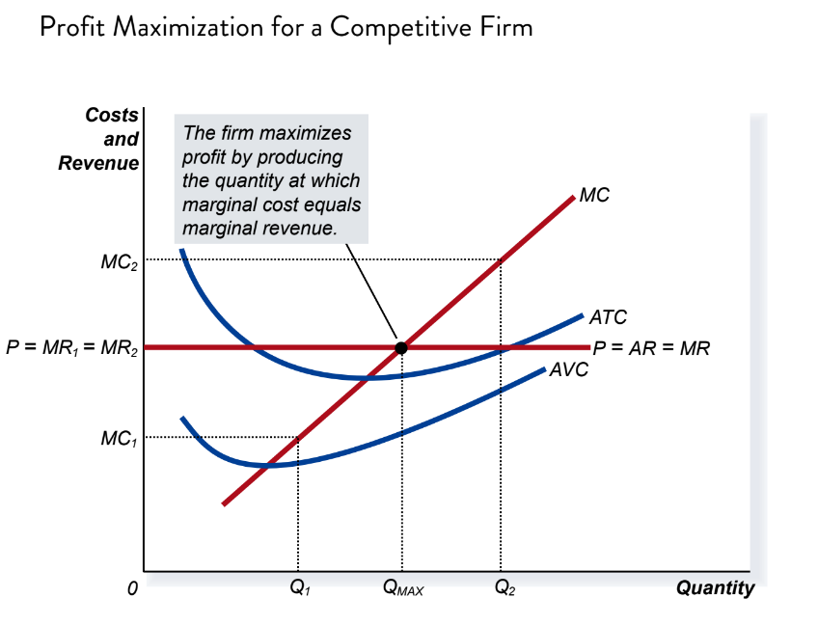

Slide 11
Predictions of perfect competition:
Price will be driven down to MC of production
No economic profits
Mkt forces push firms to be operating at their minimum SRATC and LRATC

Slide 12
In reality, few markets are perfectly competitive
(but that doesn’t mean our model of PC can’t help us understand the world around us)
The extreme opposite of PC is monopoly

Slide 13
Monopoly is when there is only one seller of a good
Instead of a “price taker” (like in the case of PC), monopolies have at least some ability to set their price
Price is a choice variable
Does that mean they can charge whatever they want?

Slide 14
For a monopoly to be able to use its market power, there must be barriers to entry
Think about a monopoly dog walker
“contestable markets”
Not all monopolies are necessarily profitable

Slide 15
To understand our model of monopoly, we need to understand the relationship between the demand curve and the MR curve
In PC, MR=Price
Not the case under monopoly
Why?

Slide 16
Quant | P | TR | AR | MR
0 | 1.1 | 0 | - | -
1 | 1.0 | 1.0 | 1.0 | 1
2 | 0.9 | 1.8 | 0.9 | 0.8
3 | 0.8 | 2.4 | 0.8 | 0.6
4 | 0.7 | 2.8 | 0.7 | 0.4
5 | 0.6 | 3.0 | 0.6 | 0.2
6 | 0.5 | 3.0 | 0.5 | 0
7 | 0.4 | 2.8 | 0.4 | -0.2
8 | 0.3 | 2.4 | 0.3 | -0.4

Slide 17
Graphing MR:
For linear demand curves, the MR curve will have the same y-intercept as the demand curve, but will be twice as steep

Slide 19
How does a monopoly find its profit maximizing quantity?
By producing up to the point where the marginal benefit of producing one more unit is no longer greater than the marginal cost
Stop when MR=MC
This is our “profit maximizing” condition

Slide 22
Is there deadweight loss associated with monopoly?

Slide 23
Should we “do something” about monopolies?
Most countries have some sort of branch of law enforcement that promotes competition
Usually the most visible form of this is sometimes trying to block proposed mergers
This can be pretty tricky because sometimes mergers are good because they sometimes increase efficiency
Think economies of scale

Slide 24
Merging b/c firms want to be more efficient:

Slide 25
Merging b/c firms want market power:

Slide 26
Practice Question:
Assume:
P=48-2Qd
MC=2Q
Calculate the monopoly profit max’ing quantity and price.

Slide 27
Answer
MR= 48-4Qd
Q* where MR=MC
So Q*= 8
Monopolist’s price= $32

Slide 29
Using the graph, find:
Monopoly profit maxing quantity
Monopoly profit maxing price
And calculate monopoly profits

Slide 30
Answers:
Q=7
P=$130
Profit= $20x7 units= $140

Slide 31
Once we step away from the world of PC (and “price taking”) there are a lot of interesting pricing options potentially available to the firm
For example:

Slide 32
My local movie theater gives students and senior citizens a discount on admission
Is this consistent with the firm trying to max profits?

Slide 33
Price discrimination:
Charging different prices to different consumers based on their willingness to pay
Perfect price discrimination
More realistic forms

Slide 34
What conditions need to hold to be able to price discriminate?
1) Know (at least roughly) a person’s willingness to pay
Or at least a rough guess at the willingness to pay for the separate groups
2) Be able to prevent arbitrage

Slide 35
Practice questions:
New books are released in “hardcover” first, usually priced around $30. Six months later, a “paper back” version is released for around $8. Note that the marginal cost of production for the two versions is very similar. Might this be considered a price discrimination scheme? Explain.

Slide 36
Practice questions:
Often, companies will print coupons for a discount on their products and put these in newspaper or magazines (“1.50 off Brand X dishwashing detergent!”). Might this be considered a price discrimination scheme? Explain.

Slide 37
Practice questions:
Airlines have historically been very adept price discriminators. For years, the inclusion of a Saturday stay in one’s travel plans yielded a different price relative a trip without a Saturday stay. (For instance, Thursday-Sunday vs. Tuesday-Friday.)
Which ticket would you expect to be more expensive (the one with or without the Saturday)? How might this fit with our price discrimination discussion?

Slide 38
A Brief Intro to Game Theory

Slide 39
Games
Often in business, one must make decisions based on what one thinks one’s rivals will do.
Game Theory is a framework to help us understand these situations.
Game Theory is thus very helpful in understanding oligopoly

Slide 40
Games
A few definitions:
Simultaneous move game: players move at the same time, without knowing what the other player will do
Sequential move game: one player observes the move of the other before moving
Repeated game: game that is played more than once
One-shot game: a game played only once

Slide 41
Simultaneous-move, one-shot games
Prisoners Dilemma
Two suspects are arrested by the police. The police have insufficient evidence for a conviction, and, having separated both prisoners, visit each of them to offer the same deal. If one testifies (defects from the other) for the prosecution against the other and the other remains silent (cooperates with the other), the betrayer goes free and the silent accomplice receives the full 10-year sentence. If both remain silent, both prisoners are sentenced to only six months in jail for a minor charge. If each betrays the other, each receives a five-year sentence. Each prisoner must choose to betray the other or to remain silent. Each one is assured that the other would not know about the betrayal before the end of the investigation. How should the prisoners act?

Slide 42
Payoff Matrix
 | Cooperate | Defect
Cooperate | 0.5 years, 0.5 years | 10 years, 0 years
Defect | 0 years, 10 years | 5 years, 5 years

Slide 43
A strategy that is preferred by a player regardless of the opponent’s move is known as a dominant strategy
Is there a dominant strategy in the PD game?
Nash equilibrium is an outcome at which no player has incentive to deviate.
Note the Nash equilibrium is not always the “best” outcome! (as in the case of the PD)

Slide 44
Practice Questions
 |  | Player 2
 |  | D | E | F
Player 1 | A | 100,125 | 300,250 | 200,100
 | B | 250,0 | 500,500 | 750,400
 | C | 0,-100 | 400,300 | -100,350

Slide 45
Practice Questions
 |  | Player 2
 |  | D | E | F
Player 1 | A | 100,125 | 300,250^{x} | 200,100
 | B | *250,0 | *500,500^{x} | *750,400
 | C | 0,-100 | 400,300 | -100,350^{x}

Slide 46
The “prisoner’s dilemma style” game can represent other situations firms may face, such as the decision to
advertise heavily or not
Include an “extra” or not
Gaming console sold with a free game, for ex.
Car sold with a generous service package
Free delivery

Slide 47
 |  | Firm B
 |  | Advertise | Don’t Advert
Firm A | Advertise | 20,20 | 80,15
 | Don’t Advert | 15,80 | 50,50

Slide 48
Hi price/ low price game
2 Firms, each with the option to “price high” or “price low”
Think of the high price as the monopoly price
If both firms price high (soft competition), they each capture 50% of the market
If your rival prices high, do you have any incentive to price “just below”?

Slide 49
 |  | Firm B
 |  | Low | High
Firm A | Low | 0,0 | 50,-40
 | High | -40,50 | 10,10

