Slide 1
Many-body quantum physics
Lecture 8

Slide 2

BDSM
Bose distribution and
statistial mechanics
consequences in many-body quantum physics
Jani-Petri Martikainen
8.3.2023

Slide 3
Learning goals
Bose-Einstein and Fermi distributions: what and how
Bose-Einstein condensation: understand where it comes from in detail. Also derivation.
Field of ultracold gases: intro
  Techniques
  Issues, opportunities….

Slide 4
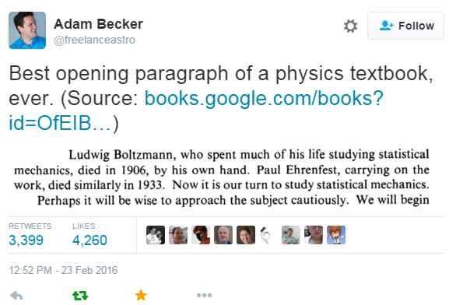
Quantum statistics

Slide 5
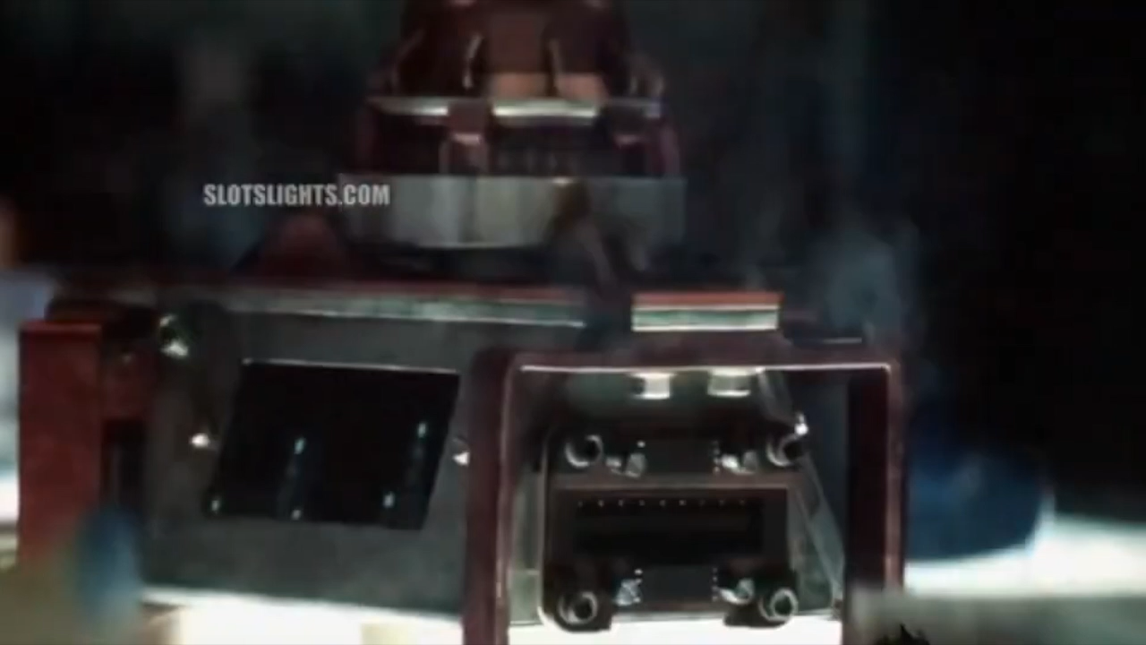
Cool to low enough T: into the “quantum realm”
Does this happen?

Slide 6
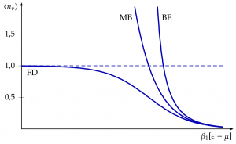
Boltzmann, Bose-Einstein, Fermi-Dirac

Slide 7
Interesting points
BE gives higher occupations for small energies
FD gives lower occupations for small energies (n=1 upper limit)
Derivation is kind of cleaner and more elegant for bosons and fermions…classical result is more of a mess and need fudge factors.
Whiteboard…

Slide 8
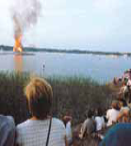


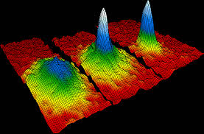
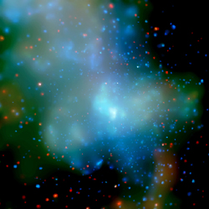
Bose-Einstein condensation
Solid
Plasma
Liquid
Gas

Slide 9
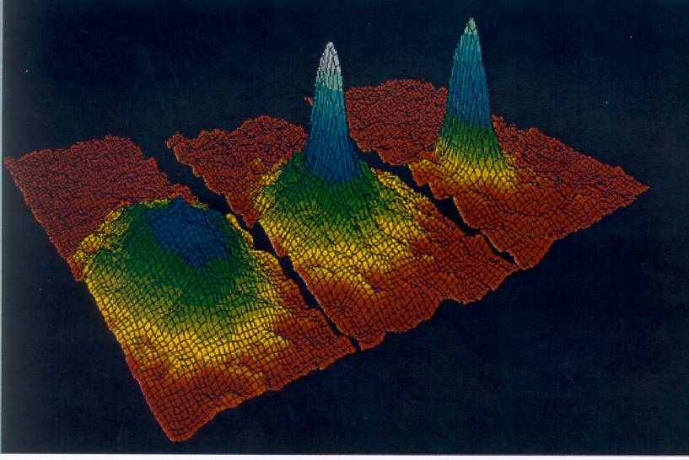
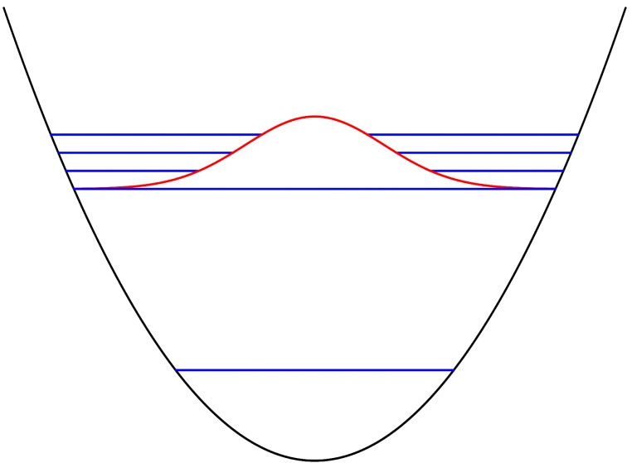
Superconductors
Superfluids: Helium
Superfluids: ultracold
atoms (bosons)
Nobel 2001
E
Notes:
The phases of matter familiar for us from everyday life are: solid, liquid, gas and plasma (e.f. flames of fire). There are, however, many other phases of matter that have been experimentally observed, for instance superfluids of Helium or of ultracold gases, or superconducting phases in metals (superconductors and superfluids are conceptually similar, but the former involves charged particles). Furthermore, there are yet a large number of other phases or states of matter observed or predicted in physics, some of them very exotic in the sense that we do not have an everyday equivalent of them.

Slide 10
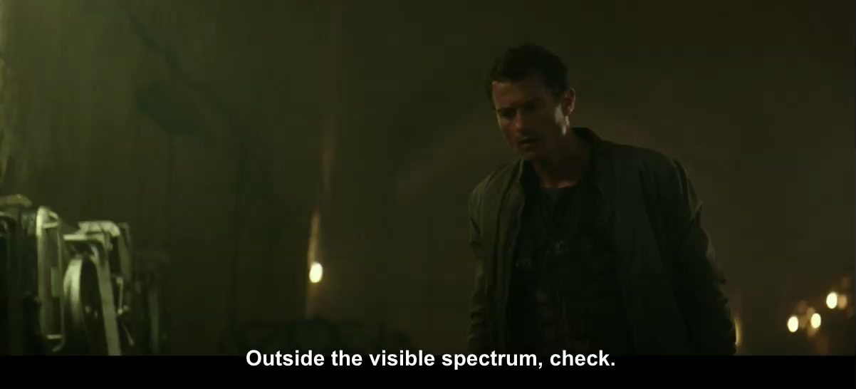
Bose-Einstein condensation
…according to Netflix (Spectral)
Derive on blackboard for real

Slide 11
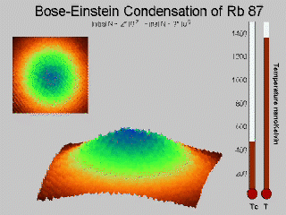
Condensation in real time
Start from thermal cloud and cool…

Slide 12
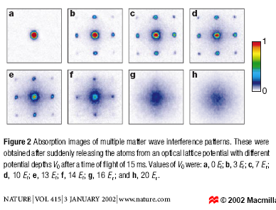
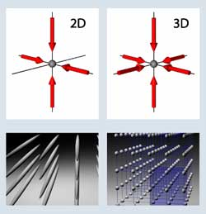
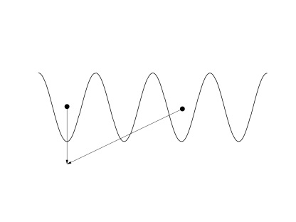
Quantum correlations visible in the optical images
Notes:
Counterpropagating laser beams create standing waves, and atoms can be trapped either in the minima or the maxima of the standing waves due to the dipole force the light field imposes on the atoms. Depending on whether one uses 2, 4, or 6 counterpropagating beams, a periodic structure in 1, 2 or 3 dimensions is created. The Figure 2 above is from the famous Mott insulator – BEC quantum phase transition experiment. The experiment was done at Max Planck Institute at Garching, Germany, and one of the co-authors, T. Esslinger, is now a professor at ETH Zurich. The pictures are absorption images after time of flight when the atoms have been released from the lattice.
If the atoms in the lattice are initially all coherent with each other, for instance they are in a BEC state, then the release of atoms from the lattice may, under certain conditions, form the type of interference patterns seen in Figures 2 b-f. Briefly, on can think that when one observes, after time of flight, an atom in a certain spot (see the small schematic picture below Figure 2), one cannot know whether it originated from one lattice site and had one momentum, or from another site but had another momentum and ended up in the same place. This type of lack of information always produces intereference both in quantum physics and in wave optics. This is expressed by the equation: the probablity includes interferences of amplitudes of particles from different sites. To see any interference, the amplitude coherence expectation value between two different sites has to be non-zero, as is the case for instance for a BEC.

Slide 13
Gross-Pitaevski equation for the condensate wavefunction
Derive (mean-field ansatz) energy functional
Find equation for wavefunction so that this is minimized
Fix from normalization

Slide 14

Interactions: scattering length
Contact interaction…
Billiard ball with radius “a”
That is a lie: complications exist
Systematically from scattering theory between two particles
Can be tuned!
Van der Waals interactions are the source of
interactions between neutral atoms

Slide 15

Dilute/weak interactions
What does it mean?
Gas of billiard balls at density n is dilute if…?
Check this for
  ultracold cloud of Rb atoms
  Liquid helium

Slide 16

Functional derivative
Usually in optimization take derivative and demand it vanishes.
Here optimize in each point in space (infinite number of ”variables”)…functional derivative
Get differential equation for the optimal solution. How cool is that!

Slide 17
Condensate wavefunction
What is it??? Wavefunction for what?
basically
Picture of a BEC appearing.

Slide 18

Gross-Pitaevskii equation
Pure BEC governed by…
This works very well in many realistic settings.
Generalizations exist
Btw. note slight terminological unclarity in lecture notes regarding ”Lagrangian density”. Usually in this context…(+interactions)

Slide 19
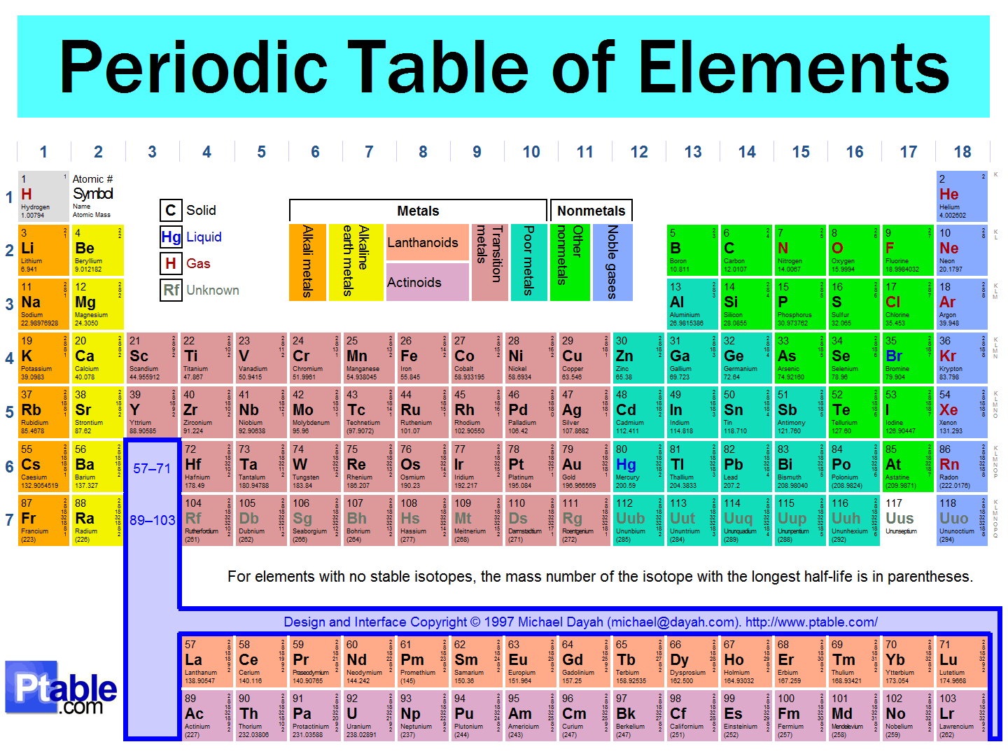
What to condense?

Slide 20

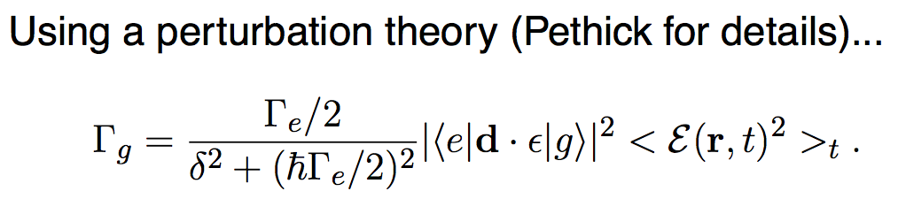
Cooling atoms?: basic ideas
Radiation pressure: photon has wavevector q

Slide 21
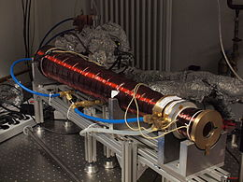
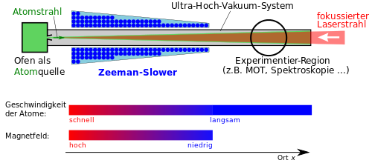
Zeeman slower
Change the resonance frequency along the way as atoms are cooled by radiation pressure…

Slide 22
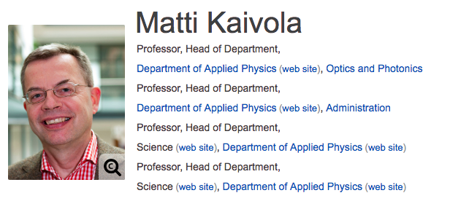
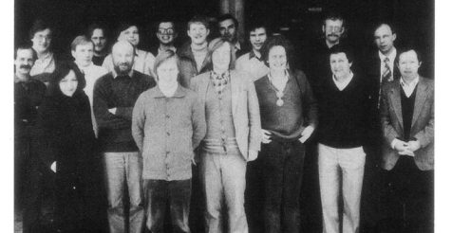
Finnish connection in the early years

Slide 23
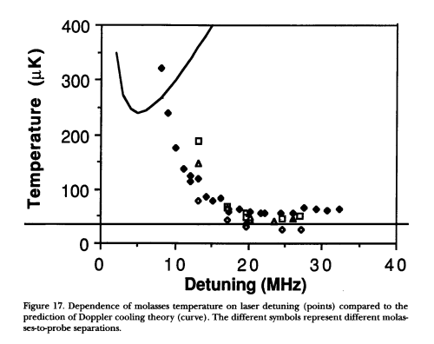

Laser cooling: below Doppler limit??
Doppler limit: Temperature about the width of the line or
about inverse lifetime

Slide 24
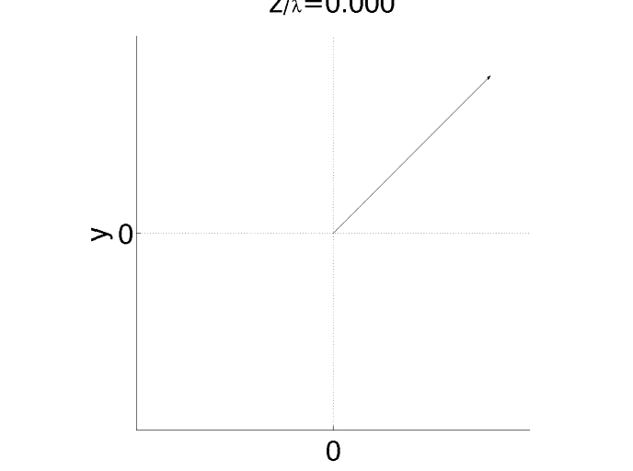
Sisuphys cooling
Two linearly polarized laser beams with orthogonal polarizations interfere→ polarization varies in space

Slide 25
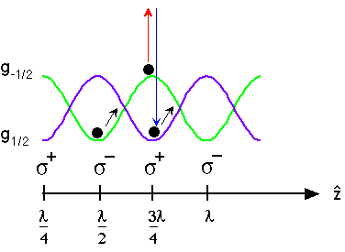
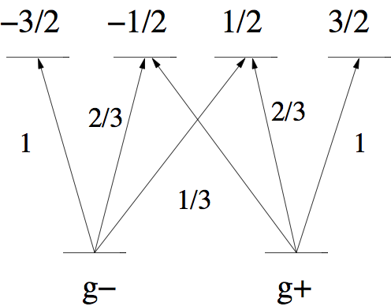
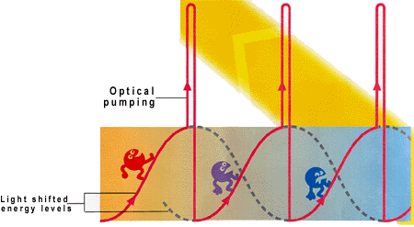

Sisyphus cooling
This could be 400 nK+ prefactor

Slide 26
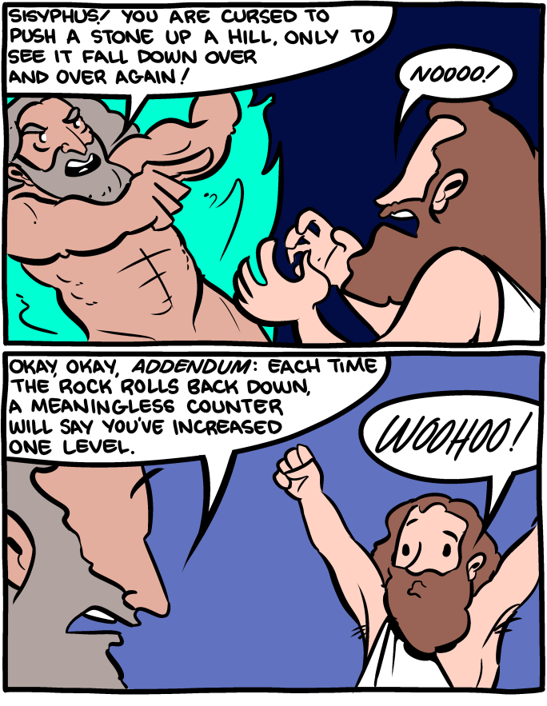
Sisyphus
cooling

Slide 27

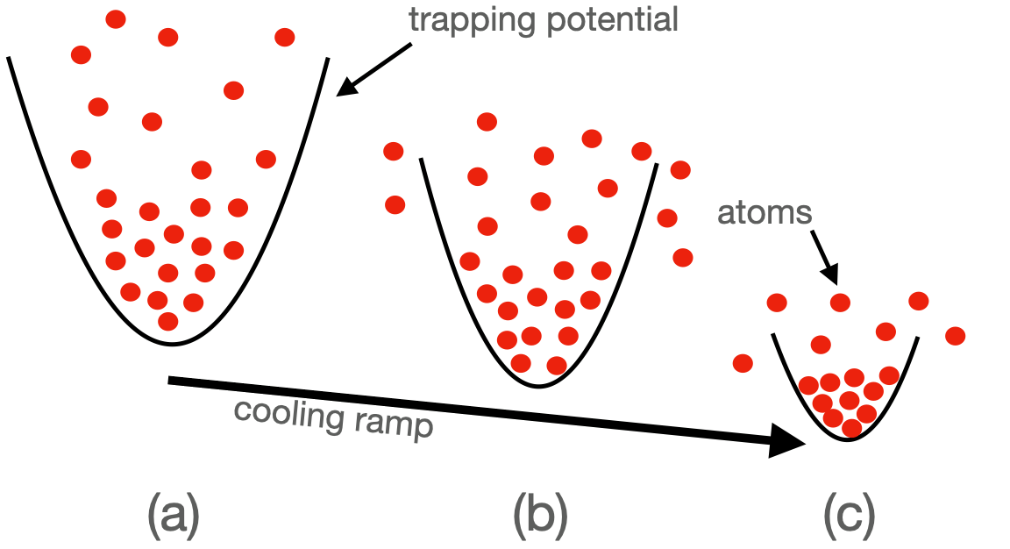
Evaporative cooling
Final step often
Lose hot atoms…colder ones left behind
Collisions thermalize to new equilibrium
Often the work horse of cold atom experiments and gets you to interesting regime.

Slide 28
Can we have Fermi condensates?
Bose-Einstein condensates are made of bosonic atoms. Other bosons: e.g. photons
Fermions are constituents of matter: electrons, protons, neutrons, some atoms…
E
E
0
r
0
r
0
0
Fermions have to make pairs (which are bosons)
to condense to the lowest state
Notes:
We have learned about Bose-Einstein condensates. Is it possible to condense fermions? Fermions are important since they are the constituents of matter. However, fermions of one kind (indistinguishable fermions) cannot Bose-condense due to the Pauli exclusion principle. There is, however, a route to fermion condensates: if fermions make pairs which are effectively bosons, and those condense.

Slide 29
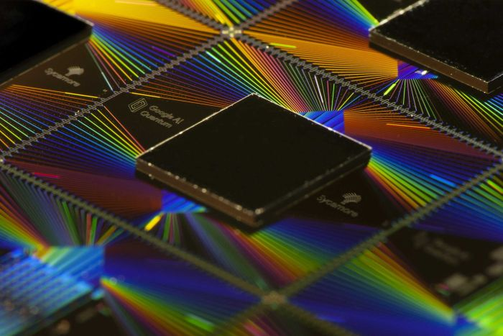
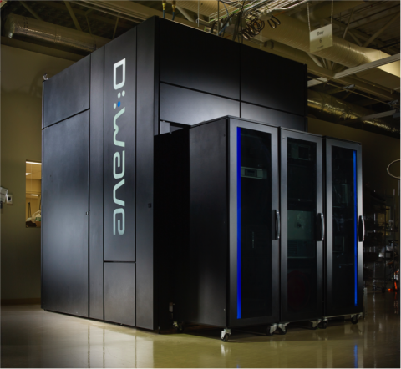
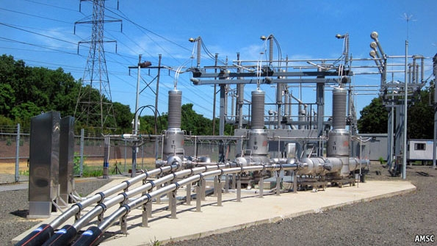
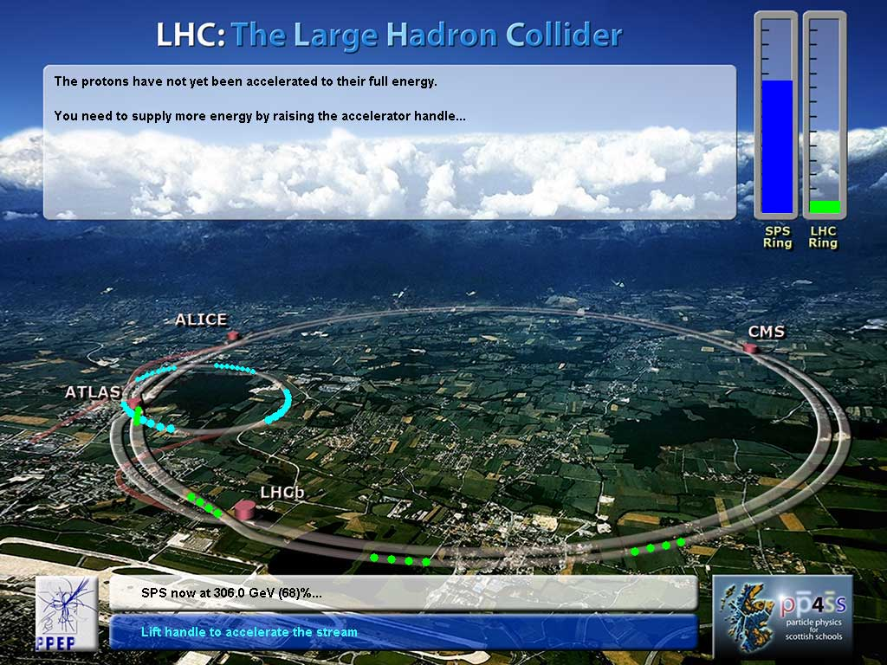

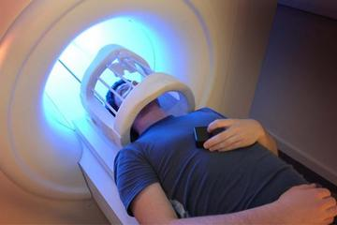
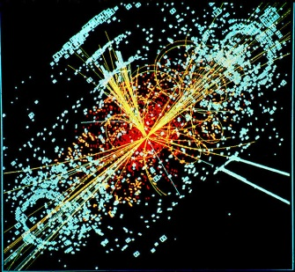
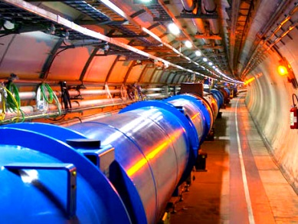
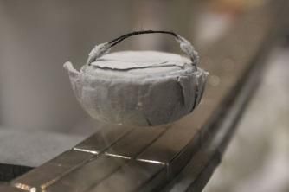
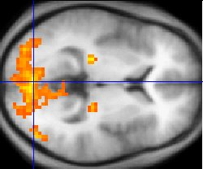
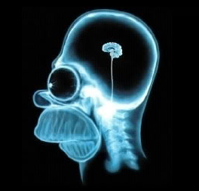
SUPERCONDUCTIVITY
WHY NOT
AT ROOM TEMPERATURE?
Highest T_{c} (ambient pressure)
~150 K – just a factor of two!
Notes:
It would be of tremendous impact, if materials that are superconducting at room temperature could be found or designed. For instance, superconducting (classical) logic would be 100 000 times more energy efficient in principle, but the cooling takes 1000 more power than room temperature operation; also the speed could be 770 GHz instead of 5 GHz. Physicists have been struggling to understand the underlying mechanism of high-temperature superconductivity (occuring for cuprates and pnictides at temperatures in the 100 Kelvin range) since the discovery of first high-temperature superconductors by J.G. Bednorz and K.A. Mueller at the IBM Zurich Labs in 1986. One of the motivations for studies of ultracold Fermi gases is to use them as a quantum simulator in exploring physics that may enable us to reach room temperature superconductivity one day in the future.

Slide 30
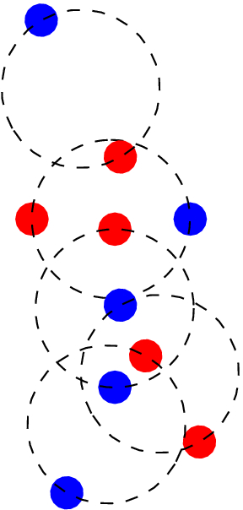
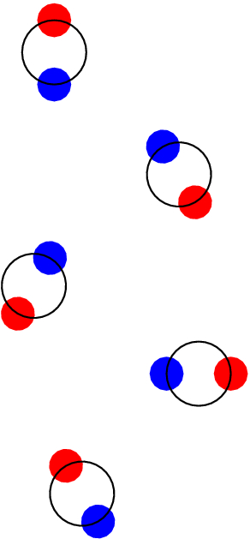
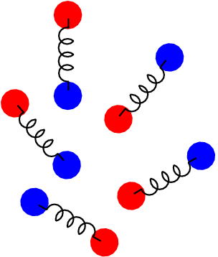
Fermi condensates!!! 2004-2005
BEC-BCS crossover
Related to, e.g., high temperature superconductivity
Important concept: Pairing gap (related to superfluid order parameter), roughly
corresponds to pair binging energy; notation Δ
Notes:
A series of experiments in ultracold gases (⁶Li and ⁴⁰K were the atoms used) by several groups proved the existence of fermionic many-body pairing, condensation and superfluidity in 2004-2005. Such Fermi condensates are analogous to superconductors (although not charged) and to ³He (although much more dilute systems with higher condensate fractions and more controllable interactions). There are also analogies to nuclear matter and to quark matter.
One of the important results was the study of the so-called BEC-BCS crossover. It had been suggested in the 80’s by the Nobel laureate Leggett, and by Nozieres and Schmitt-Rink (and in the 60’s by Eagles), that Bose-Einstein condensates of bosons and superconductors of Cooper pairs are actually two sides of the same coin, that is, they are extreme cases of the same phenomenon and there is simply a crossover between them, no (quantum) phase transition. In ultracold gases, it was for the first time possible to study this question experimentally and show that indeed it is only a crossover. The phenomenon of Feshbach resonance was used to tune the interaction between two types of fermions (e.g. two hyperfine states of Li atoms) so that they evolved from tightly bound molecules into a loosely bound Cooper pairs. The BCS-BEC crossover is related to the puzzle of high-temperature superconductivity, a phenomenon yet without deep theoretical understanding, in the sense that high-T_{c} superconductors are known to be in the intermediate regime between the BEC and BCS ends. In ultracold gases, this regime is called the unitarity regime, because there the scattering length formally diverges and in practise the only energy scale describing the interactions will be the Fermi energy. Thus, ultracold gases are expected to provide new insight to the problem of high-temperature superconductivity, possibly even solve it. In one of the following lectures in this course, we will learn physics of the BCS-BEC crossover more thoroughly.

Slide 31
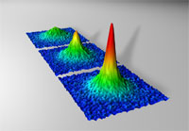
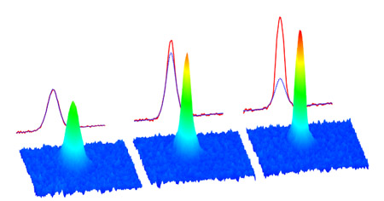
Science and Physics World ranked the observation of Fermi condensates among the top ten scientific breakthroughs of the year 2004
BEC of molecules (dimers of two
Fermions) 2003-2004
Grimm, Jin, Ketterle, Salomon
Fermion pairs near the Feshbach
Resonance 2004
Jin, Ketterle
Density profile throughout the
crossover
Grimm 2004
Heat capasity
Thomas 2005
Collective modes
Thomas 2004,
Grimm 2004
Vortices
Ketterle 2005
Pairing gap Grimm 2004
Notes:
Several groups contributed to the creation of fermionic pairing and condensation. Superfluidity was demonstrated by quantized vortices. The observation of the pairing gap was done by the group of Prof. R. Grimm in Austia, with theory collaboration by the group of P. Törmä, Finland.

Slide 32
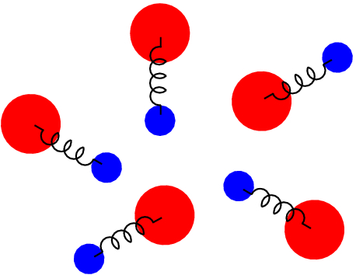
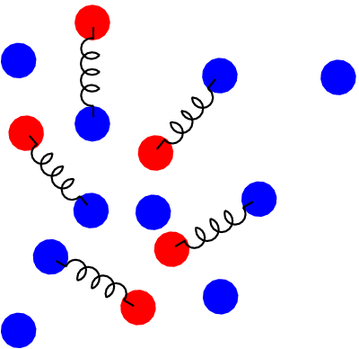
Polarized Fermi gases
Polarization
Pairing between particles with unequal mass or unequal
total number
Related to, e.g., high energy physics (colour superconductivity
of quarks)
Understanding pairing and other quantum many-body
correlations is at the heart of designing new materials
Does the FFLO (Fulde-Ferrel-Larkin-Ovchinnikov) state
exist? It is an exotic state of matter with coexisting superfluidity
and polarization P. Note that in usual superconductors and
superfluids P=0.
Notes:
Polarized Fermi gases, i.e. gases with different number of the two fermion types, typically two different hyperfine states of an atom (or two types of fermions of different masses, e.f. Li and K) have been under intensive investigation in recent years, and are continuing to be so.

Slide 33


[1] P. Kapitsa, Nature 141, 74 (1938)
[2] J.F. Allen , A.D. Misener, Nature 141, 75 (1938)
[3] S. O. Demokritov et al., Nature 443, 430 (2006)
[4] T. Giamarchi, C. Regg, O. Tchernyshyov, Nature Physics 4, 198 (2008)
[5] M. H. Anderson, J. R. Ensher, M. R. Matthews, C. E. Wieman, E. Cornell, Science 269, 198 (1995)
[6] K. B. Davis, M. O. Mewes, M. R. Andrews, N. J. van Druten, D. S. Durfee, D. M. Kurn, W. Ketterle, Phys. Rev. Lett. 75, 3969 (1995)
[7] J. Klaers, J. Schmitt, F. Vewinger, M. Weitz, Nature 468, 545 (2010)
[8] J. Marelic, R.A. Nyman, Phys. Rev. A 91, 033813 (2015)
[9] H. Deng, G. Weihs, C. Santori, J. Bloch, Y. Yamamoto, Science 298, 199 (2002)
[10] J. Kasprzak et al., Nature 443, 409 (2006)
[11] J.D. Plumhof et al., Nature Materials 13, 247 (2014)
[12] K. S. Daskalakis et al., Nature Materials 13, 271 (2014)
[13] H. K. Onnes, Comm. Phys. Lab. Univ. Leiden, Nos. 119, 120, 122 (1911).
[14] J. Bardeen, L. N. Cooper, J. R. Schrieffer, Phys. Rev 108, 1175 (1957).
Family of condensates
Helium superfluids^{1,2}
Magnon BECs^{3,4}
Ultracold gas superfluids^{5,6}
Photon condensates^{7,8}
Inorganic and organic polariton condensates^{9,10,11,12}
Superconductors^{13,14}
New member: plasmonic BEC
Notes:
Bose-Einstein condensates have been experimentally realized in various systems (not only ultracold gases).

Slide 34
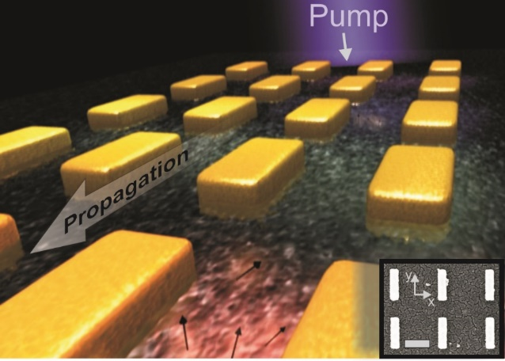
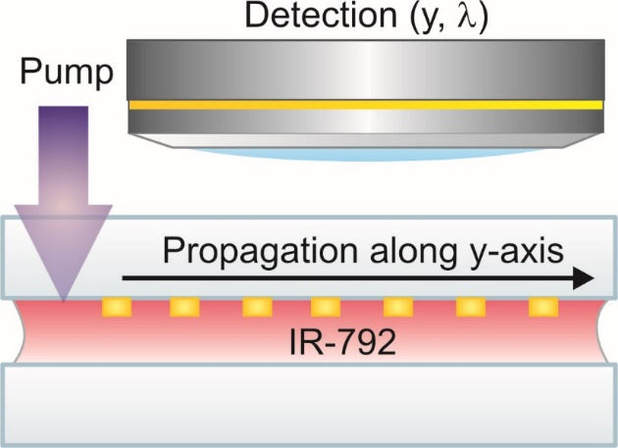
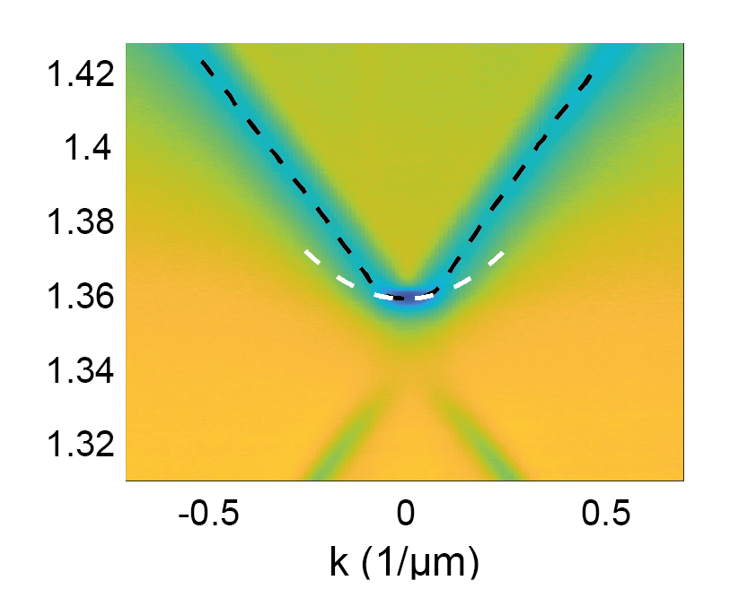
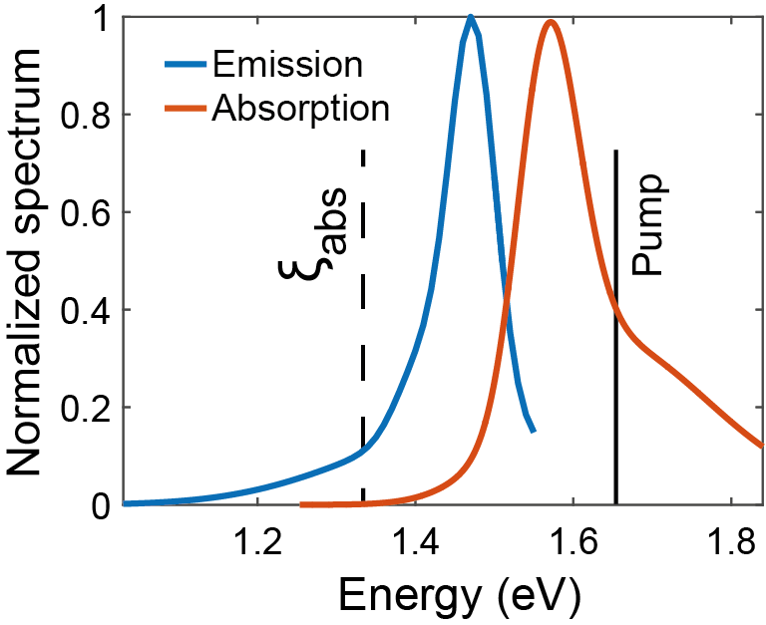
Nanoparticle array + molecules (weak coupling)
Energy where absorption rate is effectively zero (i.e. smaller than the loss rate)
band edge
Hakala, Moilanen, Väkeväinen, Guo, Martikainen, Daskalakis, Rekola, Julku, Törmä, Nature Physics 14, 739 (2018)
Notes:
Recently, a new type of Bose-Einstein condensate: a condensate of surface plasmon polaritons and light, was experimentally realized in a gold nanoparticle array at Aalto University. The nanoparticle array has dispersive modes and a band edge. The array is combined with fluorescent molecules, which are pumped to the excited state, but only at one end of the array. The excitations of light and plasmons start to propagate from the end of the array. Along the propagation, some of them scatter out and are monitored. In this way, time evolution maps into spatial location, and it is possible to observe the sub-picosecond dynamics of the system.

Slide 35
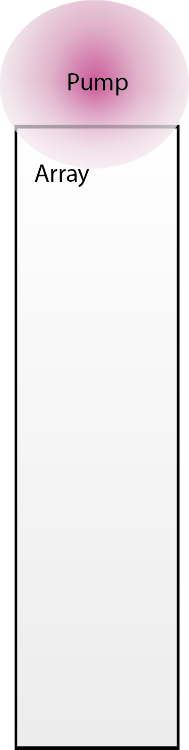
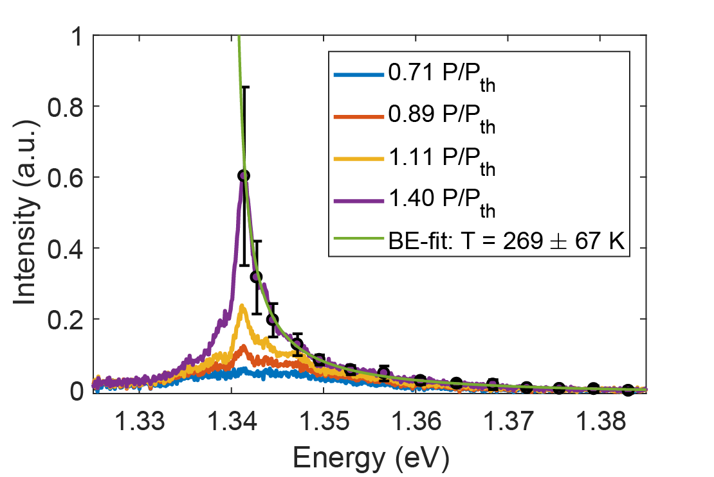
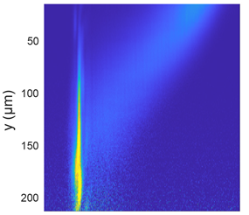



Bose-Einstein distribution at room temperature
Experiment
Rate equation simulation
For a video, see https://www.youtube.com/watch?v=okZmnB3Hhb4
(or google Bose-Einstein Aalto youtube)
Notes:
It was observed that due to the interaction of the excitations with the molecules, they lose energy during the propagation (the light redshifts). If the band edge energy is chosen correctely, the redshifted population condenses at the band edge and follows the Bose-Einstein distribution.

Slide 36

Bose-Einstein condensates
Interesting stuff
To be continued next week!

Slide 37

Thank you!
Questions?

