Slide 1
Many-body quantum physics
Lecture 9

Slide 2
Learning goals
Concept: quantized vortices
Status of research on BECs
Optical lattices: how to and what type of things are possible
Fermions: 1st scratch to Fermi liquid theory…continue next week…

Slide 3

Bose-Einstein condensates
Interesting stuff

Slide 4
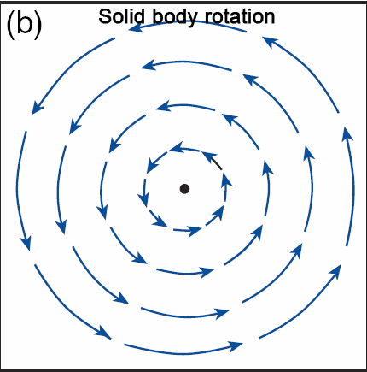
Solid body rotation and condensates?
Velocity field?
Vorticity?
Impossible with a wavefunction?
Handwritten notes

Slide 5
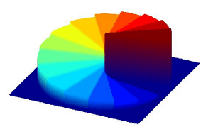
Vortex: phase of the wavefunction
Vorticity requires singular behavior

Slide 6

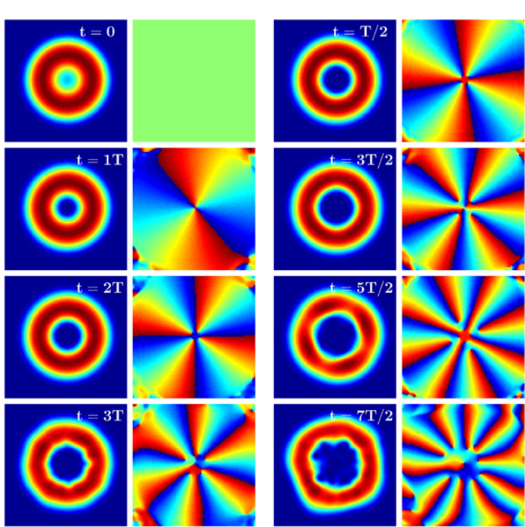
Vortex: higher “winding number”
https://www.aalto.fi/en/department-of-applied-physics/quantum-gases

Slide 7
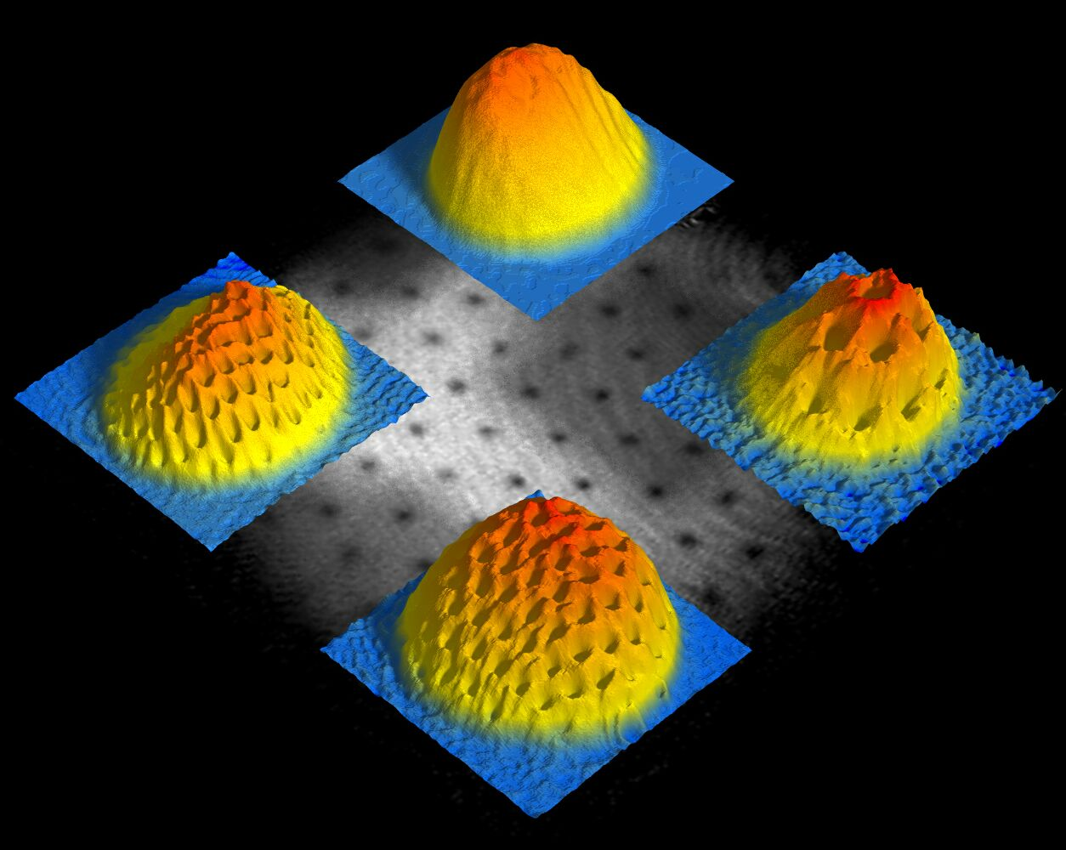
How to get something like a classical solid body rotation?
Lattice of quantized vortices

Slide 8
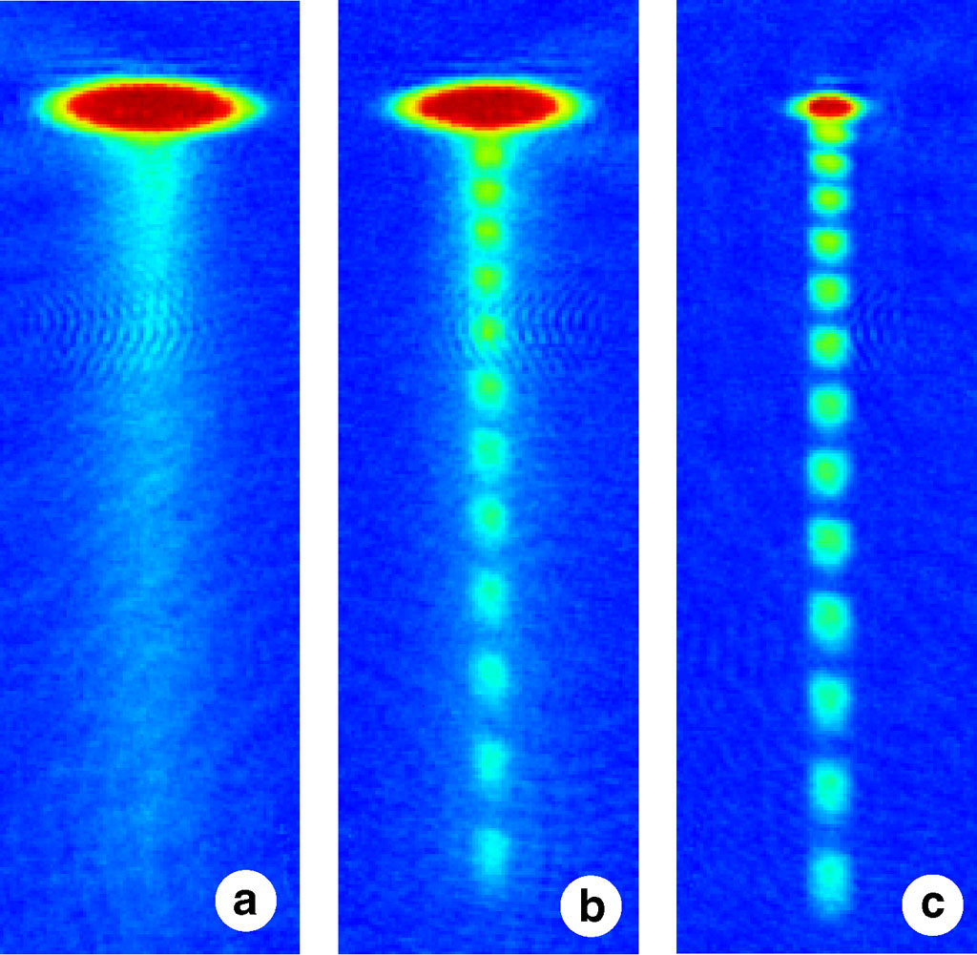

Interesting stuff: atoms lasers
Will it kill you?

Slide 9
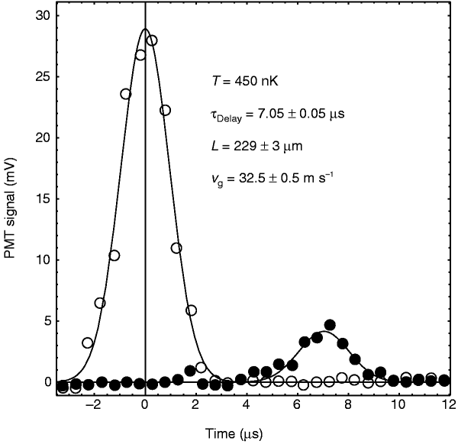
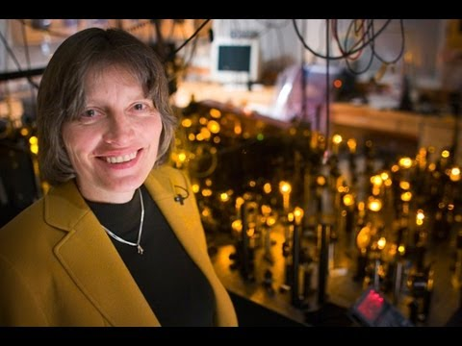
Slow light/light stopping
https://www.youtube.com/watch?v=RIc5llW66sU

Slide 10
Strongly interacting systems: beyond mean-field
Bye bye Gross-Pitaevskii equation
Weak to strong coupling transitions
Effective spin model
Beyond billiard balls
Erbium magnetic dipole moment of 7 μB

Slide 11
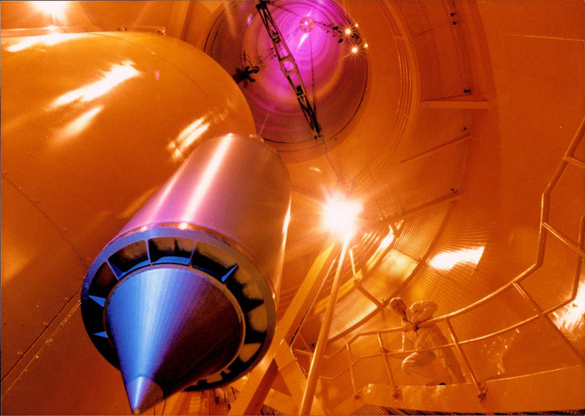
Throw the BEC from 146m tower
In Bremen

Slide 12
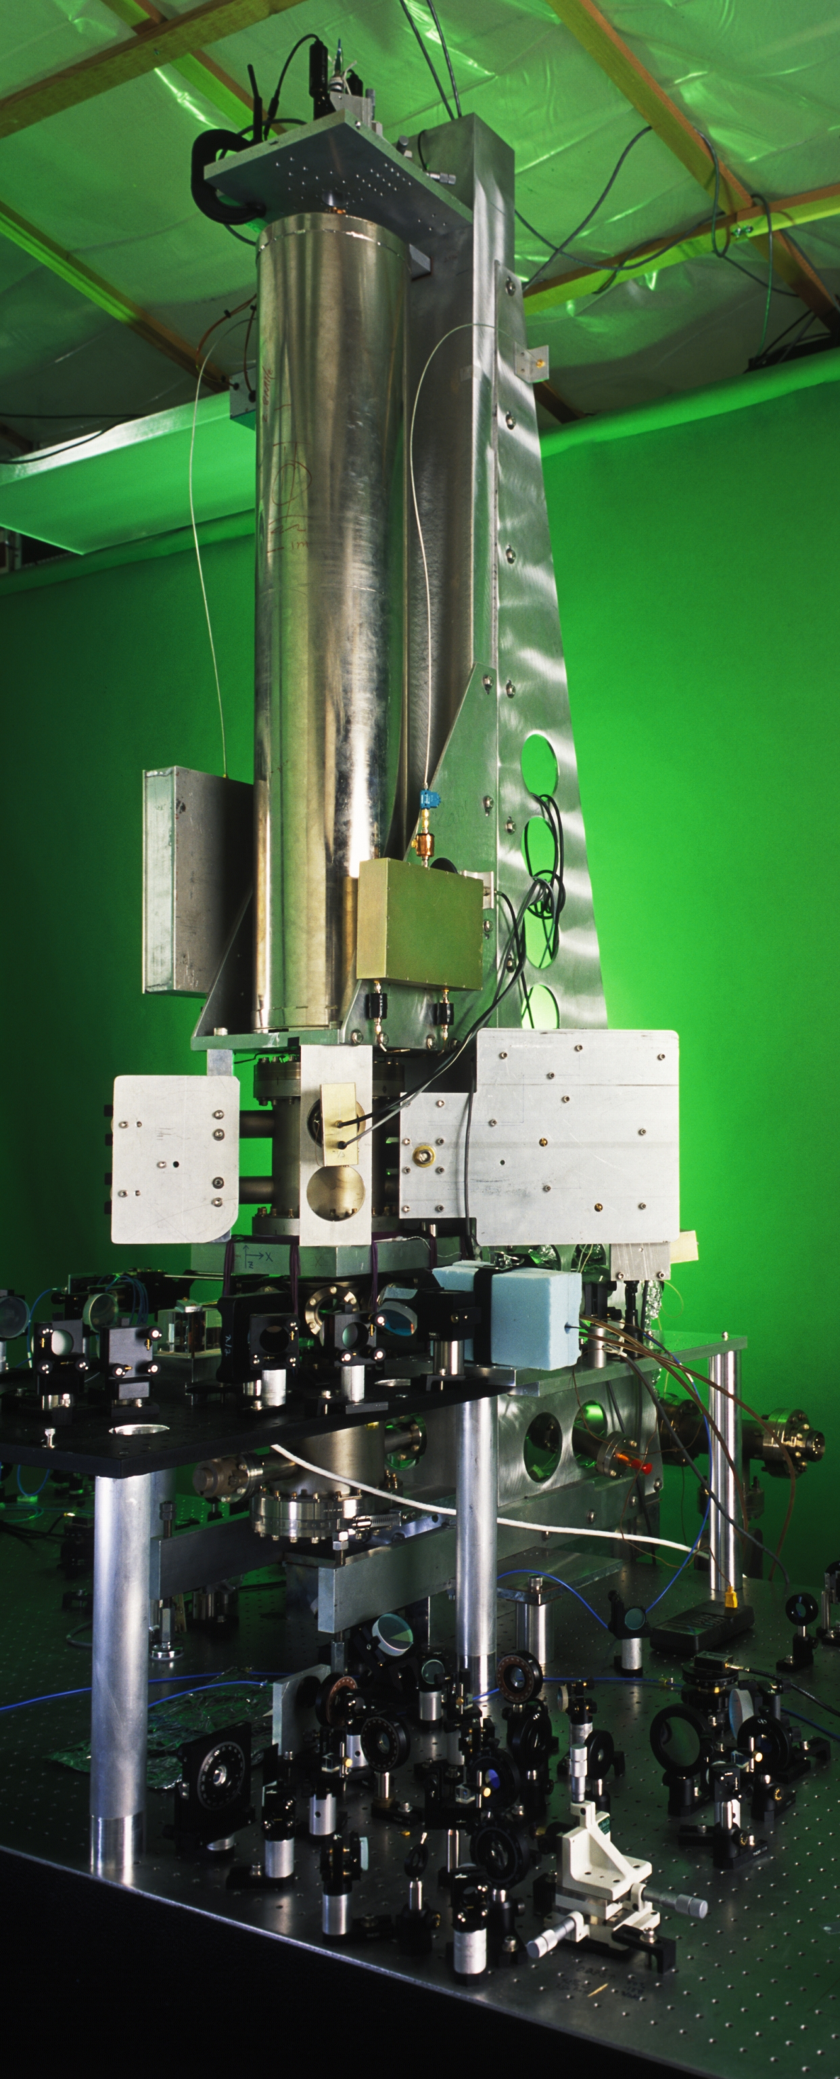
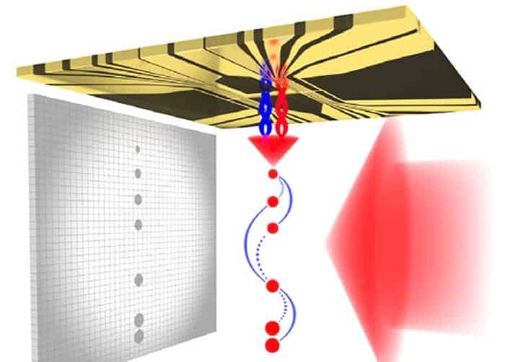
Precision measurements
Clocks
Gravity
Acceleration
Cesium fountain in NIST

Slide 13
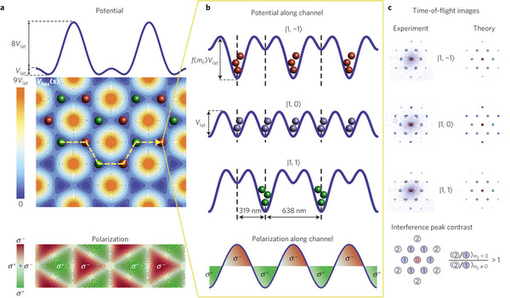
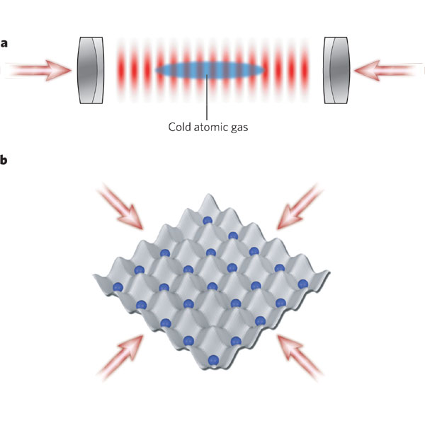
Optical lattices/optical potentials

Slide 14
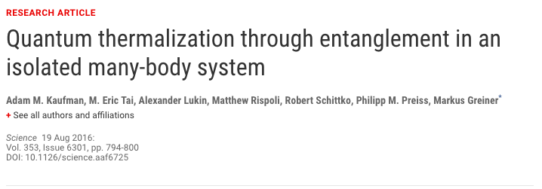
How statistical mechanics
appears from QM?

Slide 15
Contents
The concept of a quantum phase transition
The Bose-Hubbard model in a lattice
  There exists also the Fermi-Hubbard model
The Superfluid – Mott-insulator transition
  Toy-model example: double well
  The phase diagram
Observation of the transition in optical lattices
  Switching off the lattice potential
  How quantum correlations can be revealed from the interference features
  New: single site imaging by the Quantum Gas Microscope

Slide 16
Quantum phase transitions
Finite T phase transitions (e.g. Ising, BCS)
T = 0 Quantum phase transitions: competing energies of the system (e.g. interaction and kinetic)
Internal energy
versus
Entropy
Notes:
We are familiar with thermal phase transitions: there the internal energy of the system (for instance caused by interactions, such as spin-spin interaction in the Ising model) competes with entropy, and at a certain temperature one wins over the other. A quantum phase transition is something conceptually clearly different. There the competition is between two types of energies in the system, thus, it can happen also at zero temperature. You may think that some parameter affects which energy is more dominant, and thus by tuning the parameter, one can see an quantum phase transition from one phase to another.

Slide 17
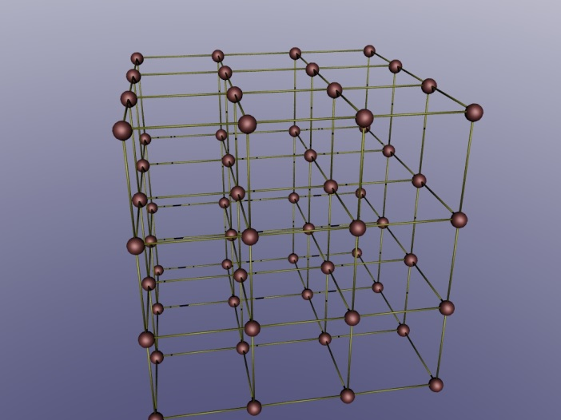
The Bose-Hubbard model in a lattice
M.P.A. Fisher, P.B. Welchman, G. Grinstein, D.S. Fisher, Phys. Rev. B 40, 546 (1989)
D. Jaksch, C. Bruder, J.I. Cirac, C.W. Gardiner, P. Zoller, Phys. Rev. Lett. 81, 3108 (1998)
c.f. Exercise 3, Task 4
bosonic annihilation operator
for a particle at site i, with
mode function
nearest neigbourghs
c.f. Fermi-Hubbard model, e.g. correlated electrons in various materials
Notes:
In this lecture, we will learn an important example of a quantum phase transition: the superfluid – Mott insulator transistion. It has been observed in ultracold atoms and is one of the landmark observations within the field.
We will study this question in the context of the Bose-Hubbard model. The Hubbard model, especially the Fermi-Hubbard model, is extremely well known and important condensed matter theory concept. It combines a lattice potential, usually described at the nearest neighbour hopping level, with interactions, often at the on-site level. The physics of this simple model is extremely rich. The fermionic version is proposed to explain important phenomena, such as high-temperature superconductivity. However, despite apparent simplicity, there are no general exact solutions of the Hubbard model for large systems, even numerical ones. Therefore, it is quite interesting that ultracold gases can very accurately realize the Hubbard model experimentally. It may therefore be possible to use ultracold gases as a “quantum simulator” where the experiments “simulate” a model that is impossible to solve by usual computers.
Let us look at the Hamiltonian. In the second quantized form, it is familiar to us. Now let us expand the field operators in the basis of single lattice site wave functions (the Wannier functions); this was done in Exercise 3, Task 4. This produces the Hamiltonian on the second line, when we assume that the overlap of the Wannier functions is non-negligible only between nearest neighbours (the so-called tight binding limit), which leads to the first term, nearest neighbour hopping. The magnitude of this kinetic energy term is given by the band width J. Interactions are on-site, resulting from the contact-interaction and the tight localization of the Wannier functions. In the grand canonical ensemble, we add the chemical potential.

Slide 18
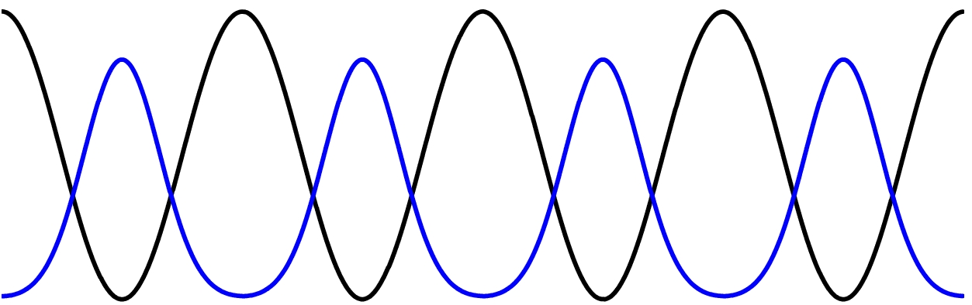
U and J compete! Quantum phase transition?
Let us consider a simple example first.
Notes:
A non-interacting particle in the lattice would like to have a momentum that corresponds to the bottom of the band. In real space, this corresponds to a wave-function that is located in all the lattice sites. This minimizes the kinetic energy, i.e. is favoured by the hopping term proportional to J. However, the interactions represented by the term proportional to U might favour some totally different type of wavefunction. There is actually a competition between the kinetic and the interaction energy within the Hubbard model, so we might expect quantum phase transitions! But to understand the nature of those, let us first consider a simple example of the double well, with one or two particles. Note that there cannot be real phase transitions in such small (finite) systems, but this example will give us intuition.

Slide 19
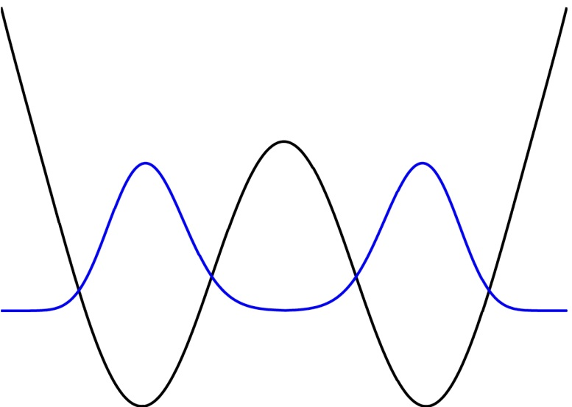
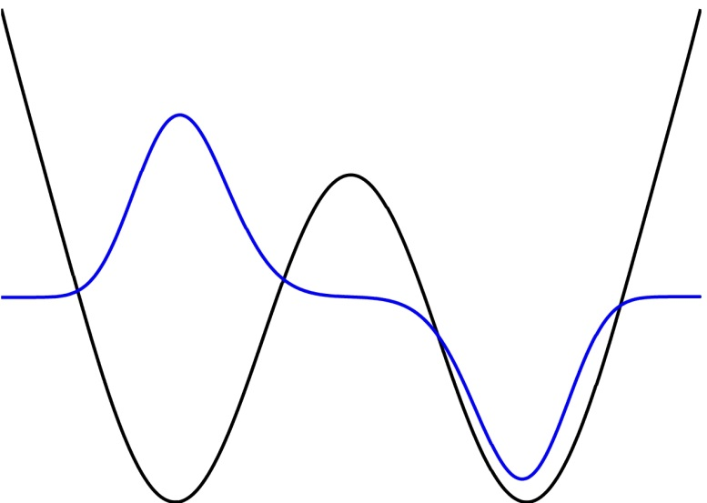
One particle in a double well
L
R
L
R
Notes:
One particle in a double well is governed by the hopping (tunneling) term between the wells. The solutions of the problem are the well known symmetric (lowest) and antisymmetric (second lowest) states of the well.

Slide 20
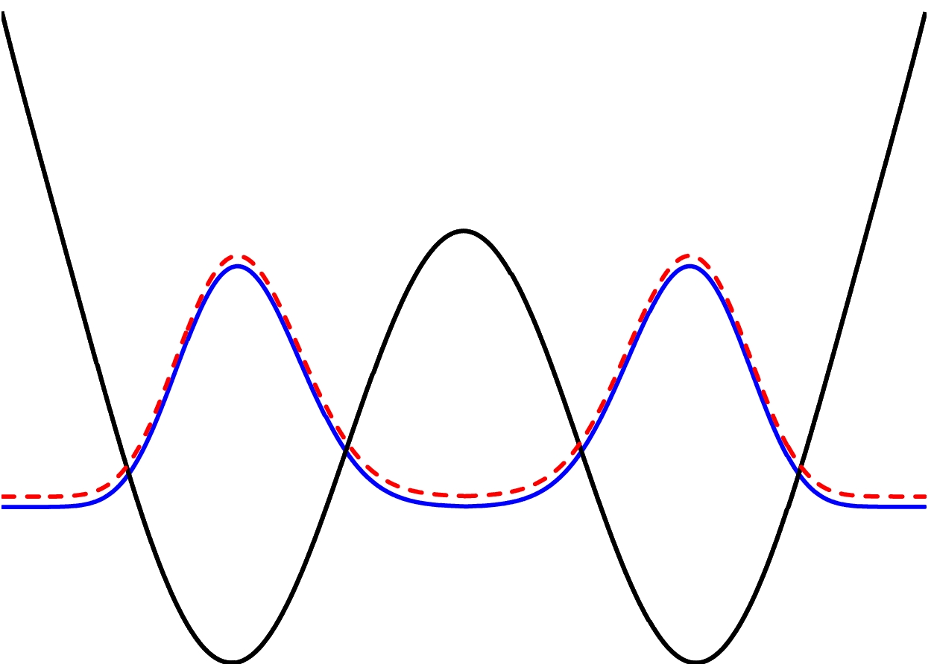
Two non-interacting bosons in a double well
Notes:
If we have two non-interacting bosons in the double well, they both go to the ground state (the symmetric one) of the double well.

Slide 21
Two interacting bosons in a double well
Notes:
If the two bosons in the double well interact, we have to solve the above Hamiltonian which also has an interaction terms. A suitable basis for representing the Hamiltonian are: one particle in both wells, two particles in the left well, two particles in the right well. No more states are needed since the two particles are indistinguishable and we are using the second quantization formalism where the states only have occupations and the boson statistics are taken care by the commutation relations for a.

Slide 22
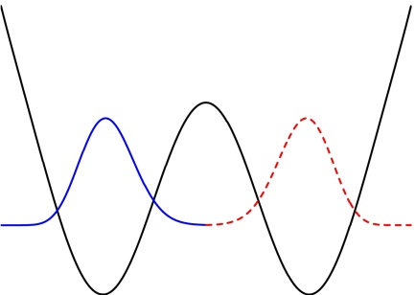
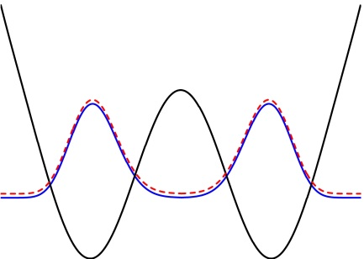
Eigenvalues[{{0, -J, -J}, {-J, U, 0}, {-J, 0, U}}]
Eigenvectors[{{0, -J, -J}, {-J, U, 0}, {-J, 0, U}}]
NOTE: This tells only about competition of the energies. But this not a phase
transition (no quantities with abrupt changes). The phase transition happens
for an (infinitely) large many-body system.
Notes:
The Hamiltonian is easy to diagonalize. Let us look at the lowest energy eigenvalue (the middle one). The corresponding eigenstate is a superposition of the basis states. However, whether it is mostly the state with one particle in each well, or a state that may contain also two particles in the same well, depends on relative values of U and J. For U>>J, the eigenstate (when normalized) becomes practically the one where the particles are only in separate wells. That is, for strong repulsive interactions, the particles do not like to overlap and they go to separate wells, even when the hopping term does not favour this. In contrast, if J>>U, the eigenstate is a more or less equal superposition of all the basis states, which is a result of having a case very close to the non-interacting one, i.e., both particles are in both wells simultaneously. By changing the U/J ratio, one can go from one extreme to another! This is the simple idea behind the Mott insulator (separate wells) – superfluid (all particles in all wells) transition. Of course, in the double well, the change from one case to another is continuous and one cannot talk about ”phases”. In a large system, however, the change will be abrupt and there are clearly separate phases of matter. The concept of Mott insulator was invented by Sir N. Mott to explain an unexpected insulating behaviour of certain metals. Indeed, strong interactions can cause particles (electrons) to be localized at sites, even in the presense of finite hopping.

Slide 23
Many-body system in a lattice
The mean field solution of the Bose-Hubbard model: two phases
  Superfluid
  Mott insulator
  Can be obtained, e.g., by the Gutzwiller ansatz (Exercises)
Fock state,
n atoms
in lattice site i
M=number of
lattice sites
Notes:
We will now go to the quantum phase transition in the large system. We look at it by using the simplest possible mean-field theory in this context: the Gutzwiller ansatz. The superfluid phase has a wavefunction which roughly resembles one with N particles that are all in a superposition of being at all sites. In the Mott phase, each site has a definite number of bosons, and all sites are uncorrelated, that is, the wave function is a product state of the wave functions of individual sites. The Gutzwiller ansatz includes both of these limits, and can describe some intermediate solutions as well. Remember, however, that it will give just a mean-field type, approximate solution, not the exact solution in general.

Slide 24
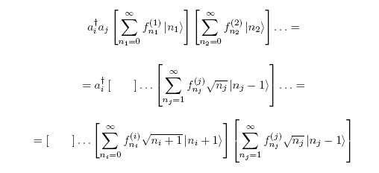
About the Gutzwiller ansatz
Notes:
Here are some hints how to apply the Gutzwiller ansatz: useful for the exercises! Taking the Gutzwiller ansatz as a variational ansatz, we wish to minimize the expectation value of the Hamiltonian (the energy) in this state. For this, matrix elements of the Hamiltonian with the state are needed. Here is an example of the result when the hopping operator applies to the state.

Slide 25
Notes:
… then continue to calculate the matrix element.

Slide 27
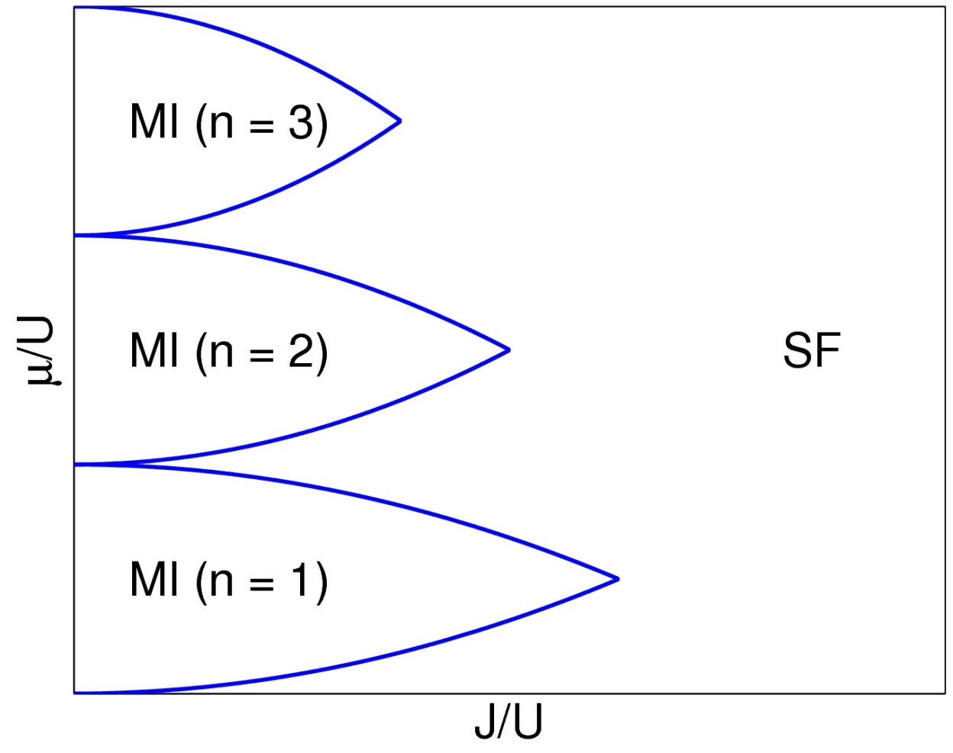
The phase diagram
BEC
Long range coherence
Particle number at a site fluctuates
Mott insulator
Gap in the excitation spectrum
Particle number at a site fixed (integer)
Zero compressibility
Notes:
This is a very important picture: it shows the phases produced by the Gutzwiller theory – these have also been observed experimentally. There are lobes of Mott insulator phases with integer number of particles per site, embedded in the superfluid phase. The BEC (the SF) phase is characterized by the non-zero superfluid order parameter, <a>. That this quantity is non-zero at a site means that there are particle number fluctuations. In the BEC, the correlators between different sites are non-zero, since there is coherence over the whole system.
In the Mott insulator phase, particle number fluctuations are nearly zero. There are no correlations between distant sites.

Slide 28
Observation in optical lattices
Switch off the lattice potential: free expansion maps the momentum distribution to a position distribution
Notes:
In ultracold gases, one has a direct access to the momentum distribution of the gas via the time-of-flight imaging. Note that such a straightforward way of learning about the system is not possible in conventional solid state systems! Basically, when the trap that is holding the gas together is switched off, the particles start to fly with the momentum they had in their initial state. The higher the momentum, the farther they reach during a time-of-flight; also the direction of the momentum is mapped on the position. This is the same that in optics, in the far field we see the Fourier image, i.e., the momentum distribution of the source.

Slide 29
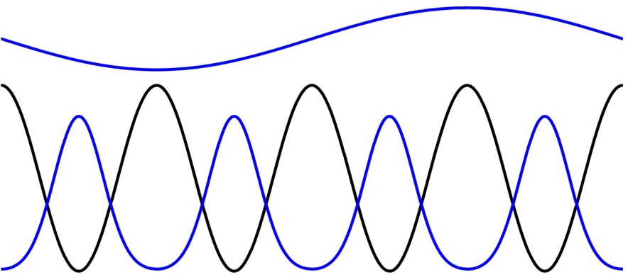
Effects of periodicity
d
Notes:
In a lattice, the situation is somewhat complicated, as the interference patterns we saw earlier suggested. Let us consider here the eigenfunction of a momentum (q) state in a lattice. It has the plane wave part, and the Bloch function part which follows the lattice periodicity. The Bloch function can be Fourier decomposed. Effectively, then, the wavefunction becomes a superposition of many Fourier components: q, and multiples of 2 Pi/d. When doing adiabatic release of the atoms (the trapping potential is switched off very slowly), the on-site parts of the Bloch function (in other words, the on-site Wannier functions) become gradually flat, so that they contain very few or practically no Fourier components n 2 Pi/d. In this case, the atom is left with the momentum q only, and this is what one sees in the experiment. In this way, one can observe the momenta in a certain band. Now, what happens if the lattice potential is switched off very fast, that is, non-adiabatically?

Slide 30

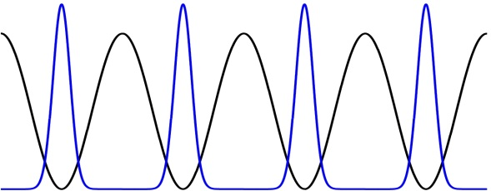
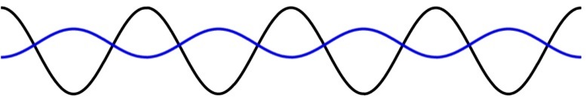
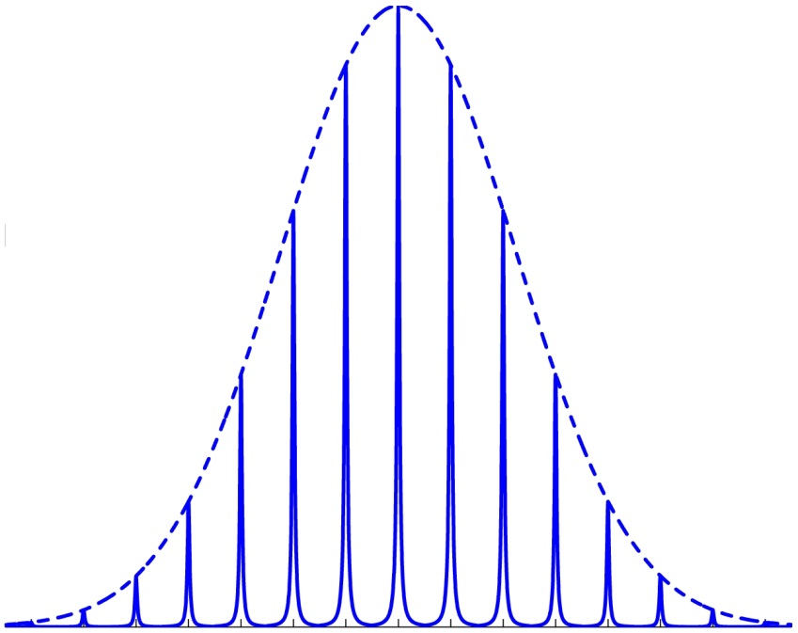
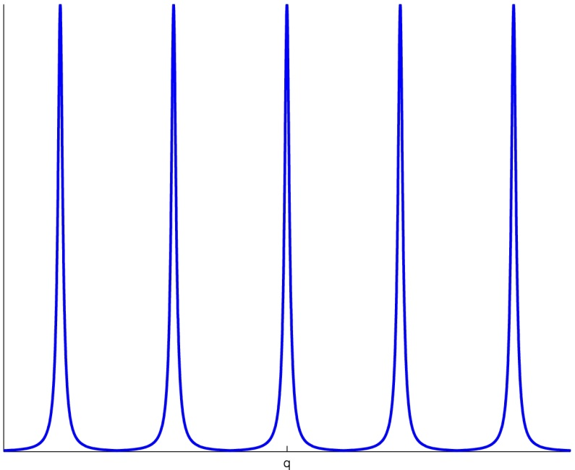
Fast release of the atoms
Envelope: Fourier transform of the initial Wannier function
Notes:
With fast release of the lattice, the atom is in a superposition that contains also the Fourier components from the Bloch functions: multiple peaks are observed!

Slide 31

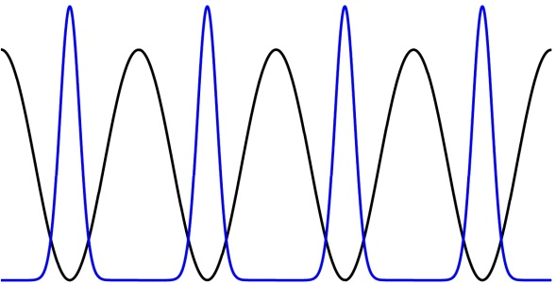
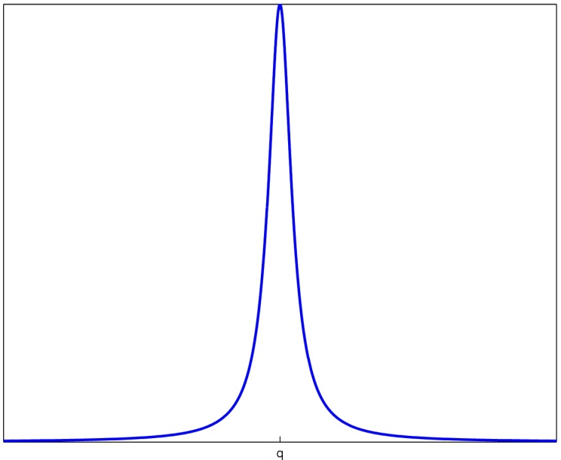
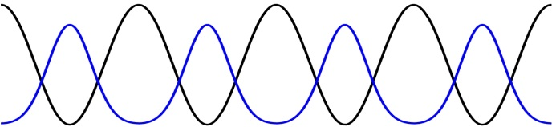
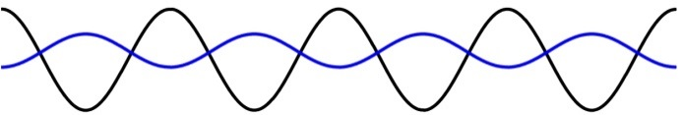
Adiabatic release

Slide 32
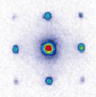
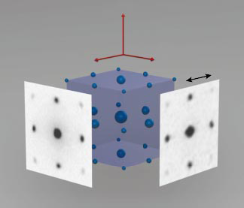
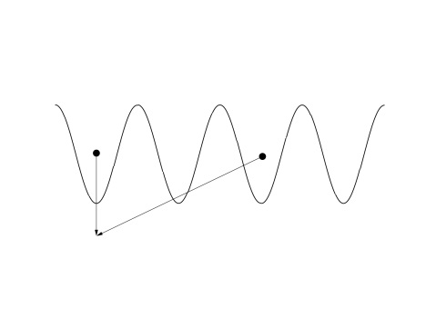
M. Greiner, O. Mandel, T. Esslinger, T.W. Hänsch, and I. Bloch, Nature 415,39 (2002)
BEC (fast switching off of the lattice potential)
q=0
Notes:
In the famous BEC – Mott insulator experiment, this was utilized: fast release of the atoms should produce multiple peaks, if all the atoms are in the same state and phase coherent (a BEC). Indeed, this was observed. The equation above expresses the same in another language; in the schematic picture in the lower right corner, one can now understand that the particles at different sites can have different momenta due to the Fourier components and thus interfere at specific points. Now, what do you expect in the Mott insulator state?

Slide 33
Mott insulator
Notes:
In the Mott insulator, no peaks are seen, because the atoms at different sites are not correlated/coherent: any interferences average out. In other words, the state of the system is very far from the example of a momentum eigenstate in a lattice. The wave functions at individual sites can still be Fourier decomposed of course, but they do not have any fixed phase relation between separate sites. Note that one of the early experiments on Bose-Einstein condensates – actually the one that deserved W. Ketterle the Nobel price – was to interfere two Bose condensates to show that they have a well-defined macroscopic phase (a property of BEC).

Slide 34
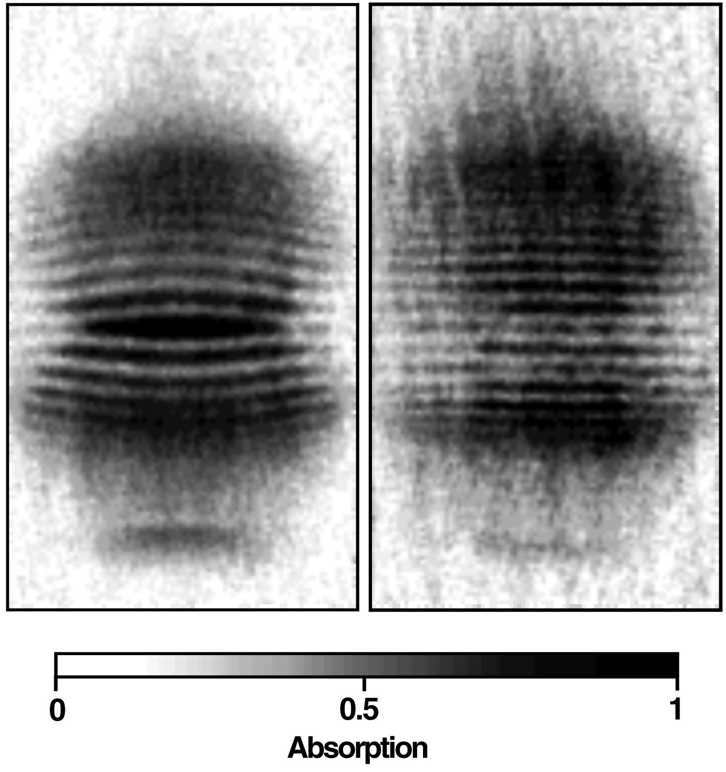
Interference of two condensates
Separate two condensates
Then let them collide
Ketterle et al 1996

Slide 35
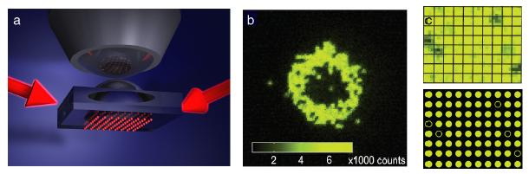
The quantum gas microscope: seeing individual atoms in an optical lattice
WS Bakr et al., Science (2010) DOI:10.1126/science.1192368
BEC
Mott insulator
M. Greiner group, Harvard
Notes:
The quantum gas microscope is a major breakthrough in the field of ultracold gases. The microscope resolves single atoms in a lattice. It takes a snapshot of one single realization of the quantum state of the gas. The gas can be initialized in exactly the same way several times, and each measurement gives a picture of the particle number in one preparation of the gas. Averaging these results, one obtains the expectation values of quantities in the system. But not only that: from the different realizations one can also extract all kinds of fluctuations and correlations in the state! These are often the crucial characteristics of the many-body states. For instance, the difference in the particle number fluctuations in the BEC and Mott insulator states has been now observed directly with single-site resolution! Which one do you think you see in the picture: a BEC or a Mott insulator?

Slide 36
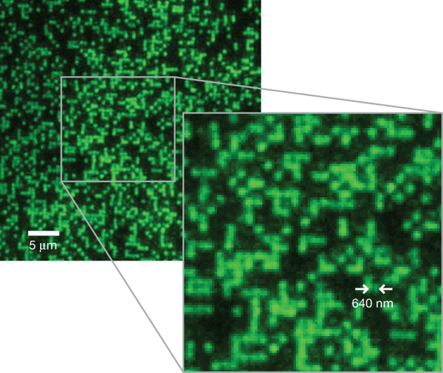
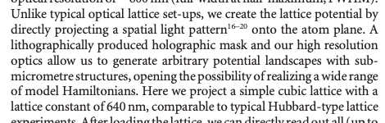


The quantum gas microscope: seeing individual atoms in an optical lattice
Site-resolved imaging of single atoms on a 640-nm-period
optical lattice, loaded with a high density Bose–Einstein condensate.
BEC
WS Bakr et al. Nature 462, 74-77 (2009) doi:10.1038/nature08482
M. Greiner group, Harvard

Slide 37
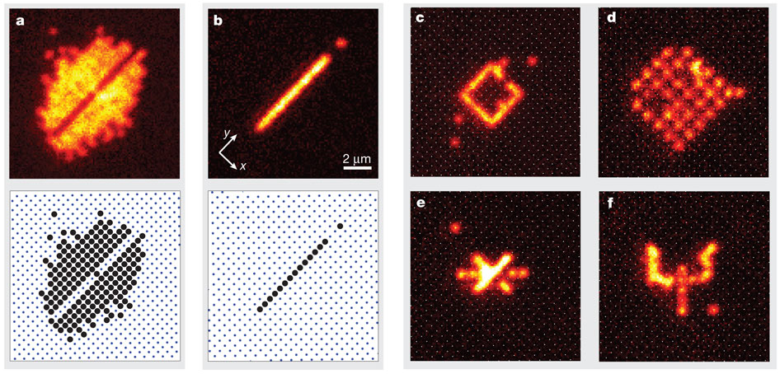
ULTRACOLD GASES: QUANTUM SIMULATORS OF
MANY-BODY PHYSICS, WITH DIRECT ACCESS TO IMAGING
CORRELATIONS AND DYNAMICS
Not only single-site imaging but also single-site addressing/manipulation is possible.
C Weitenberg et al. Nature 471, 319-324 (2011) doi:10.1038/nature09827
I. Bloch group, Max Planck Institute for Quantum Optics, Garching

Slide 38
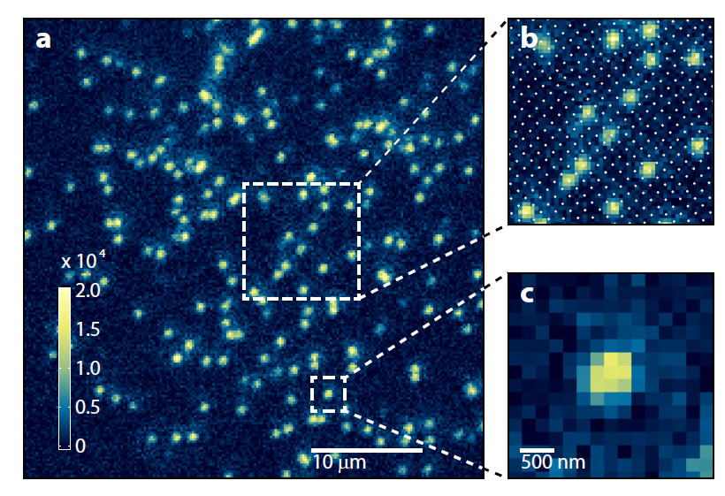
Notes:
In 2015, the first quantum gas microscopes for fermions have been reported!

Slide 39
Notes:
Chapters 3., 9. and 10. from this book will be used during the rest of the course. Moreover, chapter 4. gives a nice and pedagogical presentation of Feshbach resonances, the topic of the previous lecture. For anybody interested in the quantum gas microscopes, chapters 6. and 7. are useful.

Slide 40
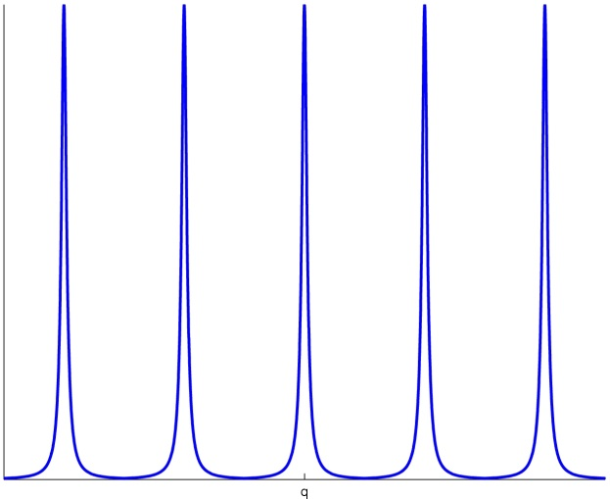
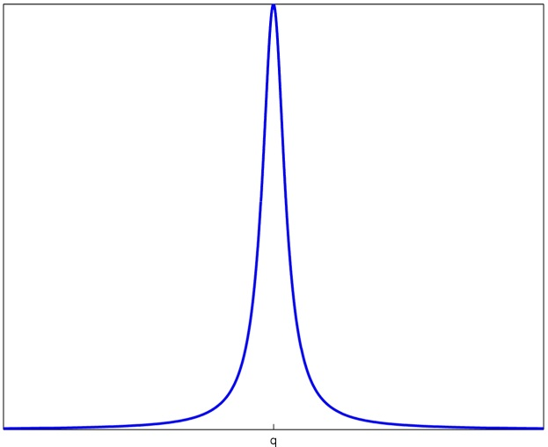
Quiz
With adiabatic switching off of the optical lattice potential one observes:
L
R

Slide 41
For the Mott insulator phase the following is true:
L
R

Slide 42

Fermi liquid theory

Slide 43
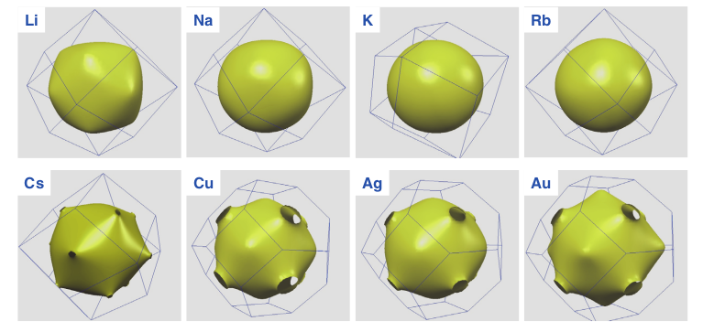
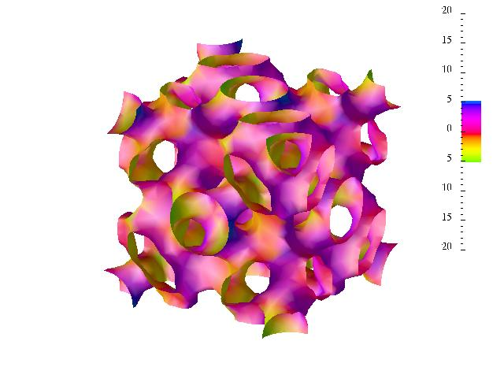
Basic concepts
Fermi energy?
Fermi surface?
Add interactions: system still kind of like Fermi gas, but with
relatively few quasi-particles
Why it can make sense?

Slide 44
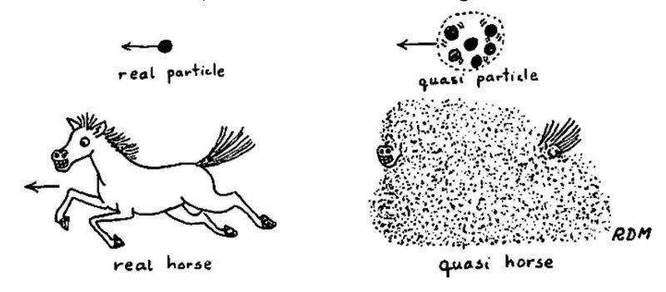
Quasi horse

Slide 45
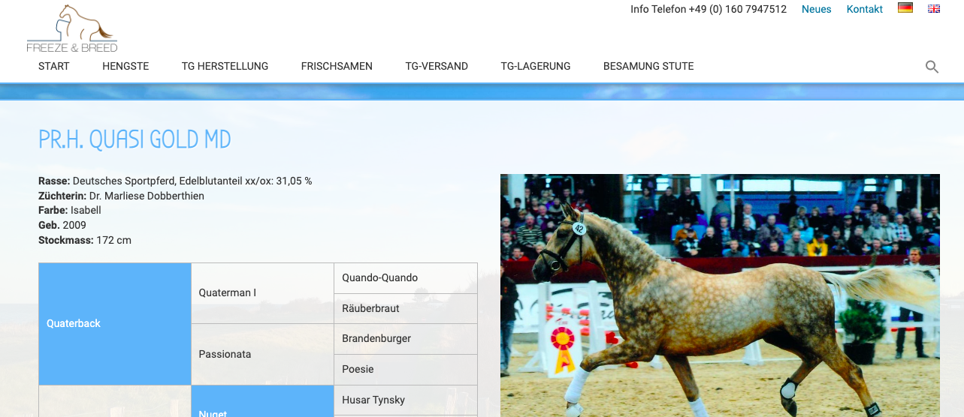
Real quasi horse!
Jokes on you physicists!

Slide 46

Thank you!
Questions?

