Slide 1
GOOD LIFE ENGINE 11.01.2023

Slide 2
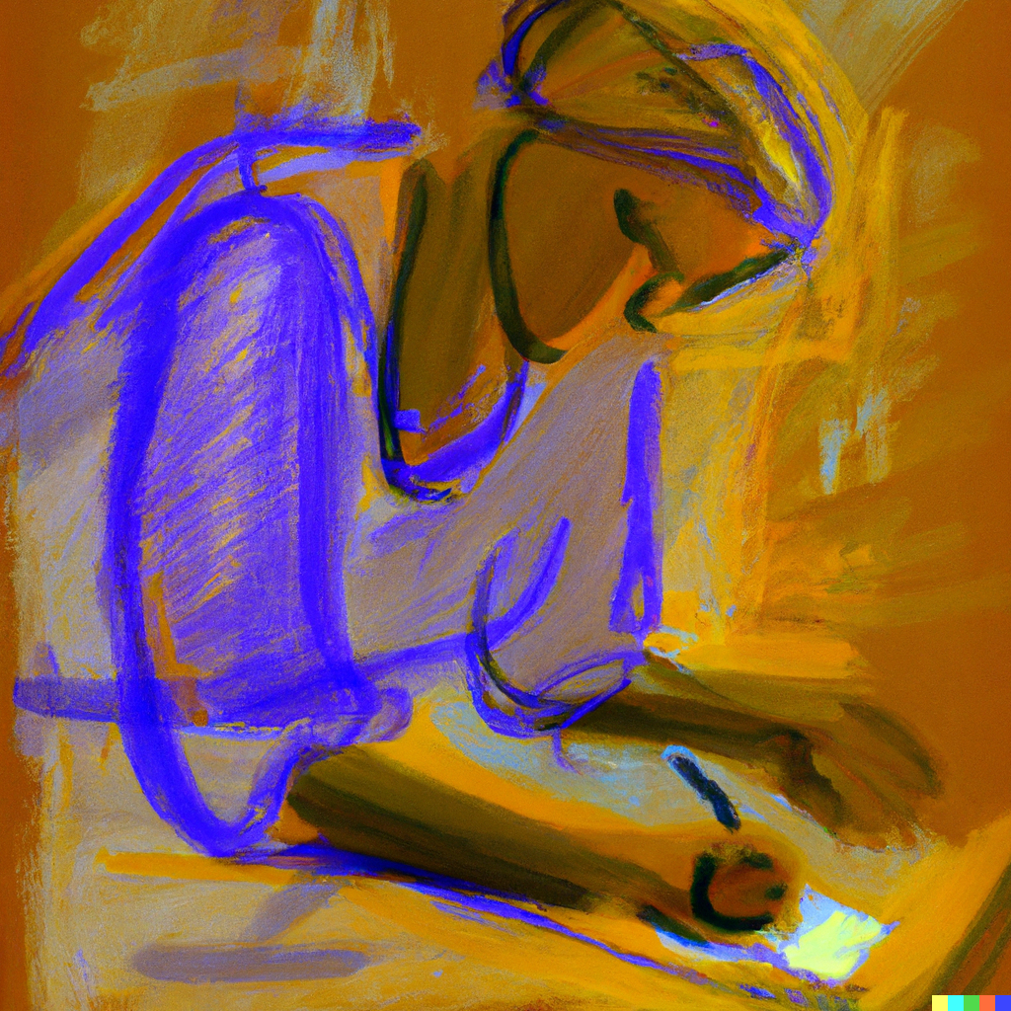
To remember when you do a New Year resolution:
Prioritisation
Approach goal setting process like you approach an apartment design. Start the year with slow pace and accelerate if you feel you can
The 12 Week Year instead of 12 months year - Moran, Brian P.: Get More Done in 12 Weeks than Others Do in 12 Months.

Slide 3
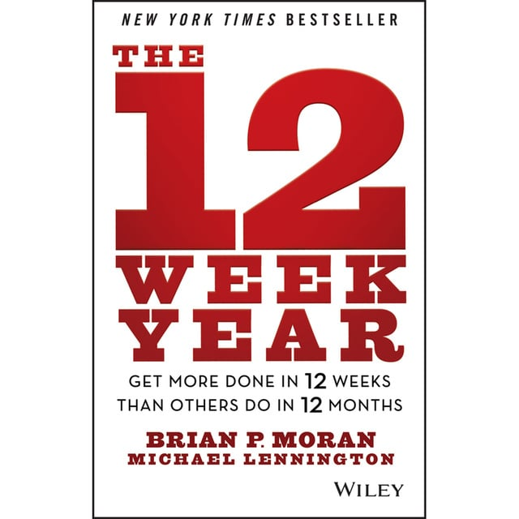

Slide 4
WABI SABI
Our imperfection is perfection

Slide 5
Wabi-sabi.
It shows us the beauty of the fleeting, changeable, and imperfect nature of the world around us. Instead of searching for beauty in perfection, we should look for it in the things that are flawed, incomplete“
Wabi-sabi for Japanese means to place such value, for example, on irregular or cracked teacup. Only things that are incomplete, not perfect, not purely symmetrical are beautiful, because they represent the nature
Ikigai: The Japanese Secret to a Long and Happy Life: García, Héctor, Miralles, Francesc
Notes:
For me it is like beauty is in the potential. The painting which is almost finished is beautiful. The movie or the book with open end. It is like you have to give a peace of you to complete this, and it is beautiful, because it is like an invitation.

Slide 6
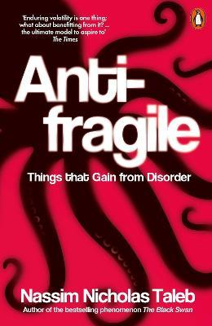
Being flexible – this is the answer to the challenges. You are flexible. You know how to adapt to change and to reversals of fortune.
“Some things benefit from shocks; they thrive and grow when exposed to volatility, randomness, disorder, and stressors and love adventure, risk, and uncertainty. Yet, in spite of the ubiquity of the phenomenon, there is no word for the exact opposite of fragile. Let us call it antifragile. Antifragility is beyond resilience or robustness. The resilient resists shocks and stays the same; the antifragile gets better.”
Notes:
When you find yourself in a hopeless situation, all your abilities are revealed in full force and the impossible becomes possible.
Antifragile reveals how some systems thrive from shocks, volatility and uncertainty, instead of breaking from them, and how you can adapt more antifragile traits yourself to thrive in an uncertain and chaotic world.

Slide 7
Scheme for antifragility:
Create more options. “Not putting all you eggs in one basket”.
Bet conservatively in certain areas and take small risks in others. 80% / 20% investment rule
Get rid of the things / people that make you fragile
Notes:
Toxic people. Jealous people
The main good point of Taleb’s message is that we shouldn’t try to stay always at the safe side. We never will growth and discover ourselves. There are so many things we can’t control and that still can happen to us. “We need randomness, mess, adventures, uncertainty, self-discovery, hear traumatic episodes?, all these things that make life worth living” (Nassim Taleb)
Fear makes us fragile. Anxiety makes us fragile. Anyway there is no mean to predict things that can happen. Again, let’s remember Taleb’s Black Swan. But what we can do, is to be flexible. It is useless to fear something that might happen. We waste our mental energy resources on it. Often the dear of event is bigger than event we are afraid of.

Slide 8
Homework
Exercise to set priorities for your studies/work (in MyCourses) – individual
Read an article - The Hard Data on Self-Love and Why It Leads to Success – https://community.thriveglobal.com/the-hard-data-on-self-love-and-why-it-leads-to-success-2/
Group assignment – each group should prepare 1 slide (pdf, jpeg, pp) presentation on the topic “Tips to staying motivated while executing routines?”. Be ready to present

Slide 9
Startup Philosophy
Startup Philosophy (TU-EV00010, 6 ECTS, III-IV)
Changing frames of thinking, evaluating evidence, and arguing your position are central skills for both philosophers and entrepreneurs. Learn philosophical concepts and probe deeper into the foundations of your ways of working.
First session on 24.01
Master’s and Doctoral levels

