Slide 1
Session 10

Slide 2
Inflation
Chapter 20 in text

Slide 3
Inflation is the term used to describe a situation in which the economy’s overall price level is rising.
  Deflation is a decrease in the PL
The inflation rate is the percentage change in the price level from the previous period.
  For any growth rate, just remember
    {(new-old)/old}*100

Slide 4
The consumer price index (CPI) is a measure of the overall cost of the goods and services bought by a typical consumer.
The Office of National Statistics for UK and Eurostat for Europe reports the CPI each month.
  It is used to monitor changes in the cost of living over time.
When the CPI rises (inflation), the typical family has to spend more money to maintain the same standard of living.

Slide 5
Five stages to calculating CPI
1) Fix the Basket: Determine what goods are most important to the typical consumer.
  Local data collection authority identifies a market basket of goods and services the typical consumer buys.
  Conducts regular consumer surveys to set the weights for the prices of those goods and services.
2) Find the Prices: Find the prices of each of the goods and services in the basket for each point in time.

Slide 6
3) Compute the Basket’s Cost:
  Use the data on prices to calculate the cost of the basket of goods and services at different times.
4) Choose a Base Year and Compute the Index:
  Designate one year as the base year, making it the benchmark against which other years are compared.
  Compute the index by dividing the price of the basket in one year by the price in the base year and multiplying by 100.
5) Compute the inflation rate:
  The inflation rate is the percentage change in the price index from the preceding period.

Slide 7
How Do I Calculate the CPI?
 | BASE YEAR (1999) |  |  | 2006 |  | 2007
PRODUCT | QUANTITY | PRICE | EXPENDITURES | PRICE | EXPENDITURES | PRICE | EXPENDITURES
Eye examinations | 1 | $50.00 | $50.00 | $100.00 | $100.00 | $85.00 | $85.00
Pizzas | 20 | 10.00 | 200.00 | 15.00 | 300.00 | 14.00 | 280.00
Books | 20 | 25.00 | 500.00 | 25.00 | 500.00 | 27.50 | 550.00
Total |  |  | 750.00 |  | 900.00 |  | 915.00

Slide 8
Calculating the CPI
CPI= (Expenditures in the current year / expenditures in the base year)*100
Applied to 2006: ($900/$750 )*100=120
Applied to 2007: ($915/$750)*100=122

Slide 9
Calculating Inflation
Calculating the inflation rate is easy:
Inf.Rate = {(this year’s CPI - last year’s CPI)/Last years CPI}*100
Say the CPI for 2006 is 120 (in $1999) and the CPI in 2007 is 122.
Inflation rate for 2007 is {(122-120)/120}*100=1.7%
We can also say that prices have increased 22% since 1999. Why?

Slide 10
Note that:
the CPI is always in relation to a base year. Always.
the CPI is an index and thus its measured in “points”, not dollars, percentages, gold stars or anything else explicitly tangible
the CPI has a direct effect on people b/c many important things are indexed to the CPI, such as income tax brackets and some gov’t payments
  Of course its also used by policy makers to make decisions and in loads of economic research

Slide 11
Is the CPI Accurate?
Increase in quality bias
New product bias
Substitution bias
  Imagine a mkt bskt w/ 5 apples and 5 oranges, $1 each
  Now imagine P of apples ↑ $2 (so mkt bskt is now $15)
    Would conclude inflation was 50%
  Is it plausible that people may partially sub away from the expensive apples towards the cheap oranges?
    Maybe they are just as happy consuming 8 oranges and 3 apples as 5 and 5
    This mkt basket costs only (8*1)+(3*2)=$14

Slide 12
Can We Use the CPI to Adjust for the Effects of Inflation?
Yes
Take the ((nominal price) / (that year’s CPI))* 100. This gives you the inflation adjusted value in base year dollars.

Slide 13
Using the CPI
YEAR | NOMINAL AVERAGE HOURLY EARNINGS | CPI (1984 = 100) | REAL AVG HOURLY EARNINGS (1984$)
2002 | $14.95 | 179.9 | $8.31
2003 | 15.35 | 184.0 | 8.34
2004 | 15.67 | 188.9 | 8.30

Slide 14
Adjusting for Inflation
The previous example converted amts into 1984$ and this is often fine. But sometime we want to convert from one specific year to another specific year (which is not the base year).
More generally:
(the value in year X dollars)= (the value in year Y dollars)*{CPI in year X/CPI in year Y}
Example:
Compare starting salaries:
  $32,000 in 2008, $35,000 in 2013.
  CPI₂₀₀₁ for 2008 = 109
  CPI₂₀₀₁ for 2013 = 120

Slide 15
Adjusting for Inflation
Let’s convert 2008 salary into 2013$:
(2008 salary measured in 2013$)= 32,000*(120/109)=
$35,229
2008 salary was greater (in “real” terms)
What if we instead convert your salary down to a 2008 level?
(the 2013 salary measured in 2008$) = 35,000* (109/120)=
$31,792.

Slide 16
Practice Questions
YEAR | Nominal income | CPI | REAL INCOME
1980 | 24, 332 | 82.4
1985 | 32, 777 | 107.6
1990 | 41, 451 | 130.7
1997 | 53, 350 | 160.5
2000 | 59, 346 | 172.2

Slide 17
Using the previous chart:
1) What might be a plausible guess for the base year for these CPI values? How did you know?
2) In which year was real household income the highest?

Slide 18
YEAR | Nominal income | CPI | REAL INCOME
1980 | 24, 332 | 82.4 | 29,529
1985 | 32, 777 | 107.6 | 30,462
1990 | 41, 451 | 130.7 | 31,715
1997 | 53, 350 | 160.5 | 33,240
2000 | 59, 346 | 172.2 | 34,503

Slide 19
Use the following information to rank these films’ box office receipts in real terms.
Nom Rank | Film | Nom BO Receipts | Year | CPI | Adjusted/Real BO Rank
1 | Avatar | $760,507,625 | 2009 | 216
2 | Titanic | $600,779,824 | 1997 | 161
3 | Star Wars | $460,935,655 | 1977 | 62
85 | Gone W/ the Wind | $198,655,278 | 1939 | 14
96 | Snow White | $184,208,842 | 1937 | 14

Slide 20
Does inflation impose a cost to the econ?
What if prices and your salary both doubled? Would you be worse off?
Hmm, maybe not….IF nominal wages keep up with inflation.
Do we think they would?
Yes (at least eventually), if the labor mkt is competitive.
But even if nom.wages adjust perfectly and instantly to changes in the price level, inflation could still be harmful.
Any ideas how?

Slide 21
Does inflation impose a cost on the econ?
Reduces the value of wealth held in currency denominated assets
  Money in savings/checking accounts, bonds, etc
  Generally, we think poorer people hold a larger fraction of their wealth in money so inflation may affect the poor more.
Menu costs
Lots of uncertainty in future price level can create risk in lending thus stifling credit mkts.
  Note there will be a winner and a loser, but if both parties are risk averse, it may reduce the overall level of lending which could mean good projects go unfunded (to the detriment of social welfare)

Slide 22
Uncertain expected inflation
As always, we note that we don’t directly care about the number of dollars/euros in our bank account:
  What we really care about is the amount of stuff we can buy with that money
Say I want to borrow €100 for 1 year and I agree to pay you a 2% rate of return (I pay you €102 one year from today)
Say the inflation rate was 2%.
Did you earn anything in “real” terms?
If you really want a 2% return, and you expect 2% inflation, what interest rate do you need to charge?

Slide 23
Uncertain expected inflation
Imagine that you expect inflation to be 2%, but it turns out to be 5%
Who won and who lost there?
At 4% nom.int.rate, I borrowed €100, paid back €104, which was really only worth about € 99 in last years dollars.
So the € 104 you get actually buys LESS in the current year than the € 100 you loaned out would have bought last year.
  You paid me (implicitly) to borrow the money!

Slide 24
Uncertain expected inflation
What if inflation was unexpectedly 0% and you charged 4% expecting inflation to be 2%?
You got a larger than expected return and I paid more for the loan than expected.
Note that if actual inflation rates match up accurately with people’s expectations about inflation rates, this is not a problem.
Nominal interest rate= real interest rate + inflation rate
  This is the “Fisher Equation”

Slide 25
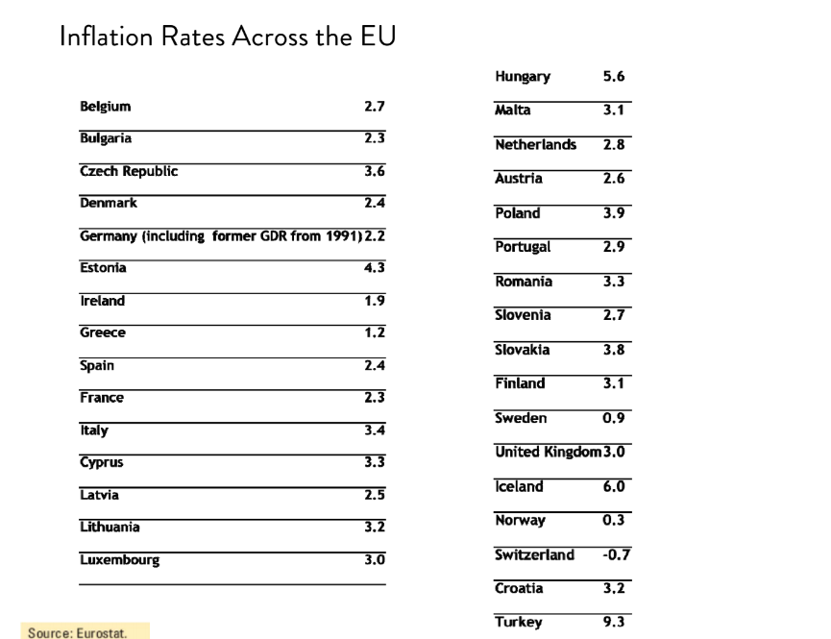

Slide 26
The GDP Deflator versus the Consumer Price Index
  The GDP deflator reflects the prices of all goods and services produced domestically, whereas...
  ...the consumer price index reflects the prices of all goods and services bought by consumers.

Slide 27
Unemployment
Chapter 22 in Text

Slide 28
Some definitions:
Labor force: The sum of employed and unemployed workers in the economy.
Unemployment rate: The percentage of the labor force that is unemployed.

Slide 29
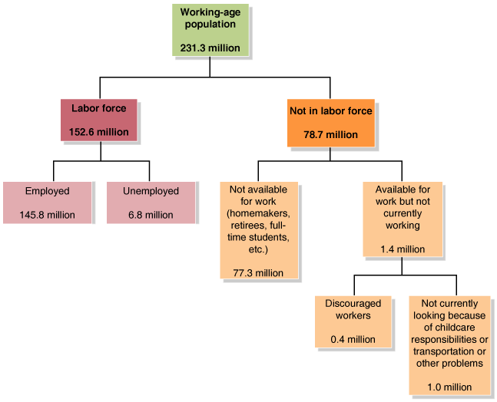

Slide 30
• The unemployment rate measures the percentage of the labor force that is unemployed.
• The labor force participation rate measures the percentage of the working-age population in the labor force.

Slide 31
Problems with Measuring the Unemp Rate
Provides useful information, but is far from a perfect measure of joblessness in the econ or of the shape of the econ in general

Slide 32
Problems with Measuring the Unemp Rate
Understating Unemployment
One problem is that its difficult to distinguish who is/isn’t in the labor force
  Discouraged workers: People who are available for work but have not looked for a job during the previous four weeks because they believe no jobs are available for them.
Underemployment
  Part time workers
It is estimated that if you added in the above groups, unemployment would be about 3-4% points higher.

Slide 33
Problems with Measuring the Unemp Rate
Overstating Unemployment
The survey does not verify the info people provide
  If they say they’ve looked for work but haven’t, they are counted as unemployed.
    They may do this for several reasons, like remaining eligible for unemployment benefits
  People might be working “under the table” to avoid paying taxes
    Might fear the tax authorities could learn about their job

Slide 34
Also note that the reported employment data is net
We would expect some amount of job creation and destruction over time in a vibrant market system as there are changes in consumer tastes and technologies.

Slide 35
3 types of unemp
Economists have identified three different types of unemployment
1) Frictional unemployment : Short-term unemployment that arises from the process of matching workers with jobs.
2) Structural unemployment : Unemployment arising from a persistent mismatch between the skills and characteristics of workers and the requirements of jobs.
3) Cyclical unemployment : Unemployment caused by a business cycle recession.

Slide 36
Is zero unemployment a worthwhile (or attainable) goal?
Even in the best of time the unemp rate is almost never below 4%
We think of frictional and structural UE as a normal, underlying level of UE in the econ and not always an indication of economic weakness.
This “normal” level of unemployment (just struc. and frictional, omitting cyclical) is known as the natural rate of unemployment
Generally believed to be around 7% in Europe
Also known as “full employment”

Slide 37
We know unemployment is a bad thing…what’s so bad about it?

Slide 38
Costs of UE to the individual or household:
  Loss of earnings (obvious)
  Stress/health problems
  Drug/alcohol problems
  Crime
  Family breakdown
  De-skilling

Slide 39
Costs of UE to society
  Less aggregate production
  Loss of tax revenue
  Crime/social problems
  Reverse multiplier effect

