Slide 1
Session 11
Long-run Growth

Slide 2
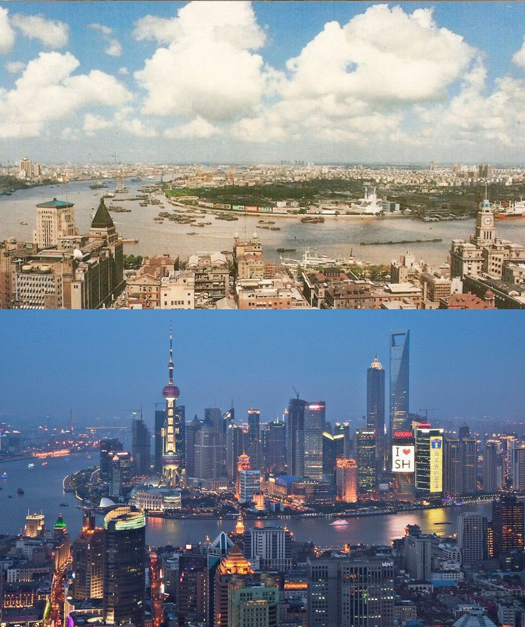

Slide 4
Life indicators
Poor
Rich
GDP per capita
$1,095
$32,971
Infant mortality rate (per 1,000)
76
5
Under
-
5 mortality rate (per 1,000)
118
6
Life expectancy at birth
57
80
Physicians (per 10,000)
1.8
29.3
Access to improved water (percent)
64
100
Female/male secondary enrollment (ratio)
0.84
0.99
Female/male post
-
secondary enrollment (ratio)
0.64
1.21
Source: World Bank. Poor nations are 40 poorest; Rich nations are 31 high income OECD nations.

Slide 5
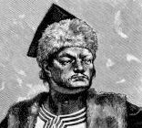

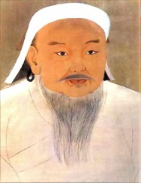
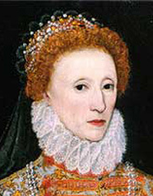
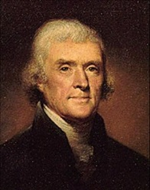

World Per Capita Real GDP, 0 - 2000
Thousands of 1990 International Dollars
$10,000
You
$8,000
$6,000
Attila
the
Genghis
Queen
Thomas
$4,000
Jesus!
Hun
Charlemagne
Kahn
Elizabeth I
Jefferson
$2,000
$0
0
250
500
750
1000
1250
1500
1750
2000

Slide 6
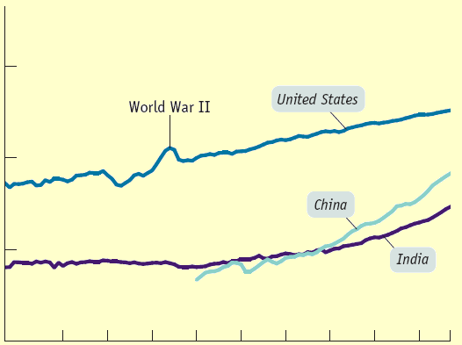
Comparing Economies Across Time and Space
Real GDP per capita
$100,000
10,000
1,000
1907 1920 1930 1940 1950 1960 1970 1980 1990 2000 2007
Year
Notes:
Figure Caption: Figure 9-1: Economic Growth in the United States, India, and China over the Past Century
Real GDP per capita from 1907 to 2007, measured in 1990 dollars, is shown for the United States, India, and China. Equal percent changes in real GDP per capita are drawn the same size. India and China currently have a much higher growth rate than the United States. However, China has only just attained the standard of living achieved in the United States in 1907, while India is still poorer than the United States was in 1907.
Source: Angus Maddison, Statistics on World Population, GDP, and Per Capita GDP, 1–2006AD, http://www.ggdc.net/maddison; International Monetary Fund.

Slide 7
GDP per capita
In 1900 real GDPpc in the west was around $5,000
100 years later it was around $35,000
But even this large increase doesn’t take into account the true increases in standard of living experienced.

Slide 8
Growth Rates
10%
8
6
4
2
0
-2
8.7%
Average annual growth rate of real GDP per capita,
1985-2015
4.1%
4.1%
2.0%
1.5%
0.8%
-1.4%
China
India
Ireland
United States
France
Argentina
Zimbabwe
Notes:
Figure Caption: Figure 9-3: Comparing Recent Growth Rates
Here the average annual rate of growth of real GDP per capita from 1980 to 2007 is shown for selected countries. China and, to a lesser extent, India and Ireland have achieved impressive growth. The United States and France have had moderate growth. Despite having once been considered an economically advanced country, Argentina has had sluggish growth. Still others, such as Zimbabwe, have slid backward.
Source: International Monetary Fund.

Slide 9
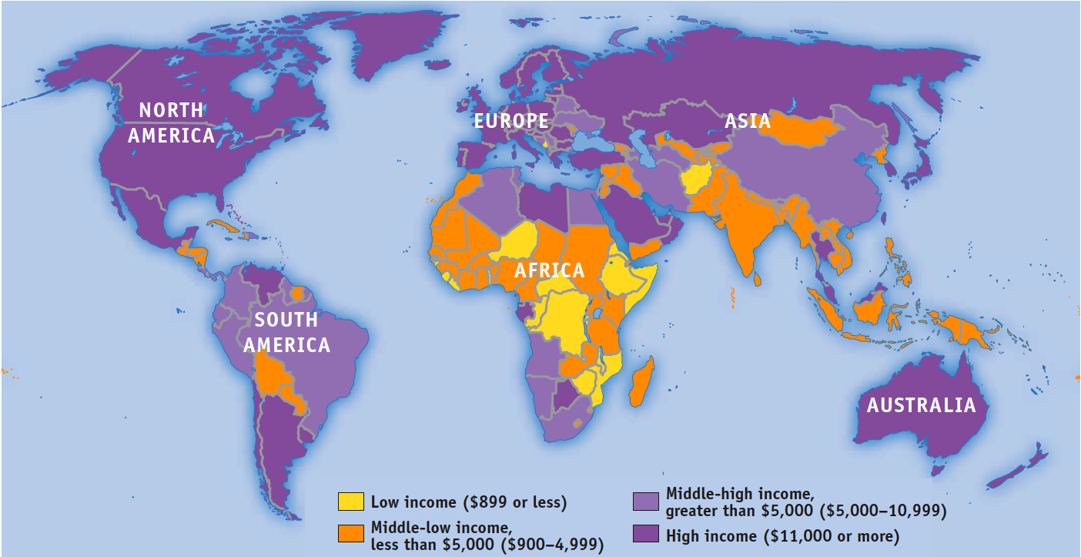
Income Around the World

Slide 10
Growth Rate
Long-run economic growth is normally a gradual process, in which real GDP per capita grows at most a few percent per year.
In the last 100 years, real GDP per capita in the west increased an average of 1.8% each year.
How did we manage to produce over seven times more stuff per person over those 100 years?

Slide 11
Growth Rate
But what does it really mean to say an economy grew by X% this year?
Why are some countries rich?

Slide 12
What are the causes of growth?
Keep in mind, the wealth of a nation lies in its ability to produce goods and services its people want.
So economic growth represents an increase in aggregate output.
This can come from several sources
  If the economy is in a recession and there are many unused resources (unemployed workers, idle factories, etc), aggregate output can increase simply by utilizing what we have.
  Will this provide us with long term growth?
  What do you think will be some important factors for long-run growth?

Slide 13
Many things can contribute to LR economic growth, but there is one thing above all:
  If we want to consumer more (per person), we need to…
Labor productivity
  Output per worker

Slide 14
Standard of living refers to quality of life: access to better nutrition, better housing, better health care, more material goods, longer life expectancy
A country’s standard of living depends on its ability to produce goods and services.
A nation’s total production (GDP) is determined by the productivity of its workers.
  Productivity refers to the amount of goods and services produced for each hour of a worker’s time.

Slide 15
Small differences in productivity may not make a big difference one or two years later…
  ….but those differences compound over time
  In 1900, many South American countries had similar rGPDpc as the United States
    100 years later, there is a huge difference

Slide 16
Ok, so productivity is important…
What influences it?

Slide 17
How productivity is determined?
1) Physical Capital
  Economic output from a previous period that is now an input
  is the stock of equipment and structures that are used to produce goods and services.
    Tools, buildings, factories, farming equipment, etc

Slide 18
How productivity is determined?
2) Human Capital
  The economist’s term for the knowledge and skills that workers acquire through education, training, and experience
  Like physical capital, human capital raises a nation’s ability to produce goods and services
  HC is less tangible (measurement is not precise)

Slide 19
How Productivity Is Determined?
3) Natural Resources
  inputs used in production that are provided by nature, such as land, rivers, and mineral deposits
  Renewable resources include trees and forests
  Nonrenewable resources include petroleum and coal
  can be important but are not necessary for an economy to be highly productive in producing goods and services
    Japan, Hong Kong have very few natural resources

Slide 20
How productivity is determined?
4) Technology
  Technological advances allow us to have better capital, thus increasing output per worker
    Think about getting a more computers per worker vs. getting better computers per worker

Slide 21
Do you think the connection between these things and output is linear?
  Especially think about physical capital
  There are probably diminishing marginal returns to adding more physical capital

Slide 22
How does the stock of physical capital grow?
Depreciation: the wear and tear and obsoletion of capital (machines, buildings, etc)
The capital/labor ratio will decline with depreciation and population growth.
Gross investment is the total amount spent on capital stock in a period
Net investment is spending on the capital stock minus the amount spent on replacing existing stock
  (i.e. depreciation is excluded from this measure)

Slide 23
Economists use a production function to describe the relationship between the quantity of inputs used in production and the quantity of output from production.

Slide 24
A model of production: the production function
Y = T {f(L, K, H, N)}
Y = quantity of output
T = available production technology
L = quantity of labor
K = quantity of physical capital
H = quantity of human capital
N = quantity of natural resources
F( ) is a function that shows how the inputs are combined

Slide 25
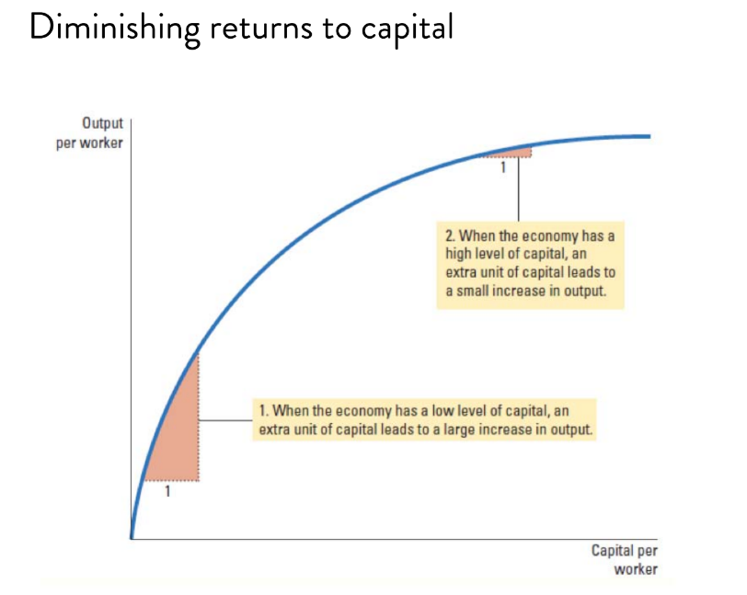

Slide 26
Ok, so increasing labor productivity is the most important factor in driving growth…
  Labor productivity is affected by human cap, physical cap, tech…
  Well what can affect those things???

Slide 27
Investment from abroad
  Governments can increase capital accumulation and long-term economic growth by encouraging investment from foreign sources
  Investment from abroad takes several forms:
    Foreign Direct Investment
      Capital investment owned and operated by a foreign entity
    Foreign Portfolio Investment
      Investments financed with foreign money but operated by domestic residents

Slide 28
Education
  For a country’s long-run growth, education is at least as important as investment in physical capital.
  In the developed economies of Western Europe and North America States, each year of schooling raises a person’s wage, on average, by about 10 percent
  Thus, one way the government can enhance the standard of living is to provide schools and encourage the population to take advantage of them
  Education contributes to the standard of living

Slide 29
Education
One problem facing some poor countries is brain drain—the emigration of many of the most highly educated workers to rich countries
  US: Indian doctors, foreign educated scientists

Slide 30
Health and nutrition
Human capital usually refers to education but it can also refer to other investments in people such as investments in improved health
  Robert Fogel, has suggested that a significant factor in long-run economic growth is improved health from better nutrition. He estimates that in Great Britain in 1780 about one in five people were so malnourished that they were incapable of manual labor

Slide 31
Health and nutrition
From 1775 to 1975, the average caloric intake in Great Britain rose by 26 per cent and the height of the average man rose by 3.6 inches (around 10 cm).
Fogel won the Nobel Prize in Economics in 1993 for his work in economic history. In his Nobel lecture he concluded that ‘improved gross nutrition accounts for roughly 30 per cent of the growth of per capita income in Britain between 1790 and 1980
Malnutrition is still a problem in developing countries and even developed countries

Slide 32
Property rights and political stability
  Property rights refer to the ability of people to exercise authority over the resources they own.
  An economy-wide respect for property rights is an important prerequisite for the price system to work.
  It is necessary for investors to feel that their investments are secure

Slide 33
Strong judicial system
  Courts are important to enforce contracts, prevent fraud, lawlessness, etc

Slide 34
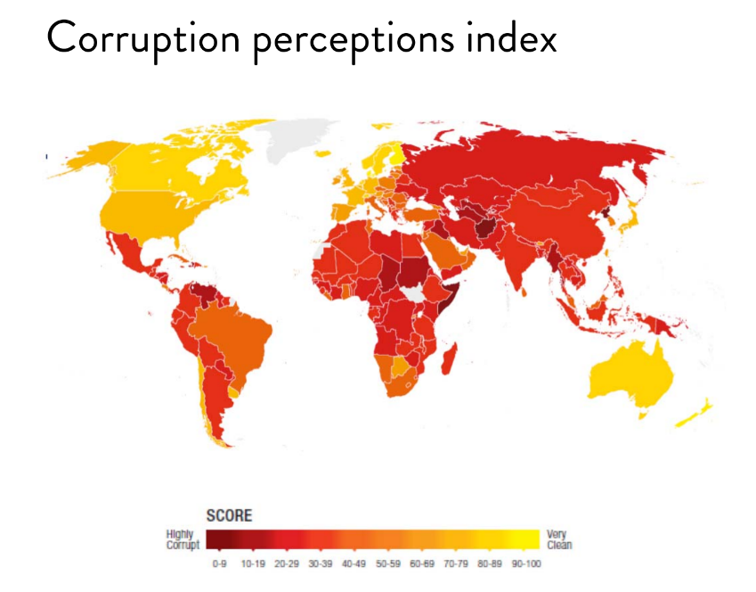

Slide 35
Free trade
  A country that eliminates trade restrictions will experience the same kind of economic growth that would occur after a major technological advance.
  When a country exports wheat and imports steel, the country benefits in the same way as if it had invented a technology for turning wheat into steel.
  Some countries engage in inward-orientated trade policies, avoiding interaction with other countries
  “outward-orientated” trade policies, encouraging interaction with other countries
    Countries that pursued outward-oriented polices and experienced significant growth: China, S. Korea, Singapore, Taiwan

Slide 36
Research and development
  The advance of technological knowledge has led to higher standards of living.
  Most technological advance comes from private research by firms and individual inventors.
  Government can encourage the development of new technologies through research grants
  (NIH, NSF in the US), support of national research labs, tax breaks, and the patent system

Slide 37
Infrastructure
  This refers to roads, power lines, ports, information networks, etc, that provide a foundation for economic activity.
  Having electricity, roads, and even things like clean water and disease control are important to econ growth.
    In the last twenty year, improvements in communication technologies have been important
      Internet, cellular phone proliferation, etc.

Slide 38
What can we do to encourage more growth?
Government Policies That Tend to Raise Productivity and Living Standards:
  Encourage saving and investment
    Investments come from savings
  Encourage investment from abroad
  Encourage education and training
  Establish secure property rights and maintain political stability
  Promote free trade
  Promote research and development

Slide 39
The importance of saving and investment
  One way to raise future productivity is to invest more current resources in the production of capital
  If resources are used to produce capital goods, fewer goods and services are produced for current consumption
  Countries that devote a large share of GDP to investment tend to have high growth rates
    Might be fair to ask “But is this the cause or effect?”

Slide 40
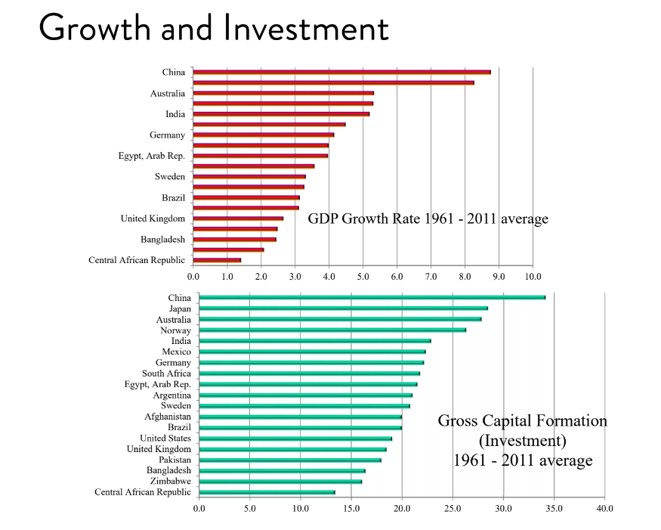

Slide 41
Correlation between growth and investment
There exists strong correlation between growth and investment
Countries that grow fast and invest a great deal: China, Japan, Australia
  China invested between 10-22% in 1960s, 44% of GDP in 1990s, 48% after 2009
  Japan invested 30% of GDP in 1970s and 1980s and grew at about 5%
Countries that grow slowly and invest a small share of GDP: Central African Republic, Zimbabwe, Bangladesh

Slide 42
Diminishing Returns and the Catch-Up Effect
  As the stock of capital rises, the extra output produced from an additional unit of capital falls; this property is called diminishing returns
  Because of diminishing returns, an increase in the saving rate (and investment) leads to higher growth initially
  In the long run, the effect of increasing saving rates (and investment) tends to diminish

Slide 43
The catch-up effect refers to the property whereby countries that start off poor tend to grow more rapidly than countries that start off rich
According to the catch-up effect, China will have a hard time growing fast forever

Slide 44
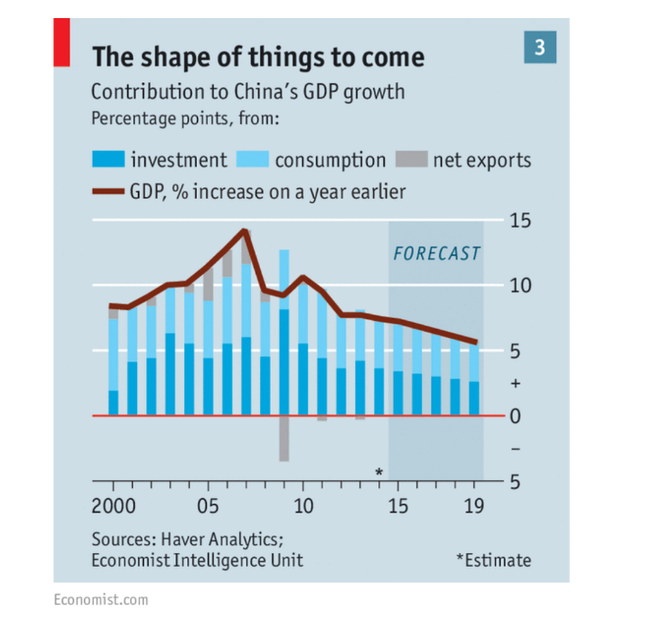

Slide 45
Economists believe there are pressures that will push economies to converge…
  But there are things that keep poor countries poor indefinitely

Slide 46
Practice Questions
1)Pretend you are an economic consultant hired to advise two different countries on how to achieve economic growth. The first country, Richlandia, is prosperous and you recommended that they invest in technology to shift their production upwards. Your other client, Poorlandia, has very low real GPDcp. Is your policy prescription the same, or different, for Poorlandia? Explain.

Slide 47
Practice Questions
2) In a speech to the nation, the prime minister says the following. Evaluate.
“GDP grew by 3% last year! This is great news. I read in the notes from some econ class at Aalto that we should be happy with growth rates of 1.5-2.0% per year. So as you can see, we are doing much better than that and thus I’m doing a fantastic job.”

