Slide 1
Session 12
Chapter 24

Slide 2
What is money? Do we really need it?
Bartering is the exchange of one good for another.
Main problem with bartering requires a double coincidence of wants.
Money is the set of assets in an economy that people regularly use to buy goods and services from other people.

Slide 3
The Functions of Money
Money has three functions in the economy:
1 Medium of exchange
2 Unit of account
3 Store of value

Slide 4
1) Medium of Exchange
A medium of exchange is an item that buyers give to sellers when they want to purchase goods and services.
A medium of exchange is anything that is readily acceptable as payment.
What are some things (besides dollars/euros/etc) that have served as money?

Slide 5
2) Unit of Account
A unit of account is the yardstick people use to post prices and record debts.
Makes selling things easier
Makes borrowing and lending easier
Why is this important?

Slide 6
3) Store of Value
A store of value is an item that people can use to transfer purchasing power from the present to the future.
Liquidity
Liquidity is the ease with which an asset can be converted into the economy’s medium of exchange.

Slide 7
What are some desirable characteristics of money?

Slide 8
Desirable Characteristics of a Money
1) The good must be acceptable to (that is, usable by) most people.
2) It should be of standardized quality so that any two units are identical.
3) It should be durable so that value is not lost by spoilage.
4) It should be valuable relative to its weight so that amounts large enough to be useful in trade can be easily transported.
5) The medium of exchange should be divisible because different goods are valued differently

Slide 9
The Kinds of Money
Commodity money takes the form of a commodity with intrinsic value.
Examples: Gold, silver, cigarettes.
Fiat money is used as money because of government decree.
It does not have intrinsic value.
Examples: Coins, currency, current account deposits.

Slide 10
Money in the Economy
Currency is the paper bills and coins in the hands of the public.
Demand deposits are balances in bank accounts that depositors can access on demand by writing a check or using a debit card.
Both of the above are very liquid forms of money

Slide 11
It might be helpful to measure the amount of money out there (perhaps it has some effect on the macroeconomy?)
Economists have a few different definitions of the money supply
M1, M2, and M3

Slide 12
M1- the narrowest definition of the MS
Includes
Currency
Demand deposits (checking account balances)
Travelers checks (but this is so small we often ignore it)

Slide 13
M2- a broader definition of the MS
Consists of:
M1
Savings account balances, small denomination CDs

Slide 14
M3- the broadest definition of the MS that we have
Includes:
M2
Long-term time deposits and other less liquid forms of money

Slide 15
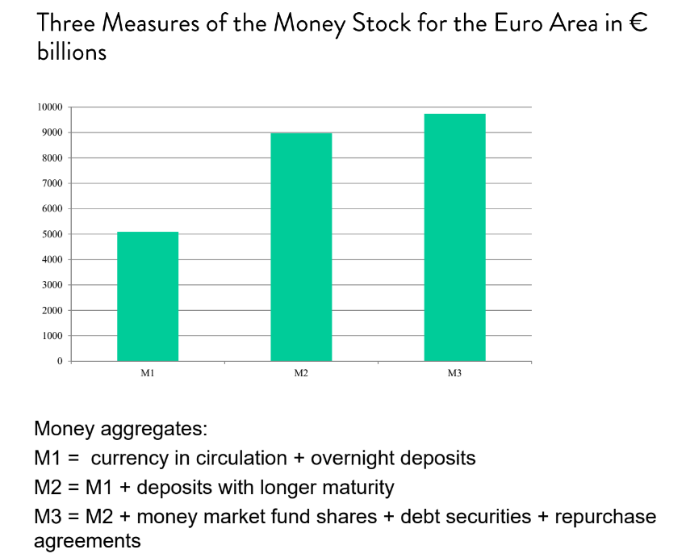

Slide 16
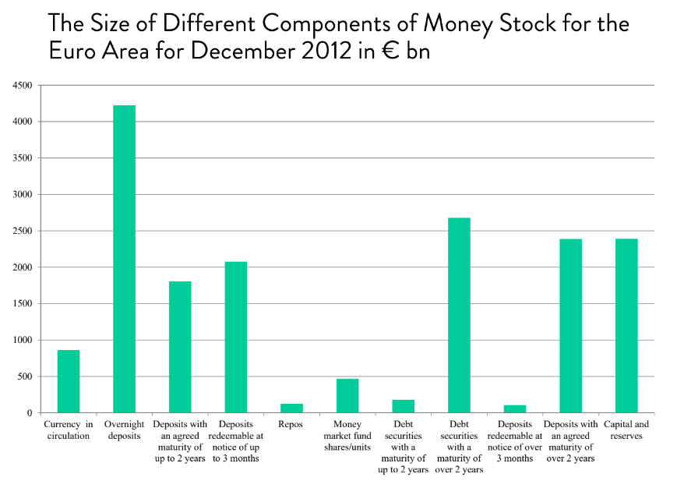

Slide 17
Practice questions:
1) This morning I moved $100 from my savings account to my checking account. What is the effect on M1? (increase, decrease, no change). What about M2? (inc, dec, or no change).
2) You overhear a classmate say “Dr. Beck forgot to tell us where stocks and bonds fit in. Are they M1, M2, or M3?” How do you respond?

Slide 18
3) In the 1940s, China's currency was losing much of it value (China was in a civil war at the time with the Communists led by Mao Zedong). At the same time, US occupying soldiers in Japan noticed that there was a serious paper shortage in Japan. Many of the soldiers purchased Chinese currency with dollars and sold it in Japan as recyclable paper at a profit. In this situation, was the Chinese currency a fiat or commodity money?

Slide 19
THE ROLE OF CENTRAL BANKS
A central bank is an institution designed to oversee the banking system and regulate the quantity of money in the economy.
Whenever an economy relies on fiat money, there must be some agency that regulates the system.

Slide 20
THE ROLE OF CENTRAL BANKS
The money supply is the quantity of money available in the economy.
prices rise when too much money is printed.
society faces a short-run trade-off between inflation and unemployment.
The MS has can have an impact on the macroecon
The regulation of the money supply is therefore a crucially important task.

Slide 21
THE ROLE OF CENTRAL BANKS
Monetary policy is the set of actions taken by the central bank in order to affect the money supply.

Slide 22
THE EUROPEAN CENTRAL BANK AND THE EUROSYSTEM
The European Central Bank is the overall central bank of the 12 countries comprising the European Monetary Union.
The ECB was officially created on 1 June 1998 and is located in Frankfurt.
It came into being because 11 countries of the European Union had decided that they wished to enter European Monetary Union and use the same currency.

Slide 23
THE EUROPEAN CENTRAL BANK AND THE EUROSYSTEM
The primary objective of the ECB is to promote price stability throughout the euro area.
An important feature of the ECB and the Eurosystem is its independence.
The Eurosystem is the system made up of the ECB plus the national central banks of the 19 countries comprising the European Monetary Union.

Slide 24
BANKS AND THE MONEY SUPPLY
The central bank can create new money, but in a way, banks can as well
Reserves are deposits that banks have received but have not loaned out.
In a fractional-reserve banking system, banks hold a fraction of the money deposited as reserves and lend out the rest.
The reserve ratio is the fraction of deposits that banks hold as reserves.

Slide 25
Money Creation with Fractional-Reserve Banking
When a bank makes a loan from its reserves, the money supply increases.
The money supply is affected by the amount deposited in banks and the amount that banks loan.
The fraction of total deposits that a bank has to keep as reserves is called the reserve ratio.

Slide 26
Money Creation with Fractional-Reserve Banking
When one bank loans money, that money is generally deposited into another bank.
This creates more deposits and more reserves to be lent out.
When a bank makes a loan from its reserves, the money supply increases.

Slide 27
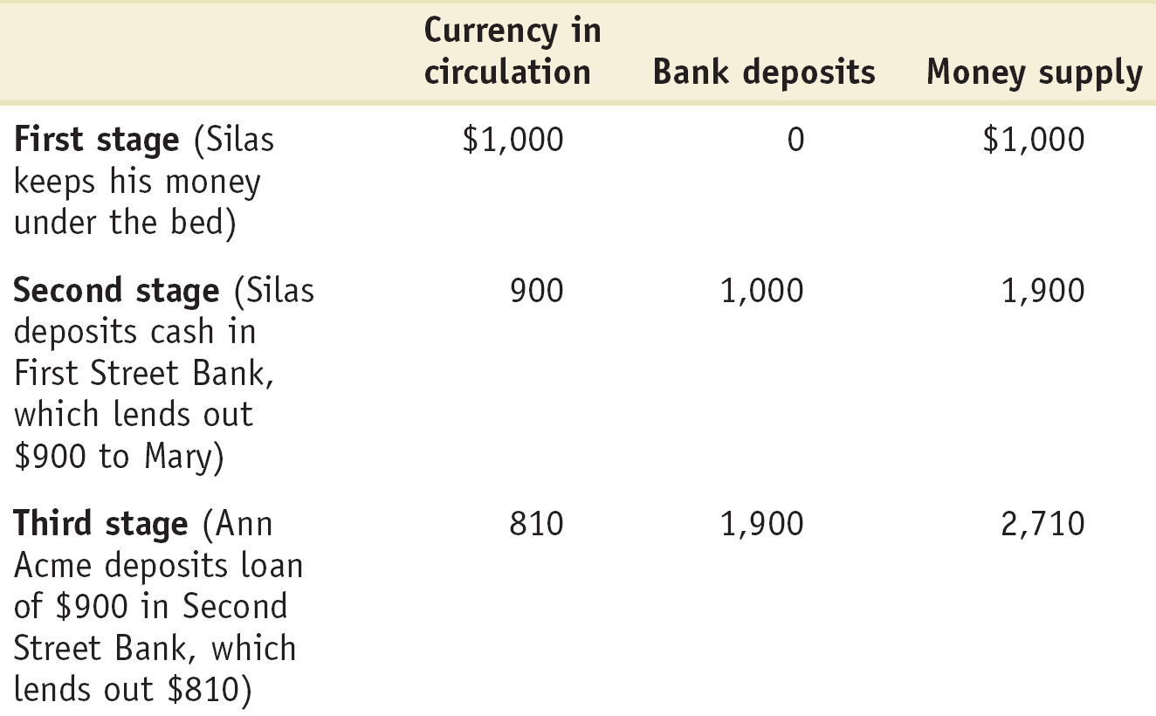
How Banks Create Money

Slide 28
The Money Multiplier
How much money is eventually created in this economy?
The money multiplier is the amount of money the banking system generates with each unit of reserves.

Slide 29
The Money Multiplier
The money multiplier is the reciprocal of the reserve ratio:
M = 1/R
With a reserve requirement, R = 20%
The multiplier is 5.

Slide 30
Practice questions:
Will the effect of a deposit on the MS be bigger with a high R (like 20%) or a low one (like 2%)?
Can you anticipate any problems with a fractional-reserve system? Explain
What is the effect on the MS if I deposit $50 into the bank. Assume R=30%.

Slide 31
The Central Bank’s Tools of Monetary Control
A central bank has three main tools in its monetary toolbox:
1 Open-market operations
2 Changing the refinancing rate
3 Changing the reserve requirement

Slide 32
The Central Bank’s Tools of Monetary Control
The Refinancing Rate
The refinancing rate is the interest rate the ECB lends on a short-term basis to the euro area banking sector.
Increasing the refinancing rate decreases the money supply.
Decreasing the refinancing rate increases the money supply.
In the USA, the refinancing rate is called the discount rate and in the UK it’s called the repo rate.

Slide 33
The Central Bank’s Tools of Monetary Control
Reserve Requirements
Reserve requirements are regulations on the minimum amount of reserves that banks must hold against deposits.
Increasing the reserve requirement decreases the money supply.
Decreasing the reserve requirement increases the money supply.
Central banks have tended to change reserve requirements only rarely.

Slide 34
The Central Bank’s Tools of Monetary Control
Open-Market Operations
A central bank conducts open-market operations when it buys government bonds from, or sells government bonds to the public:
When the central bank buys government bonds, the money supply increases.
The money supply decreases when the central bank sells government bonds.

Slide 35
To understand how changes in the MS can have an effect on the macro economy, we first need to understand the “demand for money”…

Slide 36
The Money Demand Curve
The money demand curve shows the relationship between the quantity of money demanded and the interest rate.

Slide 37
The Money Demand Curve
Interest rate, r
Money demand curve, MD
Quantity of money
Notes:
Figure Caption: Figure 15-1: The Money Demand Curve
The money demand curve illustrates the relationship between the interest rate and the quantity of money demanded. It slopes downward: a higher interest rate leads to a higher opportunity cost of holding money and reduces the quantity of money demanded.

Slide 38
The Money Demand Curve
Why is the MD curve downward sloping?
The tradeoff between opp cost and convenience.

Slide 39
Equilibrium in the Money Market
Interest
rate, r
Money supply
curve, MS
r
H
H
Equilibrium
Equilibrium interest rate
r
E
E
L
r
L
MD
M
H
M
M
L
Quantity of money
Money supply
chosen by the Fed
Notes:
Figure Caption: Figure 15-3: Equilibrium in the Money Market
The money supply curve, MS, is vertical at the money supply chosen by the Federal Reserve, M. The money market is in equilibrium at the interest rate rE: the quantity of money demanded by the public is equal to M, the quantity of money supplied. At a point such as L, the interest rate, rL, is below rE and the corresponding quantity of money demanded, ML, exceeds the money supply, M. In an attempt to shift their wealth out of non-money interest-bearing financial assets and raise their money holdings, investors drive the interest rate up to rE. At a point such as H, the interest rate rH is above rE and the corresponding quantity of money demanded, MH, is less than the money supply, M. In an attempt to shift out of money holdings into non-money interest-bearing financial assets, investors drive the interest rate down to rE.
39

Slide 40
The Effect of an Increase in the Money Supply on the Interest Rate
Interest
rate, r
An increase
in the money
supply . . .
MS
1
MS
2
. . . leads to
a fall in the
interest rate.
r
E
1
1
E
2
r
2
MD
M
1
M
2
Quantity of money
Notes:
Figure Caption: Figure 15-4: The Effect of an Increase in the Money Supply on the Interest Rate
The Federal Reserve can lower the interest rate by increasing the money supply. Here, the equilibrium interest rate falls from r1 to r2 in response to an increase in the money supply from M1 to M2. In order to induce people to hold a larger quantity of money, the interest rate must fall from r1 to r2.
40

Slide 41
Overnight Rate
Overnight Rate: the interest rate banks charge each other for overnight loans
Note this is not controlled by the ECB directly, but will often be targeted.
This is b/c many other interest rates will track the Overnight rate.

Slide 42
Setting the Overnight Rate
Pushing the Interest Rate Down to the Target Rate
The target Overnight Rate is the ECB’s desired federal funds rate.
Interest
rate, r
An open-market
purchase . . .
MS
1
MS
2
. . . drives the interest rate down.
r
E
1
1
r
E
2
T
MD
M
1
M
2
Quantity of money
Notes:
Figure Caption: Figure 15-5: Setting the Federal Funds Rate
The Federal Reserve sets a target for the federal funds rate and uses open-market operations to achieve that target. In panel (a) the initial
equilibrium interest rate, r₁, is above the target rate. The Fed increases the money supply by making an open-market purchase of Treasury bills, pushing the money supply curve rightward, from MS₁ to MS₂, and driving the interest rate down to r_{T}.

Slide 43
Setting the Overnight Rate
Pushing the Interest Rate Up to the Target Rate
Interest
rate, r
An open-market
sale . . .
MS
2
MS
1
. . . drives the interest rate up.
r
E
T
2
r
E
1
1
MD
M
2
M
1
Quantity of money
Notes:
Figure Caption: Figure 15-5: Setting the Federal Funds Rate
The Federal Reserve sets a target for the federal funds rate and uses open-market operations to achieve that target. In panel (b) the initial equilibrium interest rate, r₁, is below the target rate. The Fed reduces the money supply by making an open-market sale of Treasury bills, pushing the money supply curve leftward, from MS₁ to MS₂, and driving the interest rate up to r_{T}.

Slide 44
How Int Rates Effect AD
1) Consumption
↑ interest rates → ↓ consumption
2) Investment
↑ interest rates → ↓ investment

Slide 45
Expansionary Monetary Policy:
Increasing the MS to lower interest rates
Contractionary Monetary Policy:
Decreasing the MS to increase interest rates

Slide 46
As we just saw, changes in the MS can affect the macroecon in the short-run…
…but in the long-run…

Slide 47
https://www.youtube.com/watch?v=xpXTZktlCNQ
https://www.youtube.com/watch?v=uUPcp845xt8

Slide 48
Practice Questions
Would an R=100% eliminate the possibility of bank runs? Do you think this would be “worth it”?
Imagine the Central Bank want to cool the economy off through changes to R. What specifically would they do?
Imagine the Central Bank want to cool the economy off through OMO. What specifically would they do?

