Slide 1
Session 13: AS/AD Model
Chapter 28

Slide 2
We hope to see steady increases in our standard of living (i.e. economic growth) over the long-run.
Even if that trend is upward, we will still see short-run fluctuations around that trend.
  “boom and bust”, expansion and recession
Our topic today will help us begin to understand these SR fluctuations.
Even though they are only short-run, downturns can still last years and thus be painful.

Slide 3
In the long-run we assume “money is neutral”
  Changes in the MS won’t impact and “real” variables.
    Things like GDP, real interest rates, UE rates
So in our discussion of LR growth, we didn’t mention much about the MS or price level
In the SR, however, we know that changes in MS and PL can impact the economy and thus the assumption of monetary neutrality is no longer appropriate.

Slide 4
Note that SR economic fluctuation is irregular and unpredictable.
It is very hard to predict when a change will happen or how long the expansion or recession will last.
An important concept, and one we will talk about later, is “potential real GDP”
  Think of this as the target level of output
  Output where UE is at the natural rate
  Business cycles fluctuate around potential real GDP

Slide 5
Our Agg Supply/Agg Demand model will be a first step in understanding these SR swings in the business cycle.
It’s a pretty simple model and makes a lot of assumptions.
  More advanced models of the macro econ might be a little more realistic, but the AS/AD is a good place to start.

Slide 6
Aggregate Supply
The aggregate supply curve shows the relationship between the aggregate price level and the quantity of aggregate output in the economy.
GDP Deflator can be used as a measure of the price level
  GDP Deflator= (Nom.GDP/Real GDP) *100
  An increasing GDP Deflator means an increasing price level

Slide 7
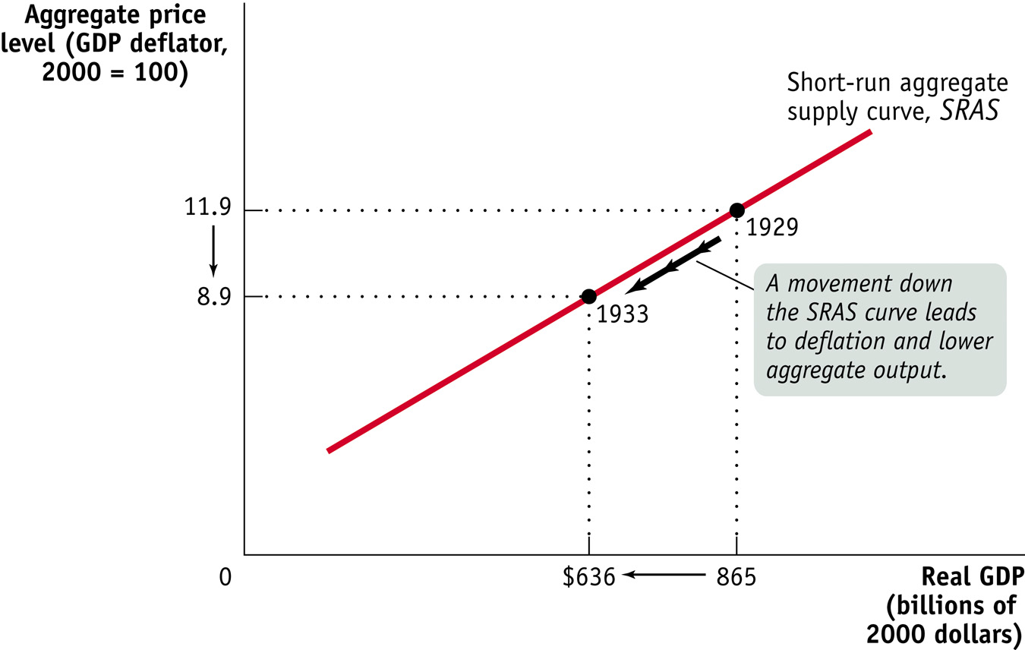
The Short-Run Aggregate Supply Curve
Notes:
Figure Caption: Figure 12-5: The Short-Run Aggregate Supply Curve
The short-run aggregate supply curve shows the relationship between the aggregate price level and the quantity of aggregate output supplied in the short run, the period in which many production costs such as nominal wages are fixed. It is upward sloping because a higher aggregate price level leads to higher profit per unit of output and higher aggregate output given fixed nominal wages. Here we show numbers corresponding to the Great Depression, from 1929 to 1933: when deflation occurred and the aggregate price
level fell from 11.9 (in 1929) to 8.9 (in 1933), firms responded by reducing the quantity of aggregate output supplied from $865 billion to $636 billion measured in 2000 dollars.

Slide 8
The Short-Run Aggregate Supply Curve
We generally think output prices change more quickly than input prices
The short-run aggregate supply curve is upward-sloping because nominal input prices, especially wages, are often “sticky” in the short run:
  a higher aggregate price level leads to higher profits (for a bit, at least) and increased aggregate output in the short run.
The nominal wage is the dollar amount of the wage paid.
Sticky wages are nominal wages that are slow to fall even in the face of high unemployment and slow to rise even in the face of labor shortages.
Often other inputs are purchased under a contracted price as well and may be somewhat sticky

Slide 9
Shifts of the Short-Run Aggregate Supply Curve
Producers supply goods based on their ability to make profits.
As opportunities for profits increase, they supply more.

Slide 10
Factors that Shift the Short-Run Aggregate Supply Curve
Changes in commodity prices
If commodity prices fall, . . . . . . short-run aggregate supply increases.
If commodity prices rise, . . . . . . short-run aggregate supply decreases.
Changes in nominal wages
If nominal wages fall, . . . . . . short-run aggregate supply increases.
If nominal wages rise, . . . . . . short-run aggregate supply decreases.
Changes in productivity
If workers become more productive, . . . short-run aggregate supply increases.
If workers become less productive, . . . . short-run aggregate supply decreases

Slide 11
Long-Run Aggregate Supply Curve
The long-run aggregate supply curve shows the relationship between the aggregate price level and the quantity of aggregate output supplied that would exist if all prices, including nominal wages, were fully flexible.
While input prices, such as wages, probably are pretty sticky in the short-run, would they forever remain “stuck”?
  No. Eventually existing contracts expire and new ones are negotiated.
In the LR, the aggregate price level has no effect on aggregate supply

Slide 12
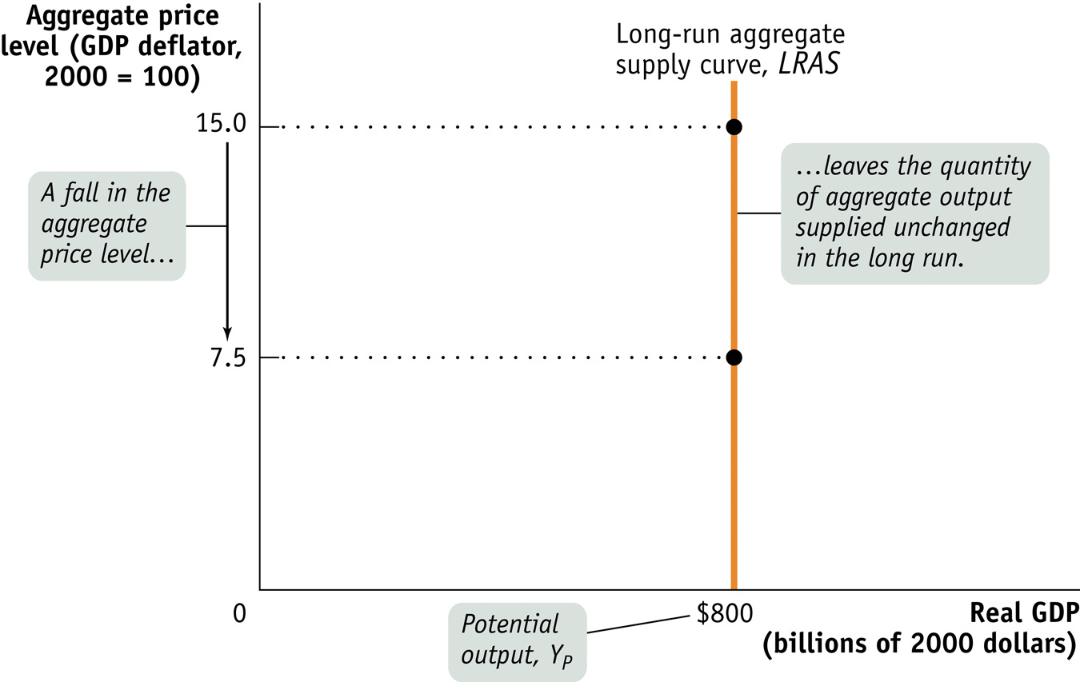
Long-Run Aggregate Supply Curve
Notes:
Figure Caption: Figure 12-7: Long-Run Aggregate Supply Curve
The long-run aggregate supply curve shows the quantity of aggregate output supplied when all prices, including nominal wages, are flexible. It is vertical at potential output, Y_{P} , because in the long run an increase in the aggregate price level has no effect on the quantity of aggregate output supplied.

Slide 13
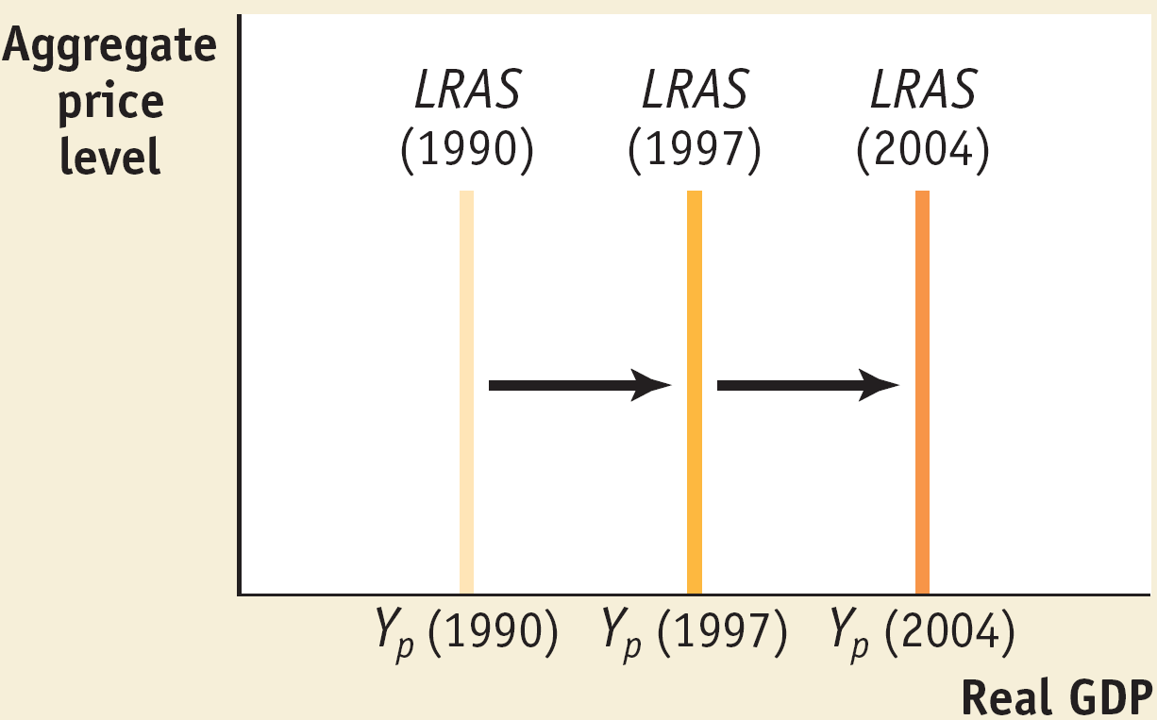
Economic Growth Shifts the LRAS Curve Rightward

Slide 14
LRAS
The LRAS curve represents the economy’s “potential output” or “potential GDP”
Potential Output: the level of real GDP the economy would produce if all prices (including wages) were instantly and perfectly flexible.
  Think of this as the level of production, nationwide, that corresponds with full employment (and remember, full employment is not zero unemployment)

Slide 15
LRAS
While the economy’s actual output may not always be right at potential output, it will always fluctuate around it.
  During recessions it will be slightly below, during expansions it will be slightly above.

Slide 16
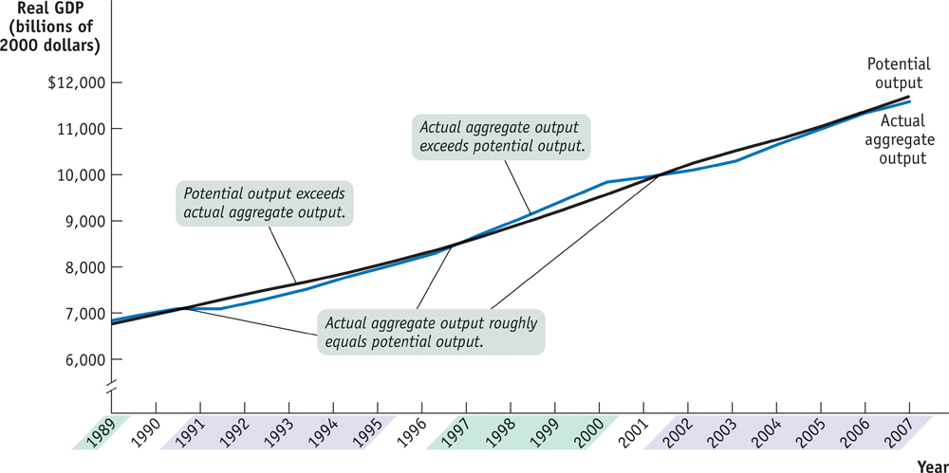
Actual and Potential Output from 1989 to 2007
Notes:
Figure Caption: Figure 12-8: Actual and Potential Output from 1989 to 2007
This figure shows the performance of actual and potential output in the United States from 1989 to 2007. The black line shows estimates of U.S. potential output, produced by the Congressional Budget Office, and the blue line shows actual aggregate output. The purple-shaded years are periods in which actual aggregate output fell below potential output, and the green-shaded years are periods in which actual aggregate output exceeded potential output. As shown, significant shortfalls occurred in the recessions of the early 1990s and after 2000. Actual aggregate output was significantly above potential output in the boom of the late 1990s.
Source: Congressional Budget Office; Bureau of Economic Analysis.
16

Slide 17
Aggregate Demand
The aggregate demand curve shows the relationship between the aggregate price level and the quantity of aggregate output demanded by households, businesses, the government and the rest of the world.

Slide 18
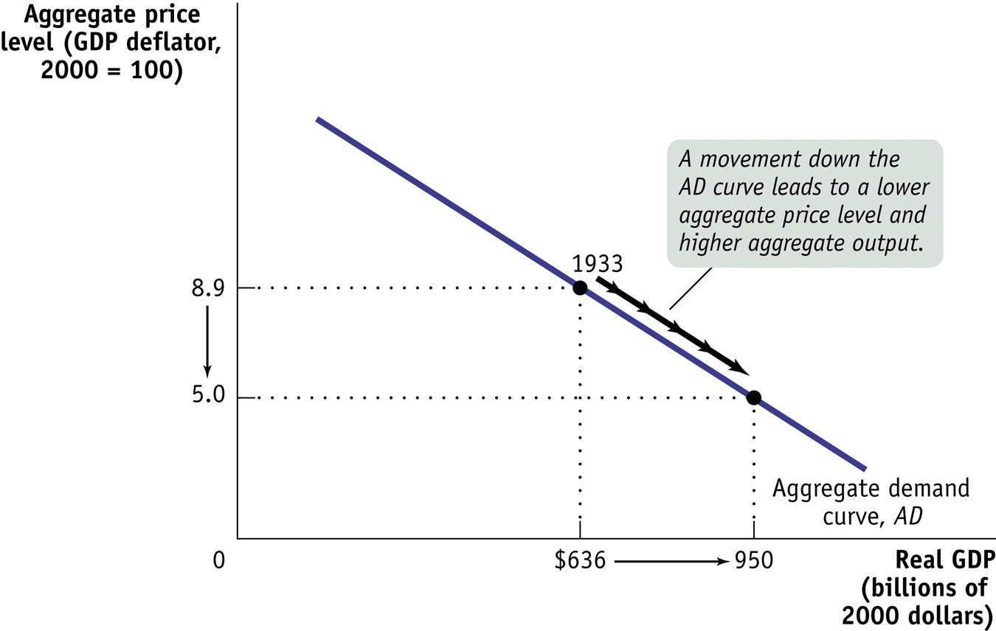
The Aggregate Demand Curve
Notes:
Figure Caption: Figure 12-1: The Aggregate Demand Curve
The aggregate demand curve shows the relationship between the aggregate price level and the quantity of aggregate output demanded. The curve is downward-sloping due to the wealth effect of a change in the aggregate price level and the interest rate effect of a change in the aggregate price level. Here, the total quantity of goods and services demanded at an aggregate price level of 8.9, the actual number for 1933, is $636 billion in 2000 dollars, the actual quantity of aggregate output demanded in 1933. According to our hypothetical curve, however, if the aggregate price level had been only 5.0, the quantity of aggregate output demanded would have been $950 billion.

Slide 19
The Aggregate Demand Curve
It is downward-sloping for two reasons:
  The first is the wealth effect of a change in the aggregate price level—a higher aggregate price level reduces the purchasing power of households’ wealth and reduces consumer spending.
  The second is the interest rate effect of a change in aggregate price level—a higher aggregate price level reduces the purchasing power of households’ money holdings, leading to a rise in interest rates and a fall in investment spending and consumer spending.

Slide 20
Shifts of the Aggregate Demand Curve
The aggregate demand curve shifts because of:
  changes in expectations
  wealth
  the stock of physical capital
  government policies
    fiscal policy
    monetary policy

Slide 21
Factors that Shifts the Aggregate Demand Curve
Changes in expectations
If consumers and firms become more optimistic, . . . . . . aggregate demand increases.
If consumers and firms become more pessimistic, . . . . . . aggregate demand decreases.
Changes in wealth
If the real value of household assets rises, . . . . . . aggregate demand increases.
If the real value of household assets falls, . . . . . . aggregate demand decreases.
Fiscal policy
If the government increases spending or cuts taxes, . . . .. aggregate demand increases.
If the government reduces spending or raises taxes, . . . . aggregate demand decreases.
Monetary policy
If the central bank increases the quantity of money, . .. . . aggregate demand increases.
If the central bank reduces the quantity of money, . . . . . . aggregate demand decreases

Slide 22
The AS–AD Model
The AS-AD model uses the aggregate supply curve and the aggregate demand curve together to analyze economic fluctuations.

Slide 23
Short-Run Macroeconomic Equilibrium
The economy is in short-run macroeconomic equilibrium when the quantity of aggregate output supplied is equal to the quantity demanded.
The short-run equilibrium aggregate price level is the aggregate price level in the short-run macroeconomic equilibrium.
Short-run equilibrium aggregate output is the quantity of aggregate output produced in the short-run macroeconomic equilibrium.

Slide 24
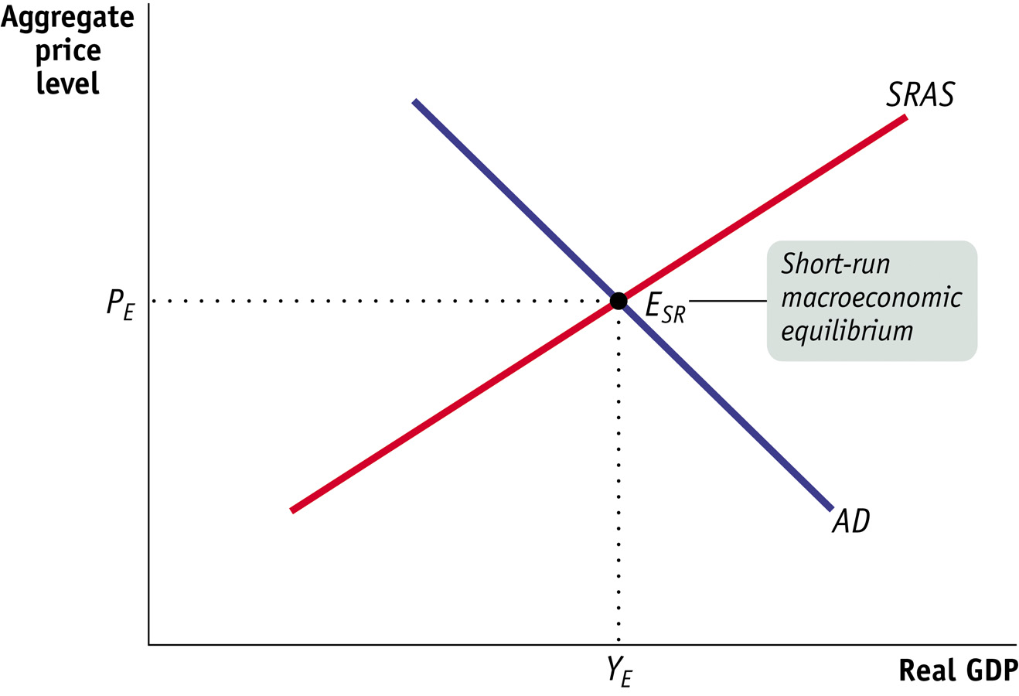
The AS–AD Model
Notes:
Figure Caption: Figure 12-11: The AS–AD model
The AS–AD model combines the short-run aggregate supply curve and the aggregate demand curve. Their point of intersection, ESR , is the point of short-run macroeconomic equilibrium where the quantity of aggregate output demanded is equal to the quantity of aggregate output supplied. P_{E} is the short-run equilibrium aggregate price level, and Y_{E} is the short-run equilibrium level of aggregate output.

Slide 25
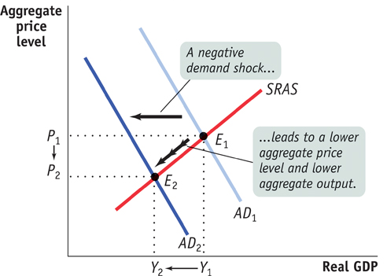
Shifts of Aggregate Demand: Short-Run Effects
Notes:
Figure Caption: Figure 12-12: Demand Shocks
A demand shock shifts the aggregate demand curve, moving the aggregate price level and aggregate output in the same direction. In panel (a) a negative demand shock shifts the aggregate demand curve leftward from AD₁ to AD₂, reducing the aggregate price level from P₁ to P₂ and aggregate output from Y₁ to Y₂.

Slide 26
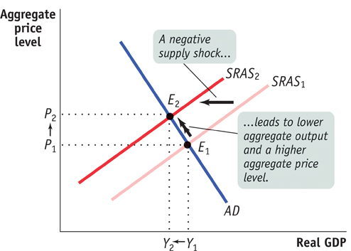
Shifts of the SRAS Curve
Stagflation is the combination of inflation and falling aggregate output.
Notes:
Figure Caption: Figure 12-13: Supply Shocks
A supply shock shifts the short-run aggregate supply curve, moving the aggregate price level and aggregate output in opposite directions. Panel (a) shows a negative supply shock, which shifts the short-run aggregate supply curve leftward, causing stagflation—lower aggregate output and a higher aggregate price level. Here the short-run aggregate supply curve shifts from SRAS₁ to SRAS₂ , and the economy moves from E₁ to E₂. The aggregate price level rises from P₁ to P₂ , and aggregate output falls from Y₁ to Y₂.

Slide 27
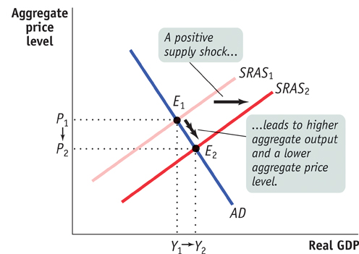
Shifts of the SRAS Curve
Notes:
Figure Caption: Figure 12-13: Supply Shocks
Panel (b) shows a positive supply shock, which shifts the short-run aggregate supply curve rightward, generating higher aggregate output and a lower aggregate price level. The short-run aggregate supply curve shifts from SRAS₁ to SRAS₂ , and the economy moves from E₁ to E₂. The aggregate price level falls from P₁ to P₂ , and aggregate output rises from Y₁ to Y₂. An event that shifts the short-run aggregate supply curve is a supply shock.

Slide 28
Long-Run Macroeconomic Equilibrium
The economy is in long-run macroeconomic equilibrium when the point of short-run macroeconomic equilibrium is on the long-run aggregate supply curve.

Slide 29
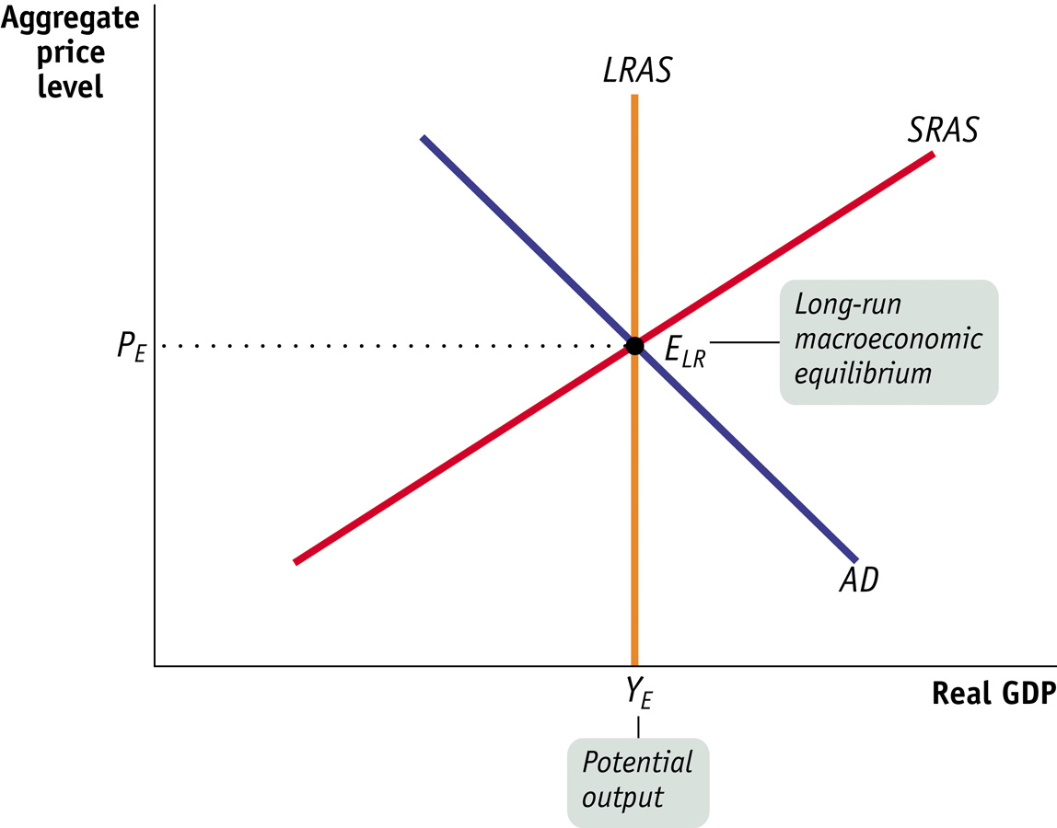
Long-Run Macroeconomic Equilibrium
Notes:
Figure Caption: Figure 12-14: Long-Run Macroeconomic Equilibrium
Here the point of short-run macroeconomic equilibrium also lies on the long-run aggregate supply curve, LRAS. As a result, actual aggregate output is equal to potential output. The economy is in long-run macroeconomic equilibrium at E_{LR}.

Slide 30
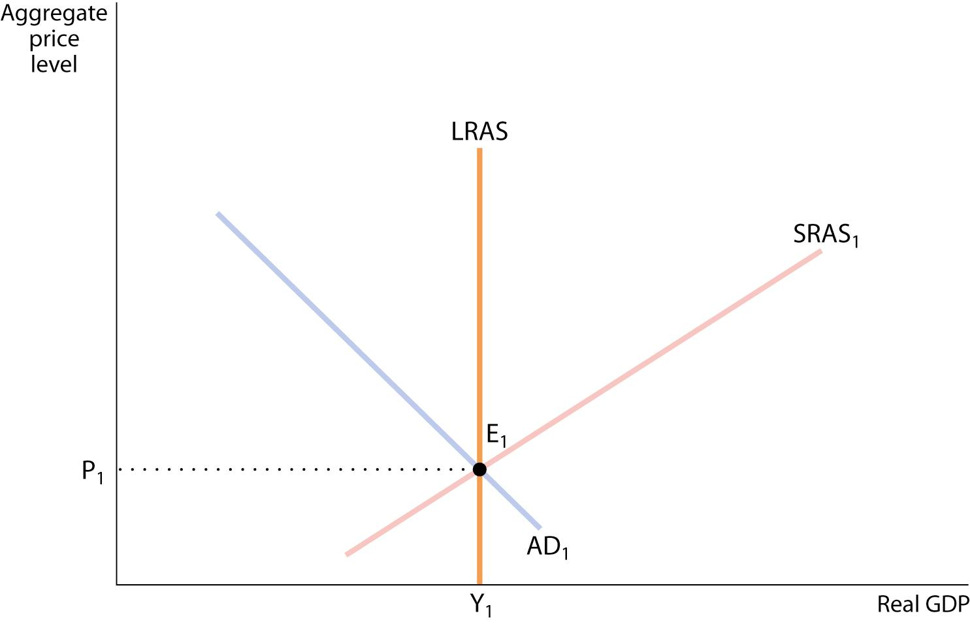
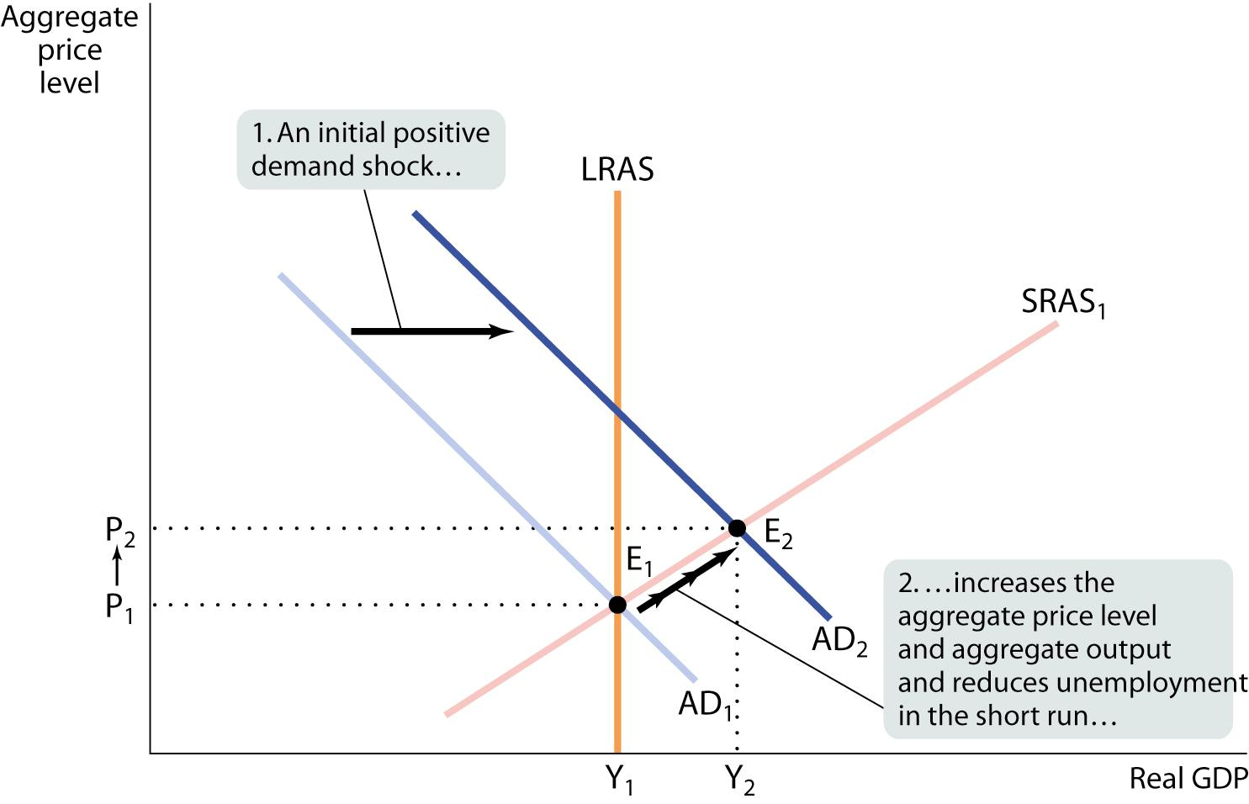
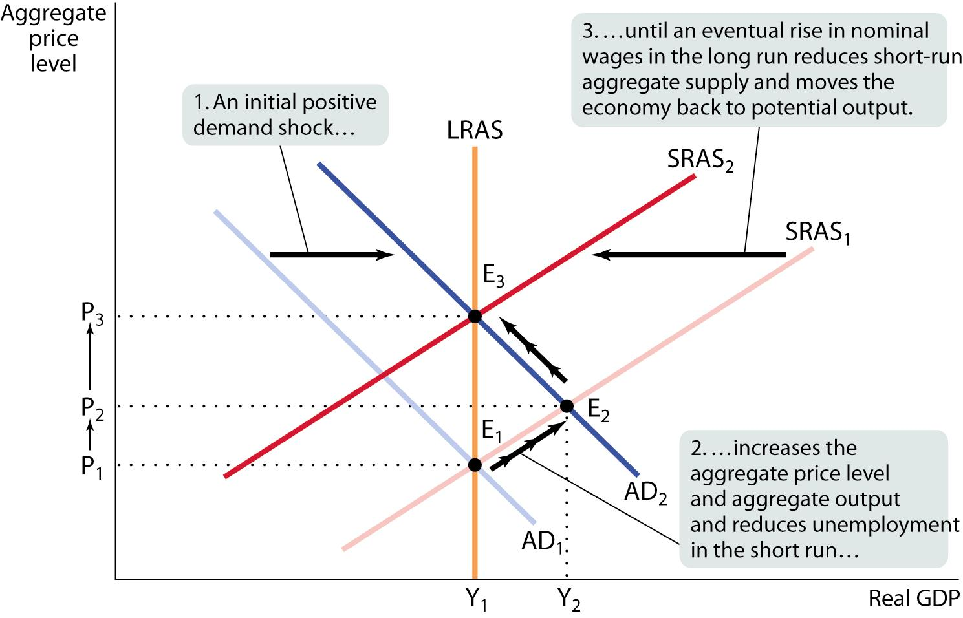
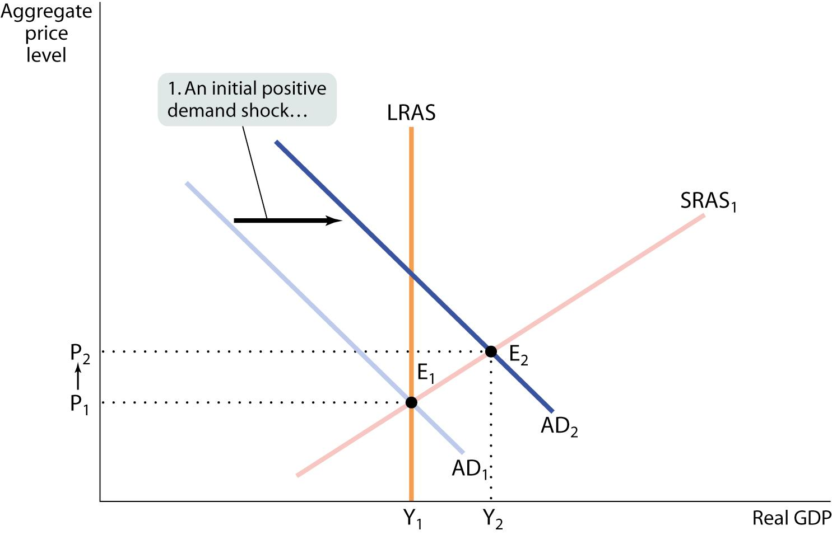
Short-Run Versus Long-Run Effects of a Positive Demand Shock
Inflationary gap
Notes:
Figure Caption: Figure 12-16: Short-Run Versus Long-Run Effects of a Positive Demand Shock
Starting at E₁ a positive demand shock shifts AD₁ rightward to AD₂, and the economy moves to E₂ in the short run. This results in an inflationary gap as aggregate output rises from Y₁ to Y₂, the aggregate price level rises from P₁ to P₂, and unemployment falls to a low level.
In the long run, SRAS₁ shifts leftward to SRAS₂ as nominal wages rise in response to low unemployment. Aggregate output falls back to Y₁, the aggregate price level rises again to P₃, and the economy returns to long-run macroeconomic equilibrium at E₃.

Slide 31
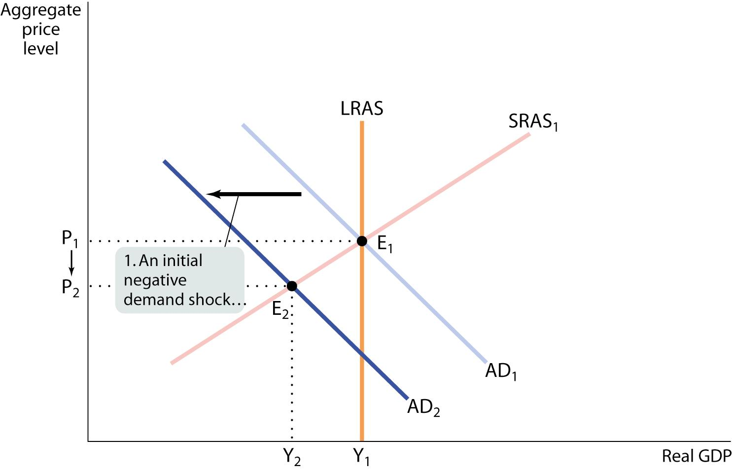
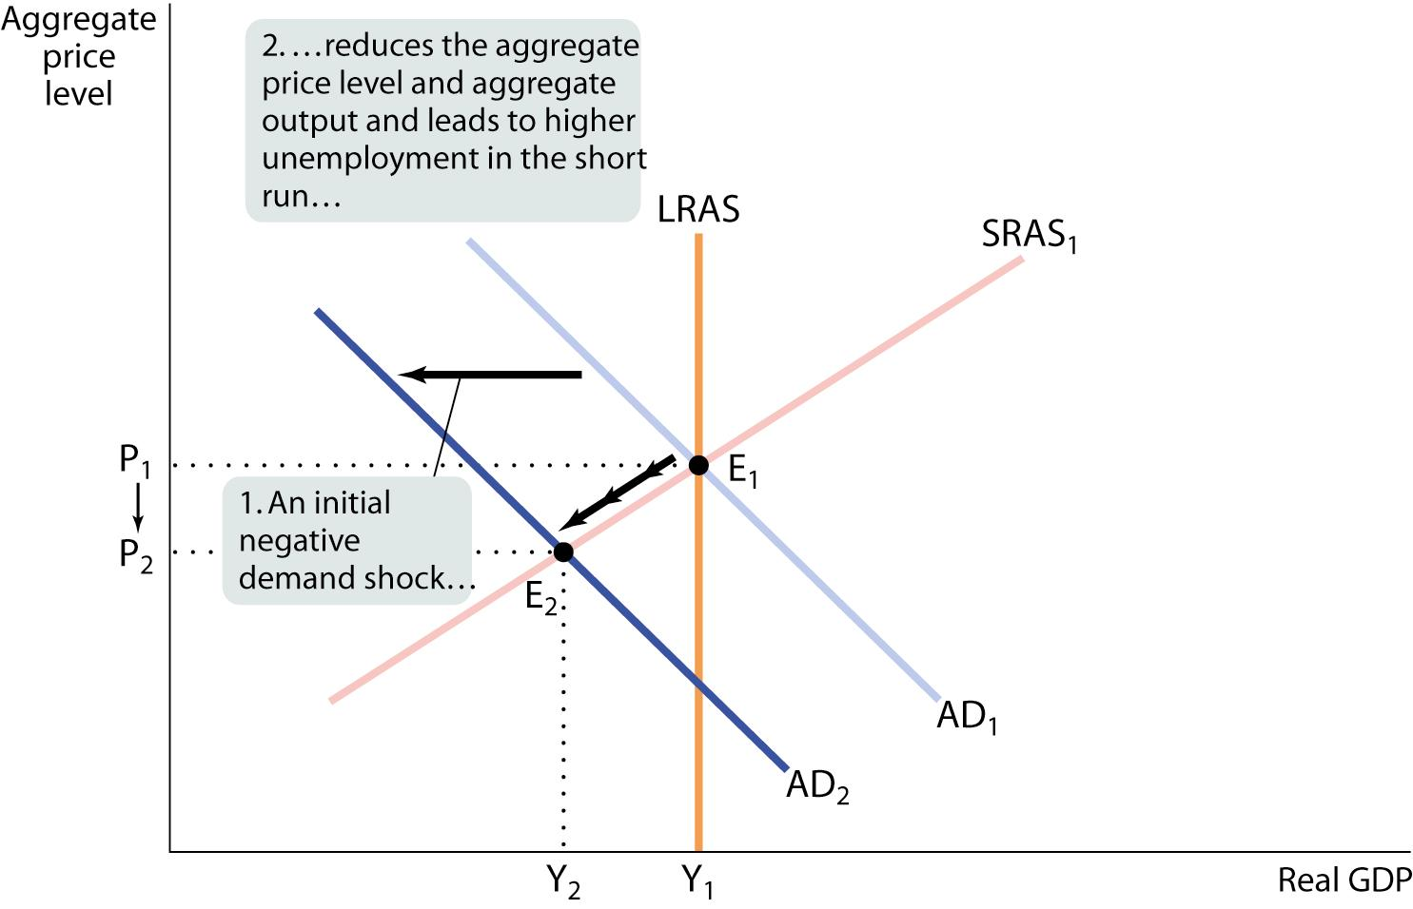
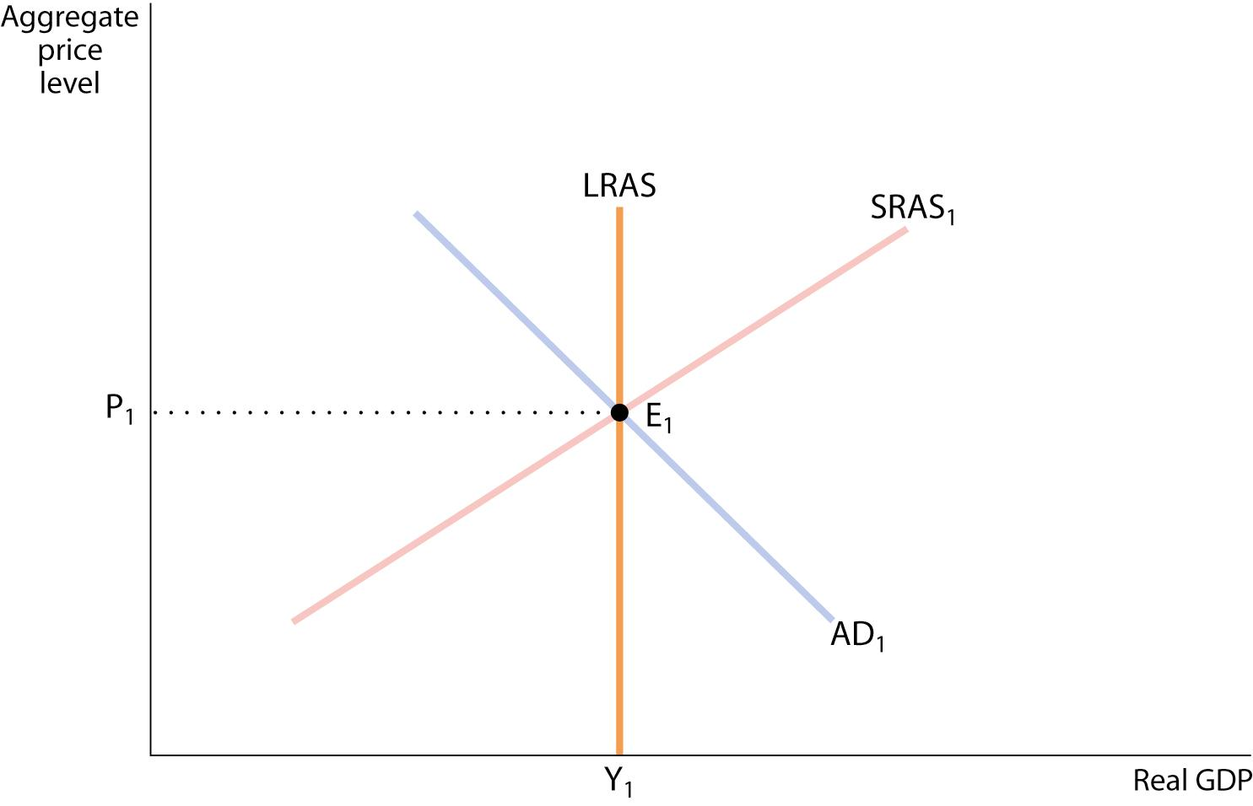
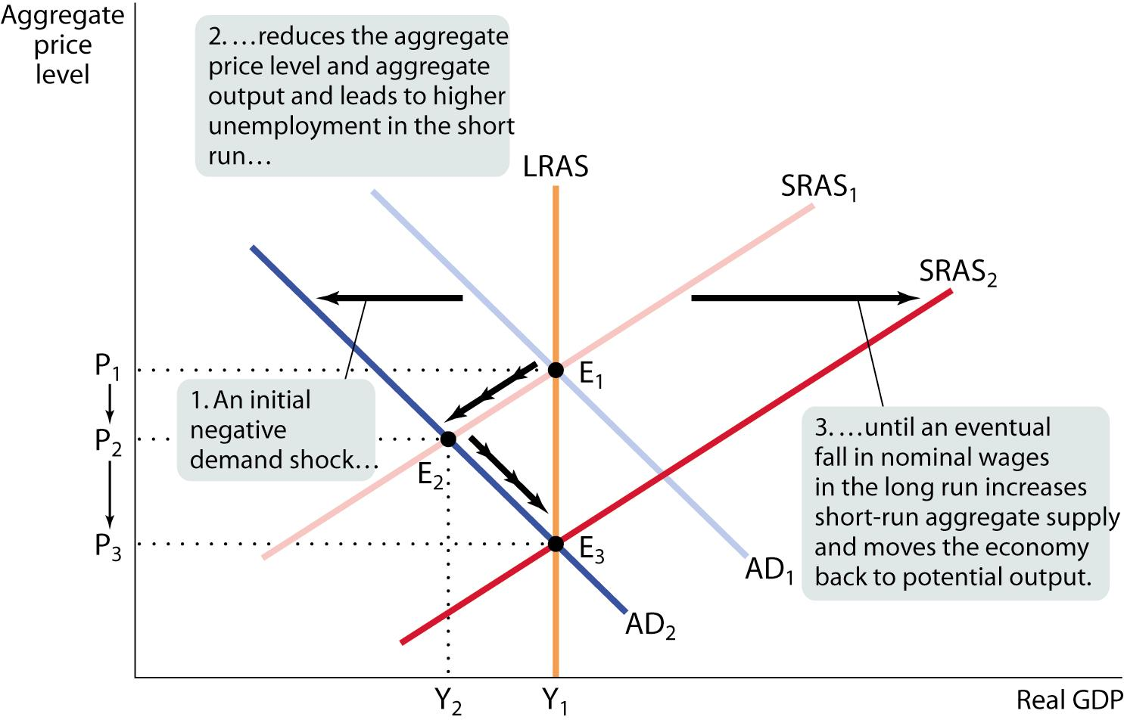
Short-Run Versus Long-Run Effects of a Negative Demand Shock
Recessionary gap
Notes:
Figure Caption: Figure 12-15: Short-Run Versus Long-Run Effects of a Negative Demand Shock
In the long run the economy is self-correcting: demand shocks have only temporary effects on aggregate output. Starting at E₁, a negative demand shock shifts AD₁ leftward to AD₂. In the short run the economy moves to E₂ and a recessionary gap arises: the aggregate price level declines from P₁ to P₂, aggregate output declines from Y₁ to Y₂, and unemployment rises. But in the long run nominal wages fall in response to high unemployment, and SRAS₁ shifts rightward to SRAS₂: aggregate output rises from Y₂ to Y₁, and the aggregate price level declines again, from P₂ to P₃. Long-run macroeconomic equilibrium is eventually restored at E₃.

Slide 32
Gap Recap
There is a recessionary gap when aggregate output is below potential output.
There is an inflationary gap when aggregate output is above potential output.
The output gap is the percentage difference between actual aggregate output and potential output.

Slide 33
Gap Recap
The economy is self-correcting when shocks to aggregate demand affect aggregate output in the short run, but not the long run.
Note that we think the economy will correct itself, given time. The problem is that this can takes years, sometimes perhaps even a decade.
Certain governmental policy (monetary policy and fiscal policy) can try to get us back in LR equilibrium faster.
This idea was championed by the British economist John Maynard Keynes, active during the Great Depression.

Slide 34
Supply Shocks versus Demand Shocks in
Practice
Recessions are mainly caused by demand shocks. But when a negative supply shock does happen, the resulting recession tends to be particularly severe.

Slide 35
Macroeconomic Policy
Policy in the face of supply shocks:
  There are no easy policies to shift the short-run aggregate supply curve.
  Policy dilemma: a policy that counteracts the fall in aggregate output by increasing aggregate demand will lead to higher inflation, but a policy that counteracts inflation by reducing aggregate demand will deepen the output slump.

Slide 36
Practice Questions
Use the AS/AD model to analyze:
1) An decrease in household optimism about the economy
2) A stock market boom that increases household wealth
3) The price of oil falls

