Slide 1
Session 14
Fiscal Policy
Chapter 33 (pgs 709-716)

Slide 2
Fiscal Policy
What Fiscal Policy Is and What It Isn’t
Fiscal policy Changes in federal taxes and purchases that are intended to achieve macroeconomic policy objectives, such as high employment, price stability, and high rates of economic growth.
Automatic Stabilizers versus Discretionary Fiscal Policy
Automatic stabilizers Government spending and taxes that automatically increase or decrease along with the business cycle.

Slide 3
Recall that:
AD=C+I+G+NX

Slide 4
Types of FP
Expansionary Fiscal Policy: increasing gov’t purchases or decreasing taxes to increase aggregate demand
Contractionary Fiscal Policy: decreasing gov’t purchases or increasing taxes to decrease aggregate demand

Slide 5
The Effects of Fiscal Policy on Real GDP and the Price Level
A Summary of How Fiscal Policy Affects Aggregate Demand
Table 15-1
Countercyclical Fiscal Policy
PROBLEM | TYPE OF POLICY | ACTIONS BY CONGRESS AND THE PRESIDENT | RESULT
Recession | Expansionary | Increase government spending or cut taxes | Real GDP and the price level rise.
Rising Inflation | Contractionary | Decrease government spending or raise taxes | Real GDP and the price level fall.

Slide 6
A Cautionary Note: Lags in Fiscal Policy
In the case of fiscal policy, there is an important reason for caution: there are significant lags in its use.
Realize the recessionary/inflationary gap by collecting and analyzing economic data → takes time
Government develops a spending plan→ takes time
Implementation of the action plan (spending the money → takes time

Slide 7
Fiscal Policy and the Multiplier
Fiscal policy has a multiplier effect on the economy.
Expansionary fiscal policy leads to an increase in real GDP larger than the initial rise in aggregate spending caused by the policy.
Conversely, contractionary fiscal policy leads to a fall in real GDP larger than the initial reduction in aggregate spending caused by the policy.

Slide 8
Fiscal Policy and the Multiplier
The multiplier on changes in government purchases, 1/(1 − MPC), is larger than the multiplier on changes in taxes or transfers, MPC/(1 − MPC), because part of any change in taxes or transfers is absorbed by savings.
Changes in government purchases have a more powerful effect on the economy than equal-sized changes in taxes or transfers.

Slide 9
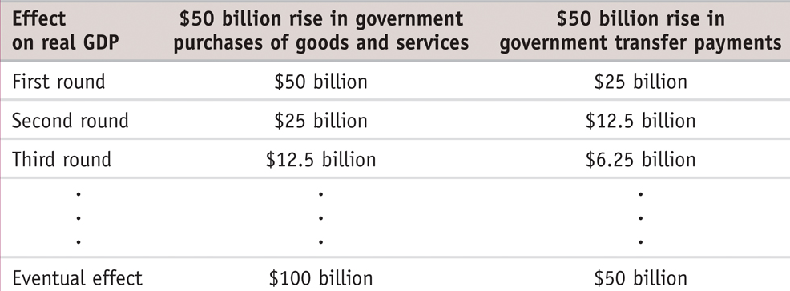
Multiplier Effects of Changes in Taxes and Government Transfers
Hypothetical Effects of a Fiscal Policy with Multiplier of 2
Notes:
9

Slide 10
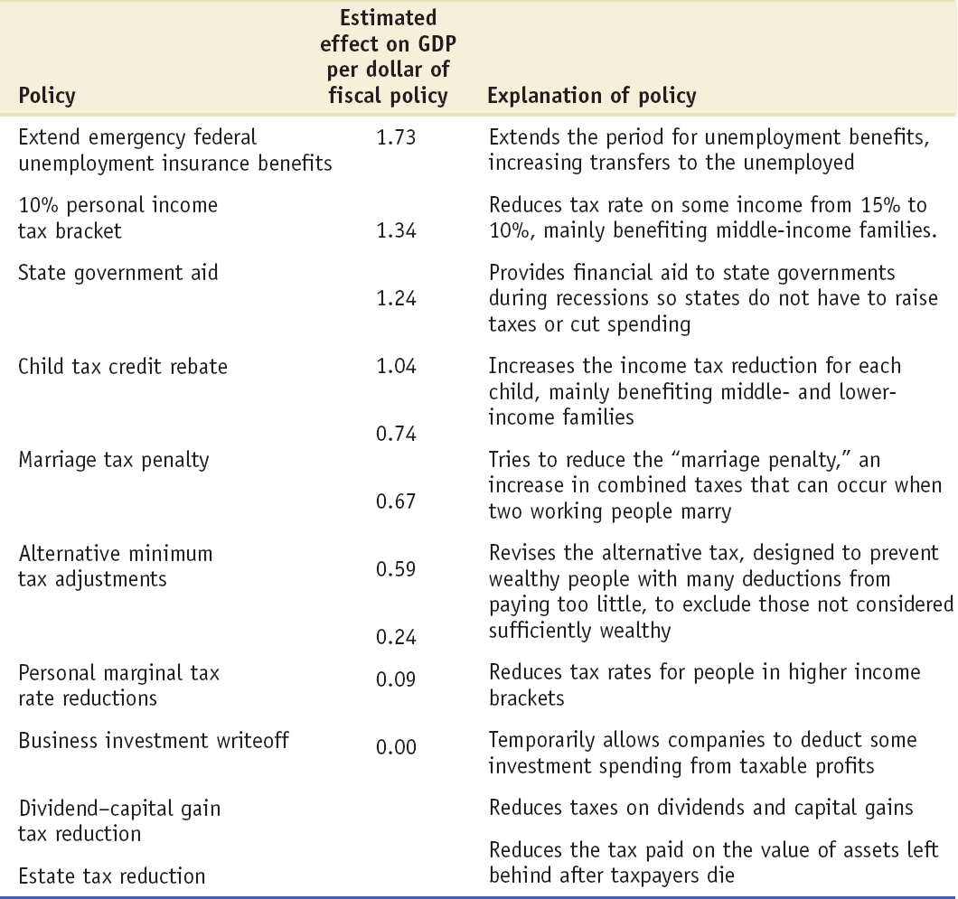
Differences in the Effect of Expansionary Fiscal Policies
Notes:
Notes to the Instructor:
Source: economy.com

Slide 11
Deficits Versus Debt
Deficit: the difference between the amt of money a gov’t spends & the amt it receives in taxes over a given period.
Debt: the sum of money a gov’t owes at a particular point in time.
Deficits and debt are linked, because government debt grows when governments run deficits. But they aren’t the same thing, and they can even tell different stories.

Slide 12
The Budget Balance
That is, expansionary fiscal policies make a budget surplus smaller or a budget deficit bigger.
Conversely, contractionary fiscal policies make a budget surplus bigger or a budget deficit smaller.

Slide 13
Should the Budget Be Balanced?
Most economists don’t believe the government should be forced to run a balanced budget every year
Yet policy makers concerned about excessive deficits sometimes feel that rigid rules prohibiting—or at least setting an upper limit on—deficits are necessary.

Slide 14
Deficits and Debt in Practice
A widely used measure of fiscal health is the debt–GDP ratio.
This number can remain stable or fall even in the face of moderate budget deficits if GDP rises over time.

Slide 15
Stability Pact—or “Stupidity” Pact?
In 1999 a group of European nations adopted a common currency, the euro, to replace their national currencies.
Members signed “stability pact”
Keep deficit < 3%
Limited the use of fiscal policy

Slide 16
Do countries have to pay their bonds back?

Slide 17
Argentina’s Creditors Take a Haircut
During much of the 1990s, Argentina was experiencing an economic boom and the government was easily able to borrow money from abroad. However, the country slid into an economic slump.
By 2001, the country was caught in a vicious circle: to cover its deficits and pay off old loans as they came due, it was forced to borrow at much higher interest rates.
It took three years for Argentina to reach an agreement with its creditors.
Argentina forced its creditors to trade their “sovereign bonds”—debts of a sovereign nation—for new bonds worth only 32% as much.
Such a reduction in the value of debt is known as a “haircut.”

Slide 18
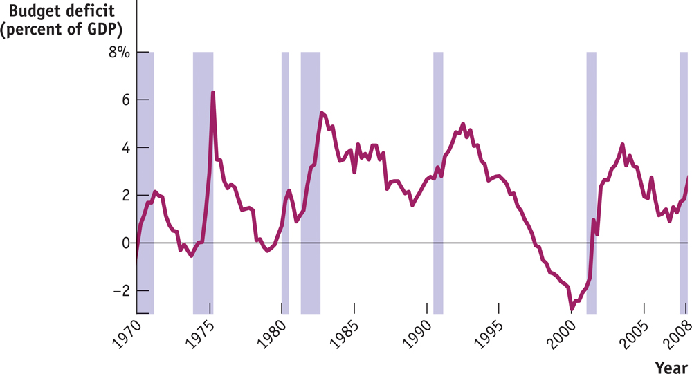
The Budget Balance
The budget deficit as a percentage of GDP tends to rise during recessions (indicated by shaded areas) and fall during expansions.
Notes:
Figure Caption: Figure 13-8: The U.S. Federal Budget Deficit and the Business Cycle
The budget deficit as a percentage of GDP tends to rise during recessions (indicated by shaded areas) and fall during expansions.
Source: Bureau of Economic Analysis; National Bureau of Economic Research.
18

Slide 19
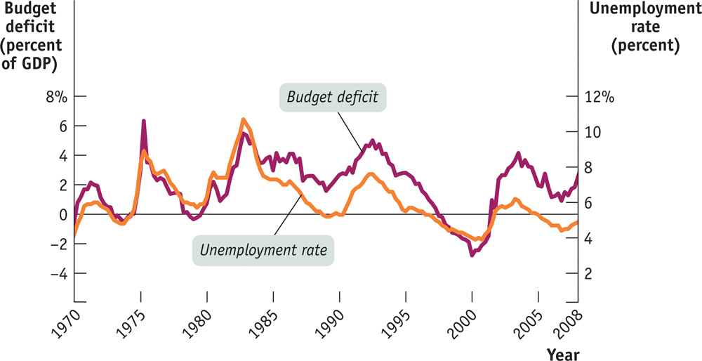
The Budget Balance
The budget deficit as a percentage of GDP moves closely in tandem with the unemployment rate.
Notes:
Figure Caption: Figure 13-9: The U.S. Federal Budget Deficit and the Unemployment Rate
There is a close relationship between the budget balance and the business cycle: a recession moves the budget balance toward deficit, but an expansion moves it toward surplus. Here, the unemployment rate serves as an indicator of the business cycle, and we should expect to see a higher unemployment rate associated with a higher budget deficit. This is confirmed by the figure: the budget deficit as a percentage of GDP moves closely in tandem with the unemployment rate.
Source: Bureau of Economic Analysis;
Bureau of Labor Statistics.
19

Slide 20
Long-Run Implications of Fiscal Policy
Persistent budget deficits have long-run consequences because they lead to an increase in public debt.

Slide 21
Problems Posed by Rising Government Debt
Public debt may crowd out investment spending, which reduces long-run economic growth.
And in extreme cases, rising debt may lead to government default, resulting in economic and financial turmoil.
Can’t a government that has trouble borrowing just print money to pay its bills?
Yes, it can, but this leads to another problem: inflation.

Slide 22
Implicit Liabilities
Implicit liabilities are spending promises made by governments that are effectively a debt despite the fact that they are not included in the usual debt statistics.

Slide 23
Practice Questions
If the government wanted to close a recessionary gap of $100 with increased spending, would it want to increase spending by $100, more than $100, or less than $100?
If the gov’t increased spending by $50 million, what would be the specific effect on GDP? Assume MPC=0.2
Explain why a $1 increase in spending will likely have a larger impact on the economy than a $1 tax cut.

Slide 24
Answers
1) Less than $100
2) Multiplier = 1/(1-MPC)=1/.8=1.25
Effect: $50mil * 1.25 = $62.5
3) Has to do with the first round effect

