Slide 1

Critique of Mainstream CSR
Aalto BIZ, Online, 9.3.2023
PhD, Professor
Jukka Mäkinen

Slide 2

Agenda for today
Introduction
CSR Paradigms
Mainstream CSR
First Challenge: Organized hypocrisy
Second Challenge: Limits of Private Power

Slide 3

1. Who am I?
Background in:
-political philosophy & economics
-business ethics
- organization studies
Research interests:
- political approaches to CSR studies
- division of moral labor in society

Slide 4


1. My Background
http://www.nytimes.com/2010/11/07/business/07shelf.html?_r=0
Mäkinen, J & Kasanen, E (2016) Boundaries between business and politics: A Study on the division of moral labor. Journal of Business Ethics

Slide 5
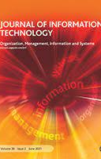
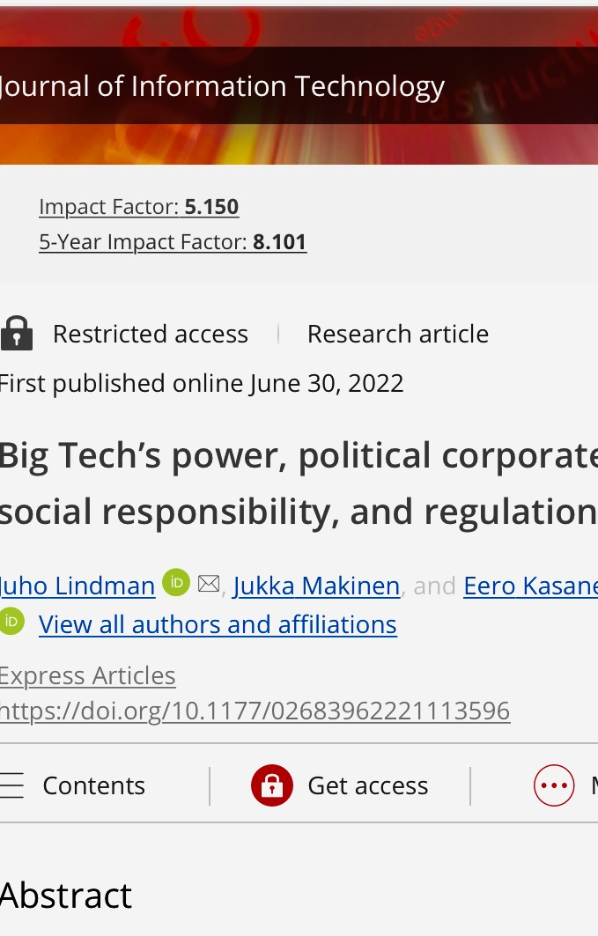
Recent Studies
https://doi.org/10.1177/02683962221113596

Slide 6

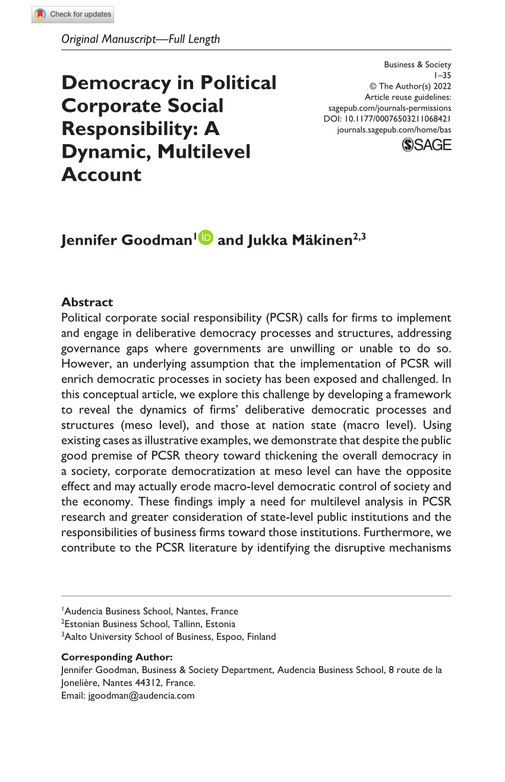
Recent Studies
https://doi.org/10.1177/00076503211068421

Slide 7
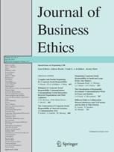
2. Three Paradigms of CSR
Synthesising Corporate Responsibility on Organisational and Societal Levels of Analysis: An Integrative Perspective
Pasi Heikkurinen & Jukka Mäkinen

Slide 8

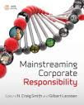

2. Perspectives to CSR
Economic
Critical
Political

Slide 9
2. Economic CSR
Corporations are perceived as economic actors operating within the public structures of societies.
The responsibility of the corporation is seen as an economic issue on the organisational level.
CSR activities of private firms need to be justified in economic terms.
Mainstream position focusing on the business case of CSR.

Slide 10
2. Critical CSR
Corporate responsibility as a neoliberal ideology aiming to extend the role of markets and economic actors i.e. the private sphere of society.
This extension of the private business sphere happens at the expense of the democratically governed public structures provided by the state and the citizens as a collective body.
The corporate responsibility is thus perceived as a power-gaining vehicle that contributes to the assumptions of free market capitalism.

Slide 11
2. Political CSR
Challenges the separation between business and politics.
Multinational corporations seen as powerful political actors operating in a strongly globalised world.
In the global setting, the traditional boundaries between business and politics are vanishing.
Firms need to go beyond the economic logic and take over the traditional governmental tasks of political and social regulation of businesses and the provision of public goods.

Slide 12


3. Economic CSR

Slide 13
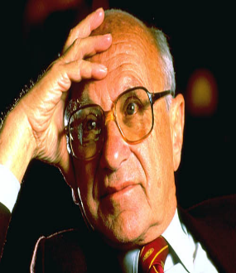
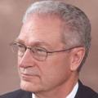
3. Classical Division of Labor
“Society uses its resources most efficiently”
“Protection of people, enforcing voluntary contracts and minimizing externalities”
“Government and state power should be separated from the particular interests and private advantages”
The role of corporations is to focus on economic issues
“Business of business is business”

Slide 14
3. Economic CSR
A firm can do well by doing good
Focus on the ”business case of CSR”
Normally not much political discussion on the roles of businesses in a society
Central aim is to develop a wider conception of CSR than Friedman’s narrow view, without losing his (classical liberal) voluntarism and economic efficiency emphasis.

Slide 15


3. The Strict Version of the Economic CSR
Investments on CSR are strategic means to advance the firm level economic performance without ethical commitments going beyond the motives of profit maximization (Gond et al. 2009).

Slide 16
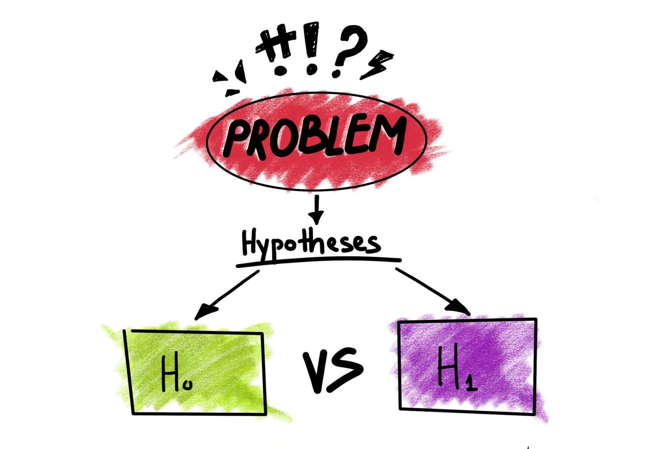
3. Economic CSR: Positive vs. Negative Hypotheses

Slide 17
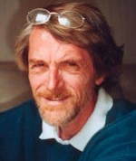

“Positive Hypothesis”
3. The spotlight and the microphone
The spotlight: The patchwork of devices and actors that make visible and assessable what firms do.
The microphone: A microphone forcibly pushed before the mouth of the spokespersons of firms whenever there is something to say relevant to the image of the firms.
Via the spotlight and microphone firms explicit CSR declarations become the effective control mechanism of businesses.

Slide 18

“Civilizing power of hypocrisy”
3. Positive CSR hypothesis

Slide 19

3. Positive Hypothesis: Power of transparency

Slide 20

3. “Corruptive power of hypocrisy”
Negative CSR hypothesis

Slide 21
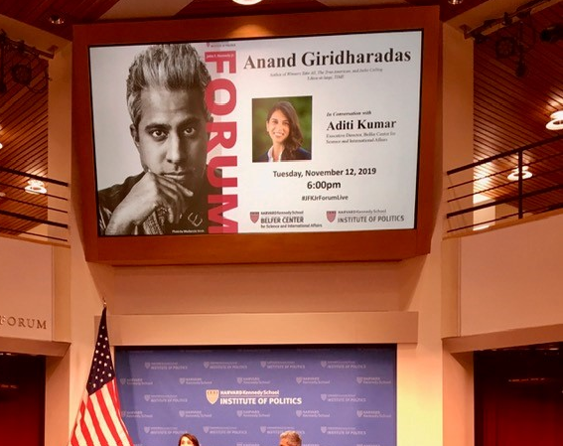
3. Negative Hypothesis
Hypocritical CSR as Detergent in Money Laundering

Slide 22
4. First Challenge of Economic CSR
Organizational hypocrisy

Slide 23

4. Ethical Role of Banks
Key institutional building block for adherence to regulations, codes of conduct, and business ethics.
Nordic banks: High-Level Ethical Image
Nordic banks would comply with rules and regulations and perform financial intermediation, oversight, payment, and settlement and in this way contribute to societal prosperity, sustainability, and welfare in society as it is supposed to

Slide 24

4. Surprise
According to international media Nordic Banks laundered more than USD 225 Billion from Eastern Europe to the West through their Estonian branch offices.

Slide 25
4. The Case
https://vimeo.com/434629476

Slide 26
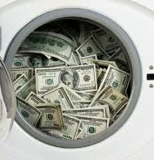
4.Money Laundering
Money “laundering is falsely claiming a legitimate source for an illegally acquired advantage” (van Duyne, 2003).
The money to be laundered is originating from the illegal and illegitimate or dirty activities and need to be represented to be in conformity with the ethical and legal norms and expectations of the society.

Slide 27

4. Logics of Money Laundering?
Economic CSR logics taken to the extreme?

Slide 28
4. Theoretical Perspective
Organizational hypocrisy by Nils Brunsson

Slide 29
4. Sample & Data
    Data
      Sample: 3 Nordic Banks in Estonia
  Period: 2005–2019
    From Thomson Reuters Eikon/ASSET4
  Ethical behavious → adherence to business ethics
    Environmental, Social and Governance (ESG) performance
    Corporate Social Responsibility (CSR) disclosures
  Unethical behavious → arising from business issue
    ESG controversies: money laundering, bribery, corruption, and tax fraud.
  Outgoing and incoming cross-border transactions → Combined with official data from Bank of Estonia
Notes:
Building of foreign presence and complexity variables
we assume that the speed of change of the presence abroad should not be faster over few years.
Sticky speed

Slide 30
Results 1
Puzzelling Ethical behavious (ESG/CSR strategy) versus Unethical behaviors (Controversies)
  The three Nordic banks have excellent ESG/CSR audit scores
  But inversely, ESG controversies have increased substantially over the last fourteen years.
Mismatch between ESG strategy and real practices: hypocritical ‘evidence’ CSR scores enhance illegitimate business
Risks of the economic CSR: fragile boundaries between approaches to ESG and logics of money laundering.

Slide 31
Results 2
Total cross-border transactions –residents & non-residents– in Estonian banking over the 2007–19 exceed:
  664 billion euros for Incoming Payments
  695 billion euros for Outgoing Payments
Cross-border transactions raise awareness of ethical dimensions of money laundering.
Nordic Banks having well-organized schemes.
→ Hypocritical organizational
ESG vs. Controversies: Nordic Banks
Hypocritical organizational, ESG practices and unethical behaviors ➔ explain the phenomenon of money laundering, before the large-scale eruption of scandal in 2018.
Banks deliberately campaign to raise their audit scores ➔ to cover up ethical controversies arising from their huge money laundering operations.
Country reputations of banks’ home countries, and audit scores ➔ function to window-dress illegitimates operations to legitimates activities.

Slide 32

Organizational structure for operations
Nordic Banks are running branch-based operations rather than subsidiaries making branches dependent to the parents’ banks in the country of origin.
Helps to use their trustable corporate identity and reputation.
Helps to avoid the host country bank activity restrictions and supervisory power.

Slide 33

4. Support for the negative hypothesis
Corruption of the legitimate and extension of the illegitimate business system

Slide 34
Organized Hypocrisy Interpretation
Could it be that Nordic banks used CSR campaigns to cover up their activities in Estonia?
Could it be that banks took advantage of their home country reputations?
Are we dealing with the case challenging the positive CSR hypothesis?

Slide 35

5. Second Challenge of Economic CSR
http://www.bostonreview.net/forum/can-global-brands-create-just-supply-chains-richard-locke

Slide 36

Global Supply-Chain Ethics
Western firms have moved their business operations to locations where costs of operations are lower.
Outsourcing of business operations to countries where production costs are lower leads easily to insourcing of ethical problems.

Slide 37
Positive Hypothesis: Power of transparency?

Slide 38
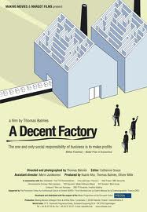

Agenda
Theoretical Part: Martha Nussbaum’s capabilities approach in the context of global supply-chain ethics.
Case: A documentary film “A Decent Factory”

Slide 39

The Basic Question
We examine issues of labor standards and gender equality in the context of global economy
Can we settle on universal standards of decency by which we can evaluate whether business practices and institutions humiliate people under their authority?
We also discuss issues related to the division of moral labor between firms, public sphere and other actors to tackle the challenges of (gender) equality in contemporary economies.

Slide 40

Asian Context
-Expanding markets
-Still relatively cheap labor
-Efficiency
-Financial problems of the western economies

Slide 41
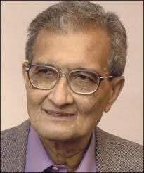

”Missing Women”
”It is often said that women make up a majority of the world's population. They do not. This mistaken belief is based on generalizing from the contemporary situation in Europe and North America, where the ratio of women to men is typically around 1.05 or 1.06, or higher. In South Asia, West Asia, and China, the ratio of women to men can be as low as 0.94, or even lower, and it varies widely elsewhere in Asia, in Africa, and in Latin America.”
Sen, Amartya. 1990. More Than 100 Million Women Are Missing. The New York Review of Books 37 (20).

Slide 42
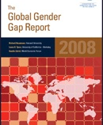

Resources: UN & WEF
There is no country in the world
where women are equal to men in
the four dimensions of economy, health,
education, and politics.
Yet the gaps between the national
gender gaps are wide.

Slide 43

Gaps between Gender Gaps
Iceland 0.89
3. Finland
0.86
46. Estonia
0.73
11. Germany
0.79
107. China 0.68
140. India
0.62
Gender inequality is strongly correlated with poverty. http://povertydata.worldbank.org/poverty/region/EAP

Slide 44
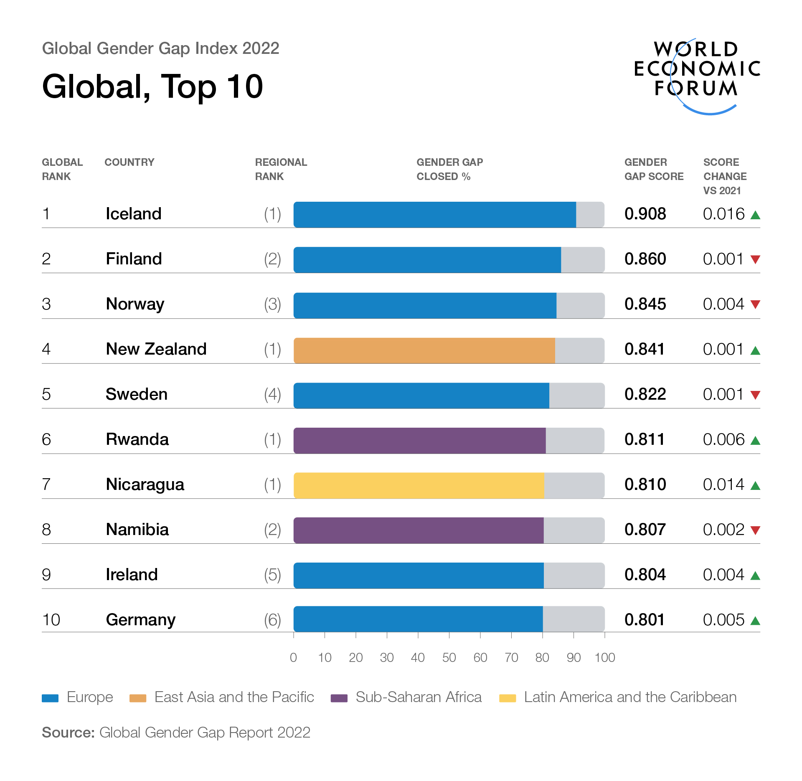

Slide 45

The Boomtowns in China
Since the 1970s, China has witnessed the largest migration in human history; 130 million migrant workers in China today, most of them women.
Via global supply chains we all become connected to the lives of these young women leaving their villages and seeking their fortunes in the factory towns.
Leslie Chang’s Factory Girls (2008); describes lives of these people in Chine’s factory boomtown Dongguan.

Slide 46
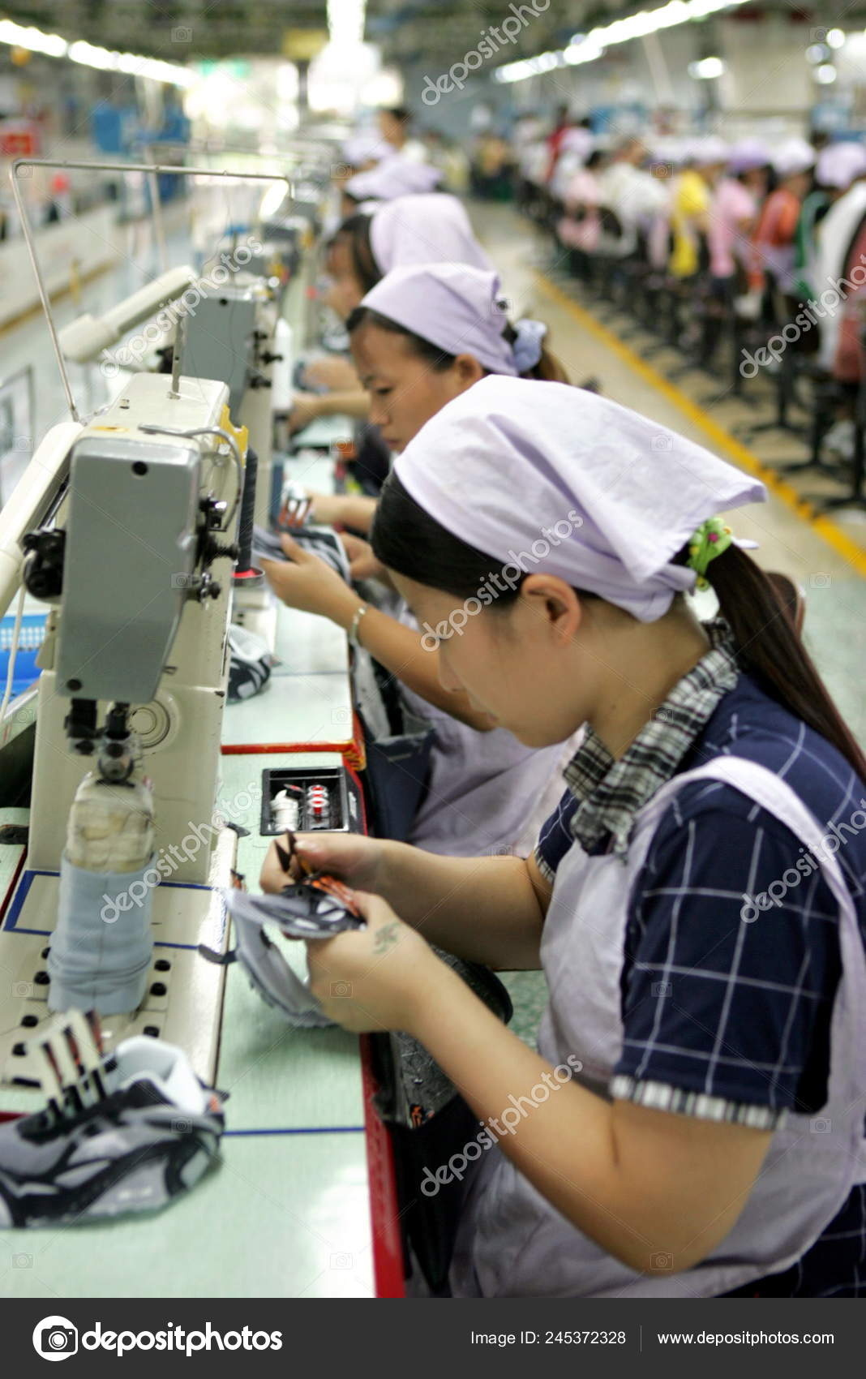
Factory Yue Yuen, Dongguan, China
Has 70 000 workers (80% women between ages 18-25)
Making our branded athletic shoes (Nike, Puma, Adidas etc.).
Workers sleep in factory dorms (10/room), eat in factory cafeterias, shop at factory commissaries.
Runs a kindergarten, hospital with a 150-member staff, movie theater and a performance troupe, volunteer activities and English classes.
Operates own power plant and fire department.
Bottles its own water and used to have own farmers to guarantee its food sources
Bays 70$/month for work done 11hours a day/sixty hours a week with Sundays off.

Slide 47

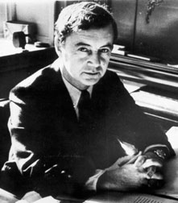
Total institution
”A basic social arrangement in modern society is that the individual tends to sleep, play and work in different places, with different co-participants, under different authorities, and without an over-all rational plan. The central feature of total institutions can be described as a breakdown of the barriers ordinarily separating these three spheres of life” (Erving Goffman 1961, 17)

Slide 48

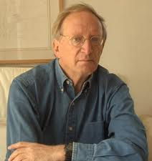
Decency
A just society; sublime ideal but hard to realize globally
A decent society; more realistic alternative?
Avishai Margalit (1996): There is more urgency in bringing about a decent society than in bringing about a just one.

Slide 49
Evaluation: The Threshold Level of Decency
One promising starting point to sketch out international standards of decency is offered by Martha Nussbaum in her work Women and Human Development (2000).
Rather than look for psychological or material indicators of well-being we should draw attention to what each person is able to do and to be.
Threshold level of basic capabilities (a decent social minimum) secured for all as a universal political goal.

Slide 50
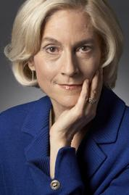
3. List of Basic Capabilities
Life
Bodily Health
Bodily Integrity
Senses, Imagination, and Thought
Emotions
Practical Reason
Affiliation
Other Species
Play
Control over one’s Environment: a)Political b) Material

Slide 51

Central human functional capabilities
1. Life. Being able to live to the end of a human life of normal length; not dying prematurely, or before one’s life is so diminished as to be not worth living.
2. Bodily health. Being able to have good health, including reproductive health; to be adequately nourished; to have adequate shelter.
3. Bodily integrity. Being able to move freely from place to place; to be secure against violent assault, including sexual assault and domestic violence; having opportunities for sexual satisfaction and for choice in matters of reproduction.
4. Senses, imagination and thought. Being able to use the senses, to imagine, think and reason and to do these things in a truly human way, a way informed and cultivated by an adequate education, including, but by no means limited to, literacy and basic mathematical and scientific training. Being able to use imagination and thought in connection with experiencing and producing works and events of one’s own choice, religious, literary, musical, and so forth. Being able to use one’s mind in ways protected by guarantees of freedom of expression with respect to both political and artistic speech, and freedom of religious exercise. Being able to have pleasurable experiences, and to avoid non-necessary pain.
5. Emotions. Being able to have attachments to things and people outside ourselves; to love those who love and care for us, to grieve at their absence; in general, to love, to grieve, to experience longing, gratitude, and justified anger. Not having one’s emotional development blighted by fear and anxiety. (Supporting this capability means supporting forms of human association that can be shown to be crucial in people’s development.)

Slide 52
6. Practical reason. Being able to form a conception of the good and to engage in critical reflection about the planning of one’s life (which entails protection for the liberty of conscience).
7. Affiliation.
Being able to live with and toward others, to recognize and show concern for other human beings, to engage in various forms of social interaction; to be able to imagine the situation of another and to have compassion for that situation; to have the capability for both justice and friendship. (Protecting this capability means protecting institutions that constitute and nourish such forms of affiliation, and also protecting the freedom of assembly and political speech.)
Having the social bases of self-respect and non-humiliation; being able to be treated as a dignified being whose worth is equal to that of others. This entails protections against discrimination on the basis of race, sex, sexual orientation, religion, caste, ethnicity, or national origin.
8. Other species. Being able to live with concern for and in relation to animals, plants and the world of nature.
9. Play. Being able to laugh, to play, to enjoy recreational activities.
10. Control over one’s environment.
Political. Being able to participate effectively in political choices that govern one’s life; having the right of political participation, protections off free speech and association.
Material. Being able to hold property (both land and movable goods); having the right to seek employment on an equal basis with others; having freedom from unwarranted search and seizure. In work, being able to work as a human being, exercising practical reason and entering into meaningful relationships of mutual recognition with other workers.

Slide 53
Conception of Well-Being
Notes:
”We cannot satisfy the need for one of them by giving a larger amount of another one. All are of central importance and all are distinct in quality.” (Nussbaum 2000, 81)

Slide 54

Capabilities better metrics than…
material resources (income, wealth etc.) since different people have different needs and abilities to use resources.
utilities or preference satisfaction since utilities and preferences are adaptive to circumstances.
functioning since different people value different functions and capabilities leave room for individual choice.

Slide 55
A Decent Factory
A historical documentary about globalization; Nokia as the subject.
https://www.youtube.com/watch?v=GmgNWos_wo8
Two European women – Finnish Nokia employee and a British consultant – are auditing a factory of a Nokia supplier in China lead by a European male manager.

Slide 56
Homework
Using the cross-cultural normative evaluative framework of Nussbaum discuss
The position of the women in the factory?
Which aspects of their lives can be problematized?
Are certain aspects more pressing than others? Why?

