Slide 1
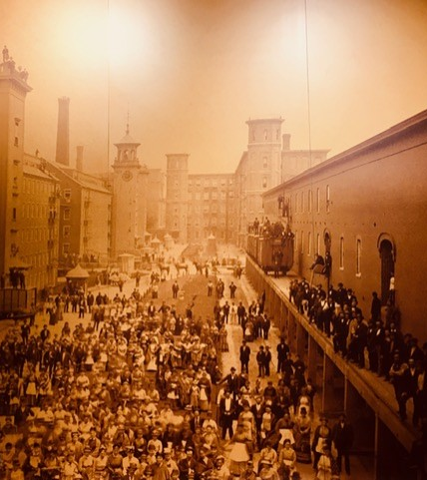
Political CSR and Its Challenges
Aalto BIZ, Online, 13..3.2023
PhD, Professor
Jukka Veikko Mäkinen

Slide 2
Agenda for Today
Recap + Homework
Paradigm Shift in CSR
Classical Liberal vs. Deliberative PCSR
Big Tech Powers as Challenge for PCSRs
Classical Liberal & Deliberative PCSRs Taming Big Tech Powers
High Liberal Integration
Conclusion

Slide 3



1. CSR Paradigms
Economic
Critical
Political
Integrative?

Slide 4
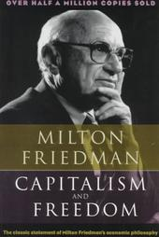
1. Classical Liberal Background
“First the scope of government must be limited. Its major function must be to protect our freedom both from the enemies outside our gates and from our fellow-citizens: to preserve law and order, to enforce private contracts, to foster competitive markets. Beyond this major function, government may enable us at times to accomplish jointly what we would find it more difficult or expensive to accomplish severally. However, any such use of government is fraught with danger. We should not and cannot avoid using government in this way. But there should be a clear and large balance of advantages before we do. By relying primarily on voluntary co-operation and private enterprise, in both economic and other activities, we can insure that the private sector is a check on the powers of the governmental sector and an effective protection of freedom of speech, of religion, and of thought.” (Milton Friedman 1961)

Slide 5
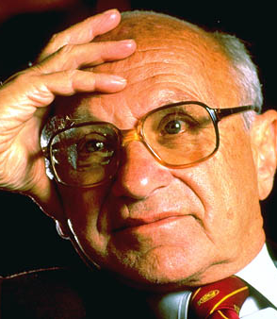
1. Shareholder Primacy
Milton Friedman
Limited public structures and shareholder value maximization in the same package.
“Business of business is business”.
The role of the state is to enforce law and order, define ownership rights…
“Such a government would have clearly limited functions and would refrain from a host of activities that are now undertaken by federal and state governments in the USA and other Western countries” (Friedman 1962)

Slide 6

1. Total Economic Value of Firm
Michael C. Jensen
Political Goal: State of affairs where society uses its resources most efficiently
Government and state power should be separated from the particular interests and private advantages.
The state has limited functions of protection of people and enforcing voluntary contracts and minimizing externalities.
The role of corporations is to extend the narrow focus of shareholder value maximization and concentrate on the maximization of the long-run total value of firms.

Slide 7
1. Business Case of CSR
Mainstream CSR
A firm can do well by doing good
Focus on the ”business case of CSR”
Normally not much political discussion on the roles of businesses in a society
Central aim is to develop a wider conception of CSR than Friedman’s narrow view, without losing his (classical liberal) voluntarism and economic efficiency emphasis.

Slide 8

1. The Strict Version of the Economic CSR
Investments on CSR are strategic means to advance the firm level economic performance without ethical commitments going beyond the motives of profit maximization (Gond et al. 2009).

Slide 9
1. First Challenge of Economic CSR
Organizational hypocrisy and money laundering

Slide 10


1. Second Challenge:
Limits of Private Power

Slide 11
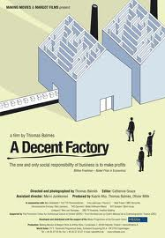
1. A Decent Factory
A documentary about globalization; Nokia as the subject.
https://www.youtube.com/watch?v=GmgNWos_wo8
Two European women – Finnish Nokia employee and a British consultant – are auditing a factory of a Nokia supplier in China lead by a European male manager.

Slide 12
1. Homework
Using the cross-cultural normative evaluative framework of Nussbaum discuss
The position of the women in the factory?
Which aspects of their lives can be problematized?
Are certain aspects more pressing than others? Why?

Slide 13
1. A Decent Factory: A Capability Interpretation
The industrial order described in the film has some main features of the total institution.
In total institutions the human functions and capabilities are under bureaucratic control and are handled in an impersonal manner to advance the ends of the organization.
Total institutions do not normally draw attention to what each person is able to do and to be.
Thus, seen from the perspective of the capabilities approach we will most likely find some problematic features in the industrial order under scrutiny.

Slide 14
1. Position of Women in The Factory
Life: Toxic chemicals, forced abortion (2. child)
Bodily Health: Working positions, noise, temperature, open sewers
Bodily Integrity: Security, control of movement, no privacy, separate boys/girls, no free choice in matters of reproduction
Senses, Imagination, and Thought: Management control thought and speech, boring and tiring work
Emotions: Difficult to establish relations to each other, long distance to home
Practical Reason: Company makes all the major decisions
Affiliation: Strong hierarchical distinction workers/managers, remove humanity from workers (speak of them as machines “low in maintenance”; no employment contracts )
8. Other Species: No apparent concern for nature
9. Play: 12 hour shifts, very tiring work, no recreational activities
10. Control over one’s environment: Forced deduction for food/accommodation; suggestion box (we don’t know how or whether they make use of these); wellbeing committee (headed by manager which might be problematic); No real/substantial choice (low wage, no privacy; farming work does not bring in enough income for survival etc.)

Slide 15

1. The Follow-up Question
Equal work: A Corporate Responsibility?
http://bostonreview.net/forum/can-global-brands-create-just-supply-chains-richard-locke

Slide 16
1.Empirical Evidence
https://news.cornell.edu/stories/2021/05/codes-conduct-supply-chains-challenged

Slide 17
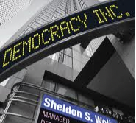

2. Paradigm shift in understanding business?
Politicization of the businesses

Slide 18

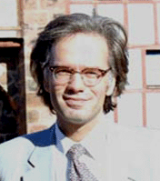
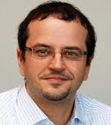
2. Classical Liberal CSR vs.
Deliberative CSR
From Economic to Political Understanding of Businesses Roles in Society

Slide 19

2. Political Paradigm
Globalization blurs the traditional boundaries between the political and economic spheres of society leading to the politicization of the business firms.

Slide 20

2. Political Paradigm
Private firms take over the traditional governmental tasks of social regulation and operate as new providers of citizenship rights and public goods.

Slide 21
2. Political Paradigm adapted from Guido Palazzo
Government
Government
Parliament
Parliament
Political Parties
Political Parties
Civil Society
Public
corporations
Private
corporations

Slide 22
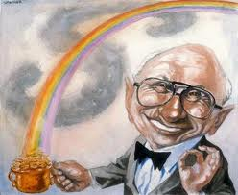
2. Political Paradigm
The traditional picture of firms as apolitical actors focusing on economic roles in society does not hold anymore. Deliberative CSR goes beyond the mainstream classical liberal CSR.

Slide 23
2. From Rational to Reasonable

Slide 24
2. Multi-Stakeholder Forums, Democratization of Firms…

Slide 25
3. Classical Liberal vs. Deliberative PCSR
Theme | Classical Liberal | Deliberative
Business versus politics | Separation. Strict boundaries needed between business and politics. | Amalgamated. No need for boundaries.
Democratic government | Needs democratic government to deliver the legitimate law and protect the individual rights. Instrumental corporate political activity as default assumption (needs to be regulated). | Applies to global settings where there are no separate democratic governments delivering legitimate law and protecting individual rights. Self-regulation by deliberatively democratic firms and civil society actors to produce democratic legitimacy and citizenship rights.
Institutions of market economy | The task of limited government is to provide the basic institutions of market economy, taking care of efficiency and protecting capitalist rights. Limited responsibility to provide common goods when economically rational. | Applies to global settings that do not necessarily have the institutions of market economy. Self-regulation by deliberatively democratic firms and civil society actors to keep economy going and to create the rules and standards for economic activities.
Firms | Economic actors focusing on economic value creation. CSR activities are implemented if they increase ecomic performance. | Political actors that need to go beyond economic value creation and take responsibility of the deliberative democratic governance of global society.
Civil society | Voluntary sphere of society focusing on non-economic values. | Sphere of society regulating businesses in deliberative democratic forums and practices.
Citizens | Free and equal members of society who have compartmentalized identities, representative roles, and divided responsibilities in the public, private, and civil sectors of society. | Democratic actors who have amalgamated identities, overlapping roles, and responsibilities in a global society with no real boundaries between the different spheres of life.

Slide 26
4. Big Tech Powers as Challenge for CSRs
Acting on both sides of boundary

Slide 27

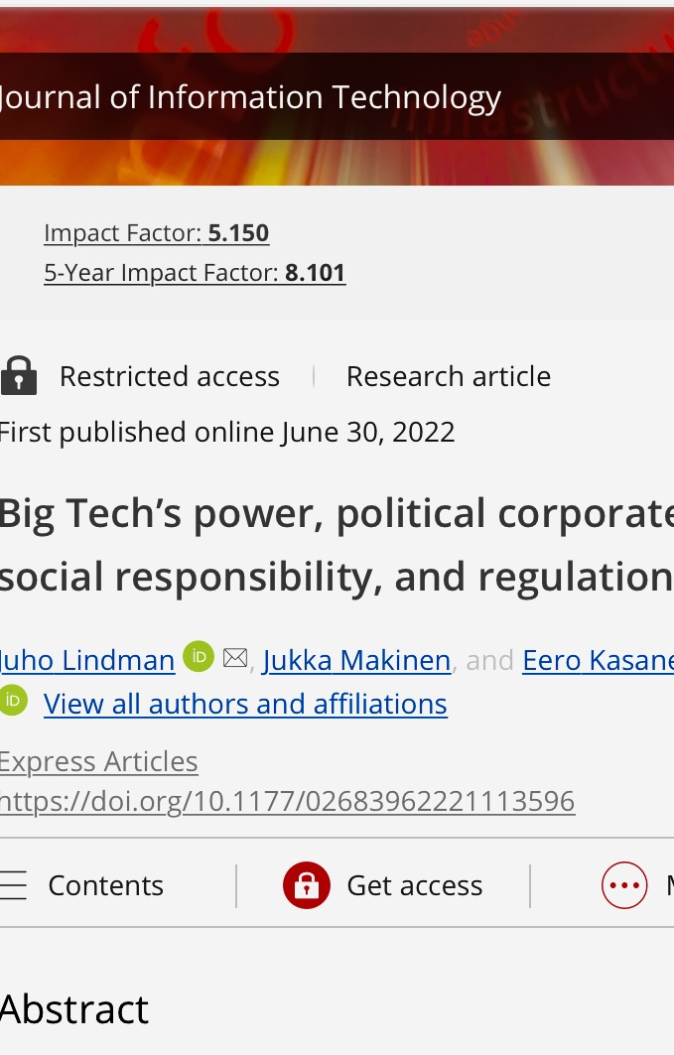
Our Paper
https://doi.org/10.1177/02683962221113596

Slide 28
4. The Issue
“The platforms know what we buy, where we work, where we live, where we go, with whom we communicate, and what we value. They know our friends and family, our income and our possessions, and many of the most intimate details of our lives.” (Fukuyama et al. 2021)

Slide 29

4. Data Capitalism
“An information environment in which every action leaves behind traces collected by companies for commercial purposes”.
“Data capitalism is a system in which the commoditization of our data enables an asymmetric redistribution of power that is weighted toward the actors who have access and the capability to make sense of information”.
(West, 2019)

Slide 30

4. Surveillance Capitalism
Surveillance capitalism as “a wholly new subspecies of capitalism in which profits derive from the unilateral surveillance and modification of human behavior”.
Surveillance capitalism constitutes “an emergent logic of accumulation” of digital traces, a new regime that emerged from pervasive computer mediation and which “produces its own social relations and with that its conceptions and uses of authority and power”
(Zuboff, 2015; 2019)

Slide 31
4. Surveillance Capitalism

Slide 32
4. Harvard Big Tech and Democracy Seminar
https://youtu.be/HbVYpP4gWAQ

Slide 33
4. Traditional and Novel Challenges
 | Traditional challenges to the boundary between business and politics | Novel challenges to the boundary between business and politics
Business versus politics | Lobbying. | Lack of expertise by the regulator.
Democratic government |  | Huge information asymmetries; control over knowledge production in society.
Institutions of market economy | Private public sector (institutions and procurement). | Power to generate private markets.
Firms | Economic size; monopolies/oligopolies. | Global reach; global customer base.
Civil society | Private control over information and communications infrastructure. | Control over media distribution; election interference.
Citizens | The “American tech dream” of founding a company in a university dormitory. | Surveillance: no privacy; limited freedom of speech.

Slide 34
5. Approaches to Govern Big Tech
 | Classical Liberal | Deliberative Democratic | High Liberal
Regulatory prescription | Focus on the economic efficiency issues such as pro-competition regulation, merger and antitrust enforcement, public utility regulation, and other antitrust measures as well as on defining property rights over data, fair competition, and pricing of externalities such as surveillance. | Focus on democratic communication and participation and on the improvement of external and internal governance mechanisms of firms and on creation of participatory platforms (multi-stakeholder forums and initiatives) to create new legitimate rules for the digital economy. | Combine the regulatory and participatory measures of classical liberal and deliberative democratic approaches by making the boundary between business and politics institutionally more robust and by redistributing the political, social and economic resources of the public, civil, and private sectors of society.

Slide 35
5. Classical Liberal Taming Big Tech Powers

Slide 36
5. Basic Hypothesis: Classical Liberal in Crisis
Big tech powers challenges the classical CSR.
Economically run tech giants are operating on the very boundary between business and politics
Their business models involve the central values and logics of the private and public sectors of society simultaneously.
These firms seem to operate efficiently in the market sphere while making at the same time the major decisions on liberal democratic political values such as privacy, national security, and freedom of speech.

Slide 37
5. Classical Liberal Institutional Tools
Address Market Failures
Pro-competition regulation
Merger and antitrust enforcement
Public utility regulation
Other antitrust measures
Defining data ownership
Treating surveillance as negative externality

Slide 38
5. Lina M. Khan: Amazon´s Antitrust Paradox
https://digitalcommons.law.yale.edu/cgi/viewcontent.cgi?article=5785&context=ylj

Slide 39
5. Externality Tax on Surveillance

Slide 40
5. Defining Property Rights on Personal Data

Slide 41
5. Limits of Classical Liberal CSR
Classical liberal CSR does not aim to neutralize the economic inequalities arising from the economic sphere of society.
Thus, the economic power of the big tech has relatively free space to expand and it is easily transformed via (well-resourced, expertise, and a high image) tech lobby into the political power.

Slide 42
5. Limits of Classical Liberal CSR
The use of money in politics is against the classical liberal idea of the democracy and it also undermines the efficiency of markets over time.
Thus, the task of classical liberal government is to block the use of this power institutionally.
However, its minimalist and anti-interventionist nature limit its capacities to carry out this responsibility.

Slide 43
5. Deliberative PCSR Taming Big Tech Powers

Slide 44
5. Basic Hypothesis: Flourishing Deliberative PCSR

Slide 45
5. Flourishing Deliberative PCSR
Big tech firms and their “sovereign-like” positions in economy and society are the paradigmatic case of the politicization of businesses
In USA big tech lack strong government oversight, it is free from any significant federal regulation
Deliberative PCSR deems as responsible the voluntary, self-regulatory, and participatory governance models based on firms´ deliberations with their stakeholders in the laissez-faire regulatory environments
Thus, big tech firms as exemplary cases of deliberative PCSR

Slide 46
5. Ways and Means of Deliberative PCSR
Voluntary, self-regulatory, and participatory governance models based on firms´ deliberations with their stakeholders in the laissez-faire regulatory environments
Industry level multi-stakeholder initiatives and forums.
Internal democratization of firms

Slide 47
5. Flip Side
The United States is virtually the only developed nation without a comprehensive consumer data protection law and an independent agency to enforce it leaving “Americans at the mercy of digital services that have every reason to exploit our personal information and little incentive to safeguard it” (New York Times 2019, November 2 )

Slide 48
5. Flip Side
America is no longer the home of free markets due to the political activities of major US corporations and Big Tech more particularly

Slide 49
5. Democratic Deliberation with Big Tech?
The democratic deliberation among free and equal citizens needs institutional structures producing background justice like equal political freedoms, equality before the law, procedural fairness, and economic justice.
However, the deliberative PCSR focuses exactly to those settings where these structures are lacking due to the governments´ unwillingness or -ability to provide them.

Slide 50
5. Democratic Deliberation with Surveillance Capitalists?
The idea of legitimate regulations arising from the deliberations among the big tech and their stakeholders may seem naïve given the situation where these firms may know better than their stakeholders know themselves and can control and manipulate with the help of modern big data driven behavior guidance techniques the knowledge acquisition and decision making of their stakeholders

Slide 51
6. Towards Integration
Interestingly, classical liberal PCSR offers novel policy tools and ideas to curb some forms of the big tech powers.
On the other hand, the deliberations about the issues of the privacy, security and freedom of speech seems useful if we can figure out proper institutional settings for these debates.
At the same time, both PCSRs face major challenges with the big tech powers.
Could it be that the one way to embed the big tech to the liberal democratic society has to do with the combination of the strengths of the classical liberal and deliberative PCSRs?

Slide 52
6. High Liberal Integration

Slide 53
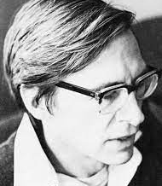
7. High Liberalism
Concerned with individual liberty, social justice, equality, poverty as well as economic efficiency.
John Stuart Mill, T.H. Green, John Dewey, John Rawls, Ronald Dworkin, Thomas Nagel (Freeman, 2011; Melkevik, 2017).
The economic contracts need to be regulated and steered more strongly than what classical liberalism is suggesting.
Markets need to have a less extensive role (than in the classical liberal setting) in order to achieve the central liberal democratic values such as equal opportunities, economic equality and wide and equal provision of public goods (Freeman, 2011).

Slide 54

7. High Liberalism
Political power as public impartial power for the good of all citizens and not a private economic good that is for sale in the marketplace.
Aim to neutralize the effects of economic inequalities on political processes to promote political impartiality and equality of political influence.
Regulation of political campaign spending, promoting of the public financing of political campaigns, education , promotion of more equal access to public media, certain regulations of media and of freedom of speech (Rawls, 2001, 149).
The scope of public sector larger than in classical liberalism.
The need for the political role of companies is diminished.
Have some tools to solve the challenges posed by the big tech powers.

Slide 55
6. Integrative Idea: More Robust Boundaries
Offers additional support and resources to protect and uphold the basic boundaries between the business and politics.
The major borderlines between business and politics are needed not only for the economic reasons.
Boundaries needed for the individual rights of privacy, freedom of speech, security, social justice, equality, and democracy.
Promoting deliberative democracy.
Deliberative democracy needs the background justice produced with the help of the basic structure institutions.
Focuses on making the institutional boundaries between business and politics more robust

Slide 56
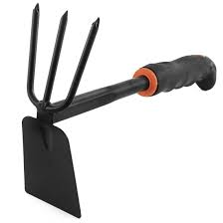
6. Combining Tools
More antitrust scrutiny that goes beyond the narrow classical liberal efficiency perspective (Khan 2017)
Surveillance seen as aggregated negative externality (Martin, 2015) that is taxed away.
To get more robust boundaries between business and politics (Rawls, 2001, 149) focus on:
limiting the economic inequalities.
the regulation of political campaign spending,
the promoting of the public financing of political campaigns.
the education and promotion of more equal access to public media.
smart regulations of media and of freedom of speech.
Personal data defined, regulated and commercialized
The institutional tools supporting the boundaries between the business and politics offer more room for the deliberative democratic governance of the big tech.
High liberal political institutions offer background conditions for the deliberative democratic spaces such as multi-stakeholder dialogues and initiatives.
The division of moral labor between strong and weak publics.
Weak publics as self-regulatory mechanisms involving firms, civil society and government actors participating various deliberative standard setting processes.
Strong publics represents the formal democratic institutions of the society.
Fairly and publicly resourced weak publics can be tasked to draft various elements of the regulatory framework, while the revision, decision making, and the enforcement tasks are on the site of the democratically governed strong publics
The economic resources collected via taxation redirected to close the information gap between the regulators and big tech over the understanding of the technical landscape (Belei et al., 2019)
Big tech lobby budgets taxed and used as resources for citizen data protection associations and NGOs to have meaningful debates with big tech over data governance.

Slide 57
7. Conclusion
High liberal PCSR seems to be able to combine the basic ideas arising from the classical liberal and deliberative PCSRs and create a meaningful division of moral labor that benefits both democracy and market economy

Slide 58

7. Stanford idea
“A combination of regulation and new technology might enable new forms of competition to emerge on top of the existing platforms, an approach we call a ‘middleware’ solution.”
The middleware remedy could allow the companies’ leaders to offload controversial decisions to a far more competitive and diverse ecosystems of firms, thus allowing the platforms instead to focus on their primary missions of serving users and meeting financial objectives.
https://pacscenter.stanford.edu/publication/report-of-the-working-group-on-platform-scale/

Slide 59
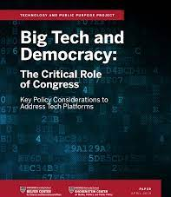
7. Harvard Discussion:
Focus on Political Institutions https://www.belfercenter.org/sites/default/files/2019-04/BigTechDemocracy.pdf

