Slide 1
Scenario design
AXM-E0002, Introduction to research skills
New Media Production
Sound for New Media
Department of Art and Media
By Prof. Lily Díaz-Kommonen
20 March 2023

Slide 2
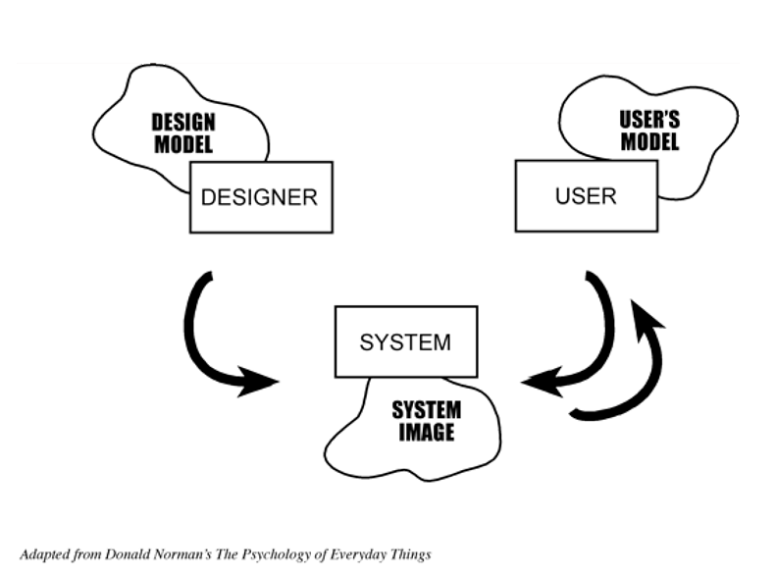
Conceptual models
Notes:
There is also a gap that exists between what is in the designers, mind and what is in the users mind….”The design model is the designer’s conceptual model. The user’s model is the mental model developed through interaction with a system. The system image results from the physical structure that has been built (including documentation, instructions, labels). The designer expects the user’s model to be identical to the design model. But the designer does not talk directly with the user--all communication takes place through the system image. If the system image does not make the design model clear and consistent, then the user will end up with the wrong mental model.” The Psychology of Everyday Things, p. 16.

Slide 3
7 stages of action
Adapted from Donald Norman’s The Pyschology of Everyday Things
Notes:
As mentioned in earlier talks there is a instrumental direction in the way of doing of design. Design activity has been described as goal-oriented/future focused action. In The Science of the Artificial, Herbert Simon defined design as a future-oriented activity that focuses on how things ought to be. Let’s review these stages of action. Note: There is a fundamental tension between thinking and doing: thinking gets in the way of ‘doing’, and ‘doing’ obstructs thinking. Sometimes this conflict is quite sharp, as when one must stop and think before taking another step.

Slide 4
Scenario design
Tries to see the situation, or context of use in many different ways, from multiple perspectives, and considering many purposes.
Seeks to envision the concrete elements of a situation, which in many cases does not even exist yet.
Notes:
Scenarios can be written at multiple levels and from many perspectives: Design moves have many effects!
Scenarios concretely fix an interpretation and solution but are open ended: design problem fluidity.
(Show Microsoft video scenario)

Slide 5
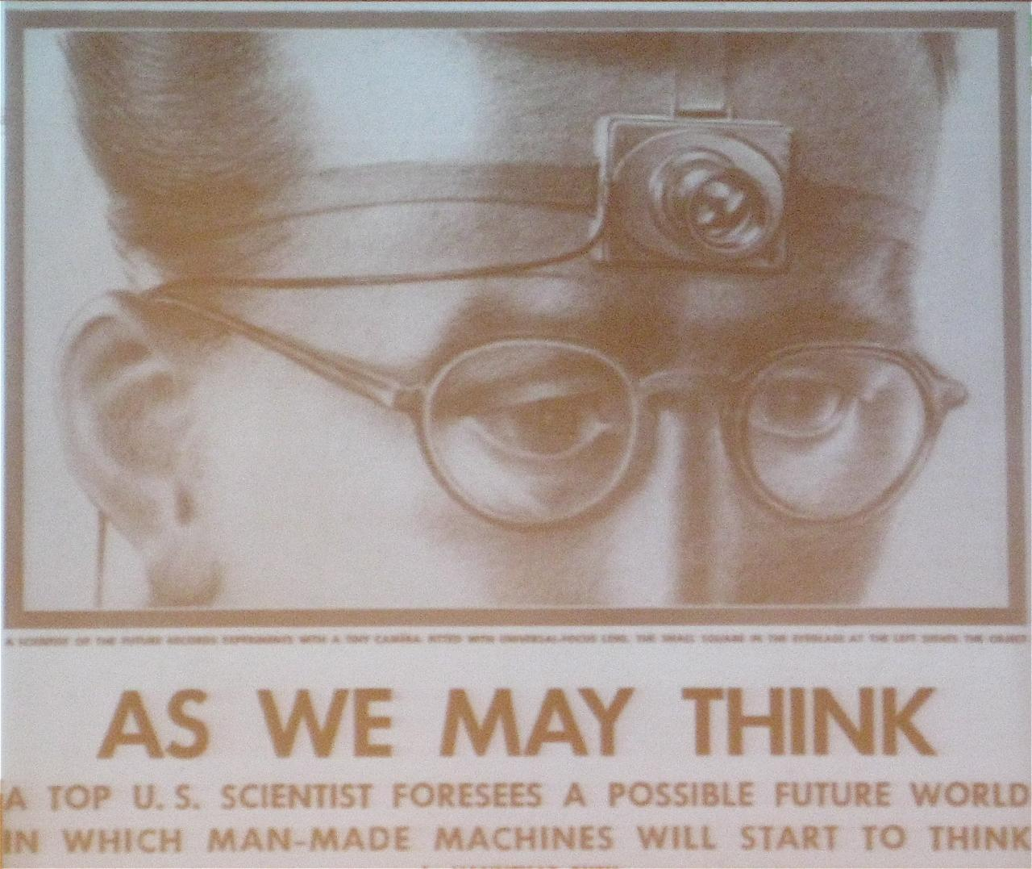
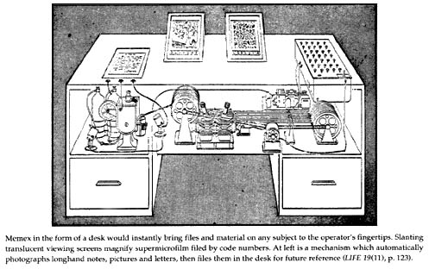
Vannevar Bush’s As We May Think
Notes:
Published in Atlantic Monthly, 1945,
https://www.theatlantic.com/magazine/archive/1945/07/as-we-may-think/303881/

Slide 6
Reaching for the tacit knowledge
Allows a designer to provisionally construct a space of user tasks despite the instability in requirements originating from the context of technology development.
Scenarios concretely embody partial views of a design, thus allowing for feedback.
Notes:
4. Critical practice (e.g is this a sustainable design?)
5. Scientific knowledge lags design application.
(Show CIPHER scenario. Pass around comic book scenario.)

Slide 7
Reaching for the tacit knowledge
Scenarios can anchor the discussion in the development work, and support participation among stakeholders.
Can enable the designer to integrate the discussion of system requirements while also considering motivational and cognitive issues.
Notes:
6. How external factors constraint design – identify communities and research the context properly
7. Action vs. reflection – What we already know, what we need to know…

Slide 8
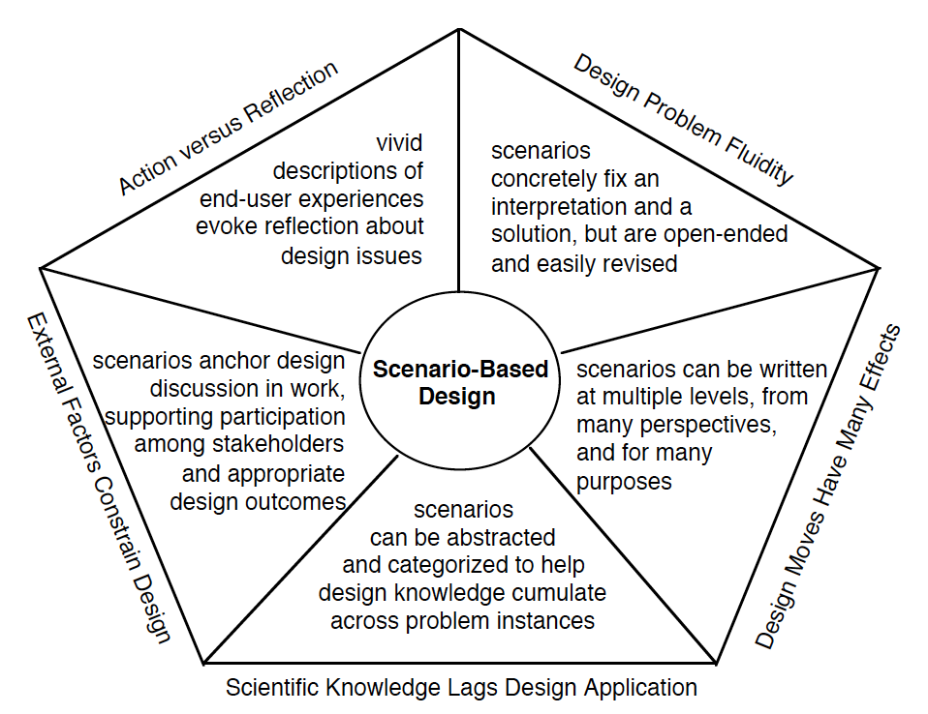
Model by John Carrol
Notes:
Model by John Carroll summarizes previous information.

Slide 9
Scenarios are…
Stories…
About people and their activities…

Slide 10
In scenario-based design, descriptions of how people accomplish tasks are used as a primary working design representation.

Slide 11
Tools for representation
Scenarios can potentially represent the material aspects of a concept, or idea
Details of Form
Functional characteristics
Context of use
Diaz-Kommonen, Art, fact and artifact production, 2002
Notes:
Scenario design can potentially represent the dimensions of: material, or what is the item made of; form how it is made; function, what it is used for and context, in what settings it is used.

Slide 12
What is a scenario?
A method that enables us to communicate (talk) about how the system we are trying to design enables/constrains/transforms user activity.
A technique used to explicitly envision and document typical and significant user activities early and continuingly in the development process

Slide 13
What is a scenario?
A boundary object that enables communication across a diversity of disciplines and communities (Leigh Star, Griesemer R. 2000, Star 2010).
Notes:
Leigh Star, S. and James R. Griesemer Social Studies of Science, Vol. 19, No. 3 (Aug., 1989), pp. 387-420.
Leigh Star, S. 201. This is not a boundary object, Reflections on the original concept, Science, Technology, & Human Values 35(5) 601-617.

Slide 14
Elements of scenarios
Title that clearly identifies the theme and elements in the scenario and indicates how these are to be interpreted.
Setting: or context of activity that includes artifacts/tools.
Agent(s)/actor(s) that engages in activities; has goals (sub-goals) and objectives as well as performs task (operations).
Notes:
Particular actions and events can facilitate, obstruct, or be irrelevant to given goals.

Slide 15
Elements of scenarios
Plot: that includes sequences of actions and events, things that actors do, things that happen to them, changes in the circumstances of the setting.
Structure that influences to how time unfolds
Linear
Circular
Networked.
Notes:
See the work of Jacques Bertin on The Semiology of Graphics for more information about the importance of the title. For a good study on the influence that captions can have on artwork interpretation, see “Constructivism in Germany: Lizzitzky and Moholy-Nagy” in Victor Margolin’s The Struggle for Utopia, University of Chicago Press.

Slide 16
Elements of scenarios
Structure
Episodes: ‘Layers’, ‘stages’, ‘levels, ‘clusters’.
Events: ‘Chunks’ of happenings.
Point of view
1st person, “I” or “Me” depicts an active agent.
3rd person, Spectator that is present or omniscient.
Notes:
See the work of Jacques Bertin on The Semiology of Graphics for more information about the importance of the title. For a good study on the influence that captions can have on artwork interpretation, see “Constructivism in Germany: Lizzitzky and Moholy-Nagy” in Victor Margolin’s The Struggle for Utopia, University of Chicago Press.

Slide 17
Types of knowledge
Knowing what – Declarative
Knowing why – Semantic
Knowing how – Procedural
Notes:
Knowing what: Declarative can be represented in communication media. It can be encoded.
Knowing why refers to knowledge which addresses the notion of the reason or meaning of some phenomenon. Can be culture specific. Work week is 37.5 hours… Why?
Knowing how: or procedural knowledge, is the tacit skills that develop only from experience. Forms of procedural knowledge, such as the ability to perform surgery, dance ballet, or speak a foreign language
Judelmann, Greg, (2004). Knowledge Visualization, Problems and Principles for Mapping the Knowledge Space. (MA Thesis)

Slide 18
3 steps to scenario design
Inspired by Cathy Marshall’s work on personnas
Notes:
Cathy Marshall: http://research.microsoft.com/en-us/people/cathymar/

Slide 19
Step 1
Establish a goal, context, or activity
What is needed to describe the scenario’s settings?
Why is the agent/actor using the system?
What will make this interaction successful?
As you create the scenario, try to focus on storytelling; don’t aim to represent a complete activity analysis; select one or two tasks at most and describe the operations that comprise them.

Slide 20
Step 2
Describe the interaction.
Stay at a high level or avoid too detailed descriptions of the interface
Imagine the new design and how it will help to solve specific problems.
If you have done user research, try to include highlights, in order to make a more compelling story.

Slide 21
Step 3
Illustrate and analyze the end results
What happens as a result of this interaction?
Was it a success or failure?
What factors might have contributed to the end result?

Slide 22
Scenarios
Can be done using…
Textual accounts
Storyboards
Video
Performance
Other ideas?

