Slide 1
About ethnography and autoethnography
AXM– E0002
Research skills for new media students
Department of Art and Media
By Lily Díaz-Kommonen
Professor of New Media

Slide 2
“[an]…experiment can serve an important role by
making visible processes that are ordinarily hidden
behind the role of habitual behavior...”
[the subject engages] “…in a variety of activities
that can be observed, not just rigidly controlled.”
But fieldwork is not like this…
Vygotsky, L. S. 1978, Mind in Society, Harvard University Press.
Notes:
Pages 12- 13, Introduction
“…Young toddlers were provided with pencil and paper and asked to make representations of events, thus disclosing to the investigator the child’s earliest understanding of the nature of graphic symbolism.”

Slide 3
Fieldwork
Has its origins in the birth of human sciences during the 18th and 19th centuries.
Travel literature
Herodotus reported on the Persian Wars
Ibn Battuta, 14th century traveler and chronicler (Africa, Middle East, Asia Minor, India…)

Slide 4
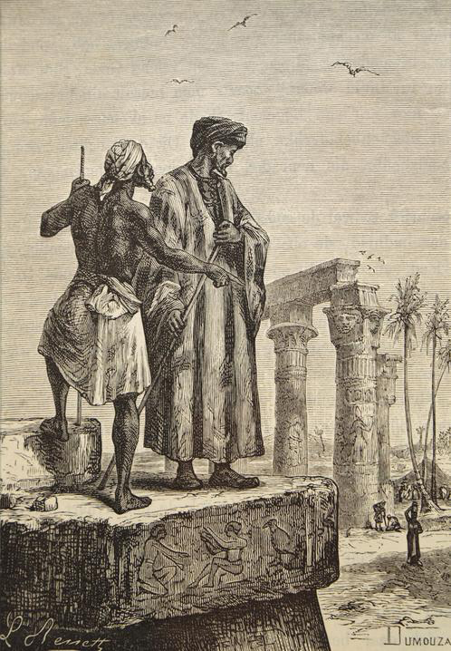
Fieldwork
Ibn Battuta

Slide 5
Fieldwork
Can provide detailed and intimate understanding of social action in relation to their context.
Allows an outsider to gain insider’s perspective
Allows the insider to look at everyday reality in a new way
Can occur in diverse settings not just in international locations
Museums
Archives
Organizations
Cities…

Slide 6
Ethnography
Considered to be part of key methods developed in anthropology.
To be used as part of fieldwork.
Participant observation is a term coined by Bronislav Malinowski to describe the type of involvement required.
It is understood that the anthropologist aims to become a part of the group under study, when collecting data to seek understanding about a social phenomenon.
“
Notes:
A pedantic explanation of “ethnography” as “writing about people” imperils the methodology by oversimplification, as individuals or communities are not omnipresent in ethnographic writings.

Slide 7
Ethnography
Clifford Geertz proposed that anthropology’s aim was to enlarge human discourse and understanding of others’ “normalness without reducing their particularity,”
This can also be regarded as form of translation or interpretation.
He described this ethnographic approach as one concerned with “thick descriptions”
However, all cultural translations, necessarily involve an element of transformation or even disfiguration.
“
Geertz, C. 1973, The Interpretation of Cultures, Basic Books, p. 14

Slide 8
How do we set about decoding people’s customs?
Natural biological activities
Technical actions
Expressive relations
Leach, E. 1976. Culture and Communication: The Logic by which Symbols Are Connected, Cambridge University Press.
Notes:
According to Edmund Leach:
Breathing, heartbeat, metabolic processes
Observe the activities by which humans alter their environment
Communication that occurs via secondary and tertiary artifacts (representations and art)

Slide 9
Ethnography
“Nearly any setting or location can become ‘the field’: a village along the Amazon river, a large corporate office in Tokyo, a small neighborhood café in Seattle, or even a social networking site like Facebook.”
See for example, the work of Lucy Suchman in technology organizations, or Sarah Pink in design anthropology.
“
Human Area Files, https://hraf.yale.edu/teach-ehraf/an-introduction-to-fieldwork-and-ethnography/
Notes:
What is common to all of them? a) the qualitative research used in the fieldwork or b) the descriptive and interpretive results – in writing or in photographs or in other media – from the research.
See, https://en.wikipedia.org/wiki/Lucy_Suchman, Sarah Pink, Digital Ethnography: Principles and Practice

Slide 10
Ethnography
An emic perspective aims to bring an insiders viewpoint.
The etic viewpoint means as seen from an outsider’s objective perspective
Reflexive approach: No researcher can ever be one hundred percent objective.
“
Human Area Files, https://hraf.yale.edu/teach-ehraf/an-introduction-to-fieldwork-and-ethnography/
Notes:
“...a series of phenomena of great importance which cannot possibly be recorded by questioning or computing documents, but have to be observed in their full actuality....such things as the routine of a man's working day, the details of his care of the body, of the manner of taking food and preparing it...” The imponderabilia of actual life, a term used by Malinowski in his book Argonauts of the Western Pacific.
https://www.definition-of.com/imponderabilia, (3/11/2021).

Slide 11
Autoethnography
Instrument for design research
Personal histories in the form of reconstructions of life are the point of origin to launch processes involving data collection, organization and visualization.
Notes:
Your OWN history can be analysed doing autoethnography.

Slide 12
Autoethnography
Is an approach to research and writing that seeks to describe and systematically analyze personal experience in order to understand cultural experience.
Challenges canonical ways of doing research and representing others and treats research as a political, socially-just and socially-conscious act.
A researcher uses tenets of autobiography and ethnography to do and write autoethnography.
Ellis, C. Adams, T.E., Bochner, A.P. 2011. “Autoethnography: An Overview”, Qualitative Social Research, Vol. 12, No. 1

Slide 13
Autoethnography
The process involves a retroactive selection and writing of past experiences.
These experiences are assembled using hindsight.
Autoethnographer can use make use of interviews with others.
Ellis, C. Adams, T.E., Bochner, A.P. 2011. “Autoethnography: An Overview”, Qualitative Social Research, Vol. 12, No. 1.
Notes:
“[Lived experience] …does not have an ontological reality independent of language and interaction… Individuals do not have experiences, rather subjects are constituted through experience.” (Scott in Denzin, page 41.)
Also, “language and speech do not mirror experience; rather they create representations of experience.” (Denzin 37.

Slide 14
Autoethnography
Or consult texts, photographs, journals (e.g. artifacts).
Experience is something that is constituted socially through discourse and performance.
‘Person’ is a cultural creation.
Denzin, N.K. 2014. Interpretive Autoethnography, Qualitative Research Methods, Vol. 17, Los Angeles: Sage Publications Inc.
Notes:
“[Lived experience] …does not have an ontological reality independent of language and interaction… Individuals do not have experiences, rather subjects are constituted through experience.” (Scott in Denzin, page 41.)
Also, “language and speech do not mirror experience; rather they create representations of experience.” (Denzin 37.

Slide 15
Epiphanies
Interactional moments perceived to have significance and impact in a person’s life.
Alter the fundamental structures in a persons life
Occur at the liminal or threshold moment of experience.
Stem from, or are made possible by being part of a culture or possessing a cultural identity
Denzin, N.K. 2014. Interpretive Autoethnography, Qualitative Research Methods, Vol. 17, Los Angeles: Sage Publications Inc.

Slide 16
Epiphanies
Denzin describes four types:
Major event
Cumulative or representative event
Minor or illuminative epiphany
Relived epiphany.
Denzin, N.K. 2014. Interpretive Autoethnography, Qualitative Research Methods, Vol. 17, Los Angeles: Sage Publications Inc.
Notes:
Four types of epiphanies:
Major event: Touches every fabric of a person’s life
Cumulative or representative: Eruptions or reactions to experiences that have been going on for a long time.
Minor illuminative experience: Represents a major problematic moment in a relationship or a person’s life.
Relived epiphany: Repetition of a previous moment.

Slide 17
Epiphanies
Consideration should be taken to investigate how others might experience similar epiphanies.
In doing so we open up new performance spaces:
Dialogues that create multi-voiced texts
Enable recursive critique and examination of the same data from different perspective.
Ellis, C. Adams, T.E., Bochner, A.P. 2011. “Autoethnography: An Overview”, Qualitative Social Research, Vol. 12, No. 1
Notes:
We can bring togther several autoethnographic accounts. In this manner we seek to create a dialogue, or a polyvocal performance or text.

Slide 18
Illustration by Oliver Tacke CC

Slide 19
Autoethnography
Enable recursive critique and examination of the same data from different perspective.
Affords critical collaboration through the research process
Synergy of data collection (storytelling) and analysis (recursive critique) can be intertwined and be mutually supportive.
Ellis, C. Adams, T.E., Bochner, A.P. 2011. “Autoethnography: An Overview”, Qualitative Social Research, Vol. 12, No. 1

Slide 20
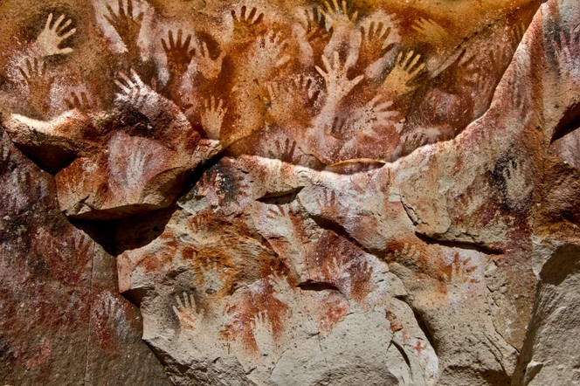
Notes:
I contend that the narratives and information representations created by the participants illustrate, among other things, Contact Zones. James Clifford defined these as the diverse cultural zones traversed by an individual throughout the course of a lifetime. (Clifford, James, (1997). Routes : travel and translation in the late twentieth century. Cambridge, Mass.: Harvard University Press.
Mary Pratt, who initially coined the term sought to describe a site for linguistic and cultural encounters. She wanted to describe notions such as relationality, contiguity and positionality (perspectivism).

Slide 21
Bringing it together
Ethnographic and autoethnographic narratives are great source material for storytelling
Rich ethnographic descriptions (Geertz).
Epiphanies (Denzin).
Notes:
A storyteller can make use of rich descriptions and anchor points of dramatic tension in the form of epiphanies, or “stings of memory” (Denzin). The turning moments that carry evidence in the flesh: memories of sounds, smells, colors...

Slide 22
Some suggestions…
Promote clarity
Untangle complexity
Reveal implicit structure
Gathering of total views, as they unfold in time.
Notes:
Because it is research it needs to be clear. What is the objective for gathering information about the world? What do you hope to get from observing and talking with people about their life? You also remember always to keep the ethical issues on the horizon.
And, gathering the information is not enough. Because we do not perceive material culture as combinations of individual parts and because the behavior we assume is not pre-assigned or rigid but rather emerges as we live our lives. The challenge is being able to gather the Whole.

