Slide 1
A pragmatic approach to research in new media Concept, Audience, Content, Interaction and Interface
By Lily Díaz-Kommonen,
Professor of New Media,
27 February 2023

Slide 2
Research
Basic research
Core of an area of knowledge or its basic foundations
In art and design includes historical research
Art and science collaboration
Applied research
Focused towards creating new artefacts
Practice led approach
Notes:
Key parts

Slide 3
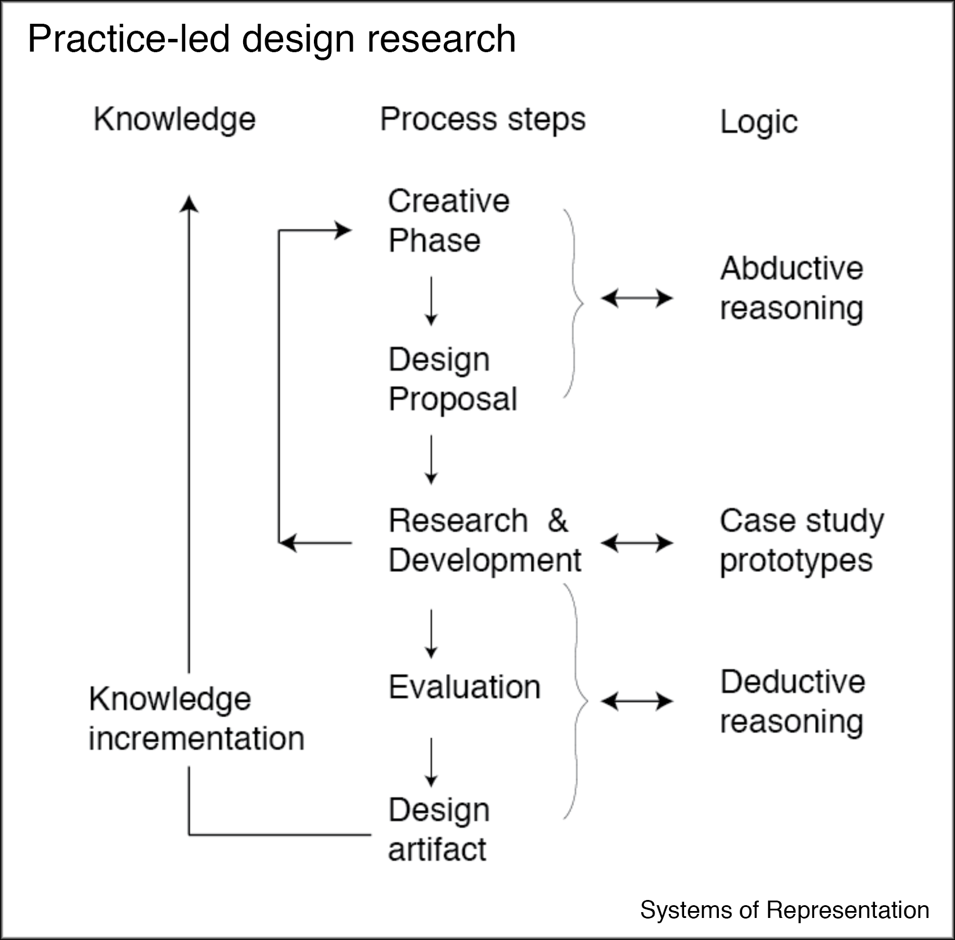
Notes:
A depiction of the practice-led creative research process, showing steps and iterative loops in the process (middle column). The model also depicts (middle column) the diverse modes of reasoning (or logic) involved and how knowledge is incremententaly grows through the design of artefacts. (Artefact or artifact? The first spelling is the UK variant, the second is the US English variant.)
The model uses cases studies and prototype building in combination with deductive thinking (evaluation) during the research and development stages,

Slide 4
What is a concept?

Slide 5
Concept
An abstract idea
Based on something intangible such as an emotion
Ex: Joy
A generalization
Based on the common properties of things.
Ex: The use of notion of ‘tree’ to describe complex data organization.
Notes:
It is primarily through language that humans communicate their conceptual thinking. For example, an abstract idea found in something intangible, such as an emotion is expressed through concepts such as “Joy”. We can then make use of that concept and say that a musical work or an art work, such as a painting is “joyful” (e.g. full of joy).
Concept creation also occurs through generalization wherein a term is used to refer to the properties shared by different artefacts. For example, the notion of “tree”, is used to patterns of information has a long history. See, Lima, M. (2014). The Book of Trees: Visualizing Branches of Knowledge. Princeton, NJ: Princeton Architectural Press.

Slide 6
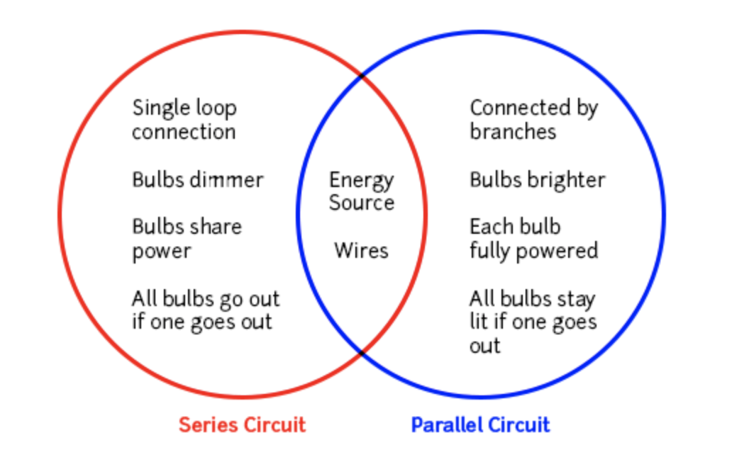
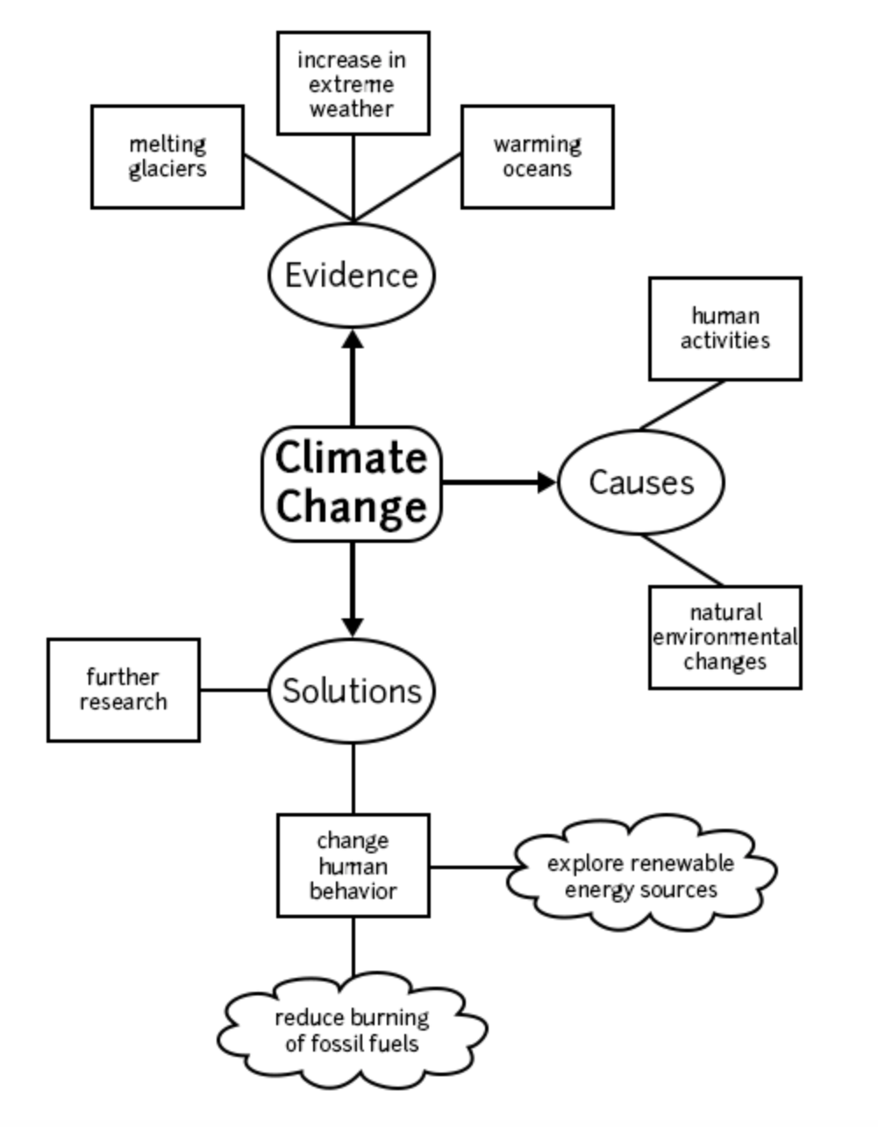
Conceptual maps
2. Concept map
1. Venn diagram
3. Causal sequence
Notes:
The Venn diagram is used to describe distinctions as well as overlapping sets.
The causal sequence is used to indicate a complex process, The Food Chain.
A concept map is used to explain a complex phenomenon, such as Climate Change and depict some of its attributes.
For your preliminary research plan, you could begin by using a concept map to describe the ideas that you have for the work

Slide 7
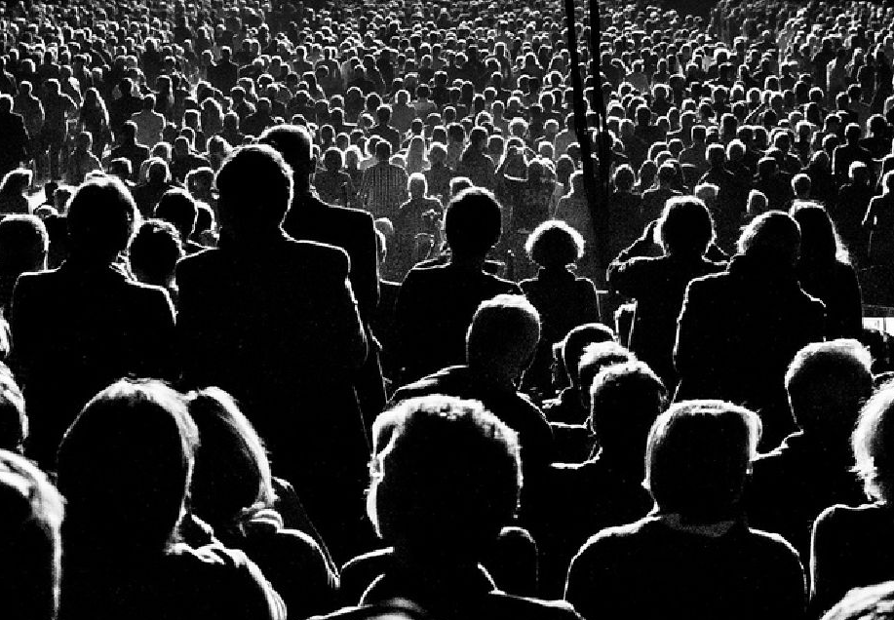
What is AN AUDIENCE?
Notes:
The audience (target audience for example) is an important component in an artists and designers work.

Slide 8
Audience
Demographics
Age
Gender
Ethnicity
Citizenship …
Generational
Baby boomers: 1946 – 1964
Generation X: 1965 – 1979
Millenials: 1980 – 2000 …
Community
Communities of practice: Museum curators, Healthcare professionals
Communities of Interest: Scuba diving clubs, stamp collecting groups
End-user communities: A term used to refer to the intended target audience of an application.
Notes:
There are different ways in which we can organize our thoughts about audiences:
Demographics – This category refers to the study of a population according to factors such as age, race, and sex. Using quantitative methods, data can be gathered and expressed using statistics, for example.
Generational – A generation typically refers to groups of people born over a 15-20 year span. Demographic data can be organised according to generation. Or as the Pew Center indicates, the ‘generational lens’ can be applied to demograhics. (See, https://www.pewresearch.org/fact-tank/2019/01/17/where-millennials-end-and-generation-z-begins/). Narrative-oriented accounts have become part of this interpretational approach to demographics.
Communities – In Co-design work, we usually work with diverse communities.

Slide 9
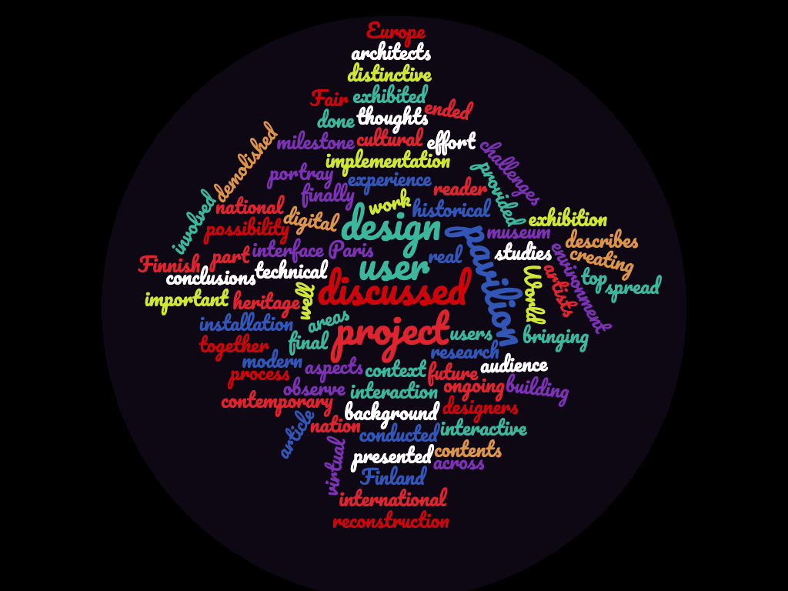
WHAT IS CONTENT?

Slide 10
Content
Aside from textual form, narrative can be (re)presented using many different systems of signs.
Ex sign systems: Alphabet, images, sounds, ect.
For the purposes of new media design, we define content as those elements in a narrative that remain constant regardless of the sign system and forms into which they are encoded.
In the next three slides I show three examples of content in the form of auto-ethnographic accounts and expressed using visual and sonic representations.
Notes:
Jacques Bertin often referred to content as the Invariant. As he said: “The invariant is the complete and invariable notion common to all the data. See: Bertin, Jacques, (1983, 2011). The Semiology of Graphics, Diagrams, Networks, Maps, Redlands, California: Eric Press.

Slide 11
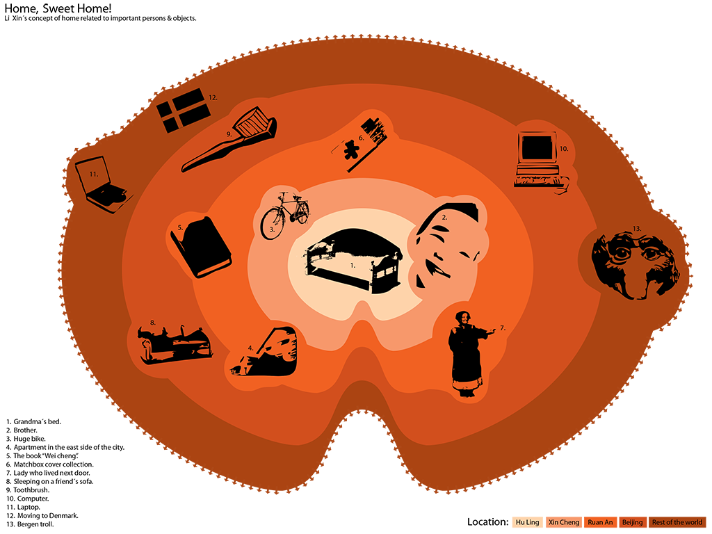
Notes:
An auto-ethnographic narrative is encoded using an information graphic representation that includes icons, colors and textual data.

Slide 12
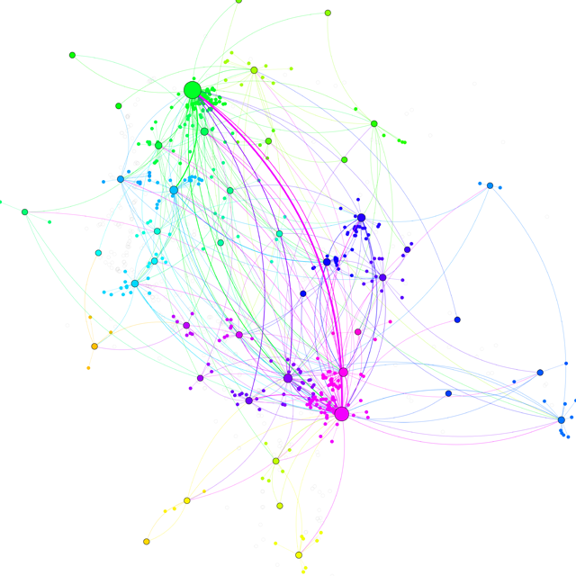
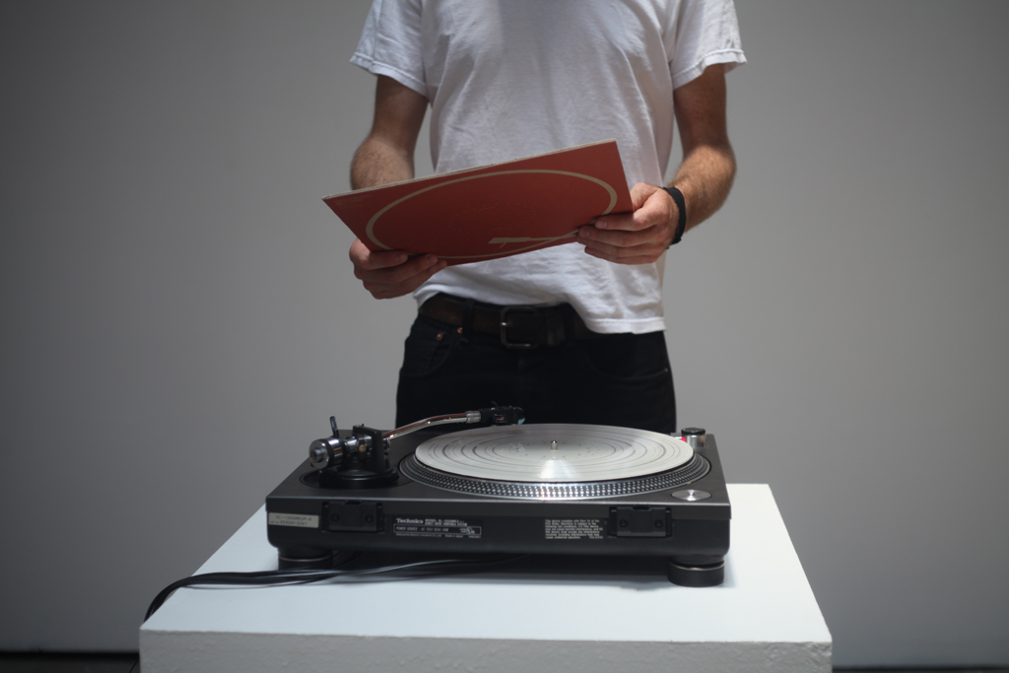
Quotidian Record,
by Brian House, 2014
Melodies depict artist’s daily life trajectories
during one year
https://vimeo.com/65185786
Notes:
Yet another example of an auto-ethnographical account. Quotidian Record is an artwork by North American artist Brian House developed in 2011 and shown at Ars Electronica in 2013. During the year 2011 House utilized surveillance technology to track all his movements. As he recalled during an interview we carried on with him: ”Where are those clusters of location that I keep returning back to? They corresponded to meaningful real world places such as ’Home’, ’Work´…” Once he had collected and visualized the data, he continued with a sonification process in which he used arbitrary rules to encode the data into melodies that were the pressed onto a vinyl record.
See, https://vimeo.com/65185786

Slide 13
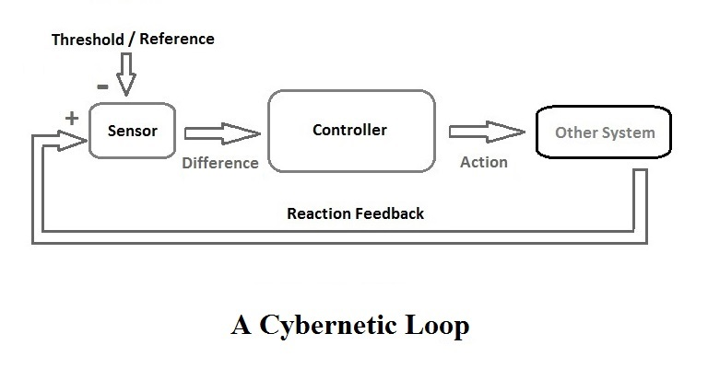
WHAT IS INTERACTIVITY?
Notes:
While interactivity can also refer to the interaction between people and people and people and things, in our area of new (experimental and digital) media, interactivity is about the processes that take place between humans using computer mediated communications systems (CMC). What do you think might be the dfference between these two (e.g. humans and CMCs)?

Slide 14
Interaction (Some navigation examples)
Egocentric – self-motivated, first person perspective related
Ex: “What can I do?” (Norman 2010) Allocentric – relying on cues from the environment.
Allocentric – relying on cues from the environment. (In VR we use this mode extensively.)
Ex: “Wandering”, “Flying” as opposed to “walking”.
What other modes can you think of?
Notes:
The question might be of particular interest to the game designers who work with ‘gamification’ strategies.

Slide 15
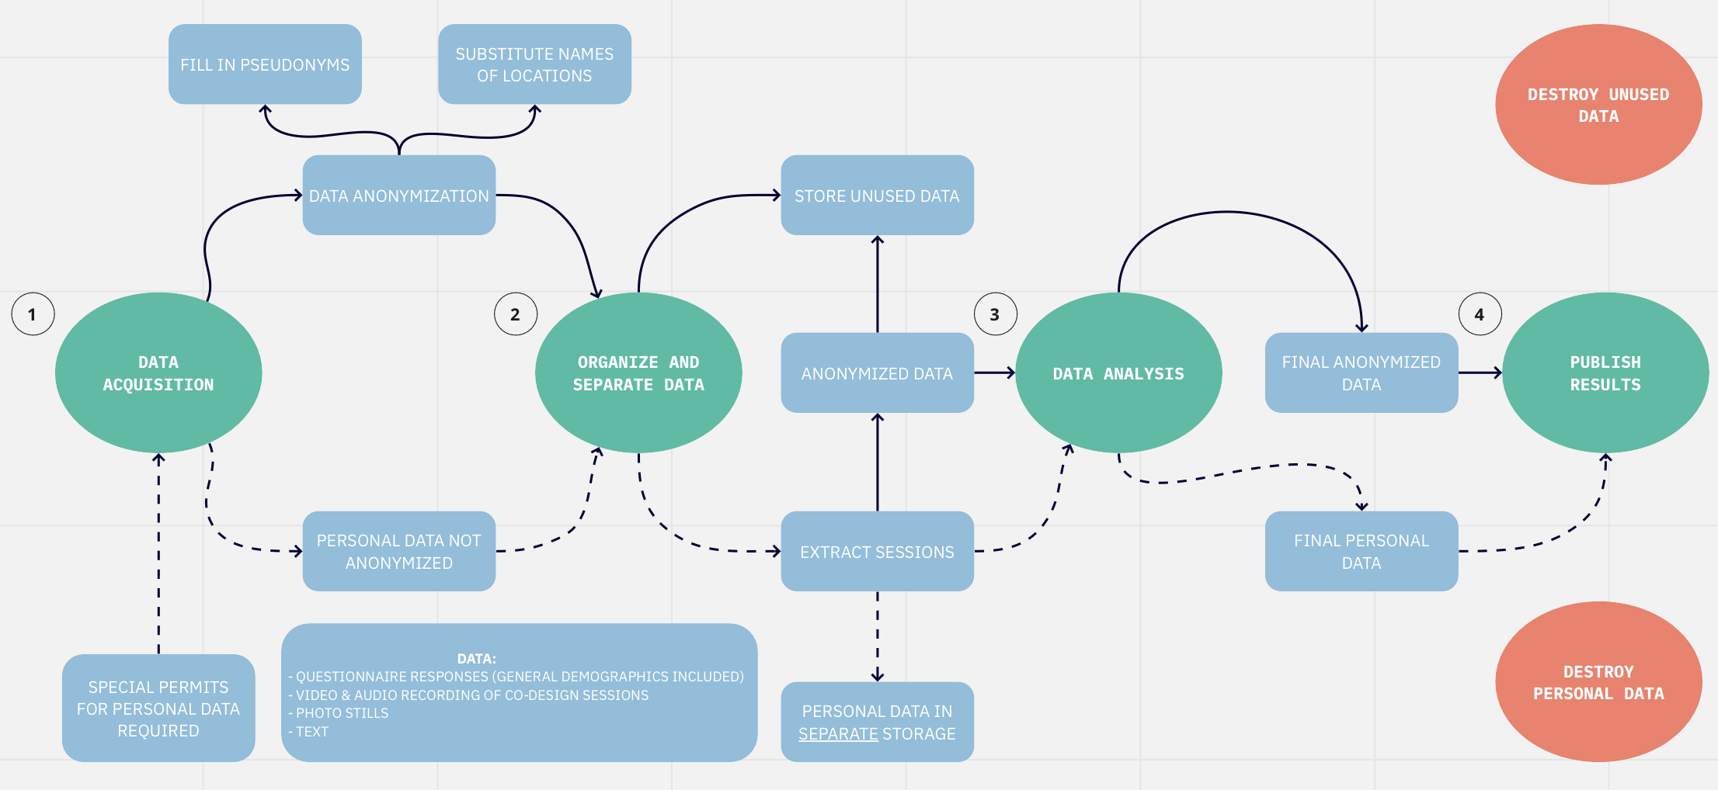
Ethical guidelines and interaction
Notes:
When working in interaction design, you need to be able to break down the tasks of an activity (such as data gathering), into tasks, and even further into operations and actions. SPICE H2020 project Case Study Finland: Data gathering workflow diagram for our co-creation activities following GDPR ethical guidelines.
See SPICE H2020, https://spice-h2020.eu AND https://spice.aalto.fi.

Slide 16
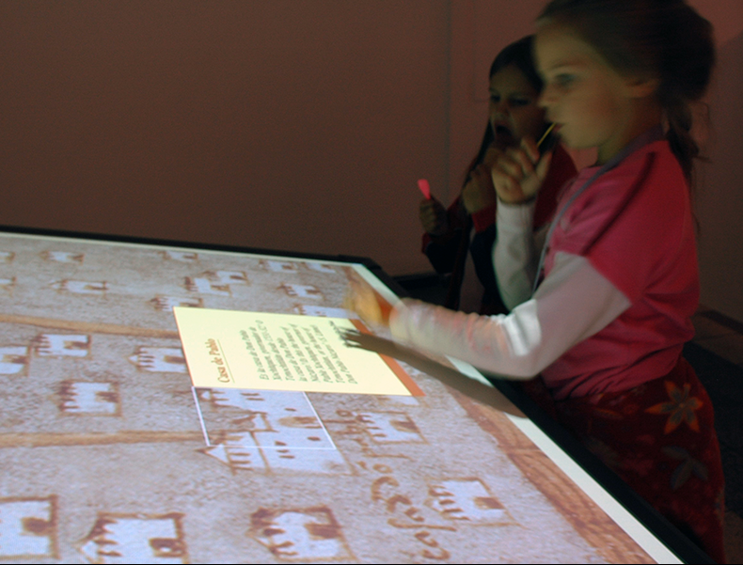
WHAT IS AN INTERFACE?
Notes:
The interface facilitates the interaction of the human with the computer mediated communication system (CMC). In the illustration above the CMS is an application that allows the human to interact with a digital replica of a 16th century map. (See, Map of Mexico 1550 digital facsimile, https://sysrep.aalto.fi/mexico/)

Slide 17
Interface (Some navigation examples)
Interface as touch point between two surfaces…???
Windows, icons, menus, pointer, WIMP interface that are based on screen, desktop and mouse interaction paradigm of traditional GUI interfaces.
Tangible user interface, TUI as an interface design where interaction occurs vis the use of artefacts from the environment.
Gesture-based interface design, in which interaction is driven through a a set of gestures.
Natural interfaces aim to remain invisible as interaction becomes progressively more complex.

Slide 18
Mapping modernism 2009-2010 (Tangible user interface, TUI)
Notes:
“The purpose of TUI development is to empower collaboration, learning, and design by giving physical forms to digital information, thus taking advantage of the human ability to grasp and manipulate physical objects and materials.” Wikipedia

Slide 19
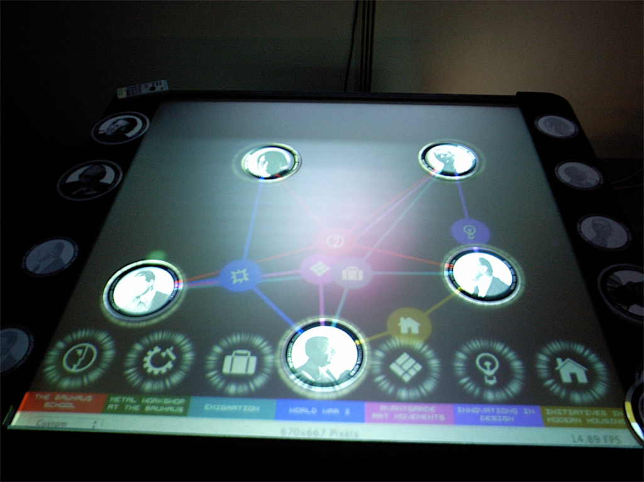
Mapping modernism 2009-2010 (Tangible user interface/TUI)
Notes:
See the video, https://vimeo.com/11616697

Slide 20
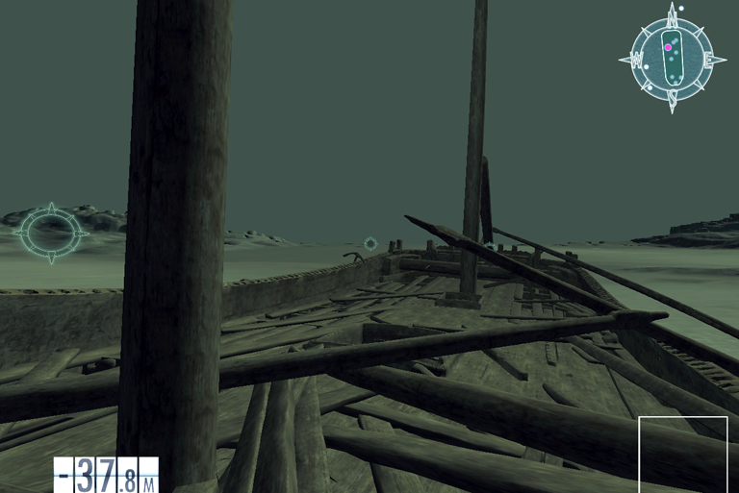
Re-discovering Vrouw Maria (Gesture-based interface)
Notes:
https://www.youtube.com/watch?v=U4Rl0gTsslU
https://www.digitalmeetsculture.net/article/re-discovering-vrouw-maria-virtual-reality-simulation/?upm_export=print
https://www.researchgate.net/publication/261499564_A_novel_gesture-based_interface_for_a_VR_simulation_Re-discovering_Vrouw_Maria
Vrouw Maria Interactive 3D installation tells the story of Vrouw Maria: Dutch vessel that sank in Finnish waters in 1732 bearing a precious cargo of goods for empress Catherine the Great of Russia.

Slide 21
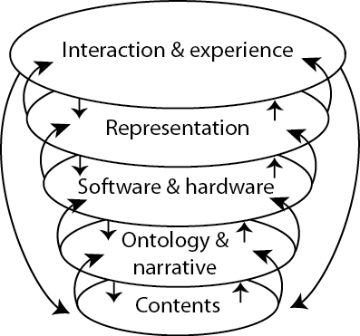
Layers of a digital artefact
Notes:
See, Díaz, L., Sen, F., Maras, S., Reunane, M., Horttana, T., and M. Hovi, (2021). “Rediscovering the Vrouw Maria”, in E. Ehanti, J. Aartomaa and I. Lounatvuori (Eds.), Lost at Sea, Re-discovered, Kotka, Finland: Maritime Museum of Finland, pp. 146–163. ISBN 978-951-616-228-0
Also, https://oula.finna.fi/Record/oy.9912023513906252

Slide 22
Thank you
Kiitos
Gracias

