Slide 1
Contemporary research paradigms and Why do research in art and design?
By Lily Díaz-Kommonen
Professor of New Media,
AXM-E0002
Research skills for new media,
6 February 2023

Slide 2
Art and Design Research (Examples)
Artist’s templates during the middle ages
Leonardo’s notebooks
In the 18th century: Los Caprichos by Goya
In the 19th century, Impressionist movement research into perception.
In the 20th century:
Lazlo Moholy-Nagy – Multimodal translations for a design pedagogy
Berenice Abbott – Scientific Photography
Judy Chicago – The Dinner Party
Fred Wilson – Mining the Museum
In the 21st century:
Laura Kurgan – Architecture and Justice from the Million Dollar Blocks project
Notes:
Lazlo Moholy Nagy work for Bauhaus pedagogy, https://iasdr2019.org/uploads/files/Proceedings/ma-s-1137-Akt-E.pdf
Berenice Abbott’s scientific photographs, https://www.theguardian.com/artanddesign/2015/mar/10/berenice-abbott-science-photography-trailblazer
Judy Chicago’s documentation of women artists for her project on The Dinner Party, https://en.wikipedia.org/wiki/The_Dinner_Party
Fred Wilson’s reinterpretation of the museum’s collection in Mining the Museum, http://www.archivesandcreativepractice.com/fred-Wilson
All links accessed on 27/10/2020.

Slide 3
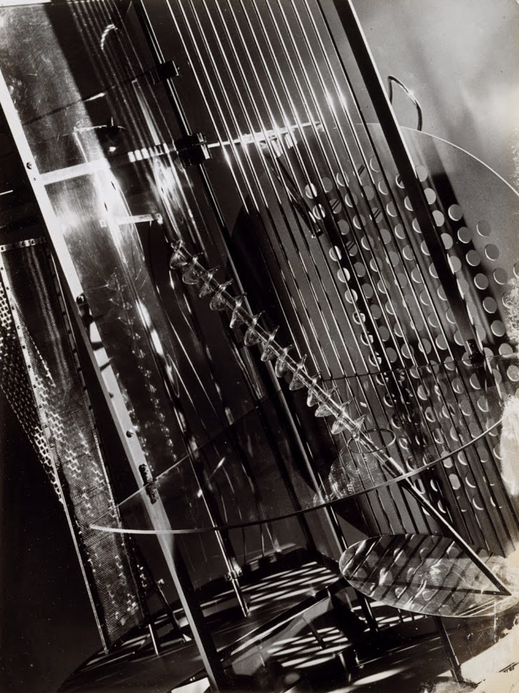
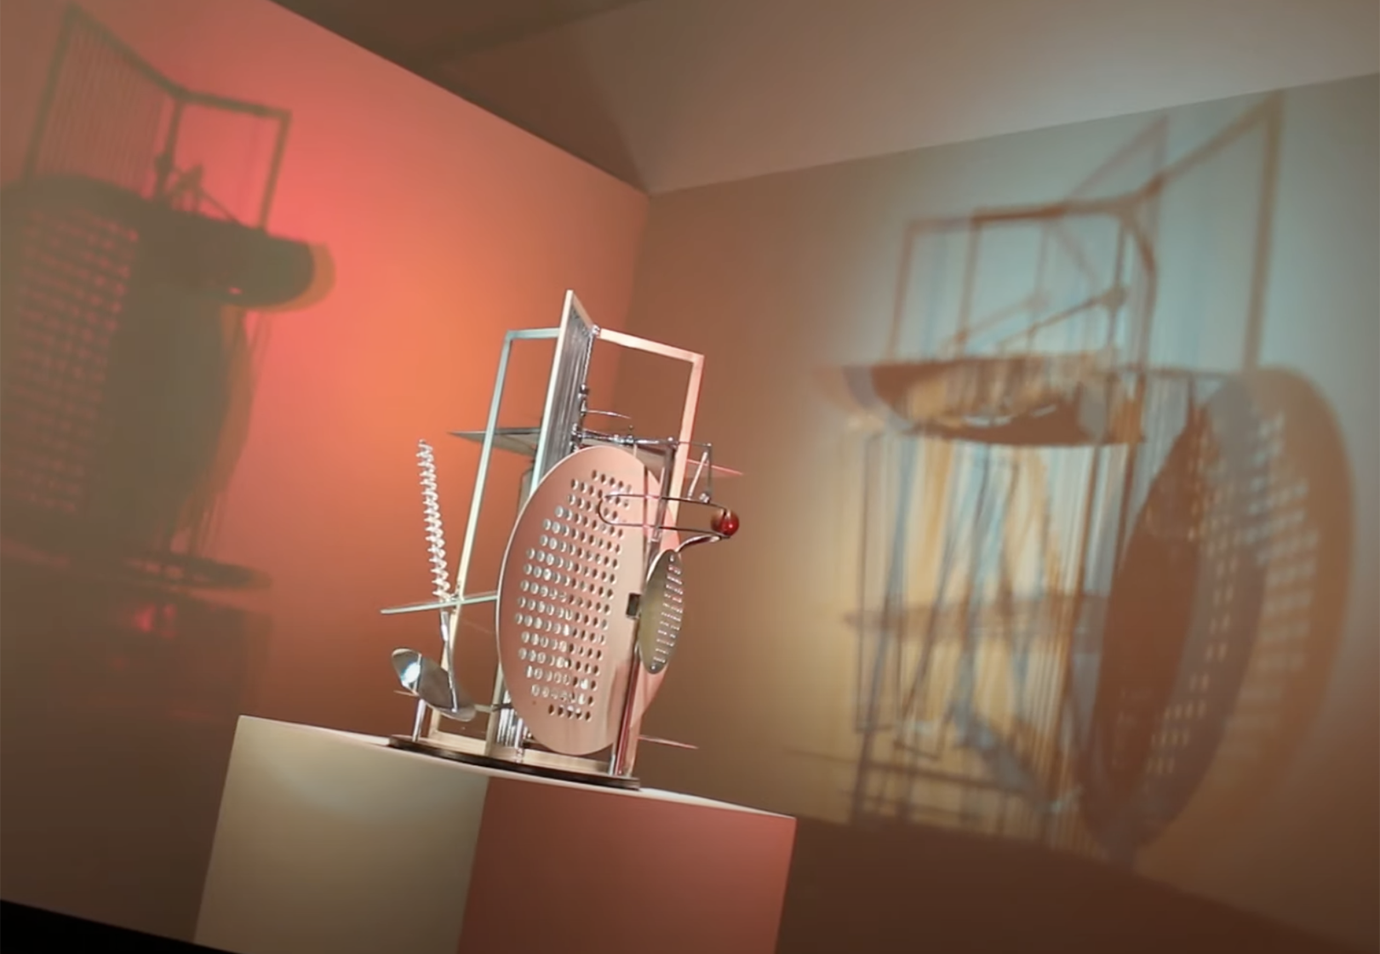
Lazlo Moholy-Nagy (1895 –1946)
Light-space modulator,
Notes:
Lazlo Moholy Nagy (working with modern materials), https://iasdr2019.org/uploads/files/Proceedings/ma-s-1137-Akt-E.pdf
https://www.google.com/search?client=safari&rls=en&q=Light+space+modulator&ie=UTF-8&oe=UTF-8#fpstate=ive&vld=cid:8a03a35d,vid:QHdK19meZTk
Berenice Abbott’s scientific photographs (scientific pursuits), https://www.theguardian.com/artanddesign/2015/mar/10/berenice-abbott-science-photography-trailblazer
Judy Chicago’s (inclusiveness, or lack off, see Guerrila Girls) documentation of women artists for her project on The Dinner Party, https://en.wikipedia.org/wiki/The_Dinner_Party
Fred Wilson’s reinterpretation of the museum’s collection in Mining the Museum, (museums as contact zones) http://www.archivesandcreativepractice.com/fred-Wilson
All links accessed on 05/02/2023.

Slide 4
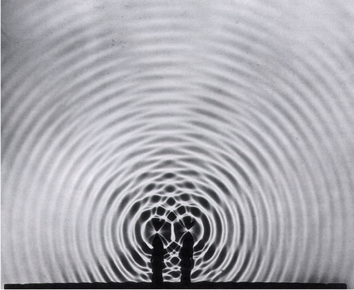
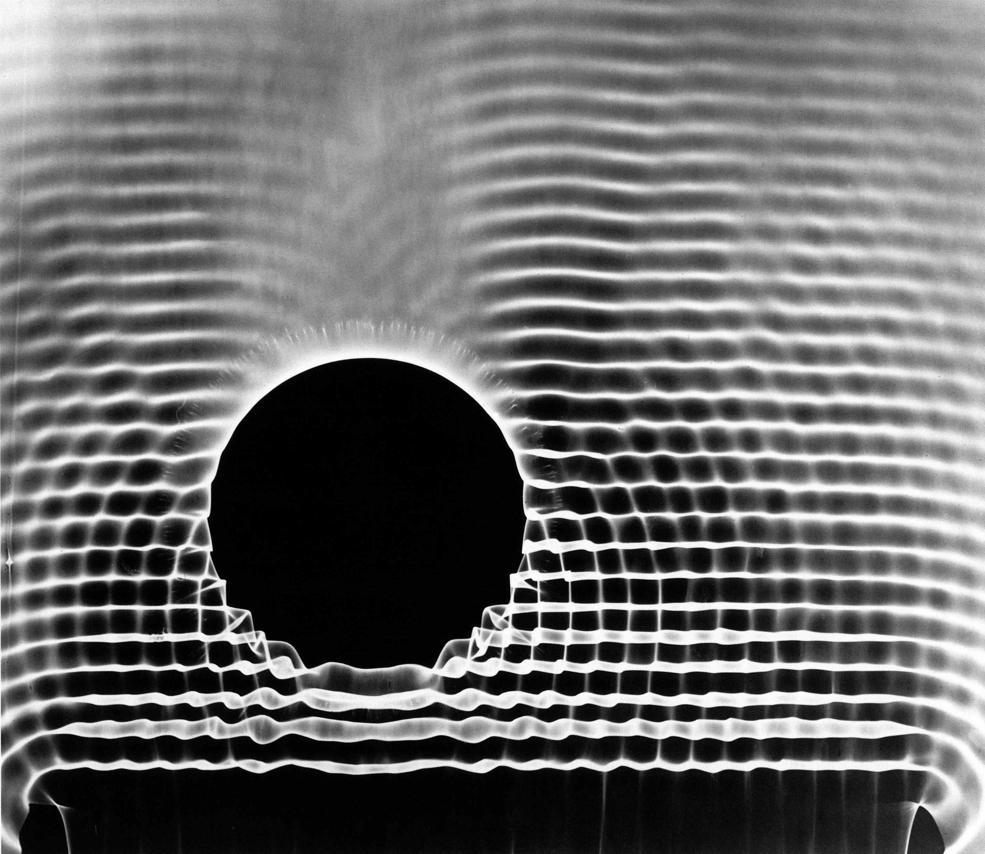
Berenice Abbott (1898 –1991)
Notes:
Berenice Abbott’s scientific photographs (scientific pursuits, camera-less photography), https://www.theguardian.com/artanddesign/2015/mar/10/berenice-abbott-science-photography-trailblazer
All links accessed on 5/02/2023.

Slide 5
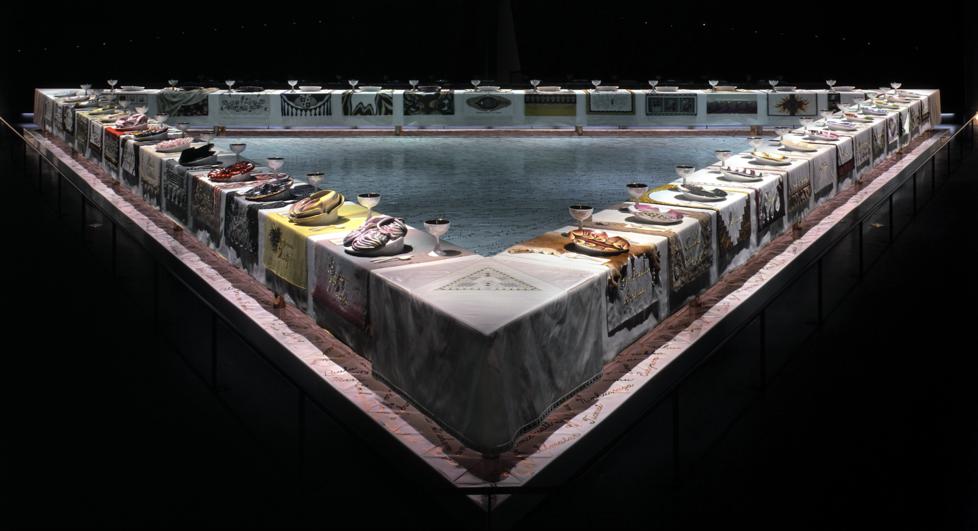
Judy Chicago (1939 - )
Notes:
Judy Chicago’s (inclusiveness, or lack off, see Guerrila Girls) documentation of women artists for her project on The Dinner Party, https://en.wikipedia.org/wiki/The_Dinner_Party
All links accessed on 05/02/2023.

Slide 6
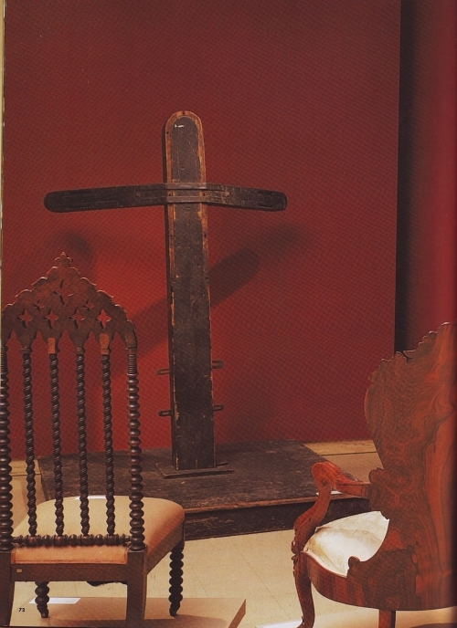
Fred Wilson
Cabinetmaking 1820-1860, Whipping Post and Period Chairs.
Notes:
Fred Wilson’s reinterpretation of the museum’s collection in Mining the Museum, (museums as contact zones) http://www.archivesandcreativepractice.com/fred-Wilson
All links accessed on 05/02/2023.

Slide 7
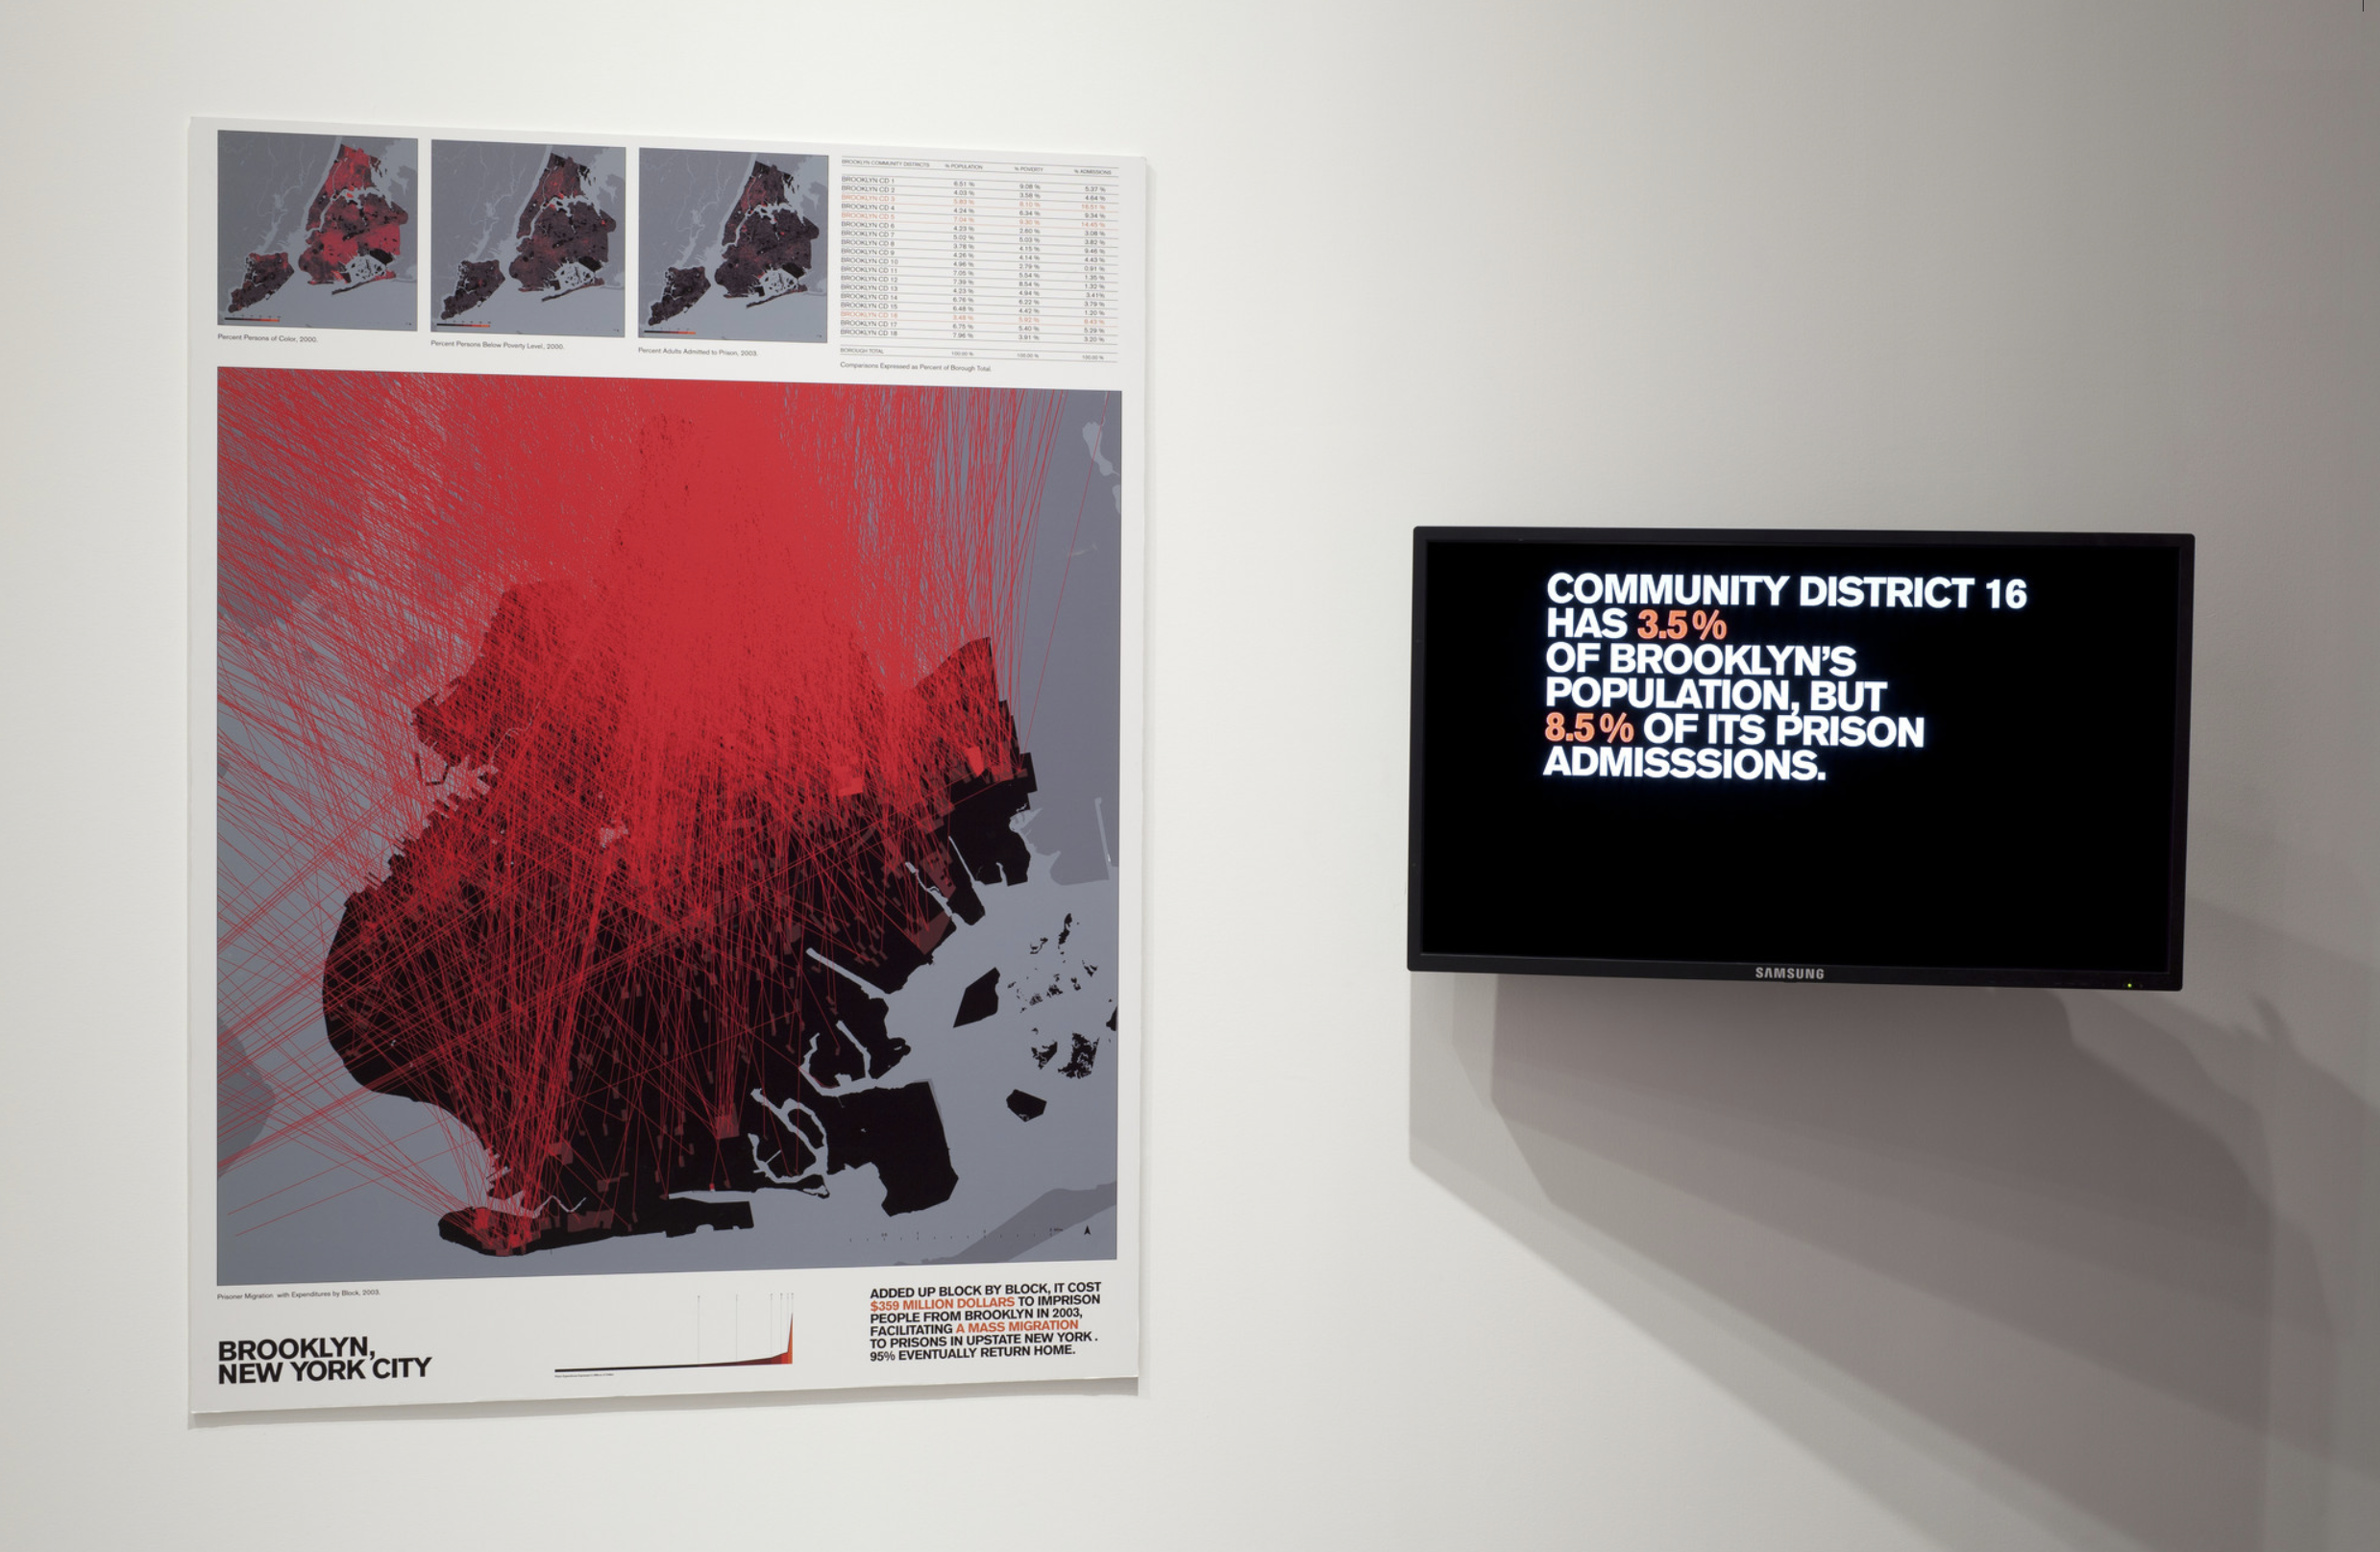
Laura Kurgan (1961 - )
Million Dollar Blocks
ESRI ArcGIS (Geographic Information System) Software, 2013.
Notes:
From the Museum of Modern Art, MOMA Archives, https://www.moma.org/interactives/exhibitions/2013/designandviolence/million-dollar-blocks-by-the-spatial-information-design-lab/
All links accessed on 27/10/2020.

Slide 8
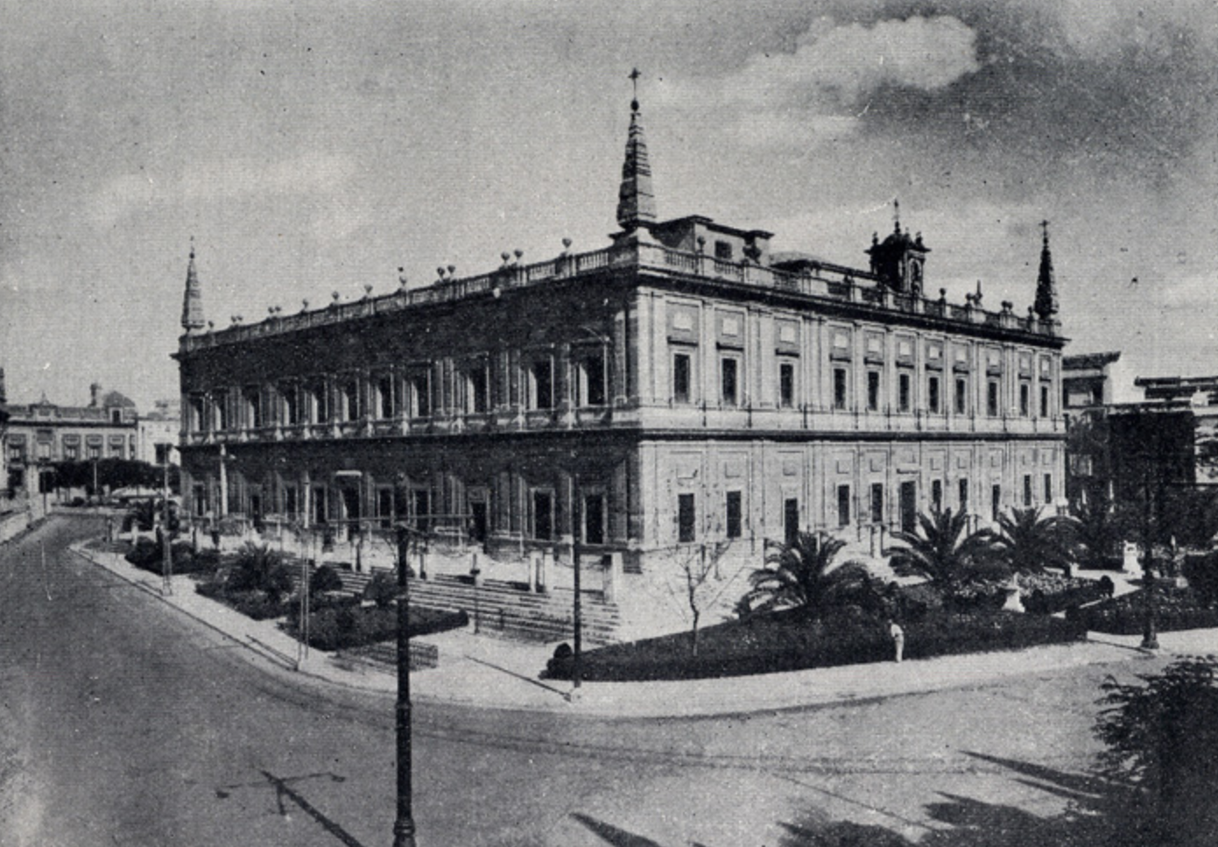
Archive of the Indies in Seville, Spain 1990-1991
Notes:
My own journey as a researcher, artist and designer began in 1990-1991, when I spent one year at the Archive of the Indies with a Fulbright Fellowship. It was here that I learned about the Map of Mexico by Alonso de Santa Cruz that I would encounter and work with years later!

Slide 9
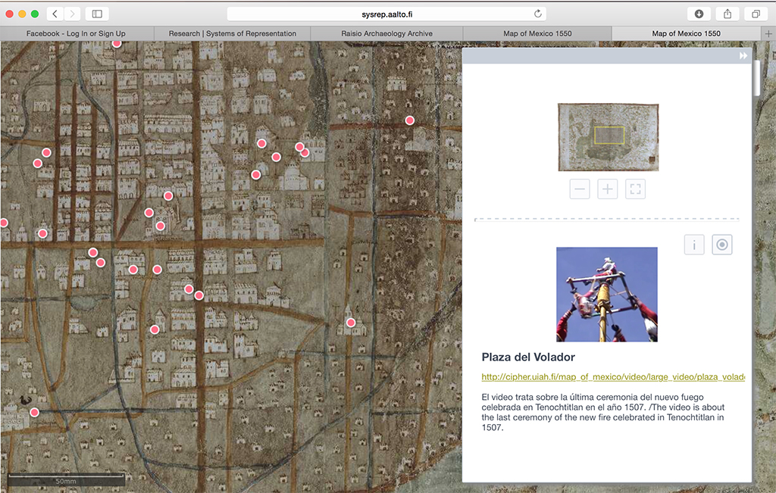
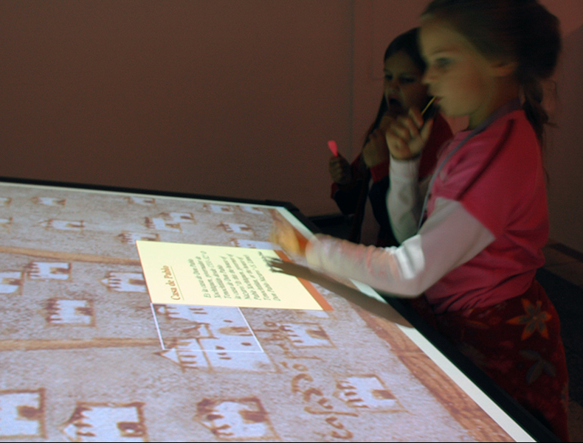
Digital Facsimile of Map of Mexico 1550
Royal Academy of Art UK, 2002
Martin Gropius Bau Berlin, 2003
Design Museum Helsinki, 2006
Universal Forum of Culture Monterrey, 2007
Houston Museum of Natural History, 2015.
Notes:
Digital facsimile of the Map of Mexico 1550, an interactive 3D reconstruction realized in collaboration with Institute of Photogrammetry and Remote Sensing at Helsinki University of Technology, Uppsala University Library Museum, and Universidad Iberoamericana de ciudad de México. Areas of knowledge to which the project contributed include: Computer science, Digital humanities, Media art.

Slide 10
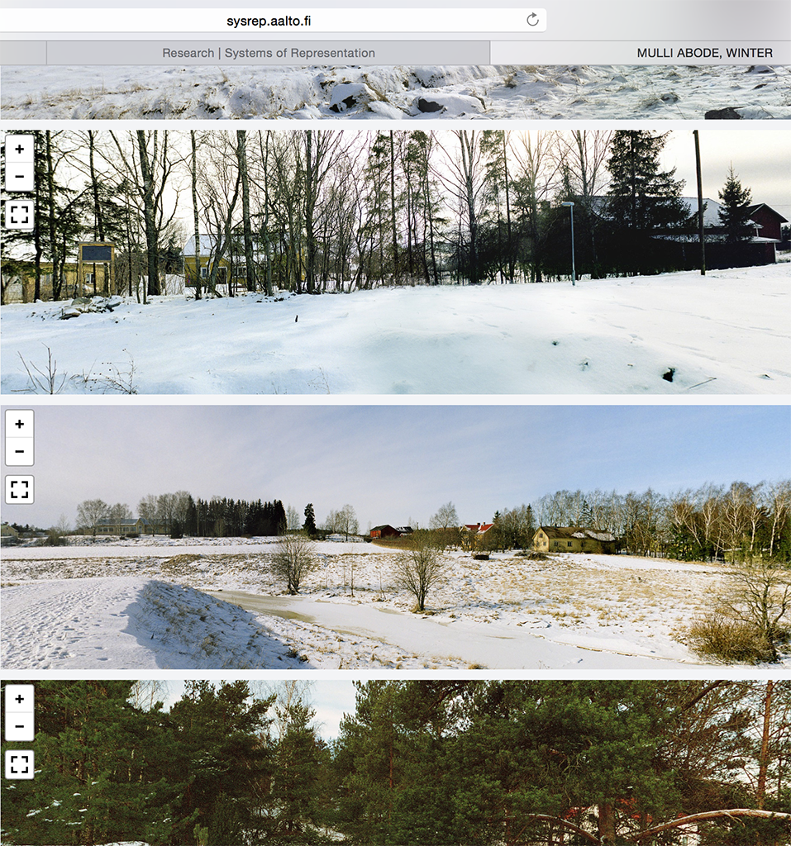
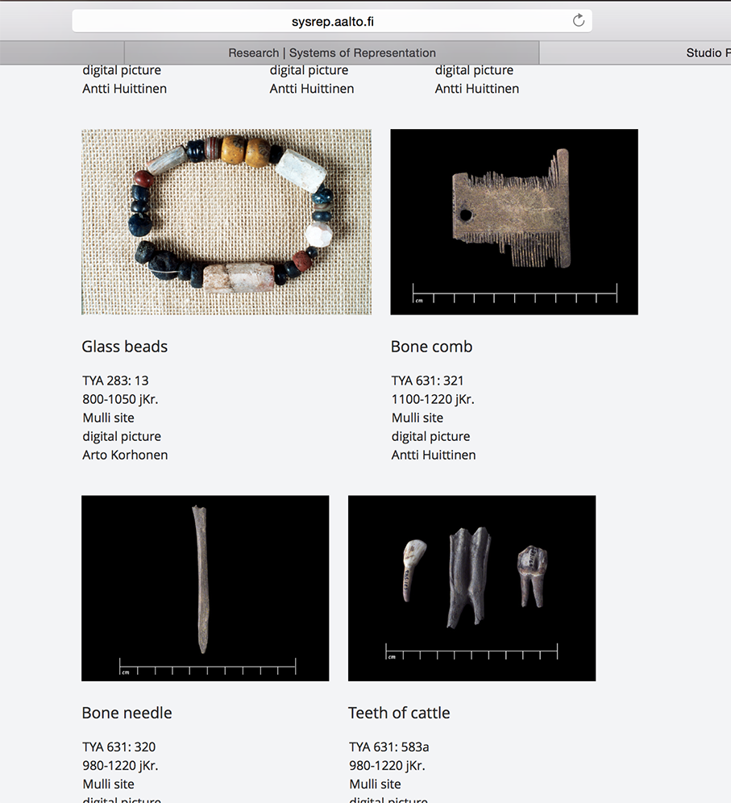
Illuminating History: Through the Eyes of Media, 1996-2002
Notes:
Realized as part of my PhD work, the project was realized through a grant from the Academy of Finland. The Digital Archive created, which can still be consulted on line, displays material culture and narratives from everyday life in south-western Finland during the early 1400s.

Slide 11
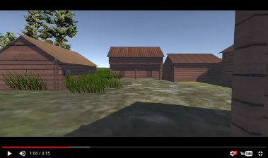
Illuminating History: Through the Eyes of Media, 1996-2002
Notes:
Realized as part of my PhD work, the project was realized through a grant from the Academy of Finland. The Digital Archive created, which can still be consulted on line, displays material culture and narratives from everyday life in south-western Finland during the early 1400s.

Slide 12
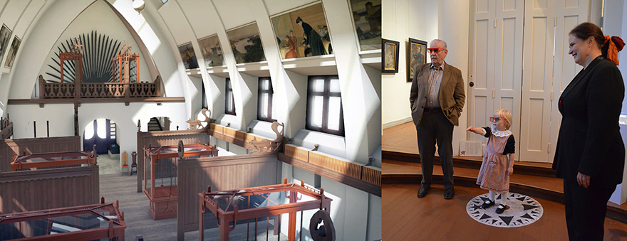
Pavilion of Finland at the
1900 World Fair in Paris
An virtual reality historical reconstruction
Rear projection edition, featuring a gesture-based interface.
Shown in the Akseli’s Treasures exhibition
Gallen Kallela Museum, Espoo, Finland
Sept. 21, 2012 – May 12, 2013.
Notes:
In 2009, through a TEKES on user interface design, we were able to begin to work on a beloved intangible heritage ‘artifact’ of Finnish design history. The Pavilion of Finland at the 1900 World Heritage Fair is generally used to mark the point of origin for the history of Finnish design, since it was the first time that Finnish design objects were showcased in an international event. As a non-permanent structure built for the duration of the Fair, the building was destroyed and its contents were scattered throughout Europe. In our research we have created a reconstruction that enables one to see the contents and experience the site.

Slide 13
Pavilion of Finland at the
1900 World Fair in Paris
An virtual reality historical reconstruction
Film documentary
Duration: 8:00 minutes
Shown in the A Passion for Finland exhibition
Musée d’Orsay, Paris
7 February – 6 May 2012
Notes:
In 2009, through a TEKES on user interface design, we were able to begin to work on a beloved intangible heritage ‘artifact’ of Finnish design history. The Pavilion of Finland at the 1900 World Heritage Fair is generally used to mark the point of origin for the history of Finnish design, since it was the first time that Finnish design objects were showcased in an international event. As a non-permanent structure built for the duration of the Fair, the building was destroyed and its contents were scattered throughout Europe. In our research we have created a reconstruction that enables one to see the contents and experience the site.

Slide 14
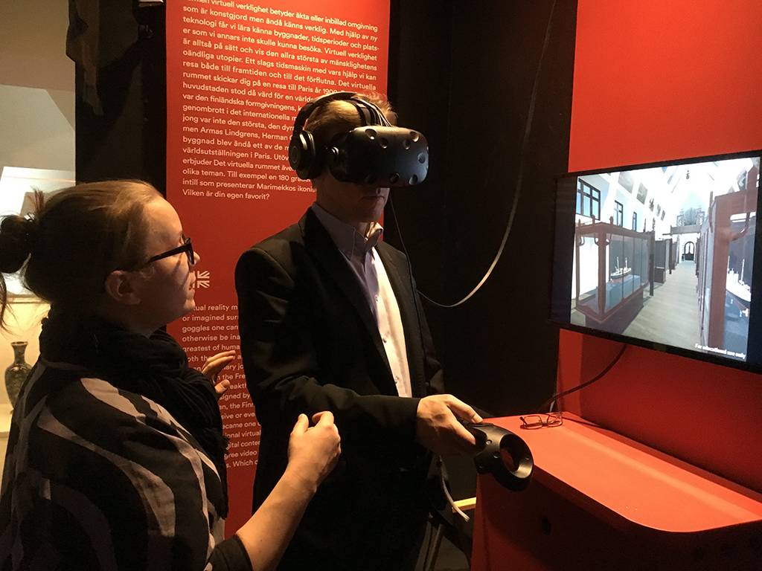
Pavilion of Finland at the 1900 World Fair in Paris
(2009 – 2018)
Pavilion of Finland at the 1900 World Heritage Site
Systems of Representation research group
Permanent exhibition, Design Museum Helsinki, 2017..

Slide 15
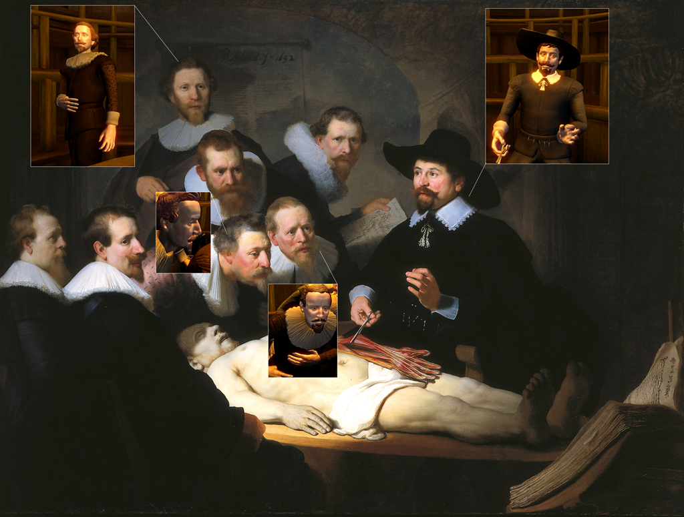
Notes:
As a type of digitally born object our simulation entails the creation of representations (in the form of audio visual content) that not only reproduce significant characteristics of the item but also trigger similar behaviour with and towards the substitute.

Slide 16
The Anatomy lesson of Dr. Nicolaes Tulp by Rembrandt, 1632
A hypothetical 3D reconstruction of the 1691 anatomical theatre of the Barber’s Surgeon Guild of Amsterdam has been re-created through the study of 18th century sources and using photogrammetry.
A sound environment that includes narrative and ambient noise has been designed.
A 3D model of Vesalius 1543 manual, De humanis corporis fabrica has been created displaying video of a modern dissection procedure.
Notes:
When roaming the theatre space the guest has the opportunity to experience the peculiar angle of vision utilized in the design of these spaces.
The sounds vary as the guest moves through the space, from the speech in Latin uttered by Dr. Tulp, to the liturgical melody that plays in the stands, to the lecture accompanying the contemporary anatomy lesson video.
The book itself features a video where we can appreciate a modern anatomy dissection of a human hand.

Slide 17
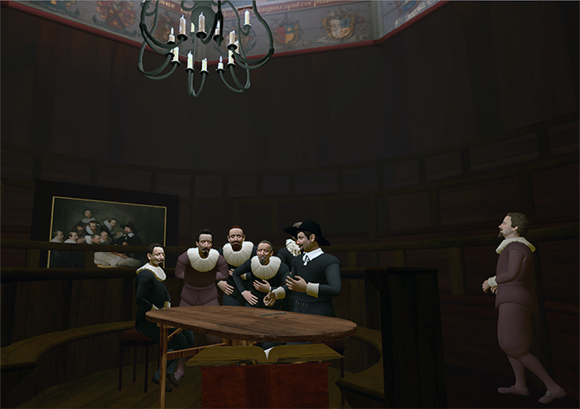
Notes:
Our installation deconstructs an important moment when the history of science and art converged in spectacle.
The experience of the installation can be divided into two sections: The first part lasts 3 minutes and it is an experience guided through a narrative. In the second part, the viewer can roam freely and interact with objects in the installation.
Indeed so many stories emerge from the work! Who were the doctors that commissioned the painting? What were their intentions? What could have been the book used in the lesson? These questions are answered partly in the 1st section narrative and also through the viewer’s interaction.

Slide 18
Navigation (Some research questions)
Egocentric – self-motivated, first person perspective related
Ex: “What can I do?” (Norman 2010)
Allocentric – relying on cues from the environment.
Ex: “Wandering” as opposed to “walking”.
VR navigation combines these two mode. How do we use these as part of our VR dramaturgy?
VR navigation combines these two mode. How do we use these as part of our VR dramaturgy?
Notes:
We need to think about navigation in a different way… (Somehow we are still infected by the WIMP interaction paradigms…)

Slide 19
Notes:
The interaction takes a special and ironic twist: Upon entering the virtual space the user realizes that it is she or he who is now on the table as subject of observation.
However, unlike Aris Kindt, we get to move away and navigate the space of the anatomical theatre. I say ironic because we face a similar choice today, when creating artificial reality technologies that seem to bypass our normal perception channels. Is this what Katherine Hayles meant when she referred to our post-human condition in which our bodies would become obsolete?

Slide 20
Navigation
Egocentric – self-motivated, first person perspective related
Ex: “What can I do?” (Norman 2010)
Allocentric – relying on cues from the environment.
Ex: “Wandering” as opposed to “walking”.
VR navigation combines these two mode. How do we use these as part of our VR dramaturgy?
Notes:
We need to think about navigation in a different way… (Somehow we are still infected by the WIMP interaction paradigms…)

Slide 21
Why do research in art and design?
Knowledge is
Situated
Heuristic
Procedural
Art and design yields knowledge about:
History
Practice
Theory
Research [can be be] about, with, and through art and design.”
Frayling, Christopher. (1993). “Research in Art and Design”, Royal College of Art Research Papers, Vol. 1, Num. 1, London UK.
Notes:
Art objects come into being through art or design activity: Situated: It happens in social and cultural context that are carried over; Heuristic: Like declarative, based on expertise, checked against facts; Procedural is like tacit. How to do something. How to dance a choreographed work.
2. Some examples that emerge:
History: Material production of art is the subject of art history. (Alpers)
Practice: Constant renewal of media is the subject of much debate and experimentation in new media
Theory: The shift in epistemological and ontological is one of the key characteristics of our contemporary era.

Slide 22
Why do research in art and design?
Artistic research can investigate ’reality’ through art.
Ex: How the changes in a city are inadvertently captured in a film.
Artistic research pries into the different forms that art assumes.
Ex: The different genres that emerge as the physical and infrastructural support, the tools and methods used in art making change.
Notes:
Sensory perception is key component in knowledge-making practices.
As research, art itself can instantiate myriad sensual historiographies about human culture and history.

Slide 23
Anthropology, art, research (1-2)
Artistic research can investigate ’reality’ through art.
Ex: How the changes in a city are inadvertently captured in a film production.
Artistic research pries into the different forms that art assumes.
Ex: The different genres that emerge as the physical and infrastructural support, the tools and methods used in art making change.
Notes:
Sensory perception is key component in knowledge-making practices.
As research, art itself can instantiate myriad sensual historiographies about human culture and history.

Slide 24
Thank you!
Kiitos!
¡Gracias!

