Slide 1
Thematic Studio I
Mid-term presentations
Pecha Kucha style
Groups A1-B1

Slide 2
Polina Korchagina
'Buddy chair'

Slide 3
1 Why

Slide 4
2 What

Slide 5
3 How

Slide 12
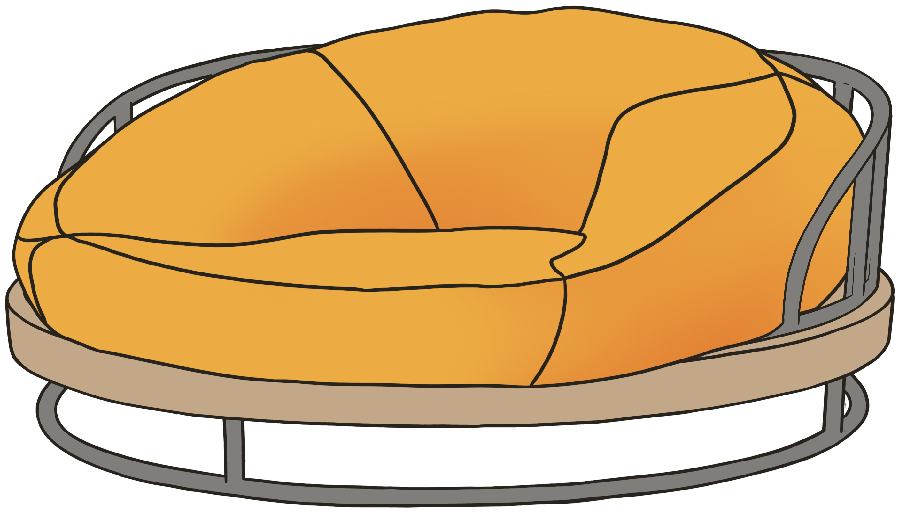
Hanna Rozmarynowska
OLVIDA the fire focused sofa chair

Slide 13
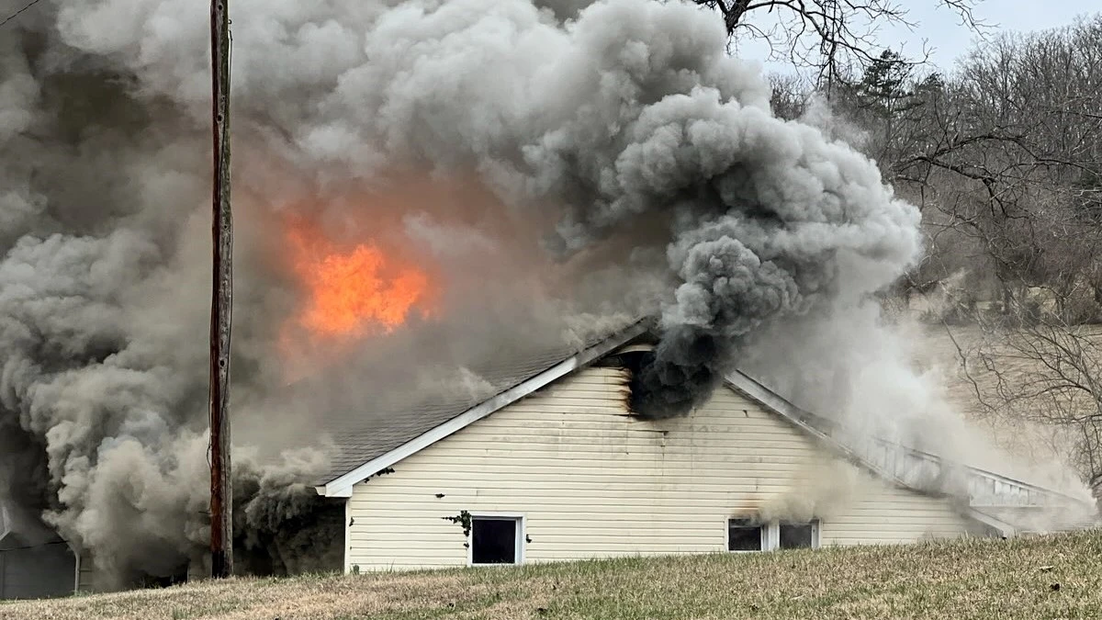
W H Y

Slide 14
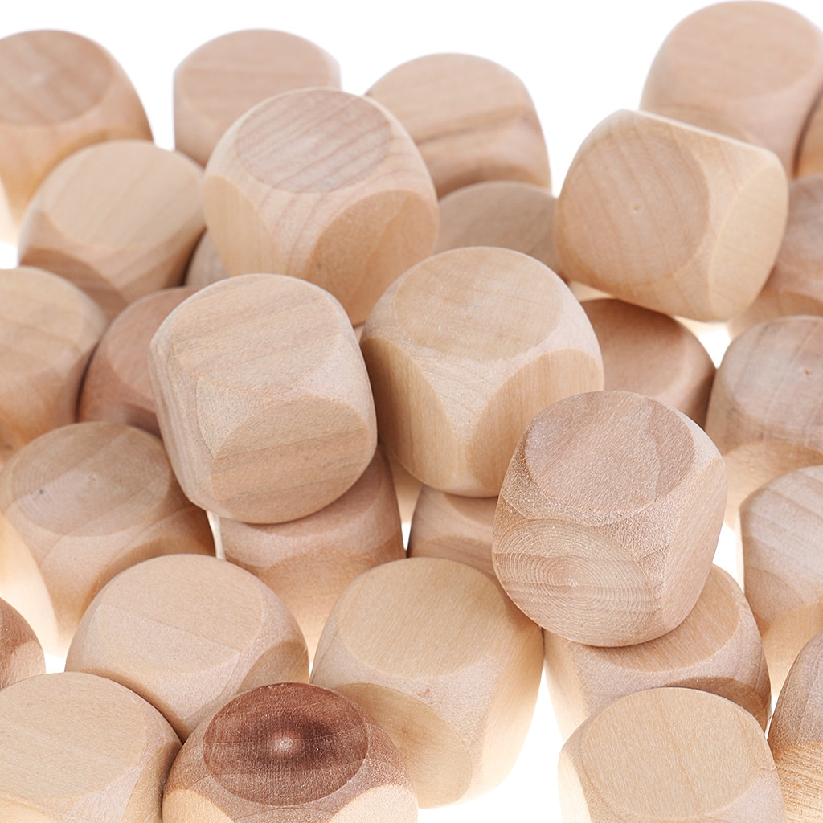
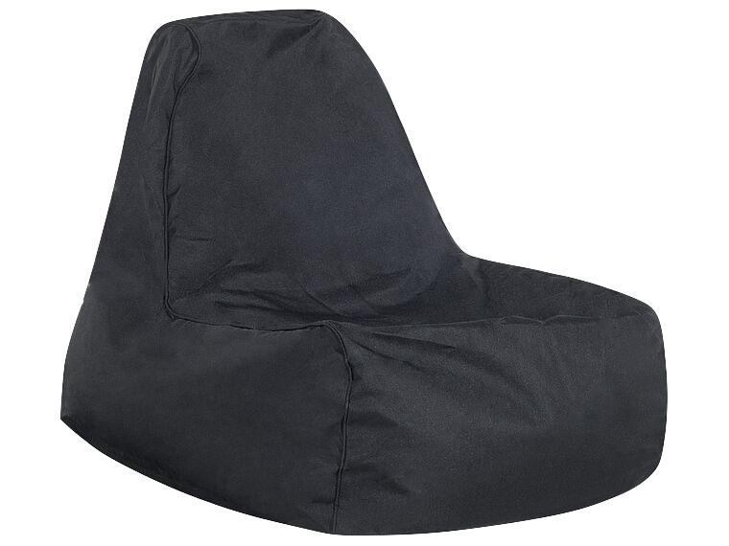
W H A T

Slide 15
H
O
W

Slide 17
Eveline Van Erven
The Back Exoskeleton

Slide 19
2 What

Slide 20
3 How

Slide 22
Yuki Yamamoto
Title of the work

Slide 27
Rebeka Kováčová
SAFELY

Slide 28
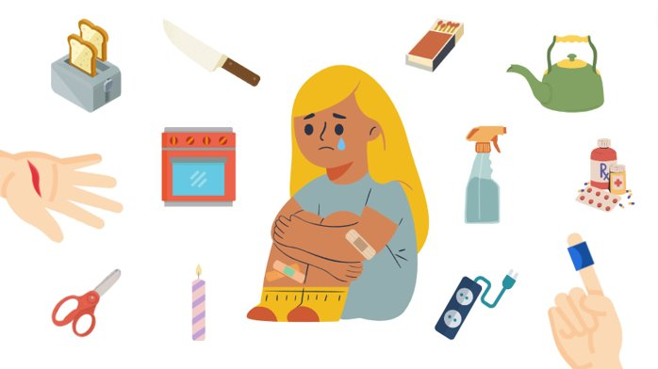
Why?

Slide 29
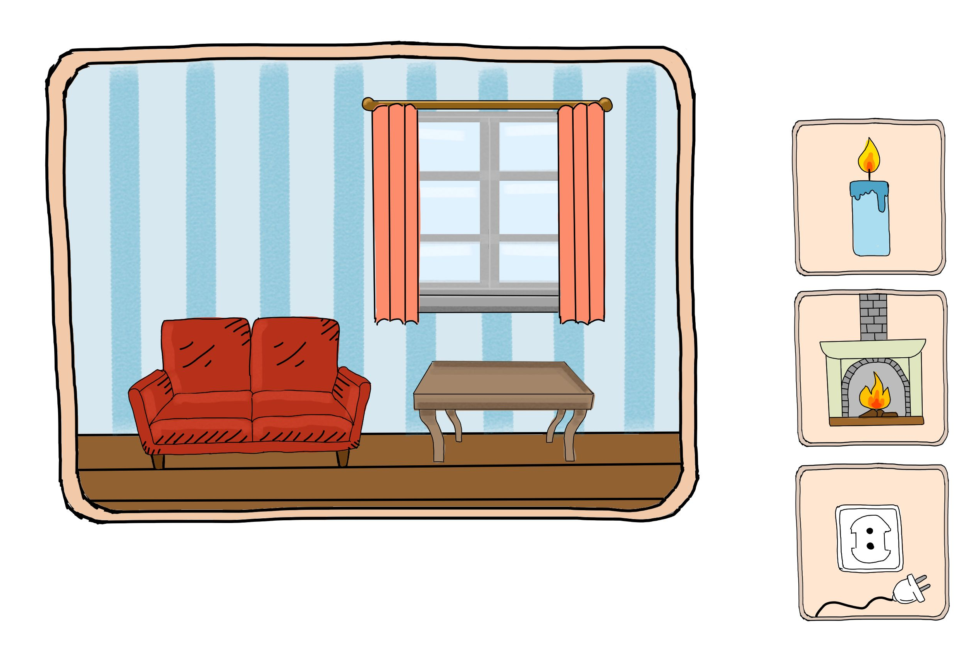
What?

Slide 30
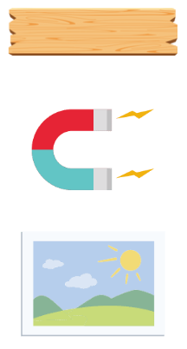
How?

Slide 35
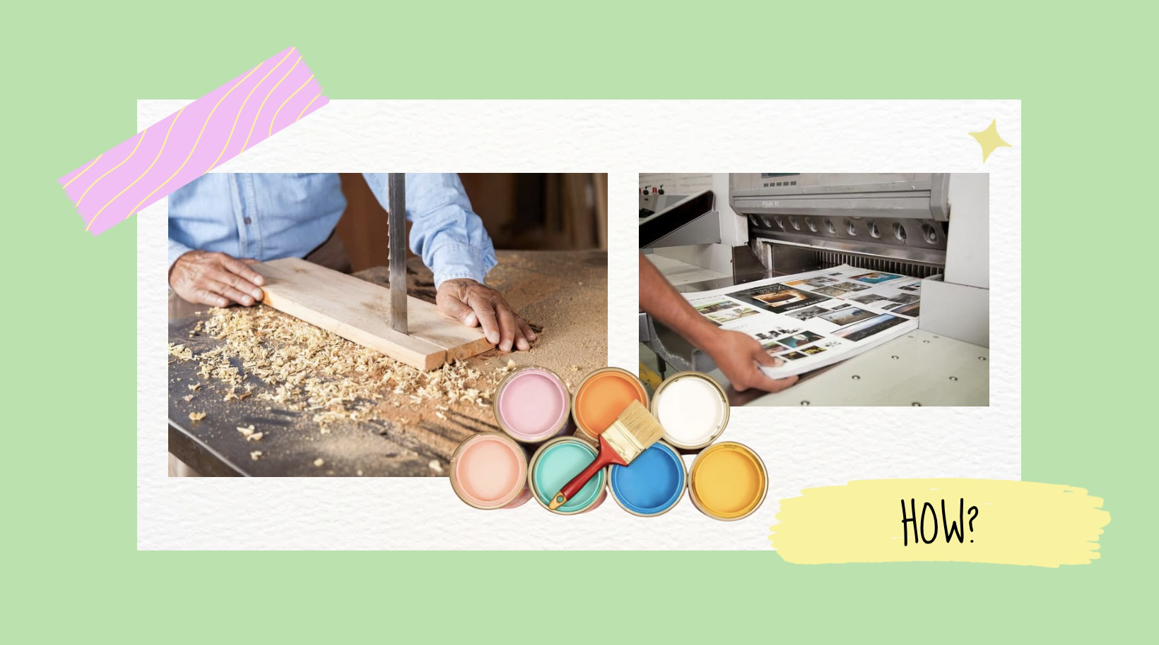

Slide 39
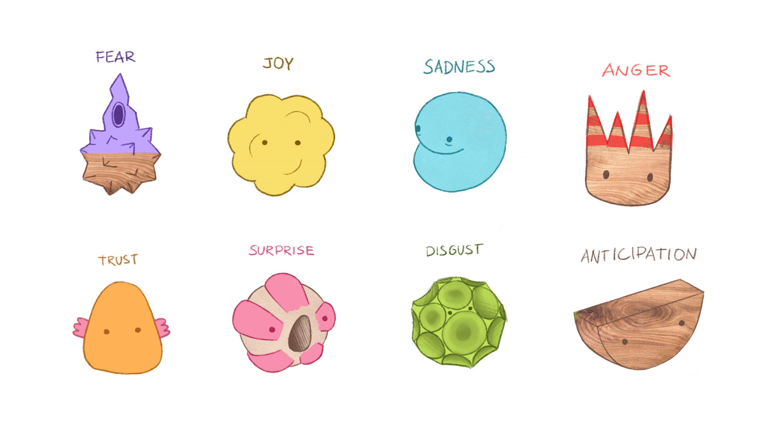

Slide 40
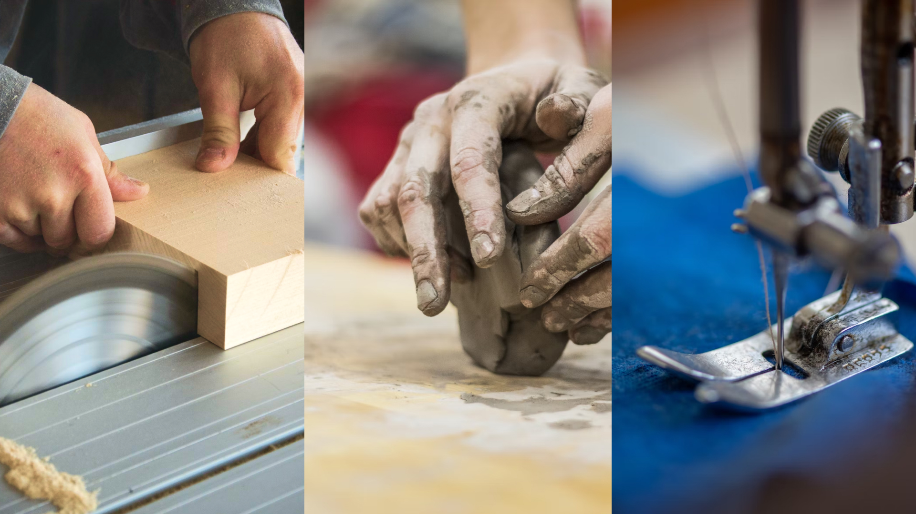

Slide 42
Unna Luoma
Sleeping Aid
Unna Luoma

Slide 43
Why?

Slide 44
What
What?

Slide 45
How
How?​

Slide 52
Jenni Suong Mai Bui
Neural Comfort

Slide 53
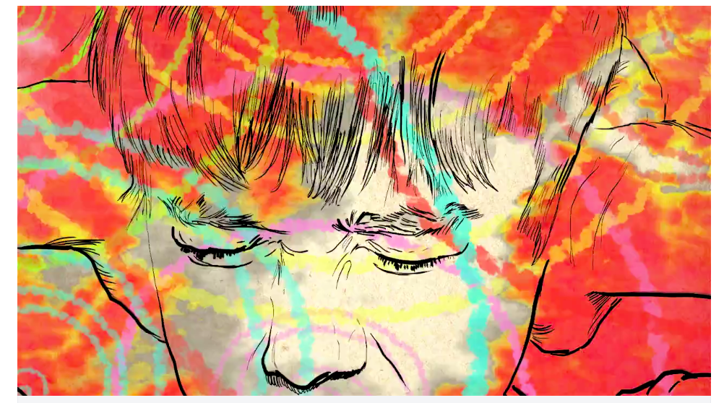
1 Why
Why?
https://the-art-of-autism.com/these-five-videos-show-what-it-is-like-to-experience-sensory-overload/

Slide 54
2 What
What?
https://www.seekpng.com/ipng/u2q8a9a9t4o0a9o0_sound-wave-png-png-transparent-stock-line-art/

Slide 55
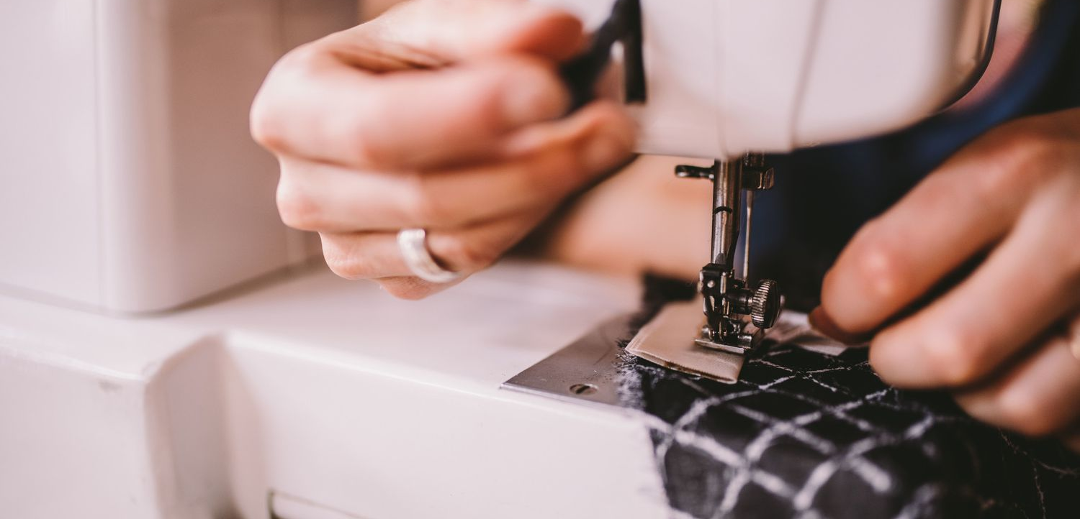
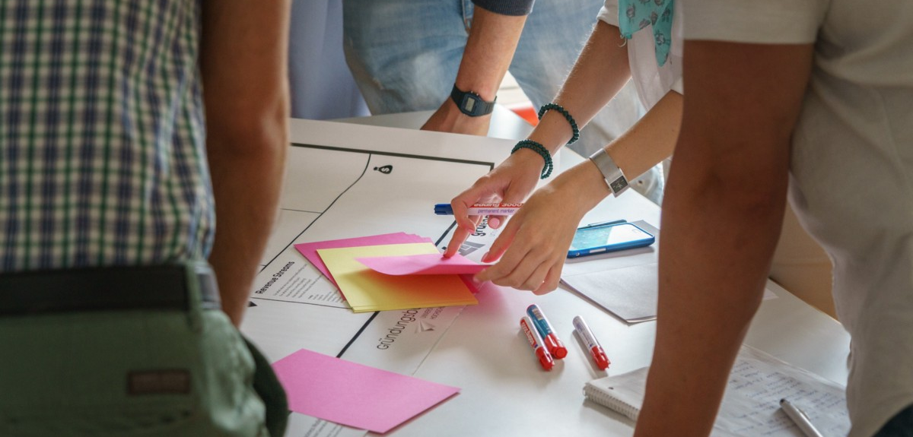
How?

Slide 60
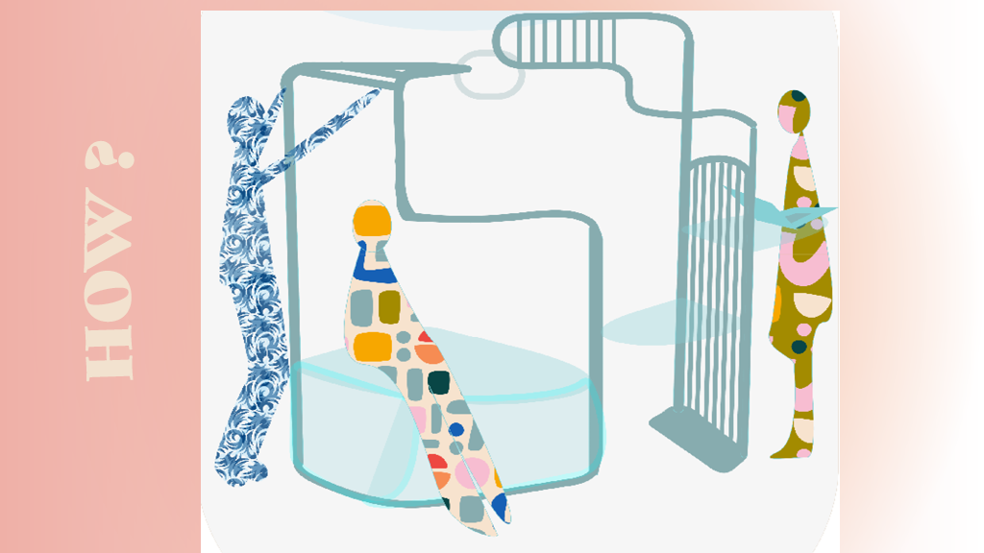

Slide 62
Joseph Hallam
Preventing Axeidents

Slide 63
1 Why

Slide 64
2 What

Slide 65
3 How

Slide 67
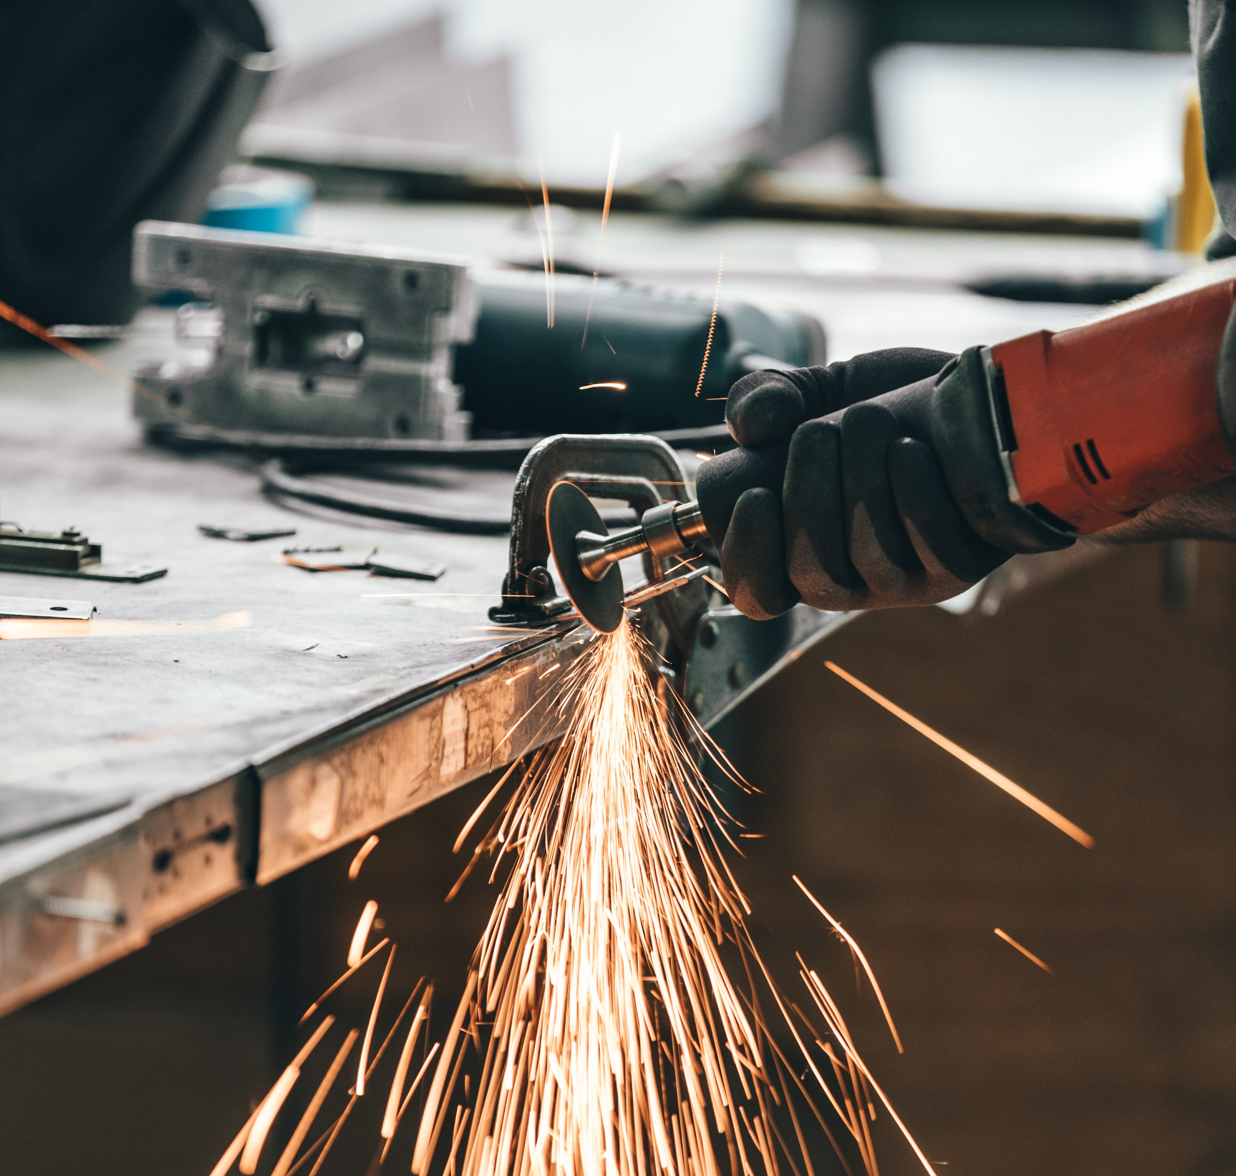
Shinwoo Kim
1. WHY
Extensive Protection Frame (EPF)
Flying Debris
entering from the top, side, and bottom gap
Poor Fit
due to the safety glasses being limited to one-size
Fogging Up
after some time. (the ones with foams or pads sealing on the inside of the glasses)

Slide 68
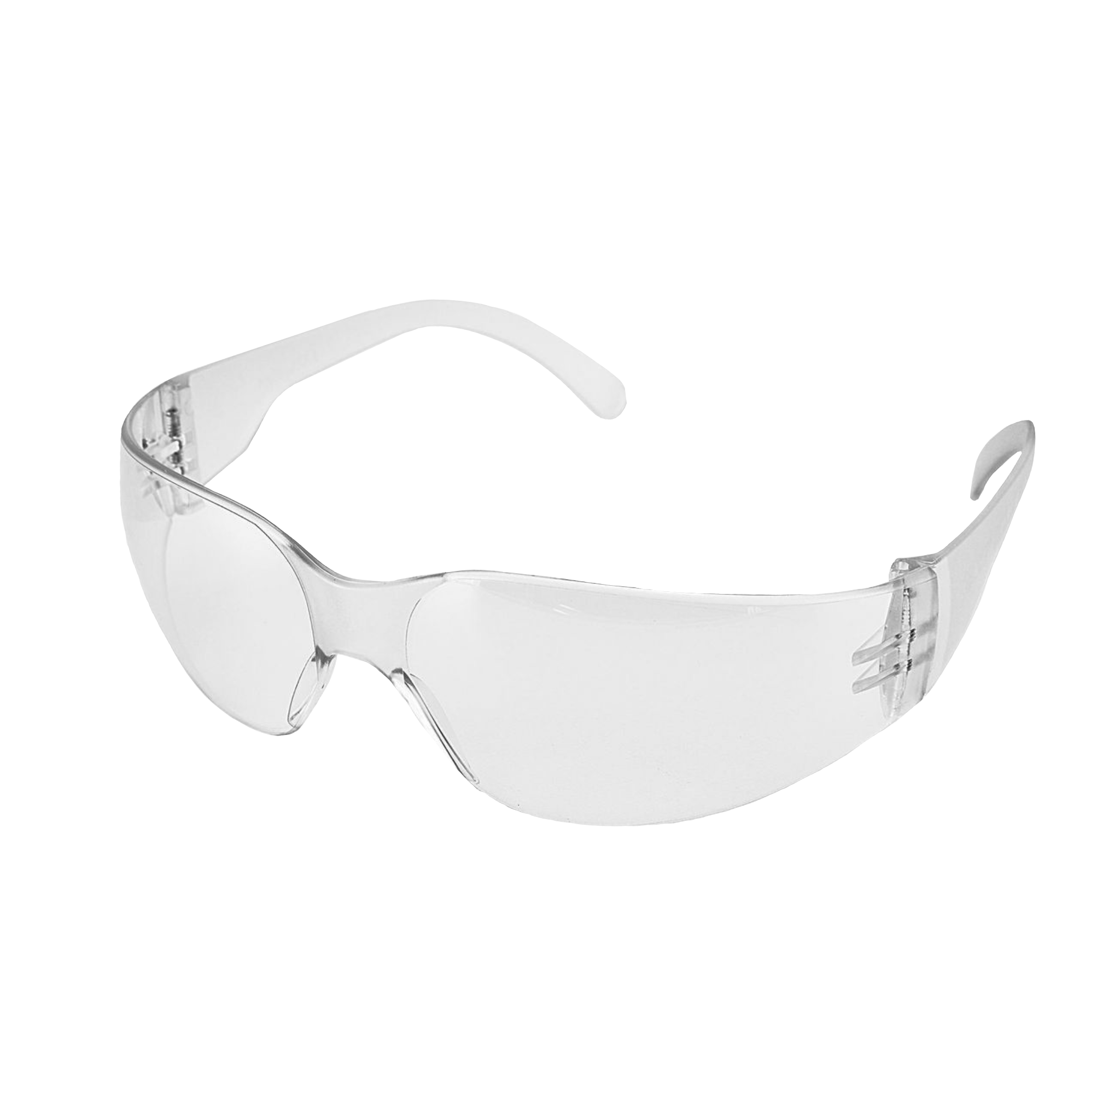
2. WHAT
1. WHY
Extensive
Protection
Frame
Attachable
Flying Debris
entering from the top, side, and bottom gap
Poor Fit
due to the safety glasses being limited to one-size
Fogging Up
after some time. (the ones with foams or pads sealing on the inside of the glasses)

Slide 69
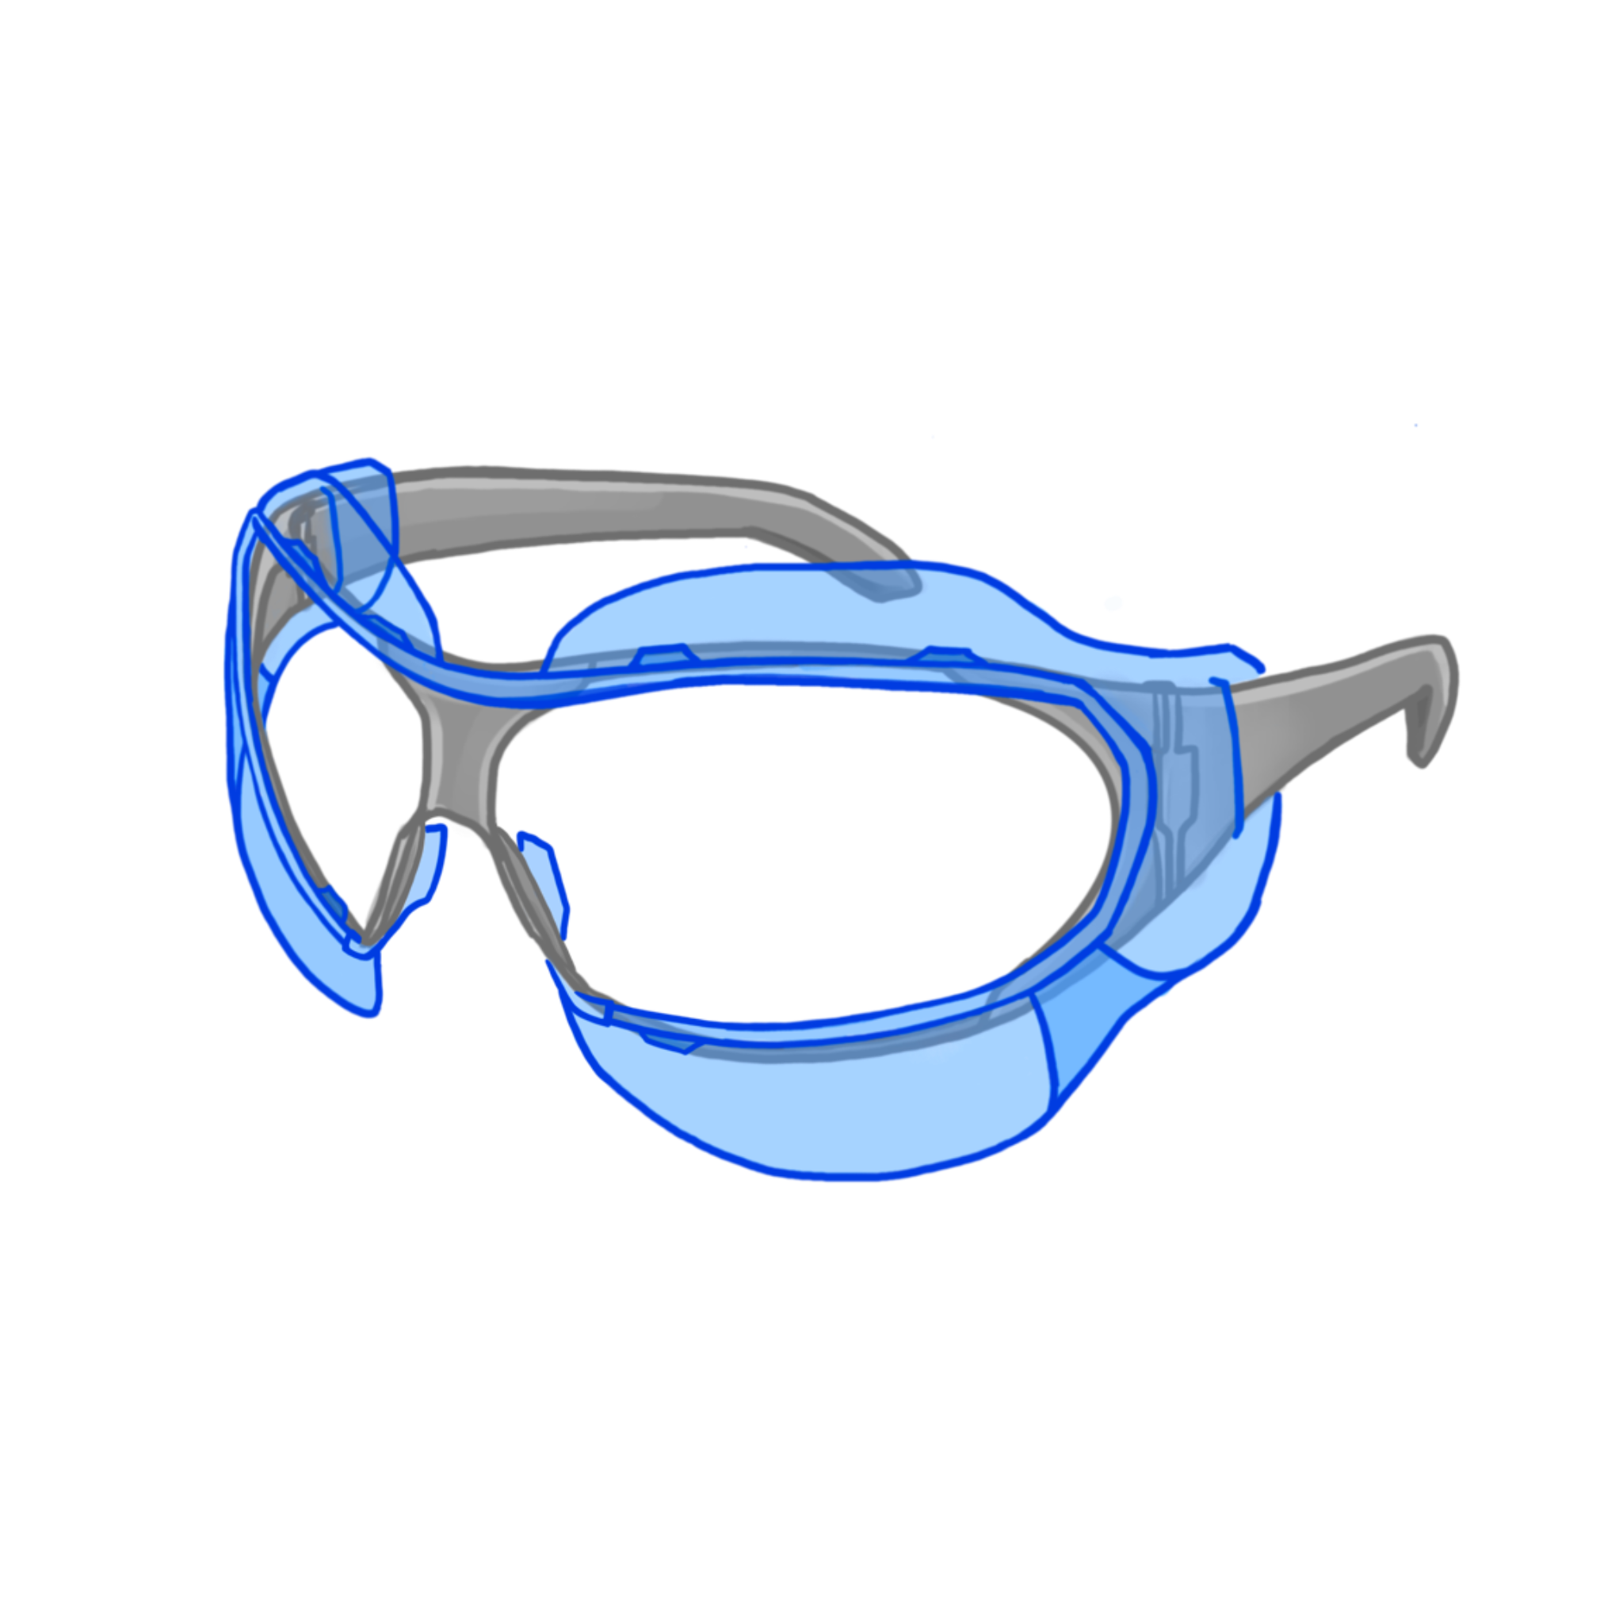
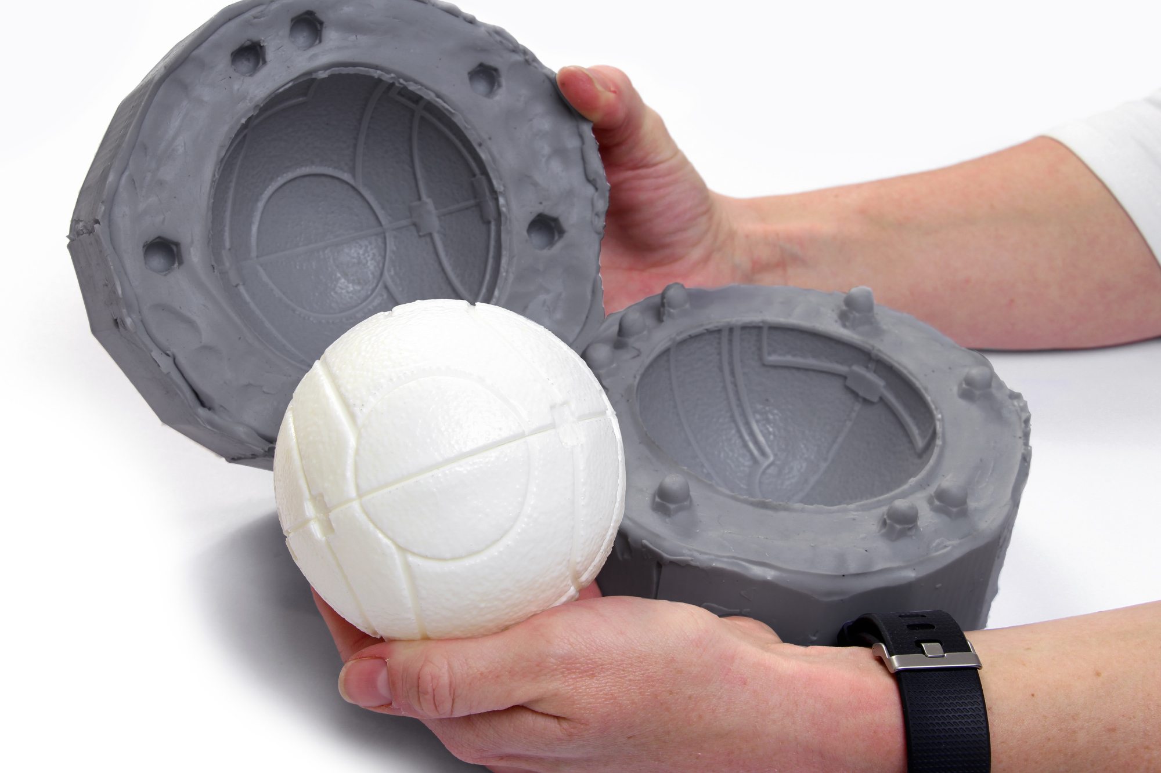
2. WHAT
?
Extensive
Protection
Frame
Attachable
Flying Debris
entering from the top, side, and bottom gap
Poor Fit
due to the safety glasses being limited to one-size
Fogging Up
after some time. (the ones with foams or pads sealing on the inside of the glasses)

Slide 70
?
6. Final product
1. Sketch
HOW
5. Prototype
2. Measure
4. Material
casting
3. Material
experiment

Slide 72
Yelyzaveta Tinus

Slide 74
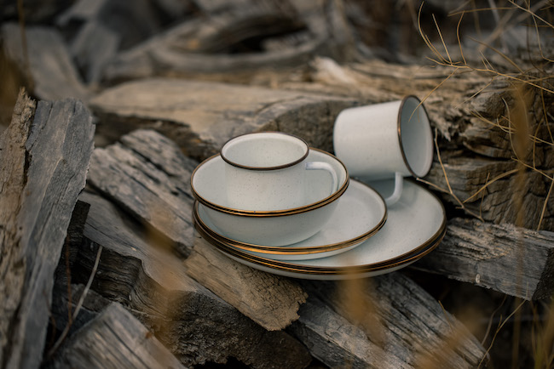

Slide 77
Marek Ševčík
Conversation mug set

Slide 79
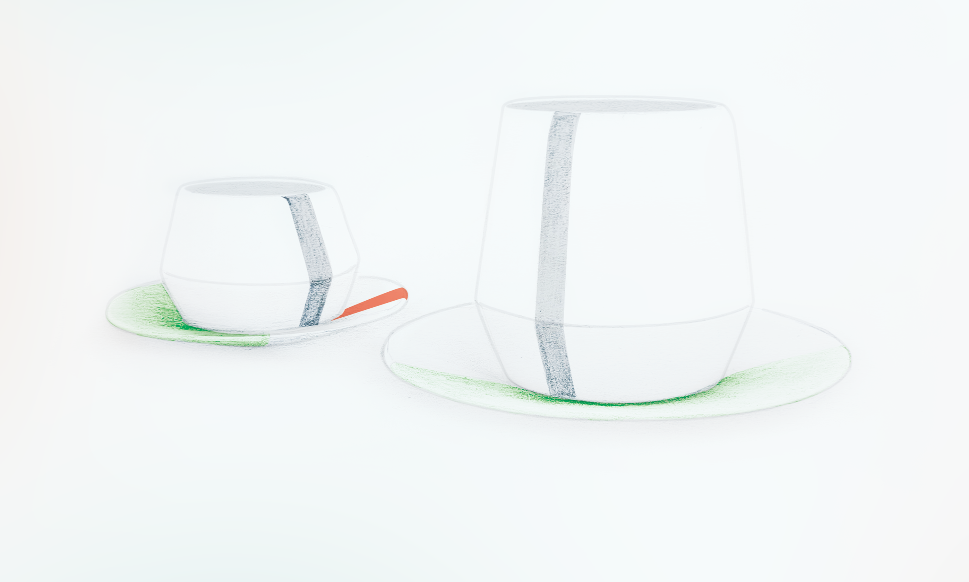

Slide 80
