Slide 1
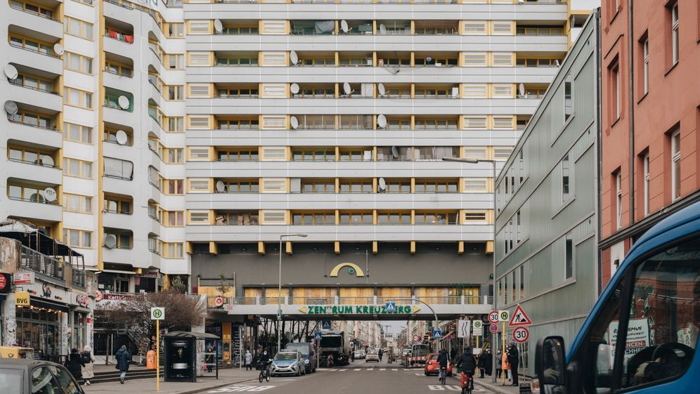
Reflection on The eyes of the skin
By Juhani Pallasmaa

Slide 2
Key points
Sensory of engagement.
The dominance of vision overall senses in the way we perceive.
Achitecture appeals to the eye but does very little to engage with the other senses.
The body is the core to perceive the world through memory, imagination and integration.
Achitecture is not a mere object, but it is an extention to our surrounding.
Sensory of deprivation.

Slide 3
Thoughts and reflection
Sensory of engagement.
How do we remember a place? and when you walk in a city, are you aware of your integration to the surrounding?
Why Väre building in Aalto and the new building of kuvataideakatemia (uniarts) fail to bring up a creative environment?
Sensory of deprivation.

