Slide 1
Hearables
TECHNOLOGY TUCKED
INSIDE YOUR EARS
WILL AUGMENT
YOUR DAILY LIFE
- Poppy Crum

Slide 2
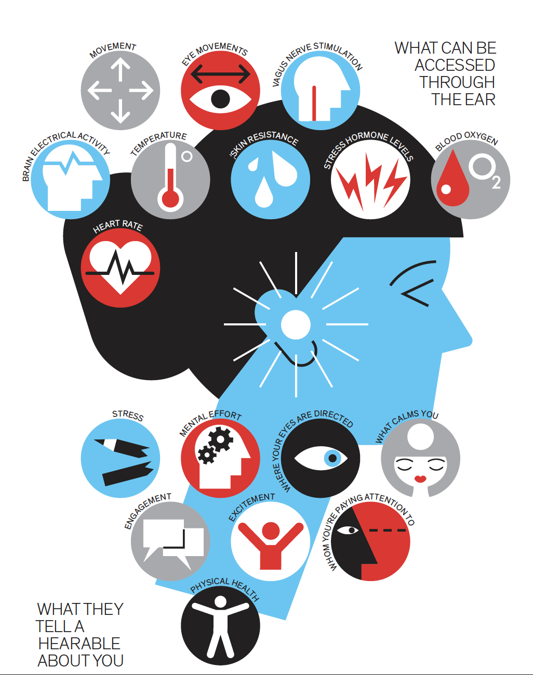
Scenarios?

Slide 3
Audio devices monitoring physiological actions
We already have technology that monitor heart rate, blood sugar etc
Audio devices may monitor the stress levels and produce a response like cancelling out certain sounds, enhancing certain voices, linking other devices with others and producing a response
Cone of silence

Slide 4
How they work?
Electrode impulses
Electricity impulses in Vagus nerve
Monitering alpha and beta frequencies in brain

Slide 5
Problems?

Slide 6
Although the author seems very optimistic but…
Surveillance society and capitalism- Panapticon by Foucault
Posthumanist perspective of relying on Artifical Intelligence- Donna Haraway
Amazon Echo

Slide 7
Why audio surveillance is easy?- perhaps relate to this course
Whereas standard cameras have a limited angular field of view, microphones can be omnidirectional (providing a spherical field of view).
Due to the bigger involved wavelength, many surfaces allow for specular reflections of the acoustic wave, thus permitting us to acquire audio events even when obstacles are present.
Illumination and temperature are not issues for audio processing.
Audio Surveillance: A Systematic Review
MARCO CROCCO, Pattern Analysis and Computer Vision, Istituto Italiano di Tecnologia
MARCO CRISTANI, University of Verona
ANDREA TRUCCO, University of Genova
VITTORIO MURINO, Pattern Analysis and Computer Vision, Istituto Italiano di Tecnologia -
University of Verona

Slide 8
Thank you

