Slide 1
Antti Vepsäläinen
Lecture notes on PHYS-C0254 Quantum Circuits

Slide 2
Agenda for lectures 7-11
7. Quantization of electrical networks
a. Harmonic oscillator: Lagrangian, eigenfrequency
b. Transfer step: LC oscillator, Legendre transform to Hamiltonian
d. Quantization of oscillators
8. Superconducting quantum circuits
a. Qubits: Transmon qubit, Charge qubit, Flux qubit 1st DiVincenzo criteria
b. Circuit-QED: Rabi model
c. Rotating Wave approximation: Jaynes-Cummings model
9.Single-qubit operations:
Initialization 2nd DiVincenzo criteria
Readout 5th DiVincenzo criteria
Control:T1, T2 measurements, Randomized benchmarking 3rd DiVincenzo criteria
10. Two-qubit operations: Architectures for 2-qubit gates 4th DiVincenzo criteria
a. iSWAP
b. cPhase
c. cNot
11. Challenges in quantum computing
SW-HW gap (qubit quality & number, gate depth)
Error-correction
Scaling challenges

Slide 3
General challenge: Scaling up
Creating a single quantum circuit with high accuracy is simple. Scaling to millions is extremely challenging.
To compensate for the errors of the system, one can detect and correct them. However, error correction creates a qubit overhead of 100 to 1000.
Currently known algorithms require thousands – millions of qubits. Currently available processors contain less than 100 qubits. This is called the Software-Hardware gap.

Slide 4
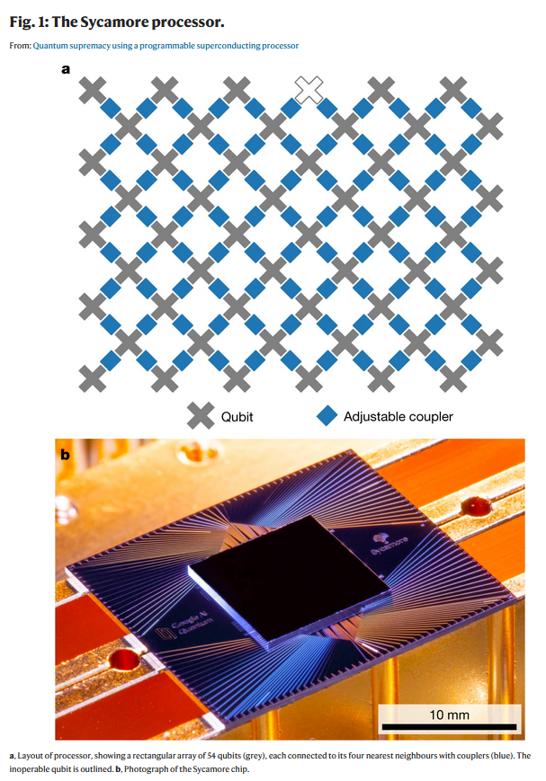
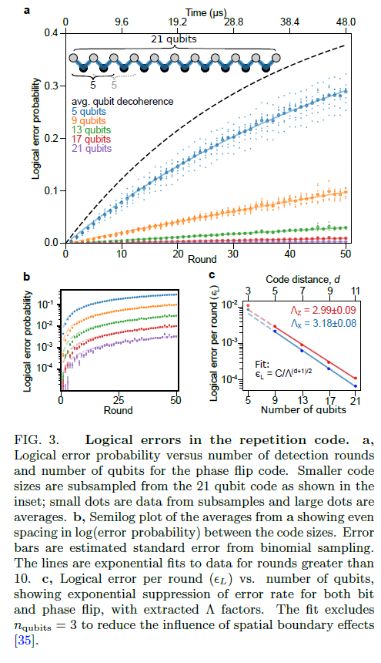
Agenda for today
11. Challenges in quantum computing
SW-HW gap (qubit quality & number, gate depth)
Error-correction
Scaling challenges
a.
b.
c.

Slide 5
General note: SW- HW gap
Even though qubit count and quality have been increasing over the years, we are still far away from closing the gap between SW requirements and HW accessibility.
A big milestone was reaching quantum supremacy by Google. They created an arbitrary circuit that is hard to simulate classically.
Bringing usefulness into the equation creates further overhead. Reaching quantum advantage requires probably thousands of qubits.

Slide 6
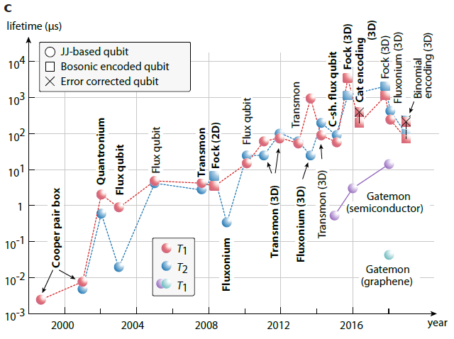
Qubit quality (solid state qubits)
The qubit lifetime has been improving over the years.
However, in the current years, no real new breakthrough has been achieved.
This raises the question: “What fundamentally limits the lifetime of superconducting qubits?”

Slide 7
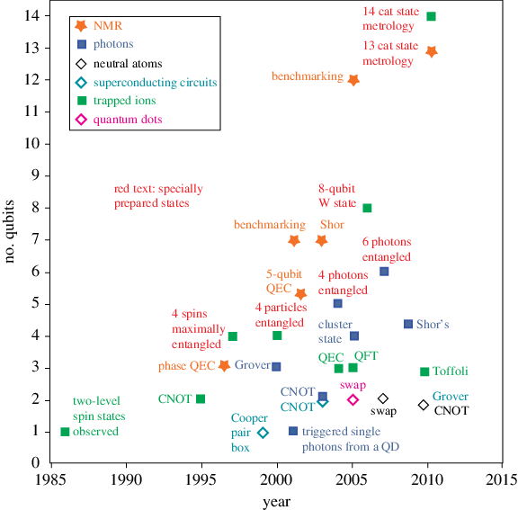
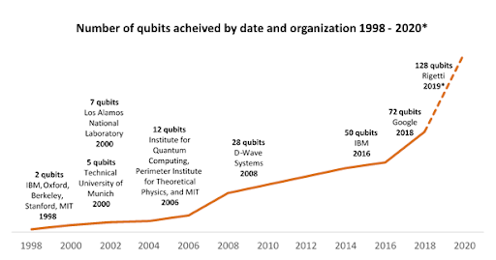
Qubit count
The qubit count has been increasing over the years.
However, certain announced milestones have not been reached.
Generally, only increasing the number of qubits does not help. One needs to be able to perform high quality gates as well.
10.1098/rsta.2011.0352

Slide 8
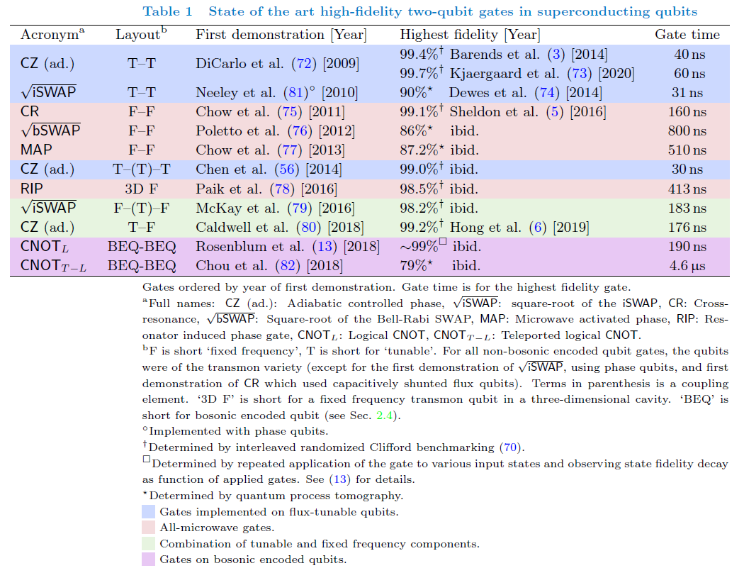
Gate quality (superconducting qubits)
The gate quality has been increasing over the years.
However, to reach error-correction limits at scale, further improvement is needed.
Generally, finding an efficient and high-quality implementation of CNOT gates is challenging.

Slide 9
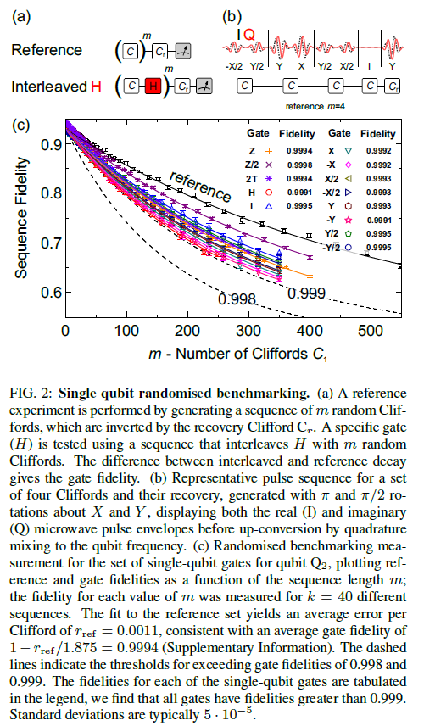
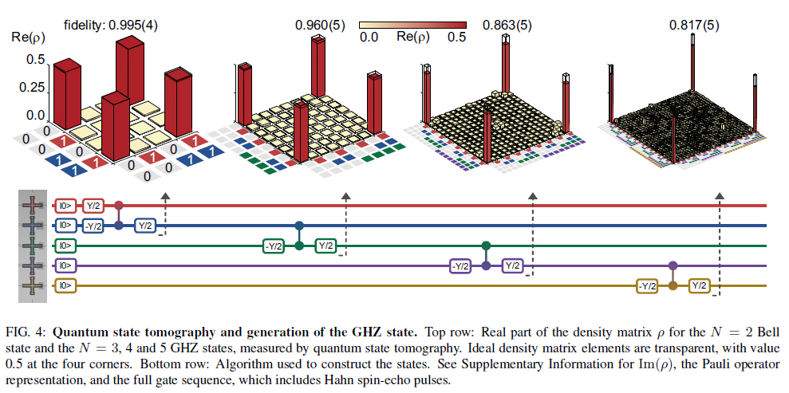
Reaching sufficient error rates

Slide 10
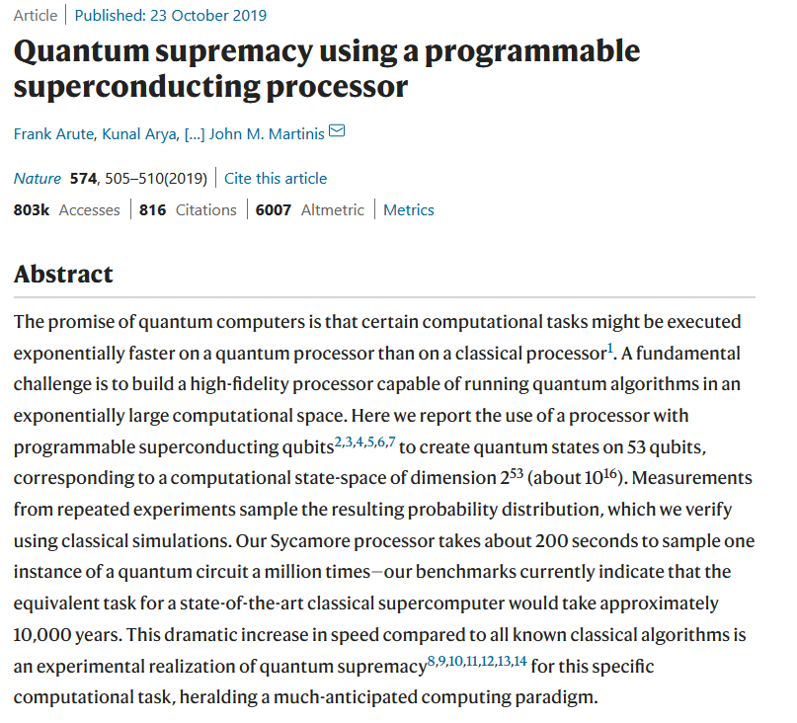
Quantum supremacy

Slide 11
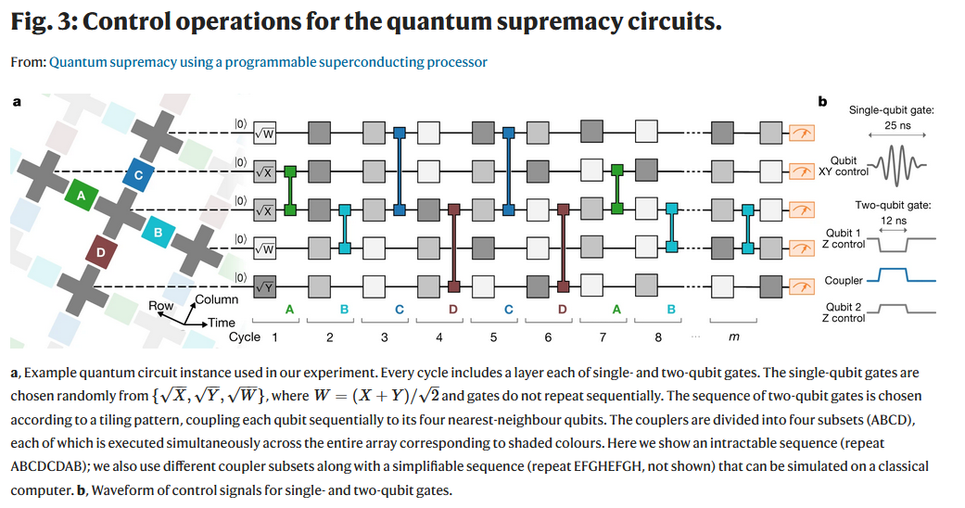
Quantum supremacy

Slide 12
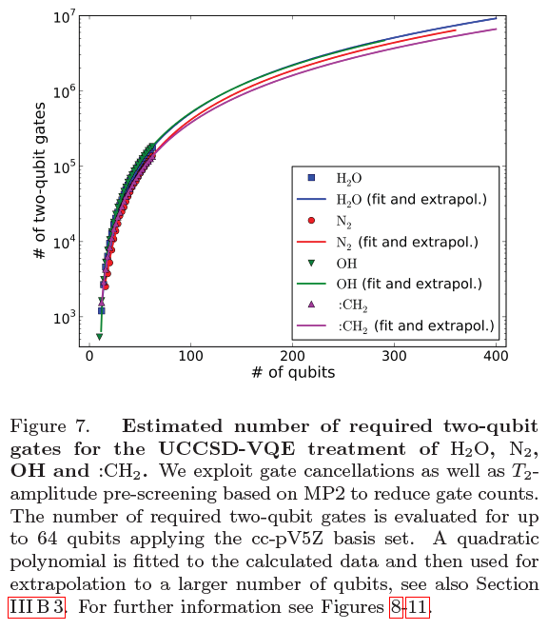
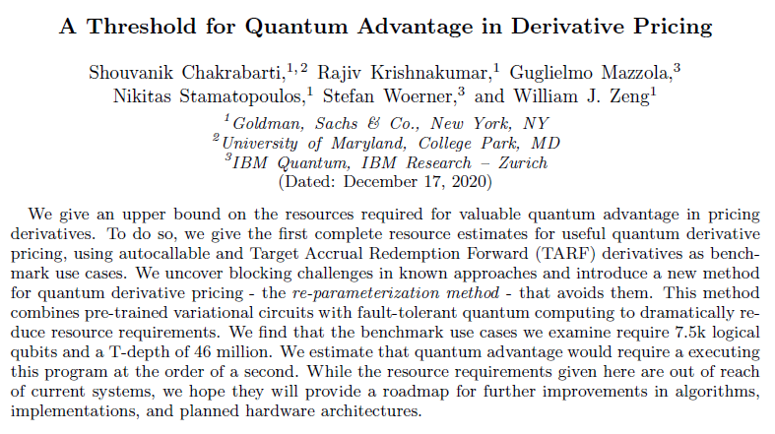
Quantum advantage?
These are logical qubits!
https://arxiv.org/abs/1812.06814

Slide 13
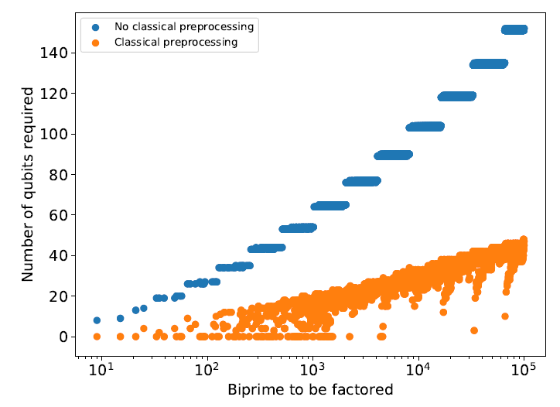
Quantum advantage?
These are logical qubits!

Slide 14
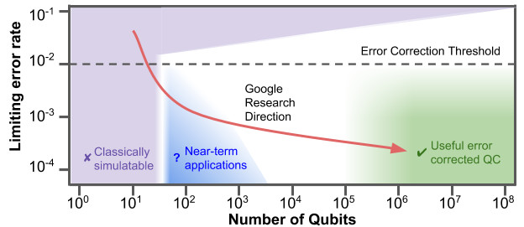
Envisioned roadmap

Slide 15
SW-HW gap

Slide 16
General note: SW- HW gap
Even though qubit count and quality have been increasing over the years, we are still far away from closing the gap between SW requirements and HW accessibility.
A big milestone was reaching quantum supremacy by Google. They created an arbitrary circuit that is hard to simulate classically.
Bringing usefulness into the equation creates further overhead. Reaching quantum advantage requires probably thousands of qubits.

Slide 17
Agenda for today
11. Challenges in quantum computing
SW-HW gap (qubit quality & number, gate depth)
Error-correction
Scaling challenges
a.
b.
c.

Slide 18
General approach: Error correction
Quantum systems will never be perfect, hence errors will always occur.
If the error rate is small enough, it is possible to detect the errors and correct for them.
Detecting the errors in a non-invasive way creates a strong overhead in the required qubit number.

Slide 19
Error detection

Slide 20
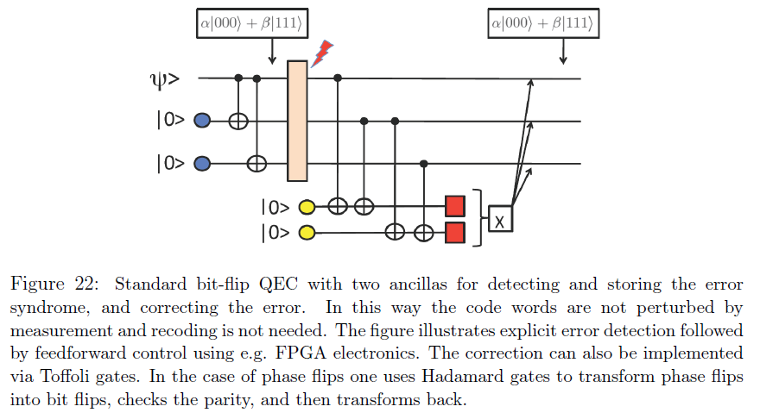
Error correction: Bit flip example
Example α = 1: Ψ = |000>
Zero bit-flip error:
On measuring (00), do nothing.
Bit-flip error in qubit 1:
On measuring (10), X-flip qubit 1.
Bit-flip error in qubit 2:
On measuring (11), X-flip qubit 2.
Bit-flip error in qubit 3:
On measuring (01), X-flip qubit 3.

Slide 21
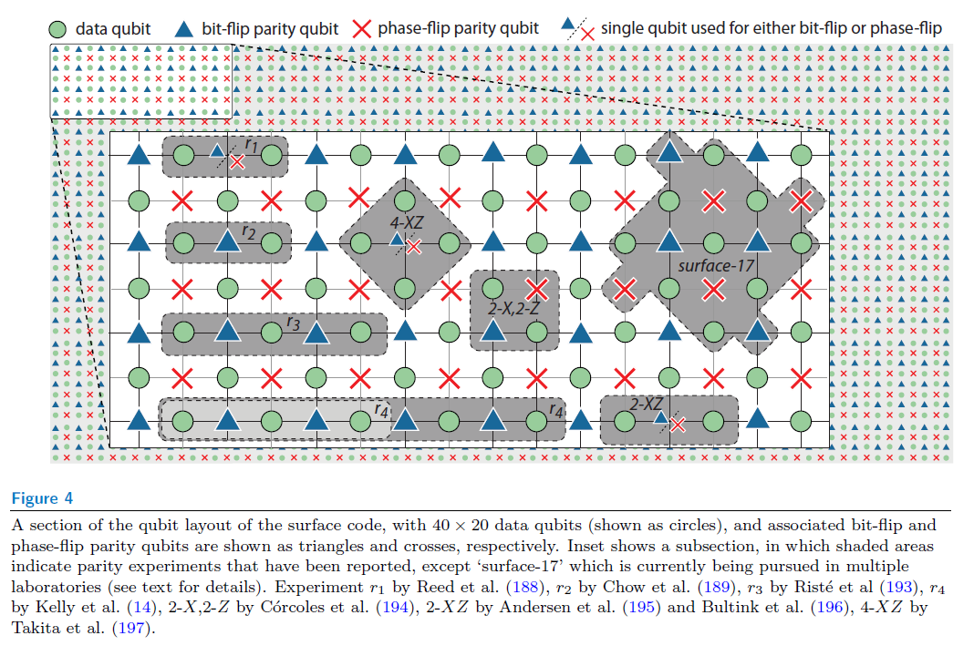
Error correction codes
Since superconducting qubits operate in 2D grids, error correction codes are called surface codes. They correct errors on a rectangular qubit grid.
In this grid, qubits are assigned different tasks. Data qubits store the information and are being actively corrected. Bit-flip and phase-flip qubits detect the errors and trigger the correction.
Depending on the number of qubits involved, the codes get names like “surface-17”.

Slide 22
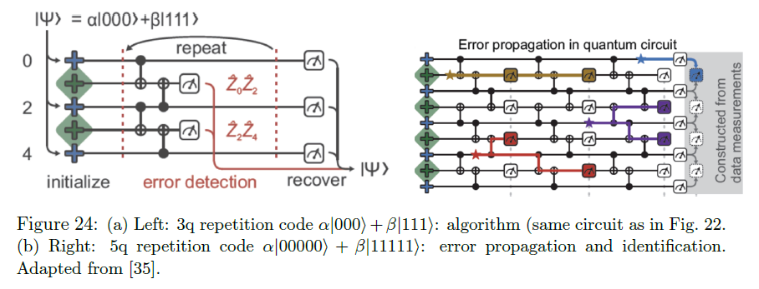
Repetitive error correction

Slide 23
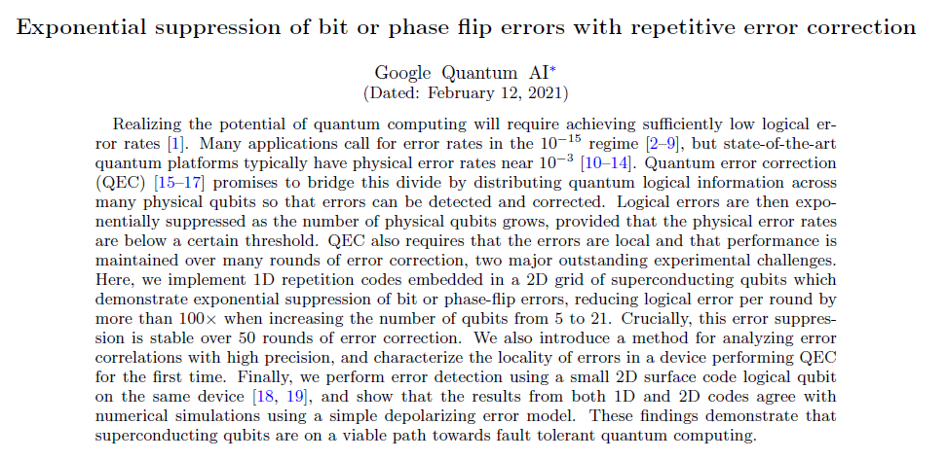
Repetitive error correction

Slide 24
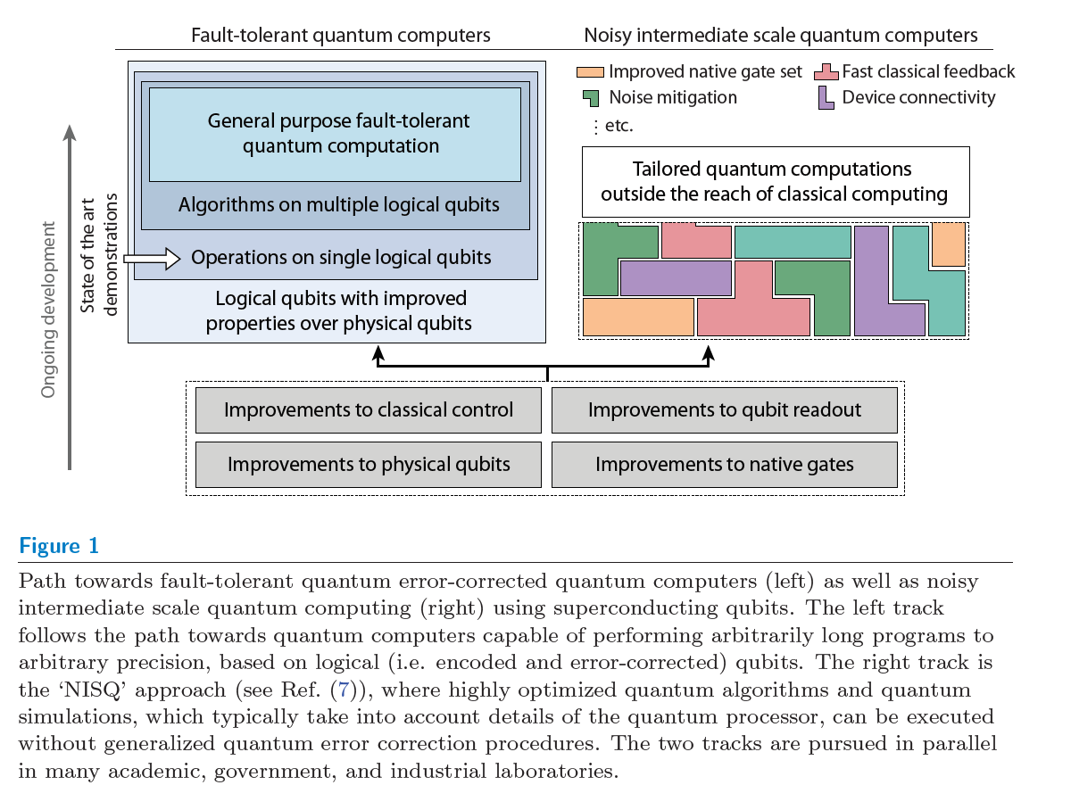
Fault-tolerant quantum computers
Building an error-corrected quantum computer requires more than “just” many qubits. Improvements are needed on several fronts.
On the computer architecture side, developments in real-time feedback, connectivity, compilers, etc need to be further developed.
On the hardware side, readout, reset and gates need to be further improved.

Slide 25
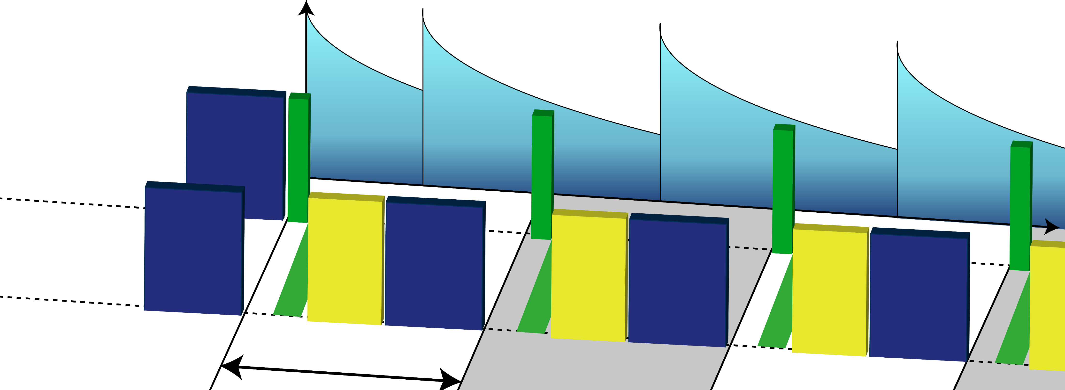
IQM’s way to address error correction:
Loss of quantum information is the biggest challenge!
Reset and readout take the longest time
The faster you make them, the less information you lose
FASTER CLOCK CYCLES
information
loss
reset
gates
data qubits
gates
gates
time
reset
readout
ancilla qubits
gates
reset
readout
gates
reset
readout
gates
reset
goal: shorten clock cycle
shorten
shorten
shorten
shorten

Slide 26
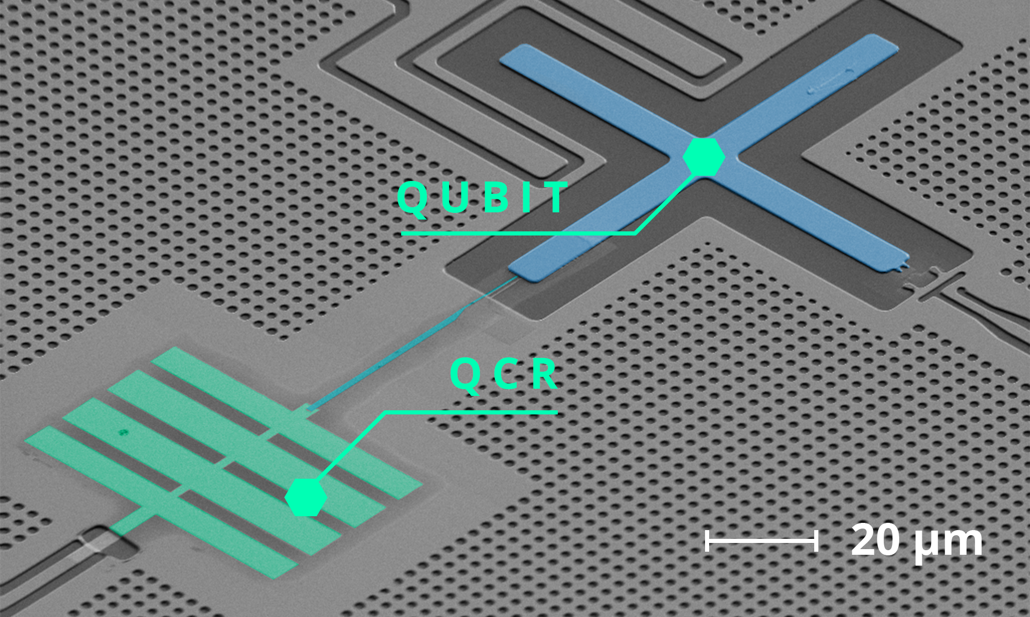
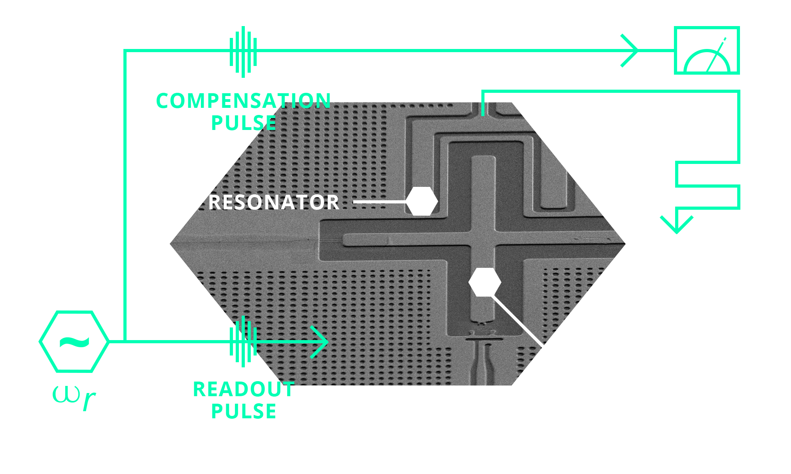
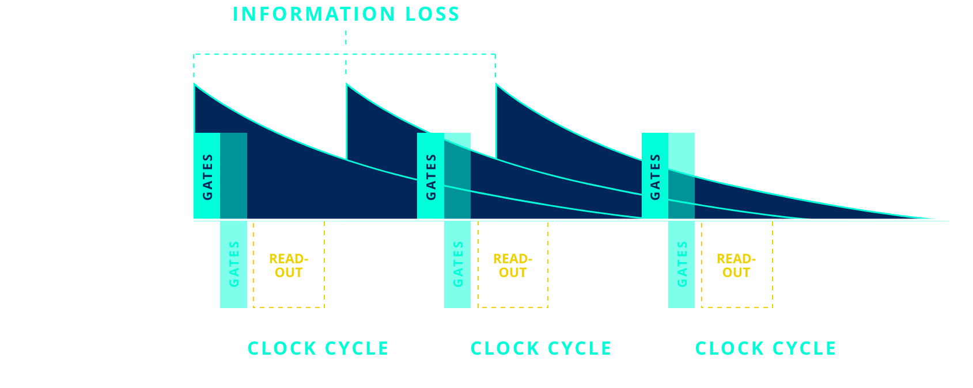
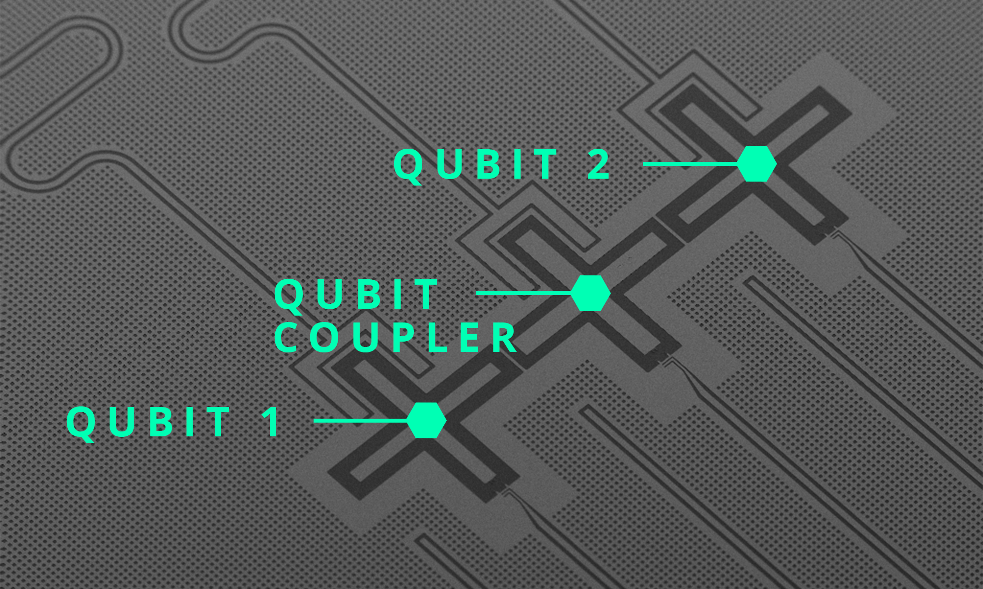
Accelerating clock cycles in IQM
PROBLEM Quantum operations too error prone for quantum advantage and too slow for error correction.
SOLUTION
IQM builds the most precise and fastest quantum processors by improving the three basic quantum operations: reset, gates, readout.
FASTER RESET: QCR WITHOUT FEEDBACK
Unconditional reset
10x speedup to current alternatives
Resets also higher quantum states (leakage errors)
No RF fields required (quasi-DC technology)
Suitable for active on-chip cooling
Protected technology suitable for licensing
FASTER READOUT: MULTICHANNEL INSTEAD OF SINGLE DRIVE
Based on a multichannel driving scheme
No on-chip overhead
Protected technology suitable for licensing
time
FASTER GATES: TUNABLE COUPLER &
N-JUNCTION QUBITS
Tunable coupler with ultrafast gate times
Utilizing higher nonlinearity of novel qubit types

Slide 27
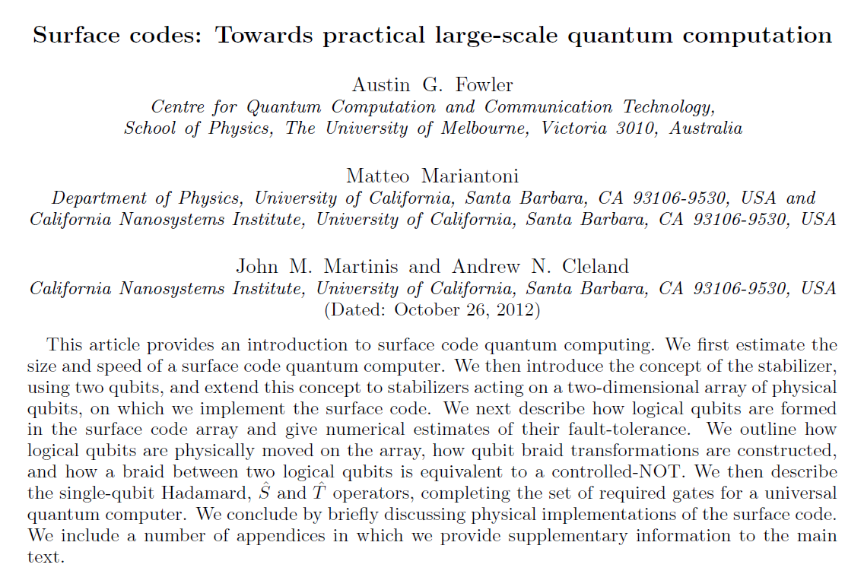
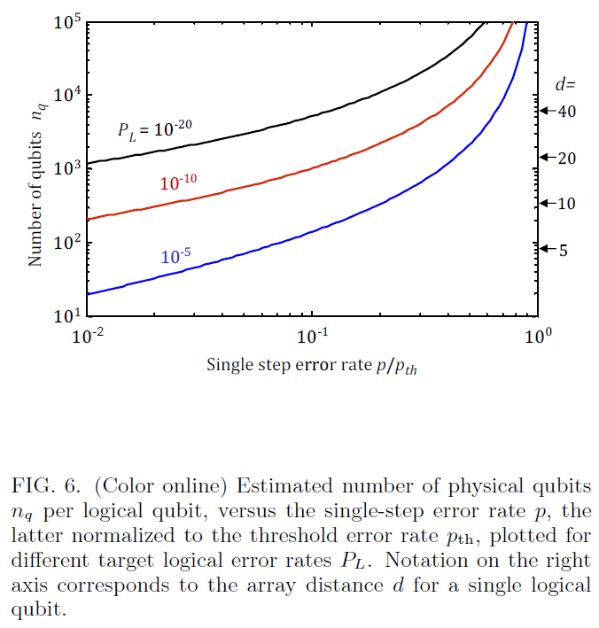
Qubit overhead
pth = 0.57%.

Slide 28
General approach: Error correction
Quantum systems will never be perfect, hence errors will always occur.
If the error rate is small enough, it is possible to detect the errors and correct for them.
Detecting the errors in a non-invasive way creates a strong overhead in the required qubit number.

Slide 29
Agenda for today
11. Challenges in quantum computing
SW-HW gap (qubit quality & number, gate depth)
Error-correction
Scaling challenges
a.
b.
c.

Slide 30
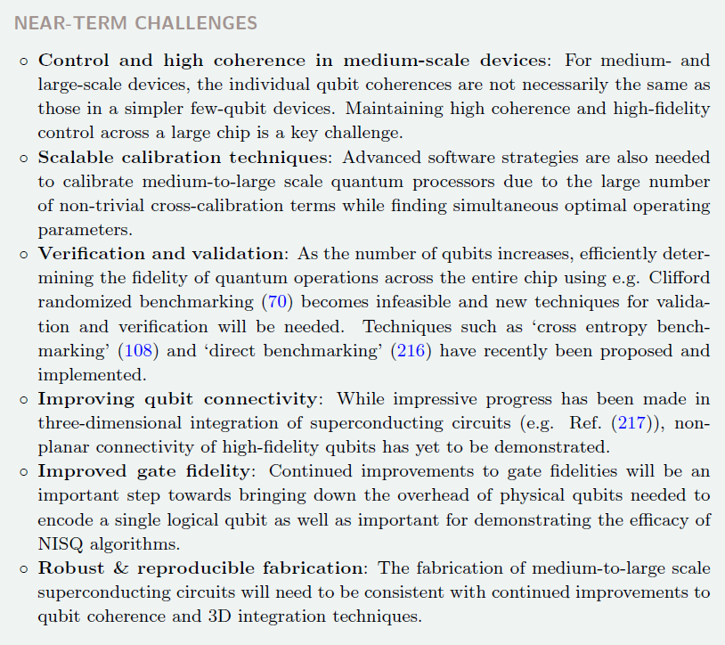
Scaling challenges
Different hardware platforms have different challenges when scaling up the systems. For superconducting systems, a good summary is given on the left.
As a rule of thumb, researchers think that up to 1000 qubits, we can scale using existing technology like coaxial cables and the like. Beyond 1000 qubits, certain components and approaches need to be replaced.
Scaling up the hardware inevitably means that one also must scale the software performance. For example, tuning up a 50-qubit processor “by hand” is impossible.

Slide 31
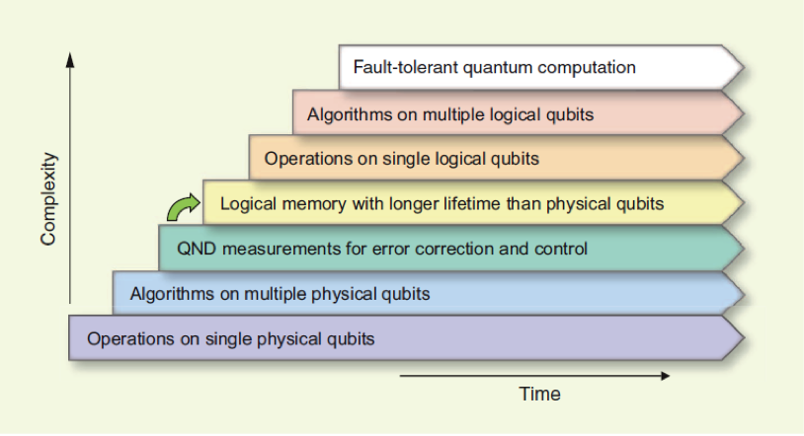
Scaling towards fault-tolerance
One main goal of the community is to reach fault-tolerant quantum computing using error-corrected system. This process requires several steps (see left picture).
To run algorithms on multiple logical qubits, the physical qubit count has to exceed several thousand.
In parallel, control electronics, calibration software, detection schemes and the like need to be improved.
http://qulab.eng.yale.edu/documents/papers/Superconducting%20Circuits%20for%20Quantum%20Information%20-%20An%20Outlook.pdf

Slide 32
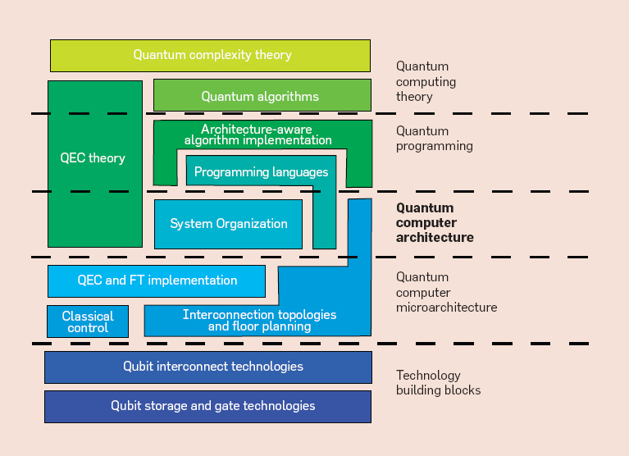
Quantum computer architecture
A quantum computer is much more than just qubits on a chip and microwave electronics. It contains several layers of abstraction.
To build a full-stack scalable systems, all the different layers need to be integrated to each other. This requires the definition of interfaces and standards.
An additional challenge is that people working on the different layers have different background and don’t necessarily speak the “same language”. Fabrication engineers need to understand the challenges of software architects and vice versa.
https://quantumcomputing.stackexchange.com/questions/9067/how-is-a-quantum-computer-programmed

Slide 33
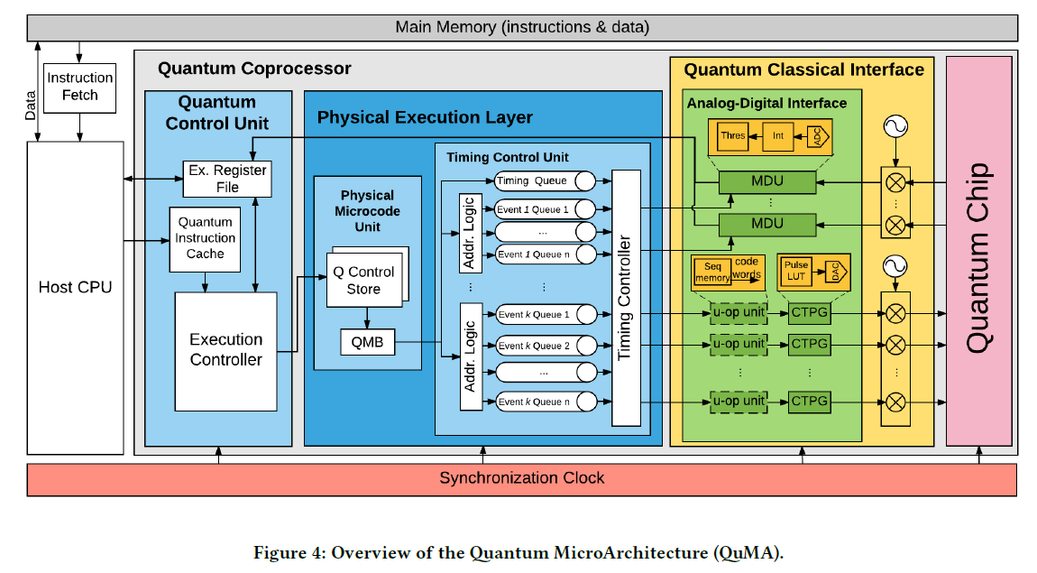
Runtime environment
To operate a quantum computer, many operations need to be coordinated in real-time. The orchestration of the runtime environment is a challenging task.
The real-time execution is usually coordinated by FPGA cards, which are synchronized by a master clock.
The overall control of the system has a host CPU. Hence, quantum computers will never work as a standalone device. Probably they will be integrated into supercomputing centers.
https://arxiv.org/abs/1708.07677

Slide 34
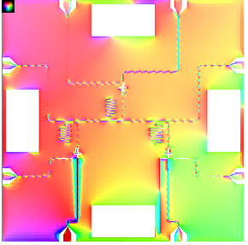
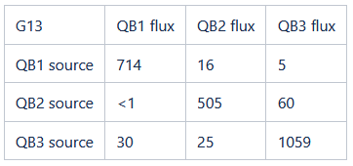
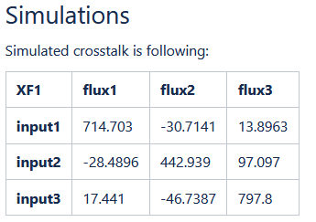
Design challenge: EM Simulations
Experiment
To create a large-scale quantum processor, operating frequencies, coupling strengths, etc need to be carefully designed. This is usually done in FEM simulations.
One task of these simulations is to reduce crosstalk between different on-chip elements because this crosstalk generates errors.
FEM simulations of large system is a challenging task by itself. Usually, superconducting processors have a very large aspect ratio between lateral dimensions and height. This makes the discretization of the geometries hard.

Slide 35
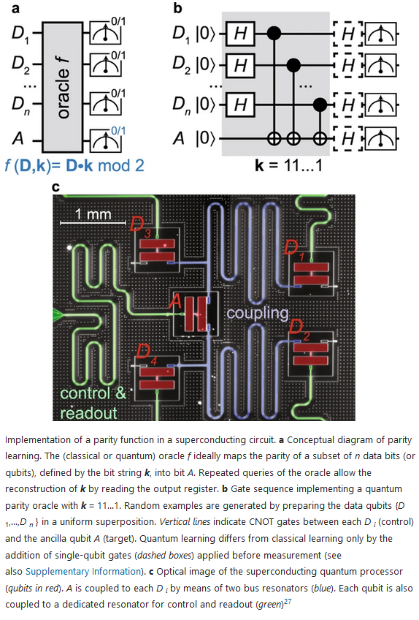
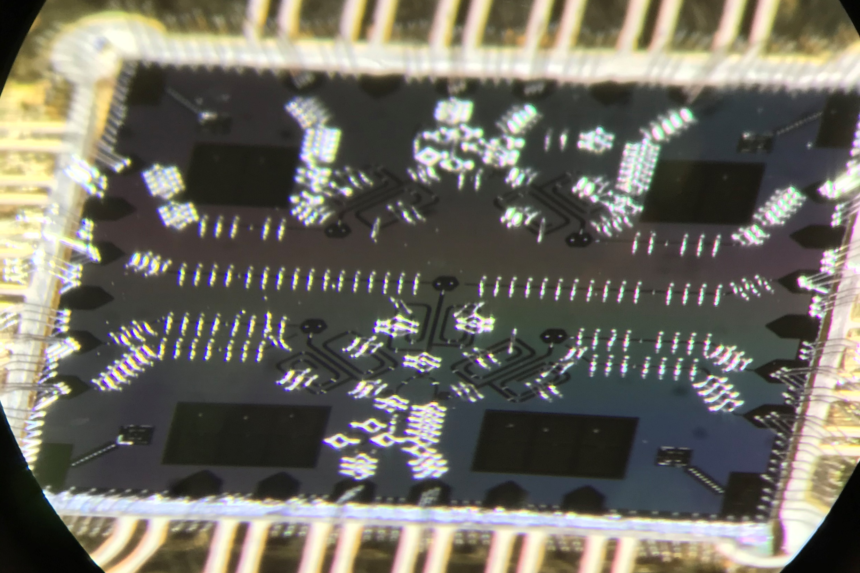
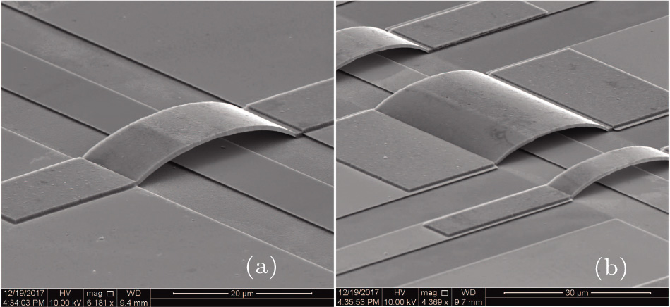
Fabrication challenges
Since superconducting processors are fabricated on silicon wafers, we usually have only 2D spheres available.
Bringing control and readout lines into the center of a larger qubit grid creates a very crowded situation with a lot of crosstalk.
For larger systems, crossing lines are unavoidable. Hence, we must use the third dimension to build scalable quantum processors.
https://www.nature.com/articles/s41534-017-0044-0#Fig1
http://cpb.iphy.ac.cn/article/2018/1958/cpb_27_10_100310.html

Slide 36
Fabrication challenges
https://www.nature.com/articles/s41534-017-0044-0#Fig1

Slide 37
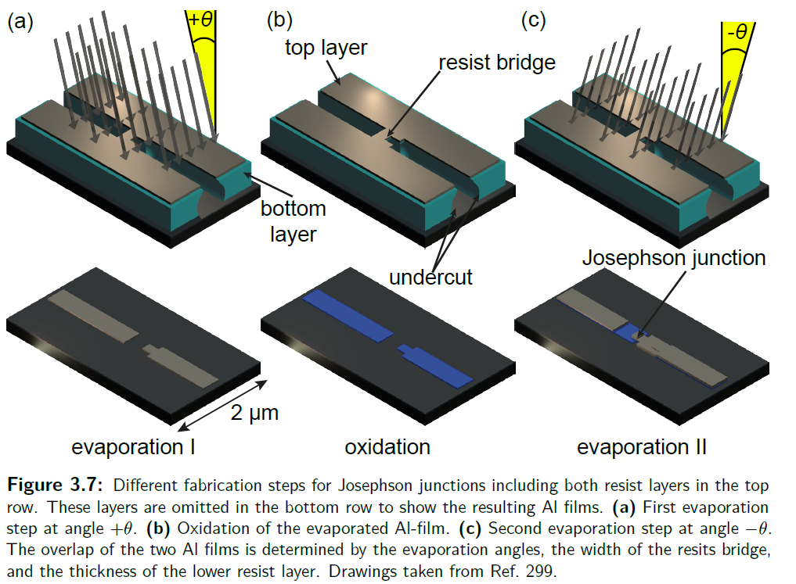
Fabrication of Josephson junctions

Slide 38
Control challenges
Increasing the qubit counts creates an increased amount of control lines.
Microwave signals are carried in bulky coaxial cables (blue on the left).
For larger systems, developing scalable cabling systems is a must-have requirement.
https://www.scmp.com/news/china/science/article/3125539/chinese-scientists-challenge-googles-quantum-supremacy-claim-new

Slide 39
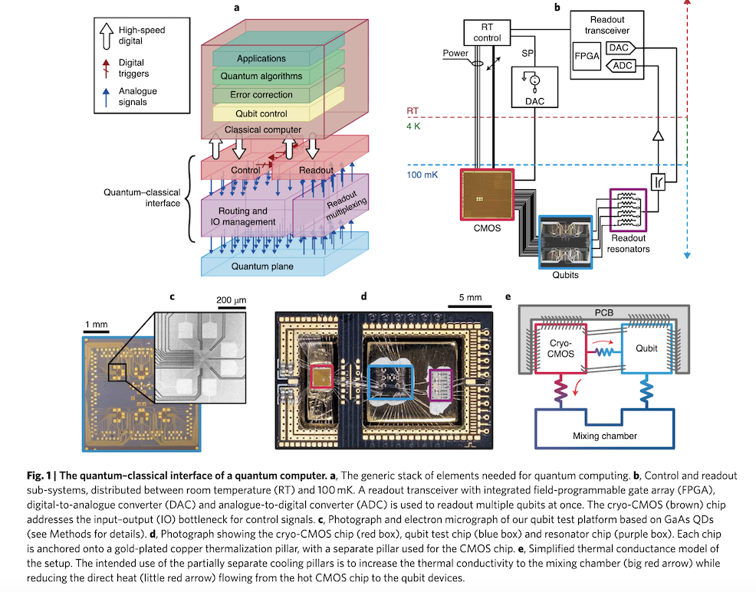
Cryogenic control: CMOS based
For more than 1000 qubits, feeding all control lines into a cryostat becomes hard. Hence, we need alternative solutions to create control signals.
One approach is to create the signals at cryogenic temperatures inside the cryostat using CMOS based circuits.
The disadvantage of this approach is the large heat generation at low temperatures.
https://www.hpcwire.com/2021/01/28/microsoft-develops-cryo-controller-chip-gooseberry-for-quantum-computing/

Slide 40
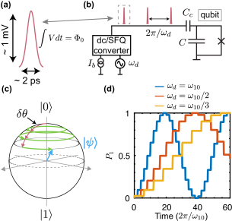
Cryogenic control: JJ based
For more than 1000 qubits, feeding all control lines into a cryostat becomes hard. Hence, we need alternative solutions to create control signals.
Another approach is to create the signals at cryogenic temperatures inside the cryostat using Josephson Junction based circuits.
The advantage of this approach is the low heat generation at low temperatures.
https://www.groundai.com/project/digital-coherent-control-of-a-superconducting-qubit/1

Slide 41
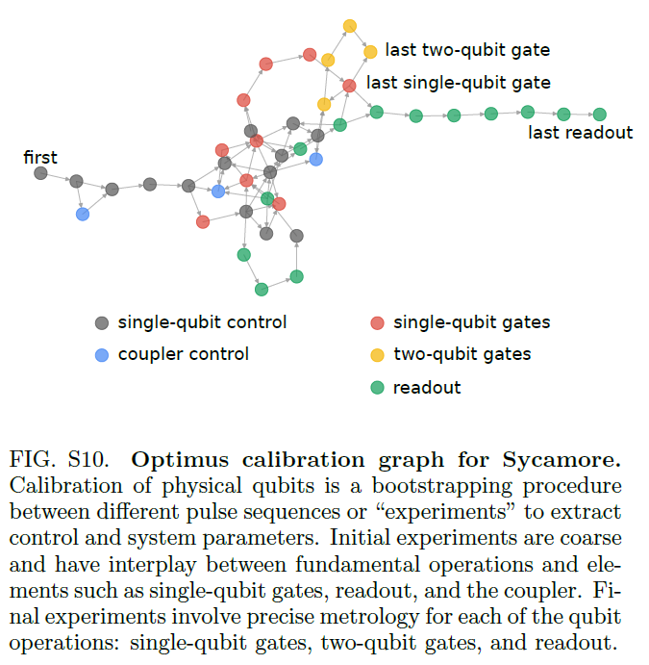
Software challenges: Calibration
Automated tune up of many qubits is a hard task by itself.
People use machine learning tools to create effective methods.

Slide 42
General challenge: Scaling up
Creating a single quantum circuit with high accuracy is simple. Scaling to millions is extremely challenging.
To compensate for the errors of the system, one can detect and correct them. However, error correction creates a qubit overhead of 100 to 1000.
Currently known algorithms require thousands – millions of qubits. Currently available processors contain less than 100 qubits. This is called the Software-Hardware gap.

Slide 43
Agenda for today
11. Challenges in quantum computing
SW-HW gap (qubit quality & number, gate depth)
Error-correction
Scaling challenges
a.
b.
c.

Slide 44
Agenda for lectures 7-11
7. Quantization of electrical networks
a. Harmonic oscillator: Lagrangian, eigenfrequency
b. Transfer step: LC oscillator, Legendre transform to Hamiltonian
d. Quantization of oscillators
8. Superconducting quantum circuits
a. Qubits: Transmon qubit, Charge qubit, Flux qubit 1st DiVincenzo criteria
b. Circuit-QED: Rabi model
c. Rotating Wave approximation: Jaynes-Cummings model
9.Single-qubit operations:
Initialization 2nd DiVincenzo criteria
Readout 5th DiVincenzo criteria
Control:T1, T2 measurements, Randomized benchmarking 3rd DiVincenzo criteria
10. Two-qubit operations: Architectures for 2-qubit gates 4th DiVincenzo criteria
a. iSWAP
b. cPhase
c. cNot
11. Challenges in quantum computing
SW-HW gap (qubit quality & number, gate depth)
Error-correction
Scaling challenges

