Slide 1
Sustainability in Business
Jukka Rintamäki jukka.rintamaki@aalto.fi
21E16000, Period V, 2023
Notes:
https://www.youtube.com/watch?v=KtSOYEr-rYQ
https://www.youtube.com/watch?v=jltnBOrCB7I
https://www.youtube.com/watch?v=VdLf4fihP78 ( about 6:30)

Slide 2
“We have become, by the power of a glorious evolutionary accident called intelligence, the stewards of life’s continuity on earth. We did not ask for this role, but we cannot abjure it. We may not be suited to it, but here we are.” (Gould, 1985, p. 431)

Slide 3
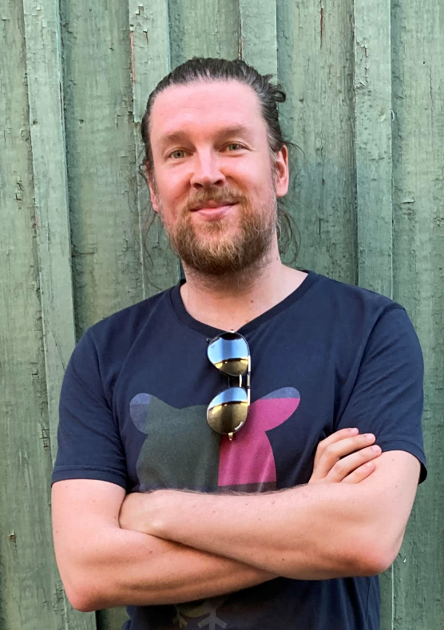
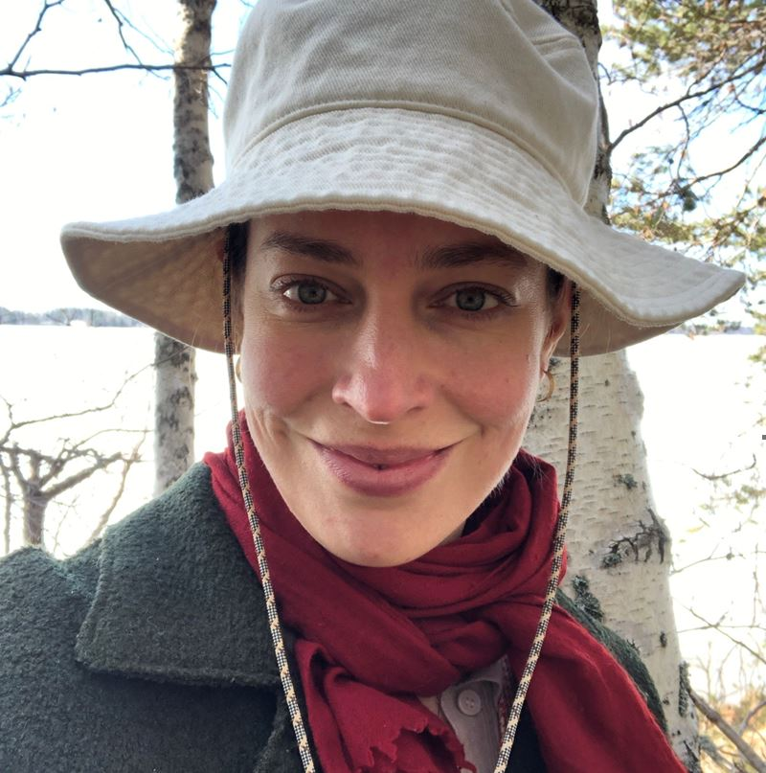
Course faculty
Martta Nieminen
martta.nieminen@aalto.fi
Jukka Rintamäki jukka.rintamaki@aalto.fi

Slide 4
Session agenda
Practicalities
State of the world
What is sustainability?
Individual in-class assignment
Action
Dissemination of results

Slide 5
Learning objectives of this session
Develop a basic understanding of
  The state of the world regarding sustainability challenges
  What is meant by sustainability and sustainable development
  What are the current conceptions of corporate sustainability, and how they relate to environmental and social sustainability

Slide 6
Practicalities
Those present: Please have nametags out every lecture
Please bring your laptops (or at least mobile phones) to class
  But keep them in your bags/pockets/inactive unless told otherwise
Let’s try to keep an interactive atmosphere – feel free to raise your hand if you have any comments or questions!

Slide 7
Aims and objectives
After completing this module, you should be able to:
Understand and analyze the core tensions between business, society, and the environment
Understand key terminology and frameworks in business sustainability and apply different sustainability tools in existing businesses
Analyze the preferences of different stakeholders and how these pressures shape a company's sustainability actions
Create plans for sustainability transformations by evaluating sustainability practices in existing businesses and considering financial realities

Slide 8
Structure
Tue. 26.4.
Practicalities + Sustainability and business
Thu. 28.4.
Sustainability strategies
Tue. 2.5
Organizing for sustainability
Thu. 4.5
Sustainability innovation
Tue. 9.5
Student presentations (management instruments)
Thu. 11.5
Sustainability communication
Tue. 16.5
Stakeholder management simulation
Tue. 23.5
Supply chain management
+
Herman Miller case
Thu. 25.5
Circular economy
Tue. 30.5
Sustainable finance
Guest lecturer: Kaja Lilleng
Thu. 1.6
Systems change for sustainability
Guest lecturer: Iana Nesterova
To get a final grade, you must attend at least 7 (of 11) lectures.
Sign attendance sheet.

Slide 9
Grading
10% Group presentation
  Deadline: 9.5. at 12.00pm
20% Herman Miller case
  Deadline: 23.5. at 12.00pm
20% Individual written assignment
  Deadline: 6.6. at 23.59
50% Final group project
  Deadlines
    Group sign-up: 28.4. at 15.00
    Group contract & topic choice: 5.5. at 23.59
    Final report: 9.6. at 23.59

Slide 10
Individual written assignment
Write a reflection of two key course papers of your choosing
  List of key papers in syllabus
  400-500 per reflection
  Provide both reflections in one document

Slide 11

Groups
4-5 students per group (no more), depending on final class numbers. You get to choose your group members, and sign-up is on MyCourses.
  In the Assignments + Submission points page
    Announce your groups in the Group project topic choice forum
Working in groups: Instructions for effective group work, peer evaluation, and group contract form are available in MyCourses
When turning in group assignments on MyCourses, only one member of the group needs to turn in the assignment
You will work with the same group in the different group assignments

Slide 12
Group presentation (management instruments)
A 5min presentation of a sustainability management instrument
Two components for each instrument:
  An introduction
  A critical analysis
The instrument and group roles will be determined by course faculty

Slide 13
Herman Miller case
You will work in groups
You will be provided
  Case materials
  Assignment
You will be expected to deliver a case report
The case is discussed in class (23.5.)
Detail on the word count will be provided soon

Slide 14
Final project
A project on the sustainability profile of a company of your group’s own choosing
Either from the perspective of
  A business world insider or
  An external such as a journalist or NGO
Report on the sustainability performance of the firm
  Compare to competition
  Key recommendations
Max. 3,500 words

Slide 15

Tips for studying effectively
Start early
Test yourself
Write notes
Avoid multitasking
Ask questions
Draw pictures
Develop the right habits
See for more detail: How students can make the most of online learning by Leonard Houx and André Spicer

Slide 16
Background to my pedagogical aims
Key motivation: To assist you develop your interpretive repertoire
Interpretive repertoire: The paradigmatic, theoretical, and methodological qualifications that guide and constrain your thinking
  Includes: Theories, basic assumptions, commitments, metaphors, vocabularies, knowledge
Interpretive repertoire impacts on the struggles of “getting control over how we see things, so that we are not simply the unknowing carriers of the conventional world's thoughts.“
Key reference:
Alvesson & Kärreman, 2007

Slide 17
Questions?
martta.nieminen@aalto.fi

Slide 18
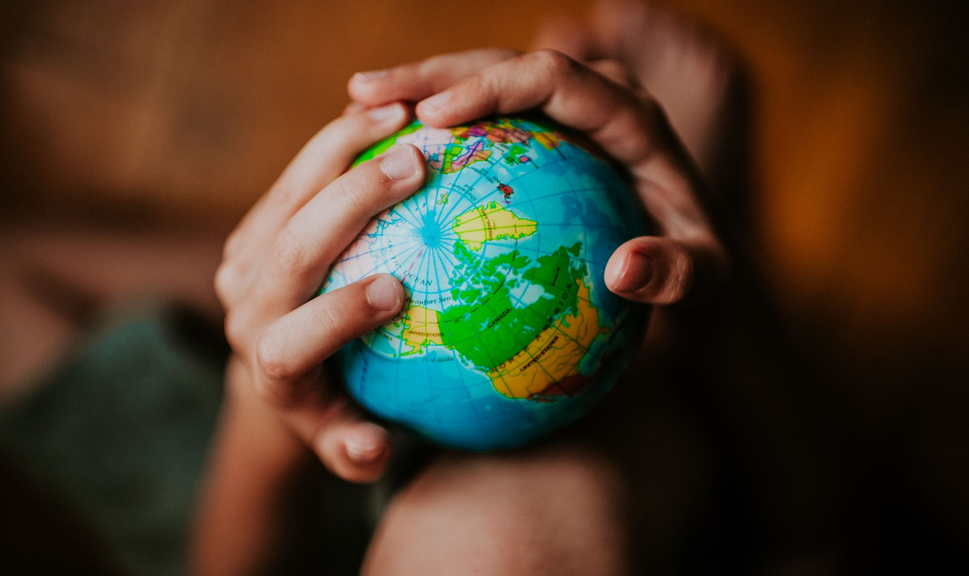
The state of the world
Where sustainability efforts thus far have taken us

Slide 19

So we didn’t have a great year, sustainability-wise
Heatwaves in Europe: More than 16,000 dead, cost $20 billion
Flooding in Pakistan: 50 million people dislocated, 1,700 dead, cost $5.6 billion
Droughts in China: Yangtze river at its lowest since 1865, cost $8.4 billion
Record-breaking heatwaves in India and Pakistan: Temperatures over 50 Celsius
Etc.

Slide 20
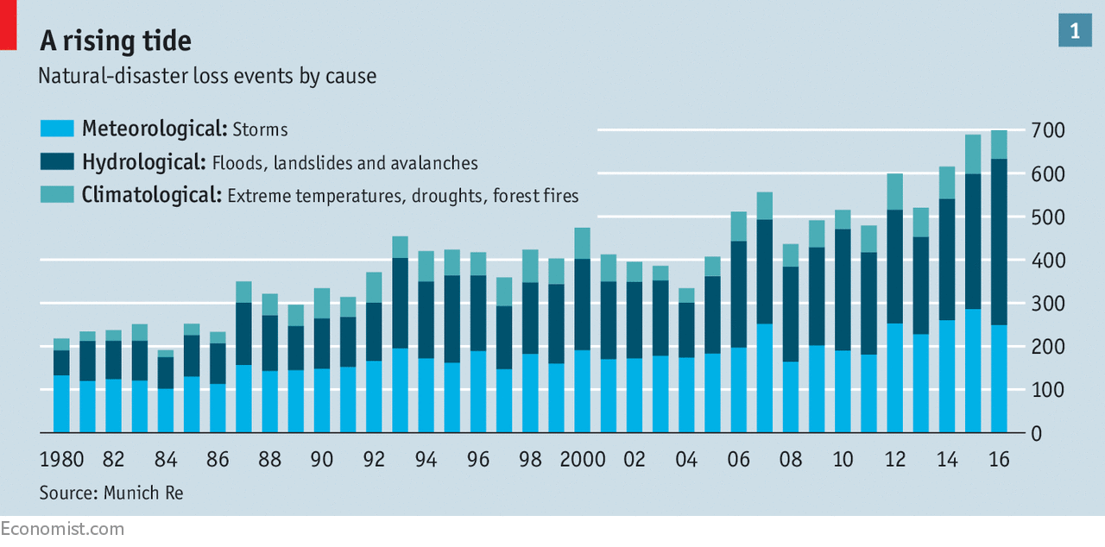
Not just 2022
Source: https://www.economist.com/briefing//the-likelihood-of-floods-is-changing-with-the-climate2017/08/31

Slide 21
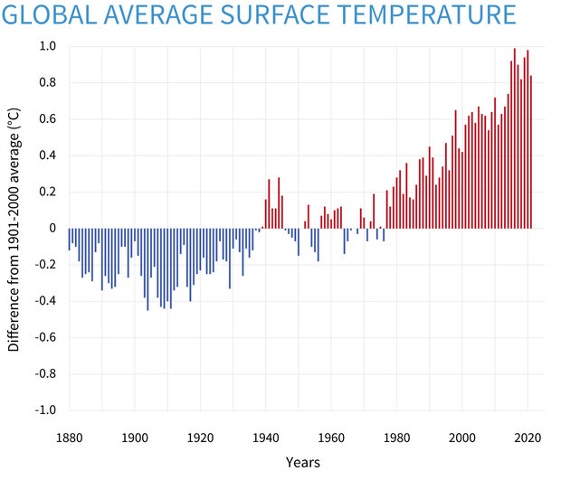
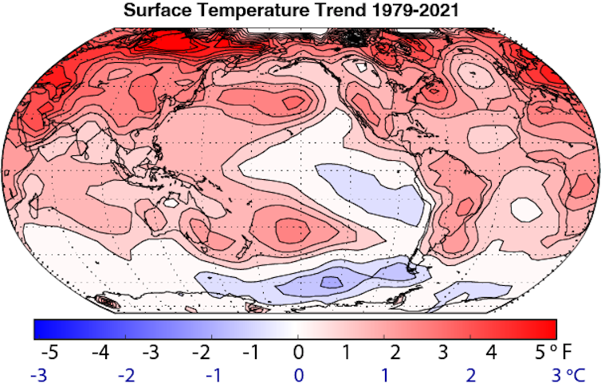
Not just 2022
Sources: https://theconversation.com/2022s-supercharged-summer-of-climate-extremes-how-global-warming-and-la-nina-fueled-disasters-on-top-of-disasters-190546
https://climate.nasa.gov/vital-signs/global-temperature/

Slide 22
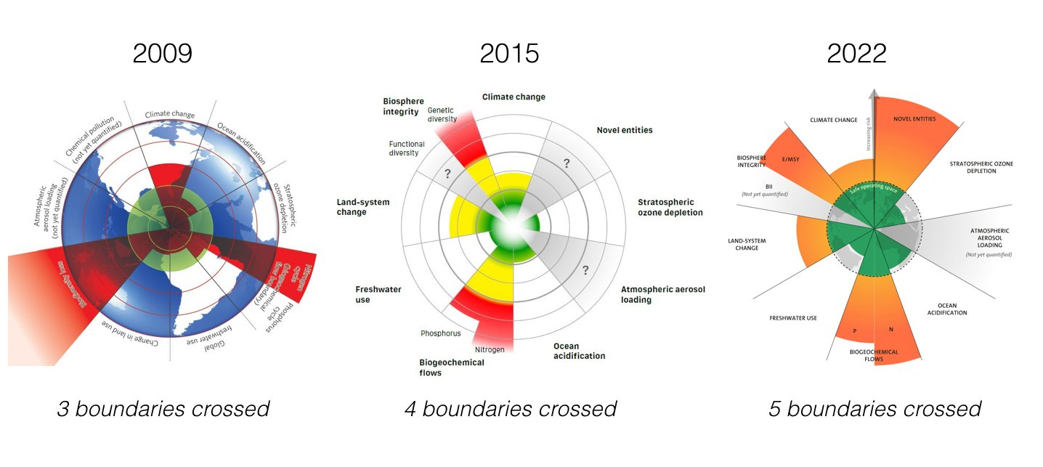
...and not just about climate
Source: https://www.stockholmresilience.org/research/planetary-boundaries.html
Notes:
E/MSY = rate of extinction
BII = ”an indicator of the average abundance of a large and diverse set of organisms in a given geographical area, relative to their reference populations” - Biggs, R., & Scholes, R. J. 2005. A biodiversity intactness index. Nature, 434(7029): 45–49.

Slide 23
We keep making the crisis worse

Slide 24
Environmental vs social boundaries

Slide 25
Projections

Slide 26
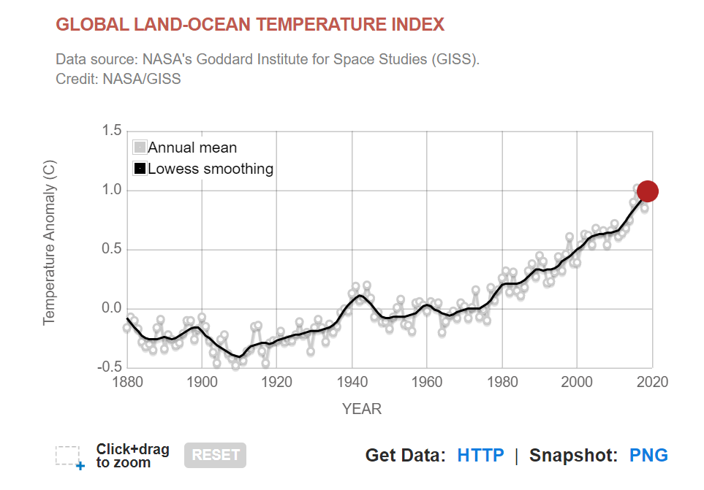
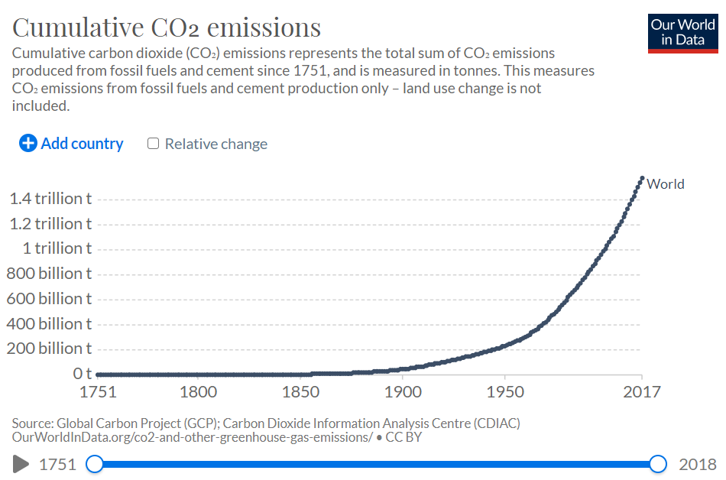
Climate change is accelerating
The term ‘sustainable development’ was coined in 1987
Big oil have known about fossil fuel contribution to global warming from the 1970s
We have doubled our global cumulative CO₂ emissions since 1990
The rising trend in global temperatures continues
  We’re at +1.2C since pre-industrial times
    +1C since the 1970s
→ We must be doing something wrong
Sources:
https://climate.nasa.gov/vital-signs/global-temperature/
https://ourworldindata.org/grapher/cumulative-co-emissions?tab=chart&country=~OWID_WRL

Slide 27
What about biodiversity?
Watch the video on the next slide and pay attention to the following issues:
What are the primary problems outlined in the video?
What are some of the key figures cited?
What kinds of solutions are proposed?
What signals doom? How about hope?

Slide 28
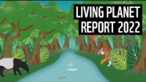
What about biodiversity?
An average 69% decline in monitored wildlife populations since 1970
  94% in Latin America
  83% in freshwater species populations

Slide 29
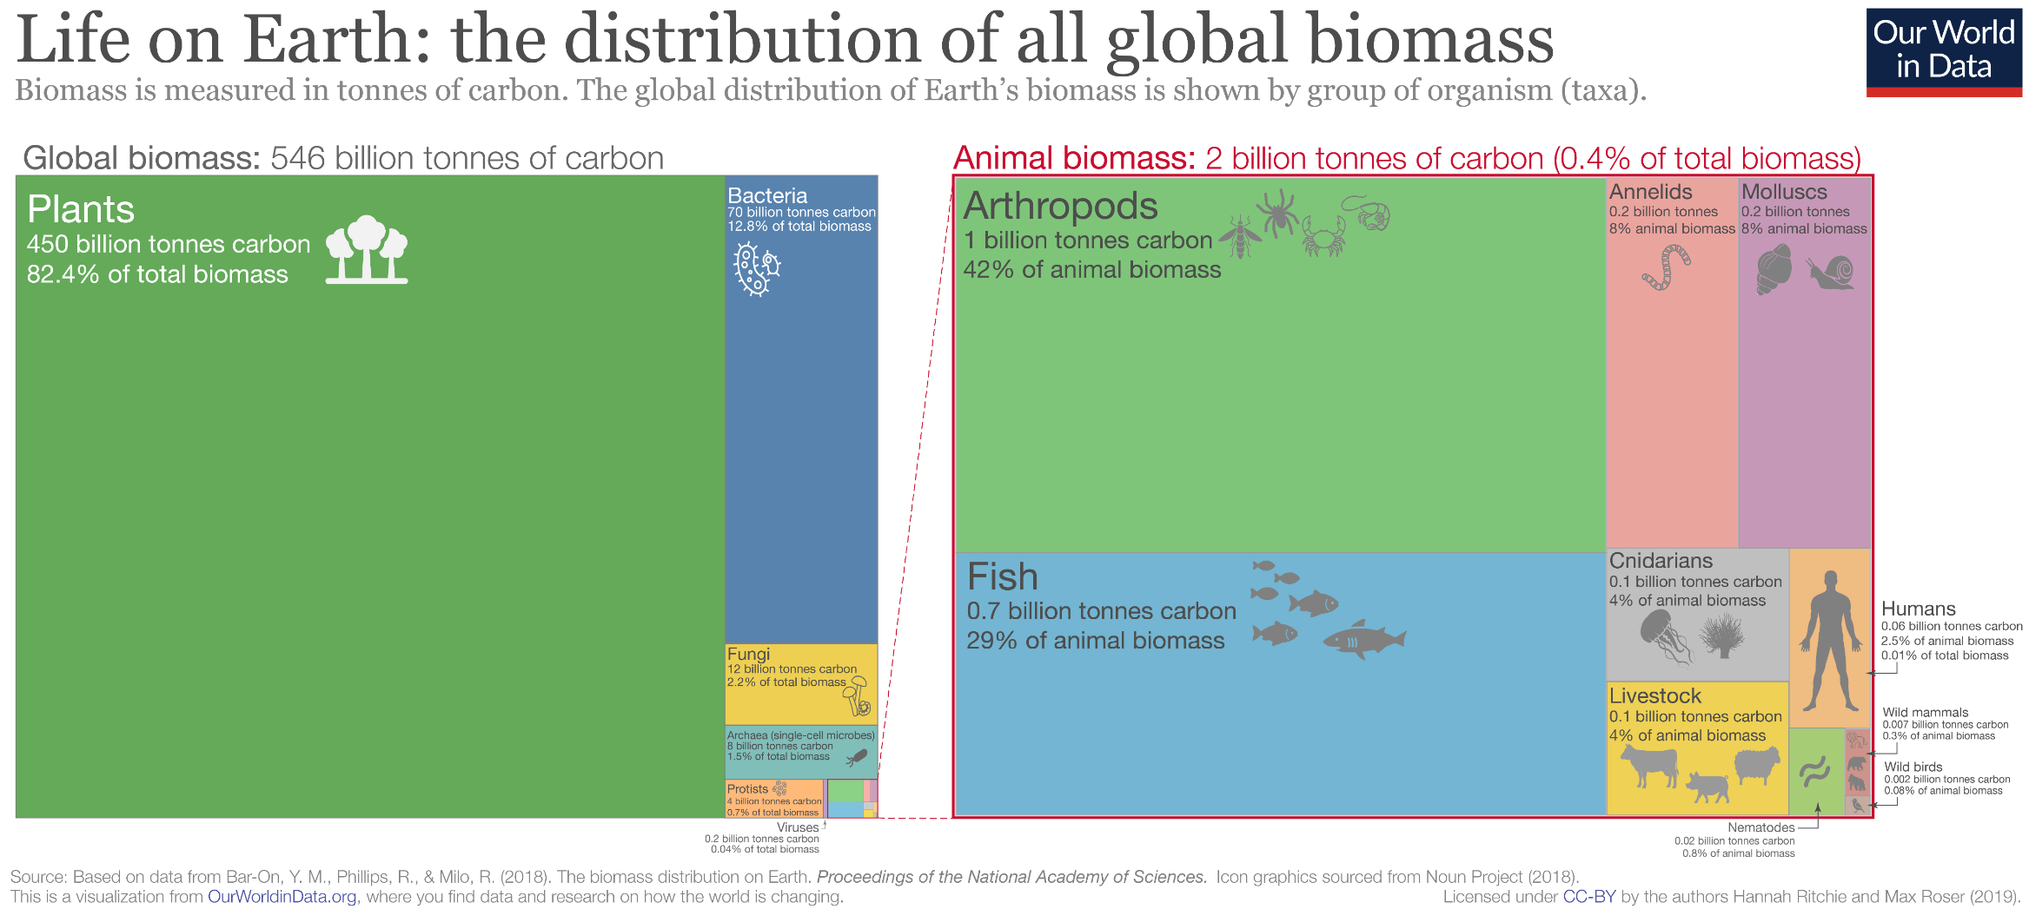
Source:
https://ourworldindata.org/life-on-earth

Slide 30
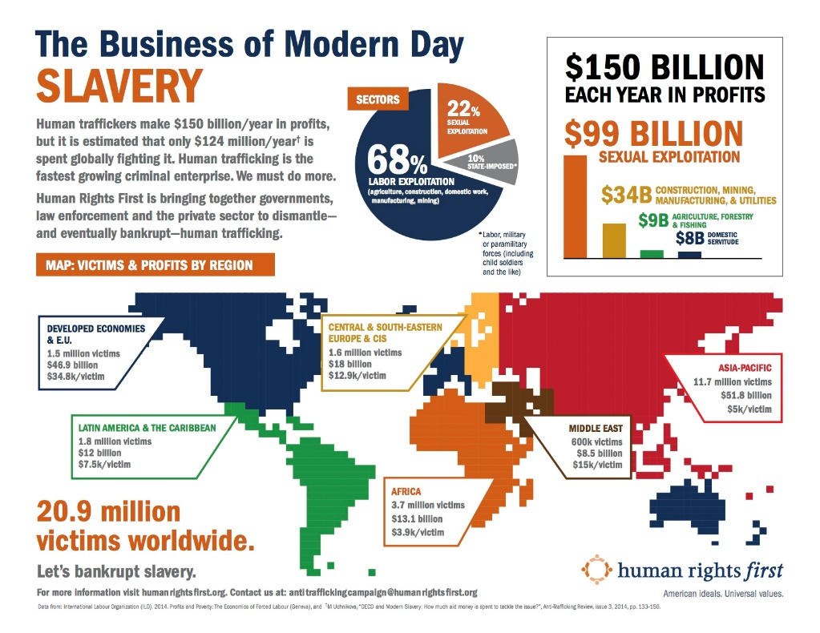
Not just the environment
Modern slavery
Global poverty
Mental health issues
Etc.

Slide 31

Where does all this come from?

Slide 32
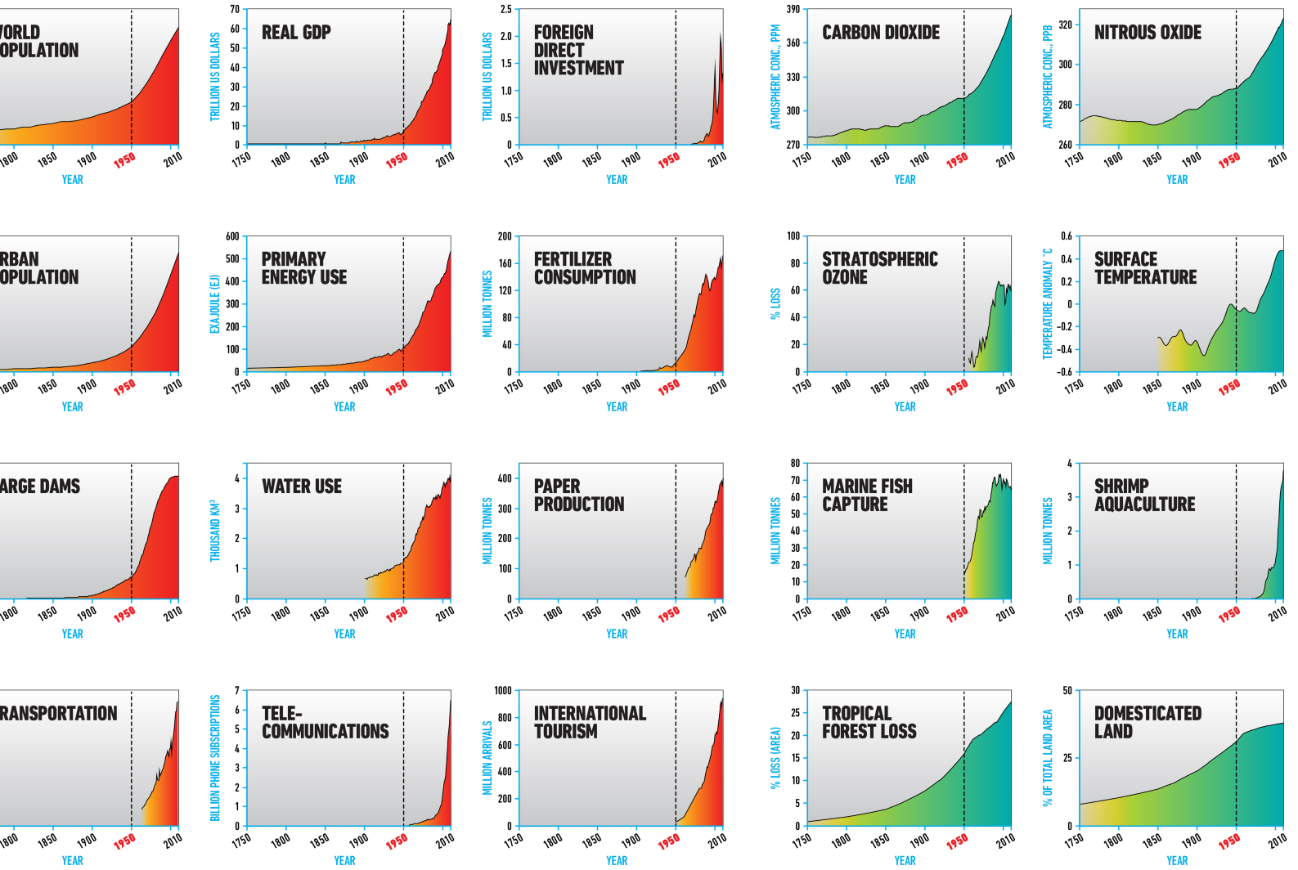
The great acceleration
Source: Steffen et al., 2015

Slide 33
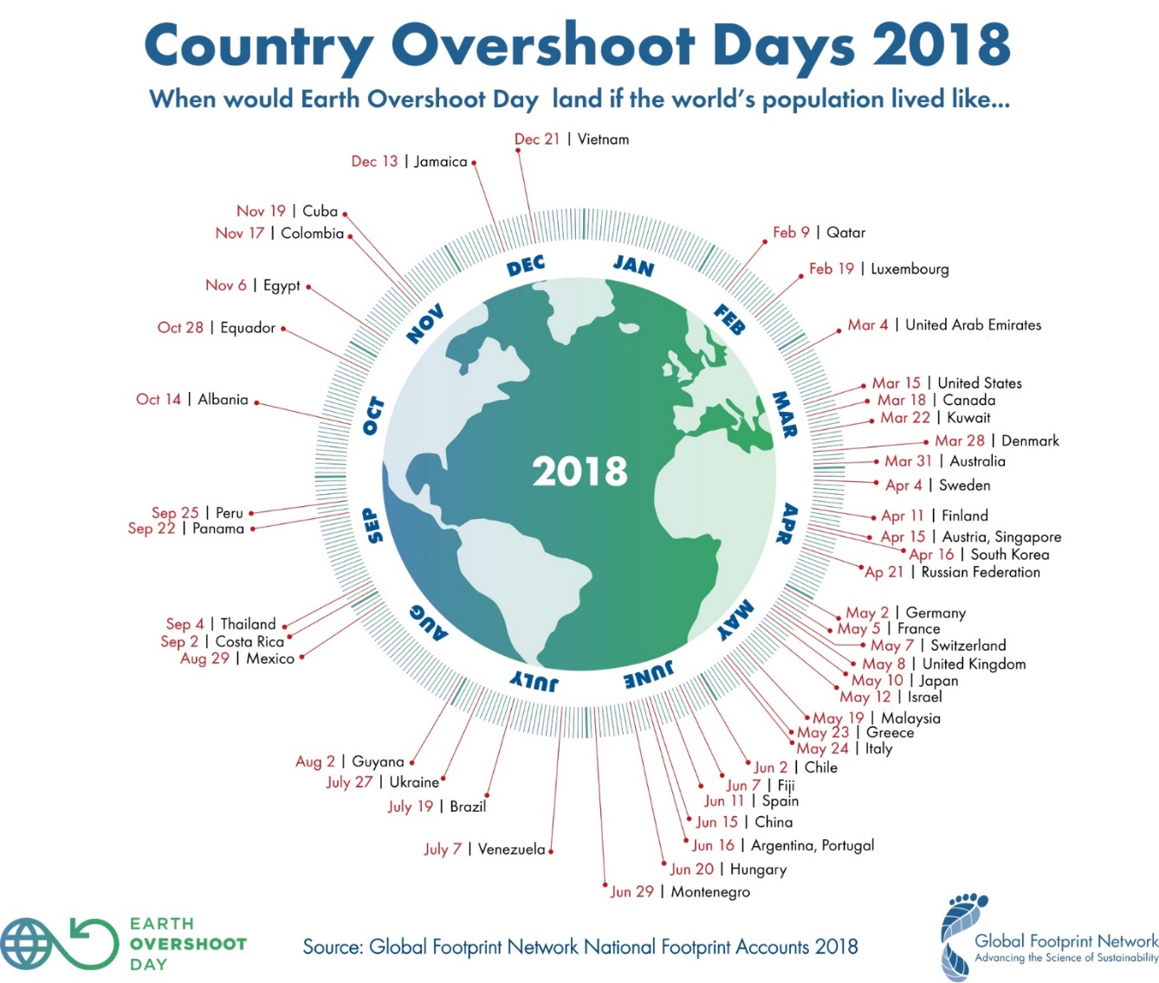
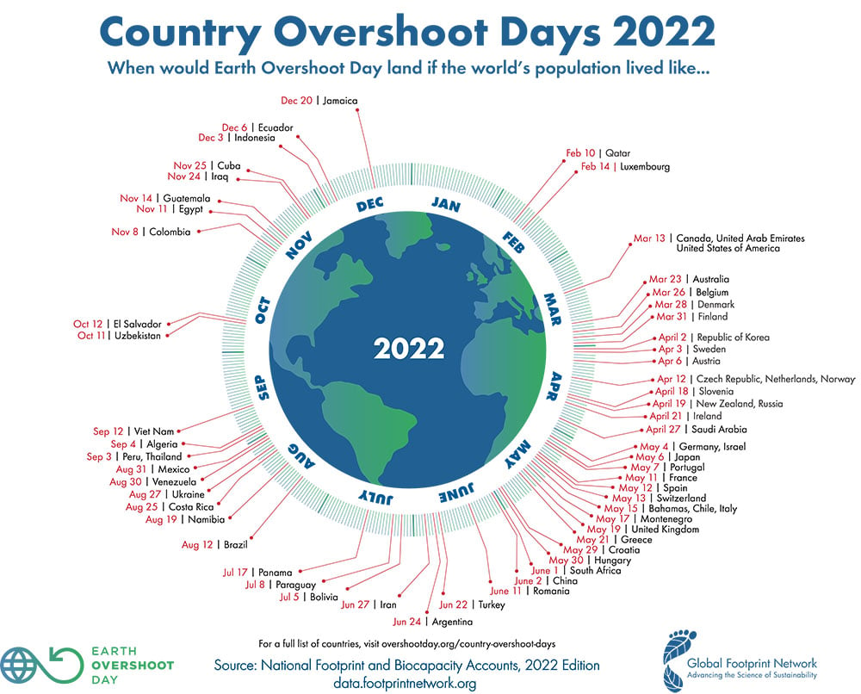
Dwindling natural resources
Source: https://www.footprintnetwork.org/our-work/earth-overshoot-day/

Slide 34
Who emits CO₂?
71% of contemporary CO₂ emissions come from 100 companies
100 fossil fuel producers (plus 8 defunct entities) responsible for 62% of all CO₂ emissions since 1751
25 state or corporate entities since 1988 producers account for 51% of emissions.
Carbon Majors Report, 2017

Slide 35
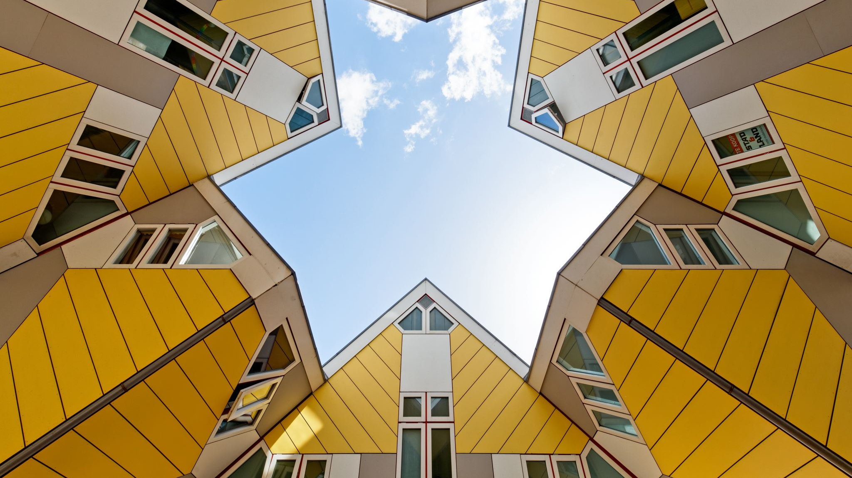
How to cope: Sustainable development
”Development that meets the needs of the present without compromising the ability of future generations to meet their own needs.”
Our common future, 1987

Slide 36
What’s sustainability?
Economy
Environment
Society
Economy
Environment
Society
Weak
sustainability
Strong sustainability
Notes:
Two problems with weak sustainability:
Economy tends to take over, due to its prevalence and its comparatively immediate time frame
These three are not actually equal

Slide 37
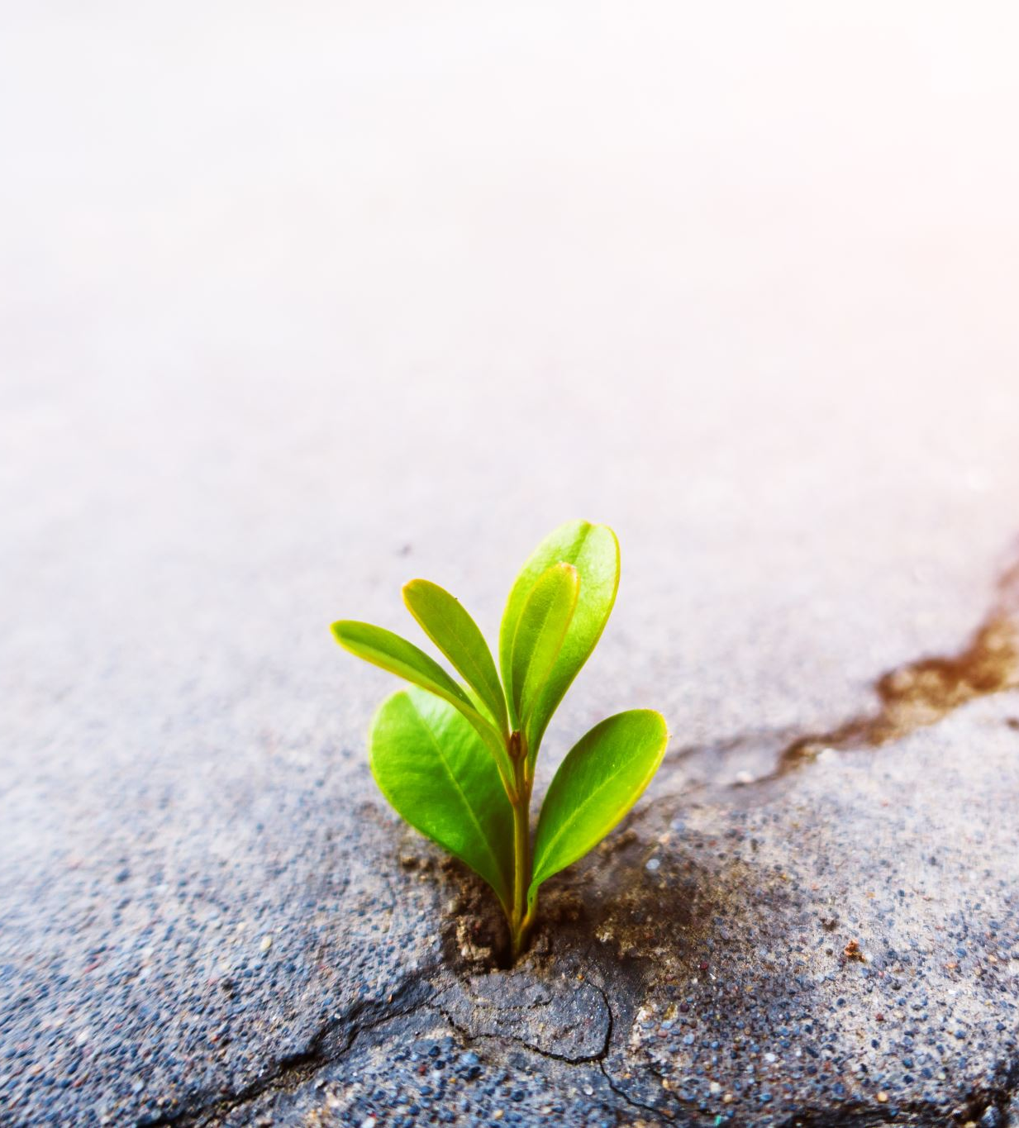

Wrap-up
We’re quite deep into unsustainability
  Our ecological system is struggling to accommodate us the way we live
The primary cause for all of the (un)sustainability problems we have stem from us; human activity
We have known about these issues for a long time, but gone about solving them weakly
A sustainable way forward can only be conceived if we prioritize the planet and people over profit
  Profit can still be made!

Slide 38
References
Alvesson, M., & Kärreman, D. 2007. Constructing mystery: Empirical matters in theory development. Academy of Management Review, 32(4): 1265–1281.
Brundtland, G.H., Khalid, M., Agnelli, S., Al-Athel, S. and Chidzero, B.J.N.Y., 1987. Our common future. New York, 8.
Fanning, A. L., O’Neill, D. W., Hickel, J., & Roux, N. 2022. The social shortfall and ecological overshoot of nations. Nature Sustainability, 5(1): 26–36.
Landrum, N. E. 2018. Stages of Corporate Sustainability: Integrating the Strong Sustainability Worldview. Organization and Environment, 31(4): 287–313.
J. Rockström, W. Steffen, K. Noone, Å. Persson, F. S. Chapin, et al. 2009. A safe operation space for humanity. Nature, 461(September).
Steffen, W., Broadgate, W., Deutsch, L., Gaffney, O., & Ludwig, C. 2015. The trajectory of the anthropocene: The great acceleration. Anthropocene Review, 2(1): 81–98.
Steffen, W., Richardson, K., Rockström, J., Cornell, S. E., Fetzer, I., et al. 2015. Planetary boundaries: Guiding human development on a changing planet. Science, 347(6223). https://doi.org/10.1126/science.1259855.
Whiteman, G., Walker, B., & Perego, P. 2013. Planetary Boundaries: Ecological Foundations for Corporate Sustainability. Journal of Management Studies, 50(2): 307–336.

Slide 39
Individual/group in-class assignment
Complete the carbon footprint calculator (10-15 mins)
  https://www.footprintcalculator.org/
  Reflect on the ”How do you feel” and ”Explore your data” sections
    How did the results make you feel? Any thoughts on the differences between the countries?
Discuss the results with classmates near you (10 mins)
Discussion with the entire class (10 mins)

