Slide 1

Sustainability & Strategy
Jukka Rintamäki
Martta Nieminen
Sustainability in Business 27 April, 2023

Slide 2
Reviewing previous lecture
We discussed some primary sustainability problems that we’re collectively facing
  Biodiversity loss, climate change, chemical flows/accumulation...
  Poverty, modern slavery, human rights issues more broadly...
We learned to distinguish between weak and strong sustainability
What else?
Questions?

Slide 3
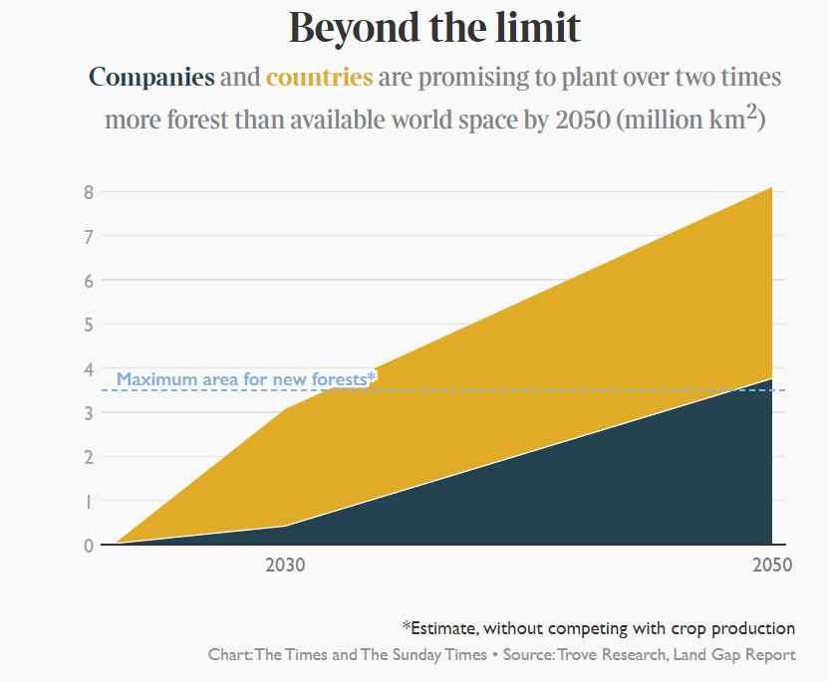
A reminder: systems perspective

Slide 4
Agenda
What is (strategic) corporate sustainability?
The story so far
What are the most common approaches to sustainability?
What critique is there regarding these common approaches?

Slide 5

Expected learning outcomes
Develop a basic grasp of the background/history of corporate sustainability
Develop an understanding of what is meant by contemporary, strategic corporate sustainability
Learn basic concepts around corporate sustainability
Know the basic critiques of integrated/strategic corporate sustainability

Slide 6

The story so far

Slide 7
Three waves of business sustainability
Source:
Hoffman & Bansal, 2012

Slide 8
Late 1960s-1970s
First wave:
Regulatory compliance
Triggered by various acknowledged threats to the natural environment
  The Silent Spring (1968 book by Rachel Carson)
  The formation of the Club of Rome (1969); Santa Barbara oil spill (1969); the first Earth Day (1970)
Environmental government agencies were formed (e.g. EPA in the US)
Corporate departments in the style of ”Environmental Health & Safety” started appearing
  Environmental issues were not a matter of huge importance for corporations, and these departments mostly focused on fulfilling legal requirements

Slide 9
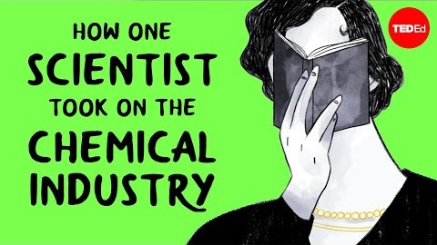
Rachel Carson’s Silent Spring

Slide 10
Late 1980s-1990s
Second wave:
Strategic environmentalism
Triggered by
  The Union Carbide Bhopal plant disaster of 1984
  Discovery of the Antarctic ozone hole, the Brundtland report, formation of IPCC, Exxon Valdez oil spill
Insurers started taking pollution issues into account
Investors started to consider environmental liabilities in their portfolio
Environmental issues thus became a strategic concern for firms
  Waste minimization and eco-efficiency became fashionable
  Increased organizational importance and power for environmental departments
Environmental issues entered the mainstream academic literature on business management

Slide 11
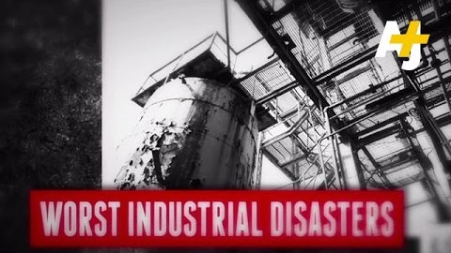
The Union Carbide Bhopal disaster

Slide 12
2010 →
Third wave:
Corporate sustainability
Triggered by
  Growing scientific consensus that humans are impacting the global climate through the release of greenhouse gases into the atmosphere
Characterized by mainstreaming of sustainability
  Firms integrate sustainability into their core strategies
  Universities promote sustainability in their curricula, and it’s mainstream in mgmt research
  Sustainable products, cars, food, transportation proliferate, and sustainability has become a token of legitimacy

Slide 13
Strategic sustainability?
”Strategic” refers to actions that are taken with particular purposes or goals in mind, typically with long-term considerations in mind
  Can be applied with all sorts of goals in mind
  With a typical business, this means that strategic CSR implies (expected) economic gains become a necessary condition for CSR-related activities
Sustainability strategies are choices available to managers to align environmental and social activities with the generic strategy of the company
Notes:
Creating shared value: akin to the Ford Model T, where Henry Ford’s idea was that by paying higher wages to workers they also generate demand for their products in the form of affluent consumers
2011: Something has been lost in the race for short-term profits; there are differences between kinds of profitability

Slide 14
Definitions are easy, but…
Sustainability is multi-faceted as it involves multiple goals areas: environmental, social, economic - Triple bottom-line as opposed to single financial bottom-line
When planning a sustainability strategy, managers essentially have to consider and decide how to put together financial, environmental and social goals.
Key questions:
  How can we combine ecological, social and financial goals?
  Are sustainability and corporate responsibility financially profitable? Is there a business case for sustainability? (“win-win”)
  Or is it just an additional cost? (“win-lose”)

Slide 15

Approaches to sustainability strategy

Slide 16
Three general approaches
Corporate sustainability as philanthropy
Charity, employee voluntarism, sponsorships etc.
Corporate sustainability as integration
Improving sustainability aspects of existing products, processes and operations
Comply with standards, acquire certificates, develop environmental management systems...
Corporate sustainability as innovation
Solving social and/or ecological problems with own (new) products, services and business models (e.g. eco-innovations or inclusive innovations for poverty alleviation)

Slide 17
Integrated corporate sustainability
Relationship to core business: Close to existing core business
Target of sustainability: Environmental and social performance of existing business operations
Expected benefits: Improvements of env. and soc. aspects of core business, image and reputation improvement
Aim: To conduct existing business more sustainably
Examples: Certification of facilities with environmental or social standards (e.g. ISO14001; SA8000), having environmental management systems in place, producing standardized sustainability information (e.g. GRI)
Source:
Halme & Laurila, 2008

Slide 18
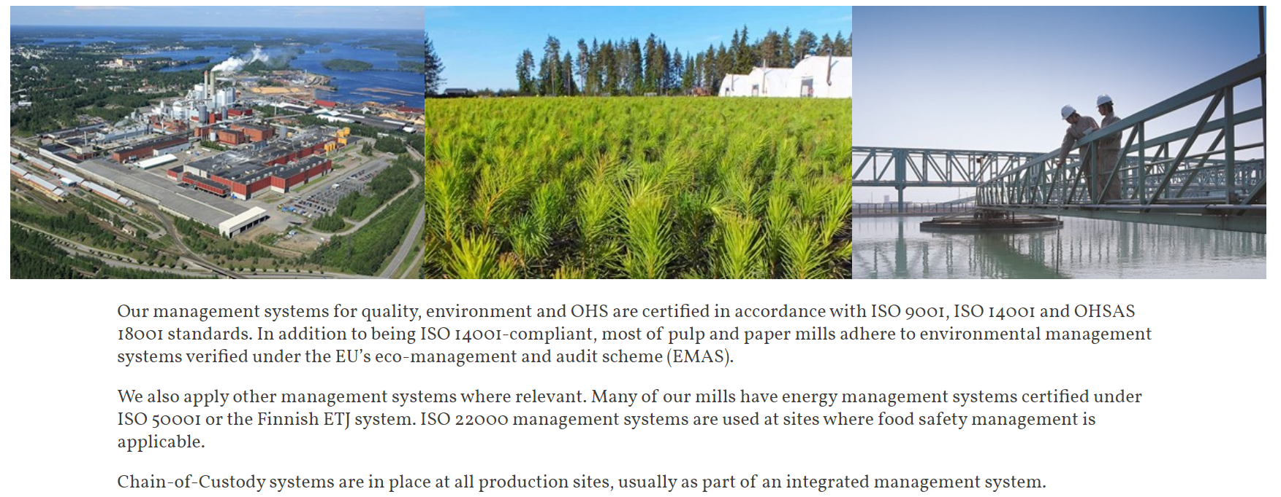

Example of integrated corporate sustainability

Slide 19
Innovative corporate sustainability
Relationship to core business: Enlarging core business or developing a new business model
Target of sustainability: New product or service development
Expected benefits: Alleviation of social or environmental problem
Aim: Generating genuine win-win situations where the benefits for the environment or people are (at least) on par with the business benefit
Examples: Various forms of social entrepreneurship or base-of-the-pyramid business models, innovative new products or services etc.
Source:
Halme & Laurila, 2008

Slide 20

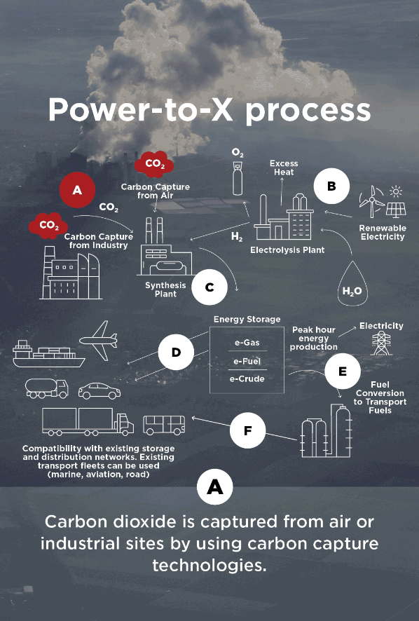
Example of innovative corporate sustainability
St1 has been designing a variety of waste based or assisted fuel manufacturing facilities/technologies
E.g. producing methanol using CO2 captured from a local cement factory
St1 thus generate revenues through the reduction of CO2 emissions generated by other companies

Slide 21
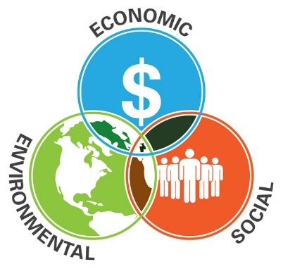
Triple-bottom line
A framework that stresses the reporting of social, environmental, and economic dimensions of corporate activity
Not a formal system of reporting as such, but is typically conducted through a more formal system such as the GRI
Impetus is on generating more value through consideration of a broader set of stakeholders; commonly associated with eco-efficiency
The background ’philosophy’ emphasizes win-win situations

Slide 22

Critiquing strategic corporate sustainability

Slide 23
Will sustainability strategy improve environmental and social performance?*
STRATEGIC sustainability management
OPERATIVE sustainability management: Implementation
Structures
”Hard”
Improved
sustainability performance
Sustainability pressures in institutional environment
Strategic goals
!
!
Practices
”Soft”
!
Risk of PRESSURE-POLICY decoupling
Risk of POLICY-PRACTICE decoupling
Risk of MEANS-ENDS decoupling
”Try but fail”: ineffective
implementation
Non-improved
sustainability performance
”Look as if”: symbolic or no implementation
”Not even try”: non-conforming response, unambitious goals
*Sustainability case
Halme, M., Rintamäki, J., Knudsen, J., Lankoski, L. and Kuisma, M. 2020. When Is There a Sustainability Case for CSR? Pathways to Environmental and Social Performance Improvements. Business and Society 59 (6): 1181-1227
Notes:
Halme, M., Rintamäki, J., Knudsen, J., Lankoski, L. and Kuisma, M. 2020. When Is There a Sustainability Case for CSR? Pathways to Environmental and Social Performance Improvements. Business and Society 59 (6): 1181-1227Best Paper Award of Business and Society 2020.

Slide 24
What’s wrong with corporate sustainability?
The business case for sustainability simply is not enough
  Prioritizing profits over planet and people leads to very little for the latter two
Talk vs walk (greenwashing)
  Glossy words alone don’t mean much
  Time frames businesses give themselves tend to be relaxed and flexible
Reducing unsustainability is different from sustainability
End-of-pipe solutions are not effective enough
Solutions per unit of production do not necessarily generate total output reductions in environmental harm
  If Zara says their target is to reduce CO2 generation per unit produced by 10% and increase sales by 20%, what will happen?

Slide 25
Problems with triple-bottom line
TBL, in practice, equates the reporting of environmental and social issues with doing something in their benefit
  As such, TBL communicates genuine impacts of corporate activity quite poorly
TBL is essentially a manifestation of weak sustainability
  The proposed equality of people, profit, planet end up in the dominance of profit
  This is evidenced (economic) value-generation impetus
It has in fact been argued that TBL has had a hand in the corporate ‘blanding’ of sustainability
Source:
Milne & Gray, 2013

Slide 26
What investigations of corporate sustainability reports tell us
Corporate reports communicate how the organization understands sustainability, and how it wishes to understand it
The business case is by some distance the most common way firms understand sustainability
  Based on an analysis of 200+ large firm reports
In other words, the weak form of sustainability is dominant
Silver lining: other understandings of sustainability were projected as well
Source:
Landrum & Ohsowski, 2018
Notes:
Corp sust reports are an integral part of the strategic approach to corp sust

Slide 27
Why is corporate sustainability so difficult?
Environmental strategy as a composite of existing business interests
Again: weak sustainability
Sustainability interests compete with many other issues that require attention and resources
They end up essentially an afterthought, typically
Source:
Hoffman, 2000
Notes:
Problems abound when no clear hierarchy between priorities – shareholder primacy tends to

Slide 28
Wrap-up
To summarize:
  Integrated corporate sustainability has enough scope, but lacks ambition
  Innovative corporate sustainability has enough ambition, but lacks scope
The most common, business-as-usual notion of corporate typically focuses on the business case of sustainability
  Profit before planets and people, though symbolically they’re equal

Slide 29
References
Ergene, S., Banerjee, S. B., & Hoffman, A. 2020. (Un)Sustainability and Organization Studies: Towards a Radical Engagement. Organization Studies, 017084062093789.
Hart, S. L. 1995. A Natural-Resource-Based View of the Firm. The Academy of Management Review, 20(4): 986.
Halme, M., & Laurila, J. 2008. Philanthropy, Integration or Innovation? Exploring the Financial and Societal Outcomes of Different Types of Corporate Responsibility. Journal of Business Ethics, 84(3): 325–339.
Halme, M., Rintamäki, J., Knudsen, J. S., Lankoski, L., & Kuisma, M. 2020. When Is There a Sustainability Case for CSR? Pathways to Environmental and Social Performance Improvements. Business and Society, 59(6): 1181–1227.
Hoffman, A. J., 2000. Competitive environmental strategy: A guide to the changing business landscape. Island press.
Hoffman, A. J., & Bansal, P. 2012. Retrospective, Perspective, and Prospective: Introduction to the Oxford Handbook on Business and the Natural Environment. The Oxford Handbook of Business and the Natural Environment, (October): 1–25.
Hoffman, A. J., & Ehrenfeld, J. R. 2015. The fourth wave: Management science and practice in the age of the anthropocene. In S. Mohrman, J. O’Toole, & E. Lawler (Eds.), Corporate Stewardship: Achieving Sustainable Effectiveness. Taylor & Francis.
Landrum, N. E., & Ohsowski, B. 2018. Identifying Worldviews on Corporate Sustainability: A Content Analysis of Corporate Sustainability Reports. Business Strategy and the Environment, 27(1): 128–151.
Milne, M. J., & Gray, R. 2013. W(h)ither Ecology? The Triple Bottom Line, the Global Reporting Initiative, and Corporate Sustainability Reporting. Journal of Business Ethics, 118(1): 13–29.
Porter, M. E., & Kramer, M. R. 2011. Creating Shared Value. Harvard Business Review, 89(1/2): 62–77.
Porter, M. E., & Kramer, M. R. 2002. The competitive advantage of corporate philanthropy. Harvard Business Review, 80(12): 57.

Slide 30



Regenerative organizing
21E16001 - Sustainability in Business, 27.4.2023
Martta Nieminen

Slide 31
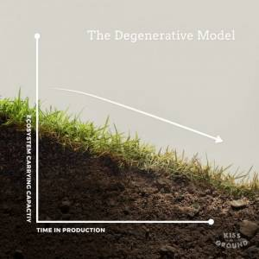
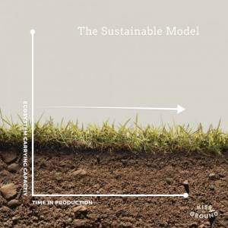
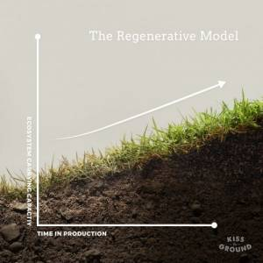
Regenerative organizing is more than mitigation of impacts
Degenerative model: current situation is ecologically and socially damaging (net negative)
Sustainable model: aims at mitigating the impact of human (net zero)
Regenerative model: aims enhancing and replenishing social-ecological systems (net positive)
Synthesis of ancient worldviews and a new scientific paradigm
Notes:
Our current economy works degeneratively.
Regeneration is more ambitious: new sustainability paradigm goes beyond current notions of increased resource efficiency and reduced impact while meeting basic needs

Slide 32
Rethinking basic assumptions

Slide 33
Economy is decoupled from the environment and society
Regenerative perspective, economy is embedded in its environment:
Current view of businesses:
ENVIRON-MENT
ECOLOGICAL ENVIRONMENT
ECONOMY
SOCIETY
ECONOMY
Origin: ecological economics
Differs from mainstream economic thinking where ‘development’ and tech is expected solve all issues
Recognizes biophysical limits – the economy cannot grow forever (at least physically)
SOCIETY
Notes:
In the current system, economy is decoupled from the society and environment, and the ecological environment and society are seen as no more than stakeholders. If you come to think about the division is in indeed very artificial.

Slide 34

The Impossible Hamster
“So, in nature, things don't grow forever. If you want to tie economics back to nature, you have to recognize that the economy is going to stop growing at some point.” Robert Costanza, Professor of Ecological Economics
Notes:
transition from the growth phase to the steady state – here regeneration comes to place

Slide 35

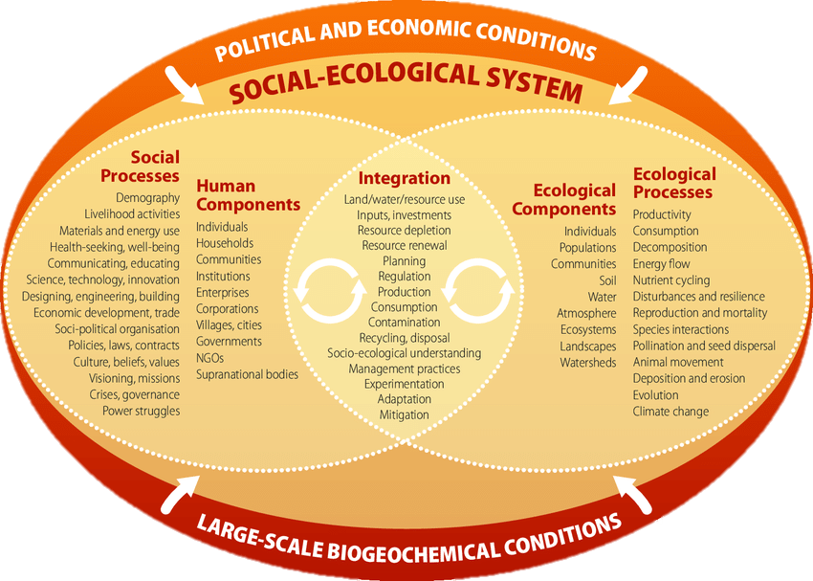
Social-ecological systems narrowing the gap between natural and social sciences
Elinor Ostrom
Organizations/companies are embedded in the social-ecological system
elinorostromaward.org
Aim: sustaining the viability of overarching SES rather than the longevity of individual organizations
Source: www.snre.ufl.edu
Notes:
Elinor Ostrom was a political scientist who made history in 2009, becoming the first woman to win the prestigious Nobel Memorial Prize in Economic Sciences
Bringing social-ecological systems (SES) to forefront has narrowed the gap between natural and social sciences (Wright et al., 2018). Natural sciences has tended explain Anthropocene as it would unattached to the power inequalities of the world, yet we may blame the environmental degradation on the privileged global north (Wright et al., 2018).

Slide 36
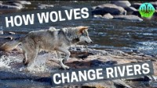
Regeneration in action – ecosystems are self-organizing and self-regenerating if given the change

Slide 37

Moving away from anthropocentrism (ánthrōpos = human)
Why was it important for humans to separate themselves from other beings?
Descartes: mind/body dualism since mind is conscious which means that our bodies are in a space but our minds are not
After the industrial revolution humans in the global North have seen animals, plants, and the non-living system as a resource to be extracted
And why is it important dismantle this dualism?
Alan Turner
Separation of humans and nonhumans has caused the environmental catastrophe – industrialization of nonhumans
Humanity is depended on the nonhuman world and hence should not be separated from the economy
Alternative ways of seeing: ecocentrism
Notes:
First of all I want point out that it is very natural to be human centric, after all we are human species and individual of same species tend to interact with each other and understand each other.

Slide 38

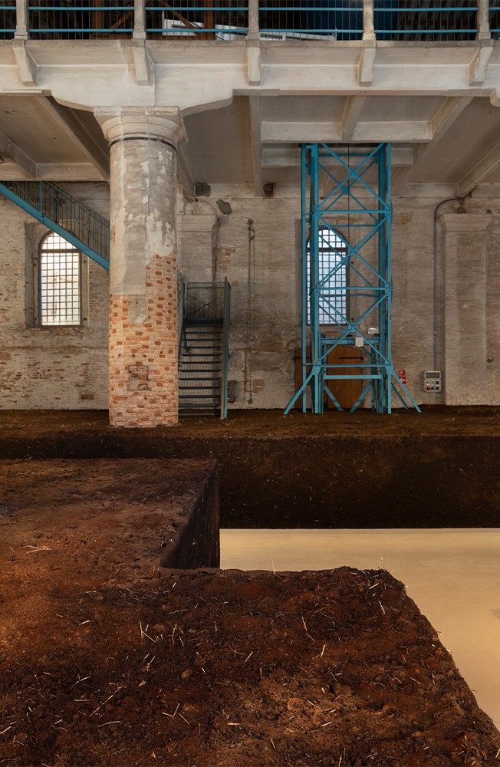
“The Milk of Dreams”: A Posthuman Revolution at the 59th Venice Biennale
Curator Cecilia Alemani curated a posthuman biennial in 2022
Lavinia Schulz and Walter Holdt
Delcy Morelos
Source: flash---art.com/article/venice-biennale/

Slide 39
Regenerative strategies for business
Notes:
Morseletto (2020) criticizes the concept of regeneration as sym-bolic and evocative, but with limited application for business, except the agricultural sector.

Slide 40
Principles and strategies of regenerative business (Hahn and Tampe, 2021)
Principles
Systems-based level of aspiration
Adaptive management approach
Strategies
Restore
Preserve
Enhance

Slide 41
Principle 1. Systems-based level of aspiration
Finality of business sustainability is the sustainability of the overarching socio-ecological system
  Not the sustainability of an individual firm
Three criteria:
  Consider SES impacts on a spectrum: from ”net positive impact” to ”net zero” to ”less harm”
  Business is nested and dependent on the socio-ecological system – their relationship is symbiotic
    Not just extracting from the environment but connecting with it, committing to a place
  The underlying rationale is about establishing a mutually beneficial relationship between business and the socio-ecological system
    Spectrum: from securing services and steady yields from SES to enhancing the viability and resilience of SES
Notes:
Why do we want a spectrum that involves less than optimal outcomes? Because we want to increase buy-in, and we want to allow for flexibility and modest beginning – the important thing is to have the systems-based level of aspiration.

Slide 42
Principle 2. Adaptive management approach
The management approach of a regenerative business ”must be adaptive for being commensurate with the characteristics and the complexity of the socio-economic system”
Three criteria:
  A distinct sense of place in the regenerative business
    A focus on the characteristics of the socio-ecological system specific to it rather than one-size-fits-all solutions
  A temporal orientation that takes into account the lagged, long-term, non-linear effects of human impacts on the SES
  To adapt to local socio-ecological systems, regenerative business strategies and practices need to be iterative and procedural
The information and knowledge tied to the evolution living and non-living systems is humbling – decolonial approach
Notes:
Important if you take a decolonial approach! How would we ever now exactly all the dynamics of social-ecological systems that have been developed during millions or actually billions of years. Hence, we need to constantly look and adopt rather than expect that we get right from the first go.

Slide 43
Three strategies for regenerative business
RESTORE
Return to a previous or original state
PRESERVE
Maintain the status quo
ENHANCE
Enhance conditions for life
Regenerative strategies as a continuum
Notes:
Restoration may sound as insufficient but it may the best approach in many cases as it aims at restoring “the capacity of local natural systems to a healthy state of self-organization”

Slide 44
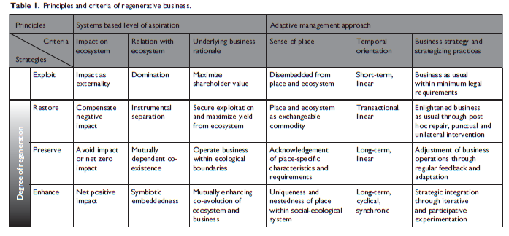
Regenerative business overview

Slide 45
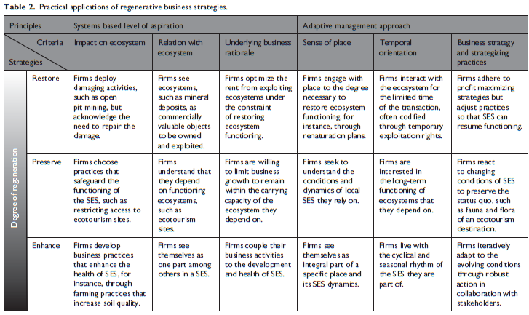
Regenerative business – practical applications

Slide 46
Group task
Search for companies that use regenerative strategies:
What do they do?
How do they market it?
What is their motivation?
15min search, then discuss in groups 10min, and share in class.

Slide 47
References
Banerjee, S. B., & Arjaliès, D. L. (2021). Celebrating the End of Enlightenment: Organization Theory in the Age of the Anthropocene and Gaia (and why neither is the solution to our ecological crisis). Organization Theory, 2(4), 26317877211036714.
Benne, B., & Mang, P. (2015). Working regeneratively across scales—Insights from nature applied to the built environment. Journal of Cleaner Production, 109, 42-52.
Du Plessis, C., & Brandon, P. (2015). An ecological worldview as basis for a regenerative sustainability paradigm for the built environment. Journal of Cleaner Production, 109, 53-61.
Hahn, T., & Tampe, M. (2021). Strategies for regenerative business. Strategic Organization, 19(3), 456-477.
Slawinski, N., Winsor, B., Mazutis, D., Schouten, J. W., & Smith, W. K. (2021). Managing the paradoxes of place to foster regeneration. Organization & Environment, 34(4), 595-618.
Wright, C., Nyberg, D., Rickards, L., & Freund, J. (2018). Organizing in the Anthropocene. In Organization (Vol. 25, Issue 4, pp. 455–471). SAGE Publications Ltd. https://doi.org/10.1177/1350508418779649
Decolonizing Regenerative Agriculture: An Indigenous Perspective – Bioneers

