Slide 1

Communicating sustainability
Jukka Rintamäki
Sustainability in Business 11 May, 2023

Slide 2

Agenda
Fundamentals of communicating sustainability
Communicating your sustainability ideas in an organization
Interview with Eero Wahlstedt of Soilwatch

Slide 3
Learning objectives
You will understand the basics of communicating sustainability
1
You will grasp some key ways of understanding the relationship between communication and action
2
You will learn a basic template for getting your sustainability ideas through in an organization
3

Slide 4

Communicating sustainability

Slide 5
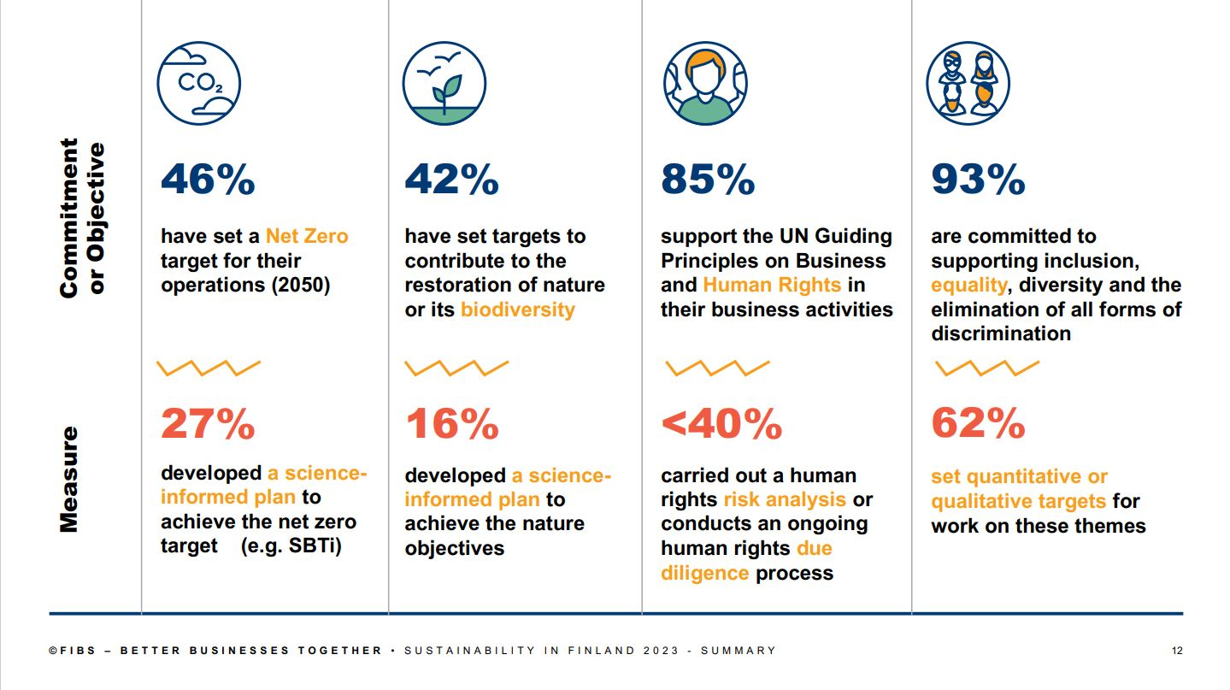

Slide 6
Why communicate about sustainability?
Sustainability is not typically visible in the product/service (duh)
  Generate awareness
Competitive advantage
  Reputational benefits
  New customer segments
  Higher margins
Potential broader reason:
  Stakeholders have a right to know about a company’s sustainability profile

Slide 7
Three audiences
Consumers
(Other) stakeholders
Managers/colleagues

Slide 8
Do you consider sustainability when making purchasing decisions?
If not always, when? Are there degrees of sustainaibility-importance between types of purchases?
What kinds of messages appeal to you?

Slide 9
Consumers
Advertising / consumer communications
Consumer labels
Declarations / commitments
Challenges:
  Understanding how environmental and social concerns relate to the firm’s products
  How to combine facts and interesting message?
    Environmental and social responsibility communication calls for facts -> easily boring message
    Catchy overly simplified message runs the risk of implausibility

Slide 10
Other stakeholders
Sustainability standards, certificates…
Reporting
Challenges
  Getting the right measures
  Measuring
  Costliness

Slide 11

Greenwashing: Unpacking some assumptions
Greenwashing is…
Information disclosure?
Deliberate?
Initiated by companies?
Beneficial to firms and costly to society?
Sources: Bowen, 2014

Slide 12
Relationship between communication and practice
What do we want to understand?
  The degree to which sustainability communication matches sustainability practice? (Functional)
  The degree to which sustainability communication generates sustainability practice? (Formative)
Sources: Girschik, 2018; Morsing et al., 2020; Winkler et al., 2020

Slide 13

Takeways from the formative approach to sustainability communication
How helpful is it to view sustainability as “aspirational talk”?
  How do we distinguish aspirational from non-aspirational?
  Are commitment processes quick enough for what we need?
Regardless, we need to recognize the role of communication in organizational sustainability processes and outcomes!
Sources: Christensen et al., 2013

Slide 14

Making a difference
Communicating your sustainability agenda in your organization

Slide 15
Making changes in organizations: issue-selling
Who?
Individuals who perceive themselves as changemakers and are dissatisfied with status quo
How?
Gradually accumulate influence and build networks to increase power in organization
Draw on the emotional and functional appeal of social issues to issue buyers
  Based on what issue sellers think issue buyers’ world-view is
Source: Wickert & de Bakker, 2018
Notes:
Selling social issues: ”a relational endeavor that sellers carry out with the aid of a repertoire of relational techniques for approaching buyers.”

Slide 16
Who: Tempered radicals
A person slightly different from the organization’s status quo
  Sees things a bit differently
Dissatisfied with some aspects of work/organization
  Generally committed and identifies with the work/organization strongly
    Struggle with the tension of acting on their important agendas and a need to fit in with the general culture
Believes the best course of action is a carefully considered one, broadly complying with important norms
  No displays of anger etc.
Is on the lookout for quick, easy victories for their cause
Sources: Meyerson, 2001; 2004
Notes:
Consider the story of Peter Grant
An African-American senior executive
Went through 18 positions in a US west coast bank, beginning in the 1960s
Very few minorities and women in the firm at the time of his hiring
Grant’s private mission: get more minorities and women hired
Over the years, in hiring people he always tried to get the women and minorities selected
Not just that, but he told those he hired to do the same
By his retirement, more than 3,500 minorities and women had been hired at the bank
Peter talked down those who got frustrated with discrimination
Was frequently angry but never showed it

Slide 17
Getting started as a tempered radical
Build networks of people who share the marginalized aspects of your identity
  It’s a cold world going it alone
Develop discipline to manage emotions
  This will help keep you in the driver’s seat
Separate ”front stage” performances from ”back stage” acts
  Act conformist, hold on to your values
Notes:
Marginalized aspects can refer to e.g. Ethnicity, religion, or sexual orientation, but also to e.g. Values related to sustainability

Slide 18

Digging deeper: The formula for issue-selling
Tailor your pitch
Frame the issue
Manage emotions on both sides
Get the timing right
Involve others
Adhere to norms
Suggest solutions
Source: Ashford & Demert, 2015
Notes:
Familiarize yourself with your audience’s goals, values, and knowledge so that you can shape your message appropriately
Once you know your audience, you’ll understand the frames around their thinking – which allows for you to frame the issue you’re selling. Moral framing, in corporate environments, tends to be less effective than business framing, for instance.
Being passionate helps – but passion easily overflows into anger! People who control their emotions (who control what they display to others!) tend to receive better evaluations, for instance.
If suggesting change that might not be an obvious sell, perhaps wait for other types of change processes to emerge – or try make the issue more salient by doing background work to raise awareness etc.
Build coalitions – coalitions mean power, increased and improved networks, better reach, a more favorable reaction from the audience…
Consider the context – if an organization (and its culture) has a strong env commitment already, selling env initiatives etc. is much easier than in a strictly business minded org. Formal approaches tend to work better – they convey the impression that you’re serious.
Don’t just point out problems – suggest solutions to the problems you point out if you want to be heard.

Slide 19

What if issue-selling doesn’t work?
Well, perhaps you’re not a tempered radical...
Or perhaps you need a change of environment

Slide 20

Guest interview with Eero Wahlstedt

Slide 21
Structure
Tue. 26.4.
Practicalities + Sustainability and business
Thu. 28.4.
Sustainability strategies
w/ Martta Nieminen
Tue. 2.5
Organizing for sustainability
Thu. 4.5
Sustainability innovation
Guest section: Karelia Dagnaud
Tue. 9.5
Student presentations (management instruments)
Thu. 11.5
Sustainability communication
Tue. 16.5
Stakeholder management simulation
Host: Guy Giffin, Prendo Simulations
Tue. 23.5
Supply chain management
+
Herman Miller case
Thu. 25.5
Circular economy
Tue. 30.5
Sustainable finance
Guest lecturer: Kaja Lilleng
Thu. 1.6
Systems change for sustainability
Guest lecturer: Iana Nesterova

Slide 22
References
Ashford, S. J., & Detert, J. 2015. Get the boss to buy in. Harvard Business Review, (JANUARY-FEBRUARY 2015).
Bowen, F. 2014. After Greenwashing. After Greenwashing. https://doi.org/10.1017/cbo9781139541213.
Christensen, L. T., Morsing, M., & Thyssen, O. 2013. CSR as aspirational talk. Organization, 20(3): 372–393.
Girschik, V. 2020. Shared Responsibility for Societal Problems: The Role of Internal Activists in Reframing Corporate Responsibility. Business and Society, 59(1): 34–66.
Meyerson, D. 2001. Radical change, the quiet way. Harvard Business Review, 79(9): 92–104.
Meyerson, D. E. 2004. The tempered radicals. Stanford Social Innovation Review, 2(2): 14–22.
Morsing, M. 2017. CSR communication: What is it? Why is it important? In: Rasche, A., Morsing, M. & Moon, J. (Eds) Corporate social responsibility: Strategy, communication, governance. Cambridge University Press.
Schoeneborn, D., Morsing, M., & Crane, A. 2020. Formative Perspectives on the Relation Between CSR Communication and CSR Practices: Pathways for Walking, Talking, and T(w)alking. Business and Society, 59(1): 5–33.
Winkler, P., Etter, M., & Castelló, I. 2020. Vicious and Virtuous Circles of Aspirational Talk: From Self-Persuasive to Agonistic CSR Rhetoric. Business and Society, 59(1): 98–128.

Slide 23
Extra slides

Slide 24
Consumers’ ability & willingness to act differ
Ability to act
High ability & willing
Consumers with
conscience
Disintrested
Greens
Wastage
focused
Basic
contributors
Willingness
to act
Currently
constrained
Long-term
districted
Low ability
and unwilling
Figure. Sustainable consumption behaviour change opportunities
Source: Barr, S, Shaw, G, & Gilg, A. W. (2006) 'Promoting Sustainable Lifestyles: a social marketing approach'. London, DEFRA.

Slide 25
WILL CONSUMERS BUY SUSTAINABLE?
Gap between attitudes (opinion surveys) and actual behaviour
  Lack of consistency between expressed concerns about
  sustainability issues and willingness to act upon these in
  consumption choices
  Inconsistency: Few consumers incorporate sustainability
  concerns into all types of consumption activities or across all
  types of goods and services
The reality of responsible consumption decisions is more
complicated than consumer-type based segmentations indicate

Slide 26
BEYOND CONSUMER TYPES: SUSTAINABILITY
CONSIDERATIONS IN A PURCHASING DECISION
Even if the attitude toward environmental and social aspects is positive, the purchase is influenced by:
☼ Degree of compromise i.e. perceived trade-offs
  Higher price?
  Lower level of product performance?
  Ease of purchase (e.g. travelling to non-standard distribution outlet)?
☼ Degree of confidence:
  Does the product influence to a genuine sustainability issue?
  Can the company behind the product be trusted?
Sources: Belz and Peattie 2009

Slide 27
SUSTAINABILITY CONSIDERATIONS IN A PURCHASING DECISION
I’m ready to pay more, because this issue is so important
I get the same quality and do good at the same time
High
Feelgood purchases​ Tony’s Chocolonely (slave-free chocolate); Solar panels (moving to win-win category?) | Win-Win purchases​ Fair trade coffee; Recycled paper; Sustainability-oriented investment funds​
Why bother –purchases​ MSC labelled tuna ​ | Why not –purchases​ Bottled water with donation of 1 cent to protection of Baltic Sea​
Degree of confidence
(influence to sustainability)
This does not make a big difference for sustainability, but I lose nothing if I go for it
Low
High
Low
Costs more and I doubt it does much for sustainability
Degree of compromise (Perceived trade-offs)
Figure: Sustainable purchase perception matrix by Belz and Peattie 2009 & Peattie, K: Business Strategy and the Environment 2001
Notes:
https://fairworldproject.org/rainforest-alliance-is-not-fair-trade/

Slide 28
INFERENCES FROM PURCHASING CATEGORIES
Responsible choices are often product specific
  For example: ”I buy fair trade coffee but I prefer driving a car to public transportation”
  ”Consciousness jigsaw” vs. consistency
Marketer’s perspective: How can we remove reduce compromises and add confidence level?
A rule of thumb: reduce the compromises,
i.e. make responsible purchasing easy for the customer

Slide 29

LABELS ASSIST IN SUSTAINABILITY COMMUNICATION
Environmental and fair trade labels
simplify customers choice

Slide 30
WHY LABELS?
Facilitate consumer decision making in selecting socially/environmentally
friendly products
Bring credibility to environmental and social claims
Who grants them?
  Official bodies, associations, commercial bodies
  The commercial label criteria are not usually as comprehensive and solid as those
  of official or other third-party label

Slide 31





Classifying labelling schemes
National labelling schemes (e.g. Blue Angel/Germany)
International labels (e.g. EU eco-label)
Schemes related to particular industries or products (e.g. Marine Stewardship Council’s blue label)
Schemes based on methods of production (e.g. organic farming)
Schemes based on business conduct (e.g. Fairtrade)

Slide 32



EXAMPLES OF ECO-LABELS IN EUROPE
Criteria based on for instance (depends on product category)
  Raw materials, country of origin, production process, recyclability,
  product life cycle
Examples of labelled product groups:
  Batteries, paper, textiles, detergents, washing machines, electronic appliances, services (e.g. hotels, cleaning)
Best-known labels in Europe:
EU flower (24 product groups/77,000 products),
German Blue Angel (125/12,200), Nordic Swan (60/25,000)
  Regulated: EU eco-label by EU commission, Angel by German ministry of environment, Swan by Nordic Council of Ministers
  Criteria tightened every 3 years. Only 5-40% of products of the group can get the label.
  Stringent criteria are set by a panel of experts from a number of stakeholders
  The whole life cycle is taken into account; attention to the life stage that has the highest environmental impact

Slide 33




FAIR TRADE LABELS
Focus:
  Working conditions: human rights of producers & workers
  Compensation: just price for food commodities & other similar produce
Mainly for agricultural products: bananas, coffee, tea, cocoa, chocolate, sugar….
FLO = worldwide Fairtrade standard setting and certification organisation.
  Permits > 1.7 million producers and workers in over 50 countries
FT products sold in over 70 countries.
  Considerable market share in NL, German-speaking European countries, the Nordic countries
  Tens of thousands of products on the market
  Finland: about 1,200 products. Finns buy most: coffee, bananas, flowers, wine, and cotton products

Slide 34







Labels are useful, but not omnipotent
Information overload for consumer decision-making
Number of labels is growing
Limited understanding of what
labels mean
Confusion between third-party certified labels & self-declarations
Co-branding
(e.g. can junk food be organic?)

Slide 35
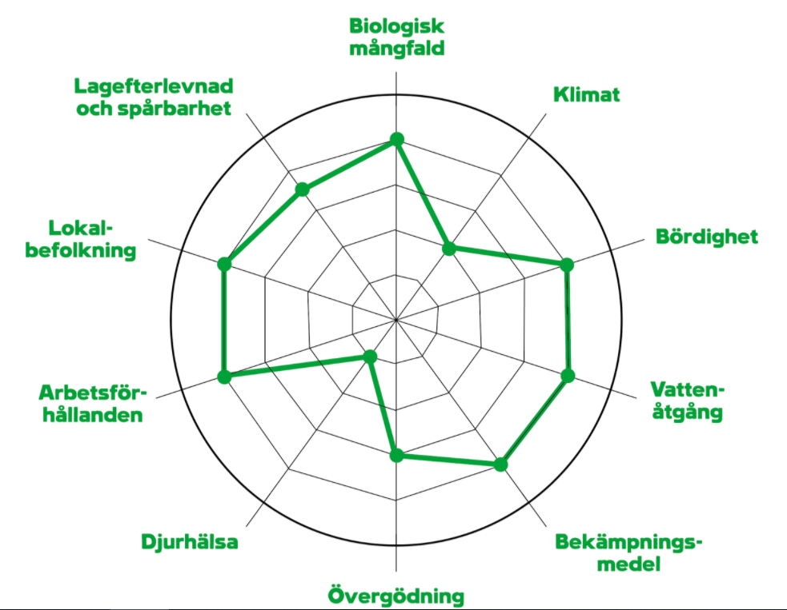

What next? Simple yet comprehensive
Swedish Coop: Sustainability Declaration “label”
Ostavastuullisesti.fi
Shades of Green for Fashion (under development; finix.aalto.fi)
Shades of Green for green bonds (https://www.cicero.green/)
Expert panel assesses: CO2, environmental footprint, local production, workers’ rights, human rights, business ethics
https://www.coop.se/vart-ansvar/hallbarhetsarbete/hallbarhetsdeklaration/

Slide 36
GOLDEN RULES FOR SUSTAINABILITY COMMUNICATION
Recognize the essential sustainability
issues of your industry and its products
  What are significant sustainability
  concerns for customers
  Sustainability messages must be truthful
  and related to significant sustainability aspects of the products
  Be prepared to justify your message
  Spot weak signals
Hunt co-benefits
  Sustainability is seldom the primary need of the customers.
  Good sustainability co-benefits
  are for instance health, safety, as well as eco- and cost-efficiency.
Sustainability communication requires
openness about your own prosesses
  Make your goals public and simultaneously emphasize continuous improvement idea
  Publisizing own goals helps also in internal commitment
Don’t be afraid of critical questions
One critical question from the media does not
imply a failure. If stakeholders observe deficiencesin your company’s sustainability performance, use the situation as an opportunity to improve the
company’s actions.

Slide 37
TAKEAWAYS FOR SUSTAINABILITY COMMUNICATION TO CONSUMERS
1) Without communication, consumers are not able to
choose between more and less sustainable products and services
2) The easier sustainable purchasing is, the more likely
are sustainability concerns to be included in consumption
decisions.
3) Implication for businesses: make it as easy as possible
to choose sustainable products and services

Slide 38
Do you know what corporate sustainability reports are?

Slide 39
Sustainability report
Corporate responsibility report
Majority of companies today use this terminology
Essentially the same as the sustainability report. The use of this term is being replaced by the sustainability report term.
Non-financial reporting
ESG reporting
The EU and national legislators often use this terminology for sustainability reporting. The EU is however in the process of adopting a new legislation and the terminology will be Corporate Sustainability Reporting
Environmental, Social, and Governance (ESG) refers to the three central factors in measuring the sustainability and societal impact of an investment in a company or business.
Investors & finance community use this terminology

Slide 40
Drivers and challenges of reporting
Investors’ and other key stakeholders’ information needs and interests
Regulations and expectations on sustainability reporting are increasing especially for bigger and listed companies
Competition issue: Image improvement for SMEs; a “must” for large corporations
The management of sustainability issues
  Finding and showing problematic/risky areas and issues & Improving sustainability performance
BUT sustainability information is multi-faceted and the quantity of data is increasing all the time.
How to define what is relevant for management and stakeholders and how to report it?

Slide 41
Key trends in sustainability reporting
Worldwide growth of sustainability reporting continues
Inclusion of sustainability data in annual reports continues and integrated reporting grows
Assurance is becoming a majority practice
Majority of large companies worldwide have carbon targets in place & linking corporate carbon targets to global climate goal grows
Biodiversity is a new focus in sustainability reporting, but few companies report risks from biodiversity loss
SDGs have a growing profile in sustainability reporting, but SDG reporting is mostly disconnected from business goals.

Slide 42
Guidance frameworks
For sustainability and climate reporting

Slide 43

Mandatory approach: EU Non-financial reporting directive
EU rules requires large companies (>500 employees) to publish regular reports on the social and environmental impacts of their activities.
Disclosing in the management report relevant information on their policies, main risks and outcomes relating to at least environmental matters, social and employee aspects, respect for human rights, anticorruption and bribery issues, and diversity in their board of directors.
Significant flexibility for companies to disclose relevant information (including reporting in a separate report), as well as they may rely on international, European or national guidelines
Has not worked as expected: Investors and stakeholders lack information they need.
Is currently being renewed into Corporate Sustainability Reporting Directive, a set of rules that will over time bring sustainability reporting on a par with financial reporting
The Commission is proposing to extend the scope to include listed SMEs. This is to avoid SMEs being excluded from investment portfolios as sustainability information becomes ever more important throughout the financial system.
This brings an increase from the current 11,000 to 50,000 companies to follow EU sustainability reporting standards
SMEs will be allowed to report according to simpler standards
The proposal: a general EU-wide audit (assurance) requirement for reported sustainability information.
EU principle: need to cover not just the risks to companies but also the impacts of companies on society and the environment (the so-called ‘double materiality' principle)
Notes:
EU rules require large companies to publish regular reports on the social and environmental impacts of their activities.
Directive in 2013, mandated to be implemented by Member States since 2017

Slide 44
Dominant “standards” for voluntary sustainability reporting
Global Reporting Initiative (GRI)
The Sustainability Accounting Standards Board (SASB)
Guidelines for organizations of any size, sector or location; in the market well over 20 years
Multi-stakeholder initiative & most comprehensive
The most commonly used reporting framework: 75% of the world’s 250 largest companies & about two thirds of the next tier companies report according to GRI guidelines
Material topics: select in consultation with stakeholders. Topics should be external-facing ones that impact people and the environment outside the organization, e.g. greenhouse gas emissions, human rights and supply chain practices
Investment community driven with a focus on industry-specific sustainability issues that are most relevant to risk, return and long-term enterprise value
Younger than GRI
More American
More monetizing of sustainability impacts
Material topics are those that are “reasonably likely to impact the financial performance of a typical company in an industry”
More focus on financials vs. sustainability compared to the GRI
GRI and SASB frameworks are complementary to one another
Both of these are often spoken about as standards although both are guidelines for reporting

Slide 45
Climate & climate+ reporting frameworks
Carbon Disclosure Project (CDP)
The Task Force on Climate-related Financial Disclosures (TCFD)
Not-for-profit charity (est. in 2000) that runs the global disclosure system for investors, companies, cities, states and regions to manage their environmental impacts.
Considered as the gold standard of environmental reporting with the most comprehensive dataset on corporate and city action
Areas of focus today: Climate, water, forests
How ít works: companies & cities provide the data according to CDP frameworks, CDP compiles reports
Est. in 2015 by the Financial Stability Board to respond to the threat of climate change to the stability of the global financial system.
Includes companies and financial stakeholders (investors, lenders, insurers)
Meant to help financial stakeholders to factor in climate-related risks into their decisions
Main disclosure sectors: Oil&gas, Automotive, Financial Services, Technology&telecomms

Slide 46
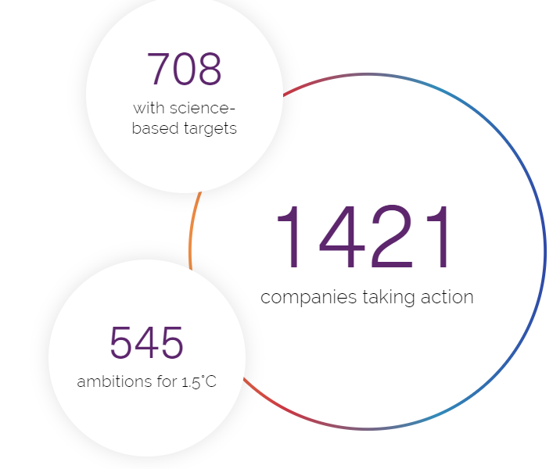
Science-based targets initiative (SBTi)
The SBTi is a partnership between CDP, the United Nations Global Compact, World Resources Institute (WRI) and the World Wide Fund for Nature (WWF)
At the background is the Paris Agreement
  Curbing global temperature rise to well-below 2°C above pre-industrial levels and pursuing efforts to limit warming to 1.5°C
  GHG emissions must halve by 2030 – and drop to net-zero by 2050
  Companies can join the SBT initiative aiming at zero-carbon transition by setting emissions reduction targets grounded in climate science
  Targets are considered ‘science-based’ if they are in line with what the latest climate science deems necessary to meet the goals of the Paris Agreement
  Upon joining the SBTi, a company develops climate targets for itself, presents them to SBTi for validation, and reports and track the progress annually
  SBT offers target-setting resources and guidance, the SBTi independently assesses and approves companies’ targets in line with its criteria.

Slide 47
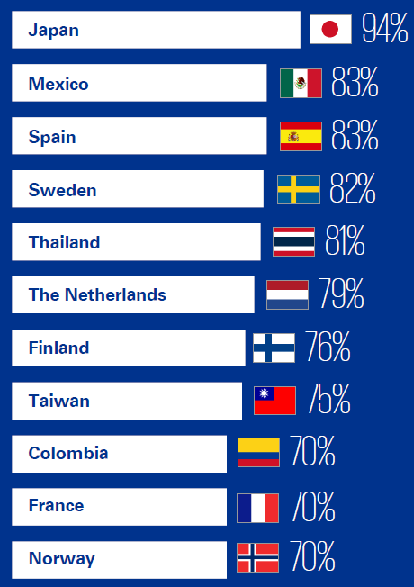
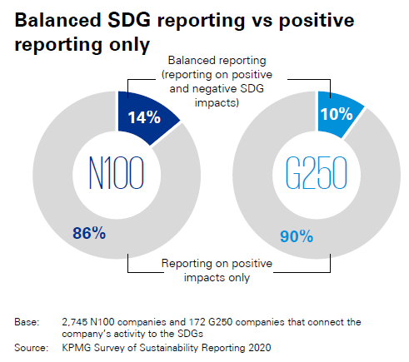
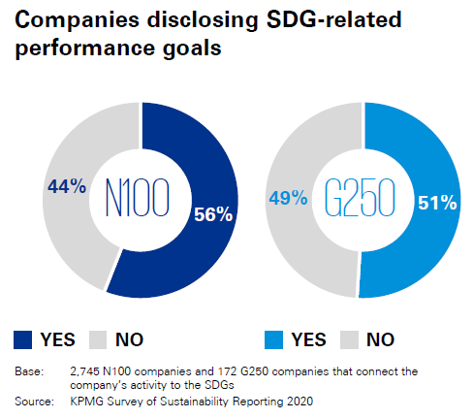
SDGs & sustainability reporting
In 2020, around 70% of large companies report about the SDGs in their Sustainability Report.
Still shallow: primarily positive reporting without links to business performance
The KPMG Survey of Sustainability Reporting 2020

Slide 48
What to report?

Slide 49

Choosing what to report
materiality
Universal Issues
materiality
Materiality here:
Which sustainability issues have the greatest impact on your business &
Which environmental issues have the greatest relevance to your stakeholders
Industry Specific Issues
materiality
Trend Issues
Identifying Key Responsibility Topics
Key Performance Indicators (KPIs)
Defining Responsibility Targets

Slide 50
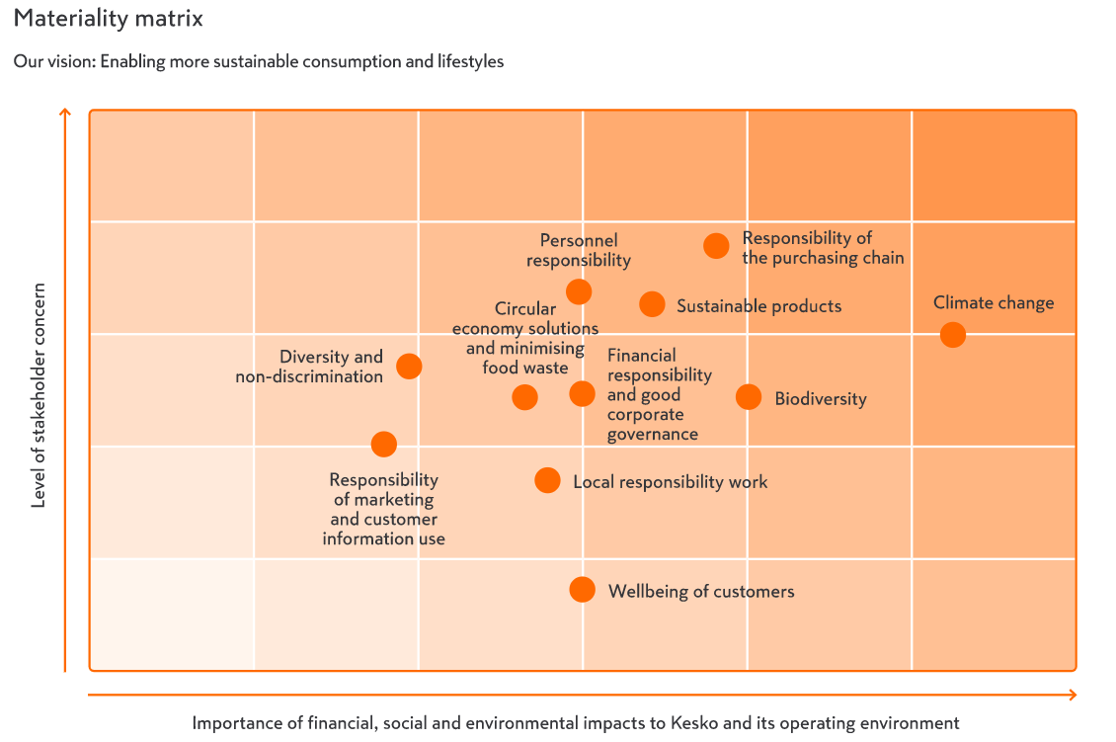


Slide 51
Typical approach for selecting priorities & material sustainability issues for large companies
1
Identification of topics & stakeholders to consider in the assessment. Review of publicly reported materials of stakeholders and peers regarding the industry, and
issues drawn from discussions employees, investors and NGOs
2
Prioritization of stakeholder
groups based on weighting
relative to their importance to the company and its brands - evidence gathering of internal and external documents
to understand priority topics and the stakeholders
3
Engagement through in depth
interviews and surveys
with internal and external
stakeholders to gather information, including
opportunities and risks
Survey stakeholders
Internal to the firm
Internal to the firm
4
Synthesis and Analysis
of findings to aggregate and score evidence so that a materiality matrix can be created to document findings
5
Validation of findings
with key business leaders
6
Stakeholder Engagement
through interviews with internal and external stakeholders to gather additional direct input to further prioritize key topics and develop final materiality matrix
Internal to the firm
Interview stakeholders
Internal to the firm

Slide 52
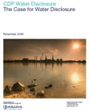
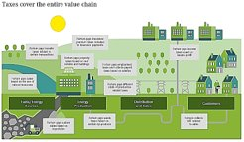
Examples of contemporary issues to report
Climate change
  Many guiding frameworks; well institutionalized
Water management
  Water footprint
Cross-border capital flows:
  Tax planning, tax avoidance, tax havens
  Reporting on Tax footprint per country etc.
Executive compensation:
  Management payroll system, retirement packages, and inclusion of sustainability in management reward system
Corporate responsibility in supply networks and global logistics
Biodiversity (newish)
Circular economy (upcoming)

Slide 53
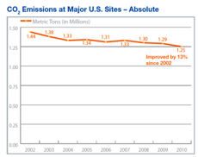
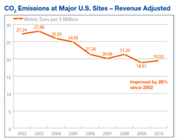
Disclosing absolute or relative data? Impact vs. Performance
Example on measuring and reporting on CO₂ at Boeing
Absolute data (impact)
The decrease of an absolute measurement value may be caused by increased efficiency, but it can be caused by e.g. close down of mills and operations as well
Normalized data (performance)
Normalized data (ratios, e.g. emission per production unit or per monetary unit) communicate performance changes more efficiently and also facilitate comparison with other organizations, especially in the same industry
Absolute emissions
DIRECT IMPACT
Normalized emissions
PERFORMANCE (efficiency)
(typically CO₂ tons per ton of product)

Slide 54
CHECKLIST OF GOOD PRACTICE
BALANCE BETWEEN RESOURCES ALLOCATED TO REPORTING AND ​TO COMMITTED CR WORK WITH REAL SUSTAINABILITY IMPACTS
ALIGNMENT WITH BUSINESS
(TRANSFORMATION) PLAN
MATERIALITY OF
ISSUES EXPLAINED
COMMITMENT & PERFORMANCE
SHOWN IN BRIEF
REFERENCE TO
RELEVANT SDGs
REFERENCE TO AWARDS ETC. INDICATING GOOD PERFORMANCE
REFERENCE TO RELEVANT REPORTING FRAMES
STAKEHOLDER
RELATIONS EXPLAINED
ASSURANCE STATEMENT

