Slide 1
Organizing sustainability
Jukka Rintamäki
Sustainability in Business 2 May, 2023

Slide 2
Agenda
Reviewing previous lecture
Organizing sustainability
The role of managers

Slide 3
A few words on the business case of corporate sustainability

Slide 4
Does corporate sustainability benefit financial performance?
Hundreds of studies on the business case for corporate sustainability/CSR
According to Peloza (2009), 63% of studies on the relationship between CSR and financial performance indicated a positive relationship – however, 15% indicated a negative one
However, due to theoretical and methodological weaknesses, it is difficult to ascertain causality or mechanisms
Measures of CSR – and financial performance – also vary hugely
Meanwhile, the relationship between irresponsibility and financial performance is (also) inconsistent

Slide 5
Mechanisms behind CSR’s positive effect on financial performance
CSR can lead to:
Enhancement of firm reputation
Increased stakeholder reciprocation
Mitigated firm risk
Strengthened innovation capacity
These explain 20% of CSR-CFP relationship
However, context matters so much that it’s difficult to say much about what exactly works for each individual firm
Source: Vishwanathan et al., 2020
Notes:
A meta-analysis of 402,863 firm-year observations
Reputation. More attractive to stakeholders e.g. prospective employees, investors, business partners, other types of partnerships (broadens customer base)
Stakeholder reciprocation. Community involvement may lead to higher likelihood of getting public procurement deals, voluntary reporting attracts institutional investors, employees that are treated well and properly are more committed, trustworthy
Risk mitigation. Firms engaging in CSR tend to consider a broader set of stakeholders and thus have better information, many CSR measures prevent or mitigate stakeholder harm so fewer problems with them (legal costs etc.). Risk mitigation helps preserve CFP rather than raise it.
Innovation capacity. Closer ties to stakeholder -> better information -> better customer-led innovation capacity (new business models, more effective differentiation…). More committed employees share more info/expertise.
Innovation example: “Danone, a food products multinational, offers an illustrative example. Since the early 2000s the firm has been launching base of the pyramid projects in rural areas of developing countries. These initiatives were an important source of strategic renewal, as it encouraged experimentation and learning within Danone, and allowed it to develop unique expertise in creating low-cost solutions”

Slide 6
Organizing sustainability

Slide 7
“Company” can mean many things
Decreases
Primacy of profits
Increases
Social enterprises
Public limited companies
Benefit Corporations
(Bcorps)
Family companies
Cooperatives
Legal form of the enterprise influences to how it can prioritize profit goals and social goals
Notes:
Of the thousands of companies accorded the B-Corp status, only four have gone public, and one quickly surrendered its B-Corp status

Slide 8
What happens when companies go…foundation?
Financial performance will tend to…
…improve
More stable growth, less volatility, more R&D investment, longer lifespan
Philanthropy will tend to…
…grow
E.g. Bosch vs. Siemens -> $100m/y vs $10m/y
Legacy is preserved more strongly
Questions: Where/how are profits invested? What about board composition?
Sources:
Gautier & Bothello, 2022

Slide 9
Working with all the functions
Corporate sustainability
Strategy
Accounting
Finance
SCM
HR
R&D
Business model
Marketing

Slide 10
Levels of corporate sustainability organization
No dedicated sustainability role
Dedicated sustainability department
Sust dept reporting to top mgmt
Sustainability embedded across the org?
Sustainability manager somewhere in the org
Sources:
Halme et al., 2020

Slide 11
What may hinder companies from integrating sustainability considerations into their strategy and operations?
Discussion
You can also think about other organizations if don’t have experience from business companies

Slide 12
Setting up sustainability
Precondition: Top management commitment
Phase 1: Nascent sustainability implementation
Large sustainability department
Manages and owns sustainability, gathers information, reaches out to corporate functions
Phase 2: Intermediate sustainability implementation
Moderate sustainability department
Decentralizes sustainability to corporate functions; orchestrates activities
Phase 3: Mature sustainability implementation
Small sustainability department
Consults functions about trends; functions own sustainability
Sources:
Risi et al., 2023; Wickert et al., 2022

Slide 13
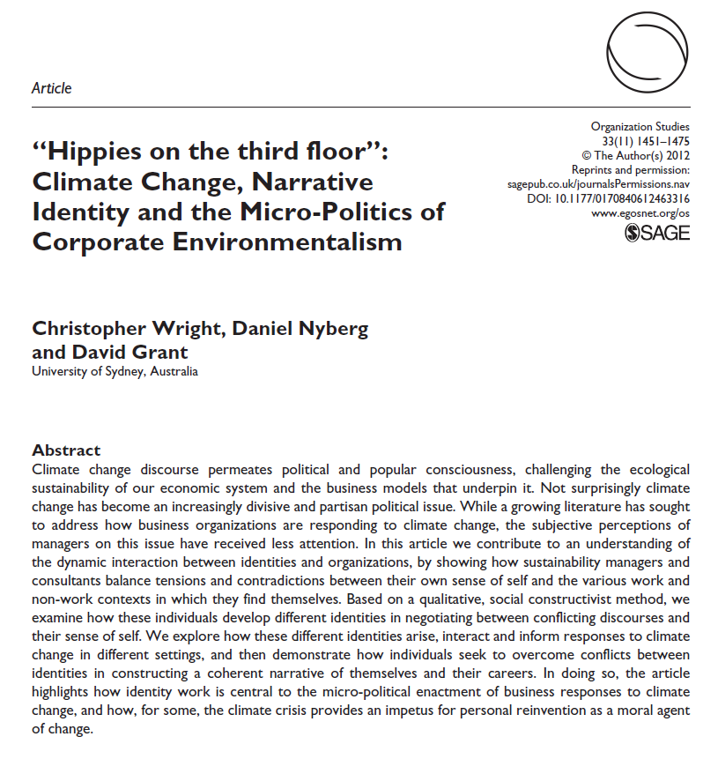
Not always simple
Sustainability managers work amidst conflicting pressures and logics
Different types of managers face different challenges:
“Green change maker”
See value in enacting small, incremental changes even in the face of resistance; see themselves as business changemakers
“Rational manager”
Think through the business case, and many greening opportunities are good for it; see themselves as business managers
“Committed activist”
Personal values close to the nature; frequent clashes with other departments; difficulties in coping; see themselves as activists first
Sources:
Wright et al., 2012

Slide 14
What did you learn from the articles of Halme and Howard-Grenville about sustainability change in organizations?

Slide 15
The role of managers

Slide 16
The importance of the role of the CEO
A bit of a contested (and complex) issue, but…
71% of UN Global Compact signatories state CEO is responsible for CSR
CEOs account for 30% of the variance in CSR
However, the effect on corporate irresponsibility is smaller!
Sources:
Wernicke et al., 2021
Notes:
Narcicisstic tendencies predict higher sustainability engagement!

Slide 17
Incentivising top management for sustainability?
Most commonly incentivization relates to ESG
Traditional focus areas: compliance and risk mitigation
28% of Finnish large listed companies have ESG incentive metrics
Denmark, Sweden: 39%, 38% respectively
76% metrics are social, 12% environmental
Occupational health and safety
73% of S&P 500 companies tied executive compensation to ESG in 2021
Up from 66% in 2020
Carbon footprint reduction goals increased from 10% to 19% b/w 2020 and 2021
Sources:
EY, 2022; Spierings, 2022

Slide 18
Incentives and disincentives for incentives
Incentives
Signaling the importance of ESG
Responding to investor expectations
Achieving ESG commitments
Disincentives
Difficulty in defining specific goals
Concerns about measuring/reporting performance
Skepticism about effectiveness in driving performance
ESG already covered by existing measures
Typically, exec incentivization is ascribed medium importance by CEOs
(for achieving ESG outcomes)

Slide 19
Upcoming changes in the sustainability executive remuneration regime?

Slide 20
Current trends: Science-based targets + Net-zero
45% global CO2 emission reductions by 2030 and net-zero by 2050 necessary for stabilizing the climate
This is applied on an individual corporate level
Five-step process
Commit, develop a target, submit, communicate, disclose
More than 2,200 business signatories (1/3 of global market cap - $38 trillion - represented)
Almost 1,100 approved targets
Seems to work to an extent: in 2020, Covid caused global CO2 emissions to decrease 5% -> 12% for companies with science-based targets
Notes:
For more, see e.g. Sciencebasedtargets.org, SDG Compass (sdgcompass.org),

Slide 21
What is a science-based target?

Slide 22
EU Taxonomy: Increasing scope of mandatory commitments
What: A classification system for (a growing list of) environmentally sustainable economic activities, across a range of formal objectives
Climate change, biodiversity, circular economy etc.
Motivation: Meet the EU’s 2030 climate and energy targets
Aims: Reorient capital flows towards sustainability, link sustainability to risk management
Especially relevant for finance
Mandatory for large companies: Large firms required to act and report on all the formal objectives

Slide 23
EU Taxonomy

Slide 24
In-class case assignment: Ray Anderson and Interface Inc.
Read the following short newspaper articles:
https://www.theguardian.com/sustainable-business/sustainability-case-studies-interface-carpet-tile-revolutionary
https://www.greenbiz.com/blog/2014/09/03/20-years-later-interface-looks-back-ray-andersons-legacy
https://www.forbes.com/sites/ericagies/2011/08/10/interface-founder-ray-anderson-leaves-legacy-of-sustainability-success/ (only the figures towards the end)
What are your thoughts in light of what we’ve been talking about in the course (or other courses) so far?
Interface in one or two sentences
What is Mission Zero?
What is Interface Climate Take Back?
How would you relate Interface with integrated/innovative sustainability? Weak/strong sustainability?
Any other considerations? Generalizability of Interface?
Notes:
Perhaps think of the difficulties of applying Anderson as part of a quantitative study

Slide 25
Structure
Tue. 26.4.
Practicalities + Sustainability and business
Thu. 28.4.
Sustainability strategies
w/ Martta Nieminen
Tue. 2.5
Organizing for sustainability
Thu. 4.5
Sustainability innovation
Guest section: Karelia Dagnaud
Tue. 9.5
Student presentations (management instruments)
Thu. 11.5
Sustainability communication
Tue. 16.5
Stakeholder management simulation
Host: Guy Giffin, Prendo Simulations
Tue. 23.5
Supply chain management
+
Herman Miller case
Thu. 25.5
Circular economy
Tue. 30.5
Sustainable finance
Guest lecturer: Kaja Lilleng
Thu. 1.6
Systems change for sustainability
Guest lecturer: Iana Nesterova

Slide 26
References
Burchman, S. 2018. How to tie executive compensation to sustainability. Harvard Business Review, 2–6.
Burchman, S., & Jones, B. 2019. 5 Steps for Tying Executive Compensation to Sustainability. Harvard Business Review, July 19: 2–8.
Cook, M., Savage, K., & Barge, F. 2023. Linking executive pay to sustainability goals. Harvard Business Review, February.
Halme, M., Rintamäki, J., Knudsen, J. S., Lankoski, L., & Kuisma, M. 2020. When Is There a Sustainability Case for CSR? Pathways to Environmental and Social Performance Improvements. Business and Society, 59(6): 1181–1227.
Risi, D., Wickert, C., & Ramus, T. 2023. Coordinated Enactment: How Organizational Departments Work Together to Implement CSR. Business and Society. https://doi.org/10.1177/00076503221110213.
Risi, D., & Wickert, C. 2017. Reconsidering the ‘Symmetry’ Between Institutionalization and Professionalization: The Case of Corporate Social Responsibility Managers. Journal of Management Studies, 54(5): 613–646.
Spierings, M. 2022. Linking Executive Compensation to ESG Performance. Harvard Law School Forum on Corporate Governance. https://corpgov.law.harvard.edu/2022/11/27/linking-executive-compensation-to-esg-performance/.
Vishwanathan, P., van Oosterhout, H., Heugens, P. P. M. A. R., Duran, P., & van Essen, M. 2020. Strategic CSR: A Concept Building Meta-Analysis. Journal of Management Studies, 57(2): 314–350.
Wernicke, G., Sajko, M., & Boone, C. 2022. How Much Influence Do Ceos Have on Company Actions and Outcomes? the Example of Corporate Social Responsibility. Academy of Management Discoveries, 8(1): 36–55.
Wickert, C., Risi, D., & Ramus, T. 2022. What a Mature CSR Team Looks Like. Harvard Business Review.
Wright, C., Nyberg, D., & Grant, D. 2012. “Hippies on the third floor”: Climate Change, Narrative Identity and the Micro-Politics of Corporate Environmentalism. Organization Studies, 33(11): 1451–1475.

