Slide 1
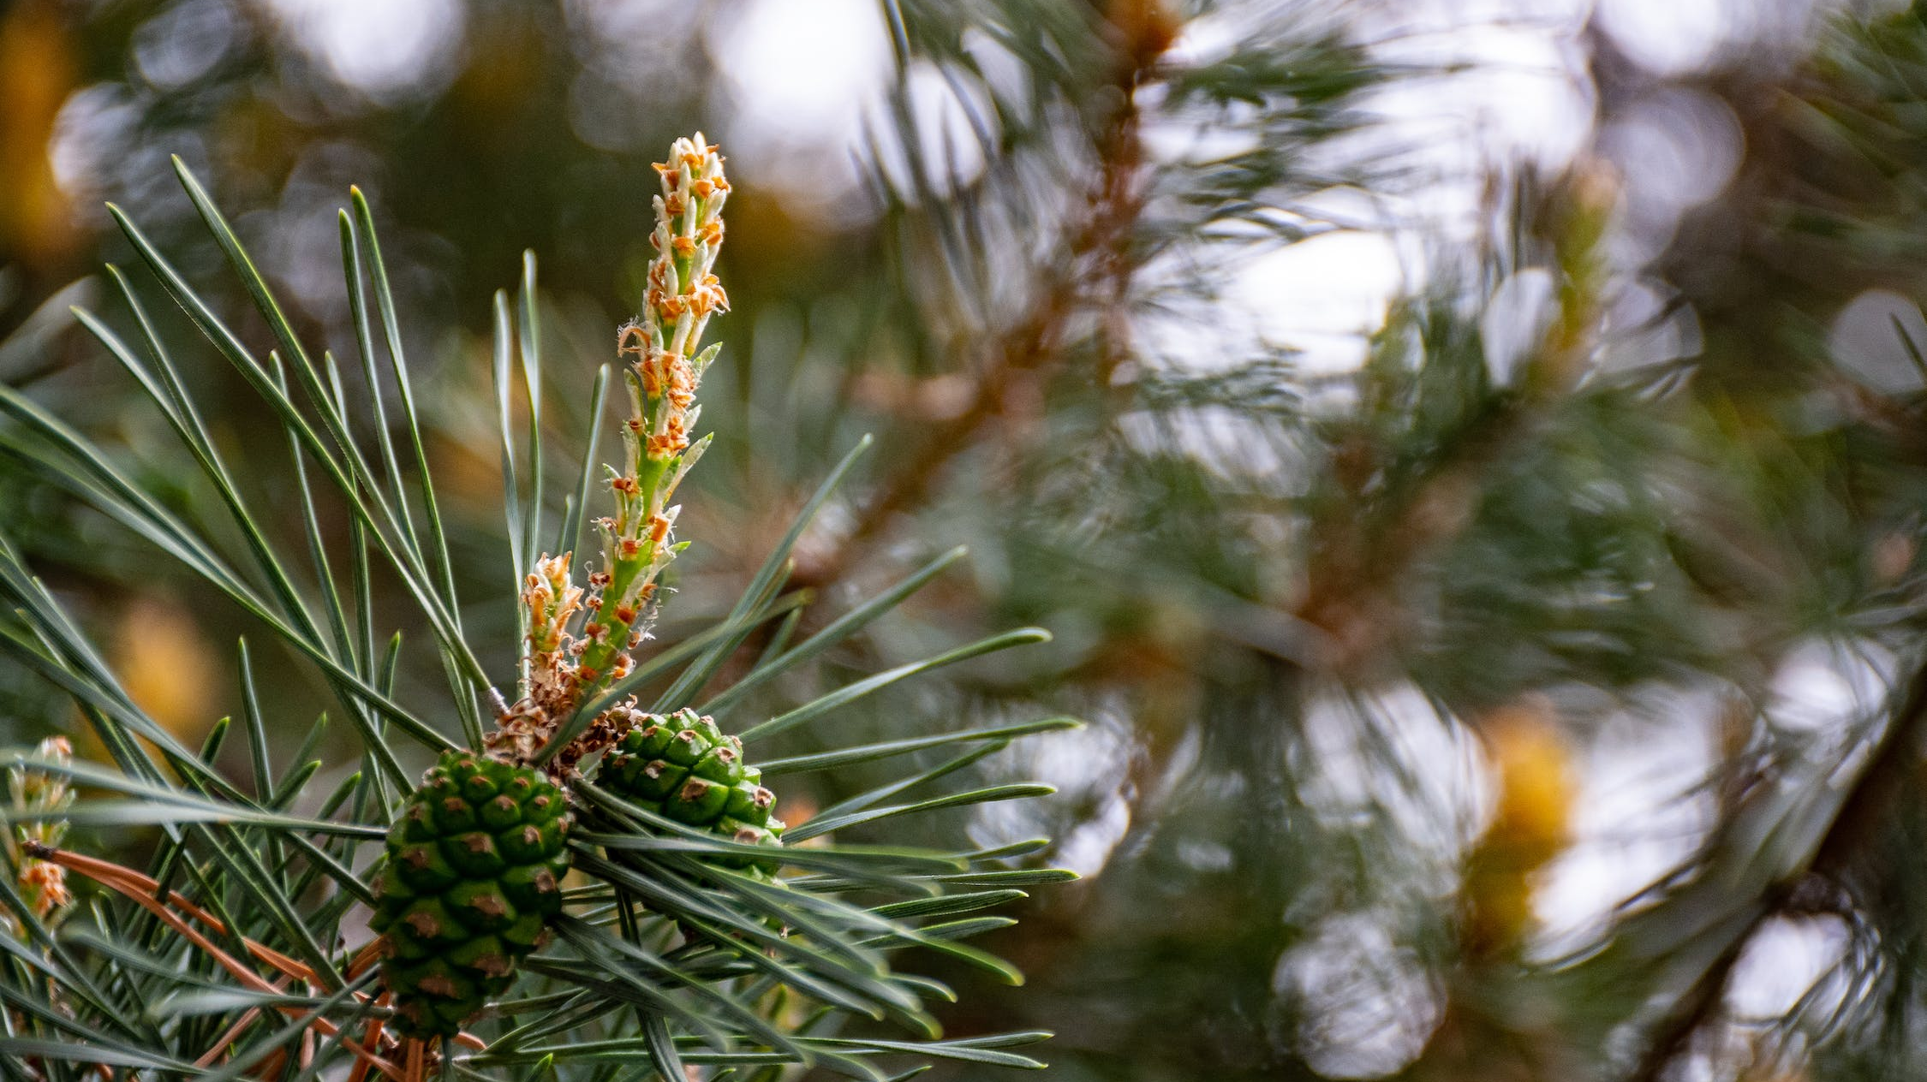
Biomimicry
Nature-Inspired Design

Slide 2
Learning outcomes
Describe key ideas of the ‘biomimicry’ concept
Recognize examples of biomimetic designs
Identify points of discussion tied to ‘biomimicry’ as an approach to sustainability innovation

Slide 3
Agenda
Defining the concept: core ideas, ‘roots’, relevance today
Examples:
Structural color in design (Shimmering Wood research)
Water-repellency in textiles (Ioncell-F research)
Discussion: mimicking or taking inspiration from nature?
Activity: thinking through a sustainability challenge from the lens of a “biological strategy”

Slide 4
1. Defining biomimicry
Core ideas

Slide 5
What is biomimicry?
Biomimicry is an approach whereby (human-made) design & engineering solutions are abstracted from forms, processes & systems found in nature. (Benyus, 1997; Fisch, 2017)
A framework that bridges engineering, design & biological research – no one definition
+ question as to what extent does the human-made design ‘reproduction’ need to reflect the ‘original’ natural form?
Notes:
Processes, forms, systems, strategies, principles

Slide 6
Why biomimicry?
Core premise: over 3.8 billion years of evolution, nature has developed solutions to many design & engineering problems that humans also face
Can we learn something from nature’s design solutions in how we design our human-engineered processes, technologies & systems?

Slide 7
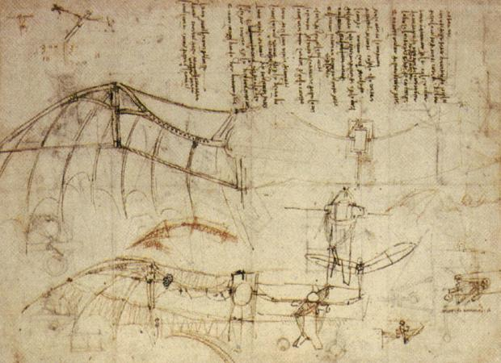
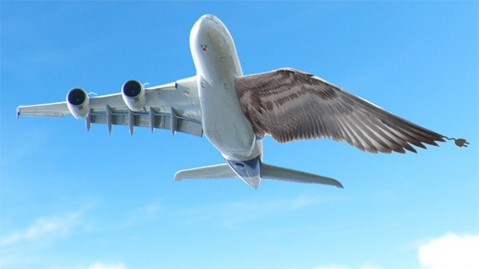
Nature has for a long time inspired human imagination & technological innovation
Image sources:
https://library.acropolis.org/biomimicry-human-creation-inspired-by-nature/
https://ec.europa.eu/research-and-innovation/en/projects/success-stories/all/smarter-wings-bird-flights
Leonardo Da Vinci’s “flying machine” (15th century)
Notes:
https://medium.com/@adsactly/is-it-a-bird-is-it-a-plane-biomimicry-in-airplanes-9862d331df2e
https://magazine.primetals.com/2020/01/01/leonardo-da-vinci-pioneer-of-biomimicry/
https://library.acropolis.org/biomimicry-human-creation-inspired-by-nature/
https://ec.europa.eu/research-and-innovation/en/projects/success-stories/all/smarter-wings-bird-flights

Slide 8
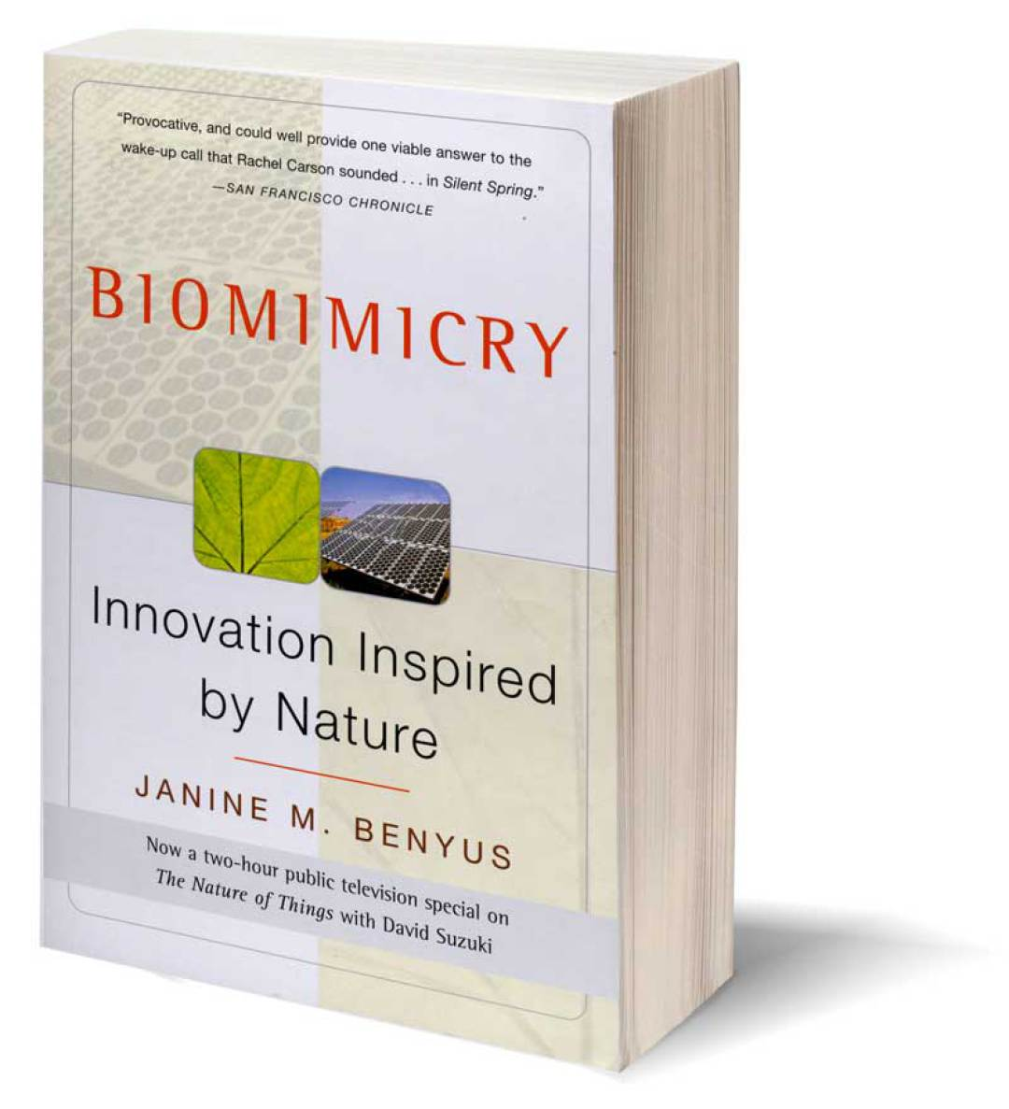
Popularizing the concept, developing a methodology
Janine Benyus: biologist, author, consultant
Book: Biomimicry: Innovation Inspired by Nature (1997)
Biomimicry Institute, Biomimicry 3.8, AskNature.org

Slide 9
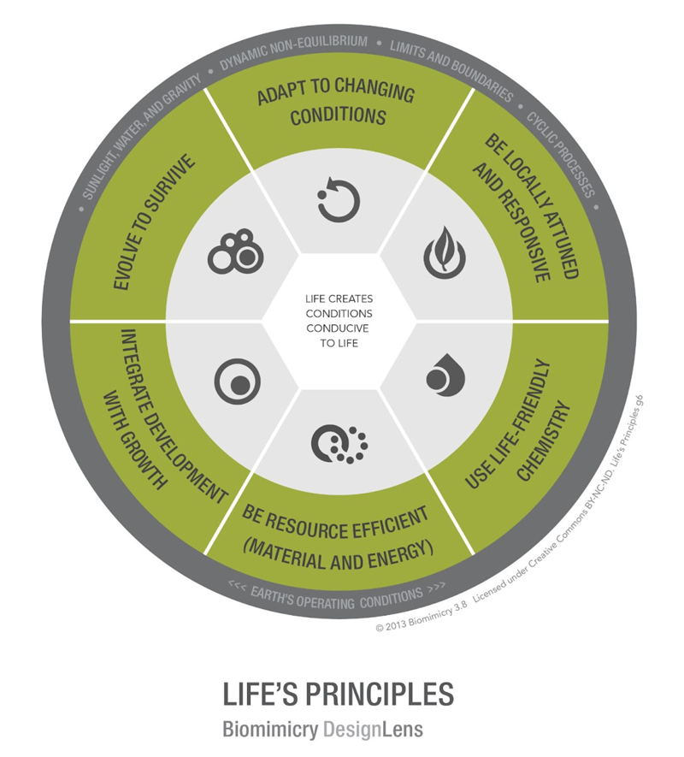
Biomimetic design (Janine Benyus, Biomimicry Institute) : 3 interrelated dimensions
Functionality of an organism’s morphology (blueprints – “form”)
Constitutive processes (chemical recipes – “processes”)
Mode of entanglement with the wider environment (ecosystem strategies – “systems”)
→ forms, processes, systems: “design principles”
3rd dimension: universal guideline for ethical ecosystem relations – “life’s principles”

Slide 10
Biomimicry: Why now?
Biomimicry as an approach to designing products, services, technologies, industrial processes, business models, organizational forms towards sustainable development goals
Learning from the durability, adaptability & robustness of biological processes to design solutions to today’s sustainability challenges
Seeking a different human relation to the natural environment

Slide 11
2. Recognizing biomimetic approaches
Examples from aalto research projects

Slide 12
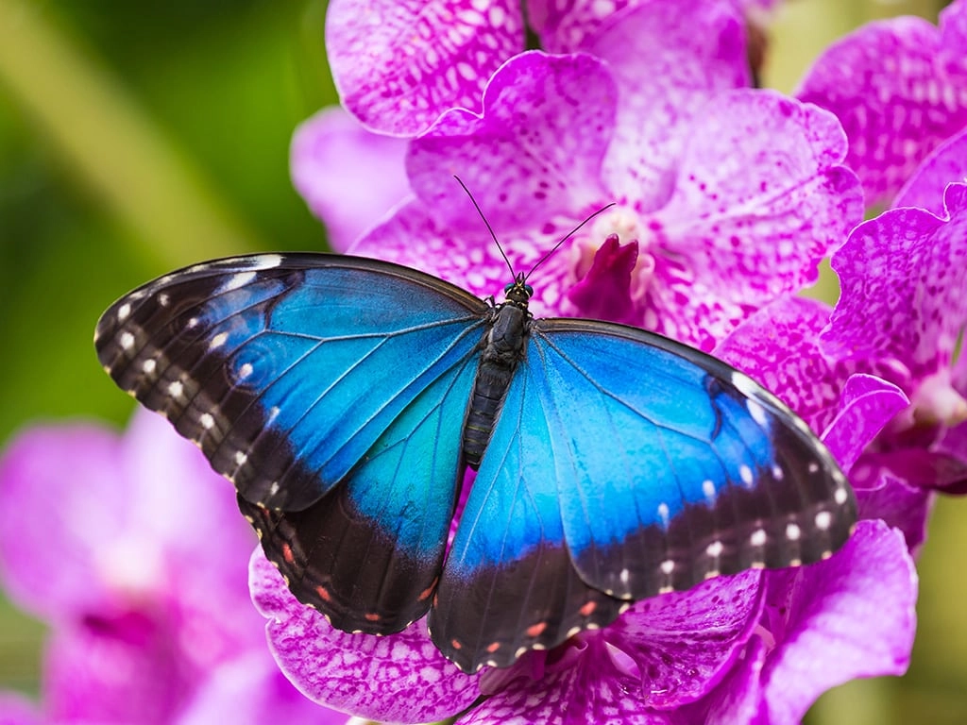
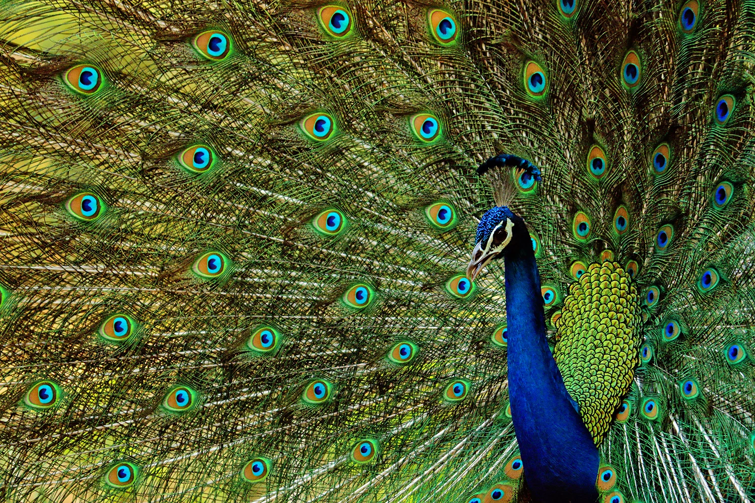
Example: Structural color
Image sources: https://www.cambridgebutterfly.com/the-famous-blue-morpho/
https://www.pnas.org/post/journal-club/peacock-s-tail-and-other-flashy-ornaments-don-t-have-come-cost
Notes:
https://www.cambridgebutterfly.com/the-famous-blue-morpho/
https://www.pnas.org/post/journal-club/peacock-s-tail-and-other-flashy-ornaments-don-t-have-come-cost

Slide 13
Shimmering Wood
Shiny or glittery effects – very popular in fashion & design today – are usually created using toxic pigments, plastic-based materials, or metallic foils.
Our structural colour is a sustainable alternative to these traditional colorants, because it is produced 100% from wood. The colourful coating is nontoxic & does not harm the environment.
Notes:
https://www.aalto.fi/fi/media/201016
https://www.aalto.fi/fi/tapahtumat/puuglitteri-kimaltava-puu

Slide 14
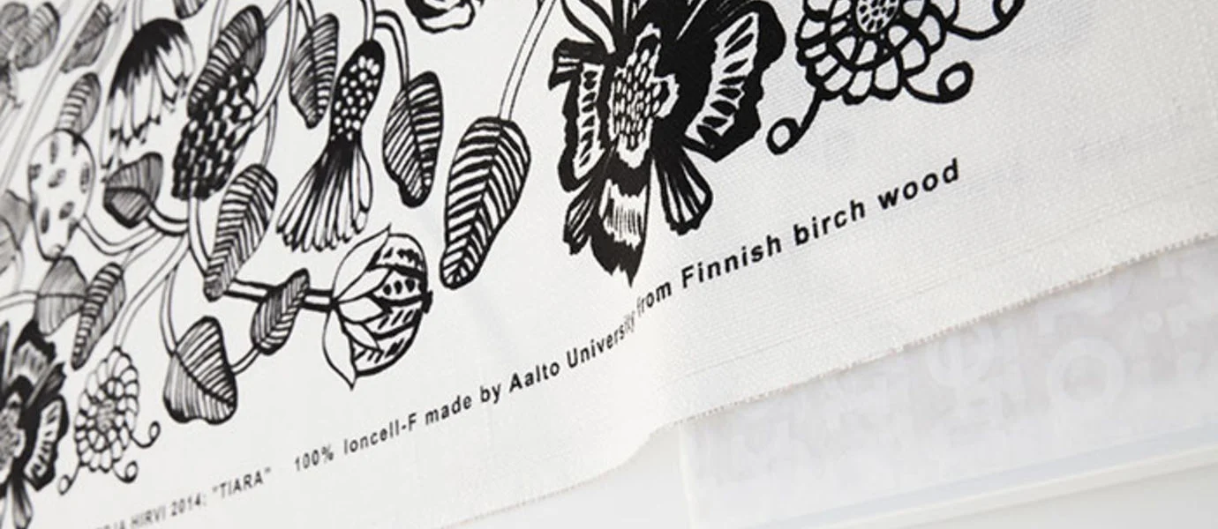
Example: Turning cellulose to textile fibers within a ‘closed-loop’ process
Ioncell-F technology turns used textiles, pulp or even old newspapers into new textile fibers sustainably and without harmful chemicals. The process converts cellulose into fibers which in turn can be made into long-lasting fabrics. Image & description sources: https://www.aalto.fi/en/department-of-bioproducts-and-biosystems/ioncell-f; https://ioncell.fi/

Slide 15
Example: Water-repellency in cellulosic textiles
Most of our outdoor garments rely on synthetic fabrics for water-repelling properties. Moving away from oil-based products, new solutions are needed to gradually replace synthetic fibers. Nature has proven that it is possible to achieve hydrophobicity without synthetic or toxic materials. Can we do it too?
By studying how nature achieves hydrophobicity, this functionality can be introduced with bio-based chemicals.
Notes:
https://www.aalto.fi/en/aalto-university-bioinnovation-center/research

Slide 16
Nature already knows all solutions to any problem we can come up with. So instead of using nature to extract materials for our own purposes, how about we look at nature and learn – because nature is also lazy and wants to find the easiest solution to, say, energy. If we learn how nature has solved the problem of hydrophobicity, which has been solved already, e.g., feathers are hydrophobic, we can learn to do the same in our laboratories and our industrialized world.
Researcher developing water-repellent textile fibers:

Slide 17
3. Biomimicry: Discussion
Reflecting further on the concept & practicing biomimetic thinking

Slide 18
Ethical issues & questions for reflection
To what extent can humans ‘unlock’ nature’s ‘design secrets’?
Does biomimicry objectify nature?
Separation of nature / human societies?
Can nonhuman life be transformed into intellectual property?
What do we use nature-inspired designs for?
Nuances in choice of verb: Taking inspiration from, thinking by analogy, emulating, copying?
(Fisch, 2017; Goldstein & Johnson, 2015)

Slide 19
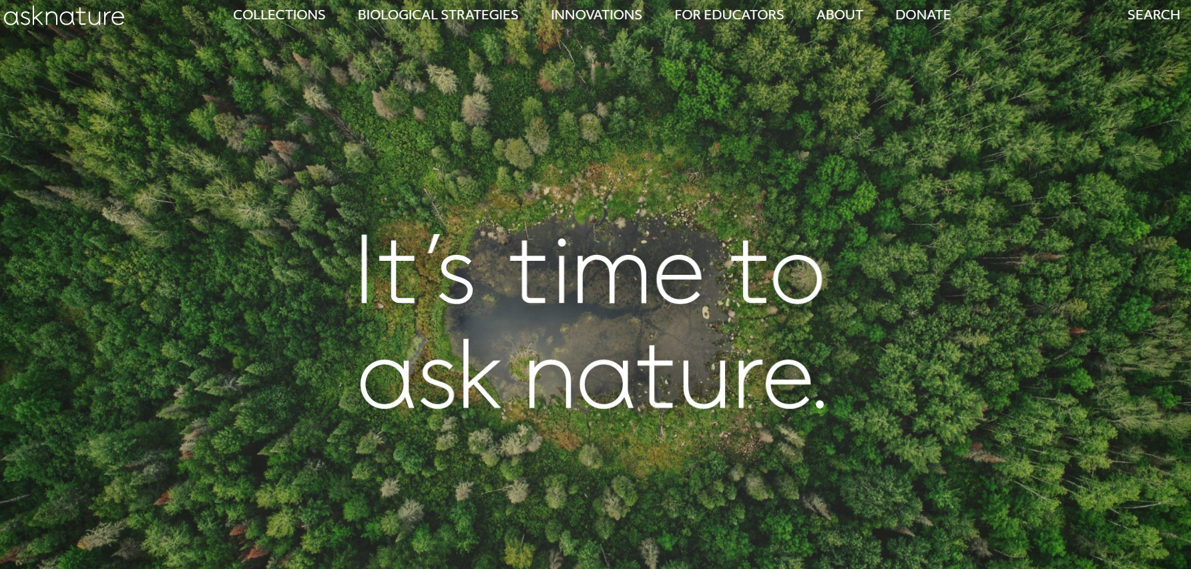
Activity (in pairs, 5 min)
https://asknature.org/
Identify a sustainability challenge that you care deeply about
In the asknature.org database, search for biological strategies to the given challenge using keywords, e.g.: ‘How does nature…store energy?’
Discuss how this biological strategy could inspire designing a solution to your chosen sustainability challenge
Notes:
https://asknature.org/?s=&page=0&hFR%5Bpost_type_label%5D%5B0%5D=Biological%20Strategies&is_v=1

Slide 20
Examples
Water-absorbant roads & built environment
Cooling public parks & gardens
Energy-efficient housing

Slide 21
the biomimetic approach gives me a whole new perspective to look at problems and maybe I will develop a better eye for looking at something that nature has done and think: “hey, that’s smart”. Even if we can’t solve every problem in the way nature does, even practicing our way of thinking as a species…
Researcher developing water-repellent textile fibers:

Slide 22
Thank you!
Karelia.Dagnaud@aalto.fi

Slide 23
References & further reading
Origins, key ideas & examples of concept of ‘biomimicry’:
Benyus, J. (2002). Biomimicry : innovation inspired by nature. Perennial.
A_Biomimicry_Primer_2011Handbook.pdf (asknature.wpenginepowered.com)
https://lauda.ulapland.fi/bitstream/handle/10024/62124/Gradu_Uuttu.pdf?sequence=2&isAllowed=y
https://science.howstuffworks.com/life/evolution/biomimicry.htm
Challenging premises & assumptions of ‘biomimicry’ concept:
Fisch, M. (2017). The nature of biomimicry: Toward a novel technological culture. Science Technology & Human Values, 42(5)m 795–821.
Goldstein, J., & Johnson, E. (2015). Biomimicry: New Natures, New Enclosures. Theory, Culture & Society, 32(1), 61–81. https://doi.org/10.1177/0263276414551032

