Slide 1

Innovation for sustainability
Jukka Rintamäki
Karelia Dagnaud
Sustainability in Business 4 May, 2023

Slide 2

Agenda
Reviewing previous lecture
Sustainable innovation
Sustainable tools - Biomimicry

Slide 3
Learning objectives
You will learn the basics of sustainable innovations: what they are and their core attributes
1
You will understand some of the complexities and challenges that accompany sustainable innovations
2
You will get a grasp of some of the most common / interesting sustainability innovation tools – biomimicry in particular
3

Slide 4


Notes:
Perhaps think of the difficulties of applying Anderson as part of a quantitative study

Slide 5
Reviewing Tuesday’s lecture
What do you remember from the lecture on organizing? What stuck with you?
Executive compensation:
  Interface took advantage

Slide 6

Main stream business models favour short product life spans, which has lead to overuse of natural resources and waste
Notes:
Let’s start off with an example that highlights the importance of thoday’s topic…This was a case that happened in the 1920s, as the electric lighting was becoming more widespread and several large manufacturers of lightbulbs had emerged. These firms formed a cartel to deliberately limit the lifespan of lightbulbs and a lower number than could be technically possible., The purpose of this was of couse to sell more bulbs to the customers, and it was one of the early known cases of planned obselesence, which leads to higer waste and environmental impacts. The purpose of this example was to highlight a key challenge for sustainability in business:
At the center: Phoebus Cartel. Was founded and consisted of Osram, Philips, GE etc. In 1925. Dissolved in 1939. Worked to standardize light bulb lifespan to 1k hours, down from 2,5k and raised prices. Members whose lamps outlasted 1k hours were fined by the cartel.
How can we address the problem?
Fulfill our needs differently – this is our focus today

Slide 7
What is a business model?
Business model commonly refers to the rationale of how a firm creates, delivers, and captures value
  I.e. How the firm makes a profit
The basic elements:
  Customer value proposition
  Profit formula
  Key resources and processes
Business models should
  Be difficult to imitate
  Depict the relationship between the firm, its customers, and its suppliers
Source:
Ludeke-Freund & Dembek, 2017
Palomares-Aguirre et al., 2018

Slide 8
Innovative corporate sustainability
Relationship to core business: Enlarging core business or developing a new business model
Target of sustainability: New product or service development
Expected benefits: Alleviation of social or environmental problem
Aim: Generating genuine win-win situations where the benefits for the environment or people are (at least) on par with the business benefit
Examples: CEMEX’s Patrimonia Hoy, various forms of social entrepreneurship or base-of-the-pyramid business models

Slide 9
Industry view of sustainable innovation

Slide 10
The nature of innovation
Sustaining innovations typically associated with:
  Established firms
  Existing customer demands
  Improved technologies
Distruptive innovations typically associated with:
  New entrants
  Not yet well-defined customer demands
  New technologies
Christensen, 1997
Notes:
“sustaining innovations occur when established
firms push the envelope to continue to satisfy existing consumers with improved products within
the prior but expanded technological trajectory; [whereas] disrupting innovations cater to
different, perhaps not yet well-defined customers with product attributes different from those in
the established producer-consumer networks”30. !

Slide 11
Where are we in the electric vehicle industry?
Source:
Hockerts & Wüstenhagen, 2010
Notes:
So a key question, when we look at this general model, is that who are the innovators within this diffusion process, and how do the sustainability impacts develop during this process?
This is an extended model of the previous one that looks at how a sustainability-oriented innovation might diffuse in the marketplace. The authors use an analogy of davids and goliaths. Davids are essentially the players that catalyze and create more radically new innovations, while Goliaths are the existing large firms in an industry. This looks the interplay between these two types of actors.
So in the introduction, you’re likely to see new types of actors that exist between the market economy and the third sector, such as social entrepreneurs or highly idealistic entrepreneurs working together with NGOs or social movements. During this time, the large firms are often largely ignorant of these grass-roots development.
In the take-off phase, some of the emerging players have developed into formal growth-oriented start-ups, that aim to scale their impact within the industry. At this point, you often start to see the premium-level incumbents create some extensions to thei main line-ups that address the same issue.
In the third phase, you start to see some high-growth davids start to combine the product innovation typically associated with start-ups with the process-innovations associated with incumbents, becoming a threat to both sides. Some of the early entrepreneurs might already exit at this point, while the mainstream incumbents start to take things seriously, and try to control new market standards in their favor.
In the maturity phase, you see a situation where some davids have evolved into goliaths and some new niche innovations start to appear. The sustainability improcement has become mostly an industry standard.
Throughout this process, you see the external costs (i.e. environmental and social imapcts) under focus gradually become internalized within the industry.

Slide 12
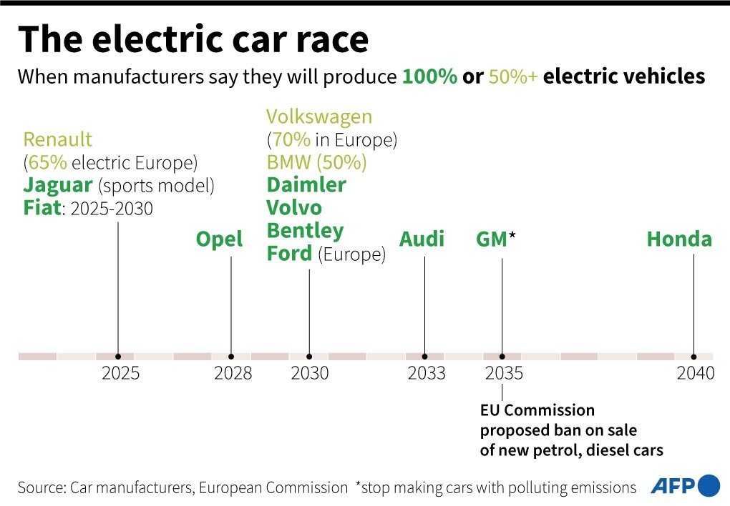
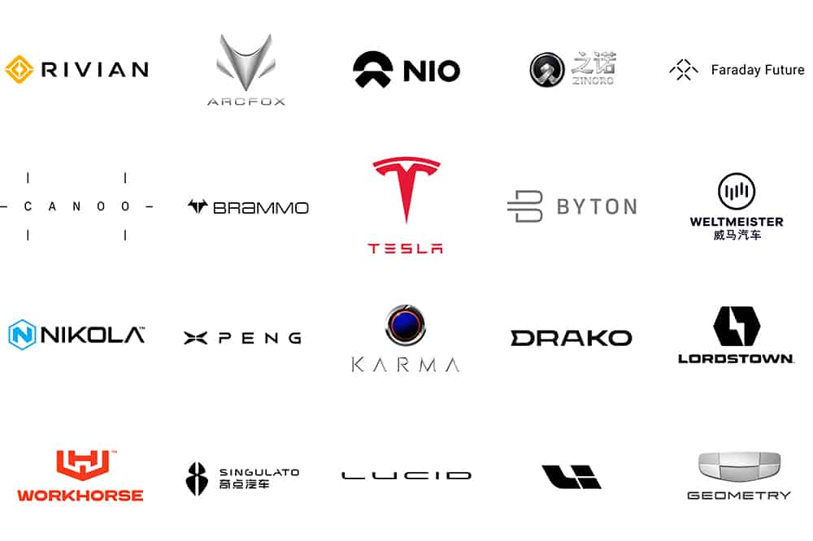
Notes:
Let’s look at the electric car industry which is a good example of this. We’ve seen a lot of this development happen within this industry in the 2000.s Tesla is obviously a new player that has grown from a small startup to a fully fledged automotive incumbent, which hadn’t happend for a long time in this industry. In the recent years, you seen the mainstream incumbents take increasing interest, first with premium brands like Volvo, Audi, BWM for instance and now nearly every mainstream car manufacturer had many electric models in the pipeline. So looking at the industry development, we’re likely in take-off phase of electric cars, although Tesla has already grown large enough to be considered an incumbent. And the development of electric cars of course, is crucial for this industry which is responsbily for a hig share of the worl’ds GHG emissions.

Slide 13
Sustainability-oriented innovations – sustainable business models?
Notes:
Next, let’s look at a few key characteristics of sustainability-oriented innovations, as well as their different forms.

Slide 14
Sustainability-oriented innovation (SOI)
“An improvement of a product, technology, service, process, management technique or business model, which, in comparison to a prior version and based on a rigorous and traceable analysis, has a positive net effect” on the sustainability of the system”
Challenge: the double externality problem
  Technological spillovers (with all innovation)
  Positive environmental/societal externalities (with SOI)
-> Value appropriation is difficult, leads to underinvestment
Source: Klewitz & Hansen, 2011

Slide 15
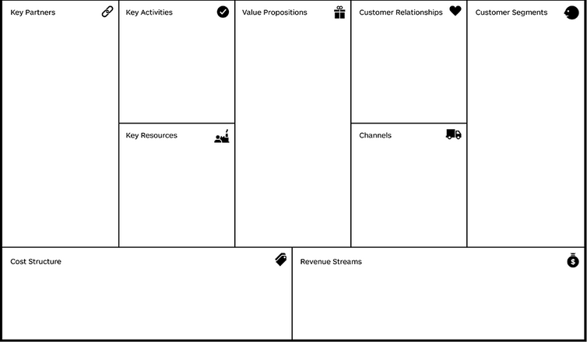
Business model innovation
Change of business model means developing a new way the organization and its value network:
1) create and deliver value (organize activities in the value network)
2) capture value (organize the cost and revenue streams) and/or
3) change the value propositions (offering to the customer)

Slide 16
Let's consider mobility as a service (MaaS) an example of a sustainable business model innovation.
What, in your view, are the potential sustainability benefits? What are the potential negative sustainability impacts?

Slide 17
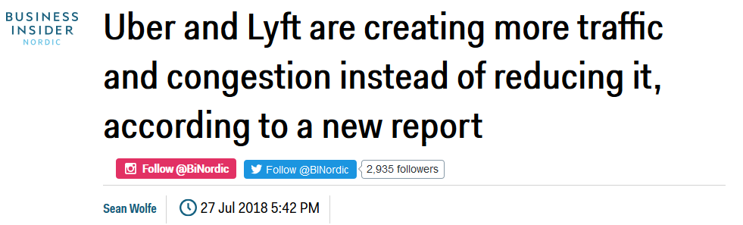

Slide 18
Sustainable business model archetypes
Source: Bocken, 2014

Slide 19
Approaches to SOI
 | Operational optimization | Organizational transformation | Systems Building
Innovation objective | Compliance, efficiency, “doing the same things better” | Novel products, services or business models, “Doing good by doing new things” | Novel products, services or business models that need collaboration. “Doing good by doing new things with others”
Innovation outcome | Reduces harm | Creates shared value | Creates net positive impact
Innovation’s Relationship to the Firm | Incremental improvements to business as usual | Fundamental shift in firm purpose | Extends beyond the firm to drive institutional change
Innovation elements | Incremental nature Existing knowledge and capabilities | Embed sustainability through organization New values and practices driving innovation Collaboration with key stakeholders | Focus on systemic change Collaboration with diverse stakeholders Diverse experimentation New business paradigms
Source: Adams et al. 2016

Slide 20
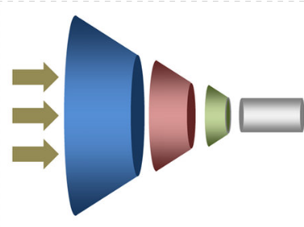
Innovation process
OPPORTUNITIES
DEVELOPMENT
IDEAS
PRODUCTS/SERVICES TO MARKET
TESTING

Slide 21
Typical stakeholder roles in SOI
(1) Private-problem holders—including both customers/users who hold private needs and corporate problem holders who hold strategic priorities
(2) Public-problem holders—the main add-on actor to conventional forms of innovation
(3) Innovation champions—entrepreneurs and intrapreneurs
(4) Knowledge holders
(5) Infrastructure holders
Jay & Gerard, 2015
Notes:
Public-problem: E.g. governments, NGOs ->
-Voicing/stewardship of sustainability need,
-Provision of legitimacy/credibility and scale for impact
Innovation champion: e.g. technology assembly, business modelin
Knowledge holders: e.g. research institutions and universities – tech- expertise
Infrastructure holders – E.g. public agencies, policy-makers, NGOs, corporations – standards, incentices, regulations, physical infra

Slide 22
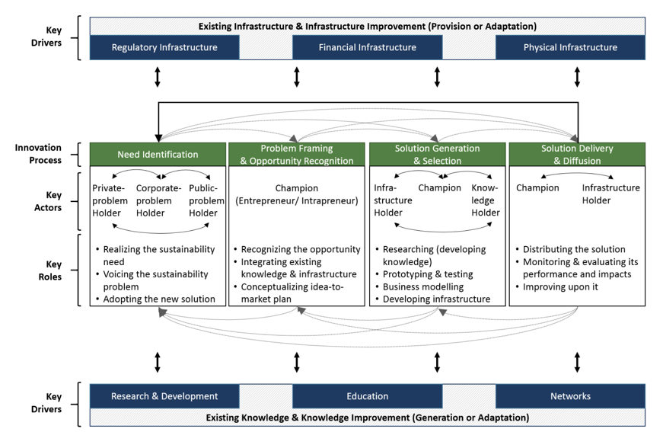
The SOI process
Notes:
The SOI process, however, is not only limited to private-problem stakeholders. Because it involves consideration of the social and environmental impacts of the innovation across its life cycle and its wider systemic effects, it also includes public-problem stakeholders.

Slide 23
Stakeholder partnership innovation in SOI
Stimulators
Innovation initiators
Brokers and mediators
Concept refiners
Legitimators
Educators
Context enabler
Impact Extender
Where can we learn about projects?
Where can we get new ideas?
Who can help us work with stakeholders?
Is our innovation right for end users?
How can we reassure the public?
How can we best explain our solution?
What about regulations?
How can we make a bigger impact?

Slide 24




Example: Sustainability partnerships in the textile sector
Companies | Partnership portfolio size
H&M | 103
PVH Corp | 67
Inditex | 59
Gap Inc | 57
VF Corp | 57
Kering | 46
Nike | 43
Adidas | 39
Ralph Lauren | 32
Lululemon | 28

Slide 25

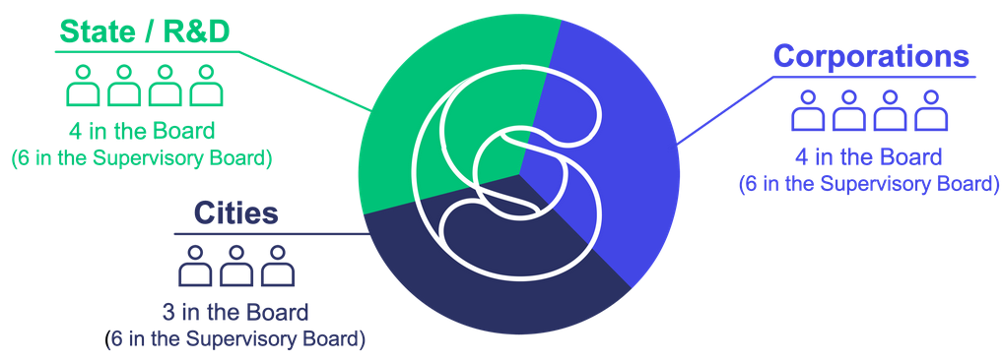
Case example: Helsinki Region Smart & Clean Foundation
“The Foundation orchestrates impactful climate solutions for systemic urban challenges in transport, energy, construction, and the waste and water sector.”
Notes:
“double externality” problem (Beise and Rennings,
2005). This is because SOI produces positive spillovers in both the innovation and the diffusion
phases. In other words, “While society as a whole benefits from the innovation, the costs are
borne by the innovator alone. Even if the innovation can be successfully marketed, it is difficult
for the innovator to appropriate the profits arising from the innovation if the corresponding
knowledge is easily accessible to imitators and if the environmental [and social] benefits have a
public good character” (ibid., emphasis ours). Not surprisingly, the double-externality problem
reduces incentives for firms to invest in SOIs (ibid.). This creates a need to engage diverse
secondary stakeholders (including public policy makers) to create the conditions that stimulate
and enable SOI. Actors therefore “must reconsider their capabilities, stakeholder relationships,
knowledge management, leadership and culture” (Adams, Jeanrenaud, et al., 2012) to advance
SOI.

Slide 26
Helsinki Region Smart & Clean Foundation – projects undertaken
Project | Public value goals | Private value goals | Key actors
Indoor air quality | Improving air quality in public buildings (e.g. schools) | Creating new air quality services | Research centre, three cities, university, technology-provider firms
Outdoor air quality | Improving outdoor air quality in the region, offering new data for decision-making | Creating a new air-quality monitoring system for use in developing services | MNE, meteorological institute, local environmental authority, university, city, several SMEs
Biofuels in mobility | Replacing fossil fuels in public transportation with biofuels | New business opportunities for biofuel and energy firms | Transport authority, Ministries, biofuel producers and distributors, transport businesses
Stormwater management | Increased preparedness for flooding | New business opportunities for stormwater management systems | City, university, several firms providing technology and material
Housing renovation | More sustainable renovation solutions for residential buildings | Piloting new renovation solutions | Research centre, housing provider organizations (public and private), several construction sector firms
Urban Food | Decreasing food waste and increasing local food production | New services and new value from excess food | Various companies and cooperatives in the restaurant and food sectors
Plastics circular economy | Reducing urban plastic waste | New viable circular economy business models | Numerous businesses, city actors,
Notes:
“double externality” problem (Beise and Rennings,
2005). This is because SOI produces positive spillovers in both the innovation and the diffusion
phases. In other words, “While society as a whole benefits from the innovation, the costs are
borne by the innovator alone. Even if the innovation can be successfully marketed, it is difficult
for the innovator to appropriate the profits arising from the innovation if the corresponding
knowledge is easily accessible to imitators and if the environmental [and social] benefits have a
public good character” (ibid., emphasis ours). Not surprisingly, the double-externality problem
reduces incentives for firms to invest in SOIs (ibid.). This creates a need to engage diverse
secondary stakeholders (including public policy makers) to create the conditions that stimulate
and enable SOI. Actors therefore “must reconsider their capabilities, stakeholder relationships,
knowledge management, leadership and culture” (Adams, Jeanrenaud, et al., 2012) to advance
SOI.

Slide 27
Repurpose for society: Base of the pyramid
Billions of people in the world live on very low income and lack access to the products and services needed to meet basic human needs
  In other words: Potential large, untapped markets and unrealized business opportunities
Central idea: Though these people have little purchasing power as individuals, their huge number makes up for it
Beginning in early 21st century, this was seen as a challenge MNCs could tackle
  In actuality, small firms target this field more frequently
Source:
Palomares-Aguirre et al., 2018
Notes:
In a large survey attempting to capture the situations of the poorest 4 billion, it turns out almost 60% of income is spent on food, followed by energy and housing at 9% and 7% respectively

Slide 28
CEMEX’s Patrimonio Hoy
The Patrimonio Hoy initiative eventually failed to grow into a trule large scale solution
  The base of the pyramid did not have the purchasing power to support the program’s infrastructure
  CEMEX begun tapping into the ”middle” of the pyramid to be able to maintain the program
CEMEX faced the problem for which sustainable business models are accused of perhaps the most: Lack of scalability
Scalability: ”The ability of a social business to increase the impact of a given program for more beneficiaries, while maintaining financial stability to ensure survival.”
Source:
Palomares-Aguirre et al., 2018
Notes:
Scalability: how many people can be reached, and how substantial problems can be remedied

Slide 29
How to remedy the scalability problem?
Source:
Palomares-Aguirre et al., 2018
Notes:
Mexico: 50+ million living in poverty, 11.5 million on less than 3 USD per day. Poor housing quality. Palomares-Aguirre et al studied three firms: Casa para Ensamblar, ¡?Echale! a tu Casa, and MIA.

Slide 30

Repurpose for the environment: Soilwatch
A company aiming to connect farmers around Africa to the global carbon offset market
  Soilwatch (www.soilwatch.eu)
  Teach and incentivize farmers to take up regenerative farming practices that bind CO2 to the soil
    This makes the soil better for farming, too
  Use machine-learning to analyze satellite images to monitor results

Slide 31
Challenges with sustainable business models
Large scale problems require scalable business models
  Sustainable business models are often not scalable
  The scale of these initiatives is miniscule in the grand scheme
Focus on small, isolated problems
  Large, complex (wicked) problems can rarely be broken down to small, atomized bits
Whether there is a business case or not determines if something can be done for a problem (and what and how)
  Generally a very selective way of solving issues

Slide 32
Tools and methods

Slide 33
Life-cycle assessment (LCA)
A standardized methodology for assessing environmental impacts across a product’s life-cycle
Guidelines covered in ISO 14040

Slide 34



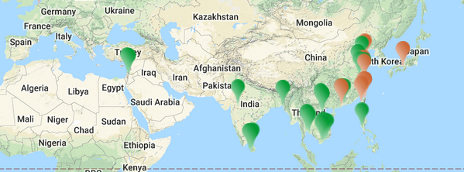
LCA example
sfsdfs

Slide 35
Ecodesign
Also referred to as Design for Environment (DfE).
Key principles:
  using materials with less environmental impact
  using fewer materials overall in the manufacture of products
  using fewer resources during the manufacturing process
  producing less pollution and waste
  reducing the environmental impacts from distributing products
  ensuring that products use fewer resources when they are used by end customers
  ensuring that products cause less waste and pollution when in use
  optimising the function of products and ensuring most suitable service life
  making reuse and recycling easier
  reducing the environmental impact of disposal
Example: C2C design protocol in the Herman Miller case

Slide 36
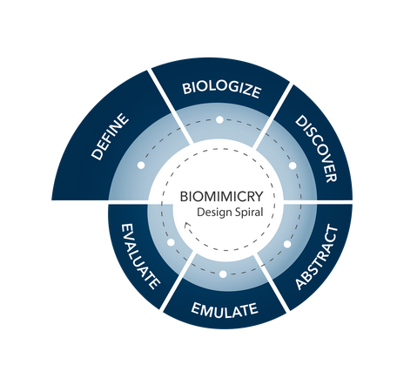
Biomimicry
Taking cues from nature for designing products, services, or business models
https://www.youtube.com/watch?time_continue=121&v=FBUpnG1G4yQ

Slide 37
References
Adams, R., Jeanrenaud, S., Bessant, J., Denyer, D., & Overy, P. 2016. Sustainability-oriented Innovation: A Systematic Review. International Journal of Management Reviews.
Bocken, N. M. P., Short, S. W., Rana, P., & Evans, S. 2014. A literature and practice review to develop sustainable business model archetypes. Journal of Cleaner Production, 65: 42–56.
Hockerts, K., & Wüstenhagen, R. 2010. Greening Goliaths versus emerging Davids - Theorizing about the role of incumbents and new entrants in sustainable entrepreneurship. Journal of Business Venturing, 25(5): 481–492.
Klewitz, J., & Hansen, E. G. 2011. Sustainability-oriented innvation in SME’s: A systematic literature review of existing practices and actors involved. ISPIM Conference (International Society for Professional Innovation Management), Sustainability in Innovation: Innovation Management Challenges, (June 2011): 12–15.
Lüdeke-Freund, F., & Dembek, K. 2017. Sustainable business model research and practice: Emerging field or passing fancy? Journal of Cleaner Production, 168: 1668–1678.
Palomares-Aguirre, I., Barnett, M., Layrisse, F., & Husted, B. W. 2018. Built to scale? How sustainable business models can better serve the base of the pyramid. Journal of Cleaner Production, 172: 4506–4513.
Ritala, P. 2019. Innovation for Sustainability: Sceptical, Pragmatic, and Idealist Perspectives on the Role of Business as a Driver for Change. In N. Bocken, P. Ritala, L. Albareda, & R. Verburg (Eds.), Innovation for Sustainability: Business Transformations Towards a Better World: 21–34. Palgrave.

Slide 38
Structure
Tue. 26.4.
Practicalities + Sustainability and business
Thu. 28.4.
Sustainability strategies
w/ Martta Nieminen
Tue. 2.5
Organizing for sustainability
Thu. 4.5
Sustainability innovation
Guest section: Karelia Dagnaud
Tue. 9.5
Student presentations (management instruments)
Thu. 11.5
Sustainability communication
Tue. 16.5
Stakeholder management simulation
Host: Guy Giffin, Prendo Simulations
Tue. 23.5
Supply chain management
+
Herman Miller case
Thu. 25.5
Circular economy
Tue. 30.5
Sustainable finance
Guest lecturer: Kaja Lilleng
Thu. 1.6
Systems change for sustainability
Guest lecturer: Iana Nesterova

