Slide 1
Supply chain management and case Herman Miller
Jukka Rintamäki
Sustainability in Business 23 May, 2023

Slide 2
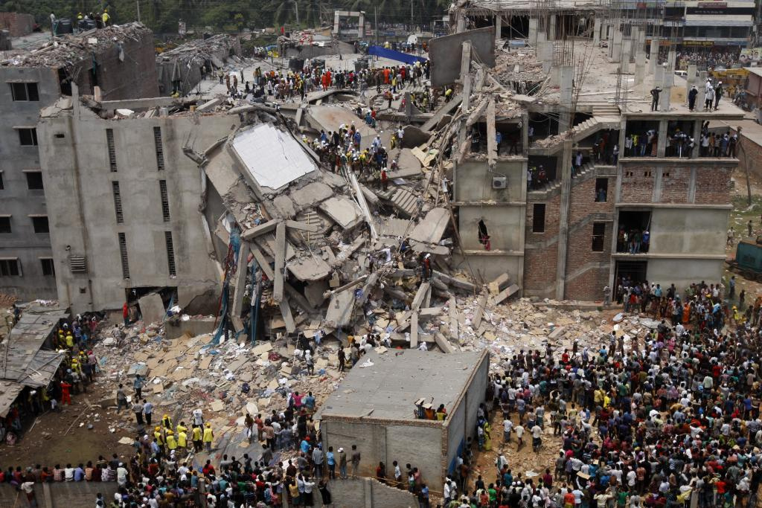
Notes:
Rana Plaza – more than 1100 deaths
http://www.cbc.ca/news/canada/bangladesh-s-rana-plaza-factory-collapse-spurs-change-finger-pointing-1.2619524
Let’s start off with an example that we discussed on the first session, the Rhana Plaza disaster. So as you may recall, this was a collapse of large industry building in Bangladesh that killed more than 1000 workers, many of them from the clothing industry. The aftermath of the disaster led to activitst campaigns agains some of the firms involved in the supply chains linked to the factory, e.g. Walmart, Primark and Benetton. What this illustrates in addition to the immense social costs is the risks that firms are facing in the upstream activities of their supply chains.

Slide 3
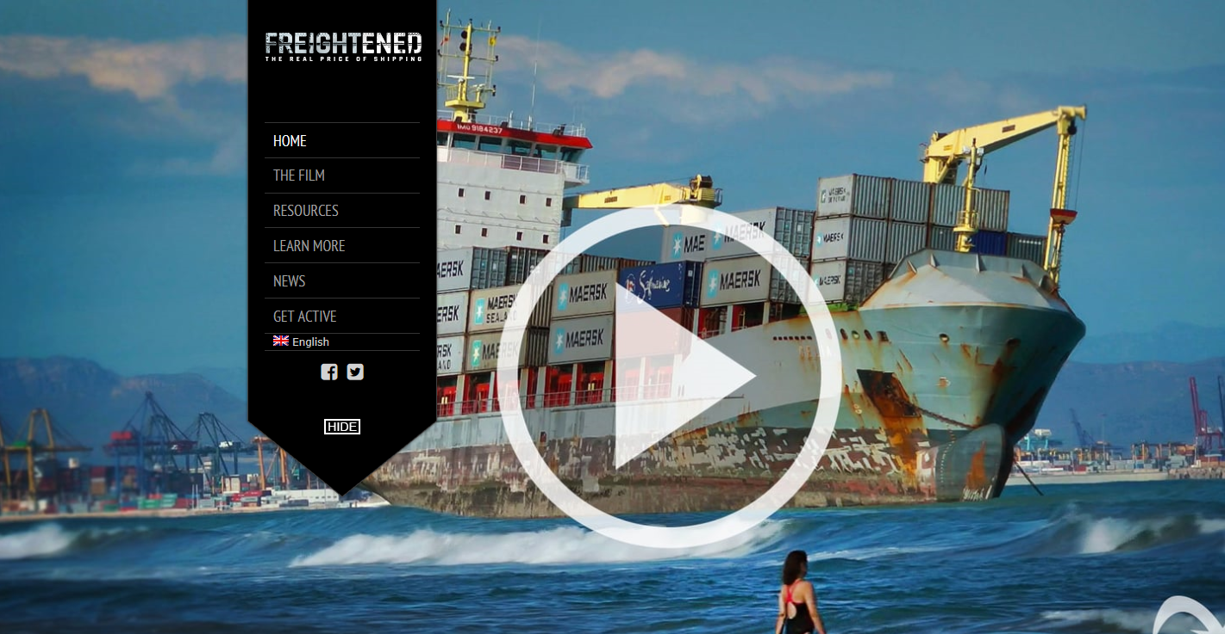
Intl. shipping example
Notes:
I can also recommend to take a look at a documentary called freightened, if you have the time. This focuses on the problems associated with international shipping, whichis at the heart of global supply chains.
Social problems: e.g. worker safety, working hours, wage practices
Environmental problems: discharges to waters, nitrogen, CO2 emissions, invasive species
Achieving effective regulation for shipping is difficult due to flags of convenience: most freight ships are registered to countries like Panama, etc. These countries have high influence over International Maritime Organization.

Slide 4
Learning goals
Understand the basics concepts of sustainable supply chain management (SSCM)
Analyze options for implementing SSCM strategies within firms, and understand the associated resource needs and potential challenges
Evaluate how a firm can create a competitive advantage through process and operational capabilities related to SSCM - Herman Miller case

Slide 5
Overview of the session
Key Concepts
Herman Miller case
Mirra chair decision
Implementation of C2C
Motives for undertaking iniative
Concluding thoughts and wrap-up

Slide 6
Supply chains
Supply chain management is the coordination of production, inventory, location, and transportation among the participants in a supply chain to achieve the best mix of responsiveness and efficiency for the market being served (Hugos, 2013)

Slide 7
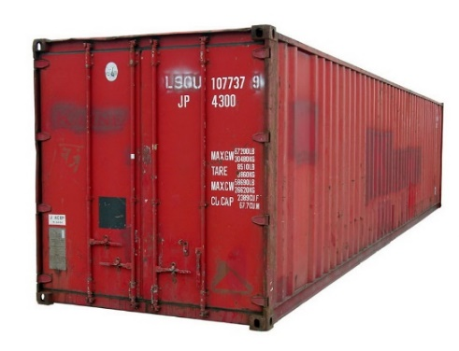
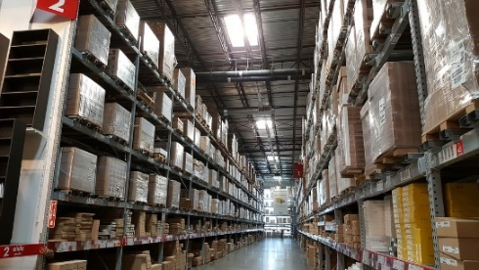
Core areas of supply chain management
Production | Inventory | Location | Transportation | Information
Efficiency vs responsiveness - right balance allows a supply chain to increase throughput while reducing inventory and expenses
Hugos, M. 2013. Essentials of Supply Chain Management (Essentials Series), Third Edition
Notes:
1. Production
—What products does the market want? How much
of which products should be produced and by when? This
activity includes the creation of master production schedules
that take into account plant capacities, workload balancing,
quality control, and equipment maintenance.
2. Inventory
—What inventory should be stocked at each stage in a
supply chain? How much inventory should be held as raw mat-
erials, semifinished, or fi
nished goods? The primary purpose of
inventory is to act as a buffer against uncertainty in the supply
chain. However, holding inventory can be expensive, so what
are the optimal inventory levels and reorder points?
3. Location
—Where should facilities for production and inventory
storage be located? Where are the most cost effi
cient locations
for production and for storage of inventory? Should existing
facilities be used or new ones built? Once these decisions are
made they determine the possible paths available for product to
fl ow through for delivery to the fi
nal consumer.
4. Transportation
—How should inventory be moved from one
supply chain location to another? Air-freight and truck delivery
are generally fast and reliable but they are expensive. Shipping
by sea or rail is much less expensive but usually involves longer
transit times and more uncertainty. This uncertainty must be
compensated for by stocking higher levels of inventory. When
is it better to use which mode of transportation?
5. Information
—How much data should be collected and how
much information should be shared? Timely and accurate
information holds the promise of better coordination and bet-
ter decision making. With good information, people can make
effective decisions about what to produce and how much, about
where to locate inventory, and how best to transport it.

Slide 8
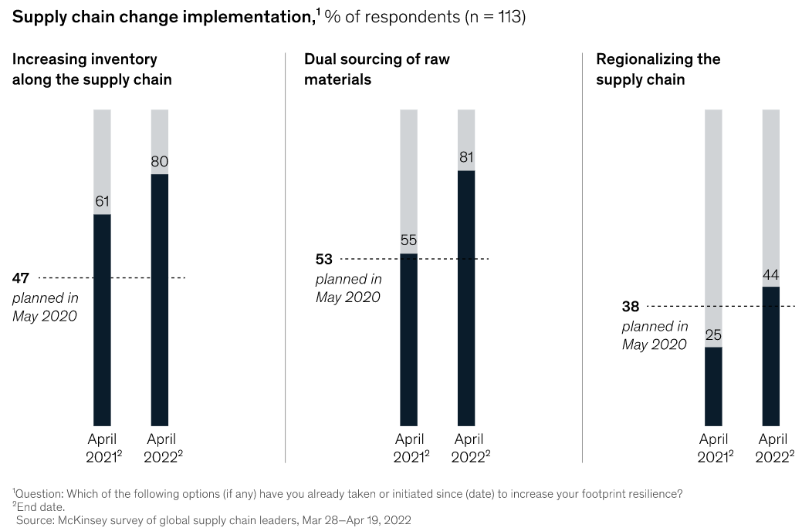
Resilience as a new key measure?

Slide 9
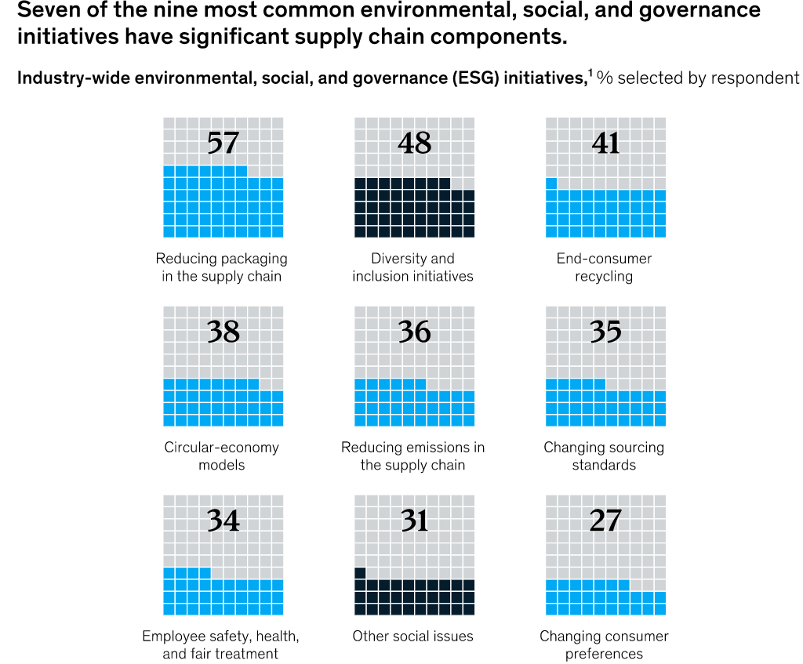
Sustainability and supply chain management

Slide 10
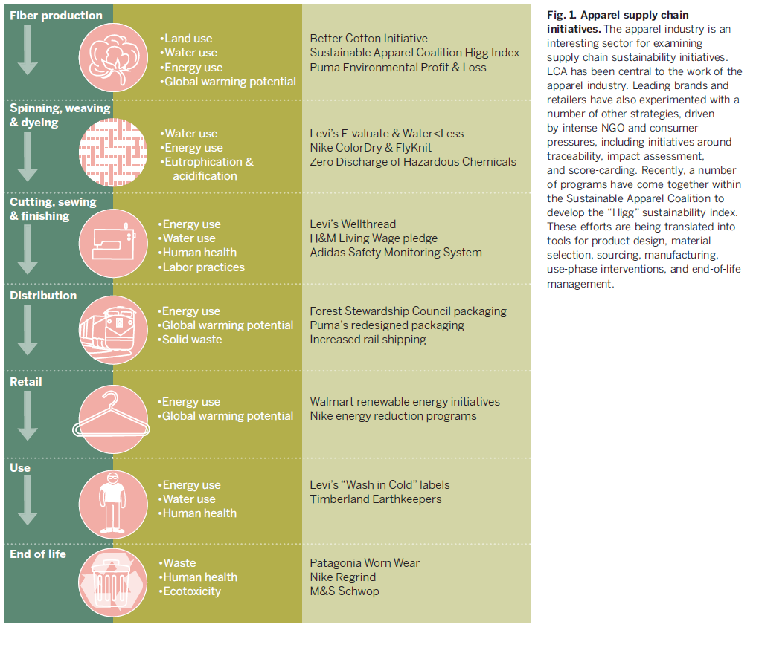
Scope of sustainable supply chain management
O’Rourke, 2014
Notes:
Main points:
Sustainable supply chain management aims to integrate sustainability issues across the whole value chain. Here is an example ffrom the textile supply chain, and describes a life-cycle assessment approach to analyze the different environmental and social impacts of products.
Describes the different stages of the garment’s life cycle, including fiber production, spinning, weaving and dyeing of yarn; cutting, sweing and finishing. Then distribution, retail, use and end of life.
The second column describes the various impact categories associated with each stage, including things like energy and water use, global warming potential, fair labour practices as well as waste
The third column describes sustainable supply chain initiatices of various companies in the sector in the different stages. For example:
1. SAC is a collaboration of large fashion and clothing firms which has developed the Higg Index to analyze sustainability of production
2. H&M has pledged that all employees in its supply chain would be paid a fair living wage, though this seems to be still rather contested
3. You have labels, such as Levi’s “wash in cold” that encourage users to save energy during the washing process.
4. Lastly, you have initiatives for reusing and recycling materials at the end of the product’s lifecycle, such as Patagonia Worn Wear, which sells used Patagonia, which are generally very long-lasting
Utilizing life-cycle assessment across the supply chain to calculate product footprints is a typical way to engage in sustainable supply chain management.

Slide 11
Labor issues in global supply chains

Slide 12
Labor standards in supply chains: State of the art
Professor Richard Locke, Brown University
How to improve labor standards in global supply chains?
Case: Nike
Labor standards have been considered relatively effective so far
Based on compliance
Effectively a policing mechanism: Regular checks on suppliers on whether or not they comply with standards
If not, they get a warning and are expected to correct their course
Further warnings will get their contracts terminated
Rates of standards have increased, improved results in worker surveys, improved results in the eyes of external observers
Sources:
Locke & Romis, 2006; Locke et al., 2007
Notes:
To be sure, Richard Locke’s research has been excellent throughout, and provided lots of understanding on how a large multinational organizes sustainability issues (especially human/labor rights) in global supply chains. However, it is all based on his extremely good access to Nike, and so we only know about Nike -> drawing broader conclusions, we should be careful. At the same time, getting good of data on the topic has generally been challenging, particularly beyond single case studies.

Slide 13
Problems with CSR standards
The complexity issue
A single factory can have e.g. 15 different customers with different expectations and standards
The evaluation scales for each customer different
Huge differences between different auditors auditing the same factory
Also in between different audits by the same auditor!
Source: Kuruvilla, 2021
Notes:
One of the primary problems in governing supply chains is that many factory entrepreneurs think the requirements are too harsh: it is considered impossible to provide BOTH the desired product (e.g. garment) quality AND sustainability requirements at the asked price (global brands in the upstream of supply chains hold considerable pricing power over providers). See Kuruvilla, 2021 for more.
Strain theory suggests actors will tend to start breaking rules the more strained with resources they become. So, as these factory entrepreneurs start feeling more and more tension around whether they can deliver everything that’s required of them, they might (and as you will see: will) begin cutting corners. This is an issue that really needs to be understood in terms of the political economy of these supply chains: global brands exerting various types of pressures (demands) on their supply chain partners, which will yield specific kinds of consequences as these partners try to meet these pressures.

Slide 14
Problems with CSR standards
New data has is now emerging on what is going on with CSR standards, and it does not paint a pretty picture
Professor Sarosh Kuruvilla, Cornell University
Notes:
Sarosh Kuruvilla and team’s recent work has shed light on supply chain sustainability issues more broadly, particularly when it comes to human/labor rights. He was approached by GAP in around 2018, and they offered him 2 million dollars to, I paraphrase, “figure out what is going on in garment supply chains and sustainability”. So he conducted a series of research projects on the topic, the first round of which has been documented in his recent book Private Regulation of Labor Standards in Global Supply Chains: https://www.cornellpress.cornell.edu/book/9781501754524/private-regulation-of-labor-standards-in-global-supply-chains/. He has also written several journal articles from those projects, most of them available through Aalto Uni library.

Slide 15
What the new data shows
40,000 audits across a broad range of firms and auditors
About 50% of audits either could not be verified to be reliable, or were considered unreliable
Audits classified as unreliable are also much more favorable (at the top end of the scores)
Unreliable audits concentrate on specific auditors
They have advanced software for quickly generating falsified records for their clients
Important: Not just one retailer over a long period of time, but several different retailers, representing an across-the-board picture
Short version: https://theconversation.com/why-apparel-brands-efforts-to-police-their-supply-chains-arent-working-136821
Source: Kuruvilla, 2021

Slide 16
What the new data shows
Emergence of auditing cheating consultants
Promise a pass
All-inclusive service: before, during, and after audits: DPPP
Generate the necessary Documents prior to the audit
Set up the factory (Place)
Provide People to deal with the auditors
Take care of the PR
Sound familiar?
Essay mills function in a similar manner, promising a pass without the student having to put in (literally) any work
Source: Kuruvilla, 2021

Slide 17
Why is this important?
All major retailers measure their CSR progress on supply-chain related issues based on general CSR ratings, which are ultimately determined by these audit processes
This is the norm currently in place
This measure is completely unreliable, based on this newly emerged data
45% of audits unreliable!
In short: private regulation data is not correlated with actual social (labor-related) outcomes
Source: Kuruvilla, 2021

Slide 18
Potential solutions?
Simplify the process:
Have fewer standards (one per field/issue)
Overlap and multiplicity create incentives for ’hastening’ the process
One auditing process?
Across different phases of the supply chain
Increased transparency?
Open databases on who have conducted which audits, publish specific results...
Empower the factory workers
This is what, in fact, some global brands are trying to do
Sources:
Reinecke & Donaghey, 2021; Kuruvilla, 2021
Notes:
Empowering factory workers is a very effective way of increasing worker welfare. However, as you will see from the paper by Reinecke and Donaghey, it’s a complex situation where these global brands are trying to improve worker conditions in their partner factories through supporting worker organization (read: unions, unionization – there is a small bit of irony here, given how many of these global brands aren’t too fond of unions among their own workers), but a considerable driver of the human rights problems at these partner factories can be traced to the stringent demands placed on them by these global brands themselves.

Slide 19
Herman Miller case

Slide 20
Herman Miller overview
Dates back to 1905
One of the top four suppliers of U.S. office furniture (16% market share in 2002)
Most customers S&P 1000 companies, large and multi-national
Sales $1,5b in 2002

Slide 21
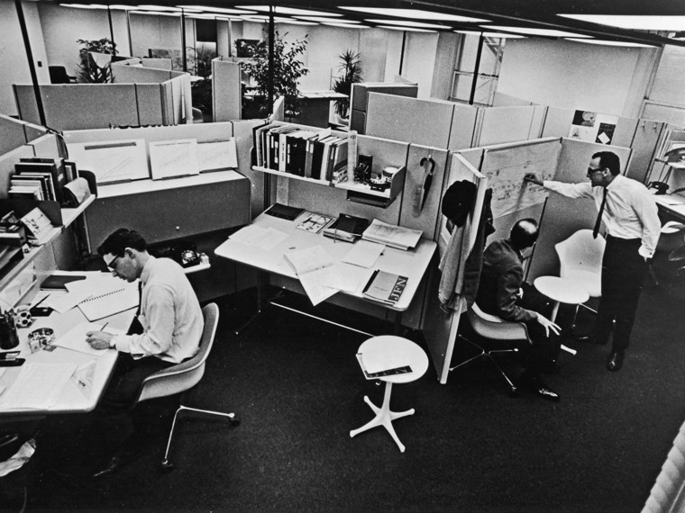

Slide 22
Mirra chair decision

Slide 23
What factors might Herman Miller consider in the decision?

Slide 24
Some considerations
Quality:
TPU potentially higher quality than PVC, but:
Supplier should retool ($100k) or modify PVC tool (uncertain)
Schedule:
The new tooling could delay launch, possibly missing trade fair
Brand:
Marketing benefits by going PVC-free
Quality image risked (if unsuccesful)
Internal credibility
Going PVC-free signals commitment to C2C, potential moral boost

Slide 25
Cost analysis
Gross margin (2002) 30% ($440m / $1469m)
Operating income (2002) 0,4% ($6m / $1469m)
Retail price $750
Retailer margin 33% (assumption)
HM’s revenue per chair: 33% * $750 = $500
Gross profit per chair: 30%*$500 = $150
Production cost: $500-$150=$350

Slide 26
Cost analysis
TPU increases costs of the armpad by 30%
Arm pad contributed to 10% of the cost of the chair ($35 per chair)
Material costs ~60% of the chair (assumption)
Cost increase: $35 * 0,6 * 0,3 = $6,3
-> low compared to selling price ($750)
Operating income per chair: 0,4% * $500 = $2
-> high cost increase when compared to operating income, should be compensated by increased retail price, this is difficult (price possibly already set and customers might not be willing to pay extra)

Slide 27
Comparison
PVC | TPU
+Cost efficiency +No launch delays +Industry standard -HM doesn’t have infrastructure for recycling PVC -Sets a precendent for other products | +Improved brand +Consitent with internal goals of footprint reduction +Competitive advantage -Cost increase -Potential launch delays -Supplier uncertainties
Who is going to make the decision?

Slide 28
Wider implications of the decision
Difficult economic situation, cost increases highly scrutinized
Domino effect: impacts to other (existing and future) products
-> wider strategic decision

Slide 29
Implementation of the C2C -protocol

Slide 30
C2C background
Conventional environmental wisdom (cradle-to-grave): conservation
Cradle-to-Cradle: focus on finding material synergies
Raw material
End-of-life disposal
Biological loop
Waste = input
Technical loop

Slide 31
Internal view
What do Herman Miller’s employees think of C2C?
Strong culture for sustainability
C2C also fits in with the design oriented culture
->C2C easy to implement from a cultural standpoint
Fit with the mission of the firm:
Mission statement | ”We contribute to a better world by pursuing sustainability and environmental wisdom. Environmental advocacy is part of our heritage and a responsibility we gladly bear for future generations”
Strategic initative | Cradle-to-cradle design protocol
Operational changes | Training, design process changes, Design-for-Environment scorecard

Slide 32
Timeline of C2C implementation
1997: Herman Millers initiates a project to develop a sustainable product development process. C2C proposed.
2000: Project ends, steering committee recommends dedicated resources to C2C
2001: C2C officially adopted as design protocol
Jan 2001: DfE team formed with two full-time hires. They initiate supplier negotiations (materials) with over 200 suppliers in 6 months
Jun 2001: training for over 300 employees on C2C, 3 hours each
Aug 2002: DfE committee meets to discss the Mirra chair case
Jun 2003: anticipated launch of Mirra chair

Slide 33
Implementation
Organization:
Creation of the DfE team, with Gabe Wing (chemist), Scott Charon (supply chain manager).
Creation of DfE steering committee that could facilitate the implementation
Training for employees
Design:
Every designer trained on C2C guidelines.
Product development process changed for interaction with the DfE team
Supply chain interaction:
enormous effort spent on negotiations with suppliers.
C2C needed accurate material data. HM’s large sized helped and eventually only two suppliers didn’t comply and were replaced (note: power relations).

Slide 34
Implementation
DfE scorecard:
based on weights of the materials,
three parts (material chemistry, disassembly, recyclability)
Costs:
$100k for materials database,
$300k for material screening by MBDC
salaries for Charon and Wing ($350k/y)
Training costs for employees

Slide 35
Operational changes
Design: imposes material constraints, might save time by limiting options, but spend more time to optimize part performance
Manufacturing: products should be easy to disassemble -> assembly process might become easier or harder (e.g. screws vs snaps). DfE consistent with philosophy of reducing waste (Toyota Production System)
Supply chain: clearer rules of engagement but the C2C process created friction. Increased transparency
Sales and Marketing: PVC-free as selling feature, some customers environmentally-focused, but the image could also backfire (PVC used extensibly at HM)

Slide 36
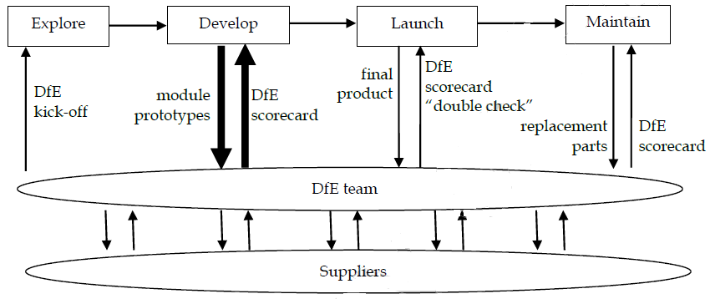
DfE and Product Development Process

Slide 37
Biosphere rules (Unruh, 2008)
Rule #1: Use a Parsimonious Palette
Rule # 2: Cycle Up—Virtuously
Rule #3: Exploit the Power of Platforms
Notes:
Use as few materials as possible, and avoid materials that are hard to recycle
Try to find higher value applications for materials, planned obsolescence might be virtuous if materials have a higher value use
Use modular platforms not only at the product-level, but also material level

Slide 38
What similarities can you see between the Biosphere rules and Herman Miller’s C2C protocol?
Notes:
Step 1: Think fewer materials.
Step 2: Rethink design.
Step 3: Think scale economies.

Slide 39
Suppliers
Why were suppliers resistant to the C2C protocol?
Need to share proprietary information
Potential product or process changes
More work
Uncertainties
What does it take for the arm pad supplier to switch from PVC?
Finding and testing alternatives
Design and fabricate tooling
Develop manufacturing processes
Risk: hold-up problem
-> HM mitigated some risks by investing its own resources to help suppliers

Slide 40
Suppliers
What are the benefits for the suppliers (as highlighted by HM)?
Shorter development cycles thanks to limited material selection
Materials assessments may aid in anticipating regulations
Public image benefits, with HM acknowledging suppliers
Implied: C2C should be adopted in order to maintain the business relationship
What would it take for Herman Miller to get rid of PVC from all its products?

Slide 41
Motives for undertaking the initiative

Slide 42
How did Herman Miller aim to capture value from the C2C protocol?

Slide 43
Possible motives
Reputation / brand benefits
Employee recruitment / retention
Anticipate impending regulations (first-mover advantage)

Slide 44
First-Mover Advantage
Should Herman Miller help its competitors implement C2C?
+Becomes industry standard
+Environmental benefits
-Competitive edge decreases?
Herman Miller’s competitive advantage lies primarily in process capabilities
Difficult to replicate

Slide 45
Based on the case, does C2C help the environment?

Slide 46
What happened
Herman Miller proceeded with TPU for the Mirra Chair arm pad
Used a modified PVC tool initially, some difficulties in production
New TPU-centric tool added later, both tools still in use
Another chair, Aeron, redesigned to be PVC-free
Currently, more than 50% of sales are from DfE approved products, commited to 100% in the future

Slide 47
Concluding thoughts

Slide 48
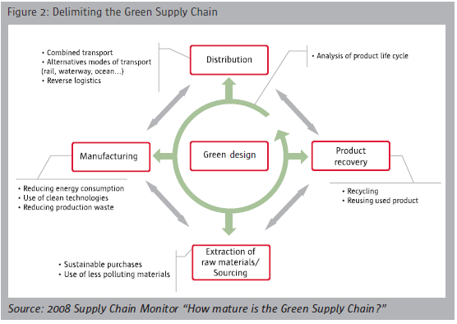
Sustainable supply chains – focus areas

Slide 49
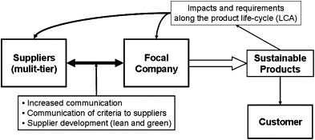
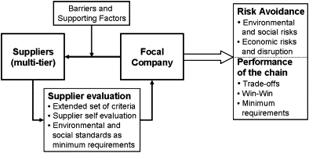
Two strategies for SSCM
Supply chain management for more sustainable products.
Supplier management for risks and performance.
Seuring & Muller, 2008

Slide 50
Approaches for interacting with lower tier suppliers for SSCM
Direct: supplier evaluation with KPIs for lower tiers, supplier surveys, working with first-tier suppliers to map the supply chain
Indirect: Provide training among first-tier suppliers to help them improve procurement from lower- tier suppliers, selecting high performing suppliers to pilot new initiatives, rewarding suppliers for cascading sustainability requirements to lower tiers
Collective: Commit to developing industry-wide sustainability standards, share resources with competitors and major suppliers via industry associations, encourage suppliers to take part in training programs by industry associations
Global: Work with relevant NGOs and international institutions, use their tools and data for dealing with suppliers, recognize suppliers that attend programs by NGOs and international institutions
Vilenna & Gioia. 2020. A more sustainable supply chain. Harvard Business Review

Slide 51
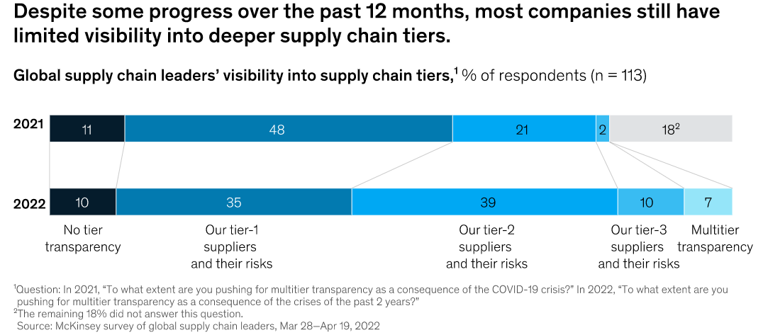
Transparency is growing but still not sidespread

Slide 52
Tensions in SSCM
A field study of sustainable supply networks identified 20 types of tensions that can emerge in the supply chains
 | Experienced by and between
Tension | Actor 1 | Actor 2 | Description
Economic tensions
2.Cost of operational changes | Supplier | Implementer | Implementer demands that suppliers adapt their processes to new codes of conduct or sustainability requirements
3.Higher prices | Customer | Implementer | Implementers charge higher prices from customers due to cost increase in their own operations
Structural tensions
5.Increased monitoring and controlling needs | Implementer | Suppliers and other network partners | Implementer needs to monitor and control that several actors in its value chain and network follow its codes of conduct
6.Dependence on key suppliers | Implementer | Supplier | Implementers fear that a dependency on a raw material that is available only from specific suppliers (e.g. by-products from forest industry to use in a bio heating plant) can give away too much negotiation and pricing power
Psychological tensions
10.Technological risk | Implementer | Customers | New SBPs lack references and proof of performance, and the implementer fears that they will not be as functional or effective as traditional alternatives
13.Fear of disclosing sensitive business information | Customer | Implementer | Customers are reluctant to share sustainability information and data if it is business-critical or otherwise sensitive
Behavioral tensions
17.Internal resistance | Implementer´s top management | Implementer´s field personnel | Employees are reluctant to learn new skills, accept new responsibilities or process changes, and adopt new work practices
20.Divergent communication and promotion needs | Other network partners | Entire network | Other network partners need to communicate and promote goals and agendas that facilitate several actors´ interests and objectives, which are often conflicting and contradictory
Tura, N., Keränen, J., Patala, S., 2018. The darker side of sustainability: Tensions from sustainable business practices in business networks. Industrial Marketing Management. https://doi.org/10.1016/j.indmarman.2018.09.002

Slide 53
Takeaways
Sustainable supply chain management (SSCM) involves decreasing impacts in manufacturing, material sourcing, distribution, product design as well as forming reverse chains for recovery
The Herman Miller case demonstrates how SSCM can create competitive advatange through process capabilities, which are hard to replicate
Requires cooperation between supply chain partners and tensions are common, takes substantial effort to set up
To close material loops, system-level cooperation and necessary infrastructure is needed.

Slide 54
References
Case: Cradle-to-Cradle Design at Herman Miller: Moving Toward Environmental Sustainability
Kuruvilla, S. 2021. Private Regulation of Labor Standards in Global Supply Chains: Problems, Progress, and Prospects. Cornell University Press.
Locke, R., Qin, F., & Brause, A. 2007. Does monitoring improve labor standards? Lessons from Nike. Industrial and Labor Relations Review, 61(1): 3–31.
Locke, R., & Romis, M. 2006. Beyond Corporate Codes of Conduct: Work Organization and Labor Standards in Two Mexican Garment Factories. Ssrn, 146(1). https://doi.org/10.2139/ssrn.925273.
O’Rourke, D., 2014. The science of sustainable supply chains. Science 344, 1124–1127. https://doi.org/10.1126/science.1248526
Reinecke, J., & Donaghey, J. 2021. Political CSR at the Coalface – The Roles and Contradictions of Multinational Corporations in Developing Workplace Dialogue. Journal of Management Studies, 58(2): 457–486.
Seuring, S., Müller, M., 2008. From a literature review to a conceptual framework for sustainable supply chain management. Journal of Cleaner Production 16, 1699–1710. https://doi.org/10.1016/j.jclepro.2008.04.020
Tura, N., Keränen, J., Patala, S., 2018. The darker side of sustainability: Tensions from sustainable business practices in business networks. Industrial Marketing Management. https://doi.org/10.1016/j.indmarman.2018.09.002
Unruh, G. 2008. The Biosphere Rules. Harvard Business Review. https://hbr.org/2008/02/the-biosphere-rules

