Slide 1
Circular Economy
Sustainability in Business
Samuli Patala
25.05.23

Slide 2
Overview
Basic concepts of circular economy
Circular business models
Enablers and governance of CE
Critique of CE

Slide 3
Warm-up
When you think of circular economy, what kind of businesses come to mind?

Slide 4
Examples of circular business models
Notes:
Let’s firstly look at some examples of CE-based business models. These are some of the firsm we are working with in our textile-focused CE-project.
Touchpoint creates high-quality and durable workwear for businesses, and can provides various services, e.g. related to inventory management and LCA, alongside the product. They wave a closed-loop solution where they collect the used workwear and find new uses for the textile materials, which gives the material a new lifecycle. You will hear about this company more duing the guest lecture.
Pure Waste manufacturers clothing from textile waste material, which is left over from cutting processes. They sell the clothing to both consumers and create collections for business customers. Utilizing waste material instead of virgin cotton saves huge amounts of resources.
Vaatepuu is a business that operates a clothing rental services, where customers can rent a clothing a use it for a certain amount of time instead of owning, increasing the usage rate and lifecycles of clothing.
These examples all illustrate different strategies for how CE can be achieved. We’ll talk about these later.

Slide 5
THE LINEAR ECONOMY
GREATER EFFICIENCY
LONGER-LASTING PRODUCTS
Source: Ellen MacArthur Foundation
Notes:
EXPLAIN: Why is increased efficiency not enough?
Facilitation guide:
You might say:
So, what could be done about this flawed system?
Greater efficiency, longer-lasting products, decreasing consumption
There are two familiar approaches that some argue for: greater efficiency and longer-lasting products. Let’s look at them in turn.
The top line shows the system as it is now – linear
Line 2 shows a more efficient linear economy (i.e. one where fewer materials are utilised to create the same or better result)
Line 3 shows a system characterised by longer-lasting products
The problem both proposals have is that the underlying system isn’t challenged, so we will eventually run into the same problems.
These approaches can help buy us some time, but buy us some time for what?

Slide 6
Drivers to circular economy

Slide 7
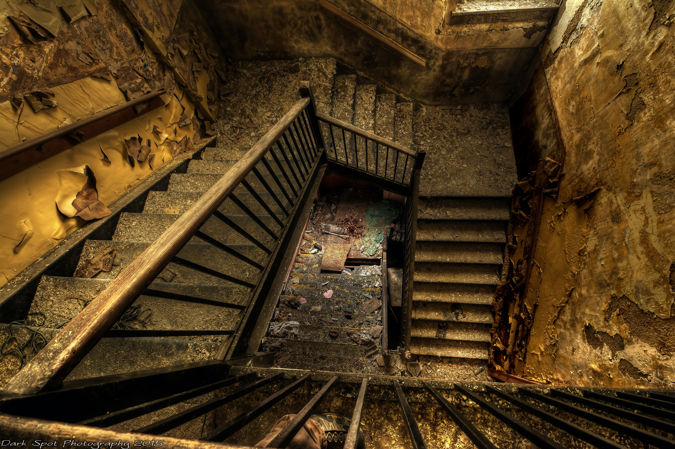
In EU:
the average car is parked 92% of the time
31% of food is wasted along the value chain
the average office is used only 35–50% of the time
Economic losses and structural waste
Notes:
EXPLAIN: Limits to the linear economy
- Economic losses and structural waste
Background information:
Understanding the limits to our current economic system can be the key to identify new opportunities. Furthermore, it provides the participants with useful arguments if they wish to engage other stakeholders in a new business activity – be it investors, suppliers, local authorities, consumers/users or colleagues.
Facilitation guide:
Building on the first exercise you will explain to the participants about flaws of the current economic system leading them to understand the opportunities of change. You might say:
The current economy is surprisingly wasteful in its model of value creation. In Europe, material recycling and waste-based energy recovery captures only 5 percent of the original raw material value.
Analysis has also found significant ‘structural waste’ in sectors that many would consider mature and optimised. For example, in Europe, the average car is parked 92% of the time, 31% of food is wasted along the value chain, and the average office is used only 35–50% of the time, even during working hours.
There is therefore great opportunities for businesses to decrease costs and/or increase value creation by finding ways to minimise waste of resources and increase utilisation assets. We will soon come back to look at how some companies already are doing this.
Image credit: ‘Nautilus Nightmare’ by Flickr user David Barnas. Creative commons license.

Slide 8
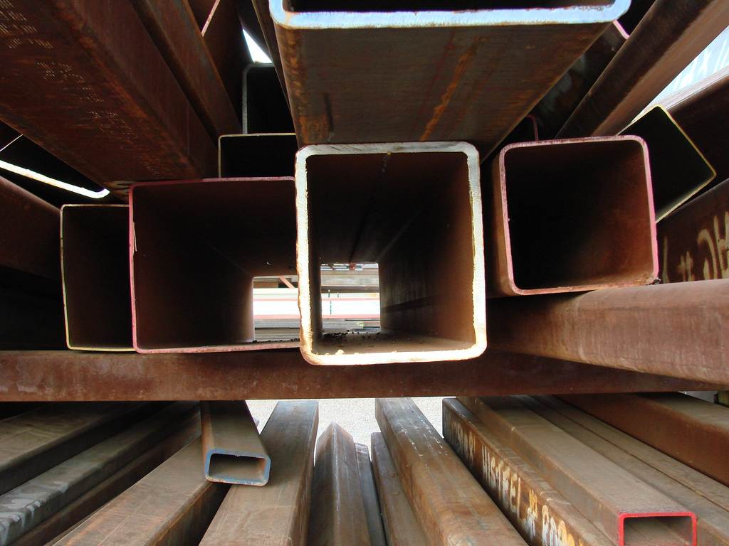
Price risks
Notes:
EXPLAIN: Limits to the linear economy
- Price risks
Facilitation guide:
You might say:
Recently, many companies have begun to notice that a linear system increases their exposure to risks, most notably volatile resource prices and supply disruptions.
Higher resource price volatility can dampen economic growth by increasing uncertainty, discouraging businesses from investing and increasing the cost of hedging against resource-related risks.
The last decade has seen higher price volatility for metals and agricultural output than in any single decade in the 20th century.
Image credit: ‘Metal’ by Flickr user Kevin Spencer. Creative commons license.

Slide 9
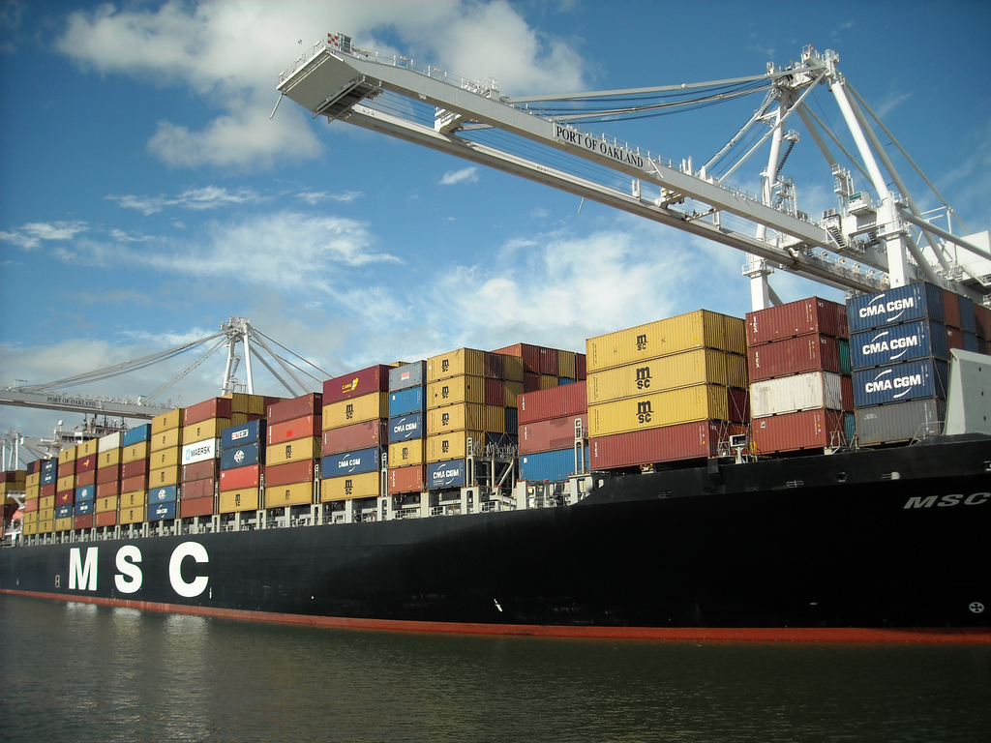
Supply risks
Notes:
EXPLAIN: Limits to the linear economy
- Supply risks
Facilitation guide:
You might say:
Many areas of the world possess few natural deposits of nonrenewable resources of their own and so must rely on imports: The European Union imports six times as much materials and natural resources as it exports. Japan imports almost all its petroleum and other liquid fuels and its natural gas, and India imports around 80% and 40% respectively.
As well as risks to the supply of raw materials themselves, the risk to supply security and safety associated with long, elaborately optimised global supply chains appears to be increasing.
Decreasing use of virgin material can therefore make a company less exposed to the risks of price volatility and supply security.
Image credit: ‘Container Ship MSC Texas’ by Flickr user Daniel Ramirez. Creative commons license.

Slide 10
Natural systems degradation
Notes:
EXPLAIN: Limits to the linear economy
- Natural systems degradation
Facilitation guide:
You might say:
A fundamental challenge to long-term global economic growth is the set of negative environmental consequences related to the linear model.
Depletion of low-cost reserves (e.g. easy accessible crude oil), and increasingly, the degradation of natural capital are affecting the productivity of economies negatively.
Elements contributing to these environmental pressures include:
Climate change
Loss of biodiversity and natural capital
Depletion of finite resources
Land degradation
Pollution of air and ocean
Image credit: ‘Flax’ by Flickr user Global Environment Facility. Creative commons license.

Slide 11
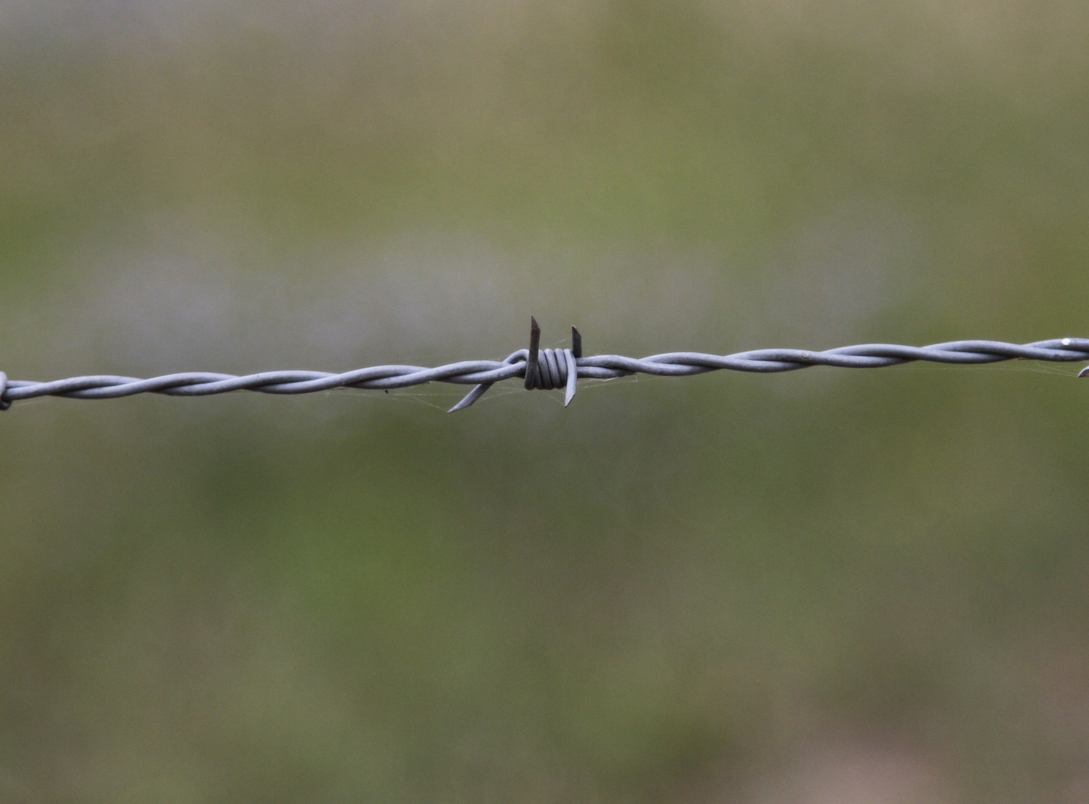
Regulatory trends
Notes:
EXPLAIN: Limits to the linear economy
- Regulatory trends
Facilitation guide:
You might say:
In recent years, businesses have witnessed an increased governmental effort to curtail and price negative externalities. For example:
Since 2009, the number of climate change laws has increased by 66%, from 300 to 500.
Carbon pricing, in the form of an emissions trading scheme or a carbon tax, has been implemented or is scheduled to commence in almost 40 countries and over 20 cities, states and regions.
In Europe, 20 countries levy landfill taxes have been implemented, which together raised public revenues of €2.1 billion in 2009/2010.
Considering these regulatory trends and strategically adjusting your business model can therefore lead to economic benefits incl.: 1) Decreased costs in terms of avoided fees and levies 2) A competitive advantage compared to those companies who are forced to change their business practice at a later stage.
Image credit: ‘No entry’ by Flickr user Percita. Creative commons license.

Slide 12
Drivers for change
Challenges
Enablers
ECONOMIC LOSSES & STRUCTURAL WASTE
ADVANCES IN TECHNOLOGY
PRICE RISKS
ACCEPTANCE OF ALTERNATIVE BUSINESS MODELS
SUPPLY RISKS
URBANISATION
NATURAL SYSTEMS DEGRADATION
REGULATORY TRENDS
SOURCE: Ellen MacArthur Foundation, SUN, McKinsey Center for Business and Environment - Growth Within: a circular economy vision for Europe
Notes:
EXPLAIN: The drivers for change
Facilitation guide:
A number of factors indicate that the linear model is increasingly being challenged by the very context within which it operates, and that a deeper change of the operating system of our economy is necessary.
Many companies have begun to notice that a linear system increases their exposure to price and supply risks, most notably volatile resource prices and supply disruptions. Added to this, many parts of the world possess few natural non-renewable resources and are forced to rely on imports. For example, the EU imports six times the amount of natural resources than it exports. This limited supply and uneven distribution of resources further contributes to great fluctuations in commodity prices and can cause economic instability.
Key arguments against the linear economy:
• It’s based on the endless consumption of materials and fossil fuels: both are finite
• Value is stripped out of the system in the form of waste at every step in the process
• A linear system exposes companies to price and supply risks
• The regulatory trend is to shift away from linearity
• It’s inherently inefficient: there is structural waste throughout the entire system (e.g. disused or underutilised offices and buildings,
the car that’s parked for most of its life)
• Natural systems degradation: the liner system uses up natural capital, leads to biodiversity decline, climate change, land degradation and ocean pollution
It is not only limits to the current linear economy that act as drivers – important positive trends are also creating new favorable conditions for circular business models making the moment for the transition opportune:
Advances in IoT enables new sharing schemes and asset tracking helps optimise operations and production
People are getting more and more used to alternative business models where they don’t necessarily own the product but just pay for getting access to the service of the product
Urbanisation has led to that more 50% of the worlds population today live in cities (75% in 2050), leading to increased proximity of people and assets

Slide 13
WHAT IS A CIRCULAR ECONOMY?
“A circular economy is one that is restorative and regenerative by design, and which aims to keep products, components and materials at their highest utility and value at all times, distinguishing between technical and biological cycles.”
Source: Ellen MacArthur Foundation
Notes:
SUMMARISE: What is the circular economy
Facilitation guide:
Repeat the definition of a circular economy.

Slide 14
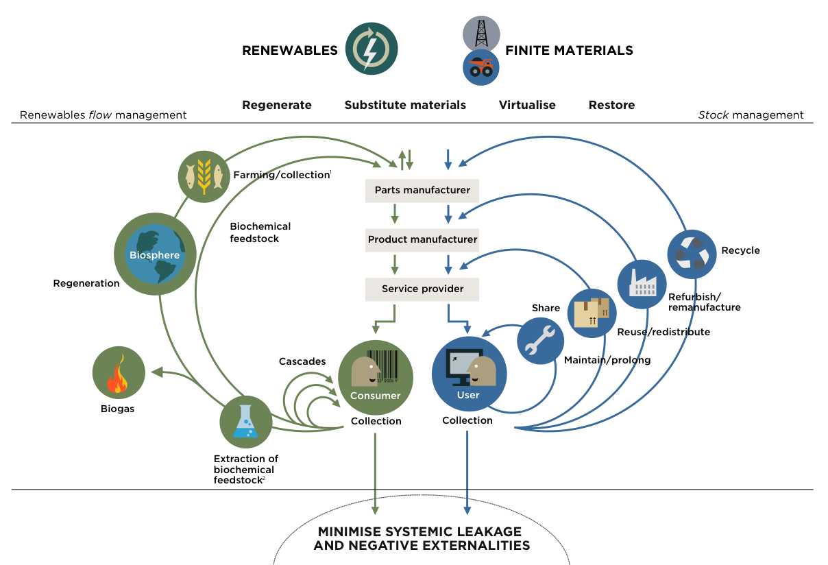
SOURCE: Ellen MacArthur Foundation; drawing from Braungart & McDonough Cradle to Cradle (C2C)
Notes:
EXPLAIN: The circular economy from the butterfly diagram
Facilitation guide:
Go into more details on what a circular economy entails, the ‘butterfly diagram’ helps to illustrate the concept. Here you should point out to the participants:
The circular economy is characterised by feedback-rich flows. The idea is to keep the materials moving – or flowing – around the system as effectively and as endlessly as possible
It consists of two material cycles – technical and biological.
There are two kinds of customer – consumers (of biological materials) and users (of technical materials).
The majority of flows return materials back into the system (therefore waste is minimised).
In the technical cycle, the closer the material loop is kept, the more profitable the action – hence rather maintain than reuse and recycling is ‘last resort’.
>> Next step is do an exercise about some of the terms on this diagram.

Slide 15
Business strategies for CE
REGENERATE
The ReSOLVE framework
Regenerate and restore natural capital
The ReSOLVE framework offers organisations a tool for identifying circular strategies and growth initiatives.
EXCHANGE
SHARE
Select resource input wisely
Maximise product utilisation
VIRTUALISE
OPTIMISE
Deliver utility virtually
Optimise system performance
Each of the ReSOLVE levers represents a circular economy business opportunity by eliminating systemic waste.
Keep components and materials in technical and biological cycles
LOOP
SOURCE: Ellen MacArthur Foundation, SUN, McKinsey Center for Business and Environment - Growth Within: a circular economy vision for Europe
Notes:
EXPLAIN: ReSOLVE – A tool to identify opportunities
Facilitation guide:
Briefly introduce the ReSOLVE framework. You might say:
Through research conducted on case studies and expert interviews, the Ellen MacArthur Foundation and McKinsey have broadly identified a set of six actions that businesses can take in order to transition to a circular economy: Regenerate, Share, Optimise, Loop, Virtualise, and Exchange – together, the ReSOLVE framework.
The ReSOLVE framework offers businesses a tool for generating circular strategies and growth initiatives.
In different ways, these actions all increase the utilisation of physical assets, prolong their life, and shift resource use from finite to renewable sources.
Each action reinforces and accelerates the performance of the other actions.
>> In the next slides you will illustrate how to use ReSOLVE by introducing one case study at a time.

Slide 16
Exercise – ReSOLVE
Take a moment to read through the three short case studies provided
Discuss in groups – which ReSOLVE strategies do you identify in each case?
REGENERATE
Regenerate and restore natural capital
EXCHANGE
SHARE
Select resource input wisely
Maximise product utilisation
VIRTUALISE
OPTIMISE
Deliver utility virtually
Optimise system performance
Keep components and materials in technical and biological cycles
LOOP

Slide 17
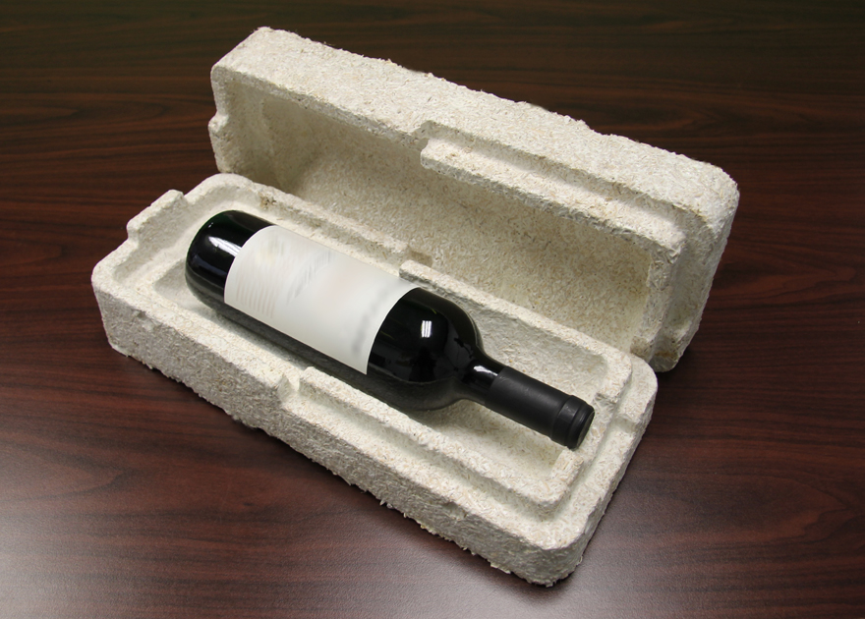
Notes:
EXPLAIN: ReSOLVE – Ecovative
Facilitation guide:
Briefly describe the business case. You might say:
Eben Bayer and Gavin McIntyre, the founders of Ecovative Design, found inspiration while observing mushrooms growing on wood chips and how the ‘roots’ of the mushrooms bonded the wood chips together.
That enabled Eben and Gavin to manufacture a number of products that are made of a mushroom-based material that is a compostable, bio-based alternative to petroleum-based expanded plastics - Products include protective packaging, insulation and even surfboards.
The material is grown in and around agriculture by-products with low economic value, i.e. plants that cannot be used for food or feed. This takes minimal processing and reduces the cost of the products and thus enables economic viability. At the end of use, products can be composted at home.
Additionally, the technique allows use of multiple feedstocks, thus allowing Ecovative to use locally available crops.
Now Ecovative supplies packaging components to Dell, Steelcase and a growing number of Fortune 500 companies.
Case study link: https://www.ellenmacarthurfoundation.org/case-studies/growing-alternatives-to-petroleum-based-packaging

Slide 18
A CLOSER LOOK
The ReSOLVE framework
REgenerate
The material is designed to be compostable and can go back into the biological cycle.
Share
Optimise
Loop
Grows fungi on agricultural waste
Virtualise
Exchange
One material is substituted with another (for customer)
Source: Ellen MacArthur Foundation
Notes:
EXPLAIN: ReSOLVE – Ecovative
Facilitation guide:
Identify the relevant actions in the ReSOLVE framework:
Regenerate: The material is designed to be compostable and can go back into the biological cycle.
Loop: Grows fungi on agricultural waste
Exchange: One material is substituted with another (for example, rather than use, say, polystyrene, people can use Ecovative) (i.e they substituted a general material for this new one)

Slide 19
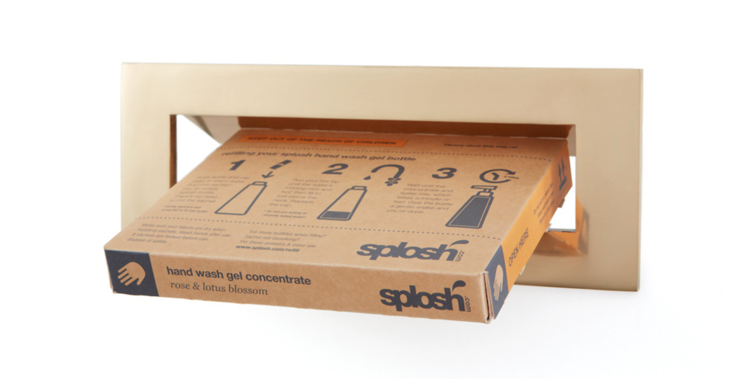
Notes:
EXPLAIN: ReSOLVE – Splosh
Facilitation guide:
Briefly describe the business case. You might say:
Angus Grahame set up Splosh in 2012 with the idea that there must be an opportunity to sell household cleaning products outside of the supermarkets using a ‘one time sale’ model. He completely redesigned the products for a new e-commerce business model.
Splosh sells customers a one-off ‘starter box’, containing a range of simply-designed bottles. A sachet of concentrated liquid is added to the bottle with warm tap water to create cleaning products. Bottles can be used repeatedly, with refill sachets delivered in boxes through the post.
Since the products are not sold on a shelf, Splosh products don’t have be designed to fight for attention with other brands. In addition, the new relationship with the customer opens up a direct marketing channel, an extremely valuable way of communicating with users.
Case study link: https://www.ellenmacarthurfoundation.org/case-studies/how-re-thinking-the-business-model-for-cleaning-products-can-influence-design

Slide 20
A CLOSER LOOK
The ReSOLVE framework
REgenerate
Share
Optimise
the life of the bottles is prolonged significantly
Loop
Virtualise
the store is virtualized
Exchange
Source: Ellen MacArthur Foundation
Notes:
EXPLAIN: ReSOLVE – Splosh
Facilitation guide:
Identify the relevant actions in the ReSOLVE framework:
Optimise: Through the design of the bottles and the e-commerce sales model the life of the bottles is prolonged significantly, which also decreases the use of resources.
Virtualise: The store is virtualised.

Slide 21
Circular Business models

Slide 22
Circular business models
(Bocken et al. 2016)
Slowing loops:
Access and performance model
Extending product value
Classic long-life model
Encourage sufficiency
Closing loops:
Extending resource value
Industrial symbiosis

Slide 23
Access and performance model
Providing the capability or services to satisfy user needs without needing to own physical products

Slide 24
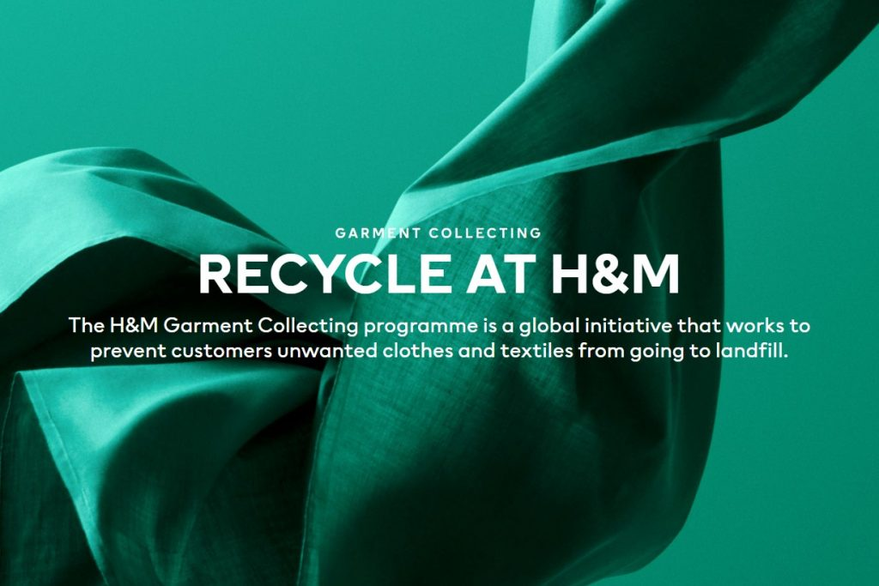
Extending product value
Exploiting the residual value of products
Remanufacturing
Refurbishing
Collecting used products

Slide 25
Classic long-life model
Business models focused on delivering long-product life, e.g. by design for durability or repair services

Slide 26
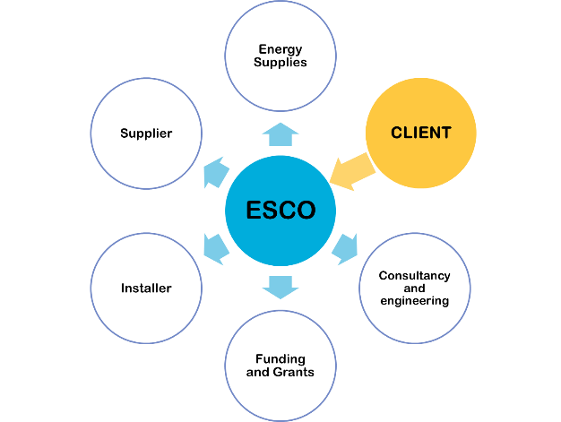
Encourage sufficiency
Solutions that actively seek to reduce end-user consumption through principles such as durability, upgradability, service, warrantees and reparability and a non-consumerist approach to marketing and sales (e.g. no sales commissions)

Slide 27
Extending resource value
Exploiting the residual value of resources and sourcing materials that would be wasted otherwise

Slide 28
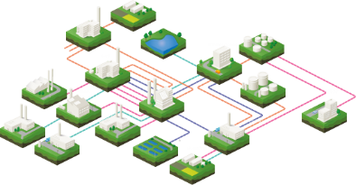
Industrial symbiosis
Process-oriented solutions, focused on utilizing residual outputs (e.g. wastes or byproducts) as inputs for new industrial processes.

Slide 29
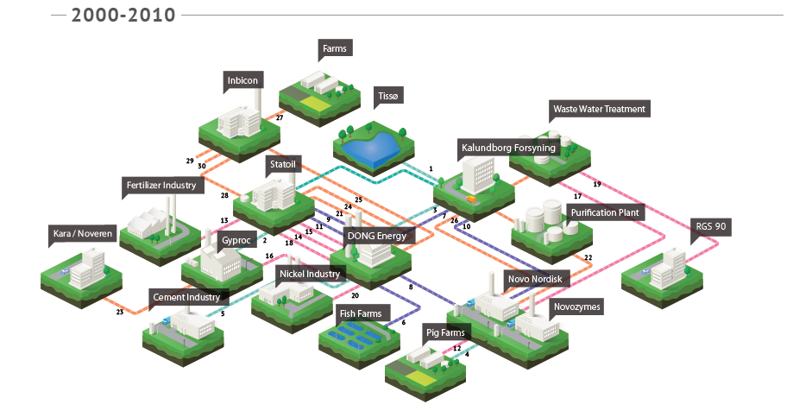
Case: Kalundborg
https://www.youtube.com/watch?v=ZCdf-TbB0hI
Industrial symbiosis network developed in the Kalundborg area in Denmark over several decades starting from 1960s
www.colorado.edu
Notes:
The challenges with this organic development models is the slow development…we need much more rapid scale up of CE models in order to address the large systemic challenges we have.

Slide 30
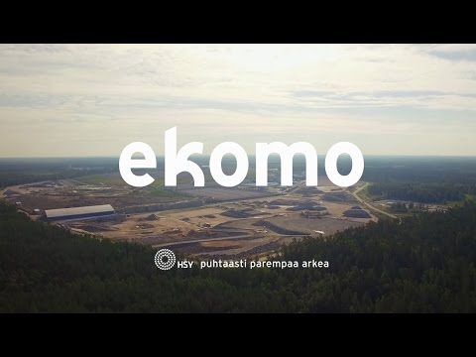
Examples from Finland
EnviGrow Park, Forssa
HSY Ekomo
https://www.sitra.fi/en/articles/nine-steps-to-establish-an-eco-industrial-park/
Notes:
EnviGrow Park Forssan alueella on enimmäkseen ruoka- ja biotalouteen keskittyvä verkosto jossa on mm. bioenergian ja luomuruoan tuotantoa. Ekomo puolestaan on HSY:n pääosin Espoon Ämmässuon alueelle keskittynyt pääosin kierrätykseen keskittyvä puisto, jossa on useita yrityksiä mukana HSY:n lisäksi. Pori-Harjavallassa puolestaan on pääosin metalleihin keskittyvä teollinen symbioosiverkosto, jossa esim on toiminut akkumetallien kierrätykseen keskittyvä Crisolteq, jonka Fortum on sittemmin ostanut.
Näissä korostuu kaksi yleistä kehityssuuntausta symbiooseille. Usein niissä korostuu joihin tiettyihin alueen vahvoihin toimialoihin liittyvä toiminta, joissa on selkeää synergiaa (esim Pori-Harjavallassa metallinjalostus) tai sitten ne kehittyvät kierrätystoiminnan ympärille kuten Ekomo.

Slide 31
Enablers and governance of CE

Slide 32
Intermediaries and industrial symbiosis
Intermediaries are organizations that facilitate industrial symbiosis without directly being involved in the exchanges
Roles: (Zaoual & Lecocq, 2018)
Revealing value in industrial symbiosis
Generating trust
Activating industrial symbiosis
Institutionalizing the practices
Intermediary challenges
(Patala et al. 2020):
Openness dilemma
Value creation dilemma
Patala, S.; Salmi, A.; Bocken, N. 2020. Intermediation dilemmas in facilitated industrial symbiosis. Journal of Cleaner Production, forthcoming.
Notes:
Välittäjäorganisaatioilla on havaittu olevan keskeinen rooli symbioosien kehityksessä.
Tietoisuuden kasvattaminen teollisen symbioosin mahdollisuuksista, esim. Case-tarinat
Luottamuksen rakentaminen toimijoiden välille. Siksi monet välittäjistä ovat usein ‘neutraaleja toimijoita’, jotta toimijoiden helpompi esim antaa tietoa
Aktivointi – esim resurssiworkshopit ja konsultointi
Institutionalisoint – lainsäädäntö, normit, pitkän tähtäimen suunnitelmat
Me havaittiin yhdessä tutkimuksessa välittäjätoimintaan liittyvän kaksi keskeistä haastetta. Yksi liittyy avoimuuteen, eli symbioosien edistämiseksi yrityksen tulisi jakaa resurssidataa. Aina tämä ei kuitenkaan ole helppoa koska yritykset saattava haluta pitää tiedon salassa. Toiseksi, välittäjien tulisi luoda arvoa pitkällä aikavälillä yhteistyökumppaneille jotta nämä eivät katoa yhteistyöverkostosta sen jälkeen kuin joku mahdollisuus on toteutetta. Välittäjillä voivat auttaa syvemmin symbioosiprojekteissa, mutta usein niillä ei kuitenkaan ole resursseja lähteä konsultoivampaan toimintaan.
Osa näistä on julkisia organisaaatioita, kuten Motiva. Mutta osa taas yksityisomisteisia, kuten NISPin taustalla oleva International Synergies.

Slide 33
Importance of local collaboration
Close mental distance (Ashton, 2008)
Informal relations
Opportunities for deeper collaboration
Champions (Kokoulina et al. 2019)
Institutional
Network
Power
Expertise
Kokoulina, L., Ermolaeva, L., Patala, S, Ritala, P. 2019. The role of champions in developing industrial symbiosis. Regional Studies, 53(4), pp.528-539

Slide 34
Need for system-level governance in CE
Challenges with industrial circular economy:
Lacking information: e.g. firms may have deep knowledge of their supply chain, but CE business often requires new, cross-industry relations
Economies of scale: material flows may be too small for viable business
A diverse set of actors involved (firms from various supply chains, public sector, non profits) with various governance mechanisms. No one party has clear authority over others.
-> system-level, polycentric governance of resources is needed for effective CE
Field study of three CE networks: FISS, Devens eco-industrial park, Basque Circular Economy

Slide 35
Need for system-level governance in CE
An empirical study of the three circular economy systems:
Devens, USA
FISS, Finland
Basque Circular Economy, Spain
Patala. S., Albareda, L., Halme. H. 2018. Polycentric governance of privately-owned resources in circular economy systems. Academy of Management 2018.

Slide 36
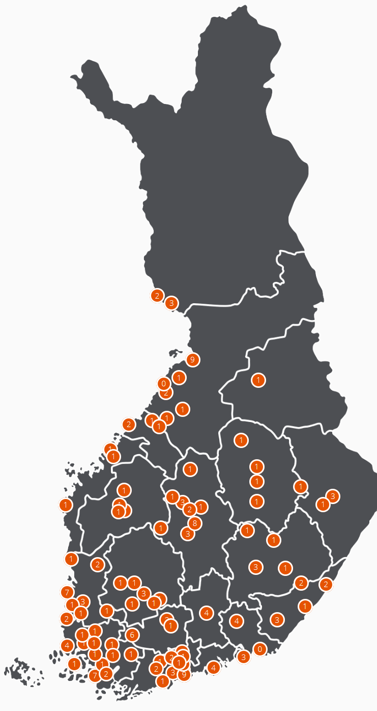
Case: FISS
Officially started in 2014
The test phase included three resource synergy workshops in different geographical locations, over 600 potential resource synergies recognized
Coordinated by Motiva, Sitra and regional intermediaries
Facilitates industrial symbiosis across Finland
http://www.industrialsymbiosis.fi/

Slide 37
Case: Devens Eco-Industrial Park
Started as a Redevelopment project of an army base, located close to Boston, MA
Close to 100 organizations in the area have been involved
Coordinated by Devens Eco-Efficiency Center and Devens Enterprise Commision

Slide 38
Case: Basque Circular Economy
Self-organized group of organizations undertaking projects and other collective activities for CE
Started in 2013
150 organizations have been involved

Slide 39
Findings
Mutual adjustments
Role adjustments
Practices for collective agency
Protocols and shared strategies
Structures for sharing
Platforms for sharing resources
Governance logic adjustments
Temporal frame adjustments
Building and sharing systemic knowledge
Master plan for the systemic optimization of resources

Slide 40
Critique of CE

Slide 41
CE limitations and challenges
Group discussion:
What might be the potential limits and challenges related to circular economy:
Problems with circularity as a vision/goal?
Challenges related to implementation of circular economy?

Slide 42
Some critiques of circular economy
Limits and boundary conditions of CE
Business case is often taken as an assumption – no consideration of trade-offs
Physical limits (e.g. entropy) are not considered
Limited perception of agency
Reliance on business models and piecemeal solutions – systems thinking lacking
Lack of attention to non-business actors and Global South
Sustainability impacts might be limited
Doesn’t address consumption – potential rebound effect
Lack of attention on the social side of sustainability
-> Overall, one potential solution to sustainability, not a panacea
Dzhengiz, Tulin, Elizabeth M. Miller, Jukka‐Pekka Ovaska, and Samuli Patala. "Unpacking the circular economy: A problematizing review." International Journal of Management Reviews (2023).

Slide 43
Summary
Circular economy aims to transform the linear economy to a closed-loop system through various means of restoring and regenerating material value
The butterfly diagram and RESOLVE –framework provide operational principles for circular economy
Industrial symbiosis is a common method to achieve circular economy between firms (i.e. B2B markets)

