Slide 1
Sustainable Finance
Kaja Kirstine H. Lilleng
Sustainability in Business, 30.05.23

Slide 2
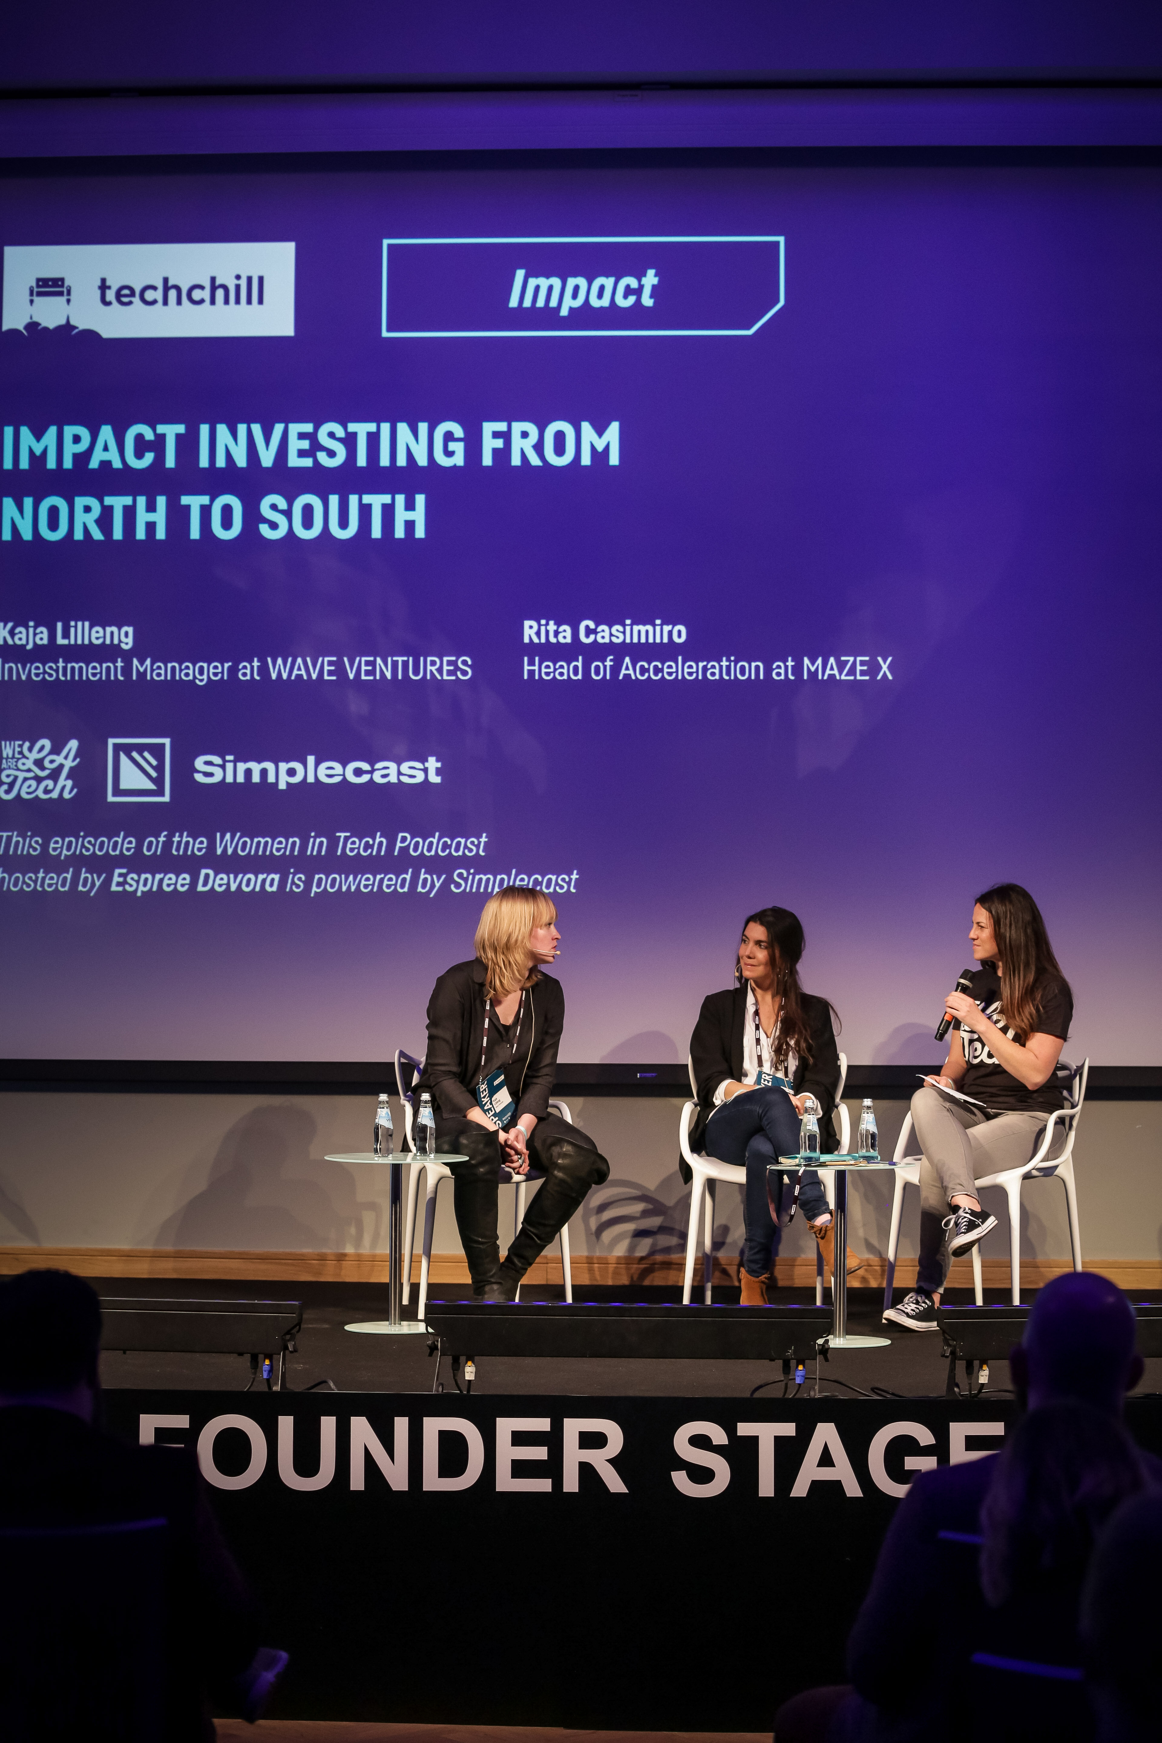
Kaja Lilleng
Doctoral Researcher, Organization and Management, Aalto Business School
Research focus: Valuation processes in impact investing
MSc Management of Innovation and Business Development, Copenhagen Business School
Thesis: Early-stage impact investing and the role of venture capital in fostering impact tech startups in the Nordics
Worked at early stage funds and impact investing initatives:
Katapult Future Fest
Nordic Impact
Nordic Impact Investing Network
Wave Ventures
2050

Slide 3
“We cannot solve problems by using the same kind of thinking we used when we created them”

Slide 4
Today’s programme
14:15-15:00
I: Introduction to sustainable finance + impact investing
15:15-16:00
II: Investing in climate solutions
Guest speaker: Hampus Jakobsson, General Manager and Co-Founder at Pale Blue Dot VC
16:15-17:00
III: Investing in systems change
🌲

Slide 5
What is sustainable finance?
The concept of sustainable finance has evolved as part of the broader notion of business sustainability over the last decades.
How can finance support sustainable development?
The systematic integration of environmental social and governance factors in financial decision-making processes (UNEP FI, 2021).

Slide 6
The role of finance in sustainable development
Provide capital and investments
E.g.: Lending and investment strategies
Influence how companies manage social and environmental issues
E.g.: Active ownership and governance
Develop products to channel money into areas where investment is needed
E.g.: Green bonds
Progress including:
Funding to positive-impact activities
Encourage better impact management
Managing and disclosing social and environmental risks
Establishment of collaborative initiatives (PRI, GIIN)
Developing new financing instruments (Green bonds)
Barriers including:
Emphasis on short term financial performance over long term sustainability considerations
Lack of consensus on what constitutes green or sustainable companies
Weaknesses in regularity frameworks

Slide 7
Discuss in pairs (5 min): Podcast episode
What was your main take-away from “Money Talks: The backlash against ESG”?
Saying versus doing – is ESG investing more talk than action?
- Impact washing and impact wishing
- How a business operates (responsibly) versus what a business does
Should the industry focus solely on E = reducing emissions?
🐳

Slide 8
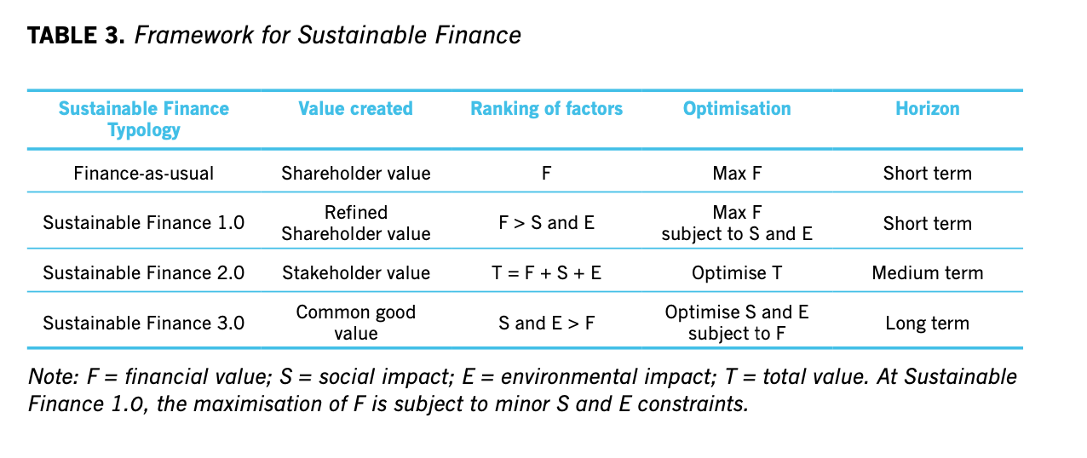
“From finance first, to all aspects equal, to social-environmental impact first.”
Schoenmaker, D. (2017), From Risk to Opportunity: A Framework for Sustainable Finance, Rotterdam School of Management, Erasmus University, Rotterdam.
Notes:
the broadening from shareholder value to stakeholder value, and finally creation of value for the common good

Slide 9
Traditional finance
Maximize shareholder value by optimal combination of financial return and risk
(Schoenmaker, 2017)

Slide 10
Sustainable finance 1.0
Profit maximization
while avoiding “sin” stock
(Schoenmaker, 2017)

Slide 11
Sustainable finance 2.0
Internalisation of externalities
to avoid risk
(Schoenmaker, 2017)

Slide 12
Sustainable finance 3.0
Contributing to sustainable development, while observing financial viability
(Schoenmaker, 2017)

Slide 13
Status?
Majority of firms put financial value first
Majority
{
Ca 1/3
< 1%
(Schoenmaker, 2017)
Notes:
ca third between 1.0 and 2.0 adopt sust principles in their investment and business practices
the group of fin intuitions found to be adopting 3.0 is less than 1%

Slide 14
SUSTAINABLE INVESTMENTS
Socially responsible investing
Social impact bonds
Impact investing
ESG investing
microfinance
Systems change investing
Venture philanthrophy
☁
Notes:
sustainable investment is a blanket term that includes a wide range of investment strategies and approaches with differing degrees of rigor from a sustainability perspective

Slide 15
IMPACT INVESTING AND SIMILAR TERMS
(Agrawal & Hockerts, 2021)

Slide 16
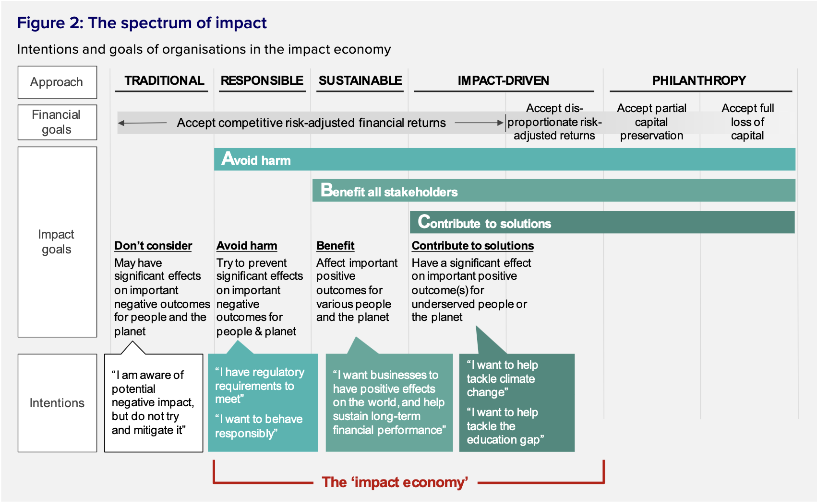
THE SPECTRUM OF IMPACT
(UK National Advisory Board on Impact Investing, 2017)

Slide 17
SUSTAINABLE INVESTMENTS
Responsible investing
Impact investing
MINIMIZE
NEGATIVE
OUTCOMES
MAXIMIZE
POSITIVE
OUTCOMES

Slide 18
IMPACT INVESTING
DEFINITION
Investments made with the intention to generate positive, measurable social and environmental impact alongside a financial return.
(GIIN, 2022)

Slide 19
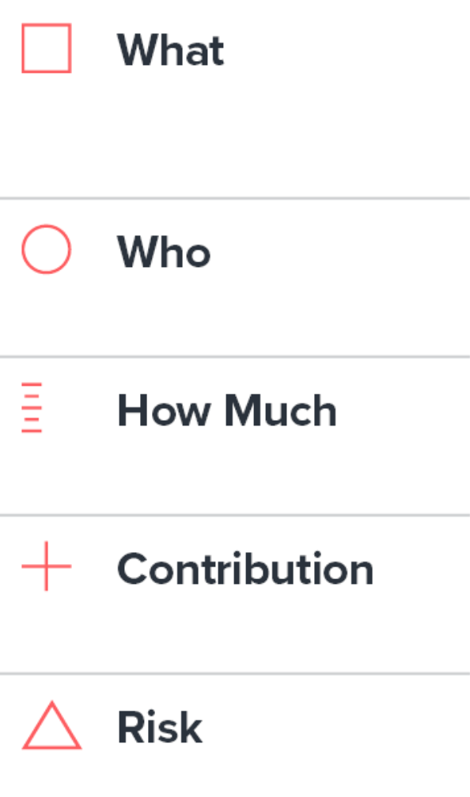
CHARACTERISTICS
IMPACT INVESTING
Example:
IMP 5 Dimensions
Intentionality
Outcomes
Profit + Impact
Impact investors & impact-driven businesses have an intentional focus on solving social and environmental problems
Generating positive, measurable social and environmental impact
Aligning profit and positive impact to scale solutions quickly

Slide 20
Questions?

Slide 21
From impact investing to
systems change investing

Slide 22
The business-case for impact
Consumer demand, talent attraction, big problem = big market opportunity
Economization, financialization and the value of nature
E.g. the global value of insect pollination services is $160 billion a year (Islam, 2015)

Slide 23
We need a variety of tools for solving complex systemic challenges
Notes:
Start w solving problems

Slide 24
From industry profit-winners to ecosystem benefactors
🐝

Slide 25
“Economists need a metaphorical career change: from engineer to gardener”
(Raworth, 2017, p157)

Slide 26
Finding systemic leverage and acupuncture points

Slide 27
From biology: Keystone species
🐺
Notes:
https://www.youtube.com/watch?v=ysa5OBhXz-Q

Slide 28
The impact fund:
~15 min in groups of 2-4 people
1) Establish your fund’s mission: What challenge is targeted or systems change contributed to?
Framework to guide? (SDGs, Planetary boundaries, other)
What does success look like?
2) What could be potential acupuncture points / levers / keystones to invest in for this system? How to go about finding that out?

Slide 29
Questions?

