Slide 1
“Systems change for sustainability: transitions, degrowth, etc.” Post-growth & business
Dr Iana Nesterova
iana.nesterova@aalto.fi

Slide 2
“Systems change for sustainability: transitions, degrowth, etc.”
Systems change: how do systems change? Towards what exactly?
No single correct answer
Transitions: (deep) transformations (emergence, unfolding)
Degrowth society: radical transformation of our systems

Slide 3
What will we discuss today?
Post-growth, what it is, critique, controversies
Degrowth and business
Degrowth business and the circular economy

Slide 4
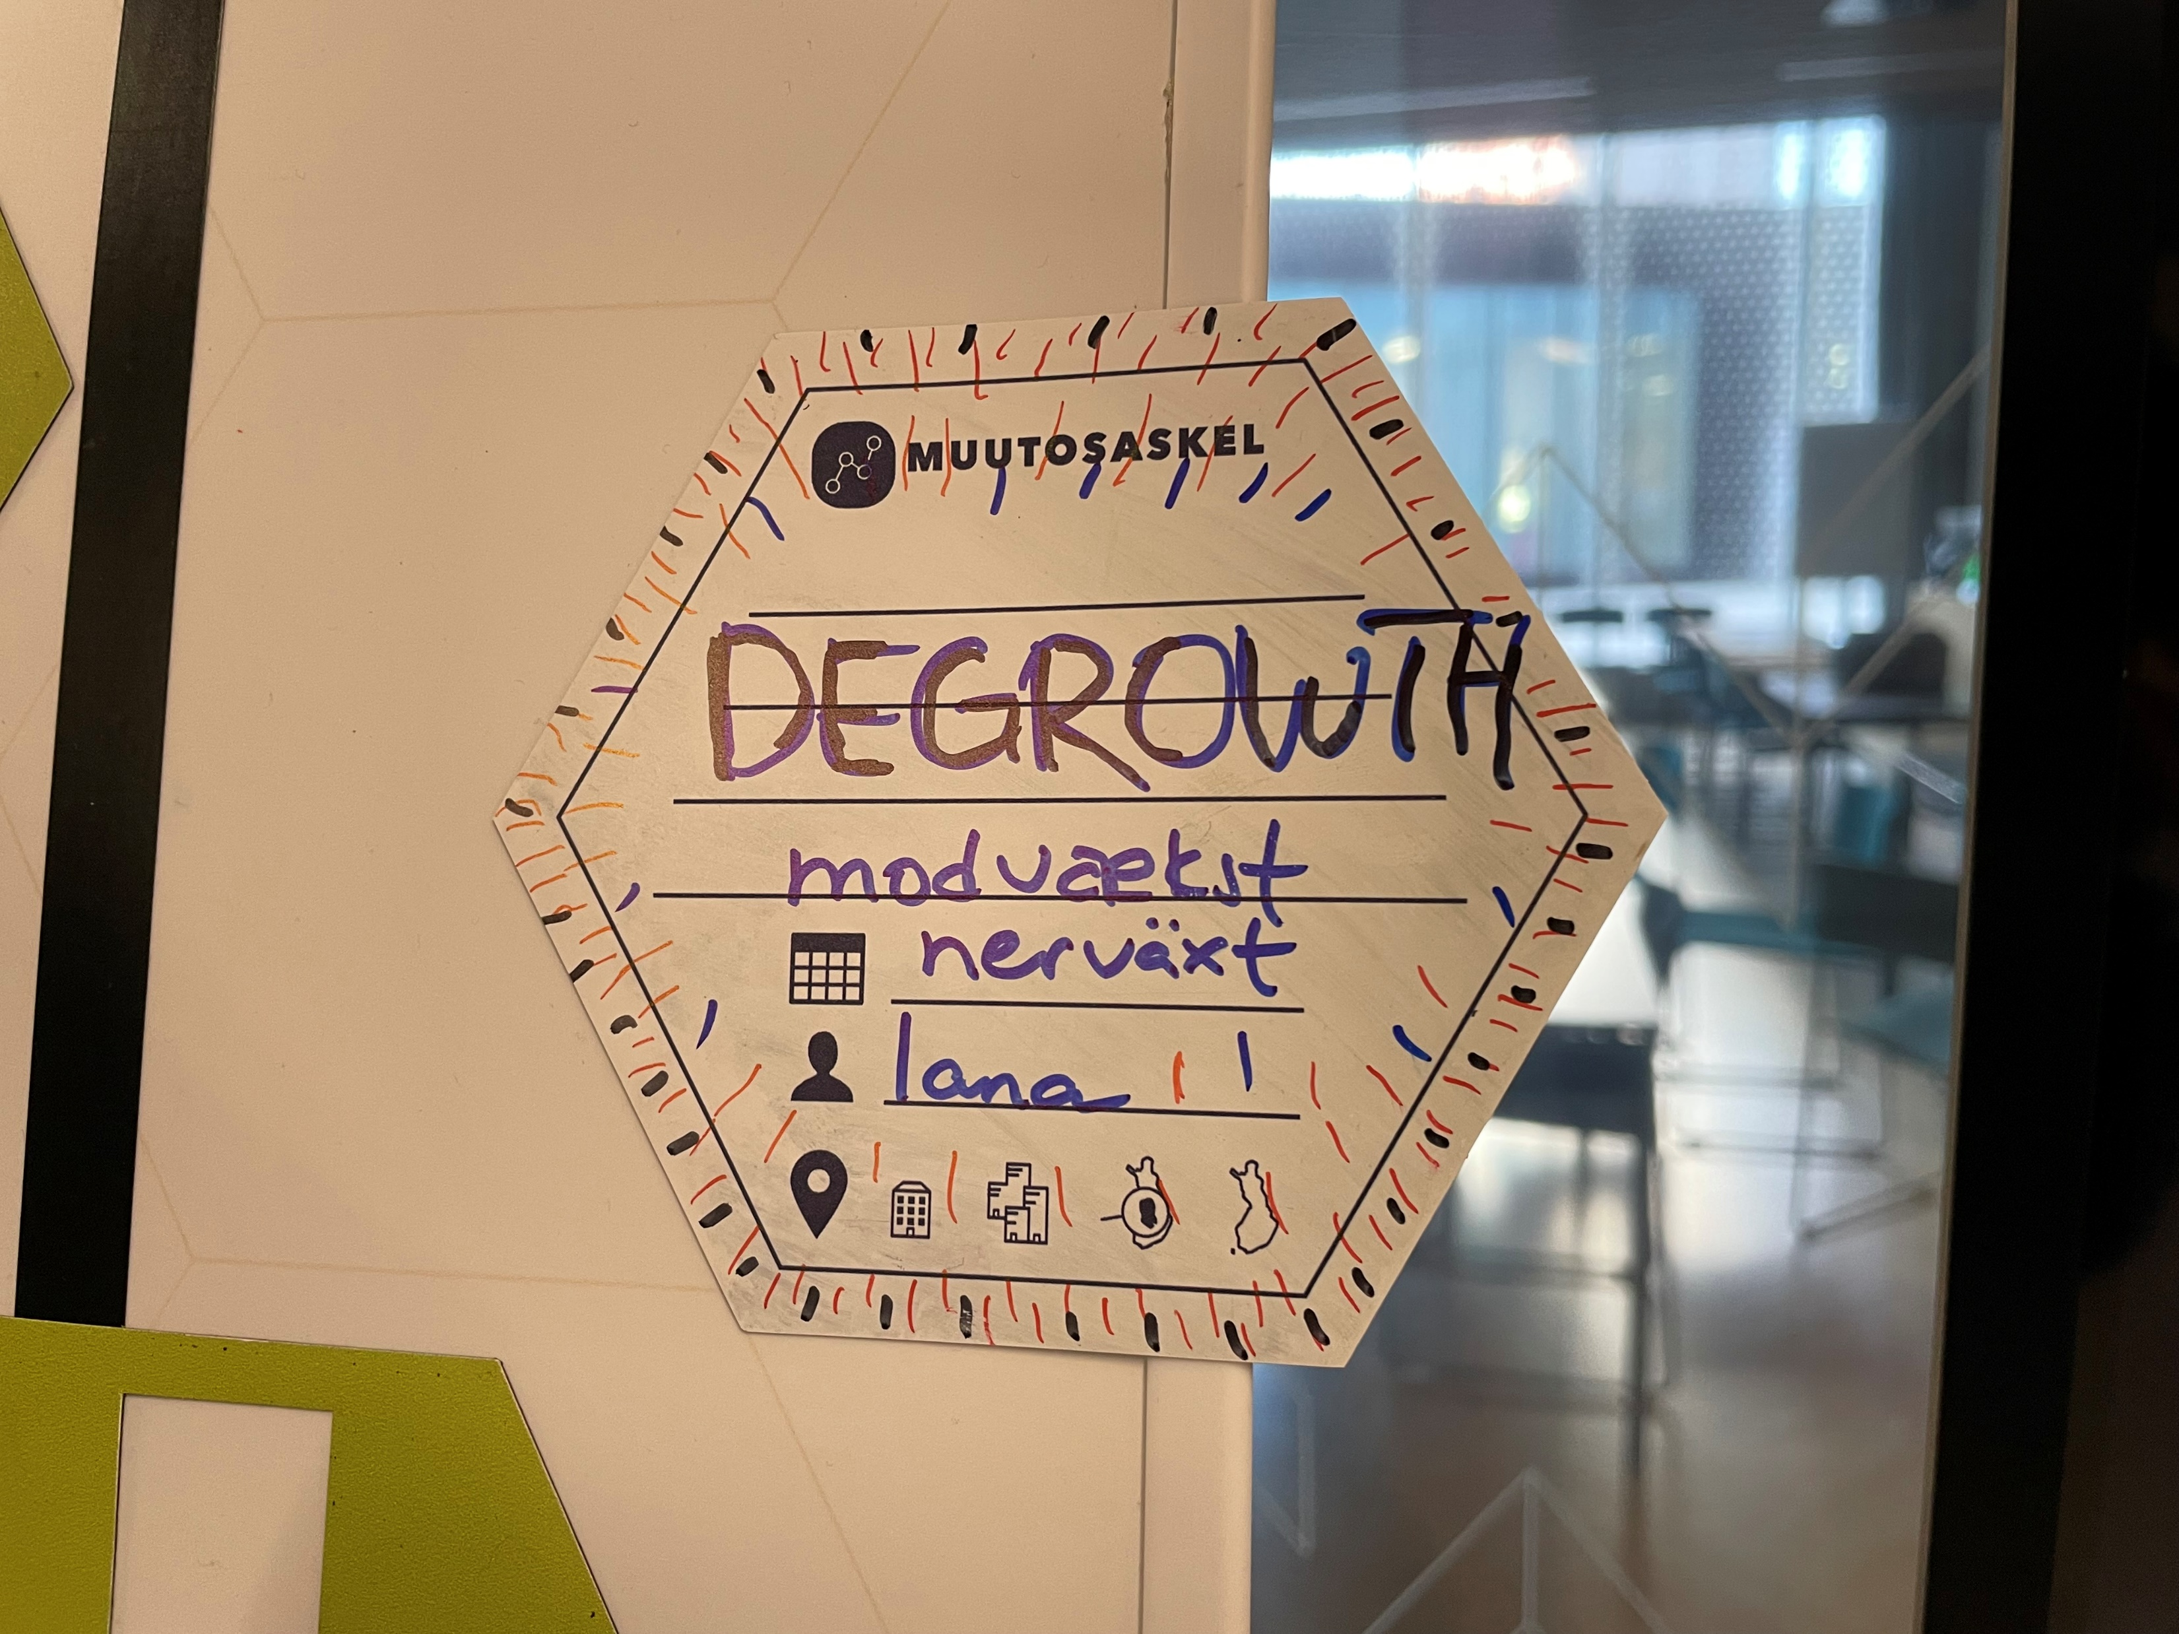
Post-growth
Using “post-growth” and “degrowth” interchangeably
Our experiences with this concept

Slide 5
Definitions
No single definition
“an equitable downscaling of production and consumption that increases human well-being and enhances ecological conditions at the local and global level” (Schneider et al., 2010, p. 511)
“Degrowth is a planned reduction of energy and resource throughput designed to bring the economy back into balance with the living world in a way that reduces inequality and improves human well-being” (Hickel, 2021, p. 1106).
“deep transformations occurring on all four interrelated planes of social being [material transactions with nature, social relations, social structures, inner being], on different scales and in all sites, guided by gentleness and care, towards a society co-existing harmoniously within itself and with nature” (Buch-Hansen and Nesterova, 2023, p. 8) (theory of social change + humanism + genuine, long-term sustainability, non-anthropocentrism)
Our theory of social change: transformation of detrimental + reproduction of nurturing structures

Slide 6
Post-growth: background
Ecological economics
Biophysical economics
Steady-state economics
And more:
Critical political economy, Marxism
Eco-anarchism
Economic anthropology (capitalism is not the only possible system)
Political ecology

Slide 7
Ecological economics: Disciplinary grounding of degrowth
Environmental critique of the 1960s and 1970s
Ecological economics emerged as a distinct field in the 1980s based on the literature on limits to growth of the 1960s and 70s
“All economic systems are subsystems within the big biophysical system of ecological interdependence.” (Daly, 1993, p. 39)
Economies cannot grow forever, nature imposes limits on human economic activities, steady-state is needed, not unlimited growth
Economies are subject to nature’s laws
Works of Nicholas Georgescu-Roegen (the entropy law applied to economic processes) and Herman Daly (steady-state) were influential

Slide 8
Ecological economics ideas
Economy as an open system (takes materials from nature, creates wastes which return to nature)
Some kind of a steady-state (constant throughput of matter and energy, constant human population size etc.) is desirable
Growth vs development: economies should not grow but they can develop. Quantity vs quality
Ecological economics = economics + ecology, but other sciences were welcomed to contribute (biology, physics, etc.)
Rejection of “homo economicus”
Openness to diverse methods, not only mathematical methods

Slide 9
Controversies
Steady state: difficult to measure, perhaps authoritarian, (tradable) birth permits
Not sensitive to social sciences (Clive L. Spash hence proposed ‘social ecological economics’)
What are the philosophical foundations, some common grounds for our scientific efforts in ecological economics? (Spash, 2012)
Largely ignored the microeconomic level of agents (including businesses)
Nature is still seen as a ‘sink’ for wastes, non-human beings ignored

Slide 10
Degrowth
Rooted in ecological economics and especially social ecological economics
Originally envisioned for the Global North
No longer limited to ecological economics
Anti and post-capitalist
Traditionally opposes ‘green growth’ and green capitalism
Sustainable development is viewed by degrowth scholars and activists as uncritical, as not taking limits to growth into account
Political, activist in its nature
André Gorz (coined the term ‘degrowth’ in 1972), Serge Latouche, Giorgos Kallis and many others

Slide 11
Degrowth: proposed benefits
Growth-based economies emphasise insatiable material consumption (Jackson, 2017)
The pursuit of economic growth, mass consumption and accumulation are not inherent to human nature, and wellbeing and affluence were not originally connected with the amount of material possessions (Gowdy, 1998).
Reduction in consumption may have a positive impact on wellbeing (Capellán-Pérez et al., 2015)
Overconsumption in wealthy nations has resulted in negative consequences such as the obesity epidemic, long working hours, debt and social isolation (Assadourian, 2012)
Allowing space for less materially wealthy nations to grow and satisfy their basic needs
Notes:
Assadourian, E. (2012). The path to degrowth in overdeveloped countries. In: L. Starke, ed. State of the world 2012: Moving toward sustainable prosperity. London: Island Press. pp. 22-37.

Slide 12
Degrowth: not a homogenous field
Many things at once: a political project, a movement, a paradigm (Buch-Hansen, 2021)
Eco-socialist, eco-anarchist, or something else?
Which instruments to use? Top-down, bottom-up?
Should we even emphasise growth or become agnostic to it (van den Bergh, 2018)?
There are multiple definitions and disagreements within this field
Felt discomfort about the term ‘degrowth’ itself (e.g., ‘Degrowth: A “missile word” that backfires?’ by Drews and Antal, 2016)
Notes:
Buch-Hansen, H. (2021) Modvækst somparadigme, politiskprojektogbevægelse. Nytfokus: Fra økonomiskvæksttilbæredygtigudvikling,17, pp. 6–9.
Drews, S. and Antal, M. (2016) Degrowth: A “missile word” that backfires?. Ecological Economics, 126, pp. 182-187.
Van den Bergh, J.C.J.M. (2018). Agrowthinstead of anti-and pro-growth: Less polarization, more support for sustainability/climate policies. The Journal of Population and Sustainability, 3(1), pp. 53-73.

Slide 13
Post-growth: before
Limits to growth, seeking steady state
Macroeconomic level, fitting “the economy” within planetary limits
Overlooking business and human agency
Market-based approaches such as tradable permits (e.g., Herman Daly)
Eco-socialism

Slide 14
Post-growth: unfolding
Diversity in post-growth theorising
Less and more
Philosophy, human agency
Inter-disciplinarity (e.g., post-growth geographies)
Recognition of the field’s limits and critique towards post-growth

Slide 15
Diversity in post-growth theorising
Diverse political perspectives (eco-socialism, eco-anarchism, anarcho-primitivism, etc.)
Diverse philosophies
More than a vision for the Global North
Diversity of capitalism(s), based on Buch-Hansen (2014):
Liberal capitalism (UK, US)
State-led capitalism (France, Brazil, Russia, India and China)
Coordinated capitalism (Scandinavian countries, Germany)

Slide 16
Diversity within capitalism (Gibson-Graham and Dombroski, 2020)

Slide 17
Less and more (Buch-Hansen and Nesterova, 2023)

Slide 18
Post-growth: critique
Degrowth is largely theoretical, what are its practical implications?
Not clear how the vision of degrowth will come about
Negative connotation and associations with stagnation and decline
Agents and humans’ inner being are overlooked. Who are we?
Struggles when degrowing are not sufficiently revealed
Simplistic arguments: e.g., extreme localisation, low technology, whole industries ceasing to exist
This word is not commonly used by non-academics

Slide 19
Difficult, controversial topics
Highly unlikely visions
Authoritarian regimes
“Reduced technology and fewer people will automatically allow large portions of the earth to revert to wilderness, and to heal.” (Skrbina and Kordie, 2021, p. 268)
“In the long run, the vision of returning to a hunting and gathering way of life is wildly optimistic compared to the technological dystopias envisioned by many science fiction authors and social philosophers.” (Gowdy, 2020)
Techno-dystopia OR becoming hunter-gatherers again?

Slide 20
Post-growth: some loose ends
Agency-structures dualism: individual actions vs systems
Where does change come from?
Actual actions
Inner transformations
Policies
Capitalism(s) + diverse economies, context sensitivity, place sensitivity

Slide 21
Possible ways forward
Recognising that similar views are shared by other fields (such as deep ecology and American environmentalism)
Teamwork with scholars looking into sufficiency, sustainable change, circular economy
Diverse methods
Uncomfortable topics (such as large-scale production)
Less hypocrisy, more seriousness (theory + practice)

Slide 22
Agency-structure dualism
Agency: human capacity for intentional actions
Agency e.g.: “Ultimately all change in the social world depends on self-expansion leading to self-transcendence.” (Bhaskar, 2000, p. 62)
Social structures, our “thrownness” (Geworfenheit)
E.g.: the effect economic life had on morality of individuals in Durkheim (1992). He observed the disappearance of moral guidance and solidarity with proliferation of economic activity.
Either/or
Middle ground positions (e.g., Giddens, Bourdieu, Bhaskar)
Notes:
Bhaskar, R. (2000) From East to West: Odyssey of a soul. Routledge: London.
Durkheim, E. (1992) Professional ethics and civic morals. 2nd ed. Routledge: London.

Slide 23
Middle ground position, example
Critical realism (e.g., Roy Bhaskar, Andrew Collier, Tony Lawson, Clive Spash, Margaret Archer, many others)
Agents reproduce/transform social structures
Social structures constrain/empower agents
Only human beings can act
Change results from transformation of detrimental structures and reproduction of nurturing structures
Everything unfolds on these four planes of social being: (1) material transactions with nature, (2) social relations, (3) social structures, (4) people’s inner being. Consider an ecological mindset

Slide 24
Post-growth & business
Can business be part of a degrowth society?
What is unfolding
Steps forward

Slide 25
A theory of degrowth (Buch-Hansen et al., forthcoming)
Degrowth is a function of these domains: civil society, state, business
Civil society: academia, consumers, trade unions, other civil society organisations, movements, communities, etc.
State: policies, creating space(s) for degrowth in civil society and business
Business

Slide 26
Eco-social policies
Minimum income
Maximum income
Universal basic income (UBI)
Universal basic services (UBS)
Wealth tax
Progressive taxation
(Tradable?) permits
Interest free loans
“Green” finance (which industries are “green”?)
Commons, public ownership
Allemansrätten (everyman’s right)

Slide 27
Post-growth & business
Can business be part of a post-growth society?
Business vs post-growth?
Alternative forms of production (cooperatives, foraging, community gardens, self-sufficiency, etc.)

Slide 28
Post-growth and business: the framework (Nesterova, 2020)
Notes:
Nesterova, I. (2020) Degrowth business framework: Implications for sustainable development. Journal of Cleaner Production, 262, 121382.

Slide 29
Post-growth & business: steps forward
Business, civil society, state
Business as an essential player
Teamwork rather than vilifying businesses and businesspersons
Dialogues with circular economy, sufficiency, eco-social policy, and real-life businesses

Slide 30
Post-growth business: what it will entail
Nature: (1) sensitivity towards location, responsibility towards places, and (2) nature at large
Social structures: working with others (customers, activists, universities, policymakers, etc.)
Relations: humans & non-humans. Non-hierarchy, fika, kindness, care, etc.
Inner being: self transformations of businesspersons, stepping on alternative paths
Transcending binaries (e.g., degrowth/not-degrowth, low-tech/high-tech)

Slide 31
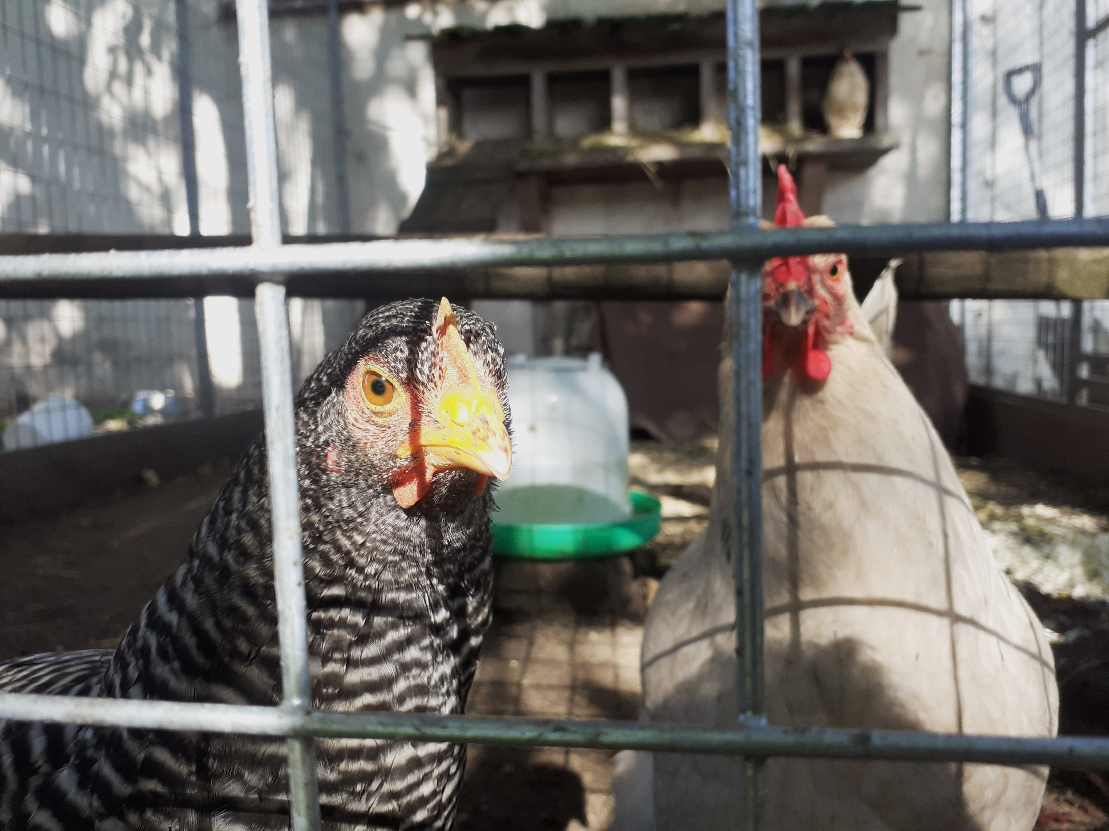
Some aspects of degrowth business to contemplate
Non-binary approach (‘circular’/‘not circular’, ‘sustainable’/‘unsustainable’, ‘degrowth’/’not degrowth’)
Contemplate one’s own sustainability practices
Business as a journey or a process

Slide 32
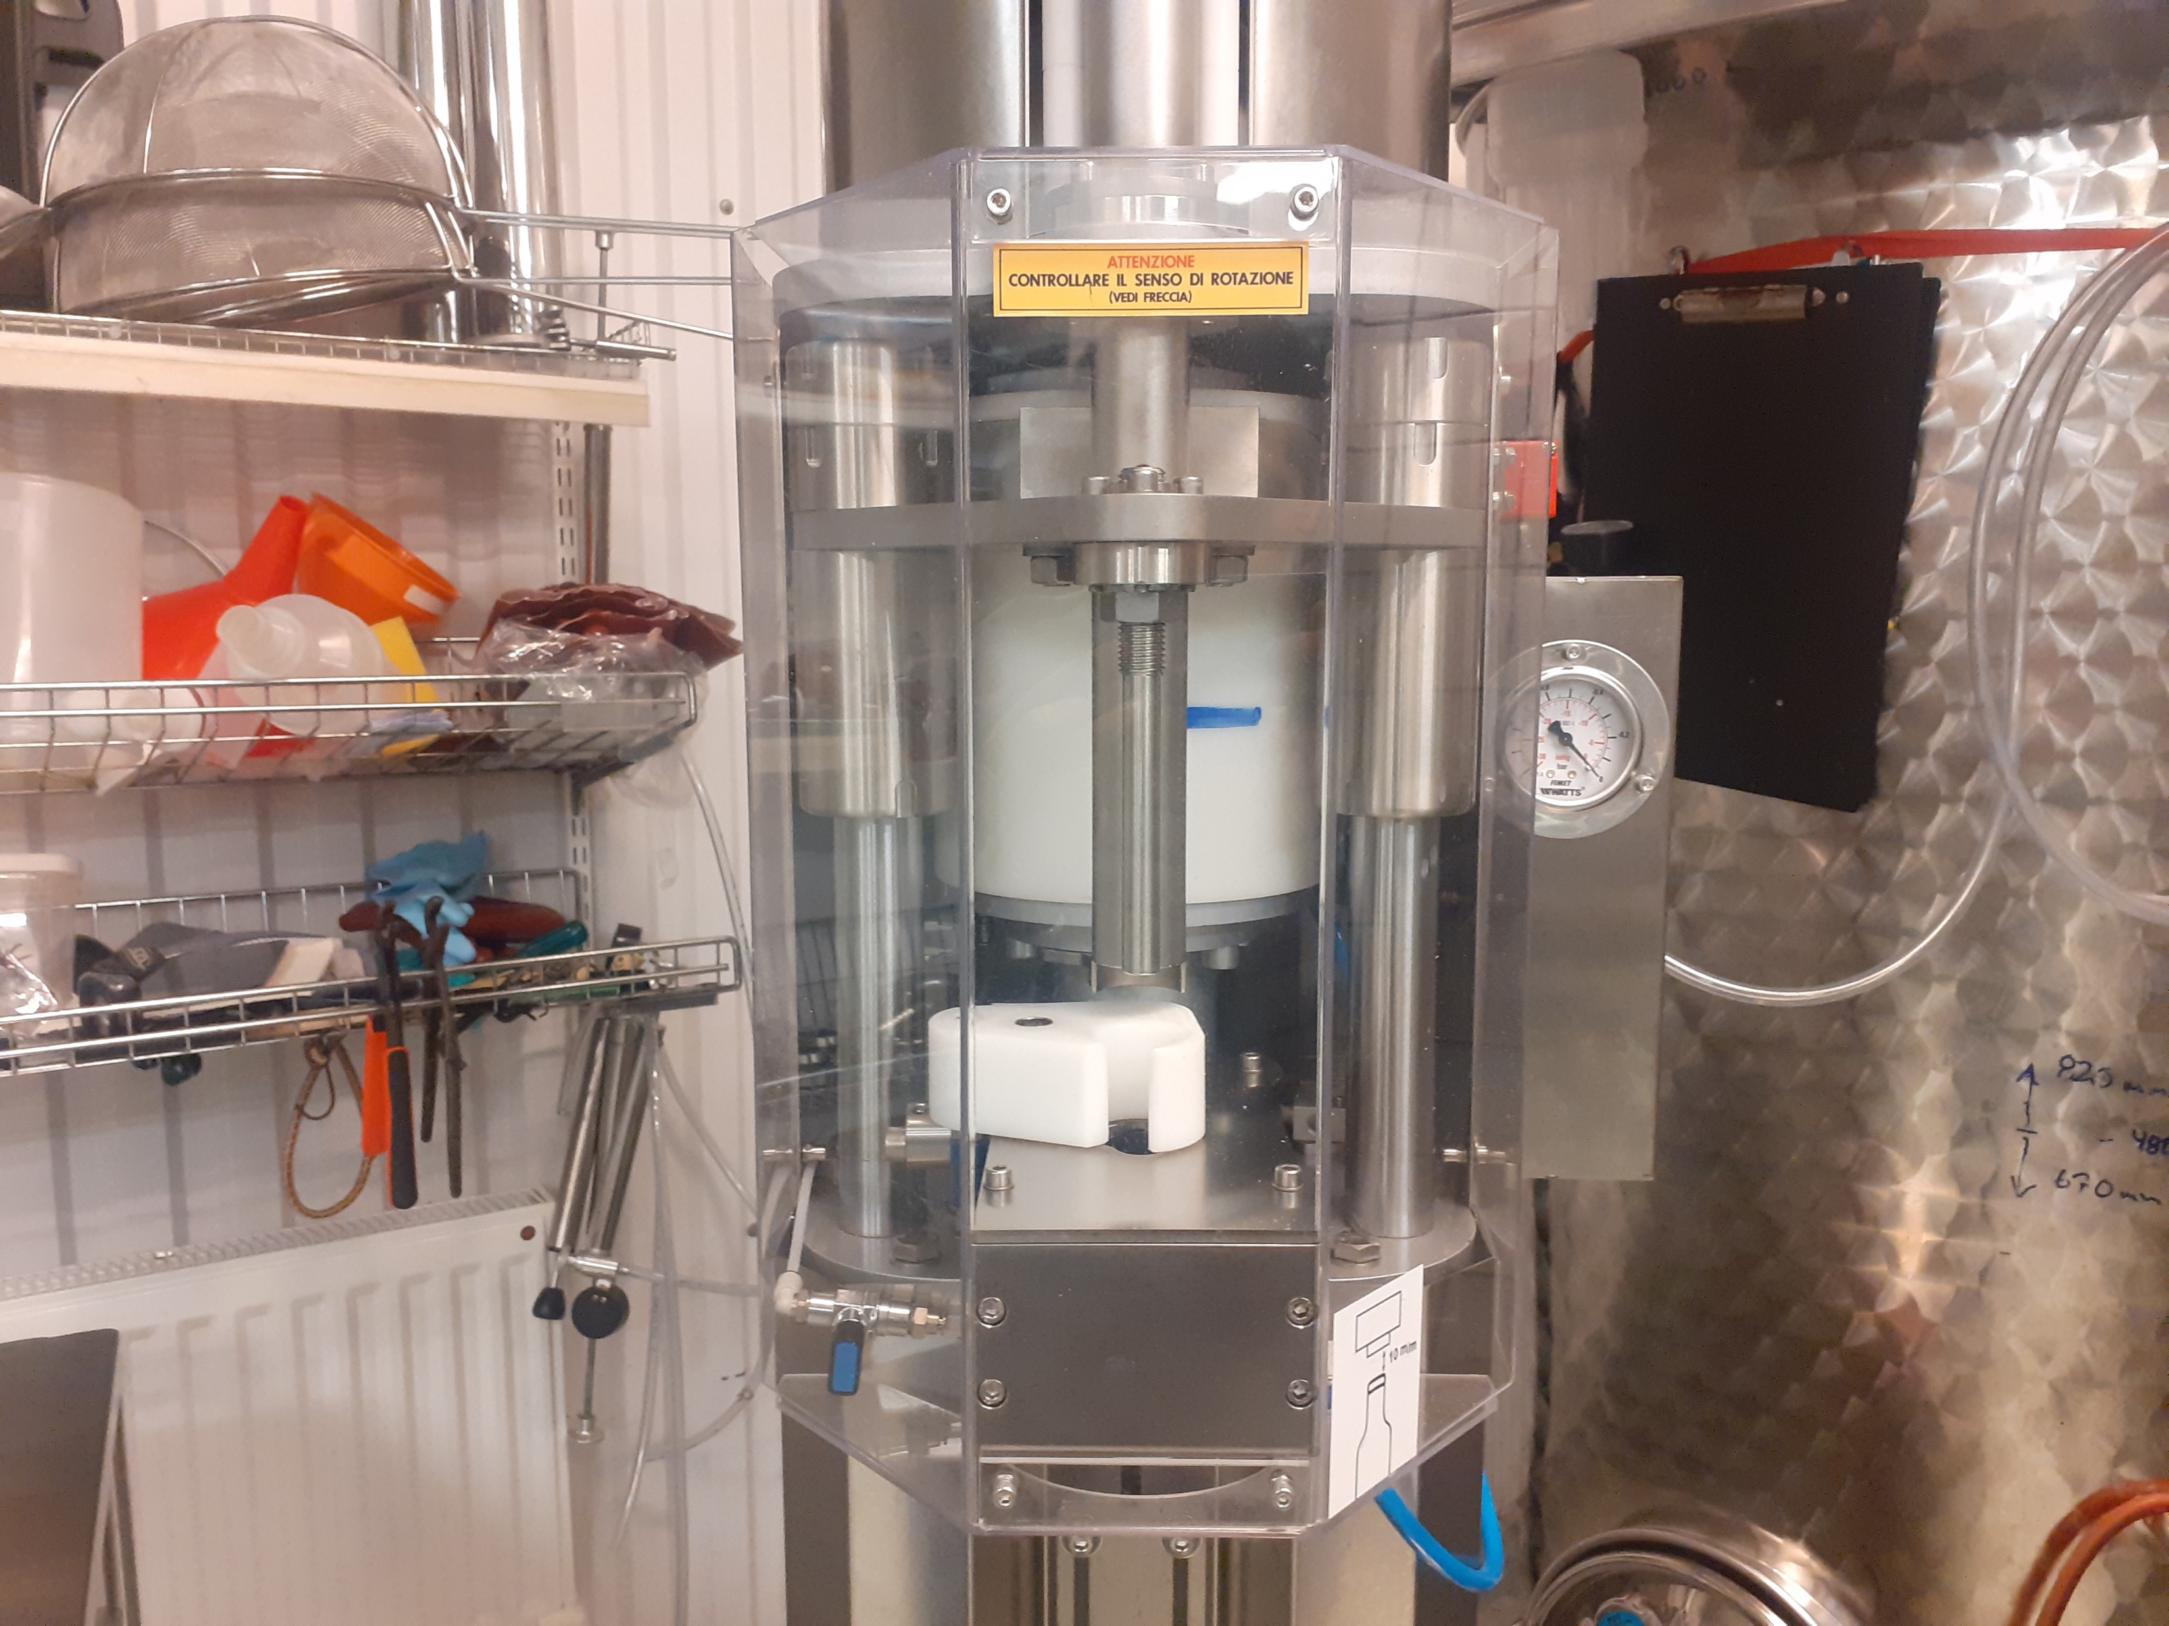
Examples: degrowth food production in Sweden?

Slide 33
Degrowth business and circularity
Establishing dialogues between degrowth and other fields (philosophy, circular economy, sufficiency, and many others)
Degrowth vs circular economy?
Better understanding, better answers
Teamwork, thinking together

Slide 34
Degrowth business and circularity (Nesterova and Buch-Hansen, 2023: Degrowth and the circular economy: Reflecting on the depth of business circularity)

Slide 35
Degrowth business and circularity (continued)

Slide 36
Degrowth business and circularity (continued)

Slide 37
References
Bhaskar, R. (2000) From East to West: Odyssey of a soul. Routledge: London.
Buch-Hansen, H. (2014) Capitalist diversity and de-growth trajectories to steady-state economies. Ecological Economics, 106, pp. 167–173.
Buch-Hansen, H. and Nesterova, I. (2023) Less and more: Conceptualising degrowth transformations. Ecological Economics, 205, 107731.
Capellán Pérez, I., Mediavilla , M., de Castro, C., Carpintero , Ó., and Miguel, L. (2015). More growth? An unfeasible option to overcome critical
energy constraints and climate change. Sustainability Science , 10 (3), pp. 397 411.
Daly, H.E. (1993). Introduction to essays toward a steady state economy. In: H.E. Daly and K.N. Townsend, eds. Valuing the Earth: Economics,
ecology, ethics . London: The MIT Press. pp. 11 50.
Durkheim, E. (1992) Professional ethics and civic morals. 2nd ed. Routledge: London.
Faver, C.A. (2000) To Run and Not Be Weary: Spirituality and Women's Activism. Review of Religious Research, 42 (1), pp. 61-78.
Gibson-Graham, J.K. and Dombroski, K. eds. (2020) The handbook of diverse economies. Edward Elgar: Cheltenham.
Gowdy, J., ed. (1998) Limited wants, unlimited means: A reader on hunter gatherer economics and the environment . Washington: Island
Gowdy, J. (2020) Our hunter-gatherer future: Climate change, agriculture and uncivilization. Futures, 115, 102488.
Hickel, J. (2021) What does degrowth mean? A few points of clarification. Globalizations, 18(7), pp. 1105-1111.
Nesterova, I. and Buch-Hansen, H. (2023) Degrowth and the circular economy: Reflecting on the depth of business circularity. Journal of Cleaner Production, https://doi.org/10.1016/j.jclepro.2023.137639
Schneider, F., Kallis, G., and Martinez-Alier, J. (2010) Crisis or opportunity? Economic degrowth for social equity and ecological sustainability. Introduction to this special issue. Journal of Cleaner Production, 18 (6), pp. 511–518.
Skrbina, D. and Kordie, R. (2021) Creative Reconstruction of the Technological Society. In P. Heikkurinen and T. Ruuska (eds.) Sustainability beyond Technology: Philosophy, Critique, and Implications for Human Organization. Oxford University Press: Oxford.
Spash, C.L. (2012) New foundations for ecological economics. Ecological Economics , 77, pp. 36 47.

