Slide 1
Copyright and agreements
Legal Counsel Maria Rehbinder
Copyright visualizations: Sanna Vilmusenaho

Slide 2
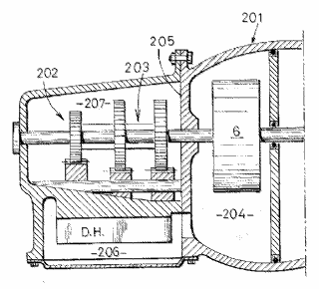
Different types of IP https://oami.europa.eu/knowledge/course/view.php?id=1738
Legal right
What for?
How?
Patents
New inventions
Application and examination
Utility models
New inventions
Application and registration
Copyright
Original creative or artistic forms
Exists automatically
EPO/OHIM Intellectual Property Teaching Kit - IP Basics
2
Notes:
Patents are granted for technical inventions. Applications for patents are examined by the patent office they are filed with, in order to determine whether they meet the stringent requirements for a patent to be granted. Patents generally last for a maximum of 20 years from the date of filing.
Utility models offer simpler protection, for a shorter period of time, but are usually registered and published much more quickly than patents.
Copyright does not need to be registered. It automatically exists when a work is created. It protects any type of original, creative expression, including literature, art, drama, music, photographs, recordings and broadcasts.
2

Slide 3
Different types of IP
Legal right
What for?
How?
Trade marks
Distinctive identification of products or services
Use and/or
registration
Registered designs
Registered designs
Registered designs
External appearance
External appearance
External appearance
Registration
Trade secrets
Valuable information not known to the public
Reasonable efforts to keep secret
EPO/OHIM Intellectual Property Teaching Kit - IP Basics
3
Notes:
Trade marks are distinctive signs indicating the source of a product or service. They include, for example, names, logos and colours applied to the owner's products or services, which distinguish them from products and services provided by competitors.
Registered designs protect the external appearance of a product. They do not give any protection for technical aspects. They include new patterns, ornaments and shapes. To be officially registered, designs need to be original and distinctive. The artistic aspects of a design may also be protected by copyright.
Unregistered designs also enjoy some protection. An unregistered design is a free, automatic right that you get when you present a design to the public. It gives you the right to stop anyone from copying your design. The protection afforded by an unregistered design is normally of more limited duration than that available for a registered design.
Trade secrets are an alternative to patents. They cover information not known to the public. If the possessor of the information is careful to keep it confidential, he can sue anyone who steals it.
3

Slide 4
Intellectual Property (IP) Legislation and Agreements
Legislation defines the scope of intellectual property rights, when they are born and to whom/to what entity
IP rights give the author the right to deny others from using of their exclusive right
Intellectual property legislation is contractual
Agreements define how IP right can be used
IP can be sold, licensed or inherited

Slide 5
Copyright notice
Copyright notice is not required, but it may help to protect from infringement and you can get better compensation in the US jurisdiction.
C (ctrl + alt+ c ) year you have created the image
Your name as an author
All rights reserved
If you wish that your work is not used as training material for AI in Finland and in EU you can prohibit this use by
It is prohibited by the author to use this work for text and data “mining “
In the website for all images or close to each image

Slide 6
In order to get paid
Include in the licensing agreement :
The license is granted only after the compensation has been paid in full.
Then, if license fee is not paid, and the company uses the image, they have infringed your copyright and it might even be a criminal offense

Slide 7
Intellectual Property that does not have to be registered
Copyright
Related rights (performers, producers, broadcasters rights )
Sui generis database right
Unregistered trademark TM
Unregistered Community Design
Trade secrets

Slide 8
Intellectual Property that has to be registered
Patents
Utility Models
Design Right (national ) ( also called Design Patent in USA and China)
Registered Community Design
Registered trademark
Company name
Domain name

Slide 9
Copyright
Copyright does not need to be registered. It automatically exists when a work is created. It protects original, creative expression, including literature, art, drama, music, photographs, recordings and broadcasts.
In addition to copyright, the Copyright Act protects also related rights of performing artists, producers, broadcasters and photographers and sui generis database right.
Producers, broadcasters and owners of sui generis database right are or can be legal entities

Slide 10
Copyright is born to an author , a natural person

Slide 11
Economic and Moral Rights

Slide 12
More information on copyright of photographs
https://libguides.aalto.fi/imagoa_eng
Aalto University Guide on Citation practices for images
https://libguides.aalto.fi/c.php?g=659426&p=4654810
Short intro to personal data protection in photographs
https://libguides.aalto.fi/c.php?g=659426&p=4654821
There are exceptions to the need to inform data subjects for uses of journalistic or artistic freedom of expression (Data Protection Act §27)

Slide 13
Exception rules
In EU there are exception rules that allow use for example for non-commercial scientific uses, these are defined in directives and implemented in national copyright legislation.
Exception rules allow for private use , to decipt buildings and artwork permanently placed in public places, art in exhibition catalogues.
Name of the author and the source have to be mentioned and right of integrity respected

Slide 14
Copyright exceptions in Finnish Copyright Act
For thesis or scientific articles it is allowed to publish , also elctronically, pictures, if they illustrate the scientific text. There has to be a link to the text, the artwork or photo has to be discussed and analysed in the text. Citations can be used according to good scientific practise. Always mention the source and all authors according to good scientific practise.
Notice that if there is a license the license terms have to be followed

Slide 15
Copyright period of protection
Protection starts from the moment of creation and last the lifetime of the author plus 70 years (USA, EU ) from the end of the year the author died
If there are several authors protection from the year the last surviving author died
When a painting is no longer copyright protected, also the photograph reproducing that painting is no longer protected.

Slide 16
Originality only requirement for copyright protection
Protection is provided by Copyright Act as soon as the work is original enough to rise above the treshold of originality
No registration is needed to achieve protection
The Berne Convention prohibits registration as a requirement for protection
Copyright can be registered in some countries for example USA and China

Slide 17
Copyright protects original form
Protection of original form, not the idea, information or subject matter
Court of Justice of the Europen Union originality criterion 1. the creation is the author’s own original creation;
2. the creation reflects author’s personality;
3. the author, in conjunction with the of their work, has been able to express their creative ability by making free and creative choices and thus stamping their personal touch on the work.

Slide 18
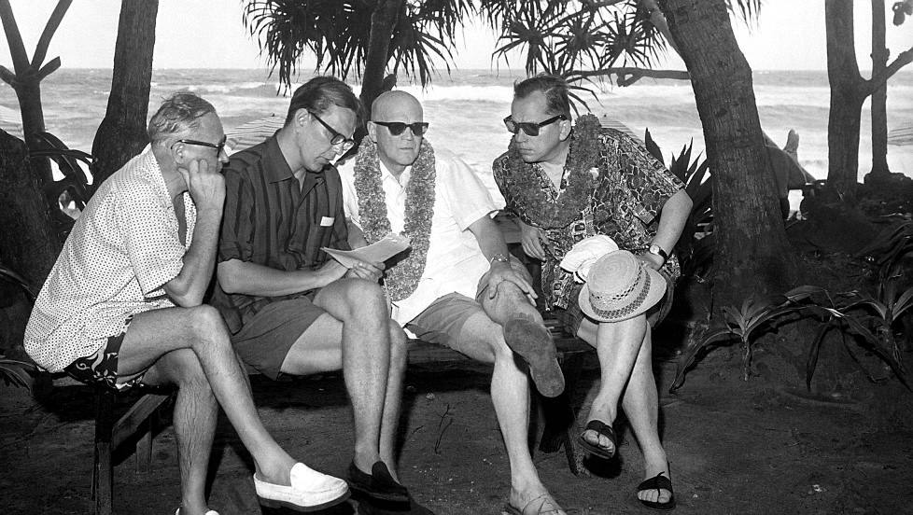
Kalle Kultala: Noottikriisi , 1961 , original work
Notes:
Kalle Kultala

Slide 19
Photographs protected
In addition to copyright protection, the Finnish Copyright Act also protects all photographs, also those lacking originality with a related right , photographers right that lasts for 50 yeras from the year the photo was taken.
The above photograph by photographer Kalle Kultala had originality above the work treshold and is protected as a work, that is for the duration of lifetime of author + 70 years, Copyright Council statement 2013:3 http://www.minedu.fi/export/sites/default/OPM/Tekijaenoikeus/tekijaenoikeusneuvosto/tekijaenoikeusneuvoston_lausunnot/2013/TN_2013-3.pdf

Slide 20
Supreme Court of Norway 27.6.2012
Supreme Court of Norway 27.6.2012, Trumf chair infringes Peter Opsvik copyright to Tripp Trapp chair , copyright lisenced to AS: Stokke

Slide 21
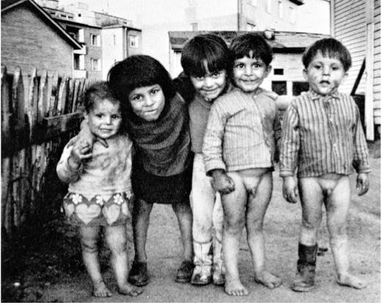
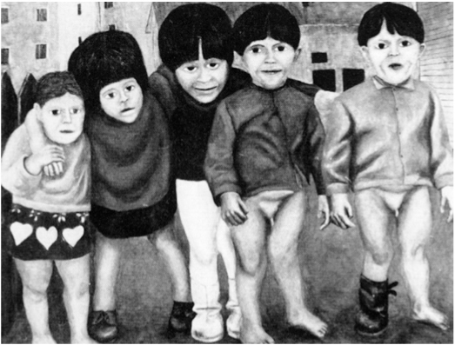
Supreme Court of Finland KKO 1979 II 64
Kalervo Ojutkangas photo was used as starting point
Pekka Viherä painting new original work , not infringing

Slide 22
New original work
According to Finnish Copyright Act 4 §2, if you make a new independent original work, based on a previous work protected by copyright, that use is allowed and not infringing on the previous work.
The Finnish Ministry of Education and Culture has a copyright Council that gives opinions on the interpretation of Copyright law.Copyright Council opinion TN 2014:17 states that the use of a photograph by Maija Louekari to create a pattern for a Marimekko fabric ”Hetkiä”, was not infringing (see next slide)
http://www.minedu.fi/export/sites/default/OPM/Tekijaenoikeus/tekijaenoikeusneuvosto/tekijaenoikeusneuvoston_lausunnot/2014/TN_2014-17_anon.pdf

Slide 23
Nwe original work
According to Finnish Copyright Act 4 §2, if you make a new independent original work, based on a previous work protected by copyright, that use is allowed and not infringing on the previous work.
The Finnish Ministry of Education and Culture has a copyright Council that gives opinions on the interpretation of Copyright law.Copyright Council opinion TN 2014:17 states that the use of a photograph by Maija Louekari to create a pattern for a Marimekko fabric ”Hetkiä”, was not infringing (see next slide, notice that images are not licensed under CC-BY 4.0 )
http://www.minedu.fi/export/sites/default/OPM/Tekijaenoikeus/tekijaenoikeusneuvosto/tekijaenoikeusneuvoston_lausunnot/2014/TN_2014-17_anon.pdf

Slide 24
Notes:
Images are not Creative Commons licensed

Slide 25
Supreme Court of Finland KKO 1988: 82 Krystyna Rudzinsky original work left, infringing work copying original features of Rudzinskys work right

Slide 26
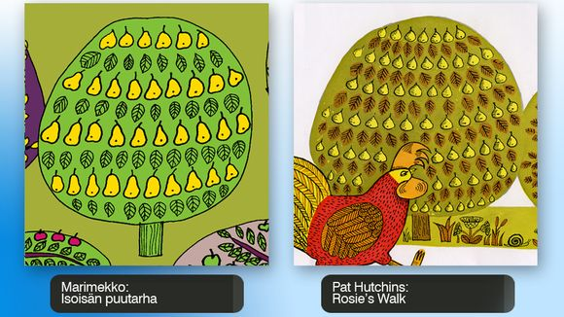
Original work or infringing? http://yle.fi/uutiset/expert_clears_marimekko_of_new_plagiarism_suspicions/6759213
Designer
Teresa
Moorhouse:
Marimekko
”Isoisän puutarha” fabric

Slide 27
Originality treshold for design
In Germany traditionally ”museum test” if a work is fit for a Design Museum collection, it gets copyright protection
Sweden originality threshold low
Maglite lamp (above) was original, design above work treshold , IKEA (below) infringed copyright
Supreme Court 9.4.2009 Sweden

Slide 28
Copyright Council decisions
Ministry of Education Copyright Council decisions
TN 2010:10 1976 The Savoy-vase designed by Alvar Aalto and Aino Marsio in 1936 is protected by copyright Copyright protection for design classics important
TN 2006:9 furniture design classics by for example Eero Aarnio pastilli chair were protected by copyright.
TN 2007:7. Ergonomic berry picking device was not original enough to get copyright protection

Slide 29
Intellectual Property Agreements
Intellectual property can be transferred with an agreement
Ownership of certain intellectual property can be transferred or rights to use can be granted with license
The rights transferred have to be be clearly defined
Also in employment contracts IPR transfer should be clearly defined in the contract
Finland does not have an work for hire clause in Copyright Act

Slide 30
Copyright Agreement
The right transferred can be an exclusive right – author can no longer use his/her work
or a non-exclusive right – possibility to grant rights to several users
or sole right- author can still use the work but cannot transfer right to a third party
According to Copyright Act the right to alter and the right to further transfer to third parties must be specifically mentioned in the agreement

Slide 31
Agreements
When using the copyright you own as an author, you balance the need to communicate and co-operate with others, and the need to remain in control and use the full power that comes from ownership and operating on your own terms.
The decision how and what to agree are case spefific and common practises are different in different fields, for example film industry and fine art

Slide 32
Licensing example
Marimekko licenses its intellectual property, copyright, for use by UNIQLO
https://www.uniqlo.com/eu/en/collaborations/women/marimekko

Slide 33
Licensing example
https://www.halofromnorth.com/
Halo licenses copyright of painting from Reidar Särestöniemi Foundation

Slide 34
Choosing an Intellectual Property strategy
All decisions about registering, enforcement or agreements concerning intellectual property protection should be done according to intellectual property strategy chosen.

Slide 35
Intellectual property strategy
Choose the same wordmark for your company name, trademark and domain name and for social media accounts.
so that would be SAMESAME OY company name, samesame.com, © 2023 SAMESAME SAMESAME ™
or SAMESAME® if you pay for registartion
If you are starting out with zero budget for IP protection you can use unregistered trademark TM, but registered trademark is always better.

Slide 36
Registration online for registered designs and trademarks
https://euipo.europa.eu/ohimportal/en
You need one picture file /pictures from different sides of the design either drawing or photo format
A credit card for payment of registration fees
For logo as trademark you also need the picture of the logo, for wordmark just write the word for example SAMESAME. For registration the wordmark is written in capital letters.

Slide 37
More information
http://copyright.aalto.fi/en/
https://www.prh.fi/en/index.html
https://euipo.europa.eu/ohimportal/en
https://www.iprhelpdesk.eu/SME_Corner
https://creativecommons.org/
Questions? maria.rehbinder@aalto.fi

