Slide 1
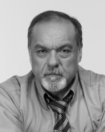
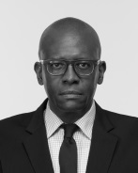
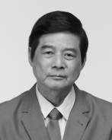
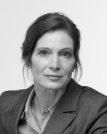
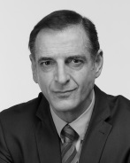
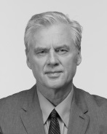
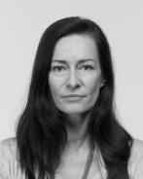
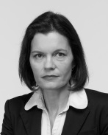
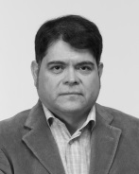
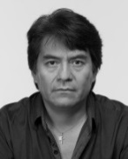
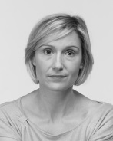
InflueNCE NETWORK
Use this worksheet to add the other influence links; with arrows showing the direction of influence (red=inverse), and arrow thickness showing the strength of the influence
Silva
Union
Jackson
Shareholder
Liang
Contractor
Vidal
Customer
Ramon
Minister
Bonnard
CEO
Wright
Professor
Martinez
Investor
Esperanza
Mayor
Gonzala
Indigenous
Klein
Activist
Crespo
Ecologist

Slide 2
Triangle Analysis
Use this worksheet to estimate the other nine stakeholders’ key interests (people, planet, economic) by positioning them on the triangle; and estimate their relative importance by adjusting the size of their circles
Bonnard
Crespo
Esperanza
PEOPLE: settlement, schools lung disease, jobs
Gonzala
Klein
Martinez
Liang
Ramon
Silva
Wright
Vidal
Jackson
ECONOMIC:
project profit
taxes
PLANET:
rainforest, parrots, river pollution

