Slide 1
Business Decision Game
From product idea to investment decision

Slide 2
Game framing
You are all working in small business looking for a new product
Your ideas are the potential new products
You will be up for a product/business review next month
What do you need to do/know/present in order to get a good decision?

Slide 3
Game objectives
What would you need to do to launch a product based on your idea?
The purpose of the game is to plan your activities from initial idea to satisfied customer
The information collected at the different stages is used to present a business case for your idea in the course final presentations
The path is built by identifying tasks and activities needed for the process
Some steps you have already taken but many steps towards delivering have yet to be planned

Slide 4
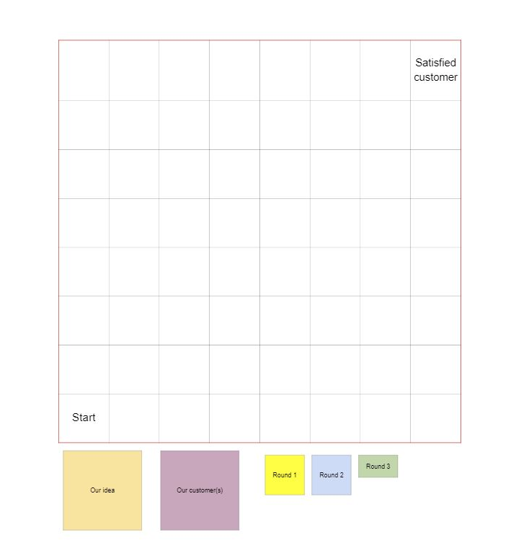
The Game board
PostIt™ notes

Slide 5
Game instructions
The game has 1 + 3 rounds
After each round, you will get the instructions for the following round

Slide 6
Step 0 – Before you start
Write down your idea
Place on the Start square
Who is/are your customers?
Place on the “Satisfied customer” square
10 minutes

Slide 7
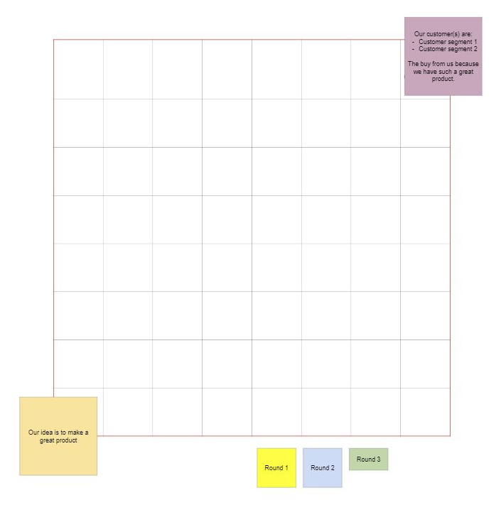
List your customers
Recap your basic idea

Slide 8
Step 1 – Activities and tasks
Identify necessary activities and functions to bridge the gap from initial idea to customer
Some of these steps you have already done as part of this course, but many other steps are also needed, add both!
Activity = things that typically occur once or a few times during development
Function = things that occur regularly (during operations phase), could have a person or unit associated with it
30 minutes

Slide 9
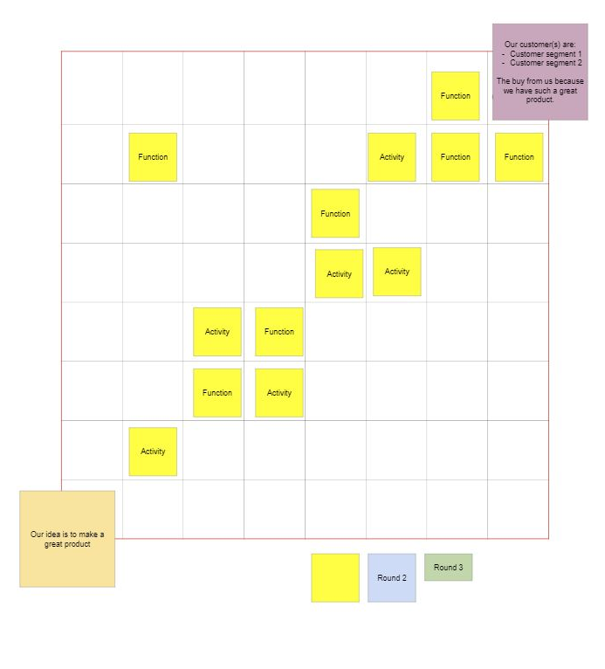
Activities and functions related to all parts of the process
“Process” for towards customer
Parts must touch

Slide 10
Step 2 – Take the real world challenge
Find some real world challenges as questions in Google Form: https://forms.gle/CjZXayZTet7yHX738
Choose one person to be the “reader/editor” and open one challenge at a time and input your comments.
For each question (15 questions, about 2 min/question):
Discuss the question and add a small comment in Google Forms
Check your process from the 1, did it include an activity to find the answer to the question? If not, then add a relevant activity
30 minutes

Slide 11
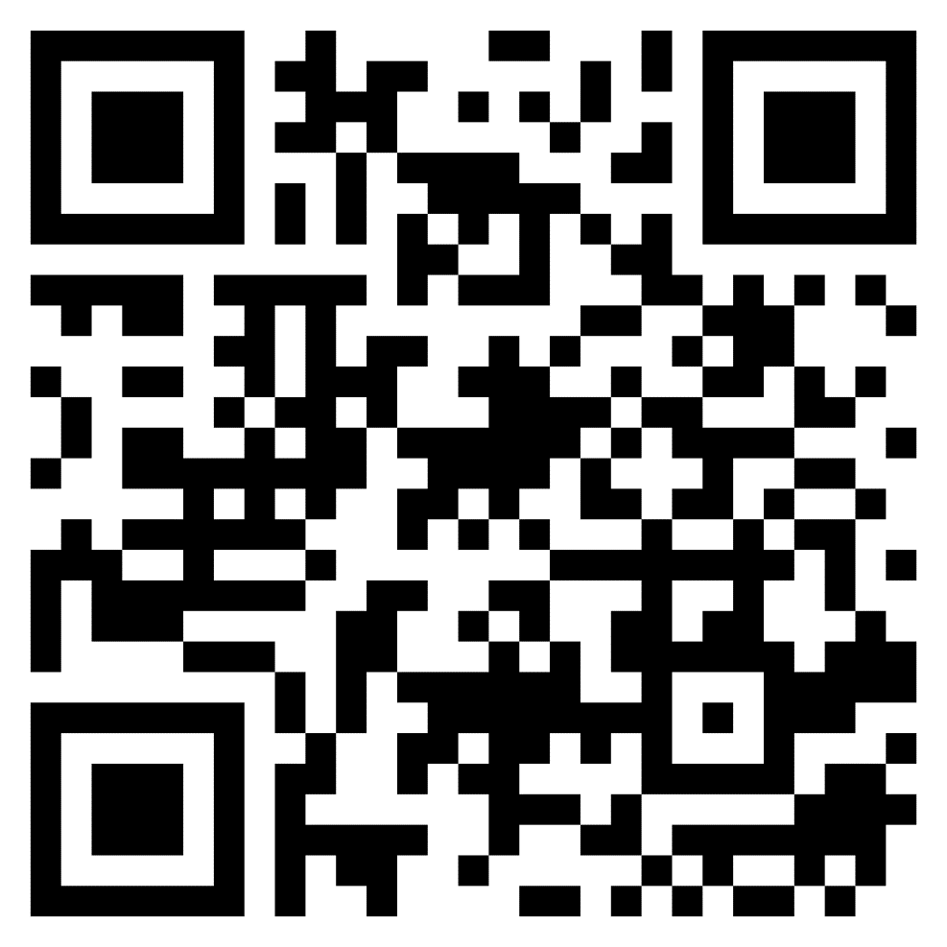
https://forms.gle/r26qPwG8MzYzEG9T7

Slide 12
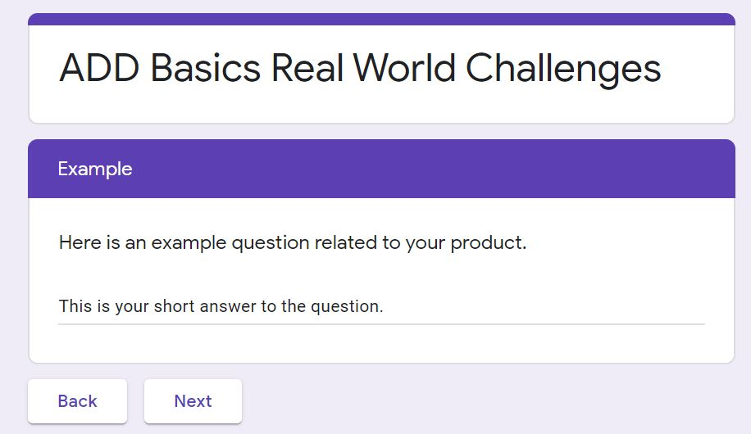
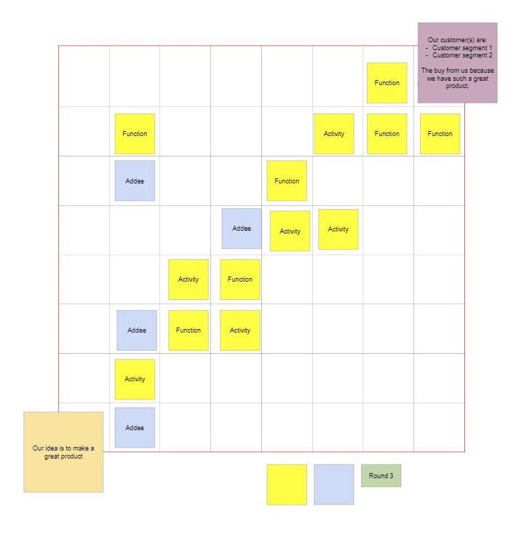
First add your answer here,
If you don’t (yet) know the answer, write e.g. “needs more work”
Additional steps to find missing information on blue postits

Slide 13
Step 3 – Prepare for your pitch
Identify which parts of your process (= what information) would be useful to present in your final pitch
Use a third color to note down what you want to use in your pitch.
On the PostIts note down:
Things you have done and ready to be included in presentation
Things you have not done, but that would be needed to give and good final presentation AND that you still have time to complete
Take a photo of your gameboard as documentation

Slide 14
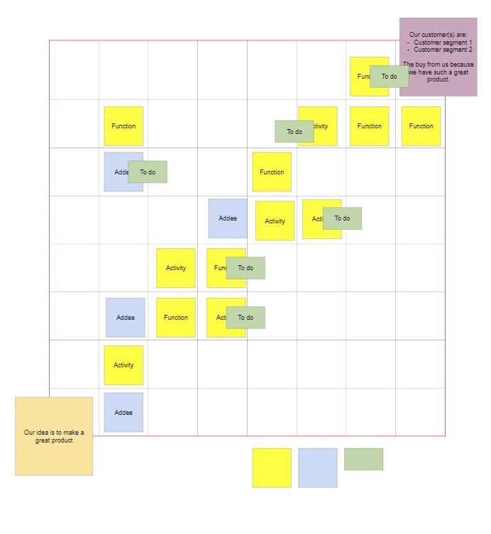
Inputs to final presentation in Green

Slide 15
“Answers”
USP = unique selling point
User research
Competitor analysis
Customizability
Marketing
Recycling, waste management
Prototyping, user testing

Slide 16
“Answers”
Feasibility study
Manufacturing, initial production
Volume production
Sustainability, life cycle analysis
Sales, sales channel
Delivery, delivery channel
Decision making, milestones, gates

