Slide 1
Your thoughts on learning goals related to sustainability in additive manufacturing
Limitations and benefits of additive manufacturing more in depth.
Sustainability impact of add manufacturing / About sustainability in additive manufacturing
how and why additive manufacturing create values in product development and industry. how it is connected to entrepreneurship and sustainable business.
about the people who have applied prototyping to their work (can be in any field, like business, sustainability, research,…)
Legal requirements and regulations that need to be adhered to

Slide 2
Sustainability in additive manufacturing
Elina Kähkönen
Apr 13th 2023
Photo by SIMON LEE on Unsplash

Slide 3
Your thoughts on learning goals related to sustainability in additive manufacturing
Limitations and benefits of additive manufacturing more in depth.

Slide 4
Is additive manufacturing sustainable?
What sustainability-related pros and cons can you think of when it comes to additive manufatcturing as a method of production?
Think 2 min individually
Discuss 5 min in pairs
Share with the class

Slide 5
Part of a solution or part of a problem?
Higher rate of product obsolescence combine to
bring about increased resource consumption (& waste production)
Improved resource efficiency: in
production and use phases
Stronger person-
product affinities and closer relationships between producers
and consumers
Extended product life: repair, remanufacture and refurbishment, and stronger person-product affinities and consumers
Reconfigured value chains: shorter and simpler supply chains,
more localised production, and new collaborations
Ford & Despeisse, (2016) , Kohtala (2015)

Slide 6
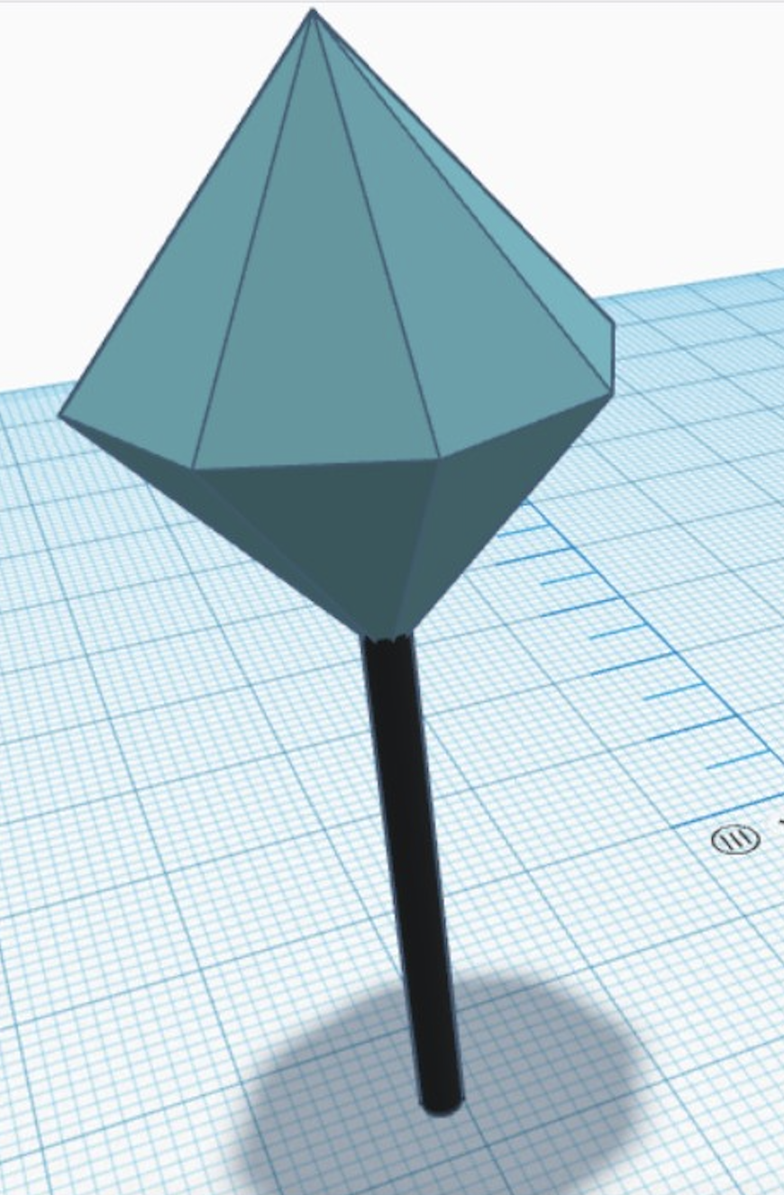
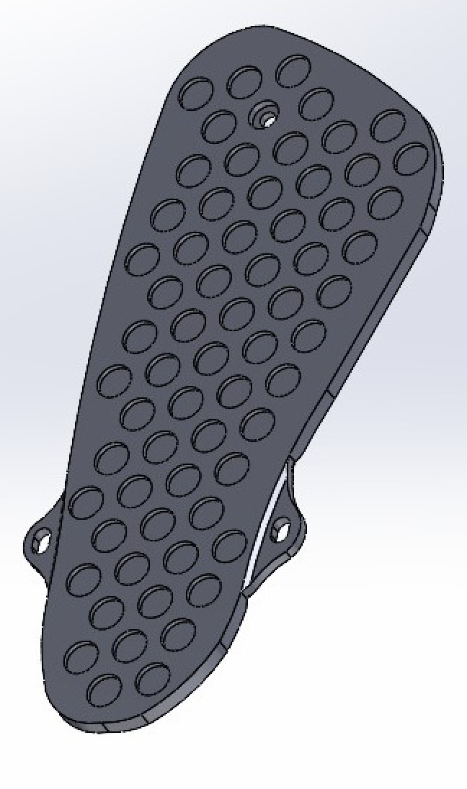
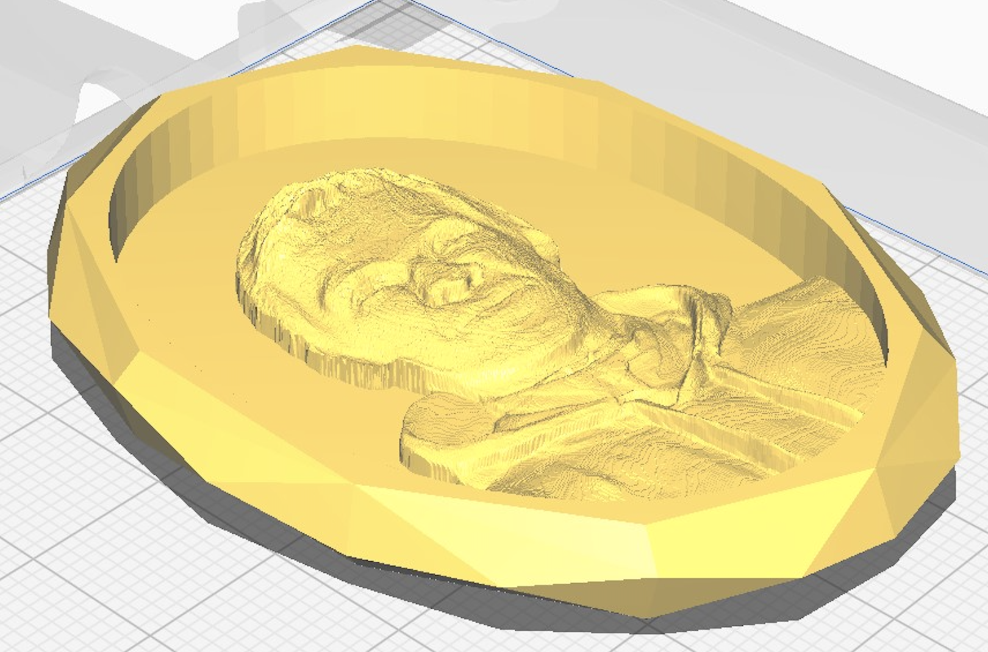
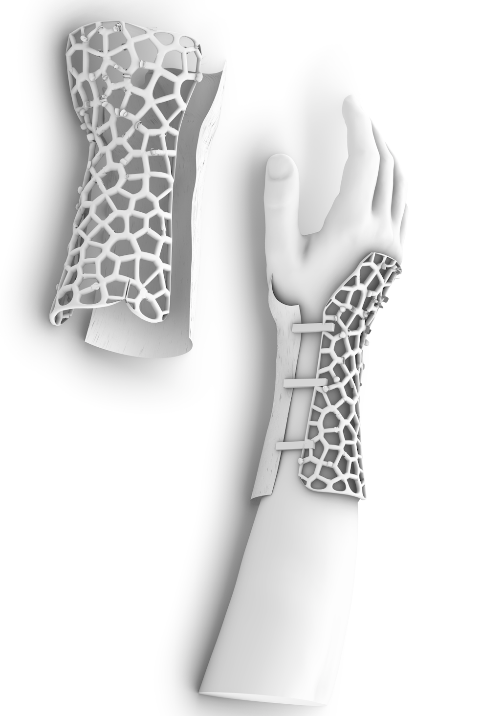
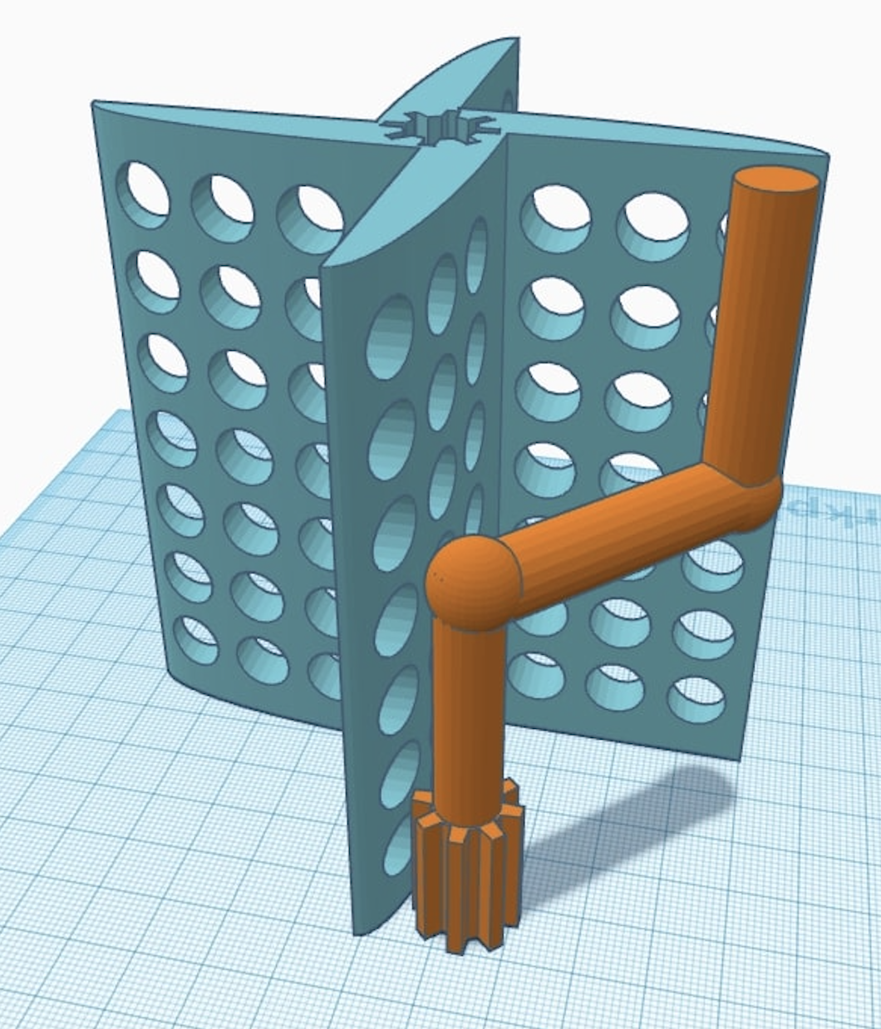
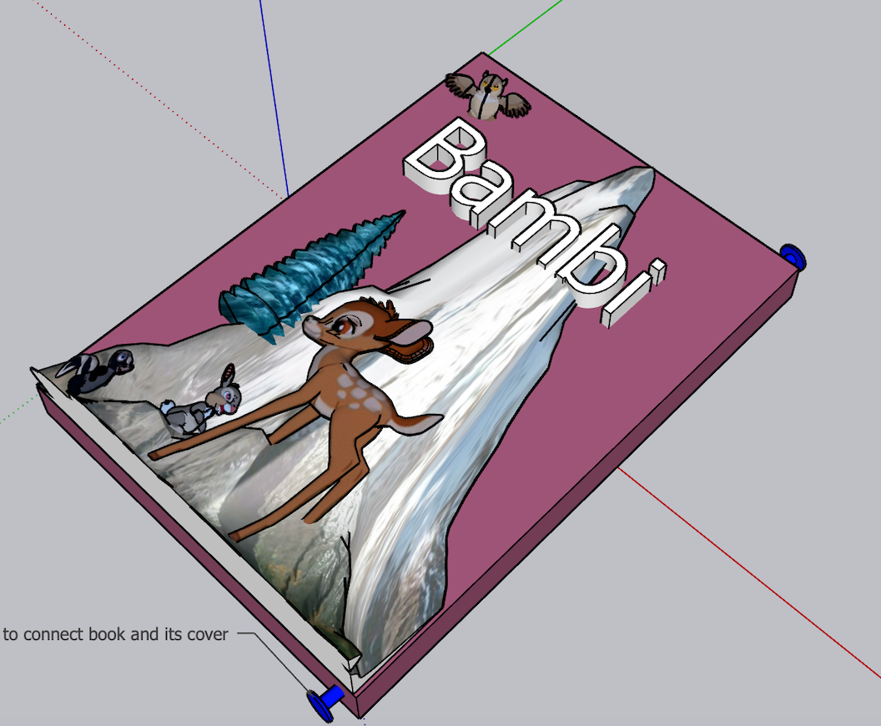
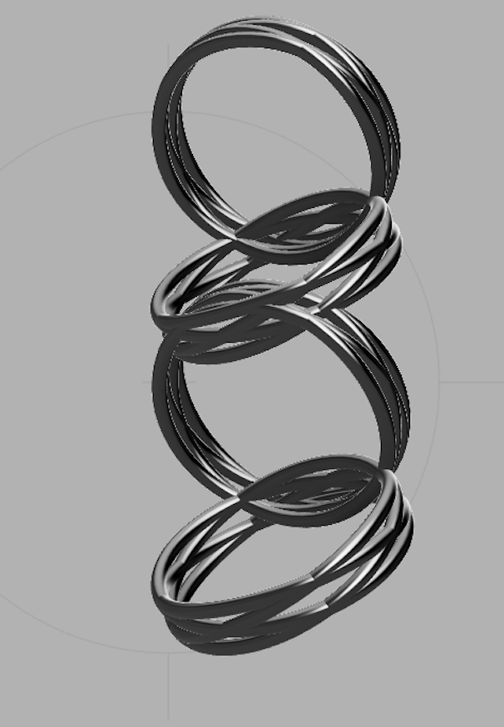
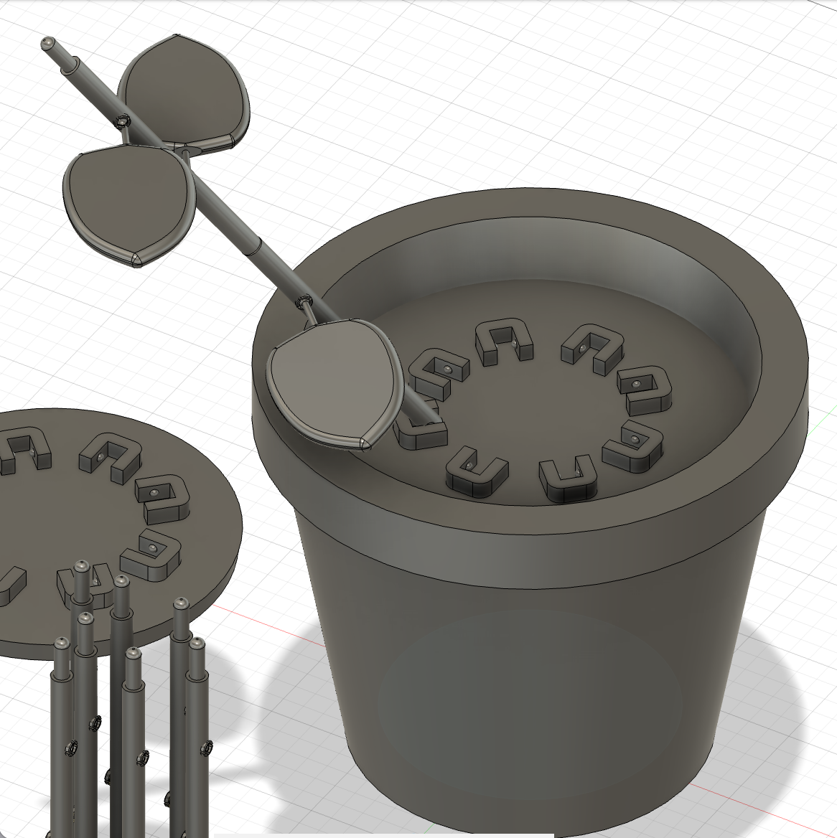
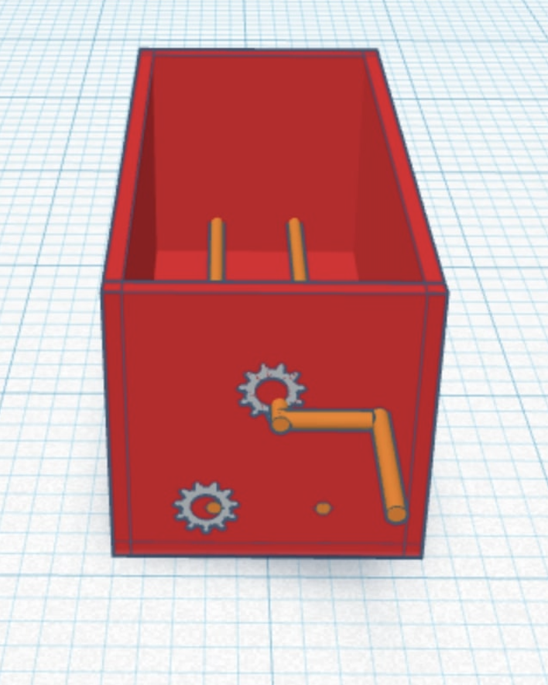
How about your product idea?

Slide 7
Discussion in tables (15 min)
Discuss your product idea from the sustainability point of view
Which properties do you consider as developments towards sustainability?
Which properties do you consider as problematic from the sustainability point of view?
Be ready to share the outcomes of your discussion.
Our solution; 3D printed ear plugs,
…will increase personalization and affinity to the product, and hence prolong the product lifetime.
…on the other hand, our product is difficult to recycle due to integrated electronics”

Slide 8
Your thoughts on learning goals related to sustainability in additive manufacturing
how and why additive manufacturing create values in product development and industry. how it is connected to entrepreneurship and sustainable business.

Slide 9
80 % of the factors related to the sustainability of a product are fixed during product development
Planning; develop design specifications
System level design; establish physical building blocks
Detail design; prepare for production
Testing and refinement
Modified from Ullrich and Eppinger, 2012

Slide 10
Tools for sustainable design: planning stage?
Planning; develop design specifications
System level design; establish physical building blocks
Detail design; prepare for production
Testing and refinement
Modified from Ullrich and Eppinger, 2012

Slide 11
Your thoughts on learning goals related to sustainability in additive manufacturing
Legal requirements and regulations that need to be adhered to

Slide 12
Sources for sustainability specifications
Regulations
RoHS
WEEE
REACH
Eco design directive
Energy labelling regulation
Guidance from NGO*
Customer requirements
Competitor benchmark
Marketing phrases
*NGO = Non-governmental organization

Slide 13
Sources for sustainability specifications
Regulations
RoHS
WEEE
REACH
Eco design directive
Energy labelling regulation
RoHS and REACH aim at steering the choice and use of materials towards safe and sustainable direction from environment and heath points of view.
Eco-design directive and energy labelling regulation focus largely on energy efficiency improvement
WEEE aims at steering towards safe and sustainable handling of electronic and electrical waste
*NGO = Non-governmental organization

Slide 14
Sources for sustainability specifications
Guidance from NGO*
Eco-lables define criteria for product composition, energy efficiency, production technologies and emissions
In general Nordic ecolabel and EU Eco label are similar and the German Blue Engel tends to set stricter limits
*NGO = Non-governmental organization

Slide 15
Sources for sustainability specifications
Customer requirements
Competitor benchmark
May refer to some standards, E.g. ISO 14 000
Can reflect to entire supply chain
*NGO = Non-governmental organization

Slide 16
Sources for sustainability specifications
Marketing phrases
Will be more strictly regulated
*NGO = Non-governmental organization

Slide 17
“A product with no customer is just highly processed waste”

Slide 18
Your thoughts on learning goals related to sustainability in additive manufacturing
about the people who have applied prototyping to their work (can be in any field, like business, sustainability, research,…)

Slide 19
User centered product development
5-47% of new product launches succeed
The source of the failure is usually related to the users
70% of the award-winning innovations are user centered
Refs: Kahn, K B. PDMA Handbook of New Product Development. [ed.] ProQuest. Wiley, 2012. Vol. 3; Schneider, J and Hall, J. Why Most Product Launches Fail. Harvard Business Review. April 2011; Smart factories, clean tech and customer experience; how to scale-up the success of learning with users? Business Innovation Observatory –trend report, Oct 2014; Saunders, M. N., Seepersad, C. C. and Hölttä-Otto, K.,ASME Journal of Mechanical Design, 2011, Vol. 133.

Slide 20
Tools for sustainable design: physical building blocks?
Planning; develop design specifications
System level design; establish physical building blocks
Detail design; prepare for production
Testing and refinement
Modified from Ullrich and Eppinger, 2012

Slide 21
Sustainable design principles
Sustainable product
Flexible / adaptable
Reliable
Durable
Modular
Reparable
Reusable
Re
use
pair
cycle
cover
More on the topic:
https://youtu.be/tlPIp_Kn7f4, https://youtu.be/vcFRvuOnWQ8, https://youtu.be/kAP0c25ApP0

Slide 22
Material choice & Testing, Design
Materials are specified in the design phase, so all stakeholders responsible for product suitability should be involved, or at least informed, during selection of materials.

Slide 23
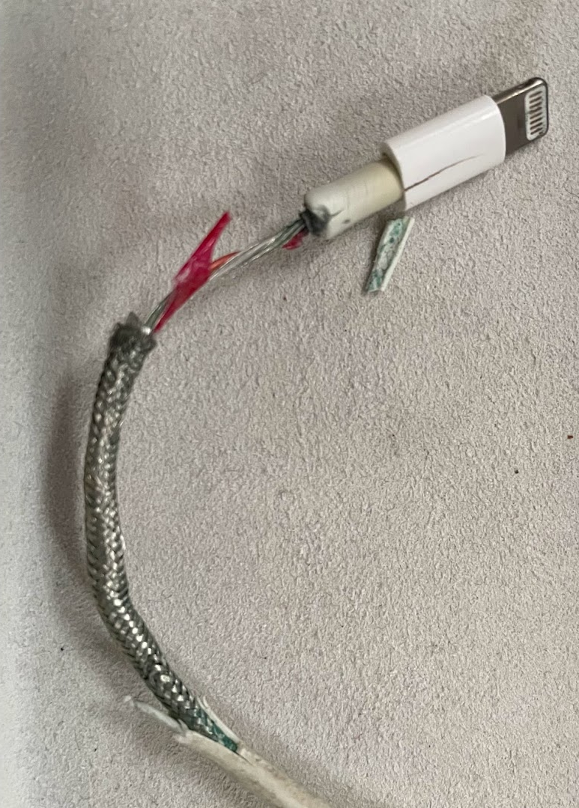
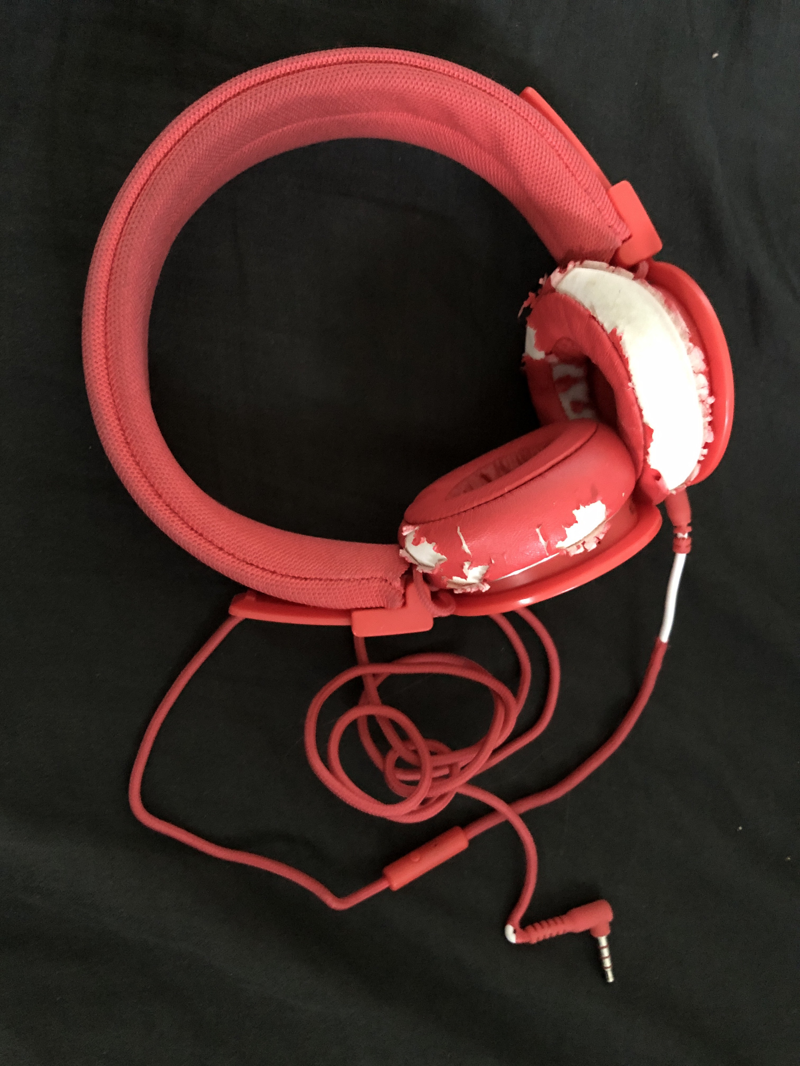
Considerations on durability, product lifetime and premature obsolesce
Performs tests to find materials that will outlast the lifetime of your product
Involve all stakeholders responsible for product suitability in the selection of materials in the design stage
Don’t let the material selection make your product obsolete before its time
Sometimes, regulations will ensure that this is considered

Slide 24
Considerations of environmental impacts of material acquisition
Scarce vs. well available
Diminishing vs. Renewable
Energy consumption
Biodiversity reduction
Virgin vs. recycled
Biopolymers: chemically modified, crosslinked polyester from nature’s own renewable building blocks, industrial and agricultural side-streams
https://www.brightplus.com/brightbio-filaments-and-granules/

Slide 25
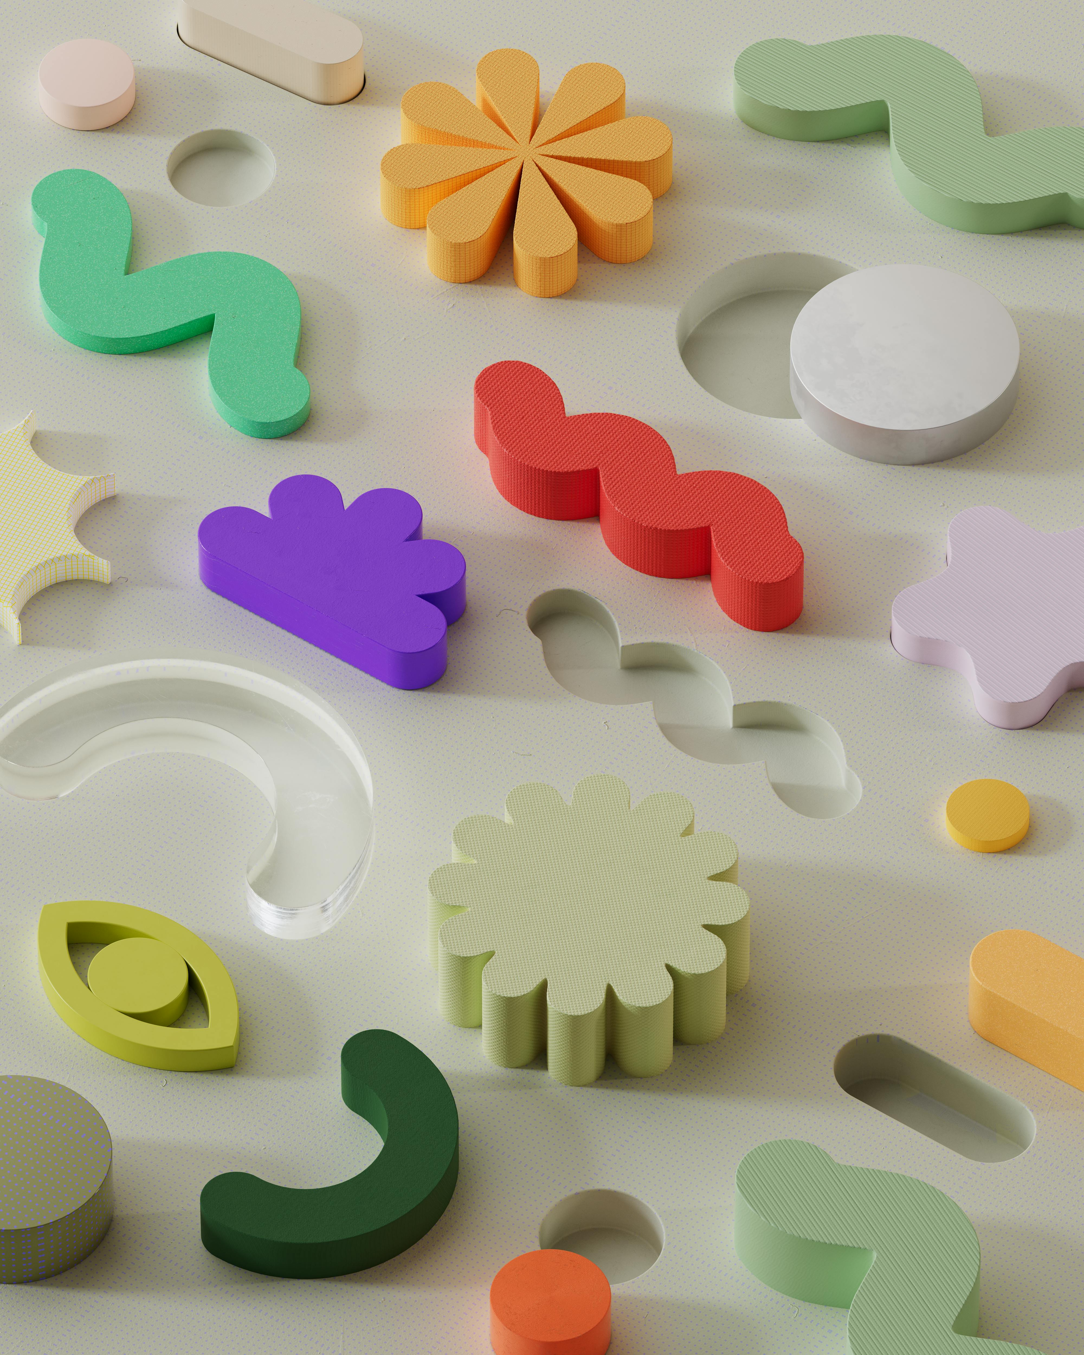
Considerations on the end-of-life treatment of a material
Energy source
Recycled raw-material
Biodegradation
Land fill
pexels-google-deepmind-17485819.jpg

Slide 26
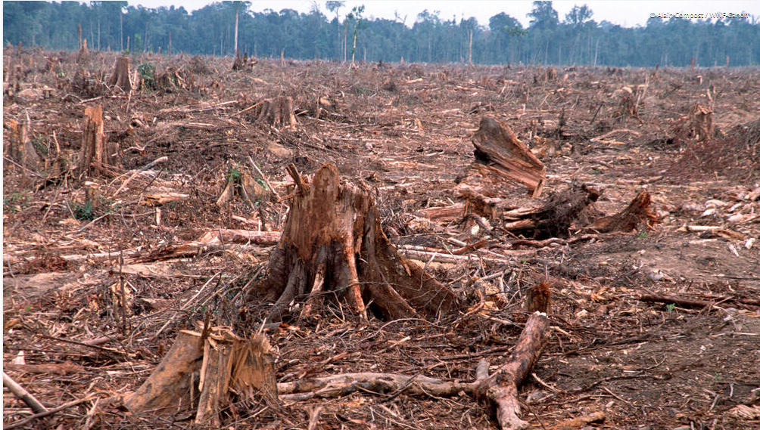
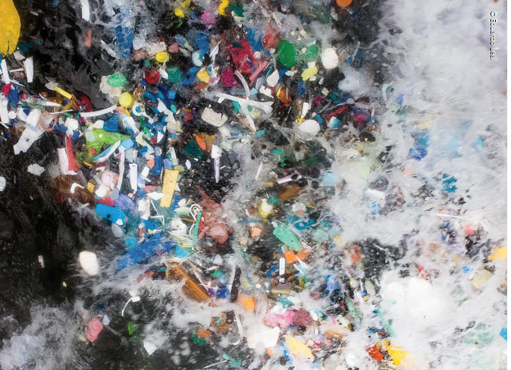
Durability, material acquisition impacts and end-of-life treatment are often in contradiction with each others

Slide 27
Additive manufacturing as an enabler when producing physical building blocks?

Slide 29
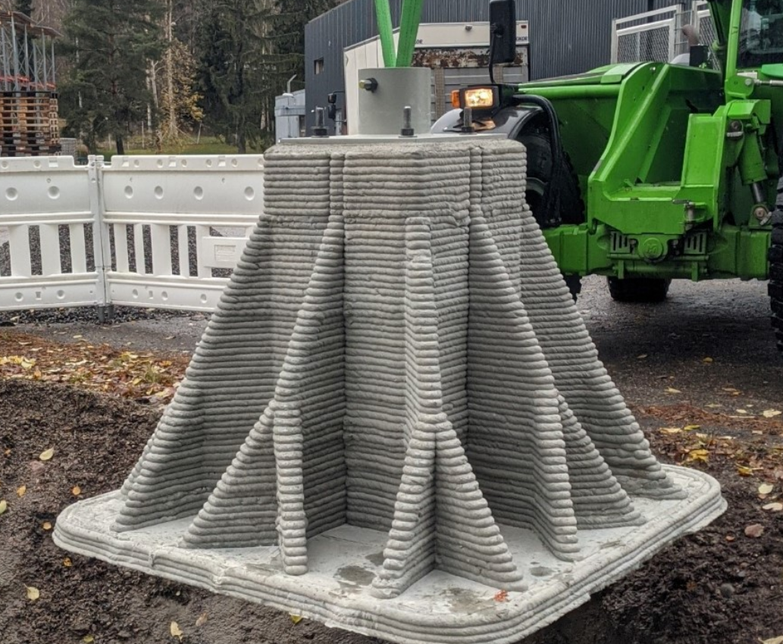

Slide 30
Tools for sustainable design: design for production?
Planning; develop design specifications
System level design; establish physical building blocks
Detail design; prepare for production
Testing and refinement
Modified from Ullrich and Eppinger, 2012

Slide 31
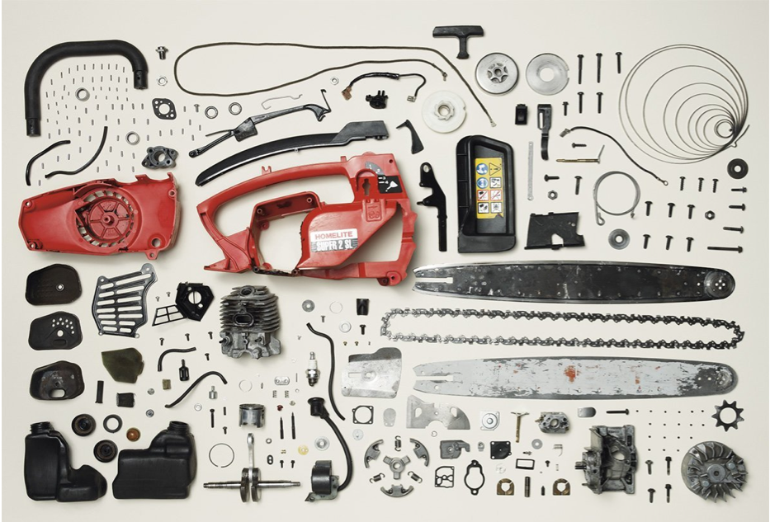

Slide 32
Considerations on sourcing of the defined material / component
Responsible supplier verification by audits, certifications, and/or contracts
Logistic optimization

Slide 33
Additive manufacturing as an enabler in the production?

Slide 34
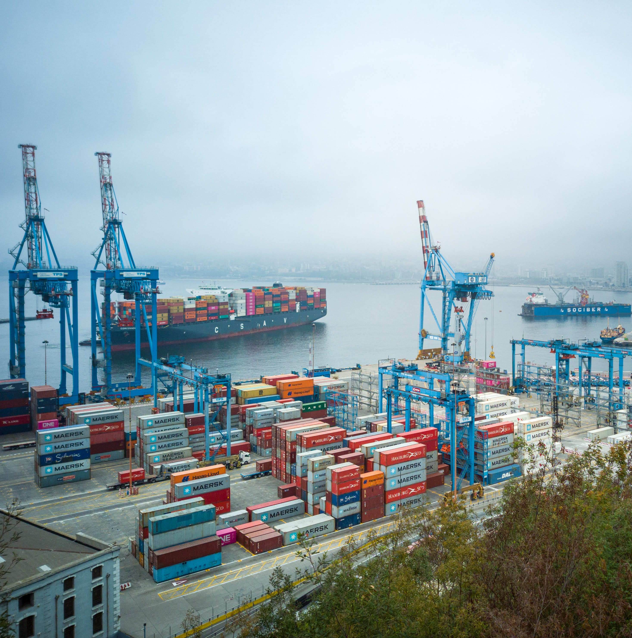
Supply chains for components and spare parts
Photo by David Vives on Unsplash

Slide 35
How can we test the sustainability of our product?
Planning; develop design specifications
System level design; establish physical building blocks
Detail design; prepare for production
Testing and refinement
Modified from Ullrich and Eppinger, 2012

Slide 36
Life cycle analysis, carbon footprint, ecological footprint
Raw material aqcuisition
Manufacturing
Product use
End of life & recycling
Databases:
Granta edupack: Carbon footprint, energy consumption
OpenLCA: More environmental and health impacts available in the assessment, challenging user interphase
Gabi: available only in some departments
Published life cycle assessments (Google scholar)
Photos by David Hofmann, Dominik Vanyi, yasin hm, Florian Schmetz Christophe Dion on Unsplash

Slide 37
Usability of lifecycle assessment
Data on sustainability
Facts available
Degree of freedom
Development process

Slide 38
Your thoughts on learning goals related to sustainability in additive manufacturing
how and why additive manufacturing create values in product development and industry. how it is connected to entrepreneurship and sustainable business.

Slide 39
+ €
Production transfer / outsourcing in “pollution haven”
Design for obsolence
Energy and material efficiency
Waste minimizing
Optimized logistics
Compliancy with binding restrictions
Unsellable product
Overaged materials
Badly planned production and logistic
Compliancy with future restrictions in production, product specifications, and in purchasing criteria
Economics vs. sustainability
-sust
+sust
- €
Notes:
Harkintaan

Slide 40
+ €
Production transfer / outsourcing in “pollution haven”
Design for obsolence
Energy and material efficiency
Waste minimizing
Optimized logistics
Compliancy with binding restrictions
Overaged materials
Badly planned production and logistic
Non-compliance with binding restrictions
Unsellable product
Compliancy with future restrictions in production, product specifications, and in purchasing criteria
Win win-
Loose loose
-sust
+sust
- €
Notes:
Harkintaan

Slide 41
+ €
Production transfer / outsourcing in “pollution haven”
Design for obsolence
Energy and material efficiency
Waste minimizing
Optimized logistics
Compliancy with binding restrictions
Overaged materials
Badly planned production and logistic
Unsellable product
Design for ReX
Investing in sustainability
-sust
+sust
- €
Notes:
Harkintaan

Slide 42
+ €
Production transfer / outsourcing in “pollution haven”
Design for obsolesce
Energy and material efficiency
Waste minimizing
Optimized logistics
Compliancy with binding restrictions
Overaged materials
Badly planned production and logistic
Unsellable product
Compliancy with future restrictions in production, product specifications, and in purchasing criteria
Profit on the cost of sustainability
-sust
+sust
- €
Notes:
Harkintaan

Slide 43
Part of a solution or part of a problem?
Higher rate of product obsolescence combine to
bring about increased resource consumption (& waste production)
Improved resource efficiency: in
production and use phases
Stronger person-
product affinities and closer relationships between producers
and consumers
Extended product life: repair, remanufacture and refurbishment, and stronger person-product affinities and consumers
Reconfigured value chains: shorter and simpler supply chains,
more localised production, and new collaborations
Ford & Despeisse, (2016) , Kohtala (2015)

Slide 44
As one element of your next task
Assess sustainability-related pros and cons
Of your idea
Of your material choices
How could you improve material efficiency? How could improve sustainability by choosing another material? What compromises would these changes entail from the perspective of your product?

Slide 45
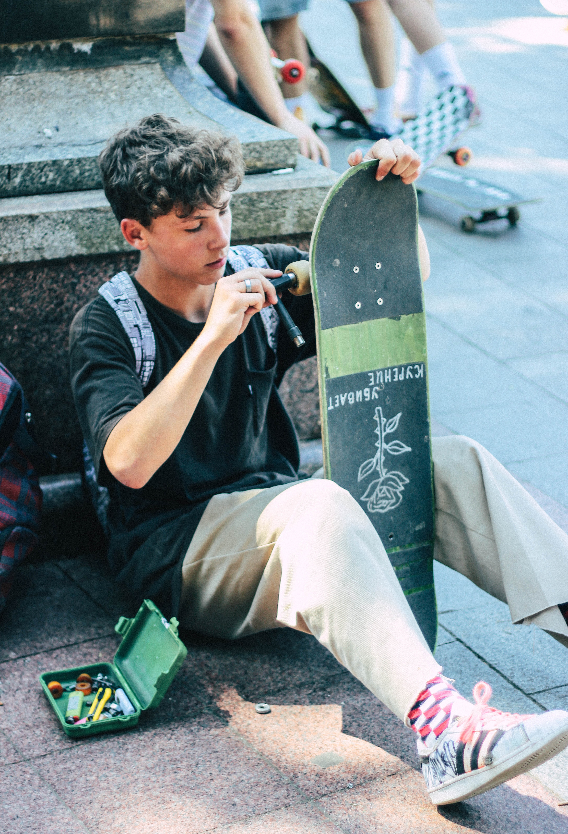
I’m hopeful but the challenges are very severe. And someone needs to do the job. For this reason, this is absolutely the most relevant generation to be alive.
- Prof. S. Michaux, GTK (HS 17.10.2022)
Photo by Oleg Ivanov on Unsplash
Notes:
Guidance, ideation

Slide 46
Material efficiency: Assess sustainability related pros and cons on material choice and use in your project.
Design for sustainability concepts: Assess how and which of the design for sustainability concepts have you applied. Also assess which ones you could / could not apply. Give reasoning for your arguments on applicability.
Sustainability of your concepts: Assess how do the economic and sustainability performance meet in your concept: are they contradictory / parallel to each other. Give reasoning for your arguments.

Slide 47
Further reading
Penga et al. (2018) Sustainability of additive manufacturing: An overview on its energy demand and environmental impact Additive Manufacturing 21 694–704. https://doi.org/10.1016/j.addma.2018.04.022
Javaid et al. (2021) Role of additive manufacturing applications towards environmental sustainability Advanced Industrial and Engineering Polymer Research 4 312-322 https://doi.org/10.1016/j.aiepr.2021.07.005
Ford & Despeisse, (2016) Additive manufacturing and sustainability: an exploratory study of the advantages and challenges, J. Clea. Prod.137 1573-1587. http://dx.doi.org/10.1016/j.jclepro.2016.04.150
Kohtala C. (2015) Addressing sustainability in research on distributed production: an integrated literature review, J. Clean. Prod., 106 pp. 654-668

