Slide 1
Business to Business Marketing
Chapter 1
Business-to-Business Markets and Marketing

Slide 2
Learning outcomes
Know what are the defining characteristics of business to business markets
Be able to differentiate between business to business markets and consumer markets
Understand how the characteristics of business to business markets affect the practice of marketing management
Appreciate the changing balance between the agricultural, manufacturing and service sectors in the world’s major economies.

Slide 3
Learning outcomes
Understand the nature and significance of derived demand in business to business markets
Be able to explain the significance of an industry concentration ratio
Understand the nature and the significance of the accelerator effect in business to business markets
Be able to apply two complementary classification schemes to the categorization of business products

Slide 4
Business marketing
Business marketing is concerned with the marketing of goods and services to organizations.
The key distinguishing feature of business marketing is the nature of the customer, rather than the nature of the product.
Although there are products that are bought only by organizations and not by final consumers, there are many products that are bought by both organizations and consumers.

Slide 5
MARKET STRUCTURE DIFFERENCES
Dimension Nature of demand Demand volatility Demand elasticity Reverse elasticity Nature of customers Market fragmentation Market complexity Market size Number of buyers per seller Number of buyers per segment Relative size of buyer/seller Geographic concentration | Business marketing Derived Greater volatility Less elastic More common Greater heterogeneity Greater fragmentation More complex Larger overall value Few Few Often similar Often clustered | Consumer marketing Direct Less volatility More elastic Less common Greater homogeneity Less fragmentation Less complex Smaller overall value Many Many Seller much larger Usually dispersed

Slide 6
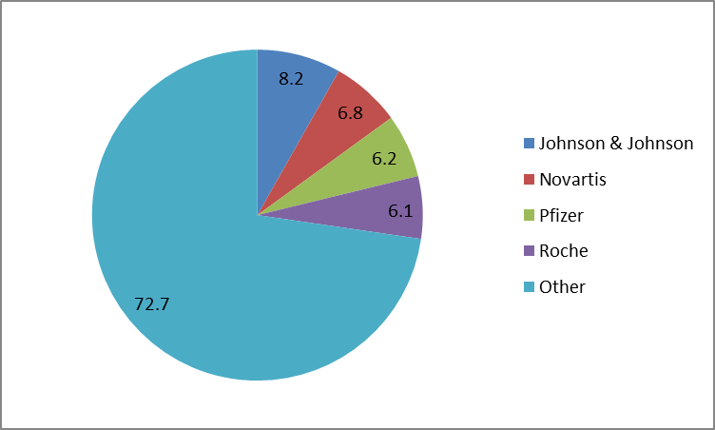
Industry Concentration Ratios
percentages
Market shares: Global pharmaceuticals, 2014

Slide 7
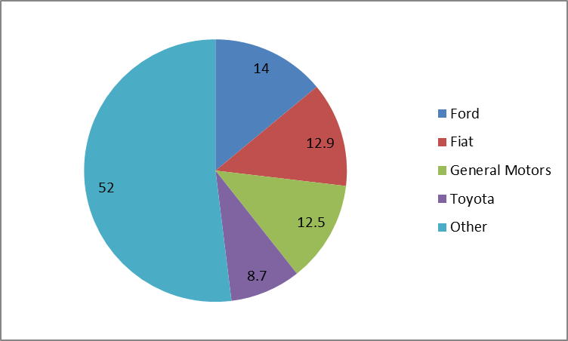
Industry concentration ratios
percentages
Market shares: Global truck manufacturing, 2013

Slide 8
BUYING BEHAVIOUR DIFFERENCES
Dimension Buying influences Purchase cycles Transaction value Buying process complexity Buyer/seller interdependence Purchase professionalism Importance of relationships Degree of interactivity Formal, written rules | Business marketing Many Often long Often high Often complex Often high Often high Often important Often high Common | Consumer marketing Few Usually short Usually small Usually simple Usually low Usually low Usually unimportant Usually low Uncommon

Slide 9
MARKETING PRACTICE DIFFERENCES
Dimension Selling process Personal selling Use of relationships Promotional strategies Web integration Branding Market research Segmentation Competitor awareness Product complexity | Business marketing Systems selling Used extensively Used extensively Limited, customer-specific Greater Limited Limited Unsophisticated Lower Greater | Consumer marketing Product selling Limited Limited Mass market Limited Extensive, sophisticated Extensive Sophisticated Higher Lesser

Slide 10
Business market classification
A common classification for business products is installations, accessory equipment, MRO* supplies, raw materials, manufactured materials & parts, business services.
A key distinction is made between products that are incorporated into the final product (entering goods), and those that are not.
* MRO = Maintenance, Repair & Operations (supplies)

Slide 11
Business market classification
Original equipment manufacturers combine components bought from other suppliers into a finished product that is sold to end-users.
The after-market comprises sales of parts for repair and upgrade to products that are already owned by an end-user

