Slide 1
Business to Business Marketing
Chapter 6
Business market segmentation

Slide 2
Segmentation and targeting
Segmentation
provides marketer with basis to achieve efficient and effective solution to customer problems,
by
establishing degrees of homogeneity in otherwise heterogeneous market place .
Homogeneous groups resulting from segmentation process
enable marketer to decide what parts of market to target with its solutions
targeted in expectation that it can solve customer problems more effectively and profitably than competitors

Slide 3
Segmentation and relationships
Segmentation enables best match between problem-solving abilities and uncertainties of both buyer and seller so that sustainable relationships can be created.

Slide 4
Figure 6.1 The segmentation funnel
Firmographics
Operating variables
Purchasing approach
MACRO
Situational factors
Personal characteristics
MICRO
(adapted from Shapiro and Bonoma, 1984)

Slide 5
Firmographics
‘Business market ‘demographics’
segmentation by industry sector
e.g. the plastics industry is a different segment from the pharmaceutical industry
segmentation by organisation size
e.g. retailers with over 100 outlets are a different segment from single-outlet shopkeepers
segmentation by location
e.g. farmers in East Anglia are a different segment from farmers in Wales

Slide 6
Figure 6.2 Using firmographics
Segment | Industry: company activity | companies worldwide 178,34
NAICS Code | 327120
Category | Clay building material and refractories manufacturing
Segment | Industry | Company size: turnover | companies worldwide ≥ $50m turnover 374
NAICS Code | 327120 | ≥ $50m
Segment | Industry | Turnover | Location | countries ≥16 companies ≥ $50m turnover 7
NAICS Code | 327120 | ≥ $50m | Countries ≥16 companies
Country | Number of companies
Italy | 39
Brazil | 33
Japan | 33
China | 32
Spain | 22
Germany | 20
USA | 16
Country | Name of company
Brazil | Magnesita Refratorios SA
 | PGB S.A.
 | Pyrotek Tecnologia LTDA
 | Gressit Revestimentos Industria E Comercio LTDA
 | Casagrande Revstimentos Ceramicos S/A
Derived from data available at Orbisbvdinfo.com

Slide 7
Operating variables
company technology
product and brand-use status
customer capabilities
customer strategic type: prospector, defender, analyser, reactor

Slide 8
Organizational purchasing approach
purchasing function organization
power structures
buyer–seller relationships
general purchasing policies
purchasing criteria

Slide 9
Situational factors in segmentation
driven largely by time and scale-dependent variation.
includes:
urgency of customer need
scale of need

Slide 10
Personal characteristics of buyers
over and above organizational structures, policies & processes
buyer motivation
buyer risk management behaviour
relationship style
similarity of world view to supplier
requires sufficient access to customer to use well

Slide 11
Figure 6.3 Buyer persona
 | Tony the transformational leader
 | IT director technical decision maker develops IT strategy and plan leads technology evaluation teams
Background | 45+ years old; first degree; Executive MBA; 10+ years experience in company-wide senior management roles
Mindset | leader; strong business acumen; prudent with budgets; not easily convinced by buisness marketer claims
Reputation | innovative; focused; respected by industry peers
Core purpose | enable company-wide transformation; shift view of technology for functional to strategic role
Practice | leadership: comprehensive approach to interpreting and presenting things expertise: broad IT knowledge rather than technical details innovation: follows latest trends; draws from evidence-based application of new technologies expectations: demanding of IT team and vendors/solutions to enable strategy implementation
Frustrations | finding technology that offers best potental securing company-wide acceptance for new software initiatives identifying ways to make measurable impact
Anxieties | making poor purchase decisions; tarnishing reputation
Key irritations | ill-prepared sales people focused on their own targets rather than his needs; withdrawal of sales rep contant and support once technology solutions are in place
Internal influencers | finance director; managing director; board of directors
Drivers | bonus; personal ego; peer recognition
Search behaviour | keywords: sources: content preferences: | enterprise software ROI; strategic software investments; illiminating functional silos; increasing firm productivity peers; online searches; Gartner; Director Magazine in-depth white papers; podcasts

Slide 12
Challenges of B2B segmentation
customers less homogeneous; this compounded further by their visibility and interaction with suppliers
customer interaction with suppliers complicates stimulus-response approaches used by marketer so that it’s less obvious as to when an outcome is the result of a specific approach
interaction can cut both ways i.e. business customers often very active in communicating their needs to suppliers directly

Slide 13
Challenges of B2B segmentation
development of offerings is typically more complex and often developed in conjunction with customers
interactions with customers are often via a variety of channels
evolution of market structure, competition, technology and product, leads to marked changes in segments

Slide 14
Set up for effective segmentation?
 | Y/N
Adequacy of infrastructure to support segmentation:
Is management committed to the process?
Are lines of communication open throughout the organization?
Do you have a management information system (MIS) in place for gathering marketing intelligence?
Adequacy of processes for undertaking the segmentation:
Do you have sufficient marketing data and internal consensus for logically grouping market subsets?
Does the chosen segmentation scheme fit the organization’s mission and strategic planning initiatives?
Do you have managerial support to provide appropriate personnel and adequate finances for the segmentation initiative?

Slide 15
Set up for effective segmentation?
 | Y/N
Adequacy of basis of response to segmentation operations and implementation:
Is communications strategy in place for informing both internal and external constituencies?
Are the right people in place and committed to operationalizing the segmentation scheme?
Has management shown long-term commitment to segmentation rollout and monitoring?
If answer to the 9 questions is generally ‘No’ then basis for effective segmentation isn’t there
Weinstein, A. (2006) “A strategic framework for defining and segmenting markets”, Journal of Strategic Marketing, 14(2), 115-27.

Slide 16
Segments and differentiation
companies that engage in an undifferentiated targeting strategy make essentially the same offer to all segments
differentiated target market selection involves choosing a variety of different segments and providing offerings that are focused on meeting the needs of those targets more specifically

Slide 17
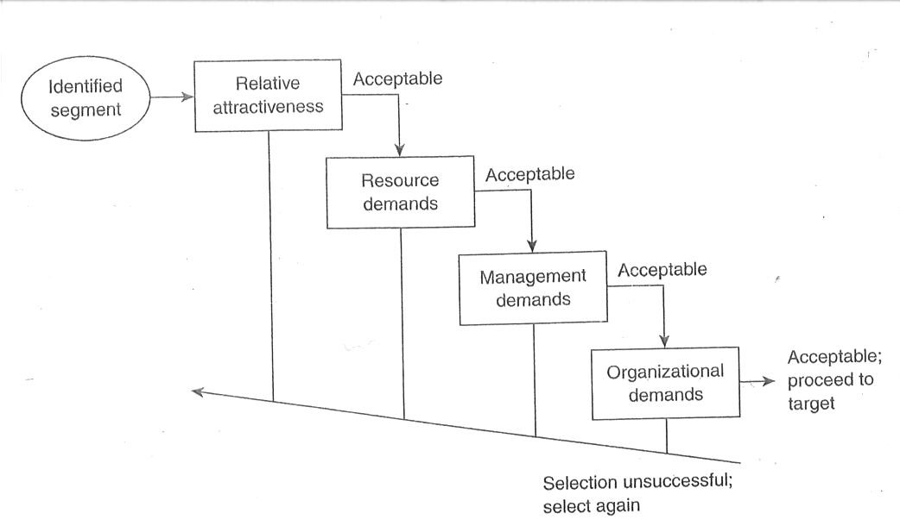
Figure 6.4 Step-wise segment selection process
(adapted from Freytag & Clarke, 2001)

