Slide 1
Business to Business Marketing
Chapter 9
Relationship Portfolios and Key Account Management

Slide 2
Portfolio management of customer relationships
APPLICABLE BECAUSE RELATIONSHIPS …
Constitute sources of risk and return
Vary in the type of risk they constitute
Vary in the level of return they bring
Vary in the time horizon over which they provide that return

Slide 3
Table 9.1 Typical strategic options for a relationship
Option | Actions
Build | Build a relationship further for growth, investing where necessary to achieve this growth
Maintain | Maintain the current levels of management effort in a relationship in order to reap the benefits from the relationship now through large volumes, high profits or a greater share of the customer’s purchases
Harvest | Harvest the value in the relationship by taking the current monetary value it brings while at the same time beginning to reduce the cost of servicing the relationship over time
Reduce | Reduce in the immediate future the level of management commitment to a relationship because the returns are diminishing with little prospect of reversal

Slide 4
Two-way customer classification
Always-a-share customers
Driven by price
Make decisions about supply on the basis of the best deals in the market
Happy to switch for a better deal
OR
Lost-for-good customers
Want greater stability
Will often subordinate price to other considerations
For example: continuity of supply, levels of product quality or a shared market view with their suppliers

Slide 5
More easily observed classification criteria
Sales
Profits
Cost savings
Relationship age

Slide 6
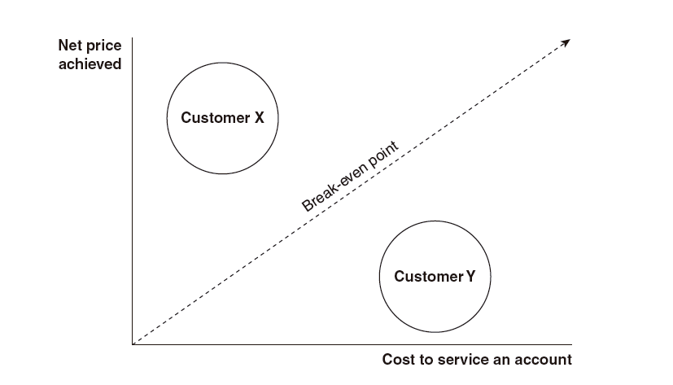
Figure 9.1: Depicting customers in terms of the prices achieved and the cost to service their accounts (adapted from Shapiro et al., 1987)
(adapted from Shapiro et al., 1987)
Notes:
Low net-price and low cost-to-serve: Bargain basement customers.
High net-price and high cost-to-serve. Carriage trade customers.
High net-price and low cost-to-serve. Passive customers.
Low net-price and high cost-to-serve. Aggressive customers.
Order of priority or resource allocation: carriage trade, passive, bargain basement, aggressive.

Slide 7
Less easily observed classification criteria
Replaceability
Criticality
Critically important products or processes
Shared vision
Interest commonality
Source of learning
Supplier’s share of customer’s purchases
Short term advantage taking

Slide 8
Relationship lifecycle variables
The experience of dealing with each other
The uncertainty associated with working with each other
The distance between the parties, incorporating social, geographical, time, cultural and technological manifestations
The commitment the parties make to each other
The specific adaptations they make to what they do and how they do it that brings them closer to the counterpart

Slide 9
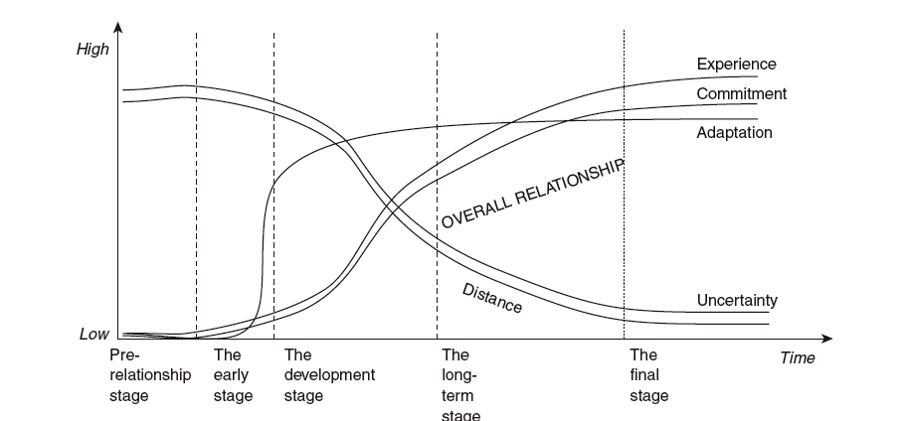
Figure 9.5: Ford's (1980) Relationship Life Cycle Stages

Slide 10
Reasons for adopting KAM
Increase market share (38% of respondents mentioned)
A change in business strategy (34%)
Allow increased customization of the product/service (26%)
Improve relationships with customers (26%)
Marketplace pressures (21%)
To become more attractive to large clients (20%)
(Boles et al., 1999)

Slide 11
Criteria for assigning KAM status
Volume of potential business (92% of respondents mentioned)
Volume of past sales (78%)
Competitors’ actions (61%)
Size of customers (55%)
Industry of customers (48%)
Management discretion (29%)
(Boles et al., 1999)

Slide 12
Key success factors in KAM
Knowledge and understanding of the key account customer’s business
Proper implementation and understanding of the KA program
Commitment to the KA program
the key account manager has a key role in bringing about commitment
Suitability of the KAM
suppliers highlighted the KAM’s skills, ability and competence
customers highlighted the importance of integrity, interpersonal skills, and sensitivity to the customer
Trust
(Abratt & Kelly, 2002)

