Slide 1
Exercise 10
Power systems

Slide 2
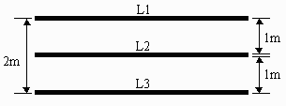
Question 1
A three-phase power line consists of three parallel
conductors in the same horizontal plane. The two
outer conductors are each 1 m from the center
conductor. If the conductor diameter is 6 mm,
calculate the average inductance per phase of a 1 km
length of the line. Assume the expression for the
inductance per meter of length.

Slide 3
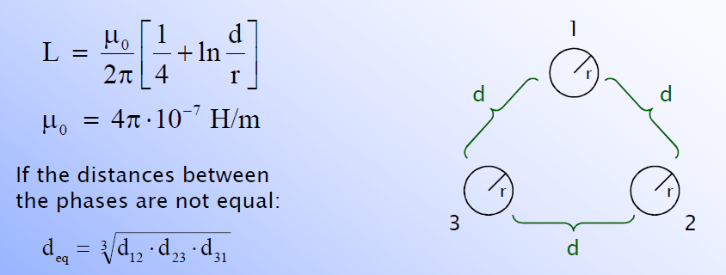
Question 1
A three-phase power line consists of three parallel
conductors in the same horizontal plane. The two
outer conductors are each 1 m from the center
conductor. If the conductor diameter is 6 mm,
calculate the average inductance per phase of a 1 km
length of the line. Assume the expression for the
inductance per meter of length.

Slide 4
Question 1
Inductance, when conductor diameter is 6 mm

Slide 5
Question 2
In a three-core cable, the capacitance between the three cores short-circuited together and the sheath is 0.87 μF/km, and that between two cores connected together to with the sheath and the third core is 0.84 μF/km. Determine the MVA required to keep 16 km of this cable charged when the supply is
33 kV, three phase, 50 Hz.

Slide 6
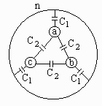
Question 2
MVA for charging 16 km of cable with 33 kV supply
2)
Three-core cable:
1) Capacitance between the three cores short-circuited together and the sheath is 0.87 μF/km:
2) Between two cores connected together with the sheath and the third core is 0.84 μF/km:
1)
n
C1
C1
C1
CA
n
C1
C2
C2
CB

Slide 7
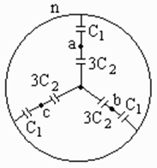
Question 2
MVA for charging 16 km of cable with 33 kV supply
We can make a delta-star transformation for easier solution:

Slide 8
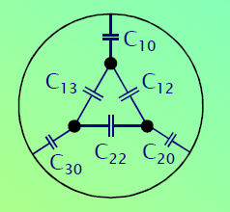

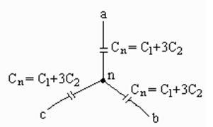
Question 2
MVA for charging 16 km of cable with 33 kV supply
From the sheats/neutrals perspective:
For a three-phase system the apparent power is:
Something to go after…
“n”

Slide 9
Question 3
An AAC is composed of 37 strands, each having a diameter of 0.333 cm. Compute the dc resistance in ohms per kilometer at 75°C. Assume that the increase in resistance due to spiraling is 2%.
Use
resistivity for aluminum:
0.0283 Ωmm^2/m at 20°C
temperature dependence:
0.00403 /°C

Slide 10

Question 3 dc resistance
An AAC is composed of 37 strands, each having a diameter of 0.333 cm. Compute the dc resistance in ohms per kilometer at 75°C. Assume that the increase in resistance due to spiraling is 2%.
AAC is an all-aluminum conductor
Resistivity →
α = 0.00403 per °C
Diameter of a strand is d = 0.333 cm = 0.00333 m
Total area of the conducting material→

Slide 11
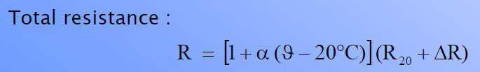
Question 3 dc resistance
An AAC is composed of 37 strands, each having a diameter of 0.333 cm. Compute the dc resistance in ohms per kilometer at 75°C. Assume that the increase in resistance due to spiraling is 2%.
Zero at DC

Slide 12
Question 4
A three-phase 60-Hz line has flat horizontal spacing. The conductors have an outside diameter of 3.28 cm with 12 m between conductors. Determine the capacitive reactance to neutral in ohm-meters and the capacitive reactance of the line in ohms if its length is 200 km. Presume that the distance to ground is much larger than the distance between conductors.

Slide 13
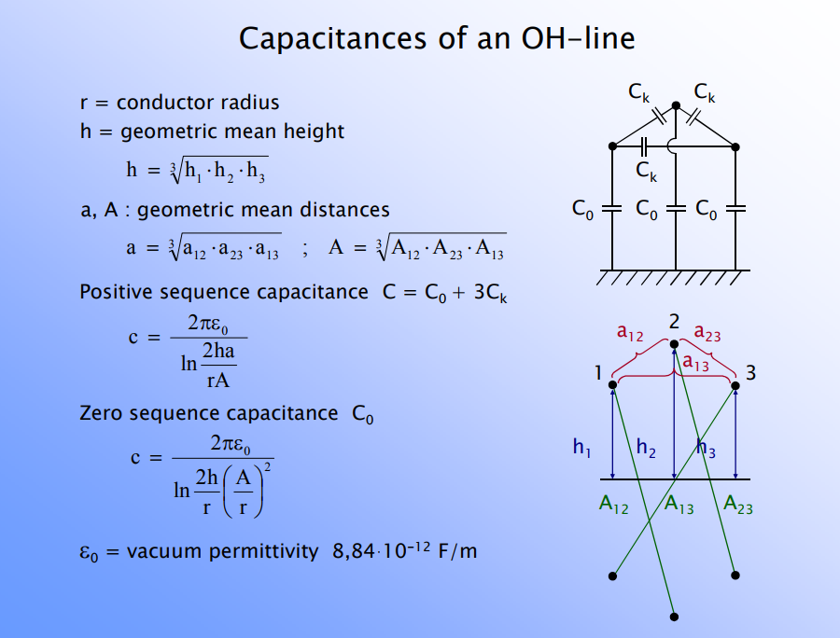
Question 4

Slide 14
Question 4
When the distance to ground (h) is much larger than the distance between
the conductors, the total distances of 2h and A are nearly equal. That is to say:

Slide 15
Question 4
A three-phase 60-Hz line has flat horizontal spacing. The conductors have an outside diameter of 3.28 cm with 12 m between conductors. Determine the capacitive reactance to neutral in ohm-meters and the capacitive reactance of the line in ohms if its length is 200 km. Presume that the distance to ground is much larger than the distance between conductors.
D
D
The line-to-neutral capacitance per meter and capacitive reactance in ohm-meters:

Slide 16
Question 4
A three-phase 60-Hz line has flat horizontal spacing. The conductors have an outside diameter of 3.28 cm with 12 m between conductors. Determine the capacitive reactance to neutral in ohm-meters and the capacitive reactance of the line in ohms if its length is 200 km. Presume that the distance to ground is much larger than the distance between conductors.
Line capacitance and reactance for the 200 km line:

