Slide 1
Exercise Session 4
Power systems

Slide 2
Question 1
Calculate the maximum active power P_{max} that can be transferred from busbar 1 to busbar 2 using the voltages shown in the picture.

Slide 3
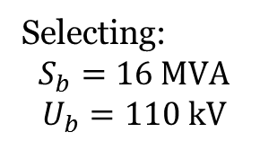
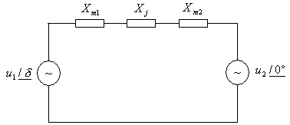
Question 1
The equivalent scheme of the line, using reactances for P.U. computation.
Selecting:
$$S_{b}=16 MVA$$
$$U_{b}=110 kV$$

Slide 4
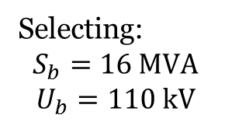
Question 1
Selecting:
$$S_{b}=16 MVA$$
$$U_{b}=110 kV$$

Slide 5
Question 1
Power-angle equation:
The highest power that can be transmitted:
Maximum value when:

Slide 6
Question 2
The power that can be transferred by a line is, usually, limited by the reactive power resources. A line has a series reactance X=100 Ω and the voltage at the beginning of the line is U₁=115 kV. The reactive power at the end of the line is Q₂=0. Derive the expressions for power transferred and reactive power Q₁ as the function of voltage angle δ. How much smaller is the maximum transferred power compared to a case where the necessary reactive power could be fed to the end of the line?

Slide 7
Question 2
Power-angle equation:

Slide 8


Question 2
$sin⁡(2$δ) = 2 sin(δ)cos(δ)
$$\sin^{2}\text{δ}+\cos^{2}\text{δ}=1$$

Slide 9
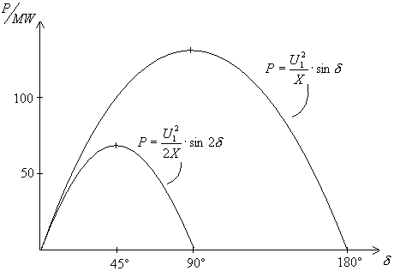
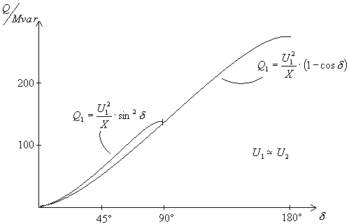
Question 2

Slide 10
Question 3: (for help, see Power System Analysis by Grainger, ch. 16 or other book)
A generator having H = 6.0 MJ/MVA is delivering power of 1.0 per unit to an infinite bus through a purely reactive network when the occurrence of a fault reduces the generator output to zero. The maximum power that could be delivered is 2.5 per unit. When the fault is cleared, the original network conditions again exist. Determine the critical angle and critical clearing time.
Hint: For clearing time, H= Wk/P & Wk = $\frac{1}{2}$J${\text{ω}}^{2}$ if using equation from lecture slides

Slide 11




Question 3: critical clearing angle
P
2.5
$${\text{P}}_{max}$$
A2
Pi
1
A1 = A2, Stability Criterion
A1
$${\text{δ}}_{0}$$
$${\text{δ}}_{cr}$$
$${\text{δ}}_{m}$$
δ

Slide 12




Question 3: critical clearing time
P
2.5
$${\text{P}}_{max}$$
A2
Pi
1
From lecture slides
A1
$${\text{δ}}_{0}$$
$${\text{δ}}_{cr}$$
$${\text{δ}}_{m}$$
δ
Multiply by 4 and
Divide by ω

Slide 13
Question 4
A 60-Hz generator is supplying 60% of P_{max} to an infinite bus through a reactive network. A fault occurs which increases the reactance of the network between the generator internal voltage and the infinite bus by 400%. When the fault is cleared, the maximum power that can be delivered is 80% of the original maximum value. Determine the critical clearing angle for the condition described.

Slide 14
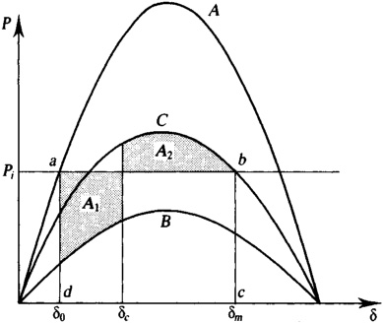

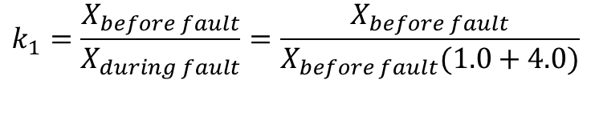
Question 4: (for help, see Power System Analysis by Grainger, ch. 16 or other book)
Power-angle curve A before a fault, B during the fault, and C after the fault such that A = P_{max} sin δ, B =k₁A, and C = k₂A, with k₁ < k₂. For stability, we must have area A₁ = area A₂.
$$k_{1}=\frac{X_{before fault}}{X_{during fault}}=\frac{X_{before fault}}{X_{before fault}(1.0+4.0)}$$
$$k_{2}=\frac{X_{before fault}}{X_{after fault}}$$
Note: picture illustrative - not from the problem

Slide 15
Question 4: Determine the critical clearing angle
In our case:
Before the fault:
During the fault:
After the fault:

Slide 16
Question 4: Determine the critical clearing angle
A = P_{max} sin δ, B =k₁A, and C = k₂A.
For stability, we must have area A₁ = area A₂.

Slide 17
Question 4: Determine the critical clearing angle
Using the previously derived equations:

