Slide 1
Exercise 6
Power systems

Slide 2
Question 1
Derive the following equation
for the voltage drop over a transmission line
Can this equation be applied in all situations?
Draw the phasor diagrams related to the equation
in cases where the reactive power is inductive and capacitive.

Slide 3
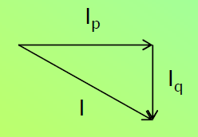
Question 1
Derive the following equation
for the voltage drop over a transmission line
Transmission line is mostly
inductive reactance
Can this equation be applied in all situations?
Draw the phasor diagrams related to the equation
in cases where the reactive power is inductive and capacitive.

Slide 4

Question 1 a) Derive the following equation

Slide 5
Question 1 a) Derive the following equation
The voltage drop is typically considered as the difference between the absolute values of the phase voltage (U1,ph – U2,ph). A good approximate for this can be attained by projecting the voltage phasor with the larger magnitude onto the smaller voltage phasor.
We can approximate that the imaginary part of Uloss is zero (projection onto the smaller voltage phasor with angle of zero).
Also, knowing that
We get:

Slide 6
Question 1 b) Can this equation be applied in all situations
The equation
is only approximate and can be applied in a case with inductive current.
For capacity current, q-component is positive:
The equation in this case is

Slide 7
Question 1 c) Draw the phasor diagrams
Inductive load:
φ
Uphase,1
XI
XIp
δ
“Uloss”
φ
Uphase,2
RI
Iq
I=Iind
RIq
φ
Ip
RIp
XIq
j → 90 deg. Counter-clockwise
Note: the figure is out of perspective

Slide 8
Question 1 c) Draw the phasor diagrams
Capacitive load:
XI
j → 90 deg.
Counter-clockwise
(in contrast to I)
Uphase,1
XIp
Ip
XIq
I=Icap
Iq
RI
RIq
φ
φ
δ
Uphase,2
RIp
Note: the figure is out of perspective

Slide 9
Question 2
Point 1
Point 2
10 MW of active power is transferred using a three-phase line shown in the picture.
Line-to-line voltages in the both ends of the line are 110 kV.
Calculate the power factor (cosϕ) of the load.

Slide 10
Question 2
Point 1
Point 2
10 MW of active power is transferred using a three-phase line shown in the picture.
Line-to-line voltages in the both ends of the line are 110 kV.
Calculate the power factor (cosϕ) of the load.
Uph,1
δ
Uph,2
φ
I

Slide 11
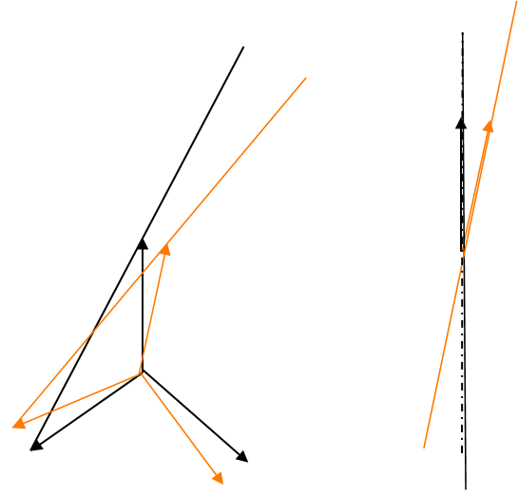
Question 2
δ
Phase voltage at point 1 and point 2
Uphase,1
Uphase,2
Power angle equation for
the three phase system
The voltage amplitudes are now kept constant with voltage control: Uphase,1 = Uphase,2
The angle difference (power angle) between the voltages is:

Slide 12
Question 2
Calculate the power factor of the load.
To calculate the power factor of the load, we need to know
Pload and Qload.
Now, the resistive losses are neglected:
P1=P2=Pload=P
In order to keep the voltage level constant, a certain amount of
reactive power has to flow into the line from
point 2 and the shunt capacitance
P→
P→
Q1→
Q2→
Qload→
Qc/2→
Reactive power angle equation for
the three phase system (between voltage U1 and U2
with a reactance between)
and reactive power produced
by shunt capacitance (lecture 6):

Slide 13
Question 2
Calculate the power factor of the load.
S
φ
Q
P
Another way:
Uphase,1
Uphase,2
Ix→
I→
Ic→

Slide 14
Question 3
A turbine generator is delivering 20MW at 50Hz to a local load;
it is not connected to the grid.
The load suddenly drops to 15MW;
and the turbine governor starts to close the steam valve after a delay of 0.5s.
The stored energy in the rotating parts is 80MJ at 3000rev/min. What is the generated frequency at the end of the 0.5s delay?

Slide 15

Question 3
A turbine generator is delivering 20MW at 50Hz to a local load;
it is not connected to the grid.
The load suddenly drops to 15MW;
and the turbine governor starts to close the steam valve after a delay of 0.5s.
The stored energy in the rotating parts is 80MJ at 3000rev/min. What is the generated frequency at the end of the 0.5s delay?

Slide 16
Question 3
What is the generated frequency at the end of the 0.5s delay?
Generated steady-state power = 20 MW.
Power usage drops to 15 MW.
Excess power of 20-15 = 5 MW accelerates the generator (frequency is increased)
Rotational energy is thus increased by:
Rotational energy now:

Slide 17
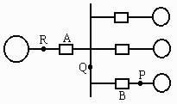
Question 4
A 625-kVA 2.4 kV generator with X”_{d} = 0.20 per unit is connected to a bus through a circuit breaker, as shown in the figure below. Connected through circuit breakers to the same bus are three synchronous motors rated 250 hp, 2.4 kV, 1.0 power factor, 90% efficiency, with X”_{d} = 0.20 per unit. The motors are operating at full load, unity power factor, and rated voltage, with the load equally divided among the machines.
For interrupting current, presume that transient reactance for the synchronous motors is 1.5 times the subtransient reactance. For the generator, apply the subtransient reactance.
(a) Draw the impedance diagram with the impedances marked in per unit on a base of 625 kVA, 2.4 kV.
(b) Find the symmetrical short-circuit current in amperes, which must be interrupted by breakers A and B for a three-phase fault at point Q. Simplify the calculations by neglecting the pre-fault current.
(c) Repeat part (b) for a three-phase fault at point P.

Slide 18
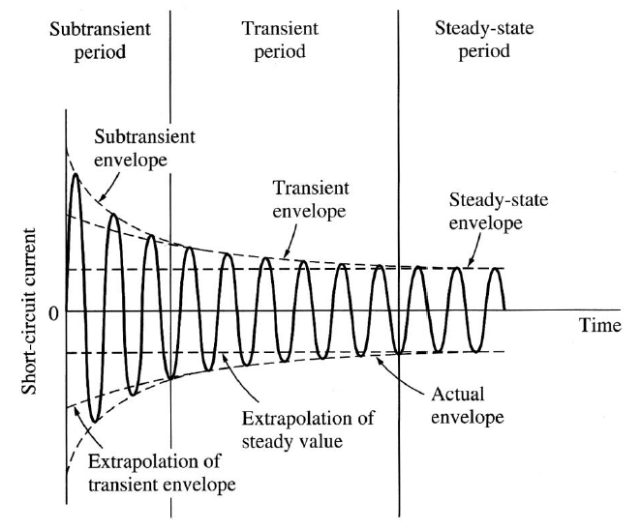
Question 4
General thoughts
Circuit breakers typically become active around 100ms after the fault. This equals around 5 cycles (50Hz → 20ms per cycle). In this case, we are in a transient state rather than in the substransient state.
breaker
http://www.egr.unlv.edu/~eebag/Fault%20Analysis.pdf

Slide 19
Question 4
(a) Draw the impedance diagram marked in per unit on a base of 625kVA, 2.4kV.
Base of 625kVA.
Motors: Output 250hp, 2.4kV, 1.0 power factor, 90% efficiency.
Motor input:
Motor subtransient
reactance:
Motor reactance in transient state:
S=207.22kVA
Ub=2.4kV
Sb=625kVA

Slide 20
Question 4 b)
Let’s calculate the transient current in Q using the Thevenin’s theorem
Any possible fault occurs between the generator and the motors.
One phase diagram (one generator, three motors):
Zth=?
Zg=j0.2
3 of Zm=x’m=j0.905
Z
th
U
If’
f

Slide 21
Question 4 b
Let’s calculate the transient current in Q (symmetrical short-circuit current) using the Thevenin’s theorem
We can calculate the value of base current and absolute value of transient current:
Sb=625kVA
Ub=2.4kV
This is current in
Fault location Q
Current of breaker A:
I’f
Ig
Im
⬄ 752A
Current of breaker B:
Zg=j0.2
Zmotors=j0.302
⬄ 1.105*150.35A=166A

Slide 22
Question 4 c) b) fault at point P
Fault at P:
Currents to be interrupted:
In this case breaker A carries the current fed by generator as in b)
Breaker B carries currents of generator and the other two motors
A
B
Im
A
B
Ig
Im
Im
Ig+2Im
Im

