Slide 1
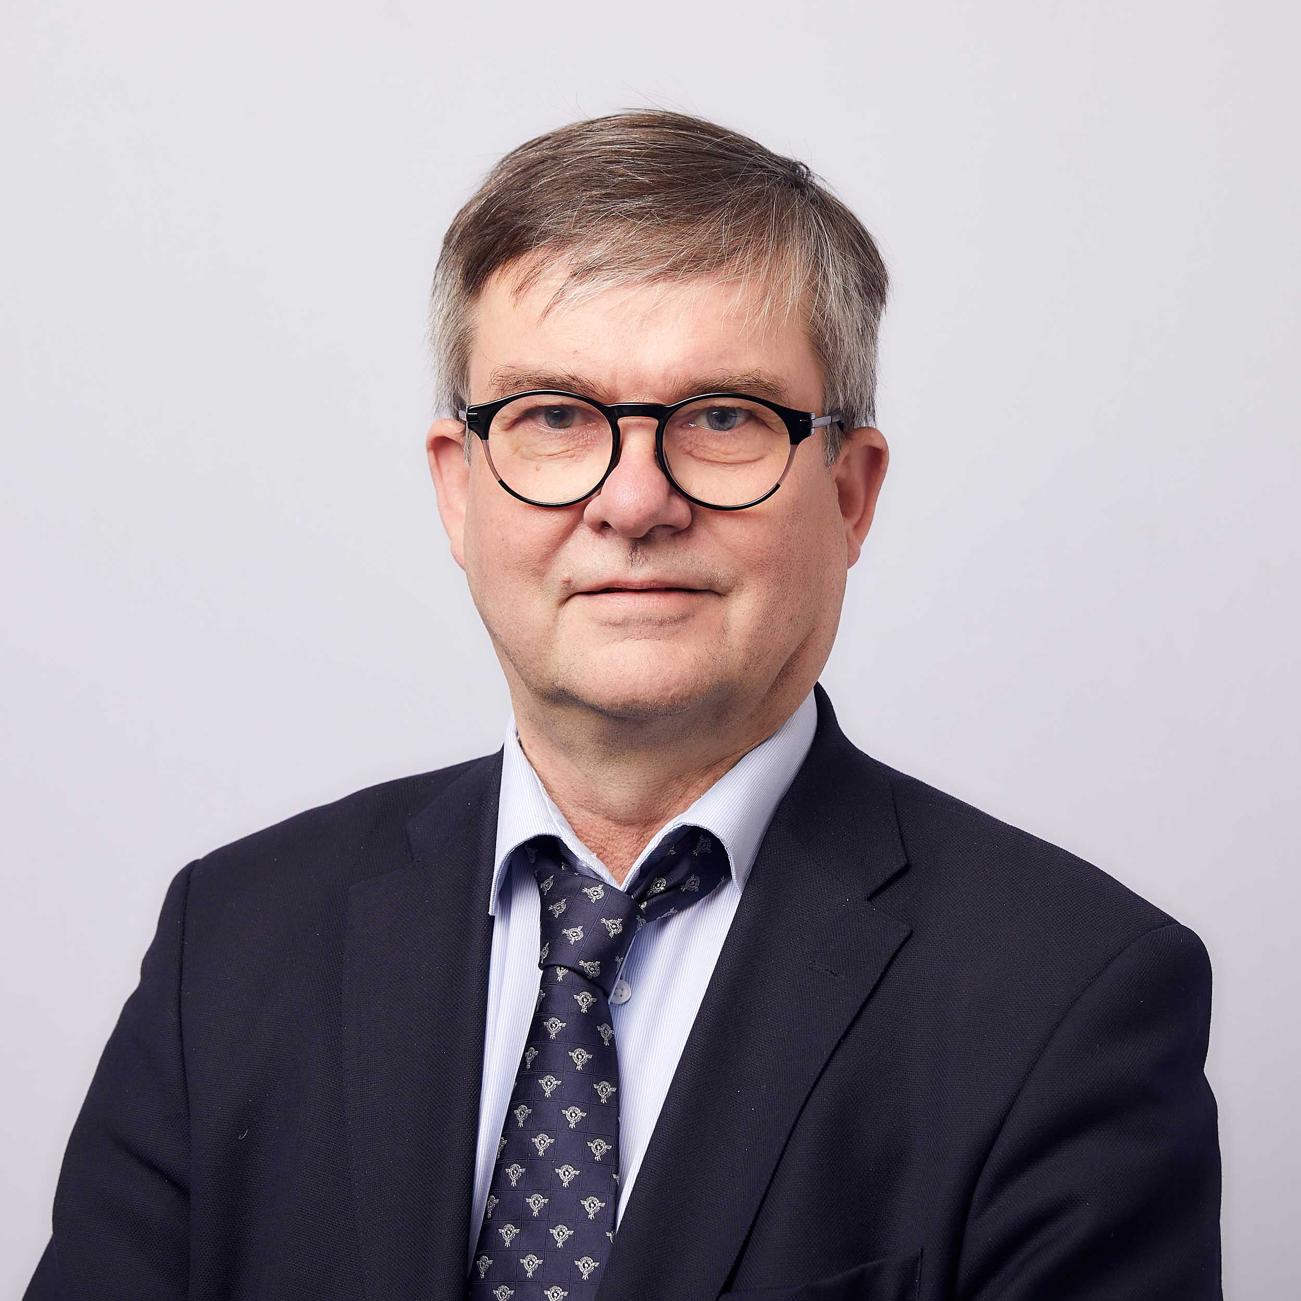
Thesis supervisor topic areas in SCM
Professor Markku Kuula
−Manufacturing management and manufacturing business operations
−Benchmarking
−Supply chain management (SCM) and sustainable SCM,
Blockchains
-Digital Transport and Logistics Eco-System
−Also other topics eg. Negotiation problems, simulation and
optimization related problems

Slide 2
Thesis supervisor topic areas in SCM
Associate Professor Katri Kauppi
−Purchasing/procurement/sourcing related topics
−Public procurement
−Sustainability in supply chains
- Information issues in supply chains
- Climate change & SCM
- Many other SCM / operations management topics as well
- Can supervise different methods:
Qualitative (case studies, interviews)
Quantitative (surveys and basic statistics approaches)
Systematic literature reviews and bibliometric studies

Slide 3
Thesis supervisor topic areas in SCM
Assistant professor Max Finne
Inter-organizational collaboration in supply chains
The role of technologies in service operations
Management of service networks
Servitization of manufacturing / Industry 4.0
Innovative pedagogies in Logistics education
Sustainable supply chains and operations

Slide 4
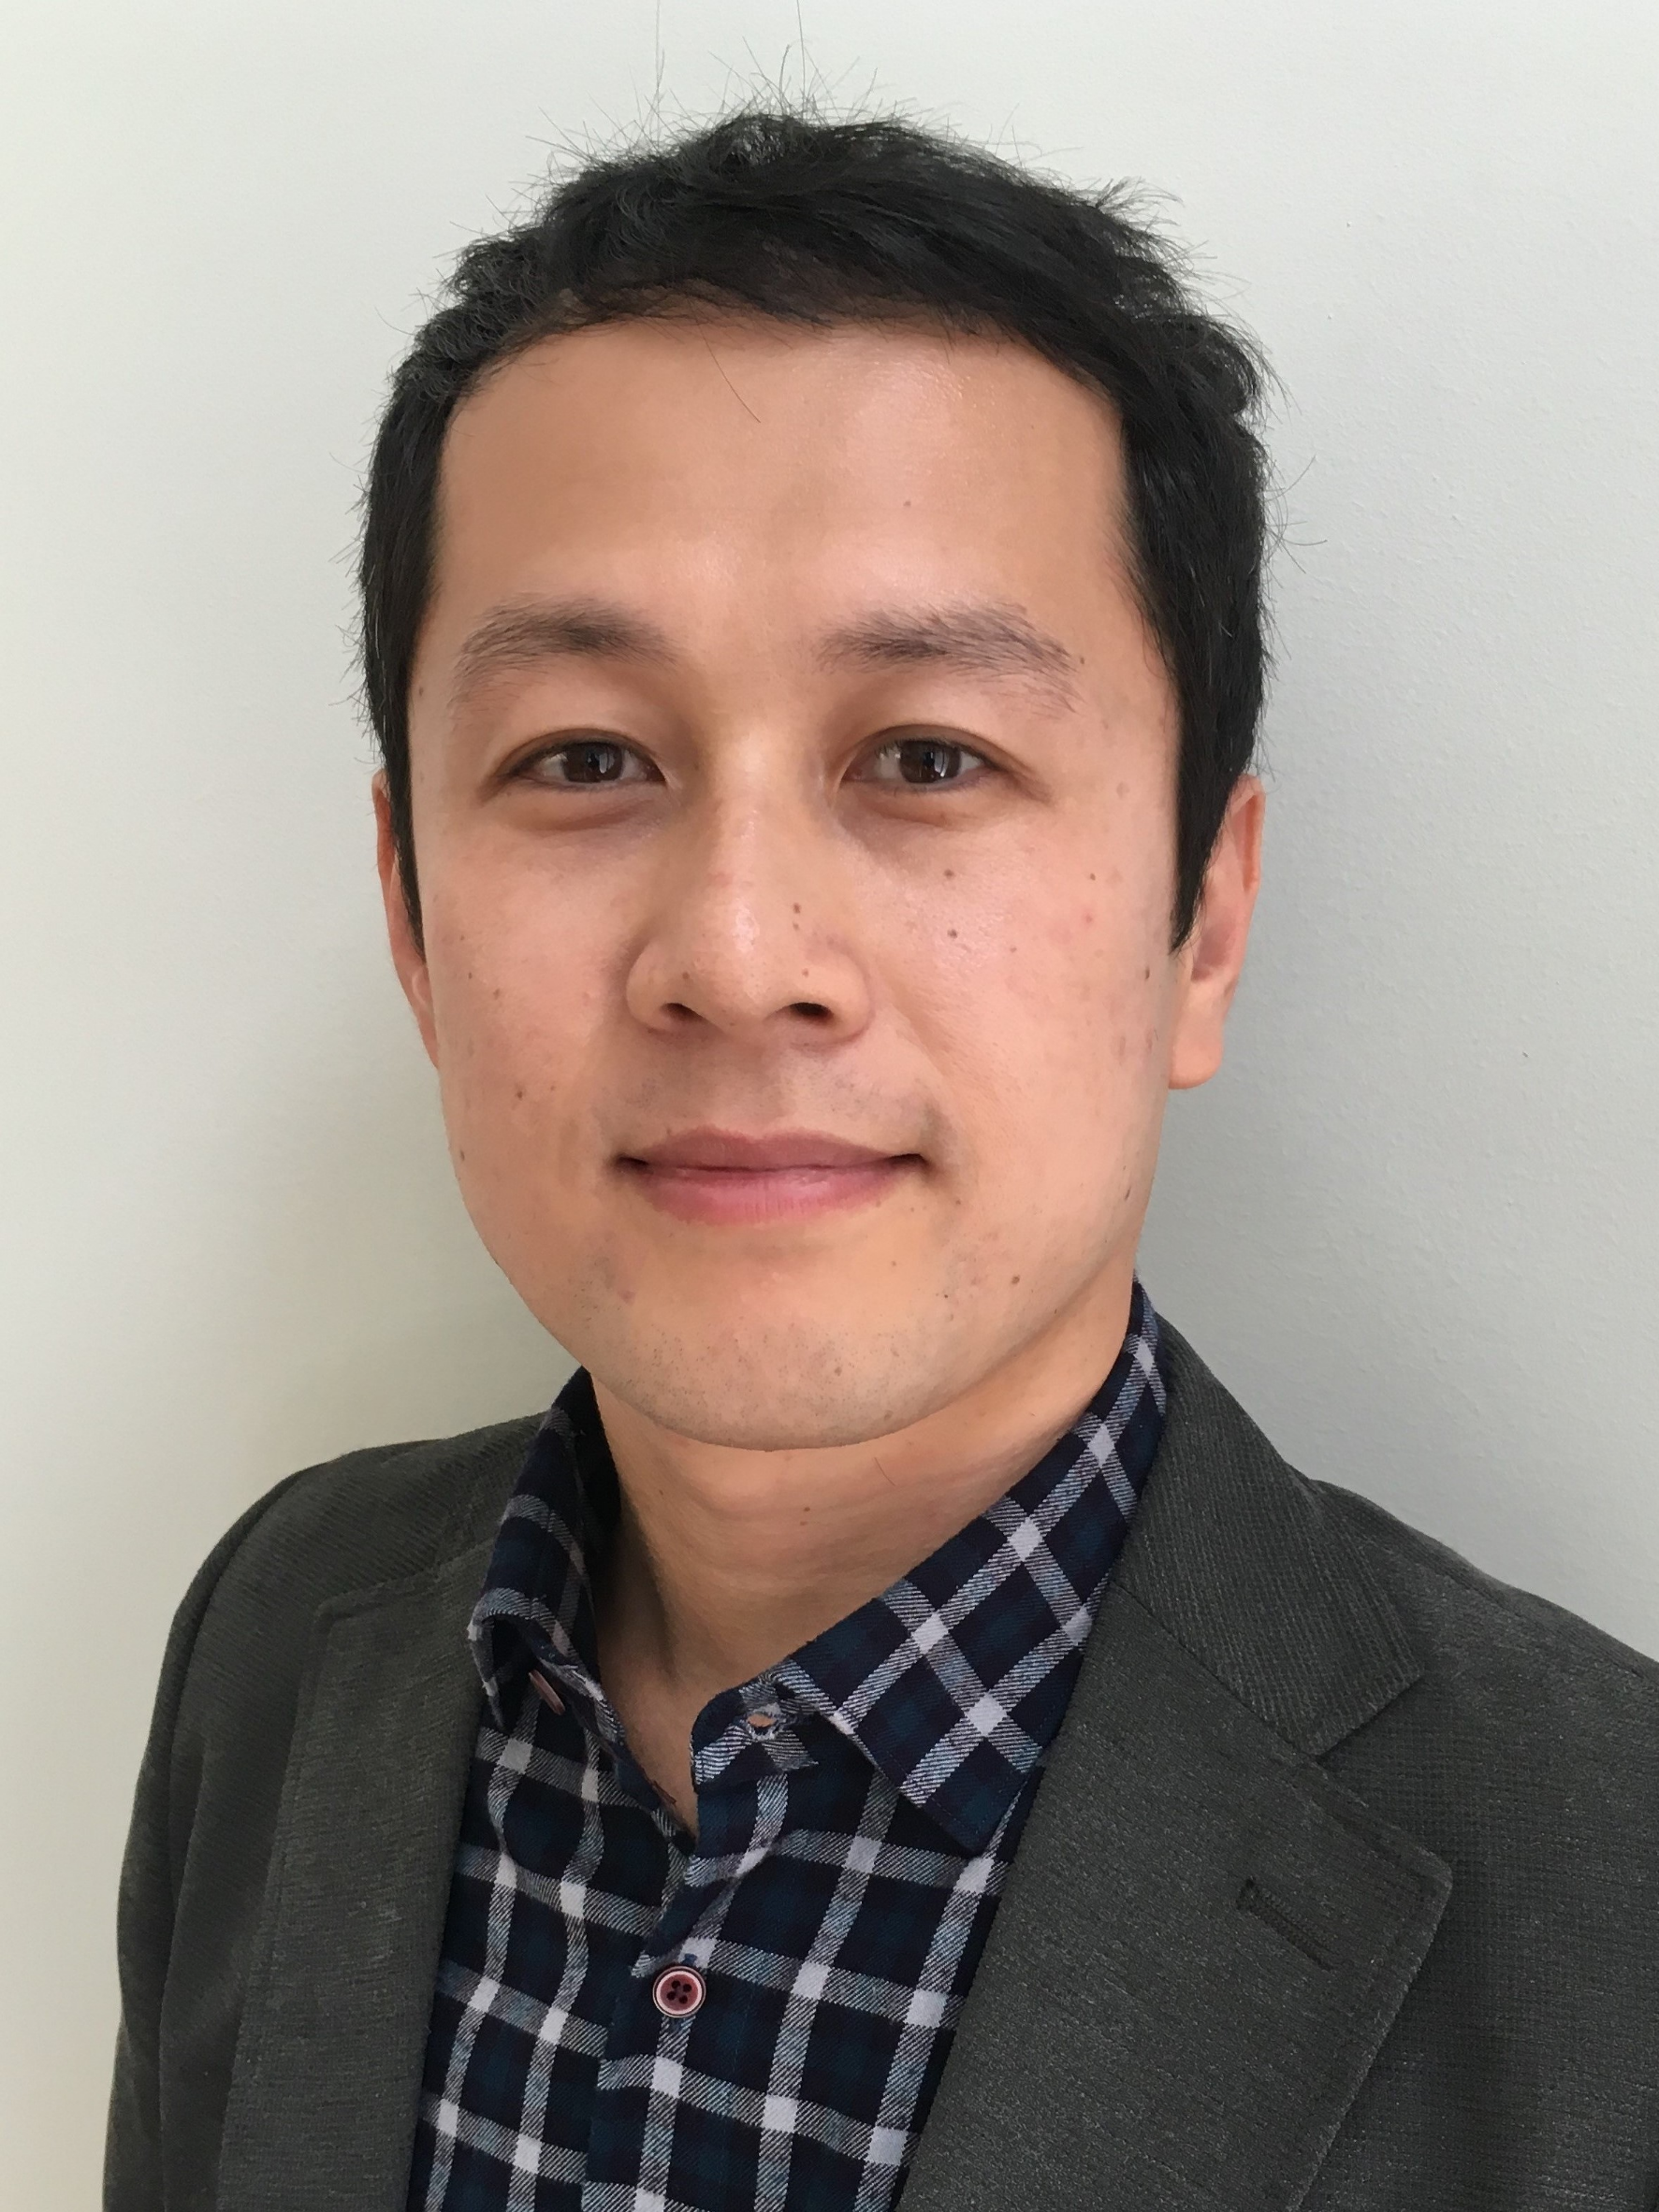
Thesis supervisor topic areas in SCM
Assistant professor Seongtae Kim
−Supply chain sustainability/ethics
−Supply chain risk and disruptions
−Complex supply networks
−Digital supply chains/logistics
−Econometric analyses particularly:
Event studies
Panel data analysis
Network analysis

Slide 5
Thesis supervisor topic areas in SCM
Postdoctoral researcher Reza Movarrei
- Behavioral/ psychological studies in SCM
- Human-computer interactions in SCM (e.g. in automated deliveries)
- Purchasing/ procurement and B2B Marketing
- Promoting products through (green, sustainable, etc.) supply chains
Other SCM topics using:
- Field/ lab/ online experiments
- Quantitative methods like regression, SEM, PCA, etc.

