Slide 1
Business Analytics

Slide 2
BA topics and supervisor specialization areas
Note that every supervisor supervises a wide range of topics, also other than mentioned in the slides
We also assist you to find a suitable topic

Slide 3
Available master thesis topics for BA
Pekka Malo
machine learning
predictive analytics and forecasting
data mining, text mining
computational statistics
applied optimization

Slide 4
Available master thesis topics for BA
Juuso Liesiö
Decision analysis
Multi-criteria / multi-objective decision making
Optimization and Mixed-integer linear programming
Risk analysis
Scenario methods
Stochastic dominance
Behavioral decision theory
Application areas: portfolio selection and management (R&D projects, products, financial assets), environmental decision making, supply chain management

Slide 5
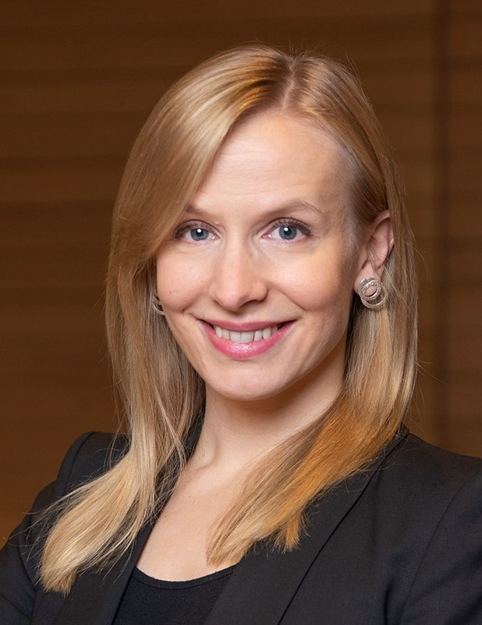
Available master thesis topics for BA
Eeva Vilkkumaa
Decision analysis
Multi-criteria / multi-objective decision making
Resource allocation
Scenario planning
Behavioral decision theory
Application areas: Strategy development, healthcare decision-making

Slide 6
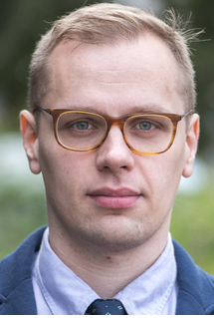
Available master thesis topics for BA
Ilkka Leppänen
Behavioural decision making
Decision theory and game theory
Computational modelling of decision making
Multi-criteria decision making and value focused thinking
Application areas: retail operations, logistics, platforms, marketing

Slide 7
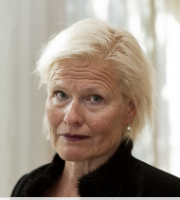
Available master thesis topics for BA
Merja Halme
Advanced surveys (multi-item measures/constructs)
typical areas: sustainability views of different services
Preference measurement
Marketing applications, especially pricing
Values, attitudes, sustainable development
Also qualitative work

Slide 8
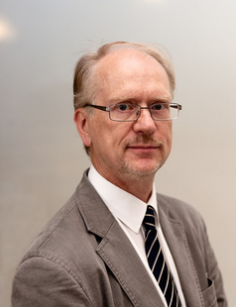
Available master thesis topics for BA
Tomi Seppälä
Statistics and Data Analytics
Simulation and Probability, Risk analysis
Finance and Accounting (e.g. investments) applications
Transportation, Marketing, International business applications
Quality Management, esp. Statistical Quality Control
Biometrics and Medicine applications
Sports and Games applications
Education studies

Slide 9
Available master thesis topics for BA
Markku Kallio (emeritus)
Finance, Asset valuation, Portfolio optimization, Mitigation of financial crises, Stochastic dominance, Investment risk management, Real options (real investment valuation), Asset-liability management
Optimization theory and applications, Multi criteria optimization,
Performance evaluation (DEA and extensions)
Equilibrium theory and applications

Slide 10
Available master thesis topics for BA
Jyrki Wallenius (emeritus)
Behavioral decision theory
Decision support and negotiation analytics
Online auctions
Crowdsourcing

Slide 11
Available master thesis topics for BA
Panu Erästö
Statistical/bayesian modeling
General statistics and Data Analytics
Transmission models
Epidemiology and health economics
Computational statistics
Visualization
Pedagogical research

