Slide 1
Scarcity and Choice
Lecture 2
Juuso Välimäki
Sep 6, 2023

Slide 2
Main topic: Choice under Scarcity
Example 1:How much to work?
Trading off leisure for fruits of labor
How many hours to work on a family farm?
Studying for an exam
Full-time or part time job?
Example 2: Saving for retirement
Trading off consumption now for consumption later
Example 3: How big a house should I buy?
Example 4: Should I take Principles of Economics I as an elective?

Slide 3
Feasible Choices
Which choices are possible or feasible?
More work implies more income (and thus higher consumption) but less leisure
Buying a bigger house leaves less money for other consumption
If you take Principles I you cannot take another course as elective
Key task is then to find a way to describe the possible choices

Slide 4
Preferences
How do you rank alternative choices?
Would you prefer to buy an ice cream cone for 4 EUR to not buying it?
How much more would you pay for a house with one more room?
Which do you like more: Principles of Economics I or Principles of Accounting?
Second key task is to find a way to describe preferences

Slide 5
Roadmap for Lectures 2 and 3
Analysis of choice behavior
Feasible sets and indifference curves
Changing feasible sets: comparative statics
Income effect and substitution effect
Measuring the effect of price changes
Consumer price index and inflation
Evaluating welfare policies
A first look at universal income

Slide 6
Trade-off between work and leisure: How long days to work on a family farm?
If you only work for one hour per day, you will cultivate the most fertile part of
your farm.
If you work for two hours, you get more output, but not quite twice as much since the new part is not as fertile.
If you work for three hours, output increases again, but by less than in the previous step.
Similarly for all additional hours (actually, output probably declines for working hours above 18 per day).
We have an instance of diminishing marginal product of labor on the farm.

Slide 7
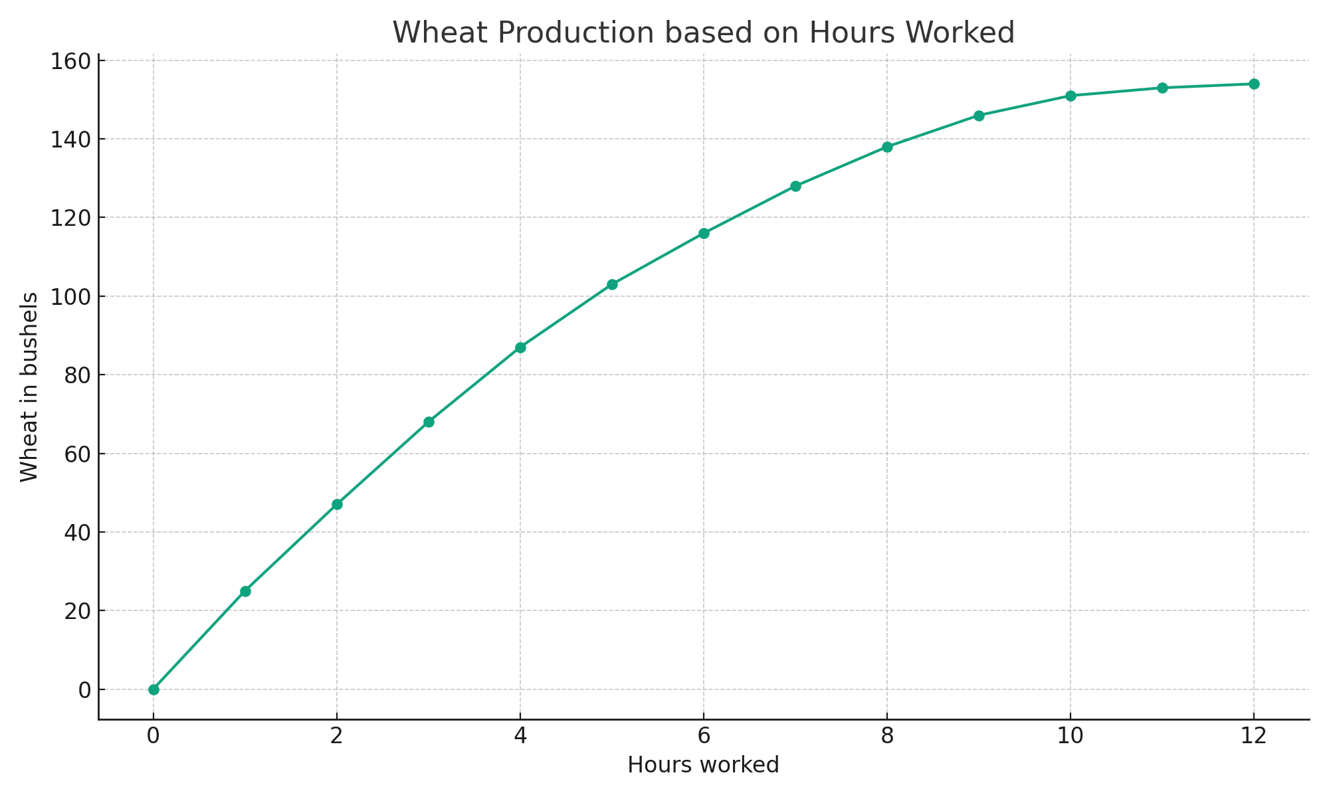
Production of wheat
Hours worked | Wheat in bushels
0 | 0
1 | 25
2 | 47
3 | 68
4 | 87
5 | 103
6 | 116
7 | 128
8 | 138
9 | 146
10 | 151
11 | 153
12 | 154
Feasible points (with linear interpolation):

Slide 8
Marginal product of labor (by the hour)
Hours worked | Marginal product by th hour
0 | 0
1 | 25
2 | 22
3 | 21
4 | 19
5 | 16
6 | 13
7 | 12
8 | 10
9 | 8
10 | 5
11 | 2
12 | 1
Same in graphical form:

Slide 9
Marginal product and the production function
Marginal product measures the (small) increase in output that results from a small increase in the input.
How can you picture this in the graph of the production function?
The slope of the tangent to the production function.
Decreasing marginal product corresponds to a concave shape of the production function.
Average product is the output of wheat divided by number of hours worked.
With decreasing marginal product, average product is above marginal product.

Slide 10
Marginal product and the production function

Slide 11
Feasible options in leisure-wheat coordinates
Since Leisure hours = 24 – working hours, we can draw the feasible frontier in (leisure, wheat) coordinates
The absolute value of the slope of the tangent to the feasible frontier is called the marginal rate of transformation (MRT). It tells how many bushels of wheat you lose (gain) if you increase (decrease) your free time by a small bit.
Inefficient

Slide 12
Preferences and Indifference Curves
Compare two alternatives:
16 hours of leisure (i.e. 8 hours of work) and 100 bushels of wheat
17 hours of leisure and 90 bushels of wheat
View the options as points in a coordinate system where leisure is on
the horizontal axis and wheat is on the vertical axis
Different points in the plane correspond to different combinations of wheat and leisure
How to picture preferences in this plane?

Slide 13
An indifference curve through point (16,100) in the plane gives all combinations (x,y) that are equally good as (16,100)
Since a more wheat is preferred to less wheat and since more leisure is preferred to less leisure, (x,y) and (16,100) cannot be on the same indifference curve if x>16 and y>100 (or x<16 and y<100).
This means that indifference curves are downward sloping
We call the absolute value of the slope of an indifference curve the Marginal Rate of Substitution (MRS)
The MRS measures how much more wheat you need to give up a (small) unit of leisure or alternatively how much wheat you are willing to lose to get an additional (small) unit of leisure

Slide 14
Indifference Curves: An Example
Better than points on IC

Slide 15
How to think about indifference curves?
Indifference curves are individual and subjective:
There are no right or wrong indifference curves
Two decision makers have generally different shapes for their indifference curves: some people enjoy leisure more while some appreciate wheat more
This is just one instance of choice under scarcity
Time is scarce so you manage carefully your time budget
But other resources are scarce too: choosing how to use a fixed budget on food or clothing, or more concretely between apples and oranges

Slide 16
Indifference curves 1
Wheat
Increasing preference
IC₃ IC₂
IC₁
0
Leisure
Figure: Indifference curves of a family farmer

Slide 17
Indifference curves 2
Wheat
IC₁
IC₂
IC₃
Increasing preference
0 Leisure
Figure: Indifference curves of another farmer

Slide 18
Indifference curves 3
Wheat
IC₁
IC₃
0
Leisure
Figure: Is this possible?

Slide 19
Summary on Indifference Curves
If we plot an indifference curve in the usual coordinate system and if the decision maker wants to have more of each good, indifference curves have a negative slope
Indifference curves do not cross each other
Curves closer to origin represent worse alternatives than curves further from the origin
Can indifference curves be straight lines?
Can indifference curves have an L-shape?
Why are the indifference curves often drawn with a diminishing slope as we increase the amount of good on x-axis?
Can you relate this to preferences for averages over extremes?

Slide 20
Constrained choice problem
 | Trade-off | On diagram | Equivalently
MRS | Amount of wheat needed in to agree to give up (a small amount of) leisure | Absolute value of the Slope of an indifference curve
MRT, opportunity cost of leisure | Amount of wheat obtained by giving up (a small amount of) leisure | Absolute value of the slope of the feasible frontier | Marginal product of labor
Model of how individuals choose:
Choices must be from feasible options given by feasible frontier
Choices reflect preferences given by indifference curves

Slide 21
Optimal Decision Making
How to find optimal choices? Start by looking at points on the feasible frontier. Each point has an indifference curve through it. Can you find a preferable feasible point?
If MRS is larger than MRT as at point D in the figure, you should work less (i.e. have more leisure).
If MRS is smaller than MRT (as at C), you should work more.
At A, MRS=MRT and 16 hours for 138 bushels of wheat is the optimal choice.
B is unfortunately not feasible.
Can you make this formal?

Slide 22
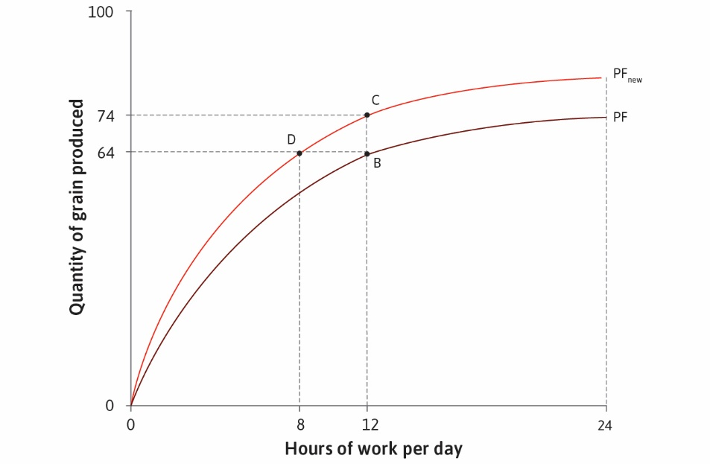
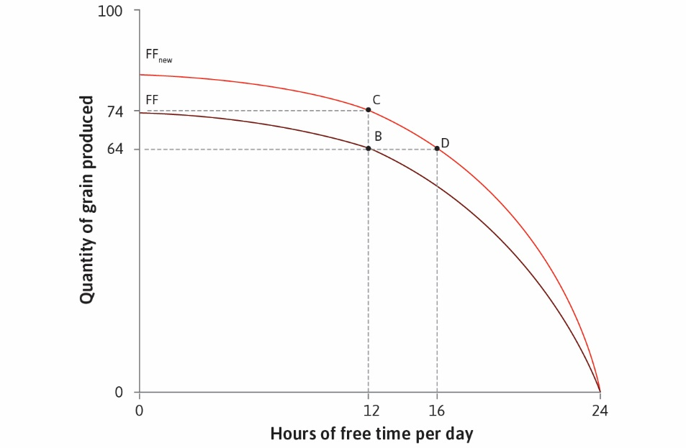
Comparative statics: A new fertilizer
Technological change shifts the production function upwards, and expands the feasible frontier.
How does this impact optimal choice of working hours?

Slide 23
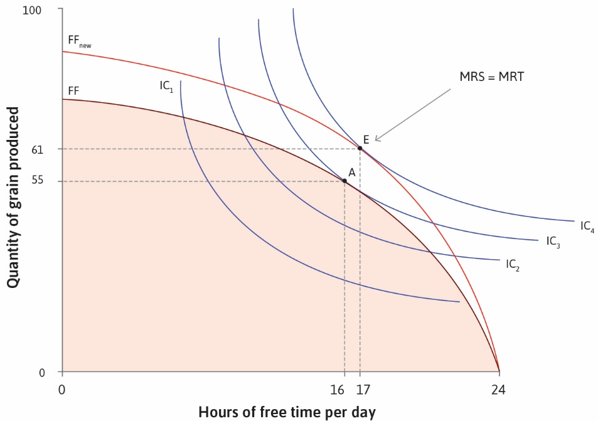
Comparative statics: feasible frontier changes
Technological progress makes it feasible to both consume more wheat and have more free time.
Choice of free time/consumption depends on relative preferences and willingness to substitute one good for another.
Can you say for sure if technological progress leads to more grain production? More leisure?
More on this in Lecture 3.

Slide 24
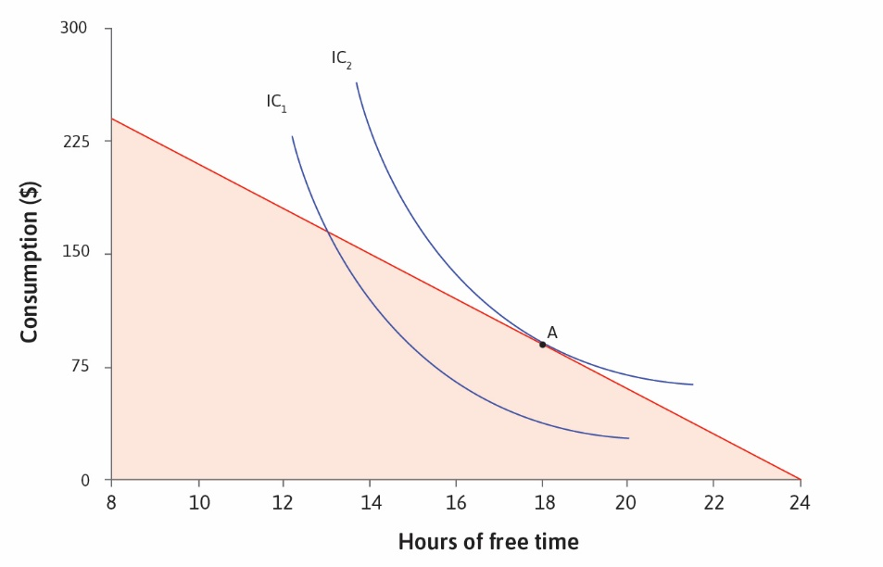
Working for wages
Feasible set given by Budget Constraint: consumption no larger than labor income. Feasible frontier is given by the budget constraint.
Indifference curves demonstrate preferences over consumption and free time

Slide 25
Budget allocation between food and shelter
Food F can be purchased at price P_{F}
Shelter S can be purcased at price P_{S}
Total income I
Budget constraint: P_{F}F + P_{S}S ≤ I.
Food
bMewpeip
IC
I/P_{F}
MRT:
By giving up
a small unit of S,
you can buy P_{S} /P_{F}
units of F.
MRS=MRT
MRT=-P_{S} /P_{F} =-slope of budget line
I/P_{S}
Shelter

Slide 26
Other examples
We can think of choice under scarcity in a number of other examples:
Saving for retirement
Consumption when young and consumption when old on the axis
Budget set depends on saving and borrowing possibilities
Any ideas for the shape of the indifference curves?
More general budget allocation problems
Many goods with different prices (or savings over many periods of life)
Cannot be represented in a two-dimensional picture
You will learn how to deal with such problems
Main message remains the same: At optimum, MRS=MRT
In problem set 1, you will get practice on different choice problems

Slide 27
Key ideas and concepts in this lecture
Feasible frontier, production function, budget set
Marginal rate of transformation, marginal product of labor, price ratio
Indifference curves, marginal rate of substitution
Opportunity cost
Feasible set
Optimal choice from feasible set

Slide 28
Next lecture
Changes in the feasible set:
changes in wealth
changes in prices
changes in technology
Income and substitution effects
Applications of the model:
Measuring the effect of changing prices
Social welfare schemes and the choice of working hours

