Slide 1
Algorithms
Technical
Sociological
Computational process, which based on input solves a well-defined problem and produces an outcome (Cormen et al., 2009).
Algorithm is an opinion written in code (O’Neil, 2016)
﻿Algorithms play an increasingly important role in selecting what information is considered most relevant to us, a crucial feature of our participation in public life. (Gillespie, 2014)
﻿﻿Using the fetish as a heuristic, we can lay out the steps by which people vest algorithms algorithms with promises and possibilities that extend beyond what the math, lines of code, steps or ingested sensors can do. (Thomas et al., 2018)

Slide 2
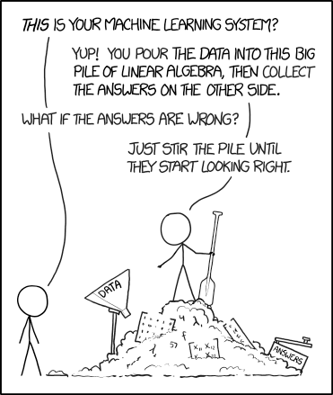
Algorithmic systems

Slide 3
Algorithmic systems
Humans
Humans
Tool
Data

Slide 4
Algorithmic systems
Assemblage of institutionally situated computational
code, human practices, and normative logics that creates, sustains, and signifies relationships among people and data through minimally observable,
semiautonomous action.
Humans
Humans
Tool
Data
Ananny, M. (2016). Toward an Ethics of Algorithms. Science, Technology, & Human Values, 41(1), 93–117. https://doi.org/10.1177/0162243915606523

Slide 6
