Slide 1
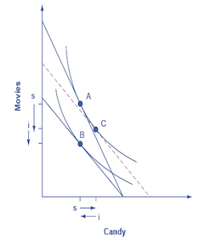
Scarcity and Choice:
Income and Substitution Effects
Lecture 3
Juuso Välimäki
Sep 12, 2023

Slide 2
This lecture: choice with changing prices?
How to decide working hours?
Do wealthier people work more?
  Inherited wealth or income from higher wages?
  Income and substitution effects
  Backward bending labor supply
  Empirical evidence
Real world issues
What does actual disposable income look like?
  Income across countries and time
  Taxes, subsidies and basic income
Measuring the effect of price changes
  Price indices and CPI

Slide 3
Working for wages
After graduating Ann starts working for a wage
  Assume first a wage of 15€/h, but jobs differ according to working hours so any length of a working day is available
  She chooses between earnings (market consumption) and free time
  Budget constraint: the set of affordable combinations of consumption and free time
    An hour less of free time<-> 15€ more of consumption
    Notice that wage per hour does not depend on working hours (no bonus for overtime)
  Preferences: Ann likes consumption and free time

Slide 4
Choice between consumption and free time
Ann chooses the point on the highest indifference curve within her budget set (feasible set), point A
What is her marginal rate of substitution (MRS) at point A? How do you know this?
A
Budget constraint: c = w(24-t)
c = consumption
w = wages (15€/h)
t = free time
Slope of the budget line: c’(t) = -w = -15

Slide 5
Income effect
Ann’s uncle gives Ann an allowance of 50€ per day.
Her budget line moves up but its slope is unchanged since the wage did not change.
Can you draw an example of another worker whose original
choice is at A, but who works for longer hours after the allowance?
B
A
Normal good: consumption increases as income rises
Inferior good: consumption decreases as income rises

Slide 6
Wage increase
What happens if Ann gets a raise?
Slope of budget line = wage
  Higher wage <->
  Steeper budget line <->
  More expensive free time, but effectively richer Ann
Under the new budget constraint, Ann works more (for these indifference curves)
B
This conclusion is not general. Because Ann becomes richer, she could also consume more leisure (if leisure is a normal good)
A

Slide 7
Bigger raise in wages
C
B
Now Ann chooses C. How is it possible that raising wages induces less work?
A

Slide 8
Income and substitution effetcs
1. Income effect: If Ann does not change her working hours she is effectively richer since she can consume more
We can demonstrate this by asking what Ann would do if her uncle gave her enough to money to reach the indifference curve after the wage increase (but at old wages). Recall the case from before.
B
D
A
Income effect

Slide 9
Income and substitution effects
2. Substitution effect: The opportunity cost of free time is higher when wages are higher
Higher wage <-> an hour more of free time leads to a higher reduction in other consumption
Substitution effect = difference between D and B in the figure
B
Here the substitution effect dominates the income effect. In the previous picture an even higher wage resulted in choice of point C where income effect dominates.
D
A
substitution effect

Slide 10
Restricted choice set
Consider now the case where Ann cannot adjust ner hours freely. She can choose to work at 15€/h full-time(8h) or half-day(4h) or not to work at all.
Her choice set then consists of just three points
How would Ann choose here? What if she could adjust working hours more flexibly?

Slide 11
Restricted choice set
Consider again the case where Ann’s uncle gives her an allowance of 50€/day.
With more wealth, she chooses part time work instead of full time.
This more realistic model yields the same conclusions but hides the mechanics of optimal choice that are based on comparison of the opportunity costs and marginal rates of substitution
Sometimes a less realistic model can allow for a clearer view of the problem at hand.

Slide 12
Is this a good model?
Is it realistic, is it relevant?
  Conceptual separation of feasible choices and preferences
  But who thinks about indifference curves when choosing work?
  Does this really matter if you behave as if you chose a point on the highest indifference curve?
  What about non-wage effects of work (to earn a promotion, to earning a reputation as a hard worker, to conform to social norm etc.)
  What about labor force participation decisions
Two ways to judge the merits of a model
  Does it give rise to a meaningful though experiment? Do we gain in understanding the tradeoffs when we assume adjustable hours?
  Can we test at least some of its implications empirically?

Slide 13
Empirical testing of causal effects
A testable implications: leisure as a normal good
  less time spent working if non-labor income is increased
An example of a causal relation
  non-labor income causes a reduction in hours
  includes a comparison to a counterfactual state of affairs: since Ann either gets more income or not, one of these cases is not observable
measured in data
real case :
(Ann has the generous uncle):
Ann’s true working hours
vs.
counterfactual:
Ann’s hours if she did not receive the transfer
estimated
(typically using a control group)

Slide 14
Measuring causal effects: bad choices
Compare Ann before and after allowance
  challenge: the world changes all the time in many different ways
    e.g if Ann gets the allowance at the onset of a recession, she could change her hours due to business cycle and not the non-labor allowance.
    the world is so complicated that we cannot account for everything
    Not a good idea to base conclusions on a single observation: how to get data on a significant number of recipients?
Compare the hours between rich and poor families
  empirical challenge: rich and poor families may differ along many dimensions
    e.g. rich have better education, they may be more connected, they may be able to bear risk better etc.
    credibility revolution in empirical economics
    see for example https://www.aeaweb.org/articles?id=10.1257/jep.24.2.3

Slide 15
An example of a natural experiment: Swedish lottery winners
Treatment group
  Ca. 200 000 Swedes that participated in official lotteries in 1980’s and 1990’s. 1 470 winners of more than 1M SEK (about 100,000 EUR).
Control group
  those who participated but did not win
    not credible to compare winners to general population (why?)
Data
  anonymized register data on winners from tax authorities, data from occupational sources etc.
    similar data available in Finland (not similar lottery though)
  possible to observe individuals also over time
Source: Cesarini, Lindqvist, Notowidigdo, Östling (2017): The Effect of Wealth on Individual and Household Labor Supply: Evidence from Swedish Lotteries. American Economic Review, 107 (12): 3917-46. http://faculty.wcas.northwestern.edu/noto/research/CLNO%20Labor%20Supply.pdf

Slide 16
Winning reduces wage income (by a bit)
Equal earnings for winners and non-winners before the winnings
After winning in lottery, working hours decline
Small effect (100 000 SEK winnings reduces yearly earnings by 1000 SEK)
95% confidence interval
Source: Cesarini, Lindqvist, Notowidigdo, Östling (2017): The Effect of Wealth on Individual and Household Labor Supply: Evidence from Swedish Lotteries. American Economic Review, 107 (12): 3917-46. http://faculty.wcas.northwestern.edu/noto/research/CLNO%20Labor%20Supply.pdf

Slide 17
Taxes, transfers and basic income

Slide 18
Taxes in Finland, 2015
Source: Viitamäki (2015): Työnteon kannustimet – mitä jää käteen? VATT-muistio 50.

Slide 19
Taxes and transfers, 2015
Living alone, rent 440 €/kk
Lähde: Viitamäki (2015): Työnteon kannustimet – mitä jää käteen? VATT-muistio 50.

Slide 20
Taxes and transfers in Finland, 2015
Single parent, one child (2y.), rent 660 €/month
rent subsidy
labor market subsidy
Source: Viitamäki (2015): Työnteon kannustimet – mitä jää käteen? VATT-muistio 50.
Source: Viitamäki (2015): Työnteon kannustimet – mitä jää käteen? VATT-muistio 50.

Slide 21
Taxes and transfers
Scandinavian welfare states (and many other societies) have chosen to provide basic services to those outside regular work
  To guarantee adequate material living standards to the sick, old and other individuals that cannot participate in labor force
    in Principles II, a deeper look into reasons for unemployment
  Those able to work can often choose to rely on transfers
    not easy to determine who is voluntarily unemployed
  Paid through transfers that are financed by taxing incomes and consumption
    public services are also financed through taxes
One of the most important topics for public policy debates
  much more on this in Principles II
  today: a first look at incentives to work

Slide 22
Comparison: no transfers
Ann earns 12€/h. she chooses point A, i.e. She works for 8h per day and
2 064 €/month.
(8h*21,5*12€ = 2064, computed with 21,5 working days per month)
A

Slide 23
Current system (roughly)
Compare to the case from previous slides where Ann lives alone and pays 440€/month in rent.
A
Anne chooses now B (more free time, less consumption)
.
B
Rent subsidy
At 8h of work per day she would be clearly worse off than in the situation without subsidies.
Labor market subsidy
Net wages

Slide 24
Basic Income (one possible version)
Basic income of 25€/day and
20% flat income tax.
C
Ann’s optimal choice at C (7h of work)
A
.
B
Those that remain unemployed suffer a loss in income of 40%.

Slide 25
How should taxes and transfers be reformed?
Economics does not provide an answer to such questions
  depends on the objectives
  economics does not tell what is a good objective
    economic analysis predicts how well economic institutions achieve the goals set
Economics helps in analyzing complex problems
  what incentives do different tax systems create
    what do individual budget constraints look like?
  how do individuals react to incentives
    e.g. empirical evidence from the basic income experiment
  how are individual decisions linked to each other?

Slide 26
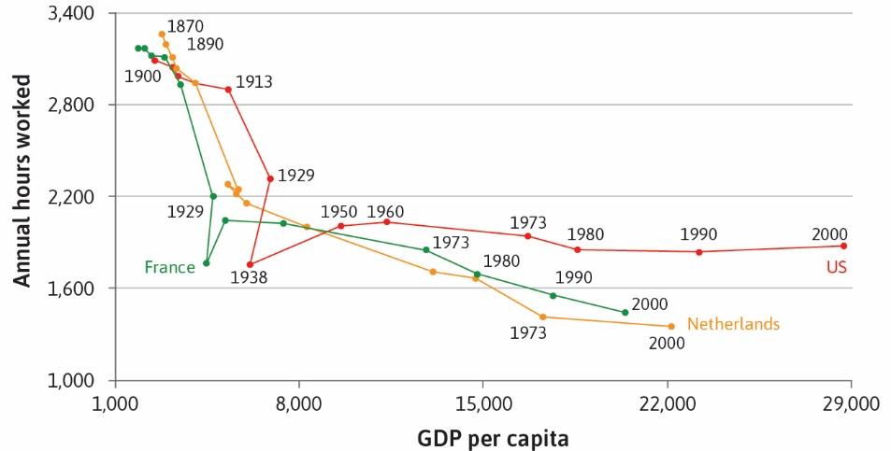
Working hours in the big picture

Slide 27
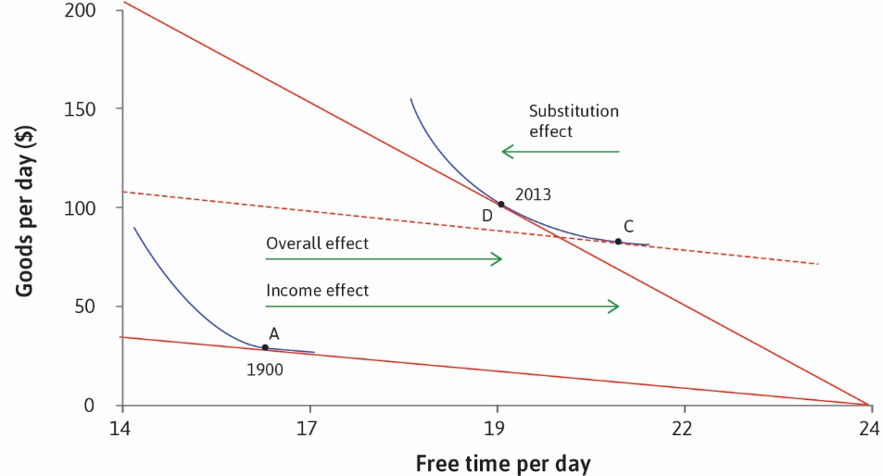
Interpreting US through technological change
Income and substitution effects can explain trends in working hours over time. E.g. In the US, the income effect dominated the substitution effect, so consumption and free time both increased.

Slide 28
Consumer Price Index
The economy has a huge number of goods
  The price of all goods change over time
  Some prices increase by a lot, some do not change much while some prices go down
  Is there a way to measure the overall effect of price changes?
  If so, can we somehow relate it to the income effects in consumer choice problems?
  The basic idea is to ask: How large an increase (or decrease) in income do you need to be exactly as well off at the new prices as at the old prices
  But this is just the income effect from the first part of the lecture
  Problem for statistical agencies: Indifference curves are not observable from sales data

Slide 29
Consumer Price Index
Task: Find a good approximation to the income effect based on observable quantities
  Statistical agencies collect price information on a large set of goods
    Traditionally this involves sending inspectors to a selection of stores to gather price data
    These days other possibilities exist: scraping data on internet sales sites (e.g. Billion Prices Project)
    Let’s concentrate on two dates, say a year apart
    N goods that sell at prices p₁, p₂, p₃,…,p_{N} originally
    After a year, the goods sell at new prices q₁, q₂, q₃,…,q_{N}
  If we knew the purchased amounts x₁, x₂, x₃,…,x_{N} of the N at the original prices, we could compute the required income for the purchase:
  I = p₁x₁ + p₂x₂ +…+ p_{N}x_{N}
  We could also compute the required income I’ for the same purchase at new prices:
  I’ = q₁x₁ +q ₂x₂ +… +q_{N}x_{N}

Slide 30
Optimal choice at old prices
Good 1 can be purchased at price P₁
Good 2 can be purcased at price P₂
Total income I
Budget constraint: P₁x₁ + P₂x₂ = I.
Good 2
IC
x₂
x₁

Slide 31
Adjusting income to allow for old purchase at new prices
Good 1: New price q₁
Good 2 can be purcased at price q₂
Total income I
Good 2
IC
Budget constraint with
adjusted income:
q₁x₁ + q₂x₂ = I’.
-sl-ope
Budget constraint with
original income
q₁x₁ + q₂x₂ = I.
x₂
-slope = q₁/q₂
-slope = p₁/p₂.
x₁

Slide 32
Consumer Price Index
▶ The consumer price index (CPI) is calculated by first computing the ratio of I′ to I.
▶ Recall that (for two goods):
_{I}′
q₁x₁ + q₂x₂ q₁ p₁x₁ q₂ p₂x₂
+ _{p2} .
I ⁼ p₁x₁ + p₂x₂ ⁼ p₁ I
I
▶
If we denote the consumption share of good 1, s₁ = p₁x₁/I , and similarly for s₂,
1
_{I}′
q₁ q₂
_{I} = _{p1} s₁ + _{p2} s₂.
▶ In other words, ^{I′} is a weighted average of individual price changes where the
I
old consumption shares serve as weights.
▶ The CPI at old prices (i.e. in base period) is set at 100
▶ The CPI at the new prices is defined to be ^{I′} x 100.
I
▶ Can be calculated for multiple consecutive periods, but the base prices and consumption shares remain the same.

Slide 33
Example: sharp rise in energy prices
Aim construct an index to reflect the increase in energy (including electricity) prices in Fall 2022
  Fix november 2021 as the base period
  Energy prices are p_{E} and q_{E}
  Prices of other goods p_{O} and q_{O}
  Energy prices increase by 40%, other prices by 4% over the year
  The consumption share of energy and electricity for households is 0.15
The index is fixed at 100 in the base period
For November 2022, the index is:
(1.4 x 0.15 + 1.04 x 0.85) x 100 = 109,4.

Slide 34
Consumer Price Index
The computation of the index is essentially the same for N goods
Consumption shares s₁ and s₂ etc. are obtained from household surveys
Does the CPI overestimate or underestimate the income effect? (It is a good estimate for relatively small price changes)
Observations: Different households have different consumption shares and therefore experience price changes differently (based on their residential location, income level etc.)
In Problem Set 2, I ask you to compute the Price index separately for different types of households
Collecting the data on prices, adjusting for quality improvements etc. are far from trivial problems: see e.g. the US documentation at CPI at BLS

Slide 35
CPI and inflation
The most common measure for inflation from year t to the next year is computed from the CPI:
inflation = (CPI_{year t+1} – CPI_{year t})/ CPI_{year t}
This is one of the most important economic measures since many transfers are tied to the rate of inflation:
Harder question: Is this a good method for longer time horizons?
There are other possible ways to compute price indices
  Weighted geometric averages instead of weighted arithmetic averages as above
Unfortunately statistical authorities in different countries use different measures
  Cross country comparisons are hard to make

Slide 36
Key ideas and concepts in this lecture
Comparative statics: changes in the feasible set
Income effect, substitution effect
Testing empirical hypothesis: effect of non-labor income on labor supply
More realistic picture of the feasible set for Finnish wage earners
Consumer price index and welfare effects of price changes

Slide 37
Next lecture
Strategic interactions: Game theory
  Choice when I care about what others do
  Anticipating others’ actions
  Anticipating others’ beliefs
Institutions
  How do the rules of the game shape the decisions?
  Curbing opportunistic behavior
  Inducing honesty and obedience

