Slide 1
Course Assignment: Marine risks and safety 2023
Section A: Hazard analysis using traditional methods

Slide 2
Presentation aim
The main aim of the presentation is to describe the overall assignment aim and practicalities
Another aim of the presentation is to introduce into section A and the system
With respect to section A, we anticipate that
The students should demonstrate that they can successfully execute any traditional method (HAZOP, FMEA, FTA)
The main focus in this assignment will be in the process and the methods application.

Slide 3
Procedures
You can do the assignment independently or in teams (max 3 persons)
If you have an issue getting a teammate pls let us know
Pls notify me on my email about your teams at victor.bolbot@aalto.fi by the end of the week.
It is highly recommended that the assignment is implemented after it is presented (section after section) but not necessary.
Assignment submission deadline 17/10/2023 22:00

Slide 4
Assignment overview
Final report will be assessed, but it should have three parts A, B, C
A – Application of traditional method - 40%
B – Application of STPA - 40%
C – Comparison of STPA and traditional method results - 20%

Slide 5
Assignment template
Cover page with picture, title, name of the team member and their relevant codes, date of submission, supervisor name and teaching assistants names, course name and code and no page number on the cover page
Table of contents should be included on a separate page
On separate page start section A, B, C
Section A, B, C and tasks names should be considered as headings (and part of contents table)
Headings should be highlighted differently from the text
Table captions above the tables, figure captions below the figures.
Word or Pdf
Readable text
Any of three styles (Arial, Calibri, Times New Romans)

Slide 6
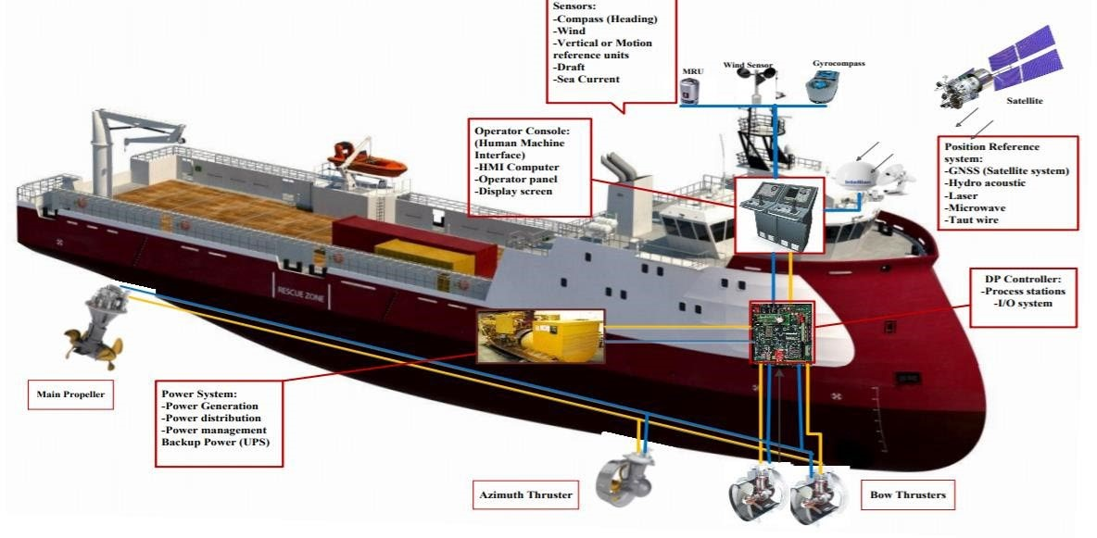
System overview
Provided on the course assignment link
Primary movers,
consumers,
control

Slide 7
Assignment requirements
Section A
We want you to consider at least 3 significant components (but one from Power system, one from Thruster system, and one from DP control system).
Approximately 5 failure modes, keywords, per component in FMEA, HAZOP
Minimum 15 basic events in Fault Tree, 2-3 levels, 20 scenarios in HAZOP, FMEA

Slide 8
Assignment methodology
Section A
Guidelines for FMEA, FTA, HAZOP implementation are provided in the assignment description and in the slides
You can check standards like
ISO 31010, ISO military standards on FMEA, and so on.
Grading
 | FTA | FMEA | HAZOP
Task 2 | 10 | 15 | 10
Task 3 | 15 | 15 | 10
Task 4 | 15 | 10 | 10
Task 5 | - | - | 10

Slide 9
Questions
You can ask your questions at the following emails: victor.bolbot@aalto.fi
sunil.basnet@aalto.fi
osiris.valdez.banda@aalto.fi
Tip: Check other publications for the same system

