Slide 2

Principles & Definitions
Notes:
pdf (europa.eu)

Slide 3
Agenda
Short repetition
Talking about definitions: Autonomized data, Pseudonymized data, Personal data, processing, sensitive data, controller, processor, joint controller
Purpose limitation & data minimization
Accountability (Article 30, 35 – DPIA)
Data breaches
Discussing case: CJEU Vyriausioji … C‑184/20

Slide 4
Definitions

Slide 5
Personal Data

Slide 6
Personal data
Any information relating to an identified or identifiable natural person
  directly or indirectly
  such as a name, an identification number, location data, an online identifier or to one or more factors specific to the physical, physiological, genetic, mental, economic, cultural or social identity of that natural person
The GDPR clarified that
  location data and
  online identifiers may also be personal data

Slide 7
Case Summary C-101/01 Lindqvist 1/2
FACTS AND LEGAL BACKGOUND
  Lindqvist worked as a catechist in Sweden and created internet pages, which contained information for parishioners. The pages were linked to the Swedish Church's website at Lindqvist's request.
  The webpages included information about Lindqvist and their colleagues such as names, jobs, hobbies, family circumstances, telephone numbers and in one case details about injured foot and working conditions.
  Lindqvist did not obtain consent or informed colleagues about the pages, but removed them as soon as Lindqvist became aware that the pages were not appreciated by some colleagues.
  Criminal proceeding was raised against Lindqvist who was charged with the breach of Swedish legislation on Protection of Personal Data (Personuppgiftslagen).
QUESTIONS:
  Whether the information about Lindqvist's colleagues constituted the processing of personal data?
  Whether the processing of personal data was outside the scope of the Data Protection Directive as an ecxeption?
  Whether information about individuals' injured foot and half-time on medical grounds constituted personal data concerning health?

Slide 8
Case Summary C-101/01 Lindqvist 2/2 - Decision
"personal data" under the Directive covers any information relating to an identified or identifiable natural person, such as their name along with telephone coordinates or details about their working conditions or hobbies.
"processing" covers any operation performed upon personal data, whether by automatic means. For example loading personal data on an internet page is performed, at least in part, automatically.
Charitable or religious activities such as those carried out by Mrs Lindqvist are not covered by any of the exceptions of Directive.
The expression "data concerning health" must be given a wide interpretation to include information concerning all aspects, both physical and mental, of the health of an individual. Therefore, information about individuals injured foot and half-time on medical grounds constitutes personal data concerning health.

Slide 9
Case Summary C-582/14 Breyer 1/2
FACTS AND LEGAL BACKGOUND
  Breyer accessed public websites operated by German Federal institutions. These websites stored access information, including IP address, in logfiles to prevent attacks and making it possible to prosecute ‘pirates’.
  Breyer brought an action to stop the Federal Republic of Germany from storing, or arranging for third parties to store, Breyer's host system's IP address as its storage is unnecessary in order to restore the availability of media in the event of a fault occurring.
  The first instance dismissed Breyer's action, while the court of appeal varied that decision in part, since it assessed that a dynamic IP address constitutes personal data together with the date on which the website was accessed to, if the user of the website has revealed his identity during that visit.
  Both Breyer and the Federal Republic of Germany appealed against the judgment.
QUESTION
  Whether an internet protocol address (IP address) stored by an online media service provider constitutes personal data if a third party, such as an access provider, has the additional knowledge required to identify the data subject?

Slide 10
Case Summary C-582/14 Breyer 2/2 DECISION
a dynamic IP address alone does not directly reveal the identity of the natural person using a computer to access a website.
It is not required that this information alone can identify the data subject, and it doesn't need to be solely in one person's hands for identification purposes.
Furthermore, the Court examined whether combining a dynamic IP address with the additional data held by the internet service provider provides a reasonably likely means to identify the data subject:
  if the identification of the data subject is prohibited by law or practically impossible due to excessive time, cost or man-power, then the risk of identification is considered insignificant.
  if the online media services provider, with the assistance of the competent authority and the internet service provider, can identify the data subject based on stored IP addresses, the dynamic IP address can be considered personal data.
The Court determined that a dynamic IP address registered by an online media services provider constitutes personal data, where the provider has the legal means to identify the data subject using additional data from the internet service provider.

Slide 11
Single Resolution Board T-557/20
This case revises part of the Breyer decision (or applies Breyer correctly, depending on where you stand).
"Accordingly, it is apparent from the revised decision that the EDPS merely examined whether it was possible to re-identify the authors of the comments from the SRB’s perspective and not from Deloitte’s "
  ➔ this shows a relative approach to personal da
Note: Case will go to the CJEU

Slide 12
SENSITIVE DATA

Slide 13
Special categories ("sensitive data")
Classes of "sensitive data" are broader
  Includes "genetic data" and "biometric data" where processed "to uniquely identify a person"
Grounds for processing sensitive data are similar as before (same principle)
  But there are wider (concrete) grounds in the area of health and healthcare management
  E.g.: assessment of the working capacity of the employee
Broad ability for Member States to adduce new conditions (including limitations) regarding the processing of genetic, biometric or health data
Photographs will not automatically be considered as sensitive processing - only to the extent they allow the unique identification or authentication of an individual as a biometric (e.g. used as part of an electronic passport)

Slide 14
Processing of special categories "Sensitive data"
Prohibited unless
  Data subject has given explicit consent
  Necessary for obligations/rights in employment, social security & social protection law
  Necessary to protect vital interests of data subject
  For political, philosophical, religious, trade-union purposes by a foundation, association or not-for-profit body
  Data manifestly made public by data subject
  Necessary for establishment, exercise or defence of legal claims
  Necessary for substantial public interest (under EU or Member State law)
  Necessary for preventive or occupational medicine, assessment of working capacity, medical diagnosis, healthcare
    Ground to allow health assessment in cars?
  Necessary for public health
  Necessary for archiving, scientific/historical research or statistical purposed

Slide 15
PROCESSING

Slide 16
Pretty much everything is "processing"
    (2) ‘processing’ means any operation or set of operations which is performed on personal data or on sets of personal data, whether or not by automated means, such as collection, recording, organisation, structuring, storage, adaptation or alteration, retrieval, consultation, use, disclosure by transmission, dissemination or otherwise making available, alignment or combination, restriction, erasure or destruction;
    Case 24/7 support

Slide 17
Anonymization

Slide 18
Where does anonymisation start and end?
Avoiding personal data
  Anonymous information (Recital 26):
  Does not relate to an identified or identifiable natural person
Data rendered anonymous in such a way that the data subject is not or no longer identifiable.
  WP 29 Opinion 10 April 2014
  De-anonymisation through combination with other sources
Pseudonymisation
  "The younger brother of anonymisation"
  So far, largely underdeveloped rules
  Risk mitigation tool
  New developments in GDPR

Slide 19
"Pseudonymous data"
Processing in such a way that the data can no longer be attributed to a specific data subject without the use of additional information
Such additional information
    Be kept separately
    Be subject to technical and organisational security measures
Is still a form of personal data
Its use is encouraged
For example:
  To be considered when determining if the processing is 'incompatible' with the purposes for which the personal data was originally collected and processed
  Technique which may satisfy requirements to implement privacy by design and by default
  May be employed to meet obligations to ensure the security requirements

Slide 20
GDPR encourages “pseudonymisation” of personal data
The GDPR creates incentives for controllers to pseudonymise the data that they collect, including
  Pseudonymisation may facilitate processing personal data beyond original collection purposes
  Pseudonymisation is an important safeguard for processing personal data for scientific, historical and statistical purposes
  Pseudonymisation is a central feature of “data protection by design”
  Controllers can use pseudonymisation to help meet the GDPR’s data security requirements
  Controllers do not need to provide data subjects with access, rectification, erasure or data portability if they can no longer identify a data subject
  The GDPR encourages controllers to adopt codes of conduct that promote pseudonymisation

Slide 21
CONTROLLER

Slide 22

Data controller
Data controller is
  A person, company, institution or foundation or a number of them who determines the purposes and means of the processing of personal data
  either alone or jointly
  TRAFI sets up a database of information about every car and car owner in Finland
    TRAFI is a data controller in relation to the personal data on the database

Slide 23
General obligations
Controllers must be able to demonstrate compliance with the GDPR's principles (Accountability)
  Implement appropriate security policies and measures
  Privacy impact assessment and prior consultation (when applicable)
  Adopt certain "data protection by design" measures
  Record of all processing activities
  Undertake audits
  Adherence to approved codes of conduct and certifications
  Implement Privacy Policies
  Appropriate staffing (e.g., data protection officer)
  Staff training programs

Slide 24
PROCESSOR

Slide 25
What is a data processor?
A person, company, institution or foundation who processes the data on behalf of the data controller either alone or jointly (Article 4(8) GDPR)
  YY engages a marketing company X to carry out a satisfaction survey of its existing customers. The marketing company will need information about YY's customers in order to carry out the survey.
  => YY is a data controller in relation to the personal data on the customers
  => The marketing company X is a data processor, processing the information on behalf of YY

Slide 26
Processor's obligations
Controller remains responsible for its suppliers' errors
Processors obligations, including:
  Only act on the controller's documented instructions,
  List of technical and organizational measures,
  Processor's staff must be bound by confidentiality obligations
  Assisting the Controller for responding to requests from data subjects for: access, rectification, suppression, limitation, objection, portability of data
  Return or delete personal data upon Controller's choice at the end of services
  Assisting the controller to notify security breaches and to implement PIAs
  Contribute to audits, including directly made by the Controller
  Provide the controller with all information
  Sub-processing only with prior consent from the Controller!

Slide 27
JOINT CONTROLLER

Slide 28
Joint controller
Wirtschaftsakademie
Jehovan todistaajat
Fashion ID

Slide 29
Principles

Slide 30
General principles of processing
Similar principles as before:
  Fairness
  Lawfulness and transparency
  Purpose limitation
  Data minimisation
  Accuracy
  Storage minimisation
  Security, integrity and confidentiality
Accuracy principle
  Controllers responsible for demonstrating compliance

Slide 31
Why do we need principles?

Slide 32
Purpose limitation & data minimization

Slide 33
Article 5: data management and data minimisation
  Data minimisation: Systems must be set up in a way to store only the minimum amount of data. Maintaining more data must be justified!
  Accuracy: data must be accurate, adequate, relevant- sometimes different systems include different sets of personal data and are not synchronised.
    Practical advice:
    Check for overly broad default settings and decide what is mandatory to collect
    Identity management is key to accuracy and should be addressed first in a privacy program!
Notes:
Different persons might have different identities => e.g. Phones

Slide 34
Purpose limitation is a key GDPR provision - Art. 6(4)
Where the processing for a purpose other than that for which the personal data have been collected is not based on the data subject's consent or on a Union or Member State law [….] the controller shall, in order to ascertain whether processing for another purpose is compatible with the purpose for which the personal data are initially collected, take into account, inter alia:
any link between the purposes for which the personal data have been collected and the purposes of the intended further processing;
the context in which the personal data have been collected, in particular regarding the relationship between data subjects and the controller;
the nature of the personal data, in particular whether special categories of personal data are processed, pursuant to Article 9, or whether personal data related to criminal convictions and offences are processed, pursuant to Article 10;
the possible consequences of the intended further processing for data subjects;
the existence of appropriate safeguards, which may include encryption or pseudonymisation.
Note: Also OECD Guidelines (art. 9); Convention 108 + (art 5(3)
Notes:
Purpose Specification Principle
9. The purposes for which personal data are collected should be specified not later than at the time of data collection and the subsequent use limited to the fulfilment of those purposes or such others as are not incompatible with those purposes and as are specified on each occasion of change of purpose.
(OECD)
collected for explicit, specified and legitimate purposes and not processed in a way incompatible with those purposes; further processing for archiving purposes in the public interest, scientific or historical research purposes or statistical purposes is, subject to appropriate safeguards, compatible with those purposes
Convention 108+

Slide 35
Data protection to be embedded into processing operations at project initiation and go-live stages
Privacy by design (Art. 25 (1)) | Privacy by default (Art 25 (2))
Design processing to implement data protection principles Data minimisation Pseudonymisation Encryption | Ensure that, by default, the minimum amount of personal data necessary for the purpose is processed Less not more data Shorter not longer Access rights constrained
See ENISA Privacy & Data Protection by Design & materials from ICO and the Ontario Privacy Commissioner

Slide 36
Privacy by design - controllers
Obligations of the controller:
  Implement appropriate technical and organisational measures
    E.g. pseudonymisation techniques
  Measures designed to implement data protection principles
    E.g. data minimisation
  Implement measures in an effective way
  Integrate the necessary safeguards into the processing in order to
    Meet the requirements of the GDPR
    Protect the rights of data subjects
When?
  At the time of the determination of the means for processing
  At the time of the processing itself
Elements to consider:
  The state of the art
  The cost of the information
  The nature, scope, context and purposes of the processing
  The risks of varying likelihood and severity for rights and freedoms of individuals posed by the processing

Slide 37
Accountability (Article 30, 35 & dpia)

Slide 38
Accountability is written into GDPR as a legal obligation
The controller shall be responsible for and be able to demonstrate compliance with [the data protection principles] ("accountability") (Art. 5 (2)).
Taking into account the nature, scope, context and purposes of the processing as well as the risks … of natural persons, the controller shall implement appropriate technical and organisational measures to ensure and be able to demonstrate that the processing is performed in accordance with this Regulation. These measures shall be reviewed and updated where necessary (Art. 25 (1)).

Slide 39
The Principle of Accountability
The principle of accountability (Article 5)
  Demonstrating compliance
  Increased documentation obligations
  It will be no longer enough to comply with legislation – the controller shall also be able to prove this
Relevance:
Controllers are liable for processors
➔ Subcontractor management via established processes and with standard terms + exception management

Slide 40
Accountability - GDPR reversed the burden of proof
      Controllers must be able to demonstrate compliance with the GDPR's principles
      Adopt certain "data protection by design" measures
      Implement policies
      Paper trails of decisions relating to data processing
      Staff training programs
      Undertake audits
      Adherence to approved codes of conduct
      Privacy impact assessment (when applicable)
The principle goes hand-in-hand with obligation to maintain a record of all processing activities

Slide 41
A word on terms
Documentation (Article 30)
List of 7 basic items (name of controller, purposes, international data transfers etc.)
Needed for ALL data processing (and also needed for processors!)
Data Protection Impact Assessment (Article 35)
A very specific assessment to evaluate risks
E.g., New technologies or high risks for individuals
Notifications to authorities (Article 36)
Done when risks cannot be mitigated
Great exception!
Privacy Impact Assessment
Not as such mentioned in GDPR, but required for accountability
Evaluates privacy in processes, developments or applications
Often includes part of documentation, DPIA or even notification

Slide 42
Documentation is key for accountability
All data processing needs to be documented, in some cases specific documentation is needed (DPIA).
The controller is responsible for documentation.
Often, processors in better position to document…
How many data sets there are
If there are international data transfers
What subcontractors are used (e.g. IT-support)
Where the servers are

Slide 43
What are DPIAs? (1)
The Protection Impact Assessments are a tool to evaluate privacy risks against given criteria (“privacy requirements”)
Those are often a mandatory part of privacy compliance
  EU Article 35 of the GDPR;
  Previously those existed, too
    Commission recommendation on the Data Protection Impact Assessment Template for Smart Grid and Smart Metering Systems (2014):
    US: E-Government Act of 2002
a record of all processing activities.
Article 29 Working Party (April 2017):
"PIA is often used [...] to refer to the same concept"

Slide 44
What are DPIAs? (2)
Assessment might be self-assessments or assessments done by trained staff/externals
Impact = likelihood and severity of the risk
Relevant factors:
  Nature, scope, context and purposes of the processing
  Sources of the risk
  Envisaged measures, safeguards and mechanisms for mitigating that risk
      Nature, scope, context and purposes of the processing
      Sources of the risk
      Envisaged measures, safeguards and mechanisms for mitigating that risk

Slide 45
Core elements of DPIA
DPIA should take place prior to the data processing
DPIA needs to be done by qualified personnel
DPIA should be based on (pre)defined requirements
DPIA should be part of a privacy program
DPIA needs follow up and decision-making on risk

Slide 46
When are DPIAs needed? (1)
Focal point: risks to rights and freedoms of individuals
  Depends on the scope, context and purpose of processing
  Might be new technologies
  Could apply in large-scale processing operations (Recital 91)
In certain circumstances it should be considered, whether a DPIA could be broader than a single project (e.g.: where several controllers plan to introduce a common application or processing environment across an industry sector) (Recital 92)
NOT mandatory: if the processing concerns personal data from patients or clients by an individual doctor, health care professional, or lawyer
Notes:
Examples for other "risky data": communications data, location data, financial data (which poses a risk of fraud)

Slide 47
When are DPIAs needed? (2)
Type of processing is likely to result in a high risk to the rights and freedoms of individuals
    Systematic and extensive evaluation of personal aspects based on automated processing (e.g. profiling such as credit monitoring or genetic testing), and on which serious decisions are based (e.g. legal effects or similar, such as exclusion or discrimination)
    Processing sensitive data on a large scale
    Systematic monitoring of a publicly accessible area on a large scale (e.g. video surveillance)
Notes:
Large scale: Art. 29 WP says single practicioner not covered.; factors to consider:
- number of data subjects as absolute number or proportion
Volume of data
Duration, permancenc, data protecting
Geographical extent of the activity

Slide 48
When are DPIAs needed? (3) – Art. 29 WP additional groups
Datasets that have been matched or combined
Data concerning vulnerable data subjects (children, employees, mentally ill, elderly, patients)
Innovative use or applying technological or organisational solutions
  E.g. combining use of finger print and face recognition
Data transfers across borders outside of the EU
Processing prevents data subjects from exercising a right or using a service/contract
  Public area used that cannot be avoided
  Such as screening used by banking
Notes:
NOTE: 2 or more needed
Examples for other "risky data": communications data, location data, financial data (which poses a risk of fraud)
Datasets that have been matched or combined
Data concerning vulnerable data subjects => recital 75
Innovative use or applying technological or organisational solutions recital 89/90
Data transfers across borders outside of the EU => 116
Processing prevents data subjects from exercising a right or using a service/contract 22/recital 91

Slide 49
When are DPIAs [not] needed? (4)
Same or similar processing
Already done within a group, e.g. municipalities
Based on a legal requirement
On the list of a supervisory authority
Notes:
NOTE: 2 or more needed
Examples for other "risky data": communications data, location data, financial data (which poses a risk of fraud)
Datasets that have been matched or combined
Data concerning vulnerable data subjects => recital 75
Innovative use or applying technological or organisational solutions recital 89/90
Data transfers across borders outside of the EU => 116
Processing prevents data subjects from exercising a right or using a service/contract 22/recital 91

Slide 50
Process – Article 35
DPIA needs to be documented!
Data Protection Officer needs to be involved (2)
Compliance with the approved codes of conduct referred to in Article 40
Where appropriate, the controller shall seek the views of data subjects or their representatives on the intended processing, without prejudice to the protection of commercial or public interests or the security of the processing operations → how?
Notes:
Privacy threshold analyis needs also be documented why a DPA should not be done

Slide 51
What should be assessed?
The assessment shall contain at least:
    a systematic description of the envisaged processing operations and the purposes of the processing, including where applicable the legitimate interest pursued by the controller;
    an assessment of the necessity and proportionality of the processing operations in relation to the purposes;
    an assessment of the risks to the rights and freedoms of data subjects referred to in paragraph 1;
    the measures envisaged to address the risks, including safeguards, security measures and mechanisms to ensure the protection of personal data and to demonstrate compliance with this Regulation taking into account the rights and legitimate interests of data subjects and other persons concerned
Notes:
Good news is: no particular form1

Slide 52
DATA BREACHES

Slide 53
Data breach definition
Breach means a security breach leading to the destruction, loss, alteration, unauthorised disclosure of or access to personal data
Breach of
  Confidentiality
  Integrity
  Availability
Have you been a victim of a breach?

Slide 54
Data breach notification under GDPR (1) – DPA
  Notification must be made without undue delay, where feasible within 72 hours after having become aware of it
  The controller must, notify the personal data breach to the supervisory authority, unless the personal data breach is unlikely to result in a risk to the rights and freedoms of natural persons
  Forms
  Tactics

Slide 55
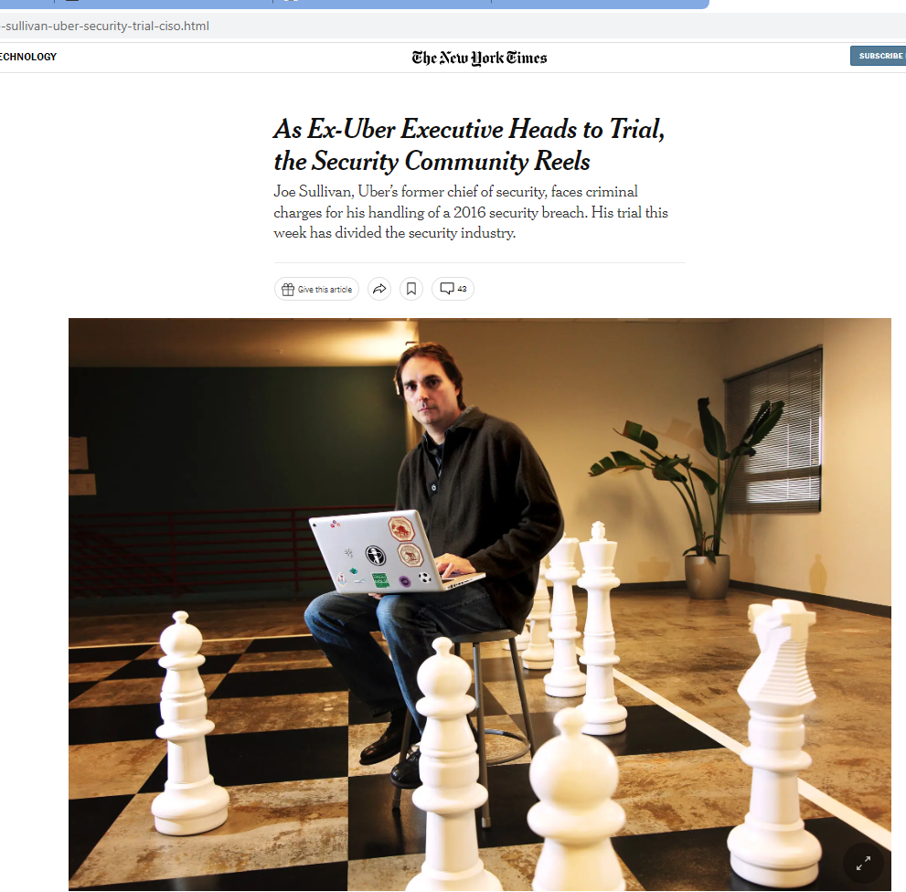
Not notifying could be costly (source: NYT 8.9.22)
  Do you think this is fair?
  How would you have reacted?

Slide 56
Data breach notification under GDPR (2) – Individuals
  When the personal data breach is likely to result in a high risk to the rights and freedoms of natural persons, the controller shall communicate the personal data breach to the data subject without undue delay unless..
    Controller has implemented TOMS so that the pd is unintelligible (e.g. encryption)
    Taken subsequent measure which ensure that the high risk wont materialize
    It would be a disproportionate effort
  Questions
    Do you think the different treatment of individuals and DPA is okay?
    Compensation?

Slide 57
Is lack of resources a good reason not to follow DP law?
" 89 However, it must be pointed out that a lack of resources allocated to the public authorities cannot in any event constitute a legitimate ground justifying interference with the fundamental rights guaranteed by the Charter. "
Do you agree?
What does that mean for the private sector?
Notes:
This the judgement Vyriausioji tarnybinės etikos komisija,

Slide 58

Activity

Slide 59
Let's discuss the judgement:
Vyriausioji tarnybinės etikos komisija
Please prepare the following answers alone (you can ask your classmates/me about things you have not understood).
Summarize the case in your own words
Which type of procedure is this case? [and what will be the next steps]
There were two main questions before the court.
a) Do you agree with the outcome of the first question? What "test" is applied?
b) Do you agree with outcome of the second question?
Notes:
The case dealt with a conflict of anti-corruption laws in Lithuania and data protection law. The Chief Ethics Commission in Lithuania is tasked with fighting corruption. It asked a director of a public establishment (= the data subject) to declare his and his spouses interests according to the anti-corruption laws. The Lithuanian regime foresaw that certain information from the declaration had to be published on the website of the Chief Ethics Commission, such as the forename and surname and as well income related data.
Preliminary ruling procedure
3a: " By its first question, the referring court asks, in essence, whether Article 7(c) and (e) of Directive 95/46 and points (c) and (e) of the first subparagraph of Article 6(1) and Article 6(3) of the GDPR, read in the light of Articles 7 and 8 of the Charter, must be interpreted as precluding a national provision that provides for the placing online of personal data contained in the declaration of private interests that any head of an establishment receiving public funds is required to lodge with the national authority responsible for collecting such declarations and checking their content.
Test: objective okay? Required to reqach this obliective? Other measures less insturisve? Balancing: Seriousness of infringement v. other goal
3b: By its second question, the referring court asks, in essence, whether Article 8(1) of Directive 95/46 and Article 9(1) of the GDPR must be interpreted as meaning that the publication, on the website of the public authority responsible for collecting and checking the content of declarations of private interests, of personal data that are liable to disclose indirectly the political opinions, trade union membership or sexual orientation of a natural person constitutes processing of special categories of personal data, for the purpose of those provisions.
"

Slide 60

Any Questions?

Slide 61
Thank you

