Slide 1
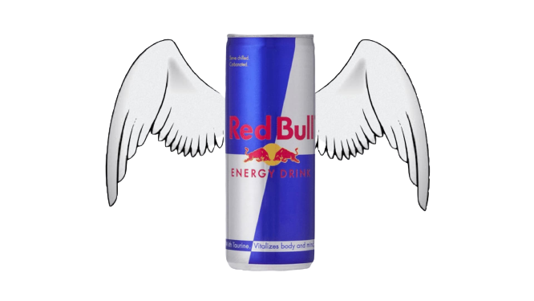
What are of Change???
Change

Slide 2
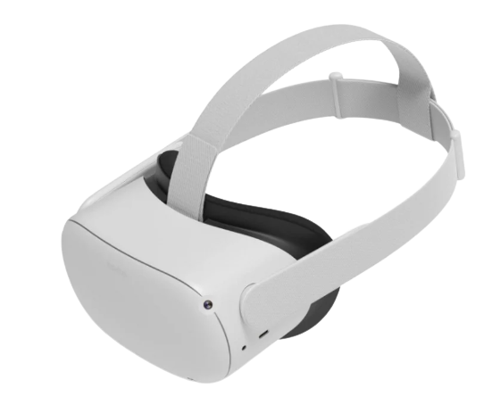
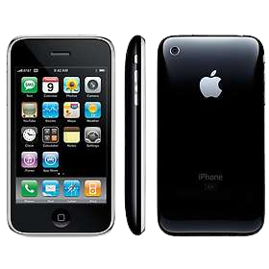
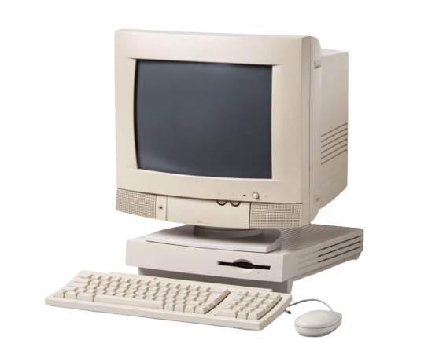
Product Development Requirements
Consumer centered
Market centered
User-centered design
Agile and Lean principles
Advanced analytics, and AI
Sustainable practices and ethics
Rapid prototyping and MVP development
Manufacturer centered
Tech driven design
Data-driven decision-making
Prototyping and MVPs (Minimum Viable Products)
Globalization
Rapid tech advancements
First mover advantage
Cost Management
Marketing and Market education
Focus on patenting and trademarks
Regulatory compliance
Pre 000s
2000s
Today

Slide 3
Challenges in Product Development

Slide 4
Pre 2000s
A
B
C
D
Desktop
Centric
Designs
Longer Development Cycles
Primitive
Research
Methods
Lack of
Technology
Stack

Slide 5
2000s
A
B
C
D
Limited Technology Stack
Bandwidth/ connectivity
Mobile Optimization
Some automation

Slide 6
Today
A
B
C
D
Market Saturation and Competition
Additive manufacturing integration
AI and ML integration
Rapid Technology Advancing

Slide 7
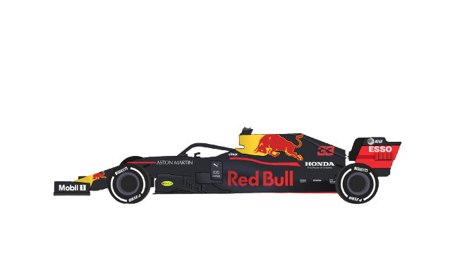
What Drives Innovation???

Slide 8
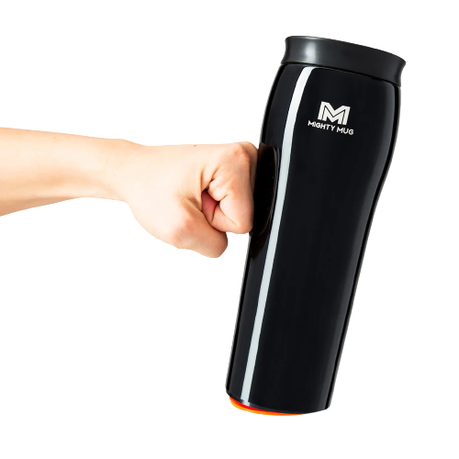
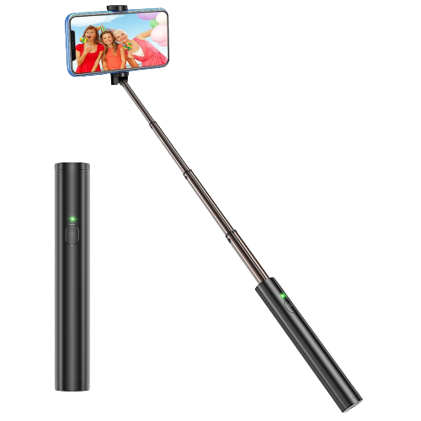
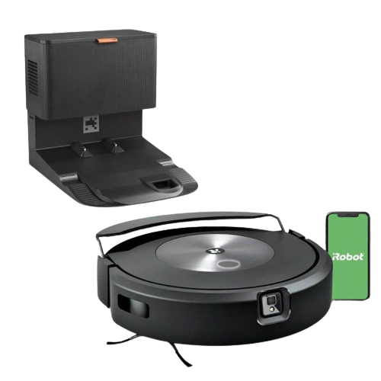
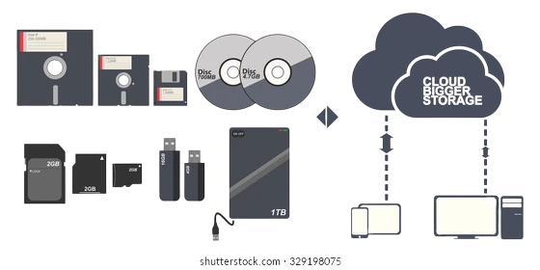
Consumer needs and expectations

Slide 9
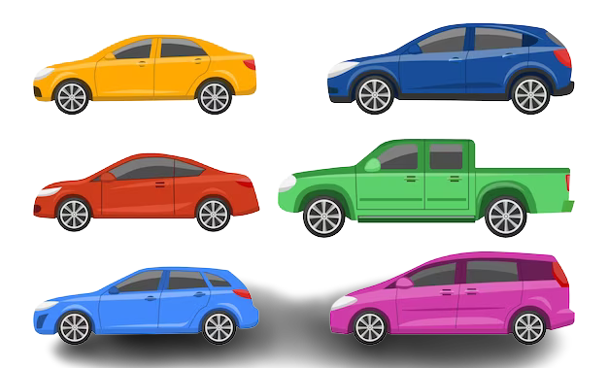
Competition

Slide 10
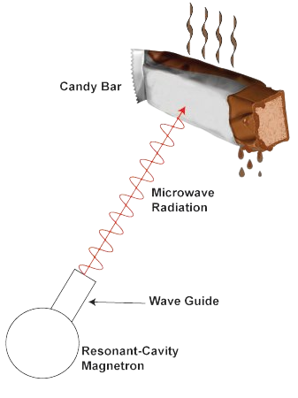
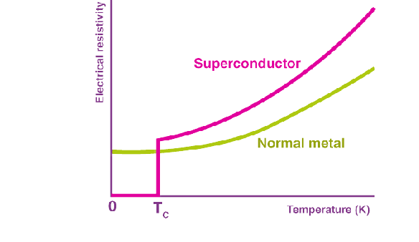
Unexpected breakthroughs

Slide 11
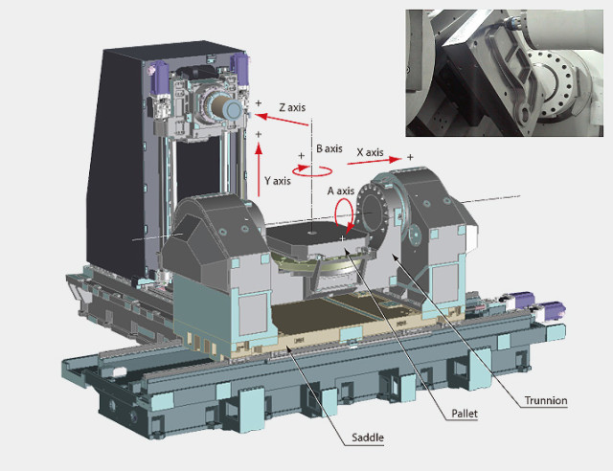
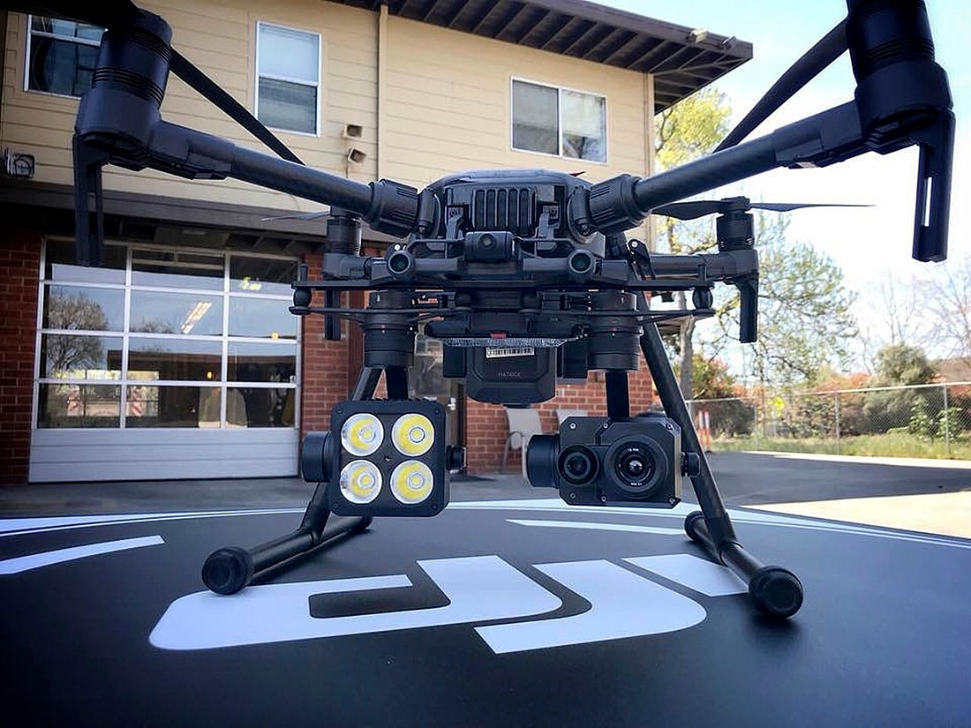
Technological Advancements

Slide 12
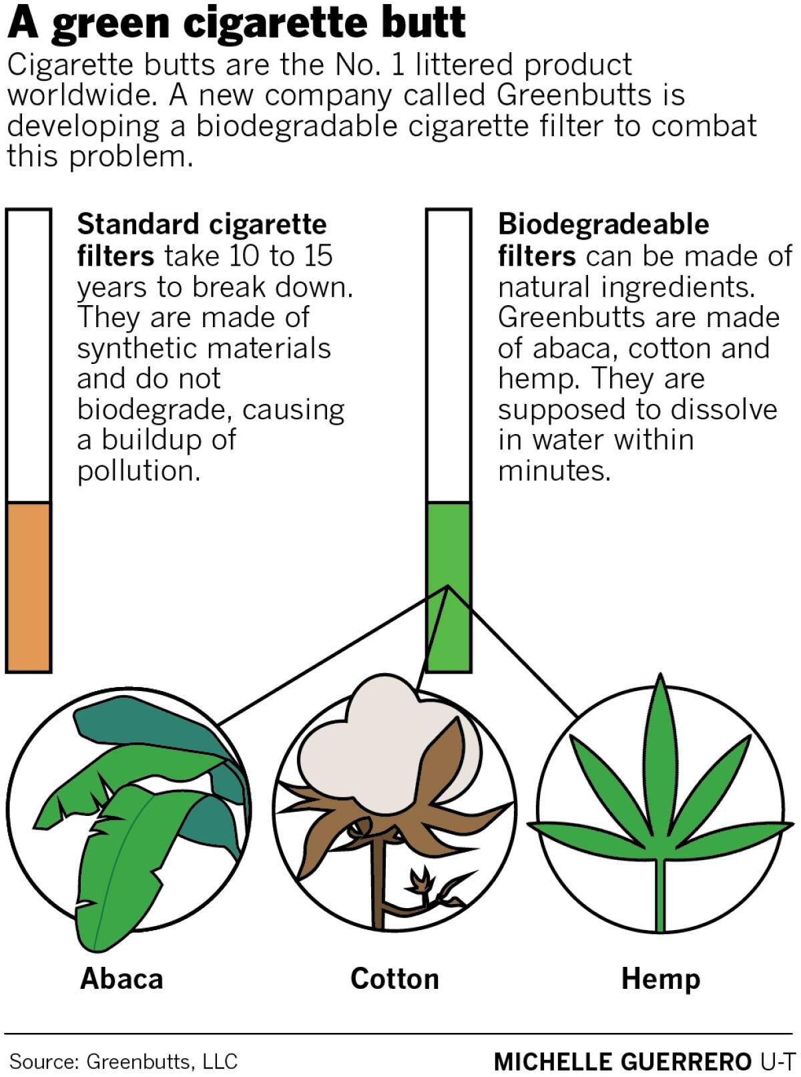
Sustainability

Slide 13
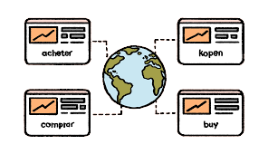
Globalization/Localization

Slide 14
The Past, The Present & The Future
Industries

Slide 15
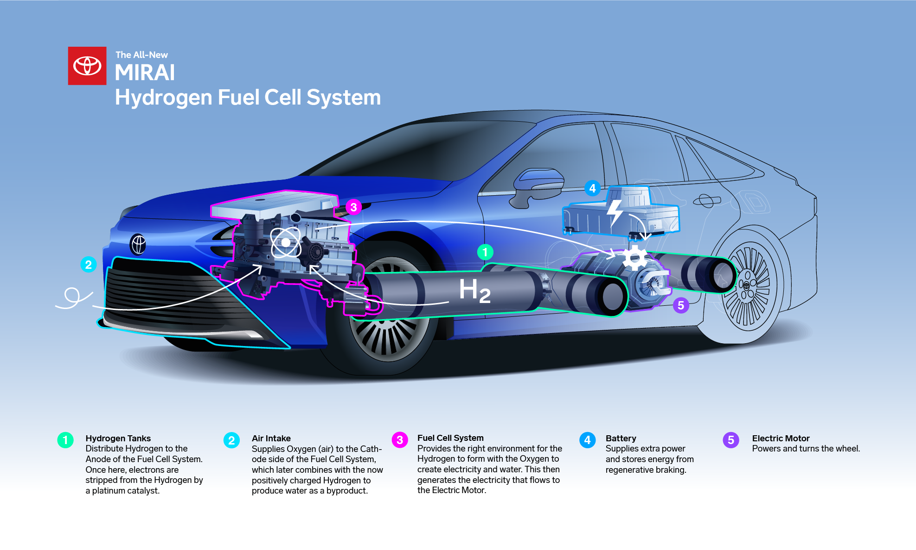
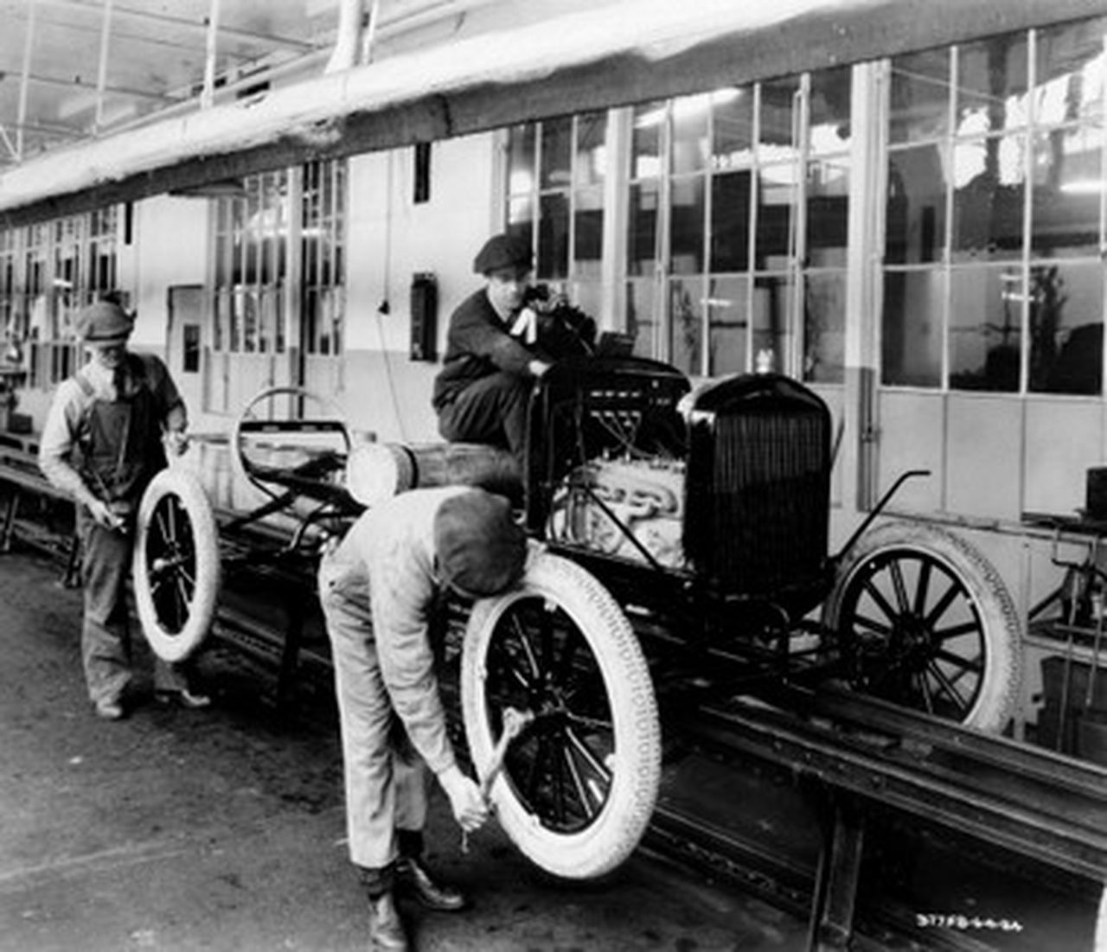
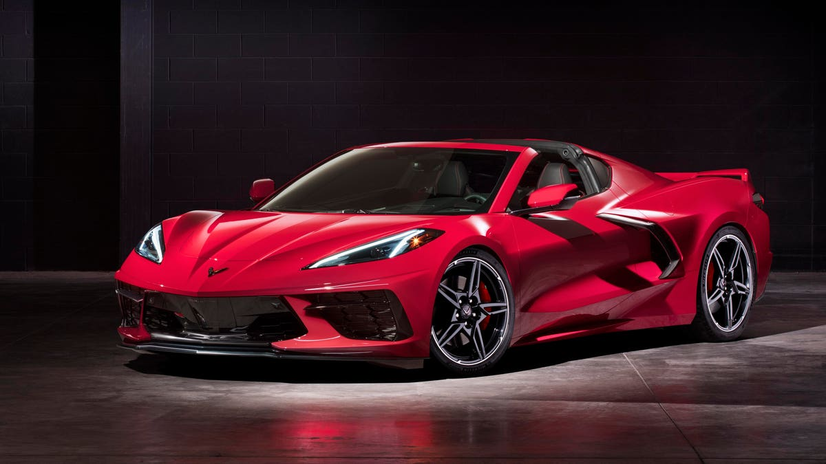
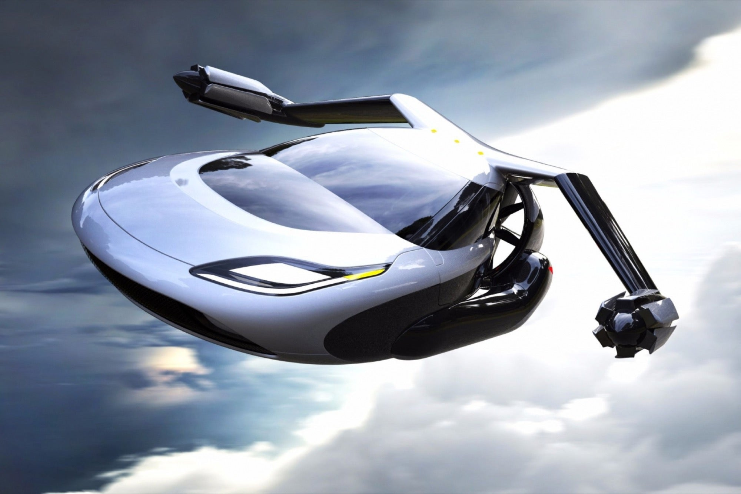
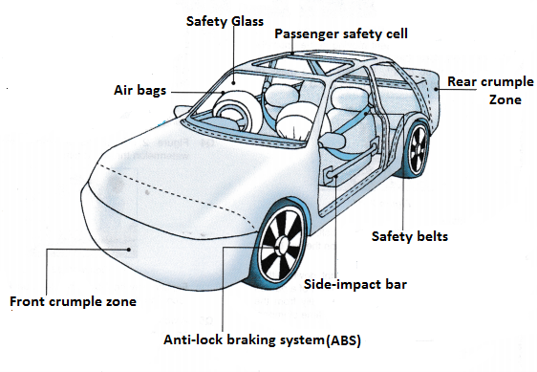
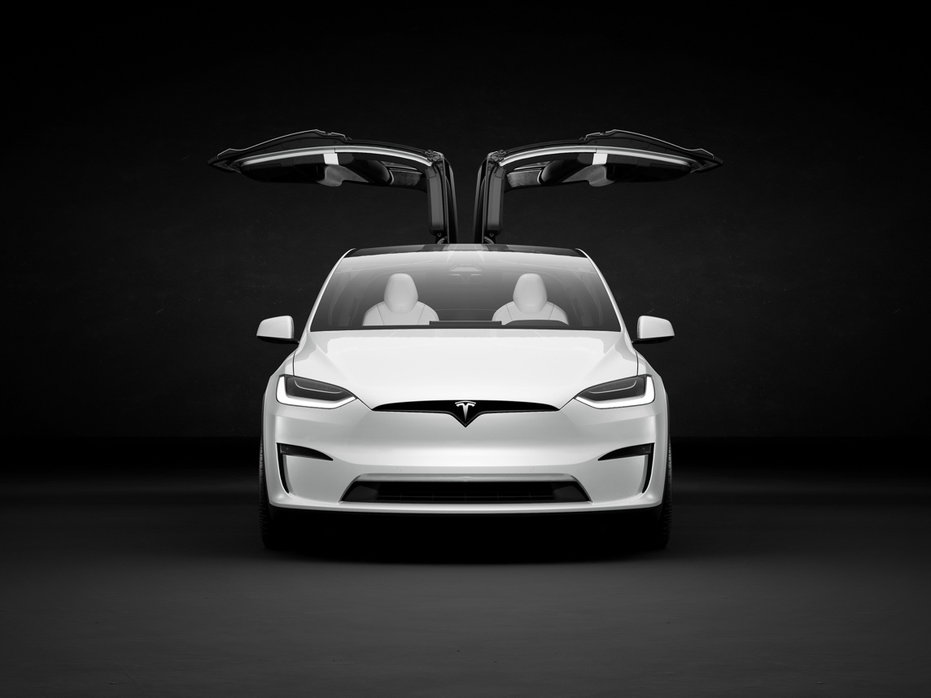
The Future
2000s to current day
Pre 2000s
Sustainability
Form and Luxury
Mass Production
C
Automotive Industry
B
Safety
Flying cars
Climate change > Electric Cars
A

Slide 16
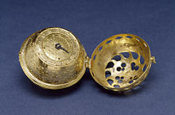
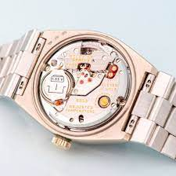
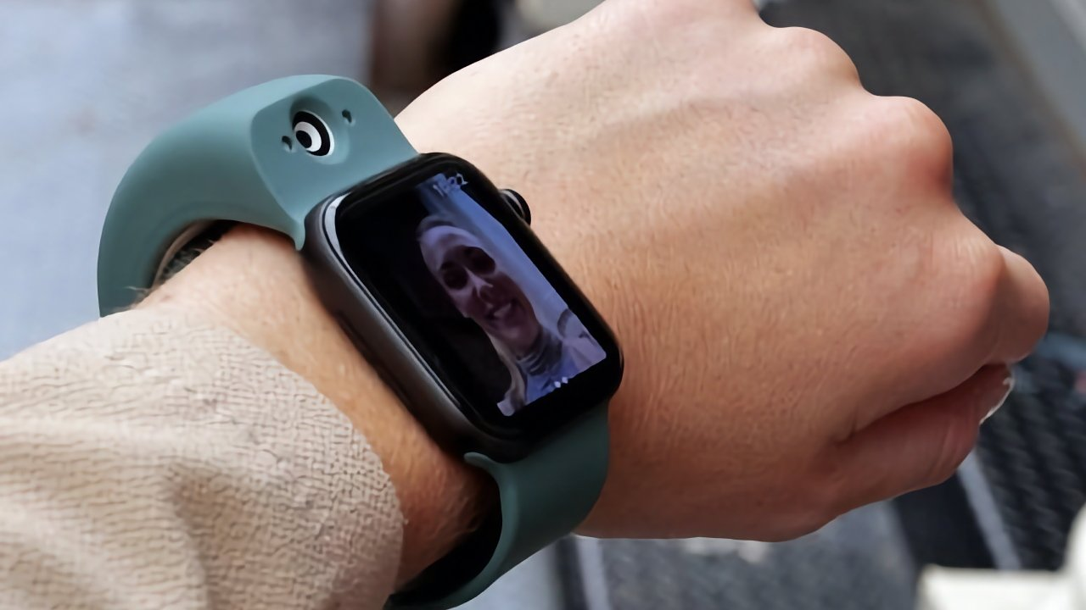
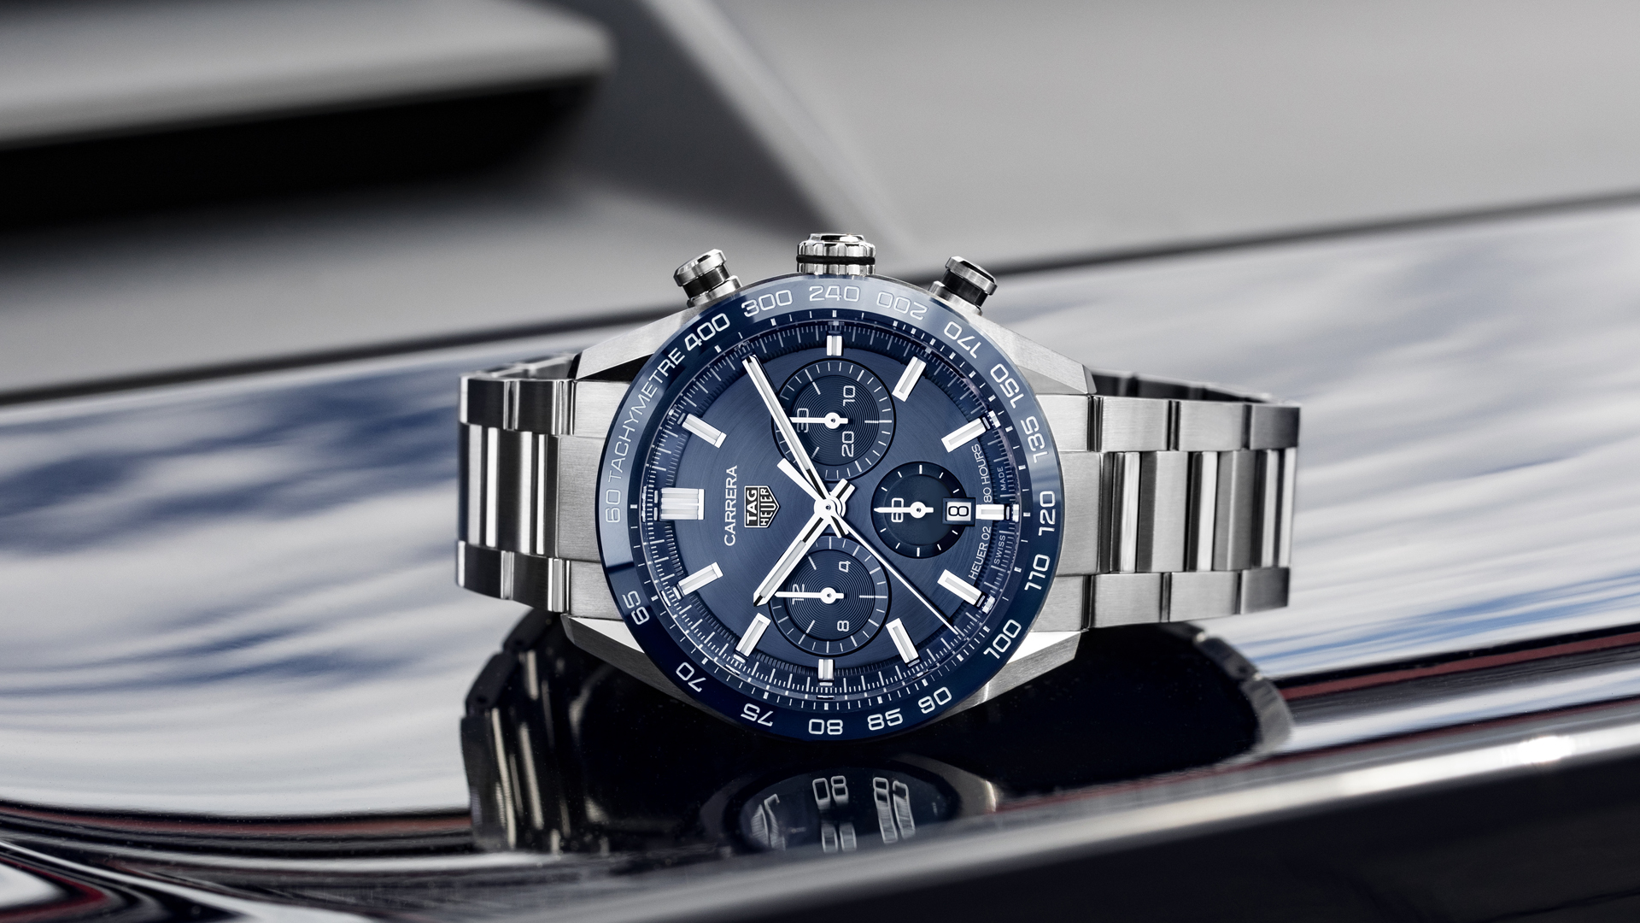
Evolution up to 19th century
20th Century watches
The Present and Future
C
Watches
B
A

Slide 17
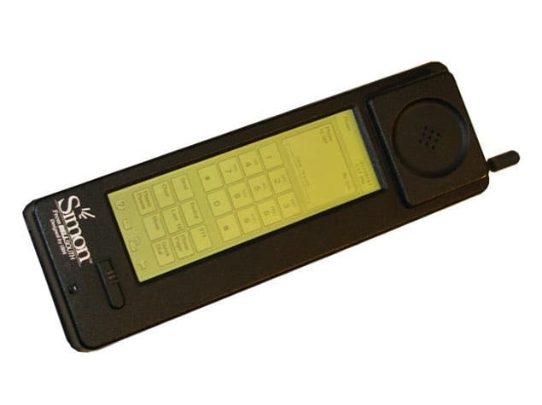
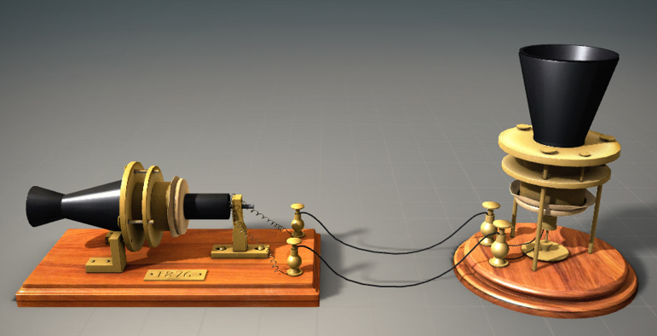
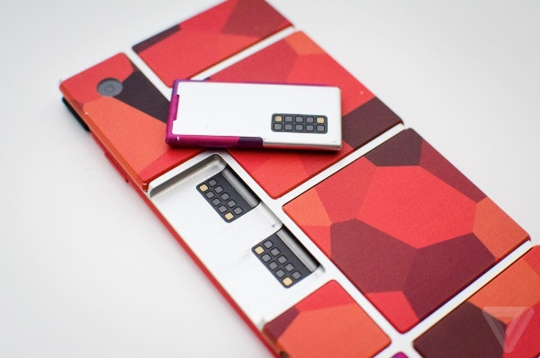
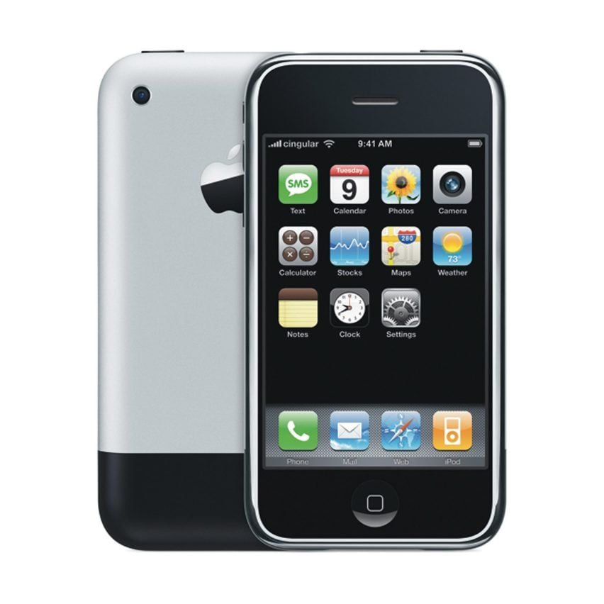
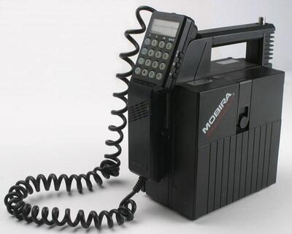
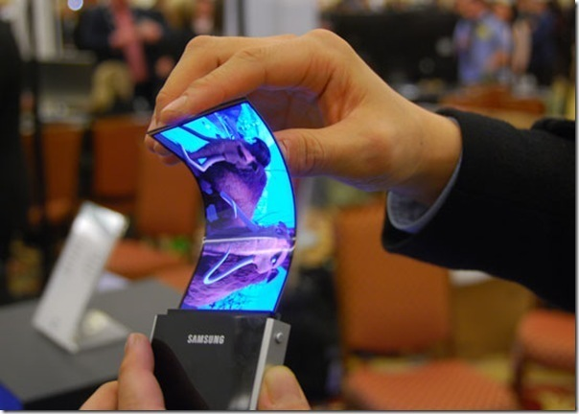
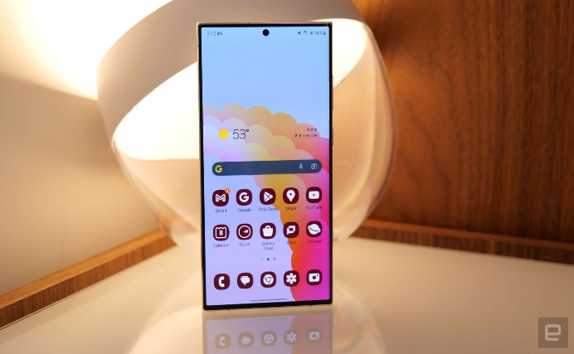
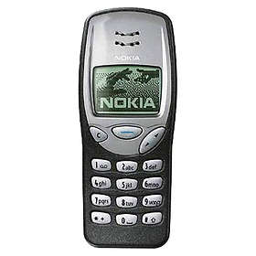
Early 2000s
Earliest phone
The Future
2010s
C
1970s
Mobile Industry
B
A
Today
1990s

Slide 18
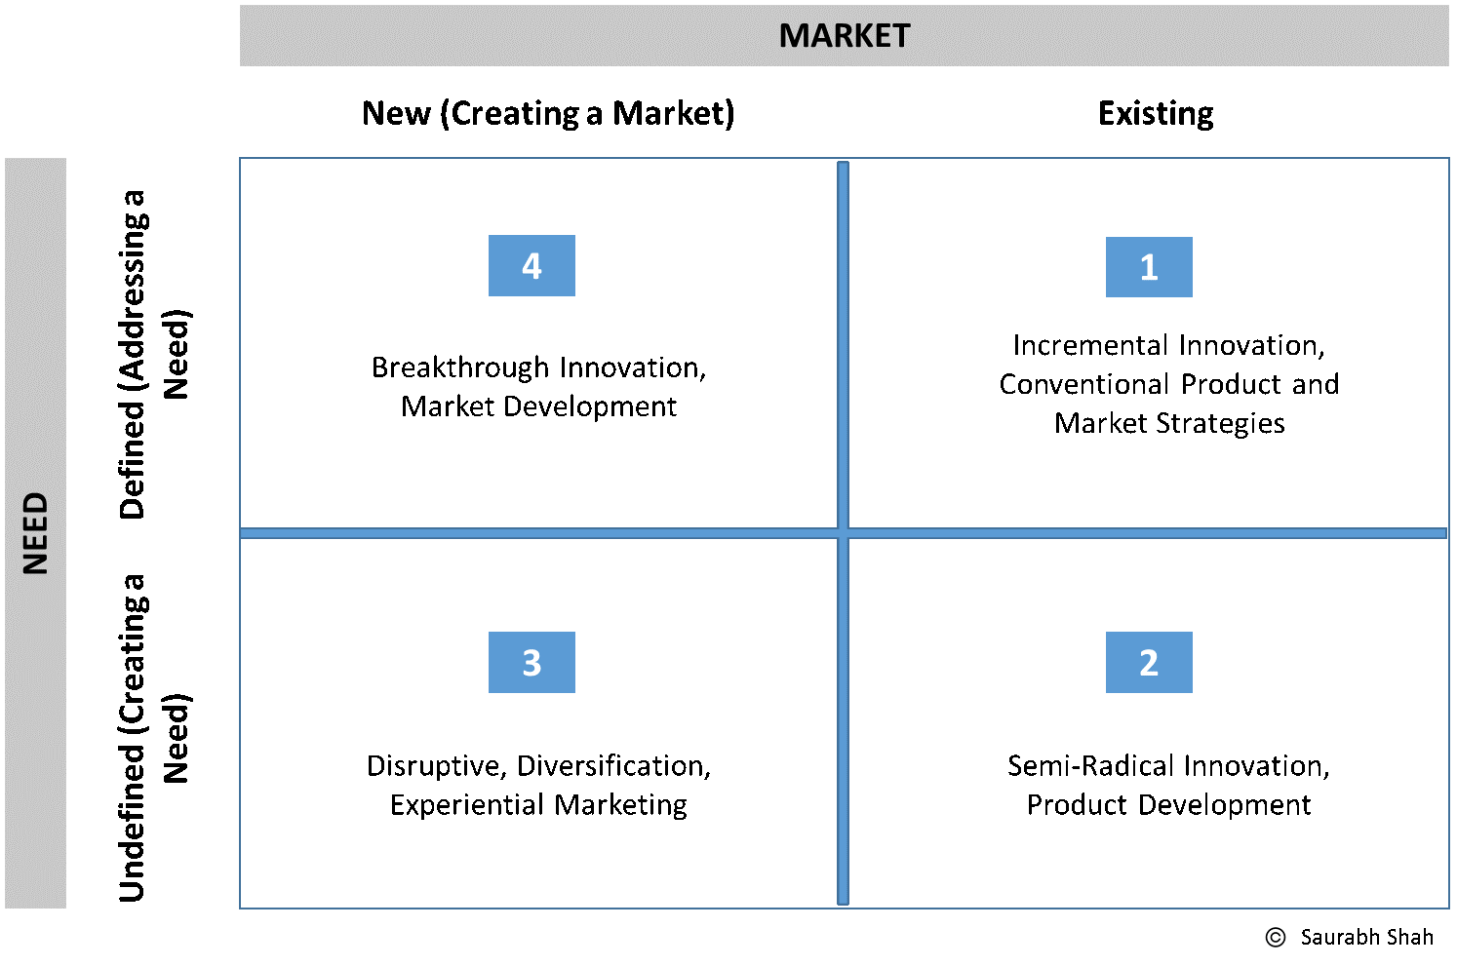

Slide 19
