Slide 1

Institutions and Allocations
Lecture 6
Juuso Välimäki
September 21, 2023

Slide 2
Introduction to Lecture 6
In the course thus far:
  Choice and scarcity
  Elements of game theory
Today: ”The Rules of the Game”
  Pareto-efficieny and fairness
  How do institutions affect economic allocations?
  Introduction to the measurement of income inequality
Next week:
  The most central institutions of the capitalist society: markets and firms

Slide 3
Institutions and allocations
Institutions
  Societally agreed upon restraints on behavior: ”rules of the game”
  Formal: laws, contracts, property rights etc.
  Informal: customs, traditions, social conventions etc.
Power
  The ability to direct a person’s actions against her will
  Bargaining power / setting the terms of trade
    e.g. power to make a take-it-or-leave-it offer, power to reject an offer
  Forcing another agent through harm or a threat of harm
Institutions determine economic power and thus also allocations: sharing of the economic cake as well as incentives to produce it

Slide 4
Pareto efficiency
moving from allocation (M,M) to (L,L) is a Pareto-improvement
(L,M), (L,L) jand (M,L) are all Pareto-efficient allocaations, if Ann and Bob only care about thenselves
Outcomes
  Determined by the actions
  Preferences: how do players like the outcomes?
Pareto efficient allocations
  You cannot make anybody better off without making someone else worse off
Numerous Pareto efficient allocations
5
L,M
4
L,L
3
Bob
2
M,M
1
M,L
0
0
1
2
3
4
5
Ann

Slide 5
Pareto-efficiency and fairness
Pareto-efficiency does not make a judgment on the fairness of the allocation
  Many Pareto-efficient outcomes are widely considered unfair
    e.g. I own everything, you own nothing (if all individuals prefer more to less)
Economics does not tell what allocations are fair or just or equitable
  this is ultimately a moral judgment and reasonable people may disagree on the right ethical principles to apply
  economics seeks to answer what types of economic institutions result in desirable outcomes according to the selected moral criteria
  quite often desirable properties are in logical conflict with each other and there is a need for compromise

Slide 6
(Incomplete) perspectives towards assessing fairness
Veil of Ignorance
  John Rawls: which society would you choose if you do not know your position in it?
Equal opportunities vs. equal outcomes: e.g. would you rather choose a society where
  income differences are small but the role in the society is predetermined by the position of the parents?
  or: incomes differ widely but parental incomes have no effect on children’s incomes (or other outcomes)?
  obviously there is no correct answer to such questions, but this thought experiment forces you to reflect on the nature of equity

Slide 7
Starting point: Alex is an independent farmer
Alex cultivates his own land and eats the output
  Trade-off between grain and leisure - > indifference curves
  More labor brings more grain
  -> production possibility frontier
Optimal choice at C
  MRS=MRT at C
Alex’ indifference curves
C
9
Alex’ production possibilities frontier
Grain
0
24
Leisure
16

Slide 8
Unfortunate development: Alex enslaved
Barry enters the scene
  Barry owns a gun Alex not
  Barry does not work but grabs a share of Alex’ production
  He also dictates the working hours
How to see an allocation in the picture?
  E.g. Barry orders Alex to work for 12 hours and grabs half the grain
How does Barry maximize his amount of grain?
10,5
Barry’s share
5,25
Grain
Alex’ share
0
12
24
Alex’ leisure
Alex’ working hours

Slide 9
Alex still enslaved
Barry’s constraints’
  Production possibility frontier determines technologically feasible allocations
  survival frontier determines Alex’s basic needs for survival
    The more Alex works, the more food he needs to survive
Production possibilities frontier
Potential allocations
Survival frontier
Grain
0
Alex’ leisure
24

Slide 10
Alex enslaved
Barry optimizes
  Is Barry maximizing his share by demanding 16 hours of work?
  No: marginal rate of transformation exceeds the biological marginal rate of substitution
    in other words, an extra hour of work increases grain production more than what is needed for survival
C
9
Barry’s share
MRT
K
3,5
Alex’ share
Biological ’MRS*
Grain
0
16
24
Aöex’ leisure

Slide 11
Alex enslaved
Barry’s optimum at A,B
  Alex works for 11 hours, gets 4 bushels of grain while Barry keeps the remaining 6
Longer hours make Alex worse off
  Less leisure
  No less hungry (he gets the bare miniumum for survival)
  Survival curve ≠ indifference curve
A
10
Barry’s share
B
4
Alex’ share
Grain
0
13
24
Alex’ leisure

Slide 12
Improvement: Alex as a contract farmer
Slavery forbidden
  Barry owns the fields but cannot force Alex to work
  Charities keep unemployed at subsistence level
Barry and Alex must negotiate the terms of employment
  If Alex refuses, point Z results-> Barry must offer a deal that at least matches Z from Alex’ point of view
PPF
A
10
B
  Z is Alex’ outside option or
  reservation
  option
4
2,5
Z
Grain
0
13
24
Alex’ leisure

Slide 13
Alex as a contract farmer
Alex’ indifference curve through Z steeper than survival curve
  To induce Alex to work, more compensation is needed than for mere survival
  If Barry offers the same deal as under slavery (B), Alex refuses
What shoud Barry offer?
Which inastitutional arangements result in best outcome for Barry?
Alex’ indifference curve
PPF
A
10
Feasible allocations acceptable to Alex
B
4
2,5
Z
Grain
0
13
24
Alex’ leisure

Slide 14
Alex as a contract farmer
One solution: Barry rents the land to Alex for 4,5 bushels
  Alex decides to work for 8h. Why?
  MRS=MRT
If Alex has power to refuse
  Increases Alex’ welfare
  Reduces Barry’s welfare
  Reduces production
Alex indifference curve’
10
C
9
4,5
D
4
PPF
Z
Grain
0
13
16
24
Alex’ leisure

Slide 15
Workers’ rights (via legislation)
New law
  4 hours working day with a minumum wage of 4,5 bushels of grain
  Alex made better off Barry made worse off
Is this Pareto-efficient?
C
9
6
E
Barry’s share
D
F
4,5
Alex’ share
Grain
0
16
20
24
Alex’ leisure

Slide 16
Workers’ rights
A Pareto improvement:
  Let Alex work for 8h to produce 9 bushels. If Barry still gets 1.5, Alex is left with 7.5 bushels and this makes him better off than at (E,F)
    MRT > MRS at (E,F) and hence by keeping the extra production, Alex can improve his own welfare while not reducing Barry’s (constant share to Barry)
C
9
Bjarry’s share
7,5
H
E
F
Alex’ share
Grain
0
16
20
24
Alex’ leisure

Slide 17
Contract curve
The curve running through all Pareto efficient allocations
  All allocations with MRT=MRS
    In this example, we have assumed that Alex’ preferences are such that this always happens at 8h of labor (no income effect)
  All points on the line between C and D are thus Pareto efficient
    Alex produces 9 bushels of grain, the shares going to Barry and Alex differs for the different institutions
Reservation indifference curve
PPF
C
9
4,5
D
Grain
0
16
24
Alex’ leisure

Slide 18
What is going on?
Key assumption that we make: Alex has the power to turn down Barry’s offer
  Some authors give this power a grandiose name: freedom, autonomy etc. It reflects the idea that Alex has a point of recourse that cannot be taken away (inalienable rights)
If Barry wants anything out of Alex, his offer must respect this autonomy
  Barry must maximize subject to Alex’ power to reject offers
If Barry gets to make a take-it-or-leave-it offer, he also has considerable power
  Alex will be kept indifferent to his outside option
But then Barry is simply moving along Alex’ indifference curve
  Alex produces additional output according to MRT but requires compensation according to MRS. At optimum, MRT=MRS (Alex’)

Slide 19
Efficient negotiations and Coase theorem
If Alex owns land and keeps output, he works for 8h
  This comes from the simple analysis along the lines of Lecture 2
When Barry owns the land and must hire Alex to work, he must offer a contract that gives Alex at least his outside option Alex is hired to work 8h
  Alex’ outside option may be working at another farm or getting unemployment benefits etc.
Working exactly 8h is a special feature here
  technically this relies on no income effects, i.e. Alex’ MRS depends only on hours not grain
In general, after negotiations labor is supplied efficiently
  This holds regardless of who owns the land and this an instance of what is know of Coase theorem (property rights do not matter)
  The sharing of surplus clearly depends on property rights

Slide 20
Moral of the story
Production technology and biology set constraints for feasible allocations
  technology -> PPF
  biology -> survival frontier
Institutions and preferences determine which one is chosen
  institutions -> outside option
  preferences -> what is acceptable
  voluntary agreements and negotiations result in efficient outcomes (Coase theorem)
Legislating allocations may result in Pareto-inefficient allocations
  the most effective way of improving the welfare of a group may be to increase their bargaining power

Slide 21
Empirics of income inequality

Slide 22
Output sharing in the real world
Whatabout the real world and observed allocations?
  ”size of the cake” ≈ income per capita, GDP (more on how to measure this in Principles II)
  ”sharing the cake” ≈ income distribution
Real world allocations depend on
  Institutions and other factors
    Other factors: individual differences in abilities etc.
Income distribution often used as an indicator of how real allocations are distributed
  an incomplete indicator of this
    does not include the size of the cake, distribution of working hours, distribution of other indicators of good life (allocation of health, education,…)
  how large are differences in income?
Great datasource for different views on income inequality:
Our world in data

Slide 23
Lorenz-curve and Gini-coefficient
Lorenz-curve
  order the population from the poorest tothe richest
  what is the income share of the poorest x percent?
  draw this share as a function of x
Gini-coefficient
  ratio of the area under this curve to the area under completely equal distribution
  if all earn the same amount, Lorenz curve is given by f(x)=x ? (see picture on the next slide)
  you can request Lorenz curves for countries of your choice at https://dart.lisdatacenter.org/dart

Slide 24
Lorenz-curve and Gini-coefficient
Disposable income in Finland in 2013 (excluding top1%)
Gini-coefficient: How far are we from perfect equality?
Values between 0 (full equality) and 1 (all income to a single individual)
Gini-coefficient≈ A / (A+B)=0.241 in this case
A
B
Matalatuloisimmat 20% saivat yhteensä 10% käytettävissä olevista tuloista
Cumulative population share in %
Source: Luxembourg Income Study Database

Slide 25
Lorenz-curve and Gini-coefficient
Disposable income in Finland and the U.S. in 2013 (excluding top1%)
0.241
0.372
Cumulative population share in %
Source: Luxembourg Income Study Database

Slide 26
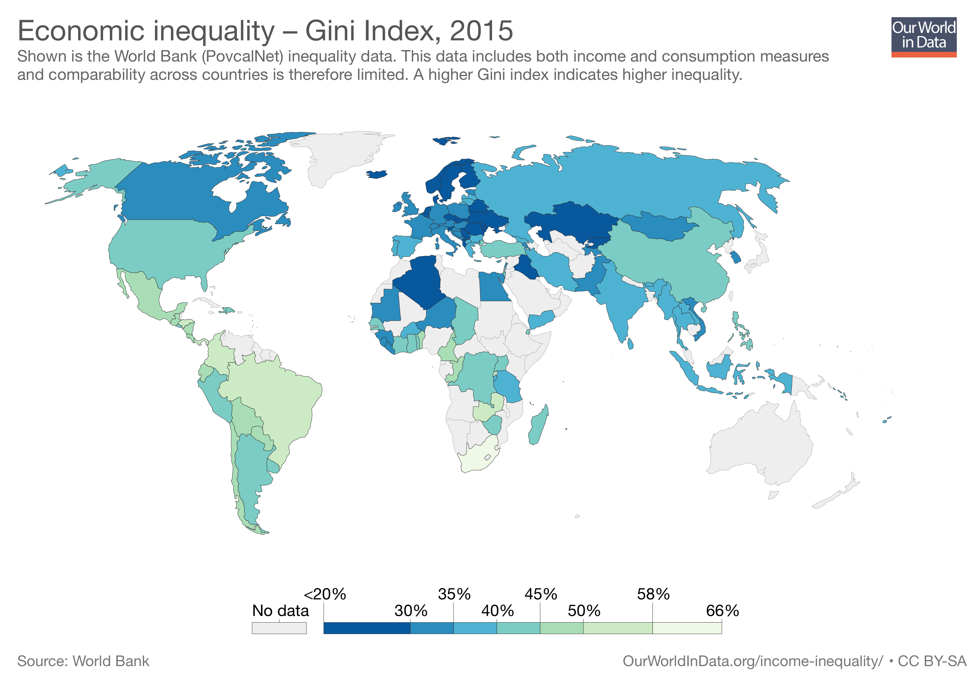

Slide 27
Taxes and transfers equalize the distribution and decrease the Gini coefficient (Finland)
Factor income
(wages+entrepreneurial income+capital income)
Equalizing effect of taxes and transfers
Disposable income
(factor income + transfers - taxes)
Source: Tulonjakotilasto (Statistics Finland)

Slide 28
Income inequality: Summary
Many different ways to measure income inequality
  Income share of the highest x percent
    easily understood, well-documented over a long period for many countries
    popularized in particular by Piketty for top shares
  Gini-coefficient
    Harder to grasp, describes the whole distribution (but is still just a single number)
Income inequality if Finland
  Sharp decline until 1980’s, after 1990 fairly flat
  Much less inequality in disposable income
Income measured in a single year tells a very partial story
  Next: intergenerational correlation and income mobility

Slide 29
Parental and children’s income in the US
Parental income (horizontal axis) their children’t income (vertical axis)
Children with parents ranked at the 25th percentile in parental income distribution ended on overage at the 40th percentile of their own cohort’s distribution
The children of the richest families rank on average 34 percentiles higher than the children of the poorest
Source: Chetty, Hendren, Kline, Saez (2014):Where is the Land of Opportunity: The Geography of Intergenerational Mobility in the United States. Quarterly Journal of Economics 129 (4): 1553-1623.
Ekstran ekstra (Chettyn ym. projektin viimeisin vaihe): https://youtu.be/P0NvsWDKwvs?t=2902

Slide 30
... and in Finland
The children of the richest families rank on average 16 percentiles higher than the children of the poorest
Children with parents ranked at the 25th percentile in parental income distribution ended on overage at the 46th percentile of their own cohort’s distribution
Source: Statistics Finland FOLK-database (preliminary result from ongoing project).
First study showing that intergenerational mobility in the US is smaller than in the Nordics: Björklund and Jäntti (1997): Intergenerational Income Mobility in Sweden Compared to the United States. American Economic Review 87(5): 1009-1018.

Slide 31
The Great Gatsby Curve
Please note that the causal interpretation of these correlations is not at all clear and under hot academic and political debate
Source: Corak (2013): Income Inequality, Equality of Opportunity, and Intergenerational Mobility. Journal of Economic Perspectives 27(3): 79–102.

Slide 32
Lecture 6: Summary
Many ways to judge allocations
  Pareto efficiency
  Fairness
The realized allocation reflects the preferences of the parties and the power in negotiations
  Institutions have an effect on outside options and bargaining power
  Changing institutions (political changes) has impacts on the efficiency and the fairness of allocations
Next week
  First steps in understanding firms and their behavior

