Slide 2

RIGHTS & TRANSPARENCY
Notes:
Quote from in Google v. Spain at 31
(2013)

Slide 3
Agenda
Repetition
Introduction
  Excursus: Tools of lawyers
  Restriction of rights
  Withdraw/ objection
Data Subject Rights
  13/14
  15
  16
  17
  18
  20

Slide 4
repetition

Slide 5
Turn to your neighbour and figure out the answers together
What is the difference between Article 6 and Article 9?
What are the four main elements of consent?
What is an example for legitimate interest processing?
What are the arguments for a sectorial approach of regulating data protection?
What the arguments for an omnibus approach for regulating data protection?
What are the two main notification obligations when a data breach occured? How do they differ?

Slide 6
Introduction

Slide 7
Excursus: Tools of Lawyers

Slide 8
1) Definitions
Definitions are essential building blocks in any legal work.
The first you need to do when reading a contract / law / policy is to understand definitions
GDPR: Article 4
Example: What is the difference?
Personal Data means personal data as defined in GDPR ..
Personal Data means personal data as defined in GDPR that is provided by the controller to the service provider for the provision of Services.

Slide 9

2) Rules ⬄ exceptions
Notes:
Important to always look for the exceptions!

Slide 10
3) Jurisdiction & Applicable law
Not all rules apply everywhere
Even if they apply, they might not be enforced
GDPR: has territorial scope and material scope
Let's take a few examples

Slide 11
Restrictions of Rights

Slide 12
Rights can be restricted under certain conditions by law
General requirements:
  Respect the "essence of the fundamental rights"
  Necessary and proportionate measure in a democratic society to safeguard:
Catalogue requirements
  National security; defence; public security;
  Prevention, investigation of criminal offences
  Other important objectives of general public interest
  Judicial proceedings
  Processing related to breaches of ethics for regulated professions;
  Protection of the data subject
  Enforcement of civil law claims.
Notes:
See article 23
Union or Member State law to which the data controller or processor is subject may restrict by way of a legislative measure the scope of the obligations and rights provided for in Articles 12 to 22 and Article 34, as well as Article 5 in so far as its provisions correspond to the rights and obligations provided for in Articles 12 to 22, when such a restriction respects the essence of the fundamental rights and freedoms and is a necessary and proportionate measure in a democratic society to safeguard

Slide 13
Withdraw and objection

Slide 14
REMEMBER: Processing is only lawful..
Data subject has given consent
Necessary for the performance of contract or to take steps prior to entering into a contract
Necessary to protect vital interests of data subject
Necessary for legitimate interests of controller or 3rd party
Necessary for compliance with legal obligation
to which the controller is subject
Necessary for task carried out
in the public interest or exercise of
official authority
      Exceptions by Member States allowed!
Notes:
MS are allowed to maintain or introduce national provisions to further specify the application of these rules
(Recital 8)

Slide 15
Withdrawal of consent: Just say no
Withdrawal of consent is a right
Before giving consent, the data subject shall be informed of this right
It shall be as easy to withdraw as to give consent.
No magic words

Slide 16
Legitimate interest processing: The right to object – Art. 20
All processing is forbidden
It is allowed if the controller can demonstrate legitimate interests
Data subject can object
Controller presents compelling grounds overriding the interests of the data subject

Slide 17
TRANSPARENCY NOTICE – PRIVACY POLICY V. PRIVACY NOTICE

Slide 18
Article 13: Information provided where the personal data are collected from the data subject (1)
the identity and the contact details of the controller and, where applicable, of the controller's representative;
the contact details of the data protection officer, where applicable;
the purposes of the processing for which the personal data are intended as well as the legal basis for the processing;
the legitimate interests pursued by the controller or by a third party;
the recipients or categories of recipients of the personal data, if any;
where applicable, the fact that the controller intends to transfer personal data to a third country + reference to the appropriate or suitable safeguards and the means by which to obtain a copy of them or where they have been made available.

Slide 19
Article 13: Mandatory information information to be provided where the personal data are collected from the data subject (2)
The period for which the personal data will be stored
Data subject rights
Right to withdraw consent
Right to lodge a complaint with a supervisory authority;
[…]
Existence of automated decision-making, including profiling ➔ keep this in mind for later.

Slide 20

Activity

Slide 21
So similar..
Compare Article 13 and 14 – where are the differences?

Slide 22
Why be transparent?
A principle (Article 5 (1)(a) GDPR) ➔ Fundamental right backing
Backed up by Article 13 and 14 GDPR
Finnish DPA likes to enforce on transparency, e.g. Posti case
Notes:
odettakoon, että 29 artiklan mukainen tietosuojatyöryhmä on antanut käytännön ohjeita (”läpinäkyvyyttä koskevat ohjeet) jäljempänä tarkemmin kuvatusta läpinäkyvyyden periaatteesta (asetuksen 2016/679 mukaista läpinäkyvyyttä koskevat suuntaviivat, WP260 rev.01, annettu 29.11.2017, viimeksi tarkistettu ja hyväksytty 11.4.2018). N

Slide 23
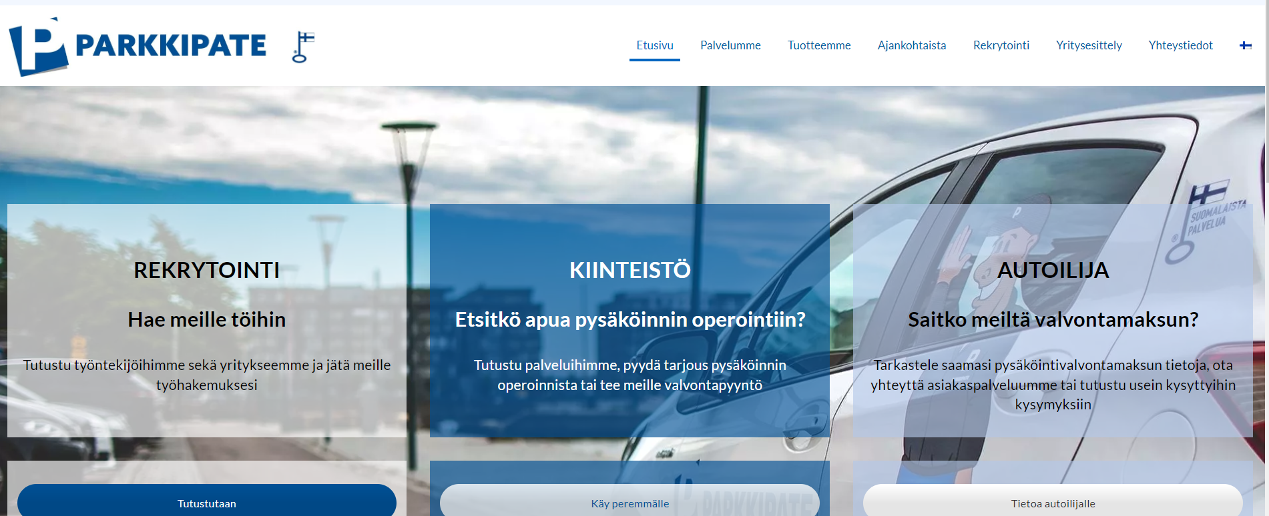
Case ParkkiPate continues
PP did not inform sufficiently inform
"The above-mentioned transparency guidelines state that the obligation of transparency comprises three main elements:
  1) tietojen asianmukaista käsittelyä koskevan tiedon antaminen rekisteröidyille,
  2) rekisterinpitäjien tapa tiedottaa rekisteröidyille näiden tietosuoja-asetukseen perustuvista oikeuksista ja
  3) rekisterinpitäjien keinot auttaa rekisteröityjä käyttämään oikeuksiaan (asetuksen 2016/679 mukaista läpinäkyvyyttä koskevat suuntaviivat, WP260 rev.01, annettu 29.11.2017, viimeksi tarkistettu ja hyväksytty 11.4.2018, s. 4)."
PP required social security number for data subject access request, even thought it did not have it to compare.
Notes:
odettakoon, että 29 artiklan mukainen tietosuojatyöryhmä on antanut käytännön ohjeita (”läpinäkyvyyttä koskevat ohjeet) jäljempänä tarkemmin kuvatusta läpinäkyvyyden periaatteesta (asetuksen 2016/679 mukaista läpinäkyvyyttä koskevat suuntaviivat, WP260 rev.01, annettu 29.11.2017, viimeksi tarkistettu ja hyväksytty 11.4.2018). N
1) providing information to data subjects on the fair processing of their data, 2) the way in which controllers inform data subjects of their rights under the GDPR; and 3) the means by which controllers assist data subjects in exercising their rights (Guidelines on transparency under Regulation 2016/679, WP260 rev.01, adopted on 29 November 2017, last revised and adopted on 11 April 2018, p. 4)."

Slide 24
Case
DPA orders PP to respect data subject rights
[..] => regarding storage data
DPA orders PP to change the practice concerning providing data
+ reprimand
+ 75.000 fine
Notes:
odettakoon, että 29 artiklan mukainen tietosuojatyöryhmä on antanut käytännön ohjeita (”läpinäkyvyyttä koskevat ohjeet) jäljempänä tarkemmin kuvatusta läpinäkyvyyden periaatteesta (asetuksen 2016/679 mukaista läpinäkyvyyttä koskevat suuntaviivat, WP260 rev.01, annettu 29.11.2017, viimeksi tarkistettu ja hyväksytty 11.4.2018). N

Slide 25
ARTICLE 15

Slide 26
Activity

Slide 27
What access rights does Article 15 include?
Please read the article carefully
Make a list and see how many you found

Slide 28
Article 15 includes several (access) rights
A confirmation whether or not personal data is processed (Art. 15 I, 1. Var.)
Access to the personal data (Art. 15 I, 2. Var.)
Basic information regarding the processing (Art. 15 I, 3. Var), such as purposes, categories, recipients…
The right to be informed about certain safeguards concerning international data transfers (Art. 15 II)
The right to receive a copy of the personal data

Slide 29
How wide is Article 15?
Very wide!
Basically a copy of any personal data
Why?
Only „restrictions“
  Asking repeated times (=> but could also be justified)
  Data subject already has the data
  Rights of other people (Art. 15 – IV)

Slide 30
Case Summary C-487/21 F.F v DSB 1/2
FACTS AND LEGAL BACKGOUND
  The controller (CRIF) provided its client information concerning the creditworthiness of third parties.
  The data subject asked the controller to provide a copy of their data and the controller submitted in a summary form the list of such personal data undergoing processing.
  Since the summary did not contain all data, the data subject lodged a complaint before the Austrian DPA, who held that the controller did not violate the GDPR.
  The data subject appealed the DPA decision and the court referred the matter to the CJEU.
QUESTIONS:
  The question referred to related to the scope of the controller's obligations in context of access requests by data subjects pursuant to article 15 of the GDPR.
  Does the obligation to provide a "copy" of the data entail:
    transmission of personal data in the form of a summary table or
    transmission of document extracts or entire documents, as well as database extracts, in which those data are reproduced

Slide 31
Case Summary C-487/21 F.F v DSB 2/2 DECISION
The GDPR does not contain any definition of "copy", but it's usual meaning indicates a 'faithful reproduction or transcription of an original' in opposition to a 'purely general description' of data.
The Court stressed that the right to a copy aims to enable the data subject to protect their rights and interests under the GDPR.
In conclusion, the right to a copy under Article 15(3) GDPR entails that data subject must be given a faithful and intelligible reproduction of all their personal data undergoing processing. This right may include copies of extracts from documents, entire documents or extracts from databases, if it is necessary to protect their rights.

Slide 32
Activity

Slide 33
Case: I want my emails
Data subject Sanna would like to receive all her emails from her employer Cooperation X. She would also like to receive emails that other people have written about her. Example: Her boss, Markku, has written to the CEO, Ritva. In his email, Markku mentioned Sanna‘s performance.
Prepare to argue the case (we will split the class room)
You have about 5 min

Slide 34
Article 16

Slide 35
Article 16 allows rectification of personal data
Part of data accuracy (art. 5): accurate and, where necessary, kept up to date; every reasonable step must be taken to ensure that personal data that are inaccurate, having regard to the purposes for which they are processed, are erased or rectified without delay (‘accuracy’);
Examples: Name changes, spelling, misunderstandings that are documented

Slide 36
ARTICLE 17: RTBF

Slide 37
Article 17: Right to be forgotten is less cool than it sounds
Conditions
  Personal data no longer necessary for the purposes
  Consent withdrawn (and no other reason)
  Objection to processing + no override
  unlawfully processed from the start
  Some other law says the data needs to be deleted
  Data of children
Exception exist even then!

Slide 38
Back to Article 17 ("right to erasure" aka RTBF)
Article 17 collects a few grounds when data may no longer be kept
  No longer necessary
  Consent or object
  Unawful processing
  Etc.
Obligation of the controller to inform controllers with whom the data has been shared
Exceptions
  Freedom of expression
  Legal claims,
  Public interests

Slide 39

Celebrities

Slide 40
Costeja case
Mario Costeja Gonzalez wanted to object to have certain search results removed, because typing his name would result in information on his insolvency
Requirement 1: Google as a controller
Requirement 2: Legitimate interest processing
  Interest of the controller could overrule (= pretty expensive to set up a system)
  Interest of third parties could overrule (= I want to know about Mr. Costeja)
    How do you think the court should decide?
Notes:
[first issue: what is Google's role => they are a controller!]

Slide 41
CJEU decision (2014) Google v. Spain
37/38: It is a serious issue, as search engines get a structural overview, allowing a profile of the user
81 In the light of the potential seriousness of that interference, it is clear that it cannot be justified by merely the economic interest which the operator of such an engine has in that processing.
81.. Regarding the interests of the other internet users, it depends, there needsd to be a balancing test

Slide 42
Screenshot from Google‘s policy ➔ some stuff will be easily removed
Personal information that Google will remove
If you are unable to have a website owner remove the content from the site, Google may remove personal information that creates significant risks of identity theft, financial fraud, or other specific harms. The following articles provide details on the types of removals that are available:
Remove non-consensual explicit or intimate personal images from Google
Remove involuntary fake pornography from Google
Remove content about me on sites with exploitative removal practices from Google
Remove select personally identifiable information (PII) or doxxing content from Google Search
Remove images of minors from Google search results
Remove irrelevant pornography from Google search results for my name
SOURCE: Report content on Google

Slide 43
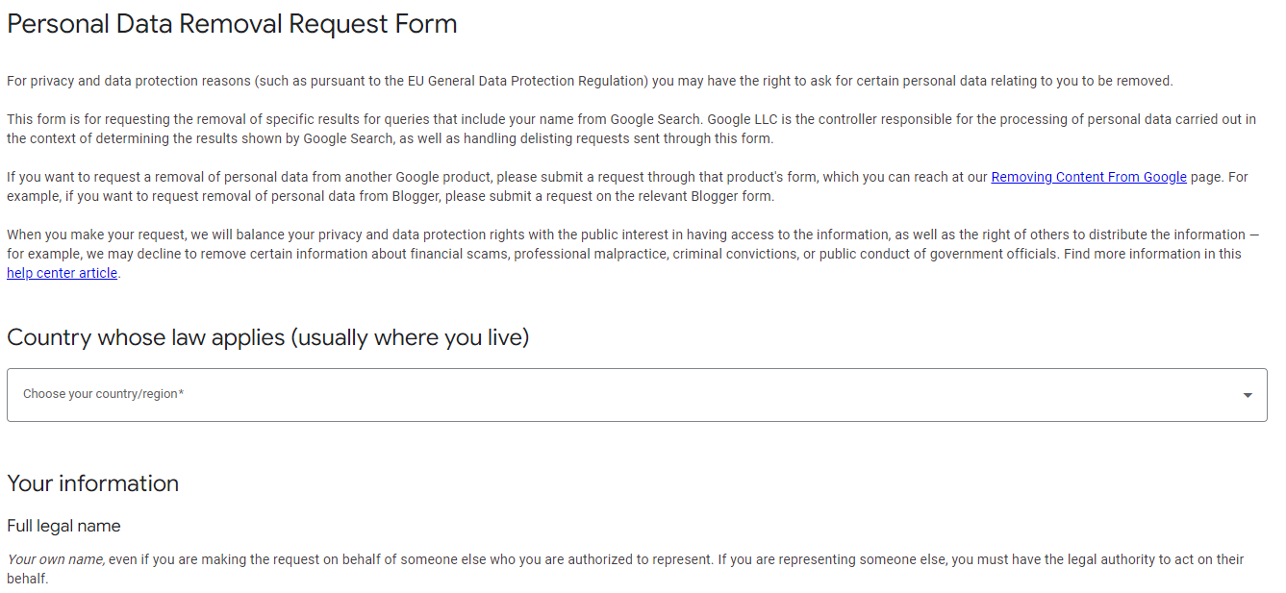
Google has an own RTBF process
SOURCE: https://reportcontent.google.com/forms/rtbf?hl=en&utm_source=wmx&utm_medium=deprecation-pane&utm_content=legal-removal-request

Slide 44
ARTICLE 20

Slide 45
Data Portability
Right to receive data in a structured, commonly used and machine-readable format
Processing is based on consent or contract
Includes 2 rights
  Move from controller to individual
  Move from controller to another controller
Can you think of examples?

Slide 46
AUTOMATED DECISION MAKING

Slide 47
Rule: No automated decision making
The data subject shall have the right not to be subject to a decision based solely on automated processing, including profiling, which produces legal effects concerning him or her or similarly significantly affects him or her.

Slide 48
Activity

Slide 49
Making sense of Art. 22
➔Open Article and read it and the GDPR carefully
Going back to the "tools of lawyers" => how can you understand the article better?

Slide 50
What is profiling? It means ..
any form of automated processing of personal data
consisting of the use of personal data to evaluate certain personal aspects relating to a natural person,
  in particular to analyse or predict aspects concerning that natural person's performance at work,
  economic situation,
  health,
  personal preferences,
  interests,
  reliability,
  behaviour,
  location or movements
    Online credit application
    Online recruiting practices

Slide 51
Exceptions
necessary for entering into or performance of a contract
authorised by law
based on explicit consent
➔ additional requirements if data is sensitive)
    Which legal bases are left?
Notes:
Paragraph 1 shall not apply if the decision: (a) is necessary for entering into, or performance of, a contract between the data subject and a data controller; (b) is authorised by Union or Member State law to which the controller is subject and which also lays down suitable measures to safeguard the data subject's rights and freedoms and legitimate interests; or (c) is based on the data subject's explicit consent.

Slide 52
EDPB guidance on the topic
Several DSR connected to automated processing
    Right to be informed of the existence of automated decision-making, including profiling
    Right to obtain human intervention
    Authorised by law
    Based on explicit consent
    Right to express their point of view and contest the decision
When is automated decision-making permissible?
    Necessary for entering into or performance of a contract (controller – data subject)
      Authorised by law
      Based on explicit consent

Slide 53

Any Questions?

